Slide 1
Wildlife corridor design in the Valley and Ridge physiographic province of Virginia using FOSS GIS technology
Presenter: thomas rubino, mgis candidate
Advisor: dr. joseph bishop
Capstone proposal, 3 august 2017
Pennsylvania state university department of geography

Slide 2
Outline
Goal and objectives
Literature review
Case studies
Existing tools
Background information
Study area
Species
Wildlife corridors
Methods
Implications
Timeline

Slide 3
Objectives
Project goal
Create a methodology for small-scale wildlife corridor design and provide a means for replication by creating an automated tool.
Acquire high-resolution GIS data layers to represent the landscape, habitat, and threats that each species face.
Focus habitat requirements for suitability and resistance modeling.
Refine habitat ranges so that small-scale wildlife corridors can be designed.
Share methodology via documentation and an automated script/tool.
Notes:
the main goal of this project is to create a methodology for wildlife corridors at a micro-level that can be repeatable with a script, and uses FOSS technology. In order for the project to be successful, the following objectives must be met;
Due to the scale of the project, high-resolution datasets must be acquired and created to accurately represent migrations that could be as little as 300 meters. The landscape, habitat, and the threats that each species faces needs to be considered.
Detailed habitat requirements for habitat suitability and resistance modeling must be collected through research and/or empirical data. The accuracy of the model is dependent on this information. During this phase, identify key habitat area, whether it is the USGS distribution model, and either known or potential breeding sites.
As you will see, many of the habitat extents that are publicly available are of a considerable size. Therefore, in order to model movement in the 1 to 3 km range, the area needs to be refined to isolate areas that are in need of a corridor analysis.
Finally, this methodology will be shared via an automated tool that will consist of a series of Python scripts. The methodology can be very specific based on the type of species being analyzed, so breaking it down into components will help the process.

Slide 4
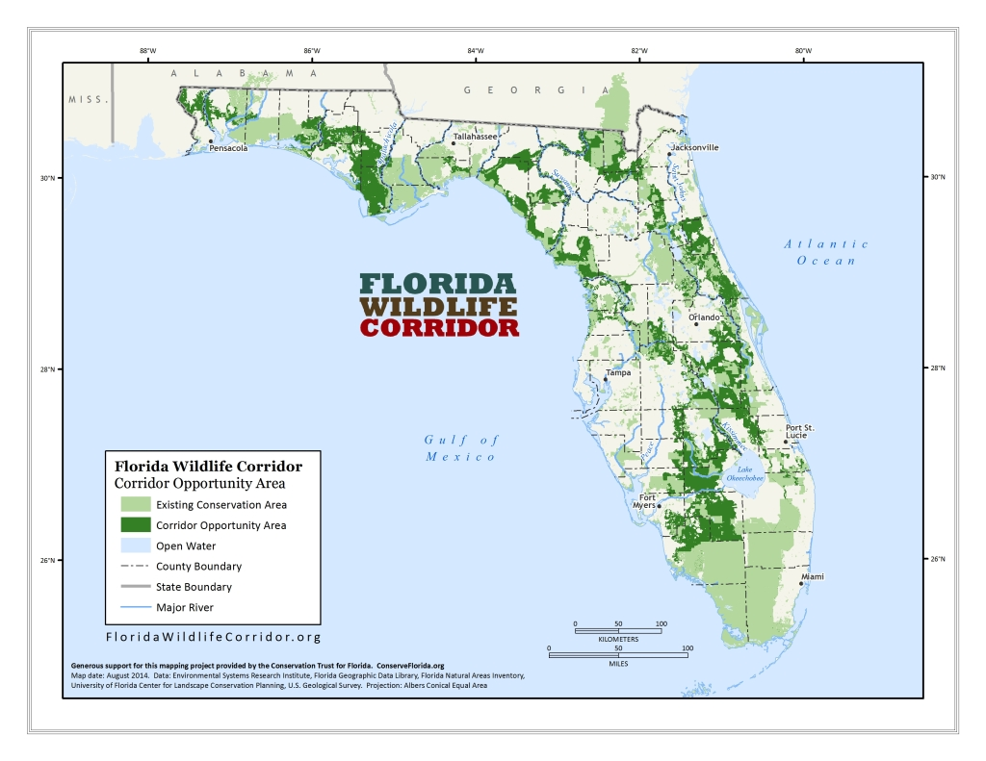
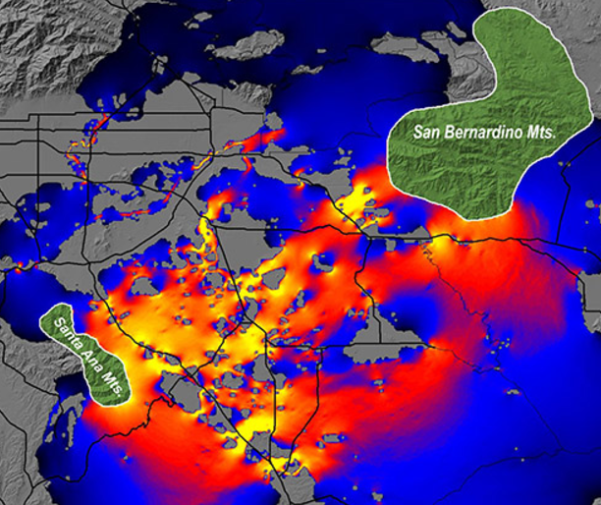
Literature review
There is an overwhelming emphasis on regional wildlife corridors focusing on large mammals.
Florida Panther connectivity
Banff National Park Wildlife Bridges
Yellowstone to Yukon Conservation Initiative
Alternative methods
Circuit theory
Parks et al., (2012) discuss an overreliance on ‘expert’ models.
Nowakowski et al., (2015) used microclimate testing, soil substrates monitoring, and predator introduction to influence results.
Florida Wildlife Corridor
Circuit theory model from Wired Magazine
Notes:
During the literature phase of this process, I came across a number of research projects and journal articles on wildlife corridors and their validity. There has been extensive wildlife corridor work done in Banff National Park in Alberta Canada that has resulted in 40 wildlife overpasses over the Trans Canada Highway. A study by Parks and others discussed the prevalence of least cost analysis, but raised concerns on an overreliance on corridors derived from expert opinion models. Such models increase the likelihood and the resulting corridors will be longer, unfeasible paths and some species will use a more direct path regardless of habitat or threats. This is something to keep in mind as I go through my project. There were also studies on alternative methods for corridor creation including circuit theory. Nowakowski and others used this method to represent patches of habitat as nodes in an electrical circuit and the genes of animals as the current that flows between the nodes. This results in flow across multiple pathways with varying degrees of resistance based on habitat requirements. Through my research, I found the research on smaller species to be lacking which is probably due to shorter migration distances and less exposure.

Slide 5
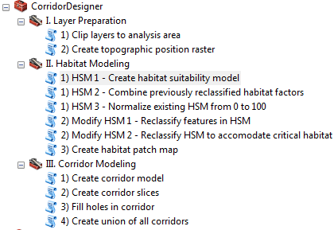
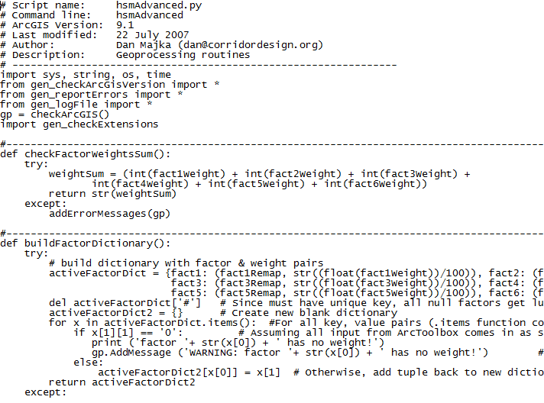
Existing tools and software
Corridor Design offers resources, methodology, and tools for corridor creation based on Esri infrastructure.
MARXAN tools utilize QGIS.
Circuitscape tools are used for corridor creation and circuit theory modeling.
These tools can be used to compare and validate the results from this process.
Corridor Design Toolbox
Notes:
I also looked at the GIS based tools that currently existed. Each tool worked in a similar manner to what I am proposing; however, they all relied on Esri software. The Corridor Design project offers a methodology that was used as a resource for this project - they also offer a series of Python scripts as ArcGIS toolboxes to simplify the process. Linkage mapper is another option that requires the user to input rasters to create corridors; however, the process seems less in-depth than Corridor Designer. FInally, Circuitscape offers a tool for running circuit theory for corridor creation. I plan on utilizing this method to compare results.

Slide 6
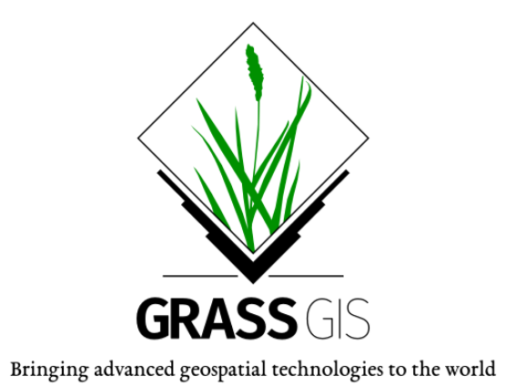
Free and open source software (FOSS)
Free refers to “freedom” and not the price. It can be freely modified and shared.
This project will rely on FOSS software to process data layers and conduct GIS analysis.
An automated Python script will be developed based on this software.
This gives users other options beside propriety software platforms.
Notes:
It is the intention of this project to complete each of the step using FOSS tools. I am going to rely heavily on QGIS and the GRASS and the GDAL/OGR environments. I’ve found that the QGIS plugins are just as valuable as many Esri tools. Finally, the project will culminate in a Python-based script that anyone could use with the proper downloads.

Slide 7
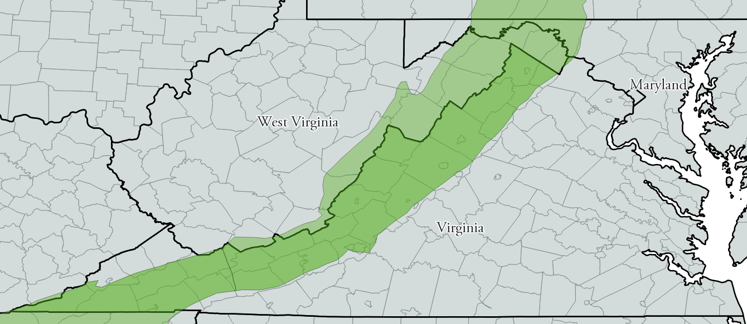
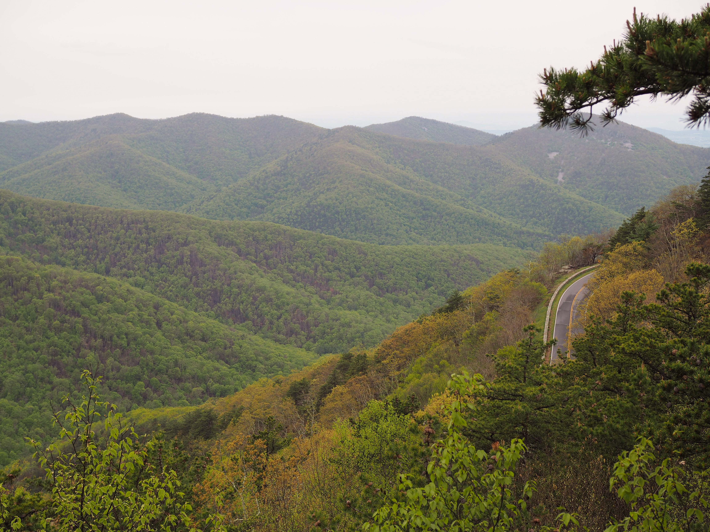
Valley and Ridge physiographic province
Extends from Alabama to New York through the Appalachian Mountains.
Located in western Virginia, west of the Blue Ridge Mountains.
Consists of a series of rugged sandstone ridges and fertile valleys.
The diverse plant and wildlife are continually threatened by economic development.
Map created with data from the US Census Bureau and USGS
Shenandoah National Park, Virginia. Photograph by T. Rubino
Notes:
For this project I decided to focus on the Valley and Ridge physiographic province because of its diverse landcover and elevation. However, it is my intention to make this process repeatable regardless of the area. The province is one of five in Virginia and makes up the western part of the state as it extends through the Appalachians from Alabama to New York. The region is characterized by rugged ridges and fertile valleys and holds a diverse population of plants and wildlife. However, as the population continues to grow, the region is threatened with economic development from agricultural conversion and urban expansion.

Slide 8
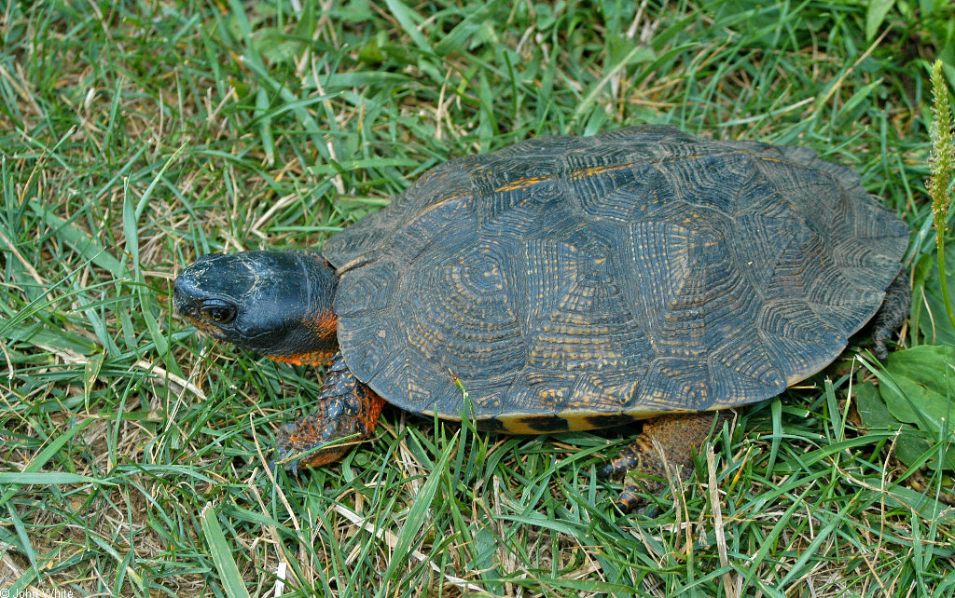
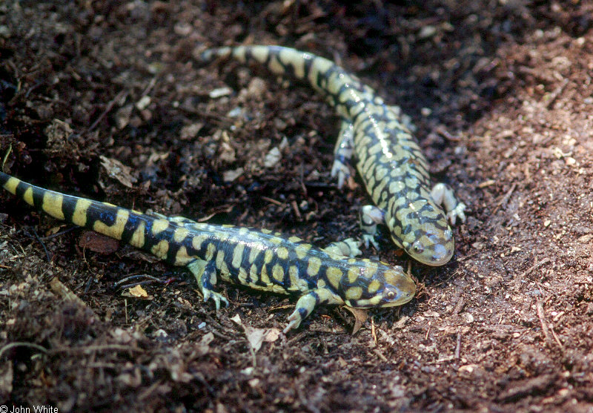
Wildlife in Virginia’s Valley and Ridge province
The Valley and Ridge province promotes a diverse population of plants and wildlife.
There are 12 species of amphibian and reptile listed as Natural Heritage Resources by the VA Department of Conservation and Recreation.
Amphibians and reptiles travel shorter distances, but many migrate to breeding sites.
Eastern Tiger Salamanders and Wood Turtle. Photographs courtesy of John White of the Virginia Herpetological Society.
Notes:
The Virginia Department of Conservation and Recreation maintains the Natural Heritage Program that focuses on protecting Virginia’s native plants and animals, and their ecosystems. They use a ranking system, similar to federal rankings of endangered species, to identify species that should be considered under the program based on their population. I queried the species that fell within S1 and S3 which includes critically imperiled, imperiled, and vulnerable within the state. There are 12 species of amphibians and reptiles in the Valley and Ridge province that meet this criteria.

Slide 9
Why are these two species being analyzed?
Ambystoma tigrinum
(Eastern Tiger Salamander)
Largest terrestrial salamander in North America.
Most widespread salamander species in North America, but is considered to be extremely rare and imperiled in Virginia.
Lives on land, but travels up to 1.6 km to vernal pool breeding sites each Spring.
Threatened by habitat loss due to agricultural conversion and urban expansion.
Glyptemys insculpta
(Wood Turtle)
Considered endangered by IUCN because of a 50% decline in population over the last century.
Ranked as a very rare and imperiled species in Virginia.
Lives in forested wetlands, meadows, and swamps, but travels up to 3 km to stream breeding sites.
Threatened by habitat loss due to urban expansion.
Both species share similar behaviors, but with different habitat requirements.
Notes:
The Eastern Tiger Salamander and the Wood Turtle were decided upon because of their critical status in the state, and because they shared similar characteristics in terms of size and behavior, but different characteristics in where they live and breed. Although the Tiger Salamanderis the most widespread salamander in North America, that is no longer the case in Virginia. The Eastern Tiger Salamander lives on land, burrowing in the ground, for most of the year - however, each spring they travel to breed, mostly in and around vernal ponds, a small temporary pool that lacks aquatic predators. As the salamanders travel to these pools, at distances of up to 1.5 kilometers, they face threats from agricultural conversion, road crossings, and general fragmentation of their habitat.

Slide 10
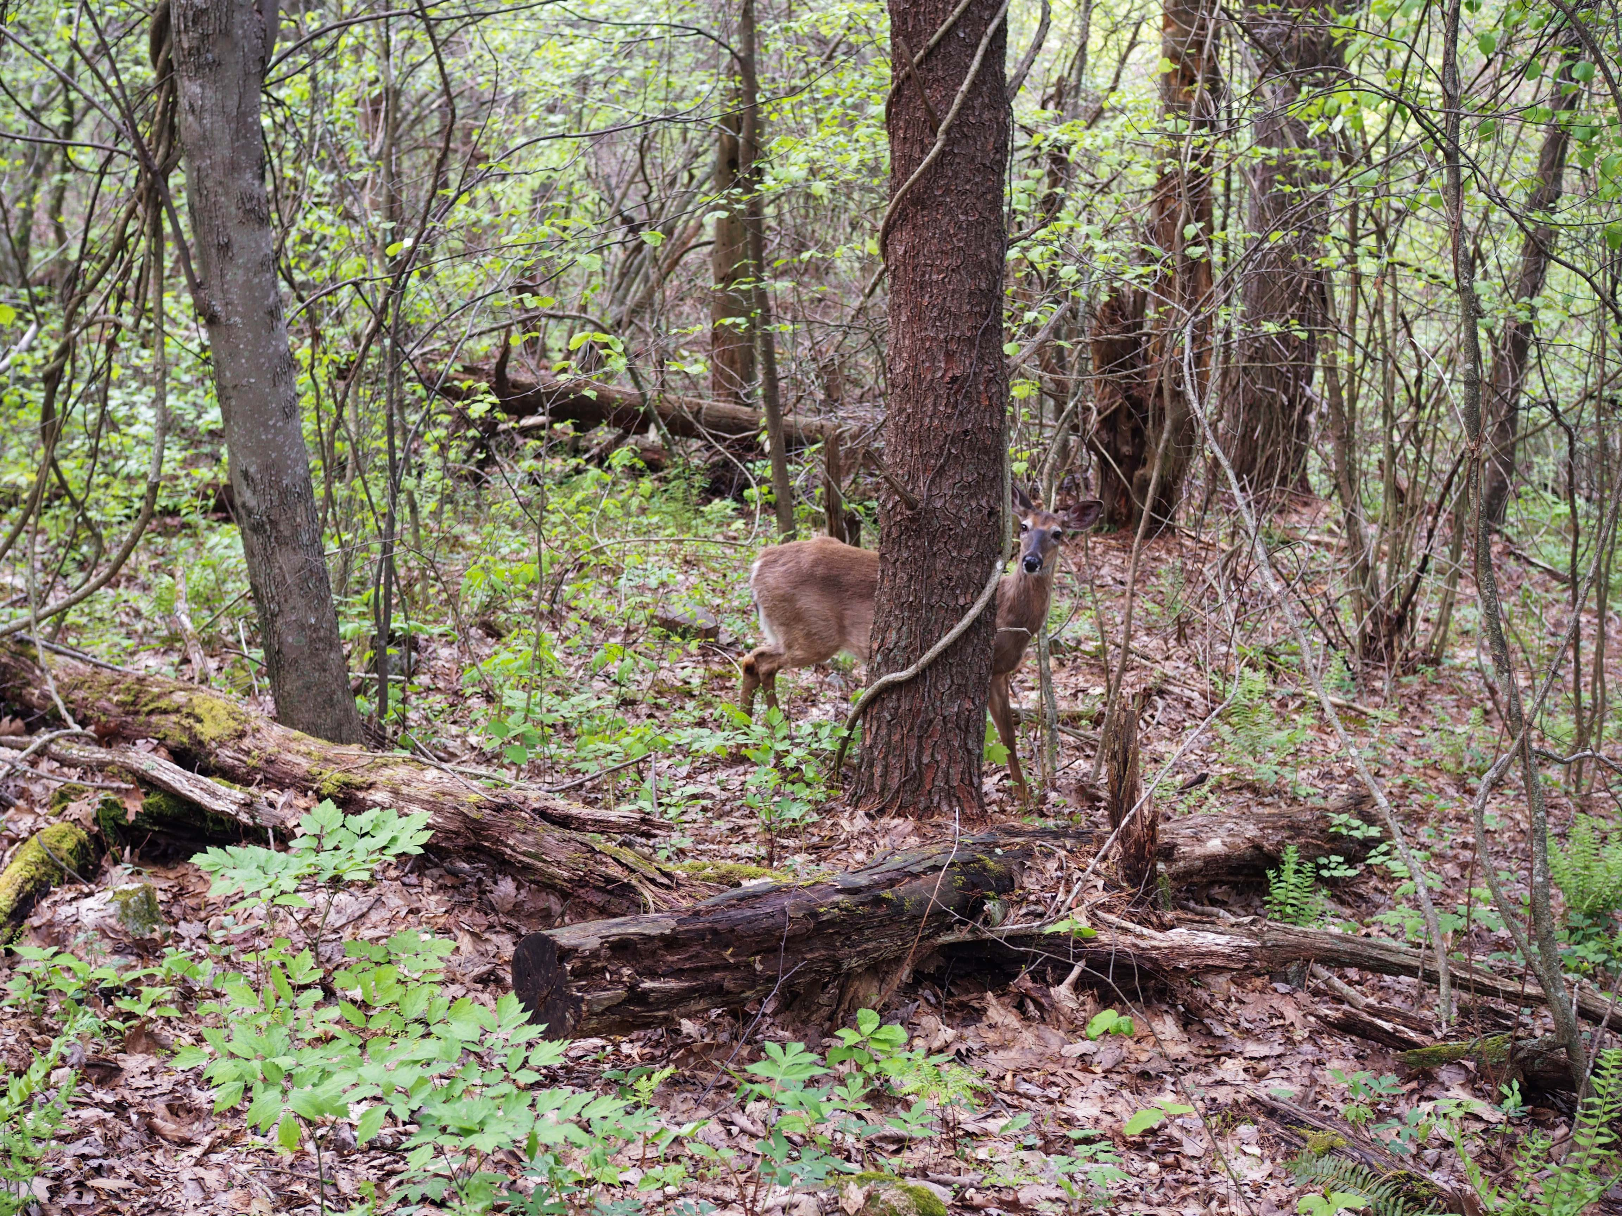
Wildlife corridors
Wildlife corridors are linear “habitats” that connect two or more habitat patches.
As agricultural conversion, urban development, and deforestation increase, many species’ habitat becomes fragmented.
The connectivity of habitat enhances population viability and eliminates threats caused by these disturbances.
The Appalachian Trail in Virginia. Photograph by T. Rubino.
Notes:
Wildlife corridors have been key to alleviating some of the threats from fragmentation. Agricultural conversion, urban development, and deforestation are the main culprits in the study region. Wildlife corridors aim to mitigate these problems. They are usually linear stretches of habitat that connect two or more larger blocks of habitat or protected land.

Slide 11
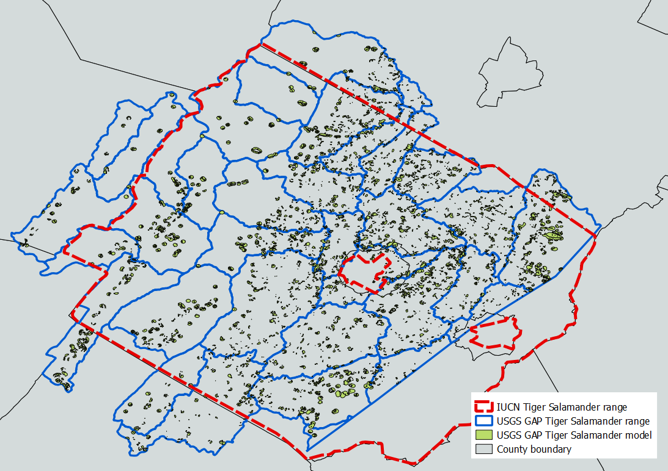
Data sources: Determining habitat range
The USGS National GAP maintains species range and distribution models for most species based on watershed boundaries.
The International Union for Conservation of Nature (IUCN) maintains species ranges at the county and watershed level.
The VA DCR maintains a database of species locations; however, this data is restricted and requires a licensing agreement.
Habitat ranges provided by the USGS and IUCN
Notes:
The USGS GAP offers habitat ranges that are based on HUC-12 watershed boundaries, equaling the approximate boundary of Augusta County for the Eastern Tiger Salamander. The program also offers distribution models for the majority of species listed that can be used to either refine the habitat or use as a key habitat area in the analytic phase of this project. Additionally, the International Union for Conservation of Nature offers habitat ranges equaling the entire extent of Augusta County for the Eastern Tiger Salamander. This project will use USGS GAP data.

Slide 12
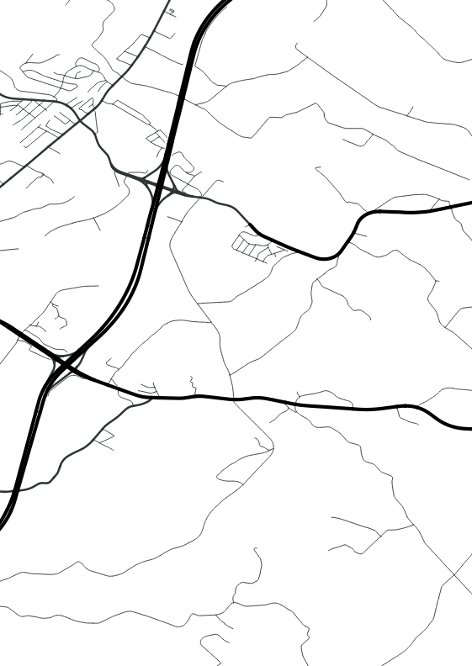
Data sources: Suitability modeling
A USGS Digital Elevation Model with 10 meter resolution covers the entire state.
The Virginia Geographic Information Network produced an 11-class land cover dataset with one-meter resolution.
The State of Virginia produces a E911 high resolution Street Centerline dataset.
Fish and Wildlife Service National Wetlands Inventory provides additional habitat granularity.
DEM provided by USGS and Street Centerlines
and Land Cover provided by the State of Virginia
Notes:
The building blocks of a wildlife corridor analysis come from the data in which it is derived. A suitability model represents favorable habitat based on a number of factors.. As I mentioned in my objectives, a series of high-resolution rasters and detailed vectors are necessary based on the small areas that these species cover. The State produces a 10-meter DEM that covers the entire state. The Virginia Geographic Information Network produced a land cover dataset with one-meter resolution classifying 11 different types of land cover. Also produced by the state, the Street Centerlines dataset is a highly detailed emergency response and police dispatch GIS dataset. And finally, the USGS National Hydrography Database will be used to isolate habitat areas like streams.

Slide 13
Methods: Modeling suitable habitat
Process will be different for each species based on habitat requirements.
Requirements are based on academic and professional research. Empirical data enhances the analysis when it is available.
Habitat analysis is scored on a scale of 0 to 100 with 100 being the most suitable.
Each factor is weighted and combined to create a habitat suitability model.
Land cover suitability score | Description
100 | Best habitat, highest survival and reproductive success
80 | Lowest score associated with successful breeding
60 | Lowest score associated with consistent use and breeding
30 | Lowest value associated with occasional use for non-breeding activities
0 | No habitat
The scoring range was developed by the Corridor Design project and describes habitat based on the ability to travel and breed.
Notes:
There are ‘expert-opinion’ models that rely on the research, experiments, and opinions of experts in the field. There are also empirical models that take many of the expert opinions into account, but are based on empirical data. I have designed this methodology based on expert-opinion. If acquired or available, empirical data can be used to enhance the habitat selection process. The Corridor Design Project has been a very valuable tool for me thus far. The project offers insight, literature, and GIS-specific input on corridor design. I utilized their scoring system which is a on a scale of 0 to 100 with 100 being the most suitable habitat. The scoring is dependent on whether a species has the ability to breed and/or travel through specific habitat.

Slide 14
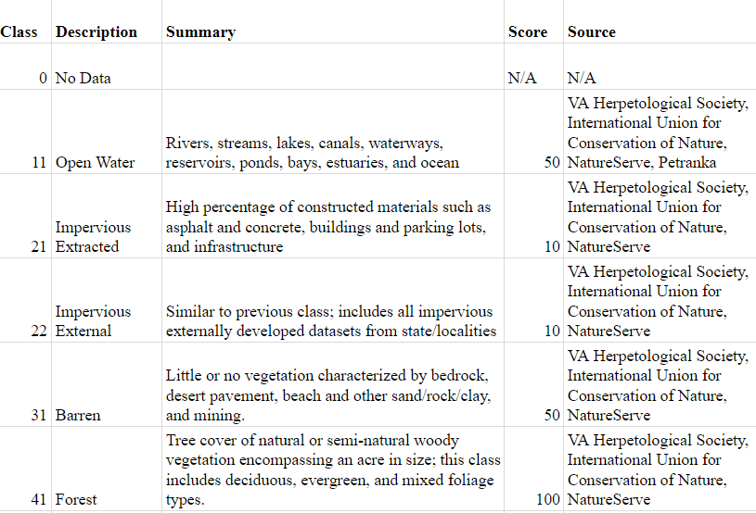
Methods: Suitability scoring
Land cover
Elevation
Slope
Aspect
Road type (based on speed)
Road barriers (medians)
Distance to roads
Distance to streams
Wetlands
Notes:
The factors that can be analyzed are listed on this slide, but in some cases, they will all not be necessary. I would expect that people with more experience than myself in dealing with these animals will be the ones running through the methodology. Besides land cover, DEM-derived layers like the slope, elevation, and even the aspect can be used. The streets are broken out based on speed limit to factor their usage. Additionally, roads that have two way traffic will be isolated because of the likelihood that the road is separated by a median or barrier - making it impassable to migrating wildlife. The distances to roads are also considered - the habitat suitability will decrease as the distance to the road decreases.

Slide 15
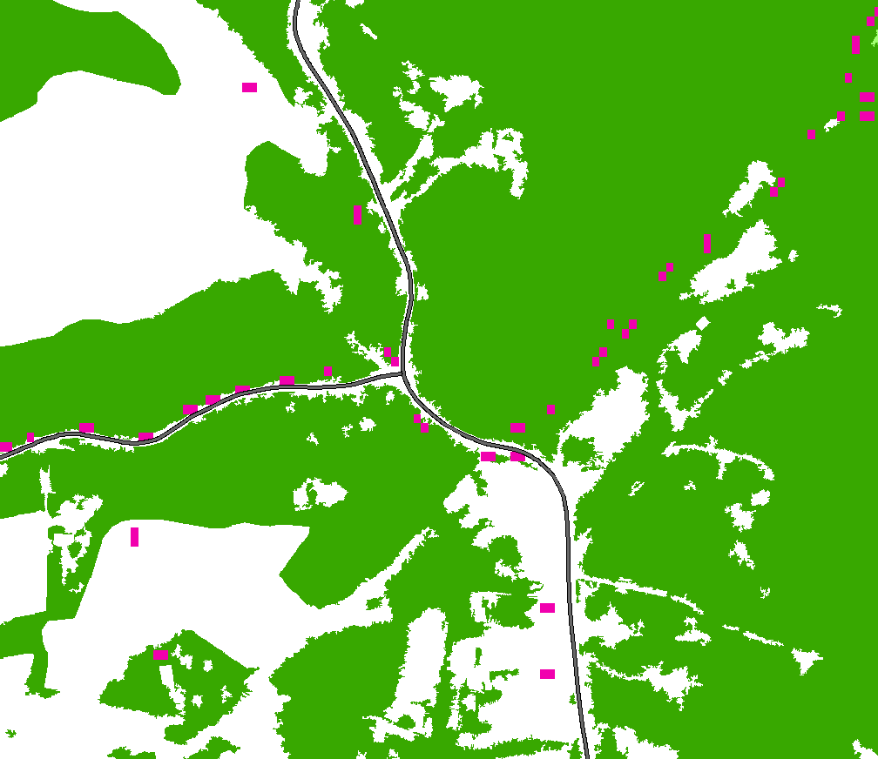
Where are the key habitat and breeding sites?
Key habitat and breeding sites are the start and end points of each wildlife corridor.
Key habitat is determined based on a minimum habitat patch size and suitability score.
Breeding sites are added separately and can be derived from the land cover or as an additional data layer.
Examples of breeding habitat include vernal pools for the Eastern Tiger Salamander and streams for the Wood Turtle.
Example of high suitability habitat, roads, and sinks representing vernal pools.
Notes:
The goal of this project is to create wildlife corridors. To do so, starting and ending points, or a destination and source, must be established. Since I will be modeling breeding migrations, the source will be key habitat and the breeding areas will the destination. Key habitat is defined as areas that meet a scoring threshold of 80 or above - the minimum score for successful breeding as determined by the Corridor Design Project - it is also based on a threshold for habitat patch size which should not be less than the minimum migration distance. This should be interchangeable based on the species. The breeding sites themselves are derived from land cover, hydrography, or in some cases, if available... from outside sources like the Virginia Department of Conservation’s database of vernal pools.

Slide 16
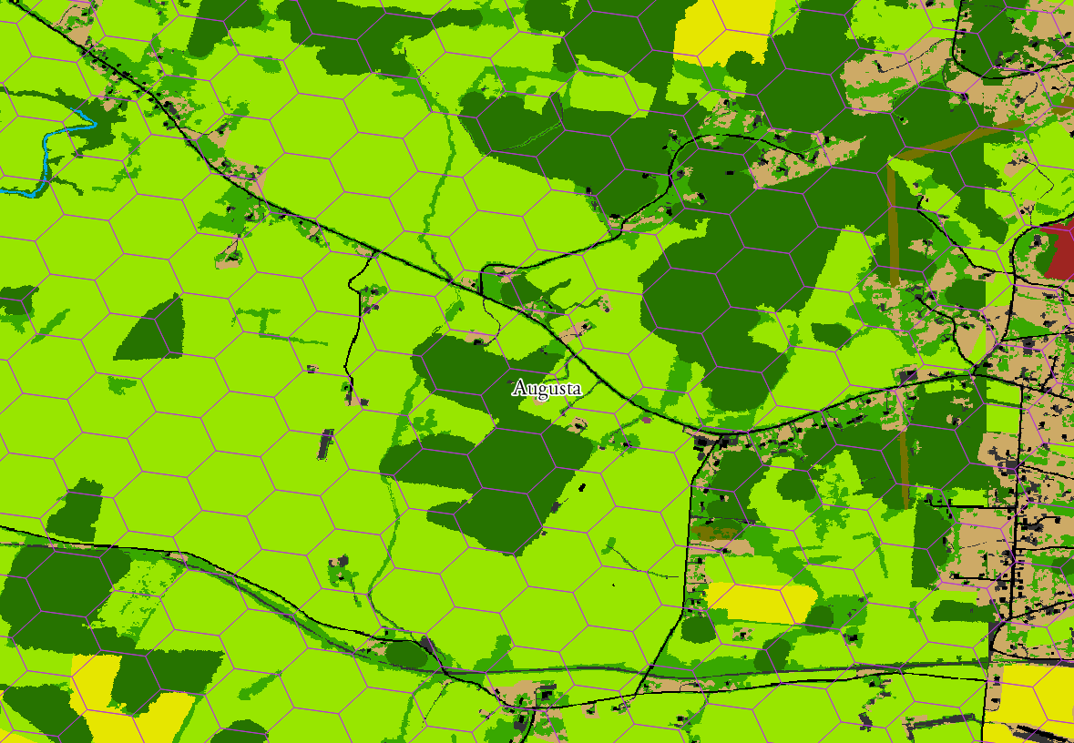
Methods: Refining the habitat range
The habitat ranges provided by USGS and IUCN are too coarse for a corridor analysis of a small species.
An hexagonal overlay is used to refine the range based on species migration distances (~6,000 acres).
The refined areas isolate key habitat patches, breeding sites, and threats based on their presence.
Notes:
I mentioned the easily acquired, yet large areas, that are available as habitat extents through the USGS and IUCN. In order to accurately depict migrations of species that are traveling considerably smaller distances, this area needs to be refined. To do so, I set a hexagonal overlay over the habitat area and will select hexagons that can be considered ‘at-risk’ based on the presence of breeding habitat and key terrestrial habitat that meets a scoring threshold of 80. Breeding habitat for many species will be specific, like vernal pools, and must be derived separately supplied by the user.

Slide 17
Methods: Least-cost path analysis
Least cost path is a distance tool that determines the least costly path between two locations.
The destination and source are breeding sites and key habitat, respectively.
Each key habitat patch is modeled to the closest breeding site.
Wildlife corridors are modeled using least cost path analysis over a resistance model, a raster comprised of inverted suitability scores.
Florida Panther wildlife corridors created by Rubino T.
Notes:
The wildlife corridors will be designed using least cost analysis. This GIS process that is derived from a resistance layer, or a raster representing the cost of travel, identifies the ‘least costly’ route from a starting point to an ending point. The resistance layer is simply the suitability layer with its values reversed. As an example, a favorable forest habitat with a suitability score of 100, would have a value of 0 on the resistance layer - meaning there is no cost and it can easily be traveled. The starting and ending points are based on the connection of areas where a species spends most of its life to the areas where breeding occurs. There is the possibility that these two areas can overlap in many areas.

Slide 18
Methods: Automating the process
A series of Python scripts will be created to automate the process.
Some aspects will require manual processing depending on data availability.
Detailed documentation will be created because of the intricacies involved with importing Python modules and environment settings.
The PyQGIS cookbook, QGIS
Notes:
The methodology in this project is designed to be repeatable. It will be shared as an automated script created in Python with the use of a number of associated libraries. The habitat requirements and scoring will be created by the user and will be input into the script through a csv file. A detailed documentation will be necessary to fully explain and instruct potential users on the appropriate data input, environment settings, and necessary Python libraries.

Slide 19
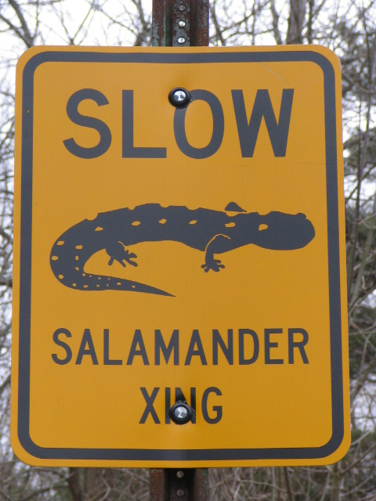
Implications
This analysis and tool will help users make decisions on how to protect species at risk.
The results of corridor analysis assist in the development of mitigation strategies including the creation of wildlife crossings/culverts.
Conservation requires many stakeholders, including landowners who would be required to act as stewards in many of the cases represented in this analysis.
New datasets must be introduced as they are made available including the USGS 1 meter 3DEP DEM.
After corridors are created, the process must evolve as new threats are introduced.
Berkshire Environmental Action Team (2011)
Notes:
The results of this project are intended to provide conservation organizations with more information about species that are imperiled in Virginia. The process will result in modeled wildlife corridors that can highlight areas of concern and can aid in the development of mitigation strategies to prevent further population decline. The use of an automated tool on different species with different habitat requirements will present challenges; however, the process and the resulting tool should be able to compensate for the differences and allow the user to dictate the results despite the different characteristics and behaviors of each species.
The creation of an automated process will cause some challenges based on the different characteristics and behaviors of each species. Hopefully, this process will provide a simple solution for many organizations to use in research and development of conservation strategies. Corridor design and the problems that it mitigates are ever present. A quote that I found interesting reads “corridor design may mitigate off-road vehicles and eradicate a major invasive species, but in a decade there will be another recreational threat and a new invasive plant”.

Slide 20
Project timeline
Complete entire
process manually
using FOSS tools
Complete script
documentation
Prepare and
submit final
report
Present at the
Society for
Conservation
GIS Conference
Action on peer review
feedback and solicit
review from professionals
Complete scripting
and tool creation
Submit abstract
August
March
April
May
June
July
August
October
January
February
September
November
December
2017
2018

Slide 21
References
Beier, P., & Noss, R. F. (1998). Do Habitat Corridors Provide Connectivity? Conservation Biology, 12(6), 1241-1252. doi:10.1111/j.1523-1739.1998.98036.x
Chowns, T. "Valley and Ridge Geologic Province." New Georgia Encyclopedia. 08 June 2017. Web. 22 June 2017.
Nowakowski, A. J., Veiman-Echeverria, M., Kurz, D. J., & Donnelly, M. A. (2015). Evaluating connectivity for tropical amphibians using empirically derived resistance surfaces. Ecological Applications, 25(4), 928-942. doi:10.1890/14-0833.1
Parks, S. A., Mckelvey, K. S., & Schwartz, M. K. (2012). Effects of Weighting Schemes on the Identification of Wildlife Corridors Generated with Least-Cost Methods. Conservation Biology,27(1), 145-154. doi:10.1111/j.1523-1739.2012.01929.x
Roble, S. M. (2016, February). Natural Heritage Resources of Virginia: Rare Animals. Retrieved May 27, 2017. Available online from: http://www.dcr.virginia.gov/natural-heritage/document/anlist2016.pdf
Notes:
The results of this project are intended to provide conservation organizations with more information about species that are imperiled in Virginia. The process will result in modeled wildlife corridors that can highlight areas of concern and can aid in the development of mitigation strategies to prevent further population decline. The use of an automated tool on different species with different habitat requirements will present challenges; however, the process and the resulting tool should be able to compensate for the differences and allow the user to dictate the results despite the different characteristics and behaviors of each species.
The creation of an automated process will cause some challenges based on the different characteristics and behaviors of each species. Hopefully, this process will provide a simple solution for many organizations to use in research and development of conservation strategies. Corridor design and the problems that it mitigates are ever present. A quote that I found interesting reads “corridor design may mitigate off-road vehicles and eradicate a major invasive species, but in a decade there will be another recreational threat and a new invasive plant”.

Slide 22
Questions?
Please contact me with additional comments or questions.
trr153@psu.edu
tomrubino@gmail.com
Thank you!
Notes:
The results of this project are intended to provide conservation organizations with more information about species that are imperiled in Virginia. The process will result in modeled wildlife corridors that can highlight areas of concern and can aid in the development of mitigation strategies to prevent further population decline. The use of an automated tool on different species with different habitat requirements will present challenges; however, the process and the resulting tool should be able to compensate for the differences and allow the user to dictate the results despite the different characteristics and behaviors of each species.
The creation of an automated process will cause some challenges based on the different characteristics and behaviors of each species. Hopefully, this process will provide a simple solution for many organizations to use in research and development of conservation strategies. Corridor design and the problems that it mitigates are ever present. A quote that I found interesting reads “corridor design may mitigate off-road vehicles and eradicate a major invasive species, but in a decade there will be another recreational threat and a new invasive plant”.

