Slide 1
Building Basemaps in the Warzones of Southeast Burma (Myanmar)
Joshua Ryan
GEOG 596A: May 2014
Advisor: Anthony Robinson

Slide 2
Agenda
Project Motivation and Background
Data Collection, Collation, and Merging
Identifying Gaps
Analysis & Adoption
The Final Product
Questions

Slide 3
Project Motivation

Slide 4
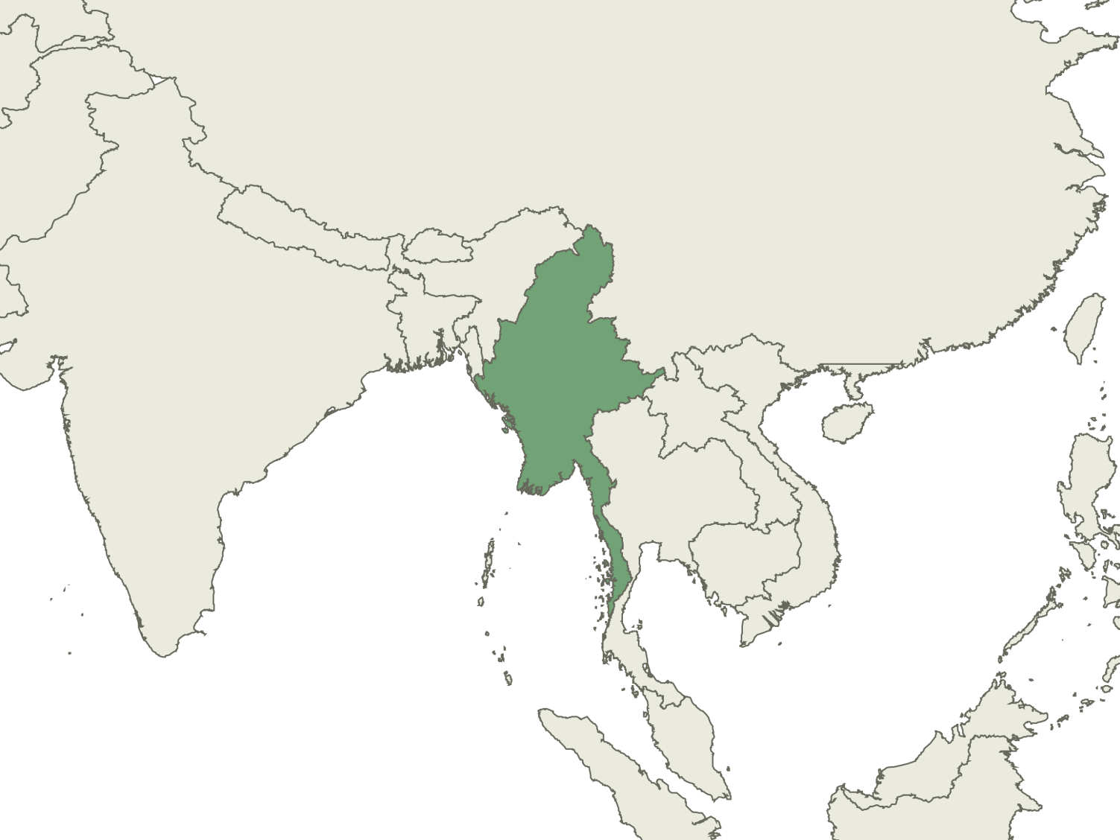
Burma Location
China
India
Burma

Slide 5
Burma History
1948 – Burma gains Independence from Britain
1949 – Karen National Union (KNU) starts fight for independence (third largest ethnic group)
1962 – Burma Army led a Coup
1988 – Student Uprising crushed
1990 – Aung San Suu Kyi won election, put under house arrest
1995 – KNU capital falls to Burma Army
2010 – Elections held, former General Thein Sein wins
2011 – KNU signs Cease-fire

Slide 6
Basic Burma Statistics
Burma’s economy is ranked 161 of 187 countries according to the IMF
Burma health expenditure rate is ranked 189 of 194 countries according to WHO
Notes:
Ethnic Areas are areas where minority ethnic groups (compared to the “majority” Burmans) traditionally claim as their homeland. For example, the Karen ethnic area is predominantly made up of the Karen ethnic group.
Explanation of Cold Chain – a cold chain is a network where every step is kept below a certain temperature – vaccines have to be kept cold until injection to ensure viability

Slide 7
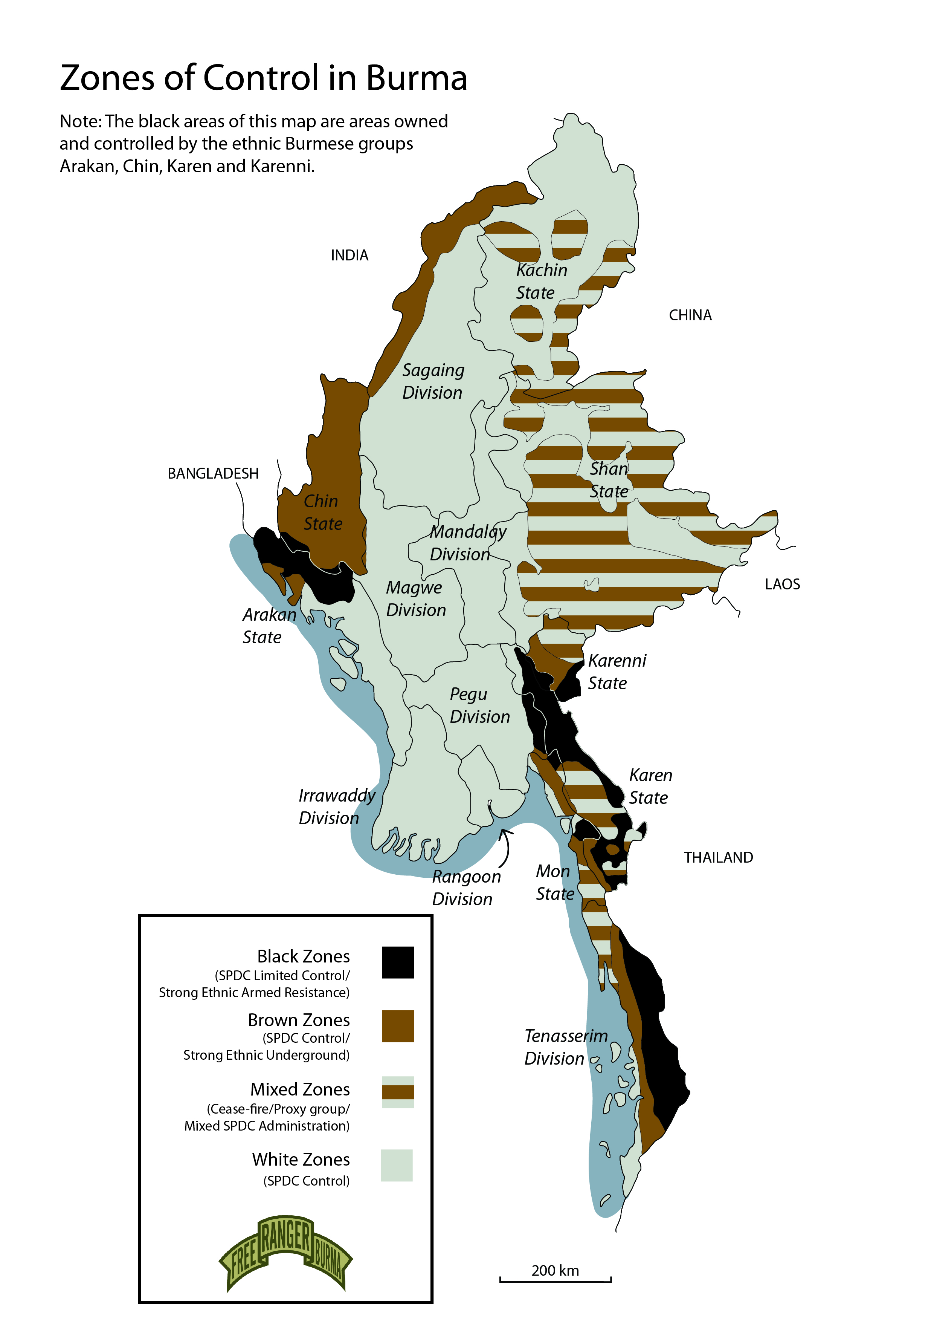
Project Partners - FBR
A multi-ethnic humanitarian service movement seeking to bring help, hope, and love to people in the war zones of Burma.
Much of the GPS information was gathered by Rangers . They have teams in all areas of Northern Karen State (FBR, 2014).

Slide 8
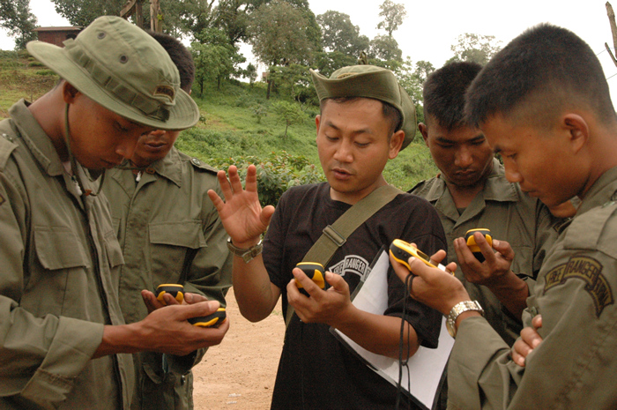
Project Partners - FBR
Field computer for use in communications and data entry
Rangers learning how to use the GPS for reporting and land navigation usage

Slide 9
Project Partners - KDHW
Karen Department of Health and Welfare
Local ethnic organization responsible for all health related activities in Karen State, Burma.
Has recently started a vaccination program.

Slide 10
No Basemaps
Large sections of the ethnic areas have no cold chain due to poor transportation networks
Known outbreaks of vaccine curable diseases
2008 – Measles affected 512 children and killed 4
2014 – Whooping Cough at JSMK
However, no accurate dataset of existing villages could be found.

Slide 11
Project Purpose
To develop a complete geospatial dataset of the villages and transportation networks located in the jungles of South-East Burma.
Research Area
Notes:
Note: Detailed maps of this region cannot be shown for security reasons

Slide 12
Project Timeline
2013 – prefatory work
2014 –
January: Survey Trip into Burma for Data Collection
February – April: Data Collation & Cleaning
May – June: Spatial Analysis and Fill in the Gaps
July: Encouraging Organizational Use of Improved Spatial Data
October 30 – November 1: Present at International Conference on Humanitarian Medical Missions in Singapore.

Slide 13
Data Collection, Collation,
and Merging

Slide 14
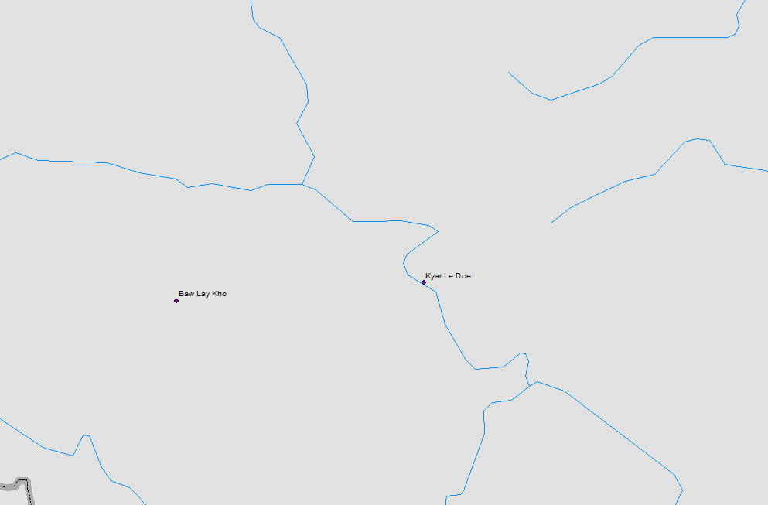
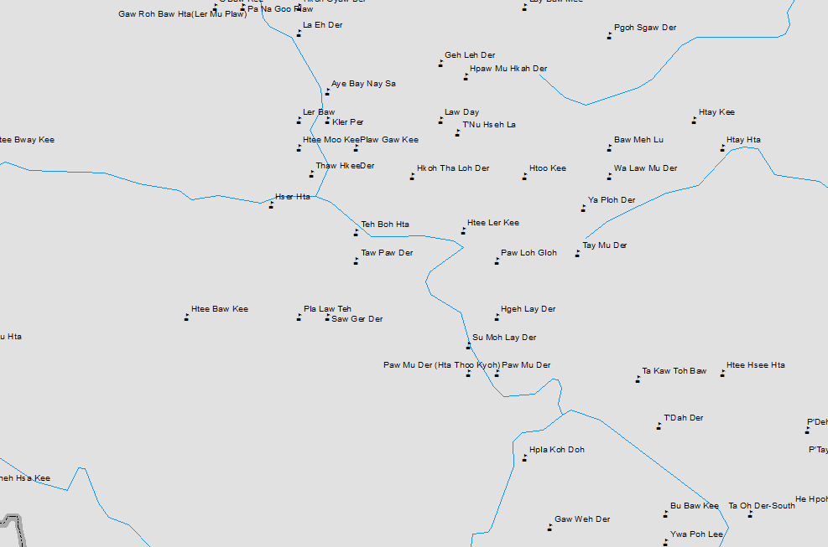
Origin of village data-sets
Organization | GPS Points included | Other Information Included
KDHW | Some (roughly 50%) | Population for some
FBR | Yes | None
Karen Education Dept. | Yes, but rounded to nearest minute | Student and teacher numbers
Myanmar Information and Mapping Unit | Yes, but very little in study area | None
MIMU Map
KED Map

Slide 15
Other Data
Source organization | Type of Data
Open Street Maps | Waterways including Shwegyin Dam area Existing roads
Karen Mapping Program | Burma Administrative Borders including Karen borders (different from official Burmese Borders) Existing roads
Notes:
-KMP Adm borders for Karen State were essential as many villages had only Karen Township locations, not Burmese Township locations.
-KMP roads included Burma Army roads which aren’t on OSM.

Slide 16
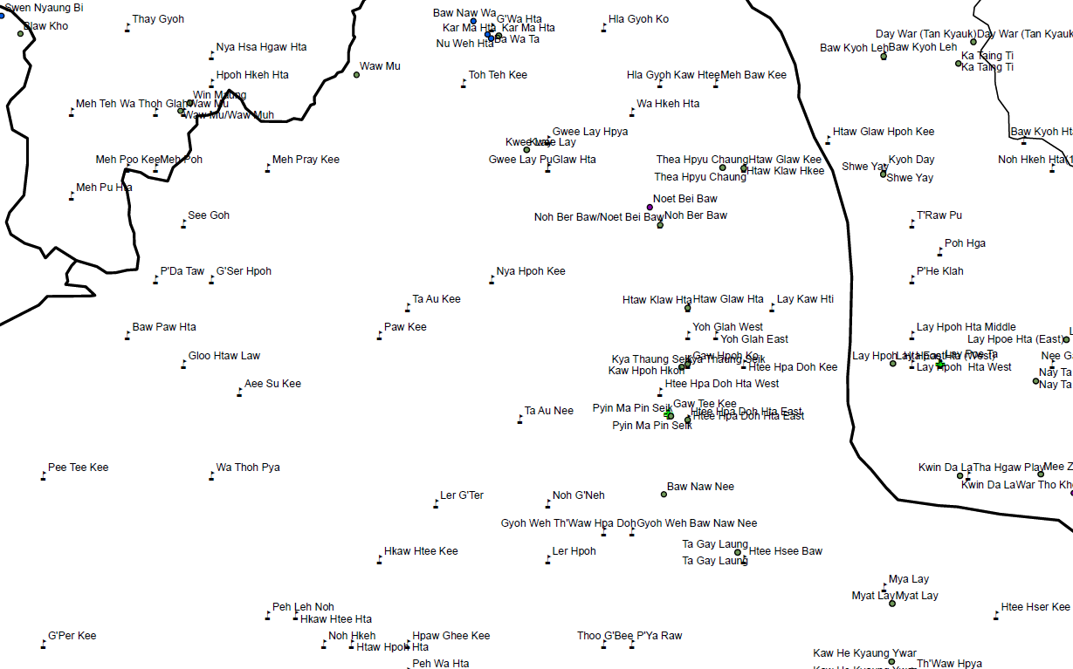
January Survey Trip
Jungle School of Medicine – Kawthoolei
15 students and teachers interviewed
Map used during interview

Slide 17
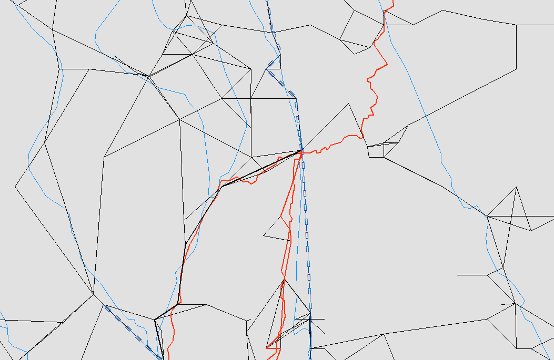
Survey Questions
Initial question – how long is it to walk from where we are now to the nearest village?
Other questions – how long to walk between villages in areas with which you are familiar?
Notes:
Red = roads, blue = rivers, blue chains = ferries/boats, black = trails
Each line segment is assigned a value in hours for how long to traverse it.

Slide 18
Data Collation and Merging
Looked for straight equivalence and merged if name was exact and the Lat/Longs were either exact or close - 350 duplicates removed.
Looked for Identical Lat/Long - Merged if names seemed to match - 125 duplicates removed
Sort by name, look for villages with no Lat/Long and see if local names match. - 26 duplicates removed
Hsaw Htee township villages were duplicated in one of the original files - 57 duplicates removed
Look on map to find duplicates - 154 duplicates removed
Clean up security areas, add JSMK - 10 removed
OSM map used to delete villages under water - 3 removed - Total = 2505.
3230 Total Places -> Merged/deleted down to 2505 Places

Slide 19
Data Collation and Merging
Looked for straight equivalence and merged if name was exact and the Lat/Longs were either exact or close - 350 duplicates removed.
Looked for Identical Lat/Long - Merged if names seemed to match - 125 duplicates removed
Sort by name, look for villages with no Lat/Long and see if local names match. - 26 duplicates removed
Hsaw Htee township villages were duplicated in one of the original files - 57 duplicates removed
Look on map to find duplicates - 154 duplicates removed
Clean up security areas, add JSMK - 10 removed
OSM map used to delete villages under water - 3 removed - Total = 2505.
3230 Total Places -> Merged/deleted down to 2505 Places

Slide 20
Data Collation and Merging
Looked for straight equivalence and merged if name was exact and the Lat/Longs were either exact or close - 350 duplicates removed.
Looked for Identical Lat/Long - Merged if names seemed to match - 125 duplicates removed
Sort by name, look for villages with no Lat/Long and see if local names match. - 26 duplicates removed
Hsaw Htee township villages were duplicated in one of the original files - 57 duplicates removed
Look on map to find duplicates - 154 duplicates removed
Clean up security areas, add JSMK - 10 removed
OSM map used to delete villages under water - 3 removed - Total = 2505.
3230 Total Places -> Merged/deleted down to 2505 Places

Slide 21
Data Collation and Merging
Looked for straight equivalence and merged if name was exact and the Lat/Longs were either exact or close - 350 duplicates removed.
Looked for Identical Lat/Long - Merged if names seemed to match - 125 duplicates removed
Sort by name, look for villages with no Lat/Long and see if local names match. - 26 duplicates removed
Hsaw Htee township villages were duplicated in one of the original files - 57 duplicates removed
Look on map to find duplicates - 154 duplicates removed
Clean up security areas, add JSMK - 10 removed
OSM map used to delete villages under water - 3 removed - Total = 2505.
3230 Total Places -> Merged/deleted down to 2505 Places

Slide 22
Data Collation and Merging
Looked for straight equivalence and merged if name was exact and the Lat/Longs were either exact or close - 350 duplicates removed.
Looked for Identical Lat/Long - Merged if names seemed to match - 125 duplicates removed
Sort by name, look for villages with no Lat/Long and see if local names match. - 26 duplicates removed
Hsaw Htee township villages were duplicated in one of the original files - 57 duplicates removed
Look on map to find duplicates - 154 duplicates removed
Clean up security areas, add JSMK - 10 removed
OSM map used to delete villages under water - 3 removed - Total = 2505.
3230 Total Places -> Merged/deleted down to 2505 Places

Slide 23
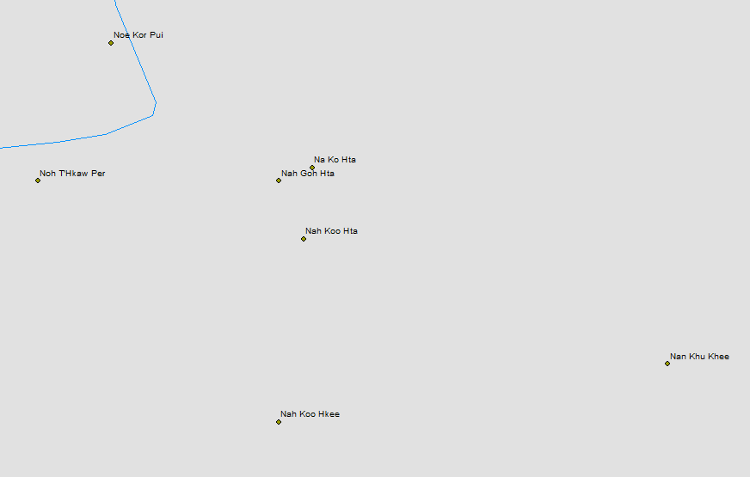
Examples of Transliteration Errors
Hti -> Htee -> Ti -> Tee
Hta -> Ta
O -> Oh -> Oo
Teh -> Day
Joe -> Joy -> Kyo
Kee -> Kei -> Ki -> Hkee -> Khee
Der -> Duh -> Deh
Hkeh -> Geh -> Kay
Ko -> Koh -> Goh
Same Village:
Points are
300 meters apart
Same Village:
Points are1.7 km apart

Slide 24
Data Collation and Merging
Looked for straight equivalence and merged if name was exact and the Lat/Longs were either exact or close - 350 duplicates removed.
Looked for Identical Lat/Long - Merged if names seemed to match - 125 duplicates removed
Sort by name, look for villages with no Lat/Long and see if local names match. - 26 duplicates removed
Hsaw Htee township villages were duplicated in one of the original files - 57 duplicates removed
Look on map to find duplicates - 154 duplicates removed
Clean up security areas, add JSMK - 10 removed
OSM map used to delete villages under water - 3 removed - Total = 2505.
3230 Total Places -> Merged/deleted down to 2505 Places

Slide 25
Data Collation and Merging
Looked for straight equivalence and merged if name was exact and the Lat/Longs were either exact or close - 350 duplicates removed.
Looked for Identical Lat/Long - Merged if names seemed to match - 125 duplicates removed
Sort by name, look for villages with no Lat/Long and see if local names match. - 26 duplicates removed
Hsaw Htee township villages were duplicated in one of the original files - 57 duplicates removed
Look on map to find duplicates - 154 duplicates removed
Clean up security areas, add JSMK - 10 removed
OSM map used to delete villages under water - 3 removed - Total = 2505.
3230 Total Places -> Merged/deleted down to 2505 Places

Slide 26
Data Collation and Merging
Looked for straight equivalence and merged if name was exact and the Lat/Longs were either exact or close - 350 duplicates removed.
Looked for Identical Lat/Long - Merged if names seemed to match - 125 duplicates removed
Sort by name, look for villages with no Lat/Long and see if local names match. - 26 duplicates removed
Hsaw Htee township villages were duplicated in one of the original files - 57 duplicates removed
Look on map to find duplicates - 154 duplicates removed
Clean up security areas, add JSMK - 10 removed
OSM map used to delete villages under water - 3 removed - Total = 2505.
3230 Total Places -> Merged/deleted down to 2505 Places

Slide 27
Identifying Gaps

Slide 28
Burned Field Analysis
Landsat imagery has been gathered since 1972 – Landsat 8 has been in operation since Feb, 2013.
Landsat is good at detecting changes in vegetation coverage
Several researchers (E. Prins, A. Marx) have used Landsat analysis to detect burned villages in Darfur, Sudan

Slide 29
Burned Field Analysis
Use the analytical method developed by Marx and Prins to find all fields that were created using Slash and Burn techniques (known as “swiddens”)
Compare with current list of villages
Swiddens > than 5km away can be considered to be related to another unidentified village
Notes:
The 5 km distance is variable depending on the results of the analysis. The goal is find the average distance swiddens are located from their respective villages and then look for swiddens that are farther than that.

Slide 30
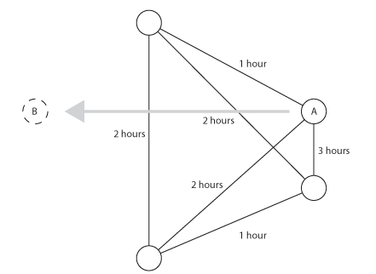
Mislocated Village Analysis
Village A is probably located in the vicinity of B. But all that can be determined is that it is currently misplaced.

Slide 31
Analysis & Adoption

Slide 32
Estimated Travel Times
Initial question (JSMK to Law Kaw Wah) provides basis of comparison
Mean/Median comparison, find regular deviation for each person
By applying those deviations to the links in each person’s individual network response, I can create a normalized travel network.
Find network link overlap
In areas with overlapping links, the mean and median of the two normalized links can be found and used, or the longer distance will be used (guaranteeing the estimate is better)
Notes:
JSMK is where the surveys took place. Law Kaw Wah is the nearest village and all people at JSMK would’ve have to have had come through that village in order to get to JSMK.

Slide 33
Filling in the Gaps
After the analysis, several organizations will be queried as to the missing point information. These organizations include:
FBR (for GPS data)
KDHW (for population data and clinic location data)
KED (for student and teacher data)
Another round of field surveys may be needed to fill in missing transportation information

Slide 34
Organizational Adoption Survey
For your particular area of expertise (medical, food, education, etc.), does the information on this dataset conceivably help you?
What tasks could this dataset help you accomplish?
Does the dataset look like it covers everything (i.e., are there villages missing; are there villages that you know are not there anymore; does the travel network look correct)?

Slide 35
The Final Product

Slide 36
Anticipated Results and Impact
A comprehensive basemap of an area that has been fighting a civil war for the past 60 years.
The basemap should help with planning and analysis of vaccination cold chains in Northern Karen State.
Notes:
Mention that the basemap will include a travel times network
Current stage and future stages (identifying gaps analyses, organizational adoption survey, presentation at conference)

Slide 37
MIMU Map

Slide 38
My basemap so far

Slide 39
Future Work
Actual travel routes for roads and potentially even trails
Dry season vs rainy season travel times and routes
Get Karen names of villages and use a standardized transliteration
Increase the diversity of people surveyed (this project only surveyed young healthy people)

Slide 40
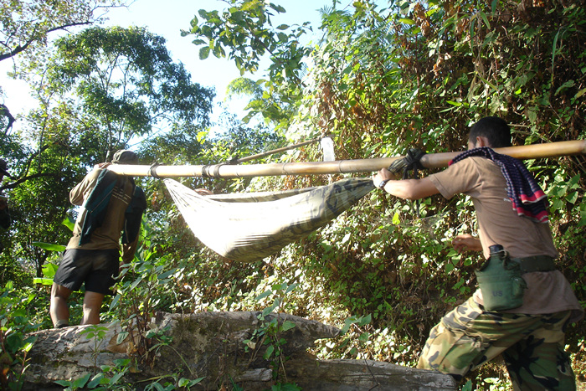
Jungle ambulance service
Questions?
Email: jjr303@psu.edu

