Slide 1
An Open-Source Approach to Creating a National Critical Habitat Web Map
Deanna Sarro
GEOG596 – Summer 2016
Penn State University
Advisor: Jim Detwiler

Slide 2
OUTLINE
Background
Method
Data
Interface Development
Functionality
Maintenance
Project Schedule
References
Acknowledgements

Slide 3
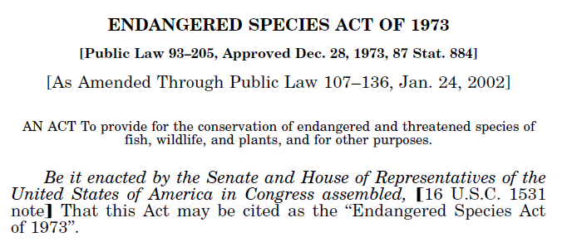
ENDANGERED SPECIES ACT
Total species on ESA list = ~2,270
Foreign only species = 650
Total U.S. species = 1,620

Slide 4
CRITICAL HABITAT
Critical habitat is defined as specific areas:
within the geographic area, occupied by the species at the time it was listed, that contain the physical or biological features that are essential to the conservation of endangered and threatened species and that may need special management or protection; and
outside the geographical area occupied by the species if the agency determines that the area itself is essential for conservation.
Center for Biological Diversity – endangered and threatened species with a defined habitat are “more than twice as likely” to be increasing in population
~1,600 total species in the U.S. on the ESA list
Of these species, only 704 species have designated critical habitat

Slide 5
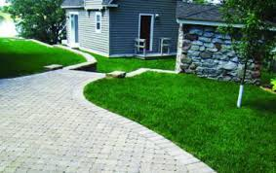
U.S. Army Corps of Engineers (USACE) Requirements
NMFS Biological Opinion – Nov 24, 2014
Requires the USACE to report on the amount of new impervious surface cover that will result from activities authorized by Corps’ Regulatory nationwide permits
Data will be captured for those locations that fall within a 10-digit HUC watershed inhabited by listed species under the jurisdiction of NMFS based on existing critical habitats

Slide 6
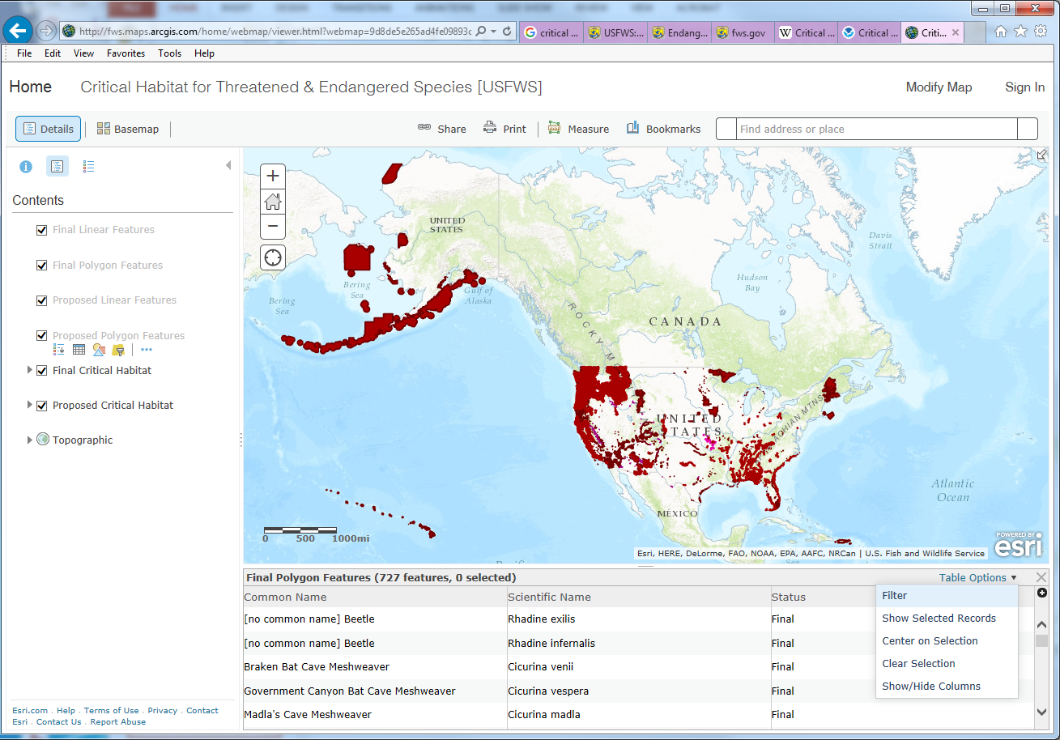
USFWS CRITICAL HABITAT MAP
Colors/patterns for overlapping critical habitat
Expanded filtering options
Interactive relationship between features and table
Select all features at one location
Provide additional basemaps for spatial analysis
Link to external web sites with species information

Slide 7
OVERALL PROCESS
Acquire critical habitat data
Compile species list for each state
Create national data for species with no defined critical habitat
Generalize datasets for each zoom level
Create styles (SLD) for each dataset
Create tiles for thematic layers and basemaps
Create Application Program Interface (API)

Slide 8
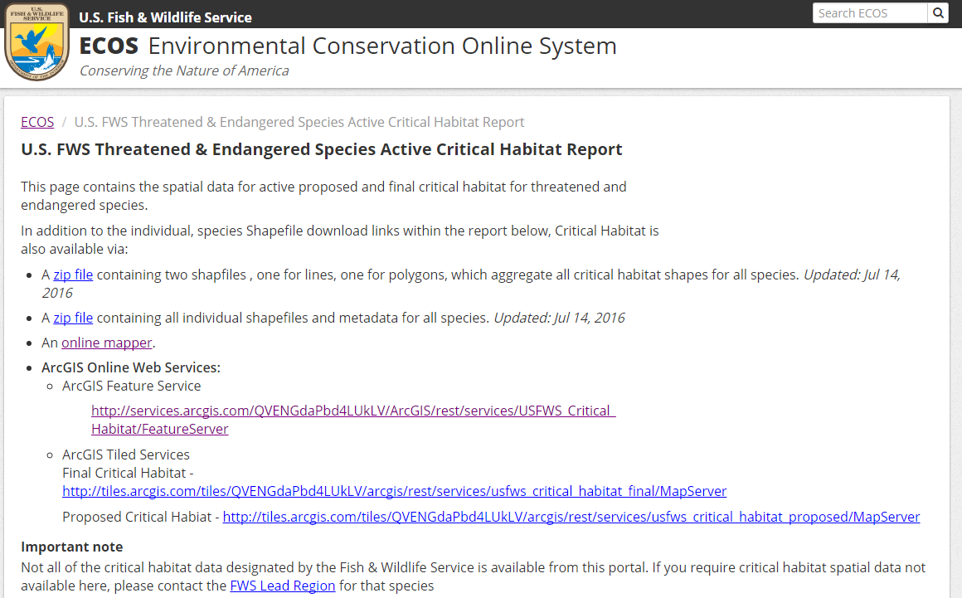
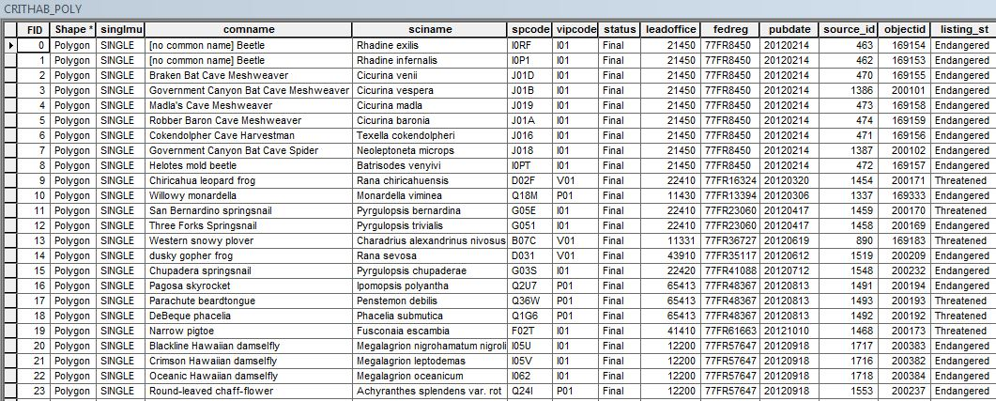
ACQUIRE CRITICAL HABITAT DATA

Slide 9
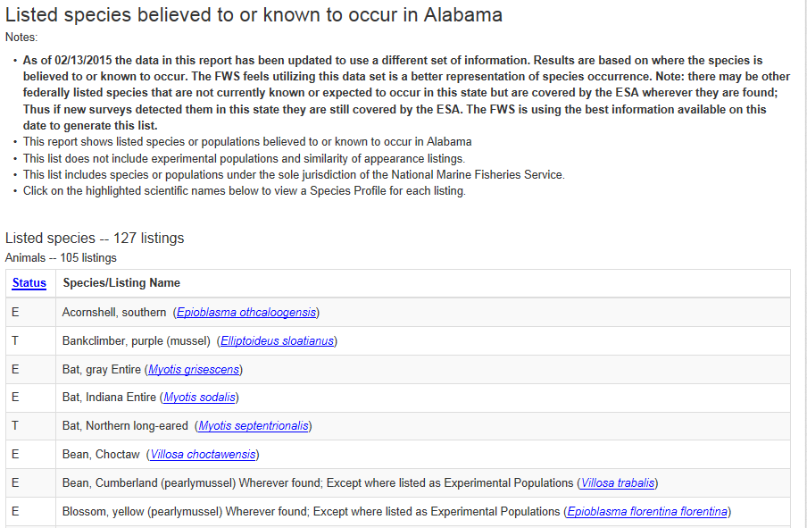
DOWNLOAD STATE SPECIES LISTS
http://ecos.fws.gov/ecp0/reports/species-listed-by-state-report?state=AL&status=listed

Slide 10
DATA FORMAT CONSIDERATIONS
Data formats considered:
File-based content
KML
GeoJSON
Shapefile
Tile-based pre-generated content
Raster tiles (WMS/WFS)
Spatially-enabled relational database (RDBMS)
Oracle
PostGIS
SQLServer
SpatialLite
Vector tiles

Slide 11
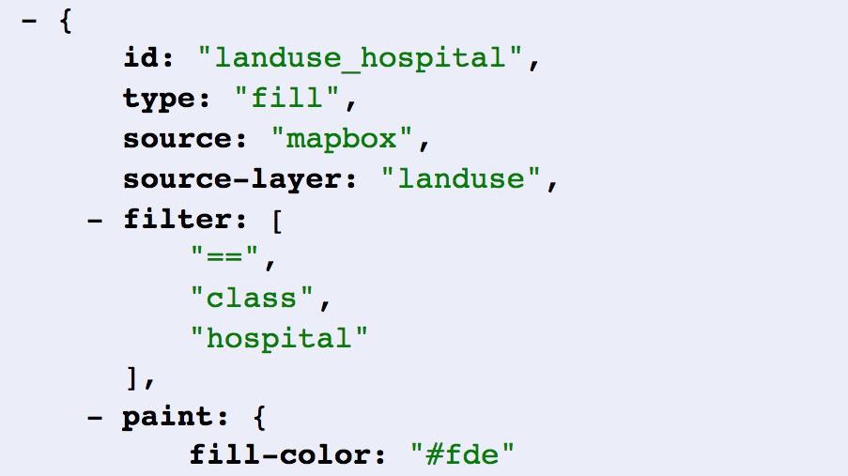
Vector Tiles versus Image Tiles
Client (not the server) decides on styling
Only need to tile the data once to have multiple maps
Drawn vectors can look better on high-resolution displays
Image Tiles are much easier to consume
There’s more know-how in working with Vectors
David Blasby [Boundless]. “Vector Tiles with GeoServer and OpenLayers.”

Slide 12
FINAL DATA FORMAT
PostGIS for data storage and spatial analysis
GeoServer to create Mapbox Vector Tiles (MVT)
Style Layer Descriptor (SLD) to control map styling
GeoWebCache to cache vector tiles
MapBox Vector Tiles
Style Layer Descriptor

Slide 13
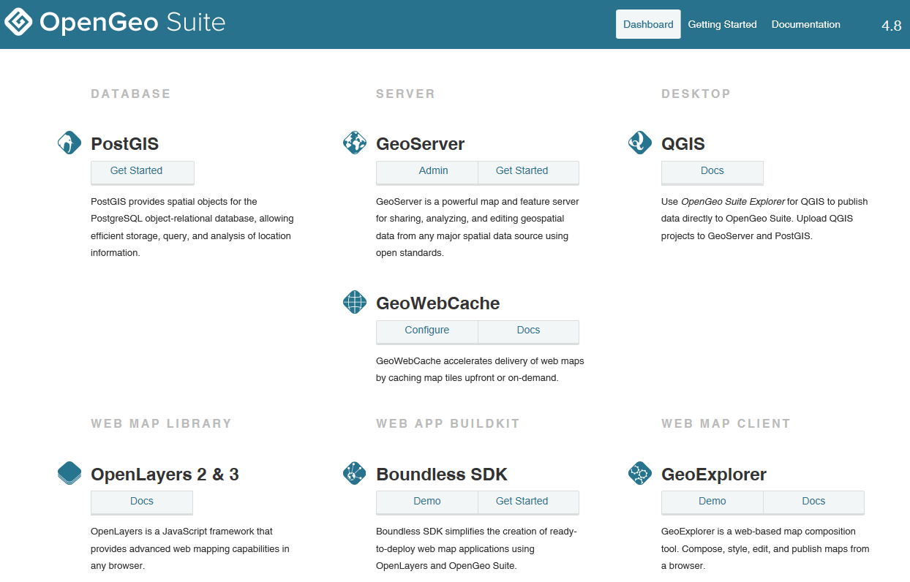
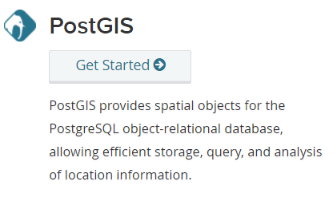
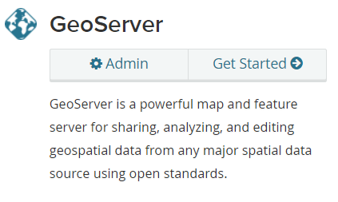
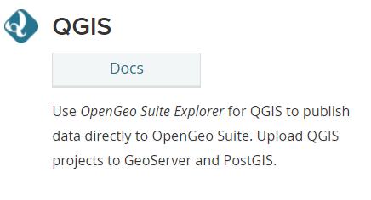
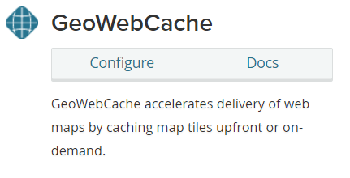
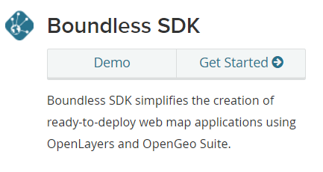
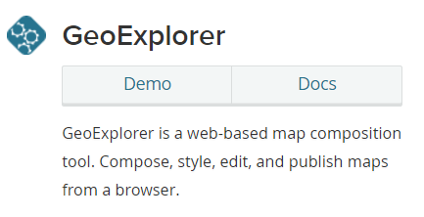
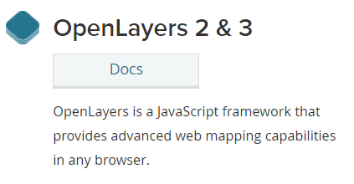
DATA PROCESSING TOOLS

Slide 14
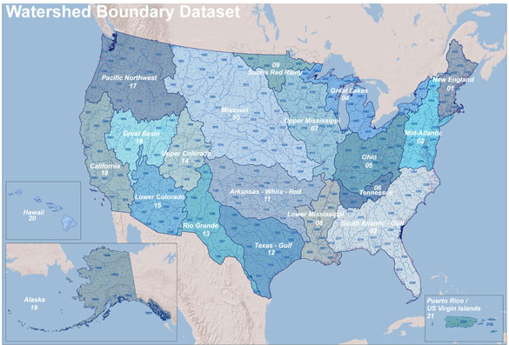
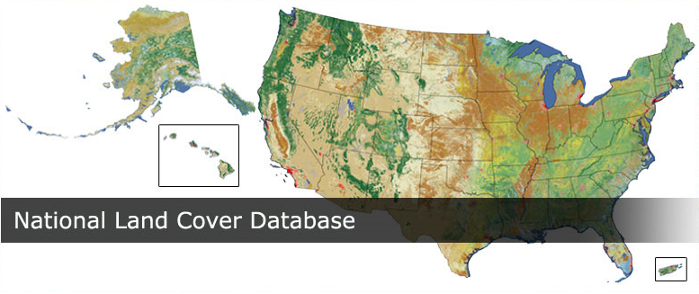
BASEMAPS

Slide 15
WEB MAP INTERFACE

Slide 16
Bird Species Map

Slide 17
BASIC FUNCTIONALITY
Display critical habitat data overlaid with basemaps
Display table of all species
Select critical habitat feature from map
Select species from table
Map interaction buttons
Zoom To Selected
Zoom To Full Extent
Clear Selection
Pan/Zoom tools
Legend for map layers
Tool to change basemap

Slide 18
DATA SELECTION
Select all species with critical habitat for
a specified coordinate
a mouse click location on map
within selected geography
Filter displayed critical habitats on map and species listed in table based on
state
species group
common name
scientific name
status
effective date

Slide 19
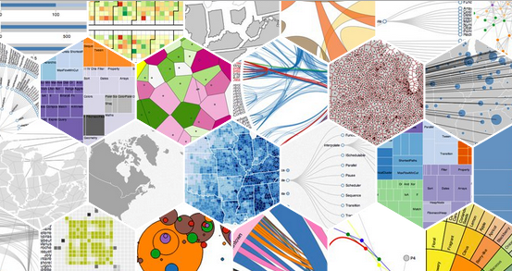
SPATIAL ANALYSIS
Create graphs showing
species added by year
species count by state
species by size of critical habitat
critical habitat to land cover type
critical habitat to amount of impervious surface
acres of land per state

Slide 20
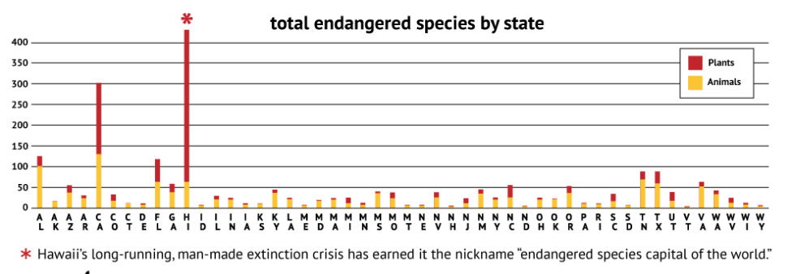
Species Count by State
http://www.mnn.com/earth-matters/wilderness-resources/blogs/which-us-states-have-the-most-endangered-species

Slide 21
MAINTENANCE
Data and tiles
Software
Documentation

Slide 22
PROJECT SCHEDULE
Fall 1 2016 (Aug – Oct 2016)
Work through GEOG596B to complete web map
Oct 20, 2016
Present project at the North American Cartographic Information Society (NACIS) annual meeting
Thursday, Oct 20, 9:00am-10:10am session

Slide 23
References
16 U.S. Code § 1531-1544, Endangered Species Act of 1973.
16 U.S. Code § 1532(5)(A)(i), Endangered Species – Definitions.
Martin F.J. Taylor et al., The Effectiveness of the Endangered Species Act: A Quantitative Analysis, 55 BioScience 360, 360-67 (2005).
Critical Habitat for Threatened & Endangered Species [USFWS] web map application http://fws.maps.arcgis.com/home/webmap/viewer.html?webmap=9d8de5e265ad4fe09893cf75b8dbfb77
The Critical Habitat Reform Act of 203: Hearing on H.R. 2933 Before the H. Res. Comm., 108th Cong (Apr. 28, 2004) (testimony of Craig Manson, Assistant Secretary for Fish & Wildlife and Parks, Department of the Interior).
GIS Cloud. "Realtime Map Tile Rendering Benchmark: Rasters vs. Vectors." <http://www.giscloud.com/blog/realtime-map-tile-rendering-benchmark-rasters-vs-vectors/>. Accessed June 13, 2016.
David Blasby [Boundless]. “Vector Tiles with GeoServer and OpenLayers.” https://2016.foss4g-na.org/sites/default/files/slides/Foss4G_VTs_FINAL.pdf. Access July 14, 2016.

Slide 24
ACKNOWLEDGEMENTS
A big thanks to my advisor, Jim Detwiler, for his great insight and helpful suggestions.
Also, thanks to Beth King for keeping me organized and making sure I was taking the right classes.

Slide 25
QUESTIONS?
Deanna Sarro
dls535@psu.edu

