Slide 1
Statistical Review of Tsunami Generated by Earthquake-Produced Submarine Landslides and Tsunami Direct Path GIS Impact Analysis
John E.S. Saunders
The Pennsylvania State University
MGIS Capstone Proposal

Slide 2
Outline
Proposed Work
Phase 1 – Earthquake Statistical Data Analysis
Phase 2 – Seafloor Analysis
Phase 3 – Tsunami Wave Propagation Modeling
Phase 4 – Impact Analysis
Significance
Work Status

Slide 3
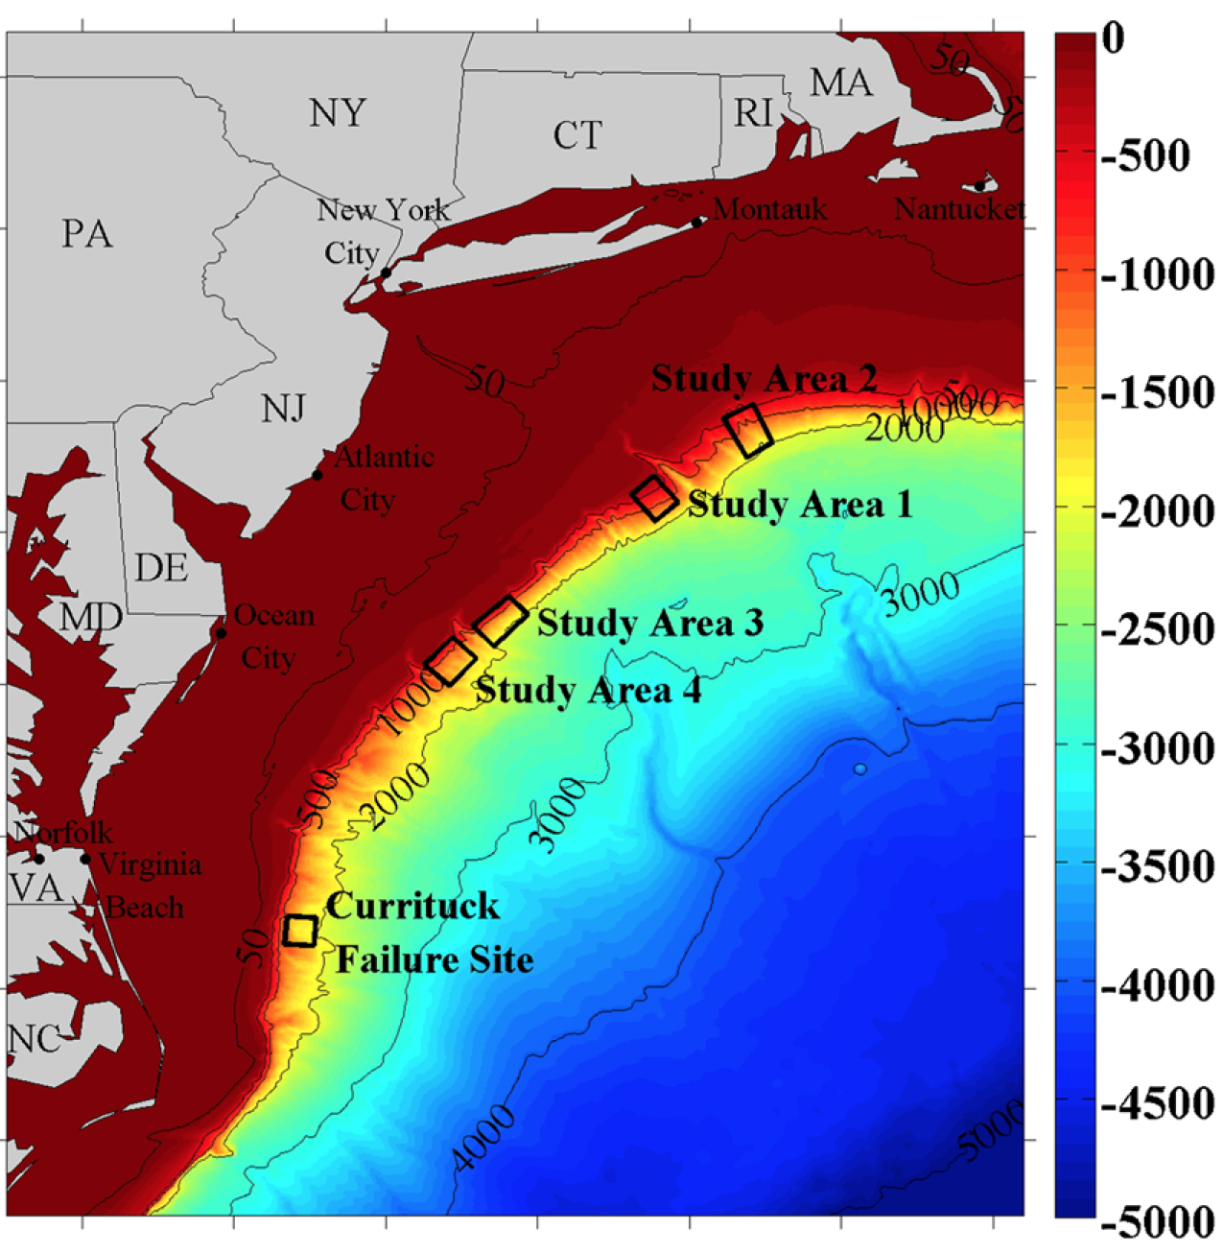
Proposed Work
Statistical analysis of earthquake activity on or around the United States East Coast
Identification of mutually located candidate submarine topographic features prone to landslide or Submarine Mass Failure (SMF).
  Seafloor/geologic similarities among historic failure locations. (Currituck Peninsula)
  Approximate slope of submarine ridges/mountains
  Depth of submarine topographic features
Grilli, S., C. O’Reilly, J. Harris, T. Bakhsh. B. Tehranirad, S. Banihashemi, J. Kirby, C. Baxter, T. Eggeling, G. Ma, and F., Shi, 2015. Modeling of SMF Tsunami Hazard Along the Upper US East Coast: Detailed Impact around Ocean City, MD. Natural Hazards, 76 (20): 705-746.
Notes:
Proposed research will first attempt to identify a submarine area prone to failure along the east coast of the United States continental shelf.
This will be based on both topographical candidate sites using data based on historic Submarine Mass Failures (SMF) and regions which have high volumes of seismic activity.
The resulting candidate research site will then act as the epicenter from which a tsunami propagation will be modeled from.
The model will then be used to orchestrate an impact analysis on a coastal region, which lies within the direct path, or the direction from the epicenter delivering the most kinetic energy in the form a waves.

Slide 4
Proposed Work Cont.
Wave propagation modeling based on landslide/SMF point of origin to determine the direct path of a potential near-field tsunamis
Impact analysis based on tsunami direct path; most likely candidate location on U.S. East Coast.
  Wave/sea-height modeling (City Engine)
  Population, Economic, Energy, Transportation, and Agricultural Impacts
  Natural Drainage
Notes:
Wave form and fluid dynamic of waves based on depth, reflection, refraction, and submarine features. Peak Wave Height Potential over Time based on previous study for near and far field studies.

Slide 5
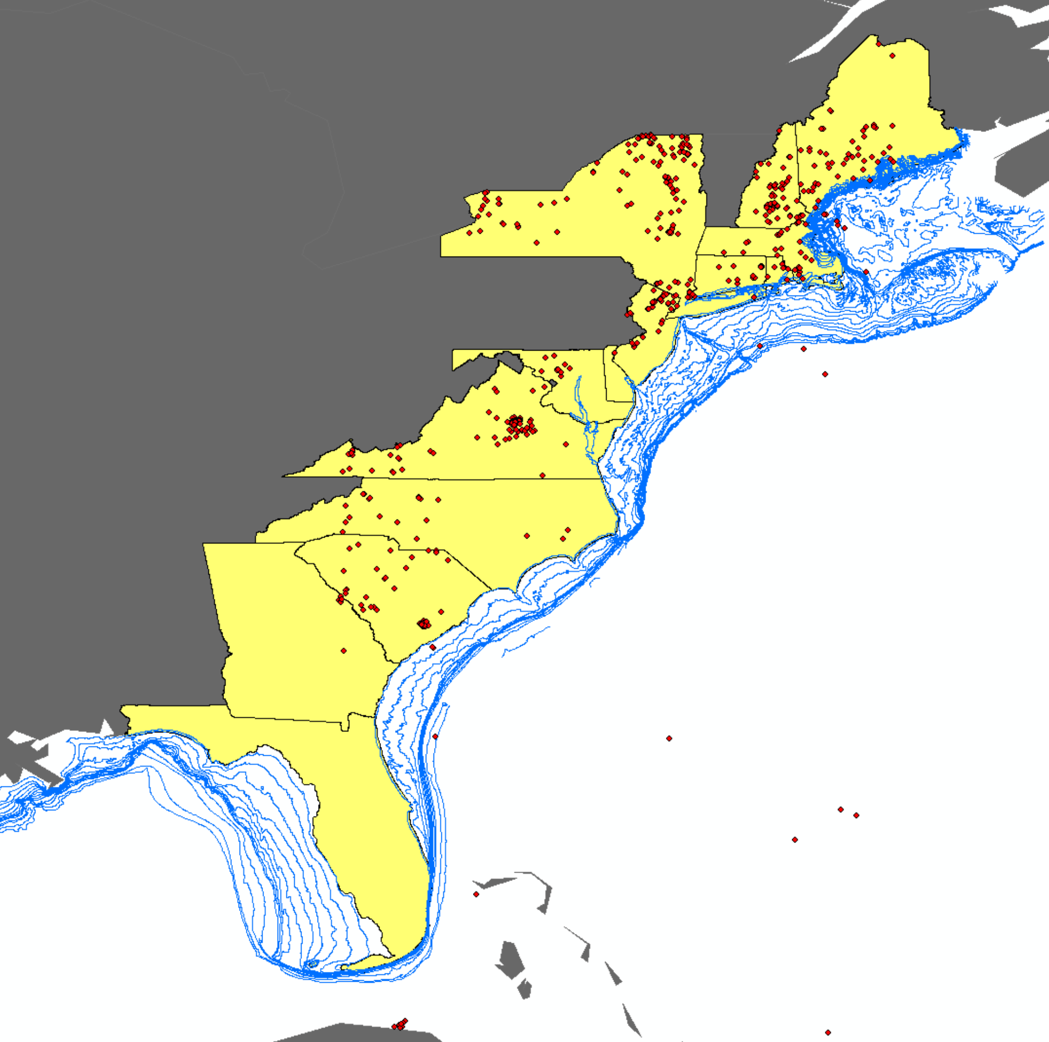
Phase 1 – Earthquake Statistical Data Analysis and data acquisition
Earthquake data points – USGS; Bathymetric imagery – NOAA (30 Arc Seconds-Global, LIDAR-Coastal)
Statistical analysis of historic earthquake data and submarine mass failures and landslides that produced tsunami
Condensing of total data points based on the standard deviation in distance of seismic events to the North American continental shelf; all other data will be eliminated
Cluster, hot spot, and outlier analysis of earthquake epicenter locations on the U.S. East Coast

Slide 6
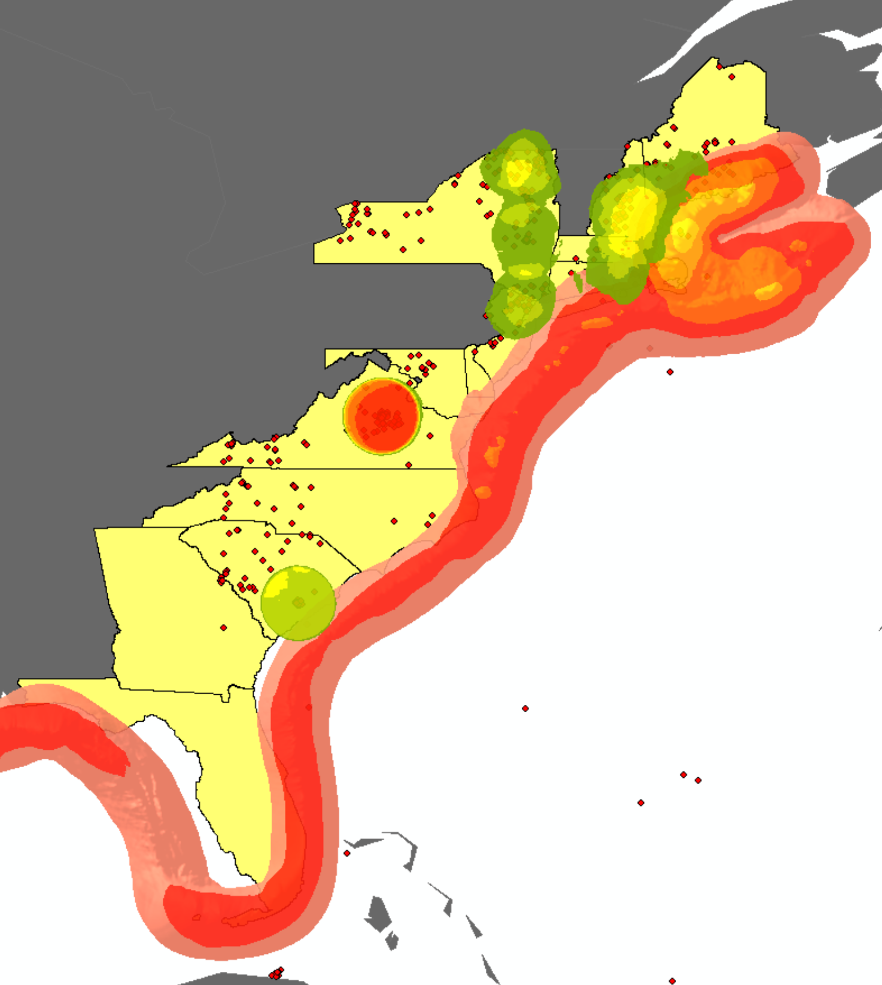
Phase 2 – Seafloor Analysis
Slope analysis of seafloor, resolution pending, using bathymetric imagery and based on research regarding minimum angles for potential failures
Identification of submarine features from which a tsunami could reflect or refract its energy during acceleration along a vector
Incorporation of previous work into candidate locations where a failure or landslide may occur
Low Volume
Earthquake Activity
High Volume
Gradual Slope
North American Continental Shelf Slope Level
Steep Slope

Slide 7
Phase 3 – Tsunami Wave Propagation Modeling
Model and simulate the propagation of a tsunami wave’s direct path within capability of the GIS and applied mathematical models (Boussinesq and Stokes Expansion)
Create a cost surface analysis based on seafloor topographic construct to identify the least-cost path for a tsunami wave to a coastal region (as a secondary measure, without standard mathematical models)
Utilize standard GIS software and/or R, Mat Lab for desired results

Slide 8
Phase 4 – Impact Analysis
Create a surface terrain model of an impact zone where the direct path of a tsunami is most likely to strike based on numerical equations or least-cost path analysis.
Create maps displaying impacts on population, economy, energy, transportation, and agriculture; include natural drainage and soil composition analysis in terrain model
Construct 3D Models using ESRI City Engine to simulate water level increase over region

Slide 9
Significance
Attempt to utilize a GIS exclusively to identify:
  Locations capable of producing tsunami along East Coast
  East Coast locations most vulnerable to tsunami
  Likely impacts of tsunami in these locations
Notes:
more than one methodology exists for projecting the likelihood of a tsunami, few scientific papers or projects utilize GIS for applying known data surrounding seismic activity or using spatial analytics to anticipate a probable zone of imminent danger.

Slide 10
Work status
Research Phase officially ended November Wk.4; Phase I in progress.
  Data for research area and bathymetry is currently being obtained
Scope modified based on preliminary findings surrounding both the vastness of the original research area (entire Atlantic) and variance in earthquake magnitude relative to depth, proving to be too far-field.
Abstract successfully submitted to Association of American Geographers 2016 Annual Meeting, San Francisco, California.
  Geographic Information Science and Systems - Hazards and Vulnerability Session
Notes:
Tsunami typically carry more energy from the sub-surface to peak wave amplitude in shallow environments. The shallowest location where a ~5.0 magnitude earthquake was in the middle of the Atlantic ridge, proving to be a very farfield.
The new research area is confined to the East Coast and areas IVO the North American Continental Shelf.

