Slide 1
Statistical Review of Tsunami Generated by Earthquake-Produced Submarine Landslides and Tsunami Direct Path GIS Impact Analysis
John E.S. Saunders
Dept. of Geography
The Pennsylvania State University

Slide 2
Outline
Abstract
Phase 1 – Earthquake and Tsunami Statistical Data Analysis
Phase 2 – Seafloor Analysis
Phase 3 – Tsunami Wave Propagation Modeling
Phase 4 – Wave inundation Impact Analysis
Conclusions

Slide 3
Abstract Summary
Exclusively using Geographic Information Systems (GIS), develop a methodology for (1) identifying submarine locations prone to landslides that are also in proximity to seismically active regions. (2) Using the historic Currituck Submarine Mass Failure (SMF) event as a control, attempt to classify a candidate site along the U.S. East Coast susceptible to landslide preconditions. (3) Implement a means for predicting the overall energy output, tsunami wave characteristics, and in determining the first human populated coastal area vulnerable to a surface wave. (4) Analyze impact on the identified coastal region.
(1) Identifying submarine locations prone to landslides that are also in proximity to seismically active regions.
Notes:
Proposed research will first attempt to identify a submarine area prone to failure along the east coast of the United States continental shelf.
This will be based on both topographical candidate sites using data based on historic Submarine Mass Failures (SMF) and regions which have high volumes of seismic activity.
The resulting candidate research site will then act as the epicenter from which a tsunami propagation will be modeled from.
The model will then be used to orchestrate an impact analysis on a coastal region, which lies within the direct path, or the direction from the epicenter delivering the most kinetic energy in the form a waves.

Slide 4
Abstract Summary
Exclusively using Geographic Information Systems (GIS), develop a methodology for (1) identifying submarine locations prone to landslides that are also in proximity to seismically active regions. (2) Using the historic Currituck Submarine Mass Failure (SMF) event as a control, attempt to classify a candidate site along the U.S. East Coast susceptible to landslide preconditions. (3) Implement a means for predicting the overall energy output, tsunami wave characteristics, and in determining the first human populated coastal area vulnerable to a surface wave. (4) Analyze impact on the identified coastal region.
(2) Using the historic Currituck Submarine Mass Failure (SMF) event as a control, attempt to classify a candidate site along the U.S. East Coast susceptible to landslide preconditions.
Notes:
Proposed research will first attempt to identify a submarine area prone to failure along the east coast of the United States continental shelf.
This will be based on both topographical candidate sites using data based on historic Submarine Mass Failures (SMF) and regions which have high volumes of seismic activity.
The resulting candidate research site will then act as the epicenter from which a tsunami propagation will be modeled from.
The model will then be used to orchestrate an impact analysis on a coastal region, which lies within the direct path, or the direction from the epicenter delivering the most kinetic energy in the form a waves.

Slide 5
Abstract Summary
Exclusively using Geographic Information Systems (GIS), develop a methodology for (1) identifying submarine locations prone to landslides that are also in proximity to seismically active regions. (2) Using the historic Currituck Submarine Mass Failure (SMF) event as a control, attempt to classify a candidate site along the U.S. East Coast susceptible to landslide preconditions. (3) Implement a means for predicting the overall energy output, tsunami wave characteristics, and in determining the first human populated coastal area vulnerable to a surface wave. (4) Apply an impact analysis on the identified coastal region.
(3) Implement a means for predicting the overall energy output, the tsunami wave characteristics, and location of the first human-populated coastal area vulnerable to a surface wave.
Notes:
Proposed research will first attempt to identify a submarine area prone to failure along the east coast of the United States continental shelf.
This will be based on both topographical candidate sites using data based on historic Submarine Mass Failures (SMF) and regions which have high volumes of seismic activity.
The resulting candidate research site will then act as the epicenter from which a tsunami propagation will be modeled from.
The model will then be used to orchestrate an impact analysis on a coastal region, which lies within the direct path, or the direction from the epicenter delivering the most kinetic energy in the form a waves.

Slide 6
Abstract Summary
Exclusively using Geographic Information Systems (GIS), develop a methodology for (1) identifying submarine locations prone to landslides that are also in proximity to seismically active regions. (2) Using the historic Currituck Submarine Mass Failure (SMF) event as a control, attempt to classify a candidate site along the U.S. East Coast susceptible to landslide preconditions. (3) Implement a means for predicting the overall energy output, tsunami wave characteristics, and in determining the first human populated coastal area vulnerable to a surface wave. (4) Analyze impact on the identified coastal region.
(4) Analyze impact on the identified coastal region.
Notes:
Proposed research will first attempt to identify a submarine area prone to failure along the east coast of the United States continental shelf.
This will be based on both topographical candidate sites using data based on historic Submarine Mass Failures (SMF) and regions which have high volumes of seismic activity.
The resulting candidate research site will then act as the epicenter from which a tsunami propagation will be modeled from.
The model will then be used to orchestrate an impact analysis on a coastal region, which lies within the direct path, or the direction from the epicenter delivering the most kinetic energy in the form a waves.

Slide 7
Phase 1 – Earthquake and tsunami Statistical Data
The Currituck Submarine Mass Failure (SMF)
Background, pre-slide bathymetric characteristics and control variables for comparison.
Earthquake Event Data
Distribution, thinning, Clustering, and Kernel Density Estimation (KDE) for research area.
Grilli, S., C. O’Reilly, J. Harris, T. Bakhsh. B. Tehranirad, S. Banihashemi, J. Kirby, C. Baxter, T. Eggeling, G. Ma, and F., Shi, 2015. Modeling of SMF Tsunami Hazard Along the Upper US East Coast: Detailed Impact around Ocean City, MD. Natural Hazards, 76 (20): 705-746.

Slide 8
The Currituck Submarine Mass Failure
Most known and researched SMF, occurring 24 – 50 ka years ago off the coast of what now is Virginia Beach, Virginia.
Slide took place over linear distance of approximately 30 km and released between 124,000 km³ – 150,000 km³ of sediment
Created an instantaneous surface wave amplitude of 40 m and a tsunami wave amplitude of 6 – 12 m. Inundated the Maryland, Virginia, and North Carolina coasts in the near-field.

Slide 9
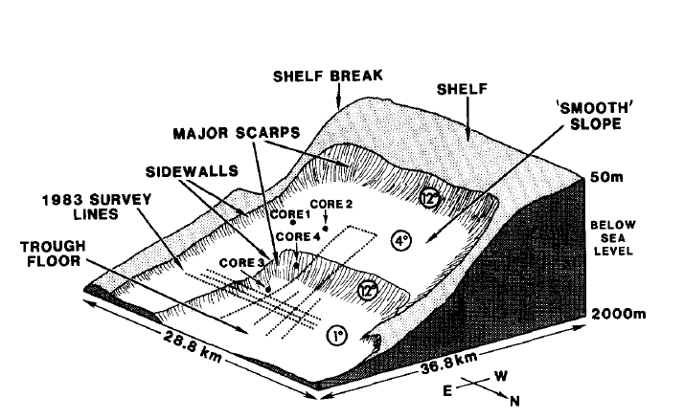
Morphological Components of Currituck Slide
This schematic reflects the post-failed slide from which the pre-failed bathymetry was calculated. Two sequential escarpments, identified here as scarps, of approximately 10°
and 30° were the locations of collapse, releasing the sediment, and producing a tsunami.
Notes:
(Prior et al., 1986).

Slide 10
Landslide Key Elements for Tsunami Generation
Motion
Typically, an angle of repose of approximately 30° is required for a significant failure of material. However, when the material involves saturated clays or sands, much smaller slopes can pose equal risk. These slides are fluid in motion, rather than tumbling.
Primary tsunamigenic energy output that has the most effect on tsunami wave creation occurs only during the initial acceleration of the slide. Linear motion has little effect on the final energy output. Deeper water also increasingly attenuates energy output to the surface.
Notes:
(Mehta, Barker, 1994)
Grill and Watts (1999, 2005); Grilli et al. (2002); Lynette and Lieu (2002, 2005); and Watts et al. (2005)
(Grilli et al., 2015)

Slide 11
Earthquake Statistical Data Analysis
USGS Earthquake data was collected over a 25 year period from Jan. 1, 1990 – Jan. 1, 2015 for any magnitude between 1 – 10 and within 500 km of the U.S. East Coast.
Previous research on the 2011 Tohoku earthquake in Japan revealed that traditional tsunami, created from subduction zones, require a minimum strength earthquake of 7.0 – 7.5.
A total of 612 earthquakes were discovered over the data range and were between magnitudes 1.0 and 5.8.

Slide 12
Total Earthquakes Greater Than 1.0
612 Total Events
Magnitudes 1.0 – 5.8

Slide 13
Earthquake Events Greater Than Magnitude 3.0 and Within 100km Buffer
17 Earthquake events

Slide 14
Kernel Density Estimate (KDE) after Data Thinning
Clusters in New England and Charleston South Carolina
Charleston identified as the most seismically active region.

Slide 15
Bathymetric Availability and Shelf Composition
Inner, Middle, and Outer layers
Each layer covers more surface area in SE versus the NE because the Continental Slope is very gradual.
Due to separation of layers, bathymetric imagery was only available for the inner and part of the middle layer.
All analysis was performed taking this into account; no absolutes are drawn from the analysis.
Notes:
School for Marine Science and Technology, University of Massachusetts-Dartmouth, Finite-Volume Community Model, 2005. http://fvcom.smast.umassd.edu/research_projects/SAltBight/

Slide 16
Seafloor Analysis
Identify a candidate location most similar to the Currituck SMF control scenario.
Calculate the overall slope difference of the candidate location and the Currituck slide.
Ascertain where attenuation of the waves' amplitude would be minimally affected.
Pinpoint the first human coastal habitat within the tsunami wake.

Slide 17
Site Selection
Due to the size of the research area, the Arc Tangent was calculated at a high level to identify the most likely candidate location for all follow-on analysis. Three locations were investigated.
Off-coast sites included
Northern Georgia
South Carolina
Southern North Carolina
Elevation and Slope Analysis used to identify final candidate site.

Slide 18
Bathymetric Depth Comparison Used to calculate Arc Tangent

Slide 19
Bathymetric Slope Analysis
Topographic conditions reflected 58% less slope than the escarpment pre-conditions of the Currituck slide.
Average of 5° – 6° slope
Tsunami wave height calculated at 1.3 m.

Slide 20
Tsunami Wave Propagation
Based on the N-wave or rebound wave and equal propagation in all directions.
Two methods used for impact site identification
Multiple Range Rings used to simulate wave propagation and identify preliminary coastal location.
Least Cost Path analysis, using slope to identify path of least resistance and specific location on the coastal area where the wave would strike.

Slide 21
Multiple Range Rings for Wave Expansion
Isle of Palms, South Carolina identified as coastal impact location approximately 12.5 km west of candidate site.
Francis Marion National Forest first non-populated location to be affected by wave.

Slide 22
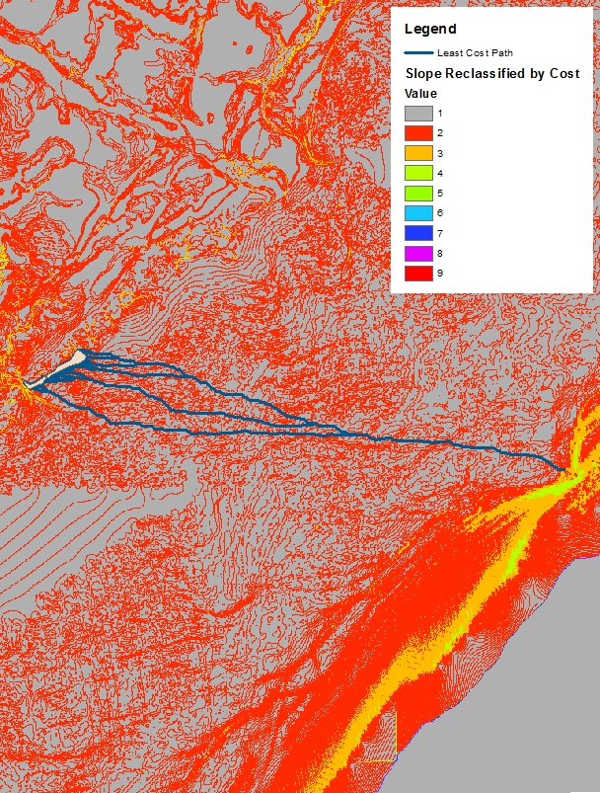
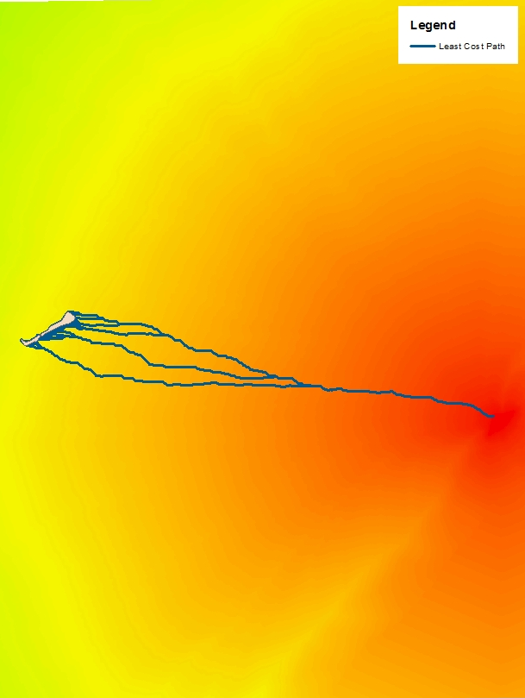
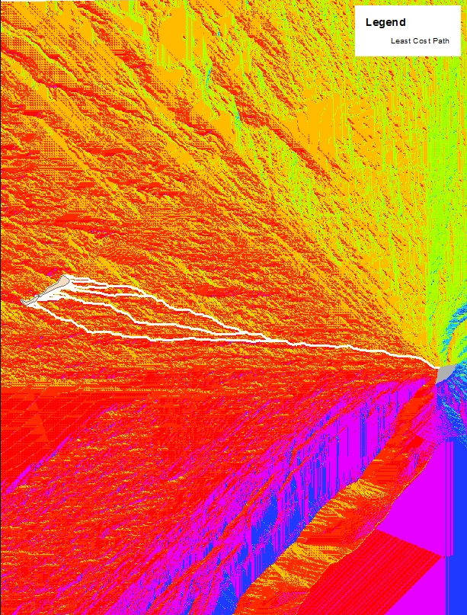
Least Cost Path Analysis Steeper Slope = Higher Cost

Slide 23
Inundation Modeling
Two methods used to identify inundation effects of the surface wave.
Difference Method: Digital Elevation Model subtracted from surface wave height. Resulting rasters susceptible to flooding.
Clack Hydrology Flood Model: Gravitational effect of the wave height being relative to the terrain height. Not universally distributed across the entire map, but rather the surface wave ‘s extent stops when the wave can no longer travel over terrain.

Slide 24
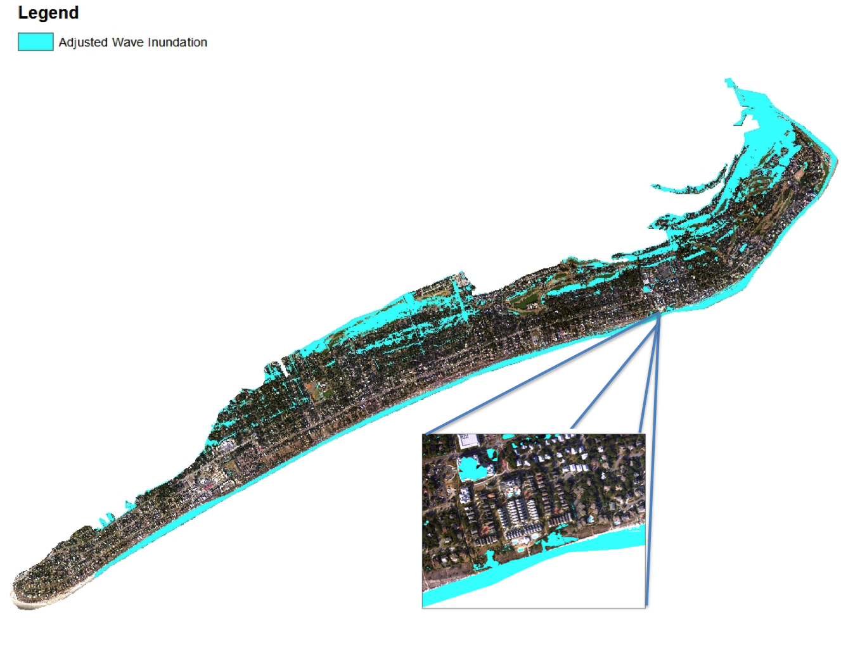
Difference Method
Accurately portrays flooding on back of island.
Inaccurately portrays motion of wave across island until forward momentum ceases.

Slide 25
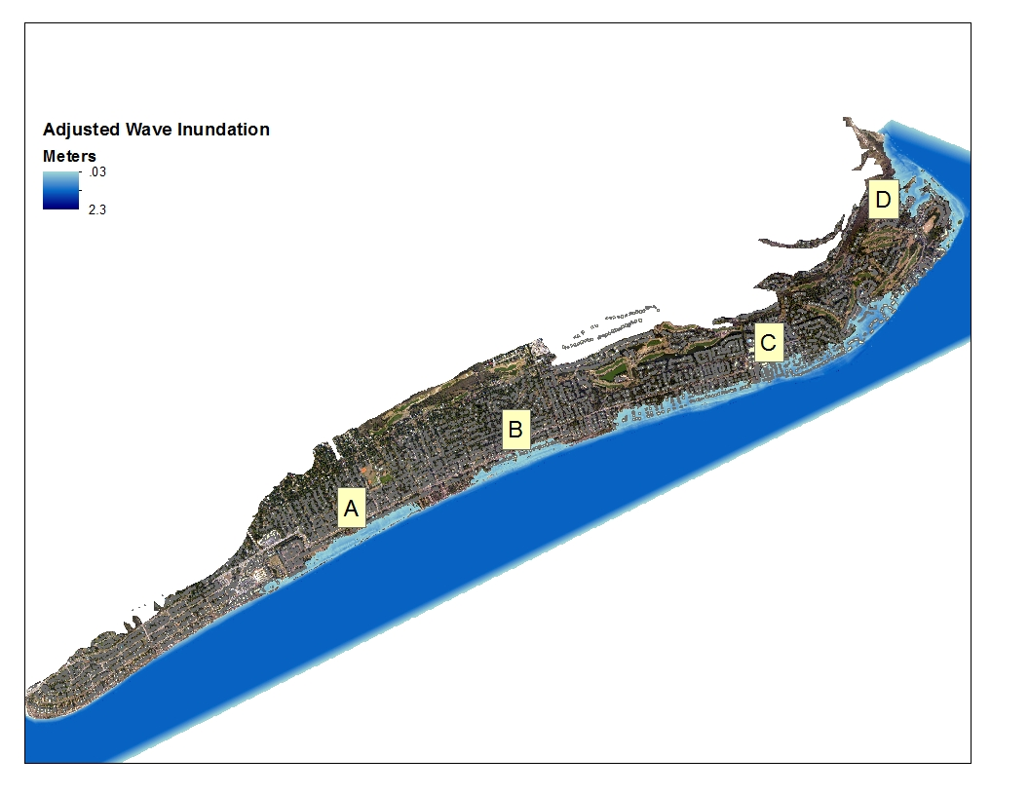
Clack Hydrology Flood Model
Accurately portrays flooding and wave momentum.
Extent of wave is captured from initial contact until wave height is too small to continue.

Slide 26
3D Static Tsunami Wave Model

Slide 27
Conclusions
Does not contend GIS are better alternatives to specialized numerical models, as those models capture and articulate precise calculations at a granular scale.
The overall process - performing statistical point data analysis, seafloor analysis, landslide and tsunami characterization, modeling, and impact analysis - could serve as a prototype methodology for assessing tsunami risk through the exclusive use of Geographic Information Systems.

Slide 29
Hardware and Software
2012 MacBook Pro Retina 16GB partitioned to Windows 7
ESRI ArcGIS 10.3
ESRI ArcScene 10.3
ESRI City Engine Web Viewer
QGIS 2.2 Valmiera
R
Google Sketch-up Pro
Notes:
Wave form and fluid dynamic of waves based on depth, reflection, refraction, and submarine features. Peak Wave Height Potential over Time based on previous study for near and far field studies.

