Slide 1
Food Secure Baltimore
Finding Better Ways to Promote Urban Agriculture Through Geonarratives
Penn State MGIS Capstone Proposal
Anthony Scavone
Advisor: Katherine Foo
Fall 2016

Slide 2
Presentation Topics
Topic Overview
  Urban Agriculture and its Benefits
  A Brief History of Urban Agriculture in the U.S
  Baltimore and the Urban Agriculture Renewal
  Urban Agriculture and GIS
  Geonarratives
Project Objectives
Research/Study Structure
Implementation Timeline

Slide 3
Topic Overview
Urban Agriculture and its Benefits

Slide 4
Urban Agriculture and its Benefits
Social
Environmental
Nutritional
Economic

Slide 5
Urban Agriculture and its Benefits
Social:
  Pro: Provides gathering space, strengthened sense of community
  Con: Gentrification, well-intentioned outsiders
Nutritional:
  Pro: Participants have healthier diets
  Con: Not all activities lead to increased produce consumption
Environmental:
  Pro: Can reduce “food miles”
  Con: Inefficiency in smaller scale growing operations, cold climates
Economic:
  Pro: Can provide an extra source of income
  Con: The extra income is minimal (often less than minimum wage)

Slide 6
Topic Overview
A Brief History of Urban Agriculture in the U.S

Slide 7
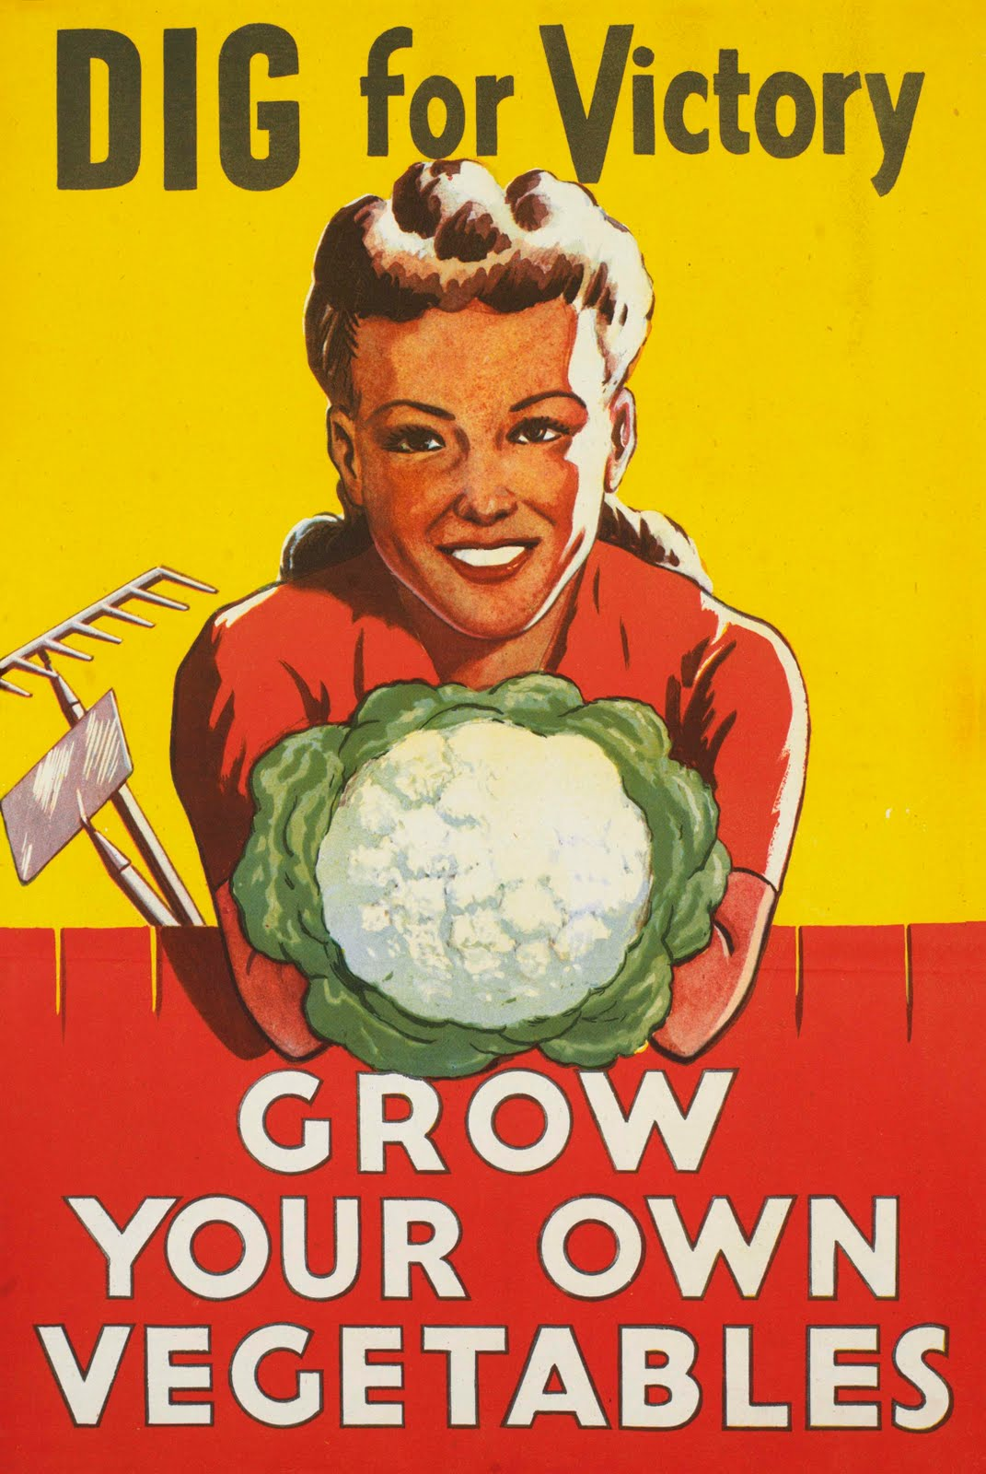
A Brief History of Urban Agriculture in the U.S
Early 1900s: Urban Farming seen as “an act of charity”
Victory Gardens in WWI and WWII
After WWII: Declining activity, overtaken by competing economic interests, no policy protection

Slide 8
Topic Overview
Baltimore and the Urban Agriculture Renewal

Slide 9
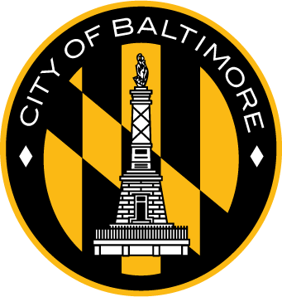
Baltimore and the Urban Agriculture Renewal
16,000 vacant buildings, 14,000 vacant lots
Sustainability plan for the city drafted
2013: Urban agriculture plan released, “Homegrown Baltimore”
Ongoing: Zoning law restructuring

Slide 10
Topic Overview
Urban Agriculture and GIS

Slide 11
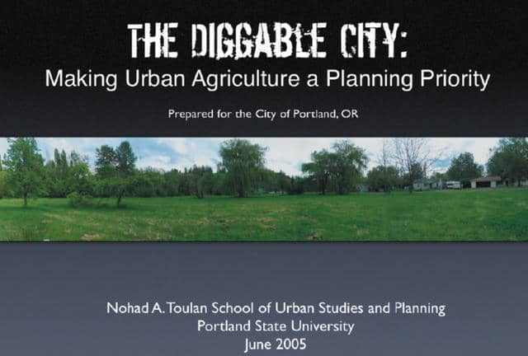
Urban Agriculture and GIS
2006: Portland State University releases “Diggable City”
Others follow suit: Vancouver, NYC, Seattle, Detroit, Oakland, etc.
Baltimore implemented it in the drafting of “Homegrown Baltimore”
Remains limited to land inventory

Slide 12
Topic Overview
Geonarratives

Slide 13
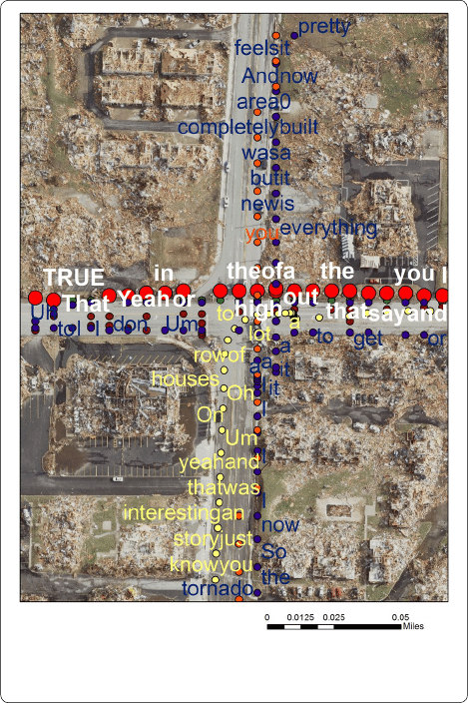
Geonarratives
A relatively new concept
Better understand environmental context of a situation
Can generate numerous datasets, is relatively easy to use
Spatial Video Geonarrative (SVG)

Slide 14
Project Objectives

Slide 15
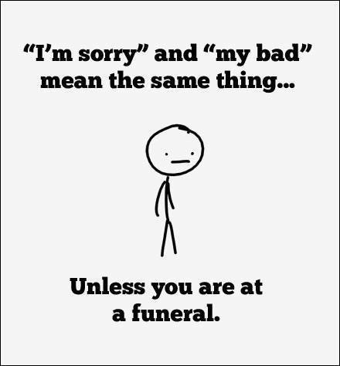
The Importance of Context

Slide 16
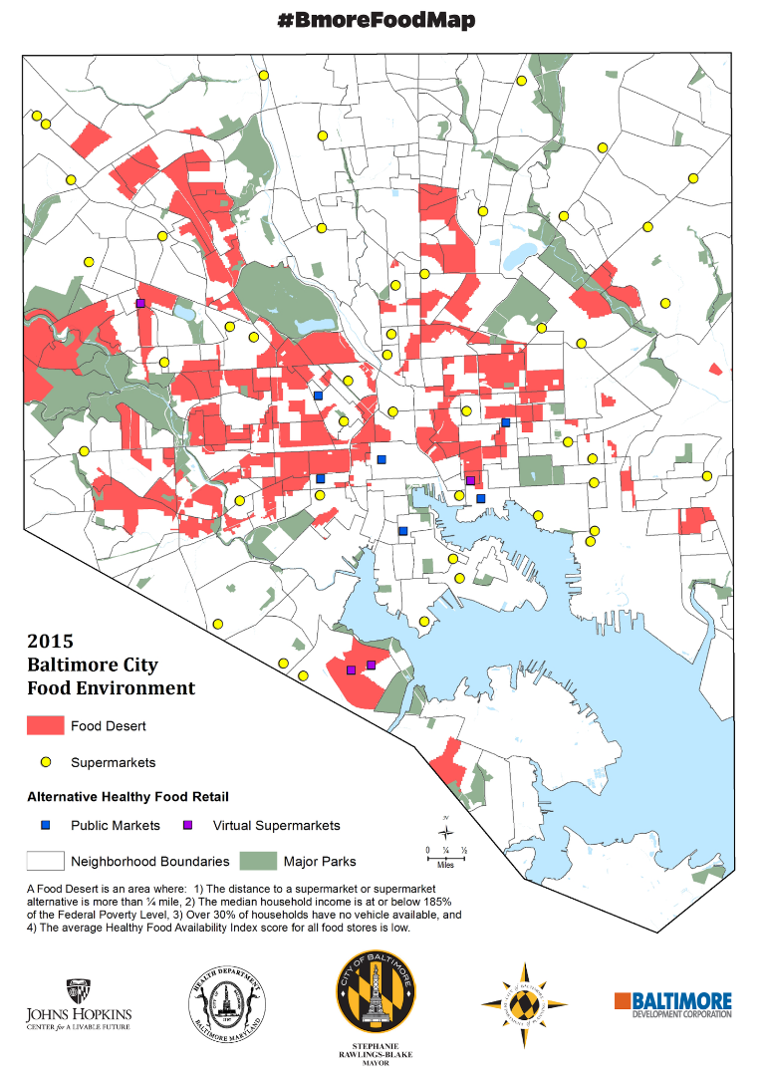
Project Objectives
Investigate the impact of urban agriculture projects on food deserts through the lens of geonarratives
Identify a neighborhood (or 2) with an urban agriculture project in a food desert
Record SVGs of two groups: community members participating and community members not participating

Slide 17
Major Question
What impact does participation in an urban agriculture project have on the manner in which a resident of a food desert procures their food?
(Possible Addition) What differences exist between how the leadership of the urban agriculture project interact with the project vs. how participants interact?

Slide 18
Research/Study Structure

Slide 19
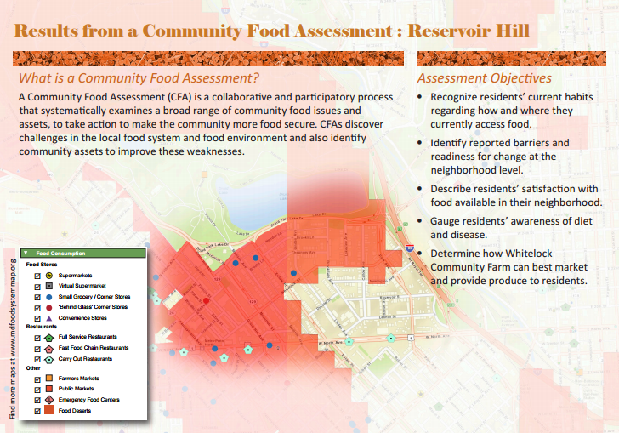
Why Geonarratives?
Surveys are quantitative and informative, but lack qualitative context
Spatially-based holistic context on the issue
What do food procurement pathways actually look like in a food desert?
What impact does urban agriculture have on those pathways and habits?

Slide 20
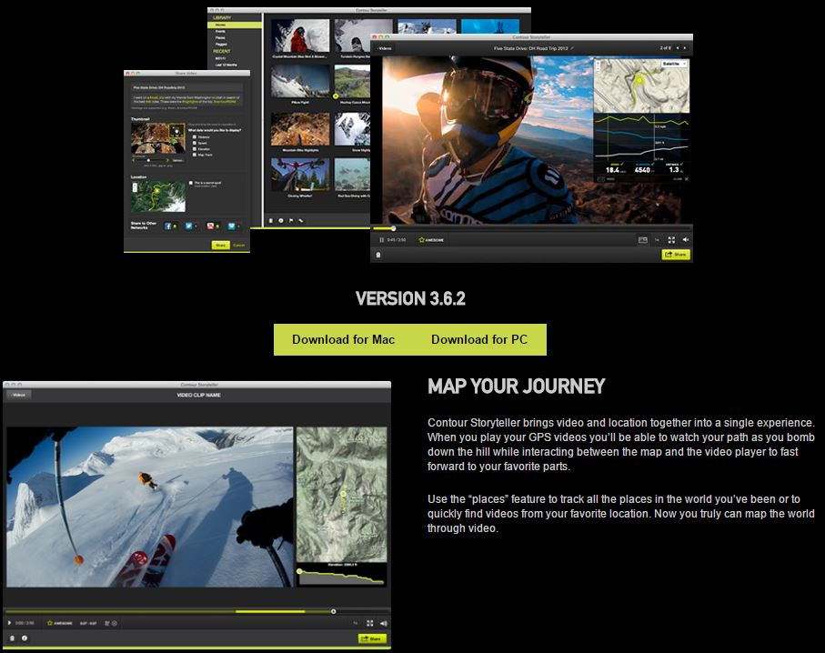
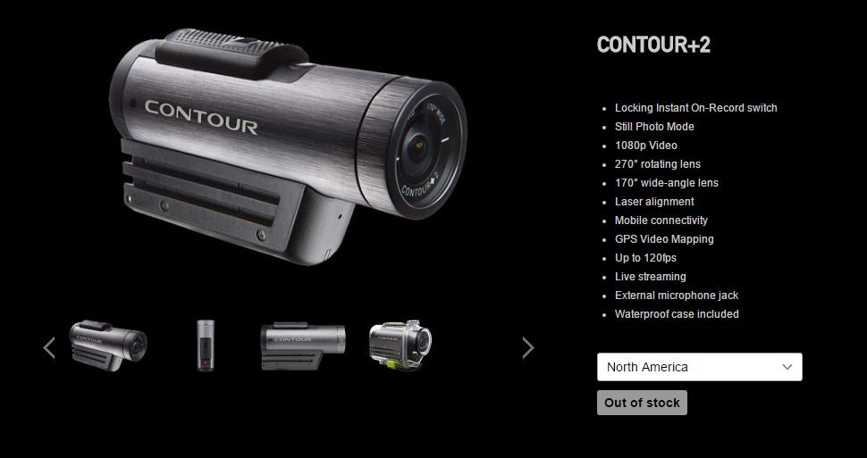
Tools
Contour +2 Video Camera
Storyteller

Slide 21

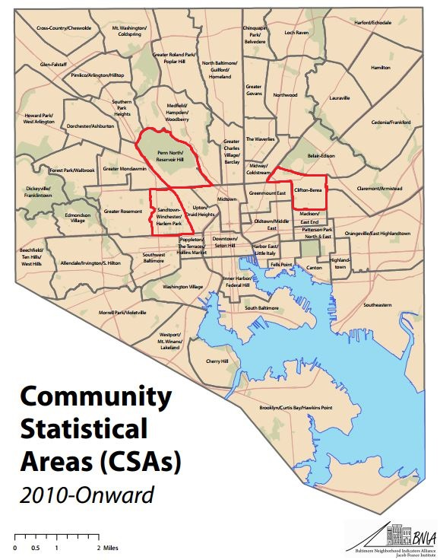
Three Potential Study Sites
BNIA neighborhood health data will serve as the study area
Johns Hopkins data will provide additional support
Each selected neighborhood has an urban agriculture project within a food desert

Slide 22
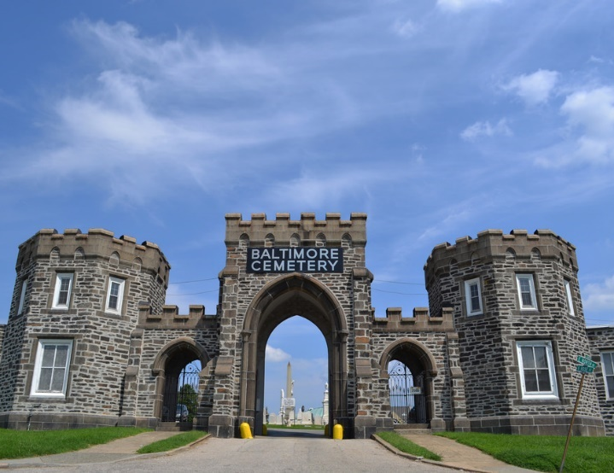
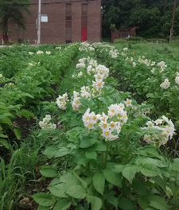
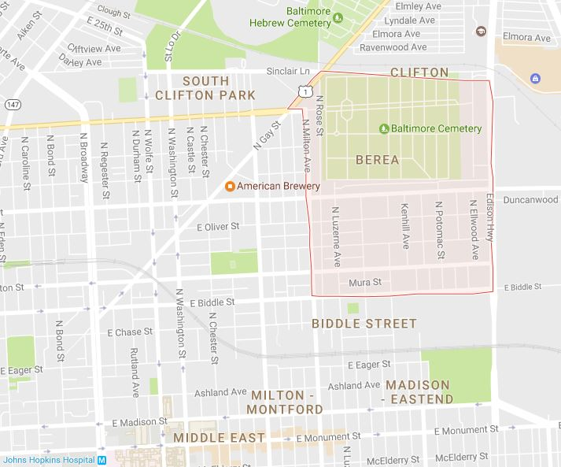
Clifton-Berea
High Concentration of Food Deserts
Perlman Place Farm (Real Food Farm Affiliate)
Urban Pastoral (indoor vertical farming, Johns Hopkins Alumni operation)

Slide 23
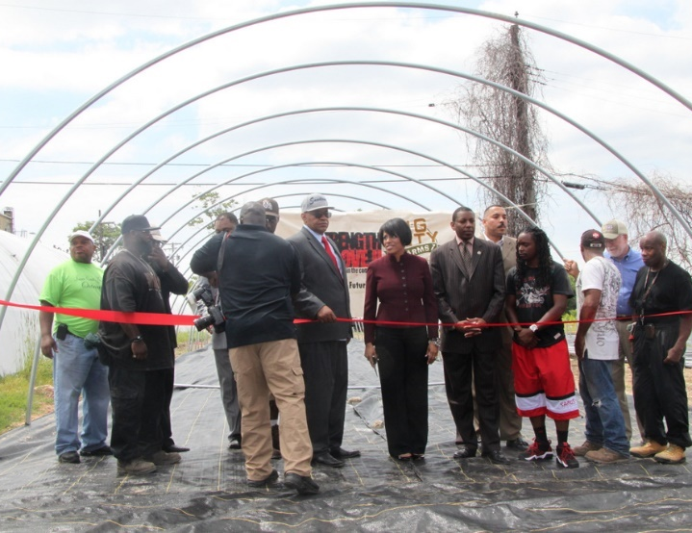
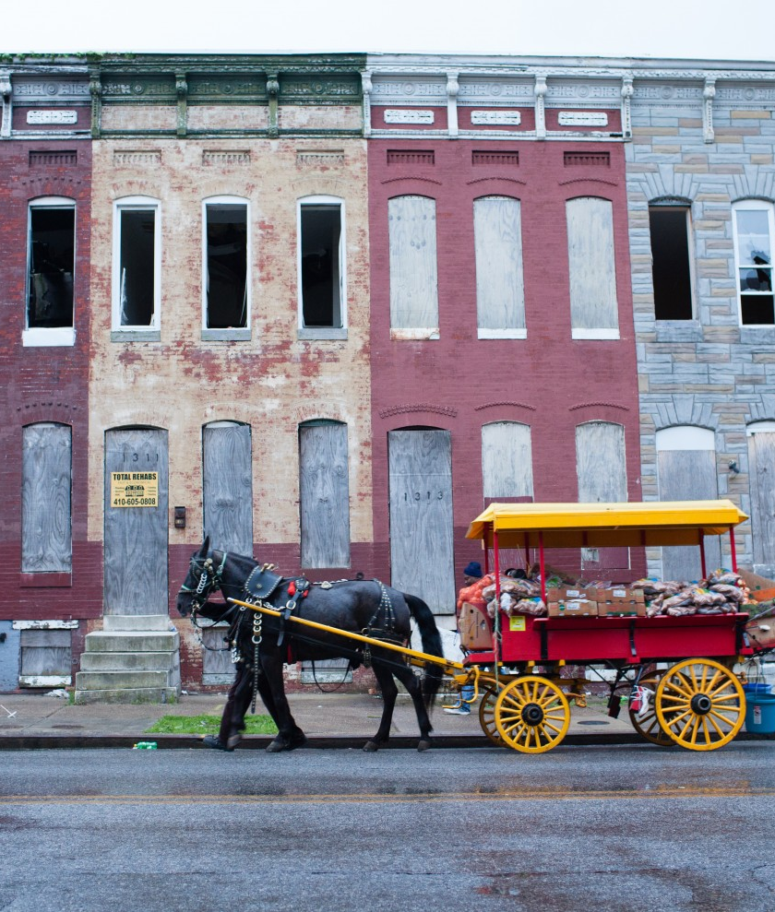
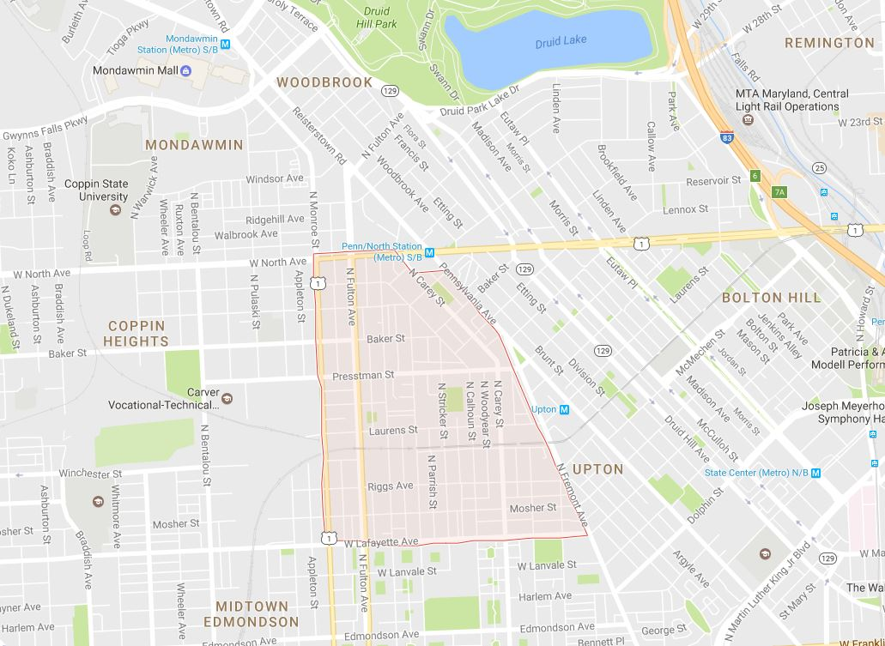
Sandtown-Winchester
High Concentration of Food Deserts
Strength to Love Farm

Slide 24
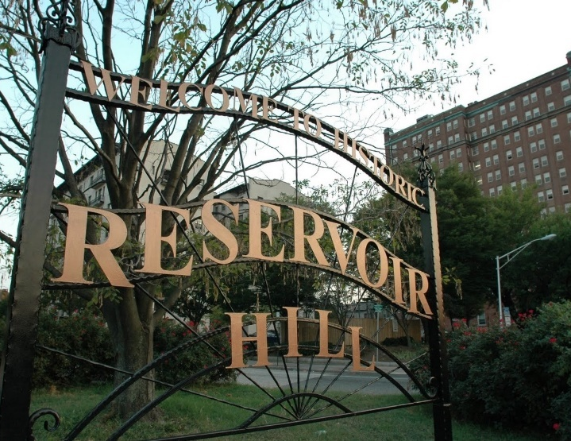
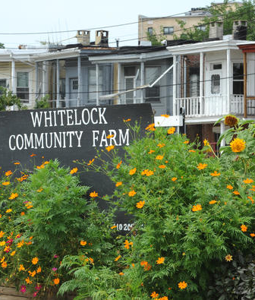
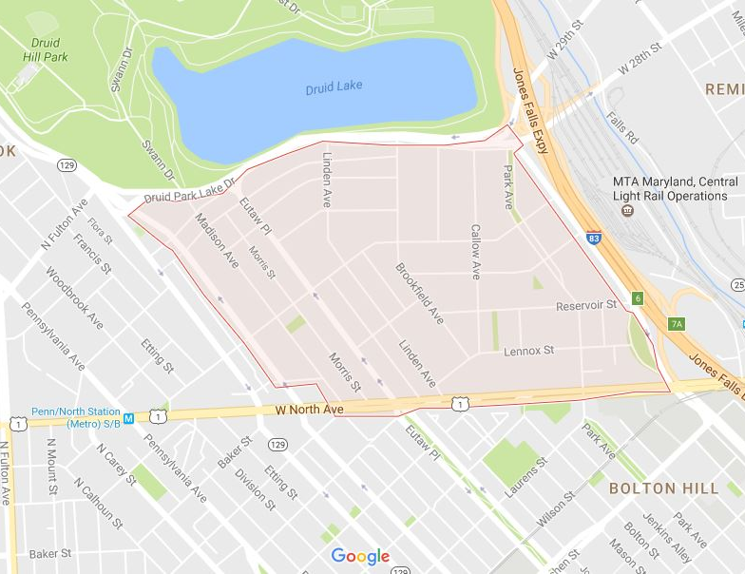
Penn North/
Reservoir Hill
High Concentration of Food Deserts
Whitelock Community Farm

Slide 25
Data to be Collected/Analyzed
“The Experience” (perspective on what obtaining food in a food desert is actually like)
Geo-Tagged Narratives (word-map generation/analysis)
Pathways

Slide 26
Implementation Timeline

Slide 27

Current Proposed Project Timeline
January-April 2017
Participant Selection, Data Collection and Analysis
May 2017
Submit Paper for Conference
June-July 2017
Present at a Conference

Slide 28
Questions?

