Slide 1
Automated Vehicle Detection with high resolution spectral imagery
By: Jed Schildroth, MGIS Student

Slide 2
Why is automation important?

Slide 3
Main Idea
Identify algorithms to detect and automatically highlight and count vehicles in a scene using their spectral properties
Use multiple types of spectral data
Elevation: with and without

Slide 4
Software
eCognition
ArcGIS Pro
Powerpoint
Excel
Word

Slide 5
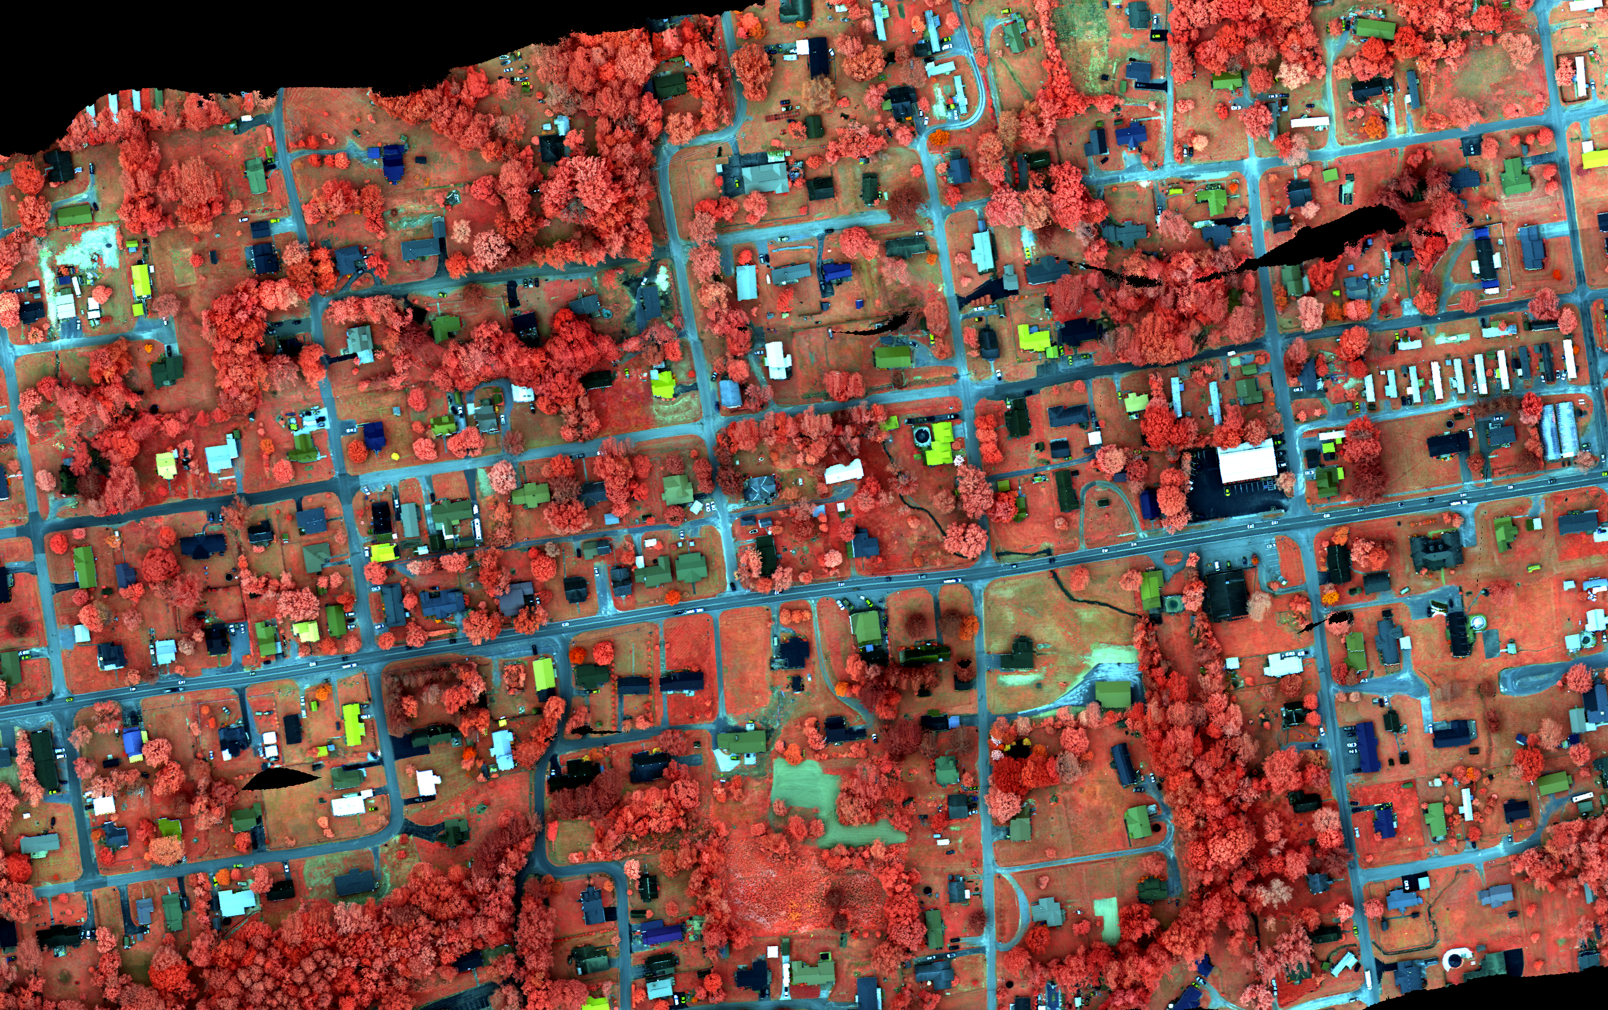
DATA
Multiple Types
Itres uCASI 72 band
MICASENSE 8cm Red Edge MX w/ paired Lidar
Itres: uCASI 50 cm resolution 72 band Image of Virginia

