Slide 1
Environmental Justice Cumulative Impact Assessment
an accessible methodology for state and local governments
Jolynn Schmidt - MGIS Student
Advisor – Amy L. Griffin, PhD

Slide 2
Problem and Goals
The City of Newark passes a Environmental Justice Cumulative Impact (EJCI) ordinance
consider cumulative pollution impacts
disproportionate burden on low-income communities and communities of color

Slide 3
Problem and Goals
The City of Newark passes a Environmental Justice Cumulative Impact (EJCI) ordinance
Problem
Communities frequently do not have access to the technical expertise or tools required
Goal
provided an accessible methodology for nonscientists in local communities with a GIS-based EJCI assessment tool.

Slide 4
Background
What is Environmental Justice?
low-income and minority groups could be disproportionately affected by environmental hazards
distributive justice
procedural justice
justice of recognition

Slide 5
Background
What is a Cumulative Impact Assessment?
Similar to an overlay that analyzes the combination of multiple stressors, chemicals, or pollutants in a given population
Identify Indicators
Weighting the indicators
Ranking the results

Slide 6
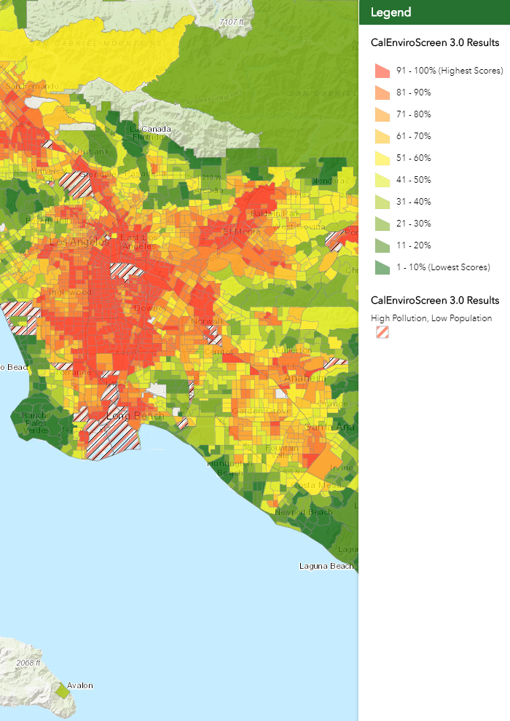
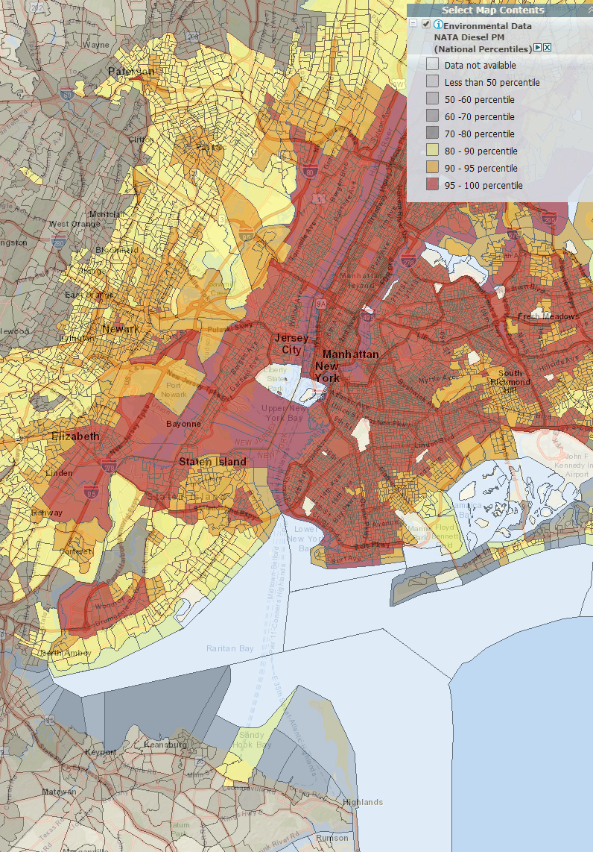
Background
Limitations of Current EJCI Assessments
Source: CalEnviroScreen https://oehha.ca.gov/calenviroscreen/report/calenviroscreen-30
Source: EPA EJScreen
https://ejscreen.epa.gov/mapper/

Slide 7
Solution
OpenEJScreen Assessment
CalEnviro-
Screen
Method
EJScreen
Indicators
Open
EJScreen

Slide 8
Data
EPA Indicators & CalEnviroScreen Methodology
OpenEJScreen Data
17 EJScreen
Indicators Ranked by State
Boundary Data
Assessment Data
Custom Indicator
Dry Cleaners
CalEnviroScreen
Results

Slide 9
Methodology Indicators
Understanding the EPA Indicators for use in CalEnviroScreen Methodology
Component | CalEnviroScreen | EJScreen
Exposure | Ozone concentrations in air | Ozone Concentration Score
Exposure | PM 2.5 concentrations in air | PM 2.5 Concentration Score
Exposure | Diesel particulate matter | NATA Diesel Particulate Matter
Exposure | Drinking water contaminants
Exposure | Not a current indicator | Pct. Housing Units older 1960 (lead paint)
Exposure | Not a current indicator | Dry Cleaners – Custom Indicator
Exposure | Use of pesticides
Exposure | Toxic releases from facilities (TRI) | RMP Proximity
Exposure | Traffic density | Traffic Proximity
Environmental | Toxic cleanup sites | Superfund Proximity (NPL)
Environmental | Groundwater threats
Environmental | Hazardous waste facilities and generators | Hazardous waste TSDF Proximity
Environmental | Impaired water bodies | Wastewater Discharge Indicator
Environmental | Solid waste sites and facilities
Sensitive Pop. | Asthma emergency department visits | NATA Respiratory Hazard Index
Sensitive Pop. | Cardiovascular disease | NATA Cancer Risk
Sensitive Pop. | Low birth-weight infants
Socioeconomic | Educational attainment | Pct. Less than High School Education
Socioeconomic | Housing burdened low-income households
Socioeconomic | Linguistic isolation | Pct. Linguistically Isolated
Socioeconomic | Poverty | Pct. Low Income (<2x poverty level)
Socioeconomic | Unemployment
Socioeconomic | Not a current indicator | Pct. Minority Population
 |  | Pct. Over Age 64
 |  | Pct. Under Age 5

Slide 10
Methodology Ranking
Exposure = Average(Ozone, PM2.5, NATAdpm, Lead, DryClean, Traffic, RMP)
Environmental = Average(Superfund, TSD, Wastewater) X 0.5
Sensitive Population = Average(Respiratory, Cancer)
Socioeconomic = Average(Education, Linguistic_Isolation, Poverty, Minority)
Pollution Burden = (Exposure + Environmental) / (1 + 0.5)
Pop Char. = (Sensitive Population + Socioeconomic) / 2
Scaled Pollution Burden = (Pollution Burden / Highest Pollution Burden) X 10
Scaled Pop Char. = (Pop Char. / Highest Pop Char.) X 10
Screening Score = Scaled Pollution Burden X Scaled Pop Char.
Screening Rank = Screening Score/ 100 (total number of scores +1)

Slide 11
Methodology Assessment
Simple?
Useful?
Create a Custom Indicator
Complexity
Time
Compare to CalEnviroScreen
Accuracy at different percentile bins
Confusion matrix and maps

Slide 12
Products & Summary
Summary
Local Communities need to create EJCI assessments
These assessment are complex and local communities do not have the resources to produce one
OpenEJScreen will provide an accessible methodology for non-scientist
OpenEJScreen methodology will be assessed for simplicity and usefulness
Products
StoryMap
Project report & methodology description

Slide 13
Timeline
January
Create custom indicator
Create OpenEJScreen ranking
February - March
Write up steps and report times for creating new methodology
Assess new methodology against CalEnviroScreen
April
Create StoryMap
May –June
Final paper and presentation
July
Present ESRI User Conference

