Slide 1
Do CCTV and GDT technology lower gun related crime?
Bill Schwarz
Advisor: Dr. Greg Thomas
Pennsylvania State University
GEOG 596A
Spring 2, 2020
Photo source: Tide Cleaners
Notes:
Tide Cleaners https://www.tidecleaners.com/tide-cleaners-in-washington-dc

Slide 2
Agenda
Interest
Research Questions
Background
Review of Literature
System Information
Data Sources
Methodology
Expected Outcome

Slide 3
Interest
Relocated to the Washington, D.C. area in 2012 from a small town in Rhode Island.
Listening to morning news always hearing about gun crime.
Repeated killings overnight
Regarding CCTV, Washington, D.C. 28th most surveilled city in the World.
In the U.S., Washington, D.C. is third behind Atlanta and Chicago.
D.C. also uses gunfire detection technology (GDT) specifically the ShotSpotter system
Graphic source: ESRI

Slide 4
Research Questions
Is there a reduction in gun crime in an area surveilled by both closed
circuit television and gunfire detection technology as compared to
an area not under surveillance?
Are these technologies optimally located both spatially and temporally
Graphic source: ESRI

Slide 5
Background 1: Tech in DC
Early 1990s Washington, D.C. became country’s murder capital
2005 District begins using gunfire detection technology
2006 District begins using closed circuit television to fight crime
CCTV Systems
Department of Homeland Security
Came online before District
Federal cannot surveil U.S. Citizens
Increases number of cameras
Special events only
vs.
District of Columbia
Passive, not around the clock monitoring
Public spaces only
Cannot view all simultaneously
Linkable to indoor school cameras
Linkable to traffic cameras
Not linkable to red light/photo enforcement

Slide 6
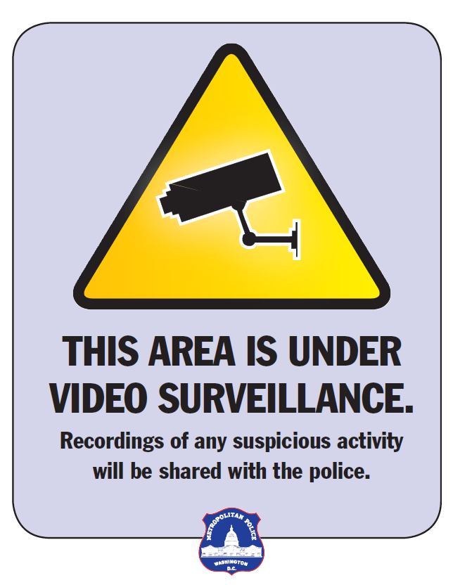
Background 2: CCTV Owners
District of Columbia CCTV owners
DCHA - District of Columbia Housing Authority (28)
DCPS - District of Columbia Public Schools (175)
DDOT - District Department of Transportation (166)
DOC - Department of Corrections (2)
DPR - Department of Parks and Recreation (26)
MPD - Metropolitan Police Department (104)*
PSD - Protective Services Division (37)
UNK - No information (2)
Total 540
Graphic source: MPD

Slide 7
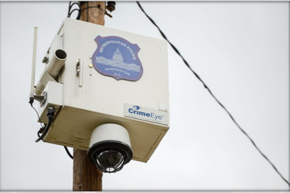
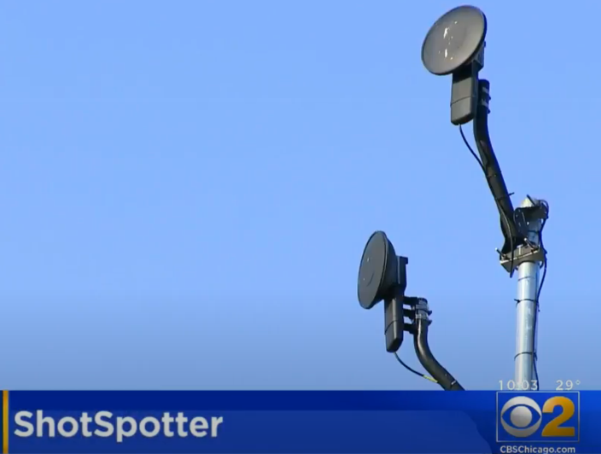
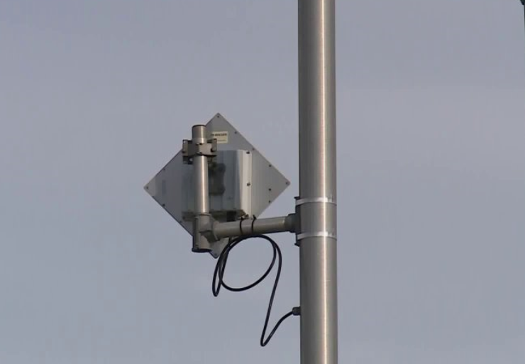
Background 3: Systems
CCTV
GDT
Washington, D.C. Metropolitan Police camera.
Source: The Washington Times
ShotSpotter sensor
Source: CBSChicago.com
GDT
GDT
ShotSpotter sensor
Source: Fox2Now St. Louis
Boomerang gunfire detection sensor
Source: Wikipedia
Notes:
https://fox2now.com/news/gunshot-detection-system-shotspotter-one-year-later/
https://www.youtube.com/watch?v=cc7fqx1vhjc
https://en.wikipedia.org/wiki/Gunfire_locator#/media/File:Boomerang_3_Gunfire_Acoustic_Detection_System_MOD_45153048.jpg

Slide 8
Background 4: GDT Data

Slide 9
Background 5: Calls Data

Slide 10
Background 6: Calls Data
Projected
2020
664

Slide 11
Literature Review
CCTV minimal to no effect on crime overall
Not a stand alone policing solution
CCTV effective when surveilling parking lots
Theft from inside a vehicle
GDT provides evidence that crime is underreported
Substantial increase between call for service and GDT
Limited studies of both technologies which incorporate a GIS analysis
Policies and policing strategy play a role in use of both technologies

Slide 12
System Information
CCTV
Active or Passive
Who can monitor
Continuous surveillance or not
Special events
Cycle time
Gunfire Detection
Effective range 200-250m
Accurate to within feet
(weapon dependent)
Shows gun crime underreported

Slide 13
Data Sources
Office of the Chief Technology Officer
Metropolitan Police Department
Census Block Groups (Shapefile titled tl_2019_11_bg)
Closed Circuit TV Street Cameras (Shapefile)
Crime Incidents (Year) (yearly Shapefiles
1 January 2008 through 28 March 2020)
Digital Surface Model (DSM 2018)
Police Districts (Shapefile)
Ward from 2012 (Shapefile)
Washington DC Boundary (Shapefile)
ShotSpotter Data (Q4 2019) (csv)
ShotSpotter Data (Q3 2019) (csv)
ShotSpotter Data (Q2 2019) (csv)
ShotSpotter Data (Q1 2019) (csv)
ShotSpotter Data (2018) (csv)
ShotSpotter Data (2014-2017) (Excel xlxs)
Graphic source: ESRI
Notes:
Logo Sources:
MPD https://www.youtube.com/user/OfficialDCPolice/about
OCTO https://octo.dc.gov/agency/office-chief-technology-officer
DC.GOV https://dc.gov/
Geographic Process ESRI

Slide 14
Data
CCTV
GDT
Crime
The camera is located
Shapefile
The event is located to 100m
Shapefile and Spreadsheet
6 years of data
The event is located to 1m
Shapefile by year
Over 12 years of data
Graphic source: ESRI
Notes:
Logo Sources:
MPD https://www.youtube.com/user/OfficialDCPolice/about
OCTO https://octo.dc.gov/agency/office-chief-technology-officer
DC.GOV https://dc.gov/
Geographic Process ESRI

Slide 15
Methodology
This study compares similar demographic areas. One area serves as a treatment area with both CCTV and GDT coverage against a non-treatment control area lacking CCTV and GDT coverage. Within the treatment area, surveillance areas will be buffered down to 500 feet for CCTV and 250 meters for GDT. Intersecting buffers will then be examined for gun crime occurring within them. The dependent variable is gun related crime and the independent variables are CCTV coverage and GDT coverage.
Graphic source: ESRI

Slide 16
Methodology
1
Assault w/Gun
Optimized Hot Spot
Target Ward
2
Wards
District Boundary
3
250 m Buffer
Target Tract
Gunfire Detects
Buffer Intersection
4
CCTV locations
500 ft Buffer
Target Ward
5
6
Target Tract
Compare to
Control Tract

Slide 17
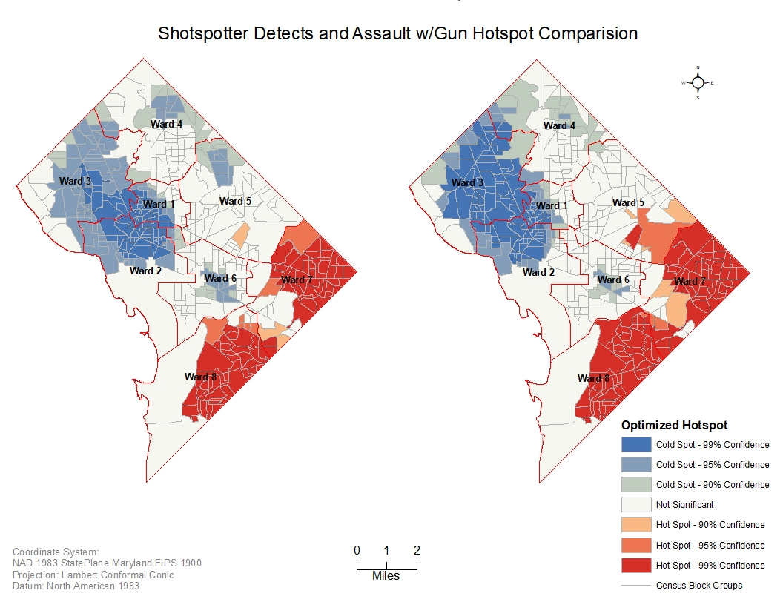
Methodology
1
Assault w/Gun
Optimized Hot Spot
Target Ward
Target Ward
2
Wards
District Boundary
ShotSpotter
Service Call Assault w/Gun
Ward 7
Ward 8

Slide 18
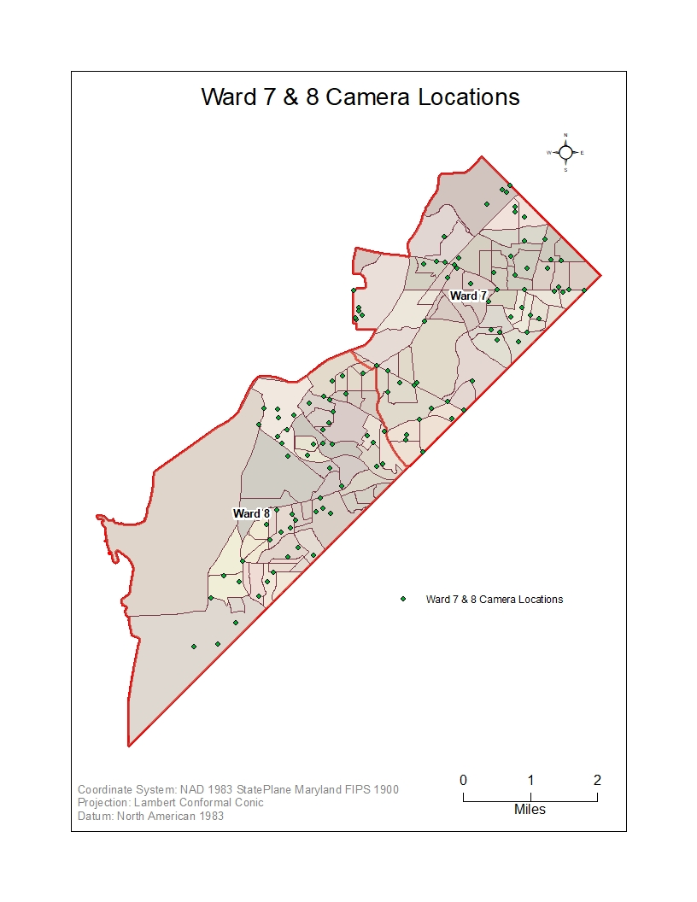
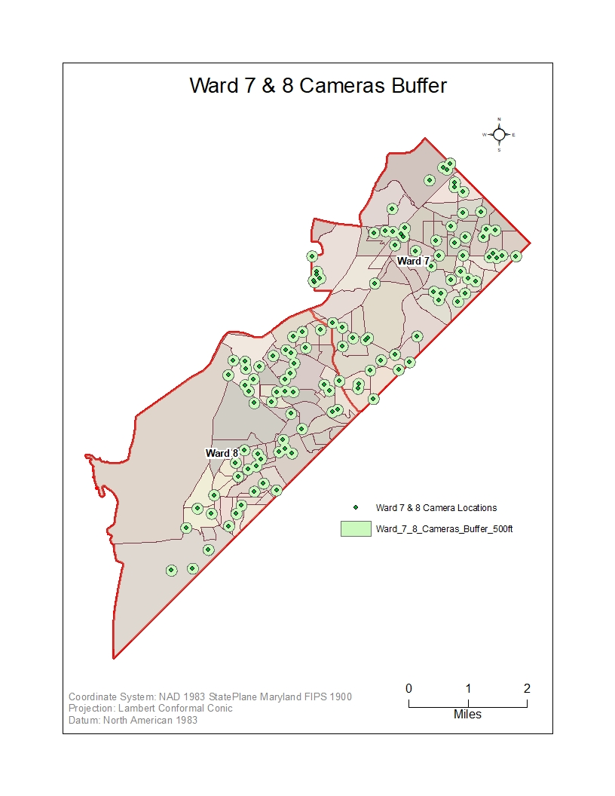
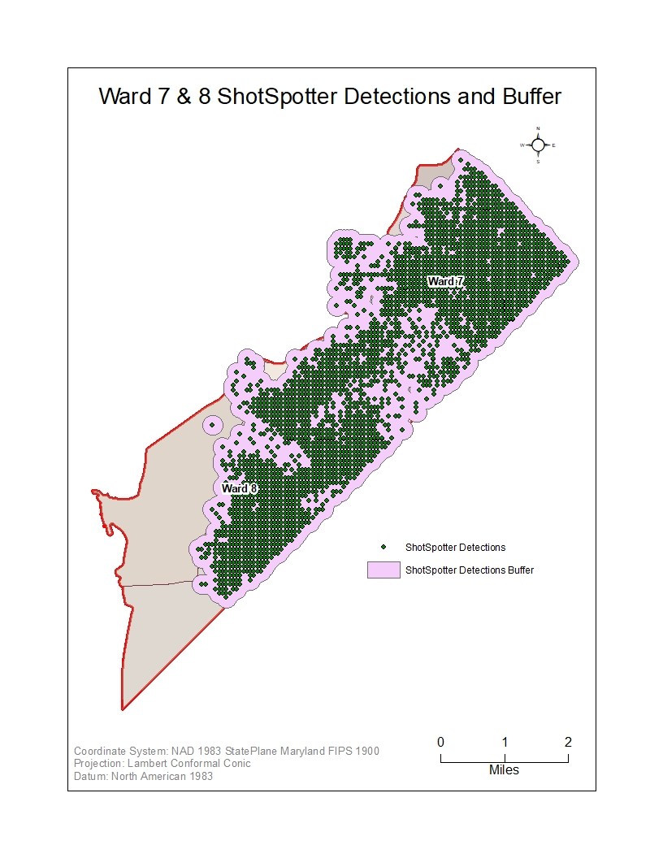
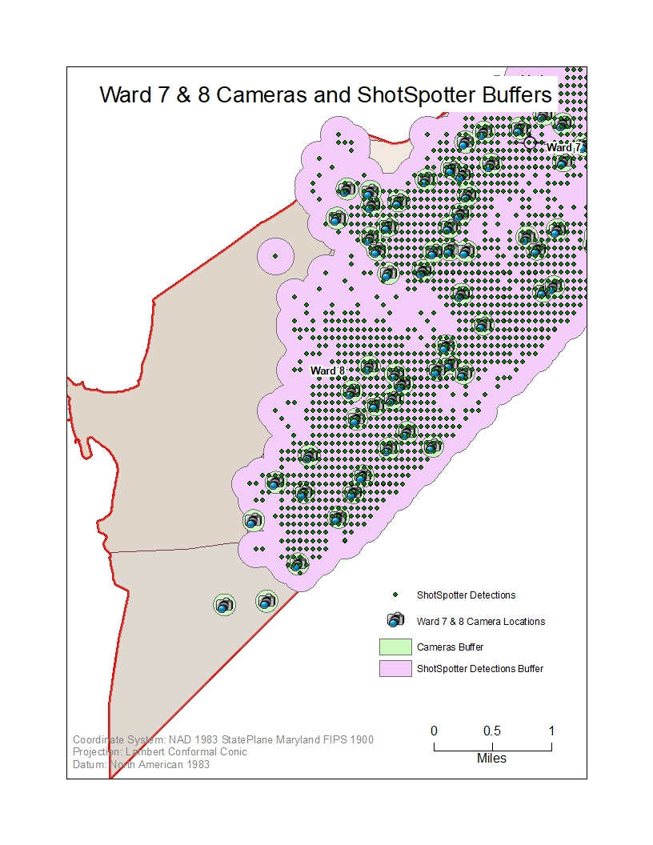
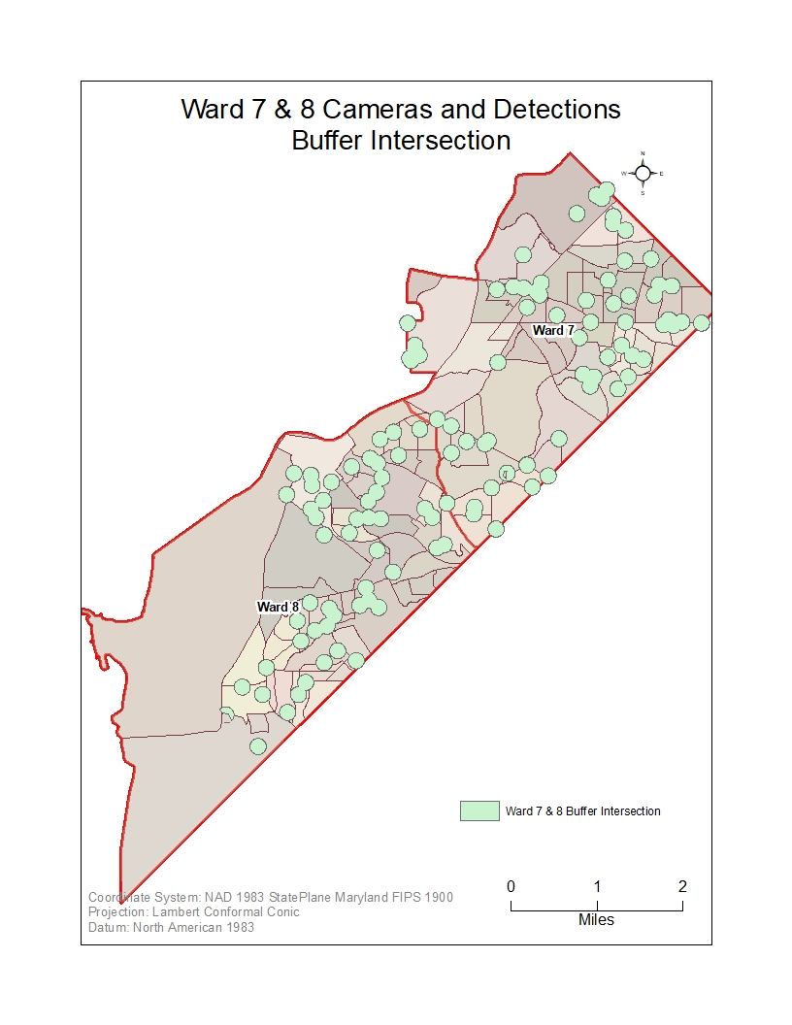
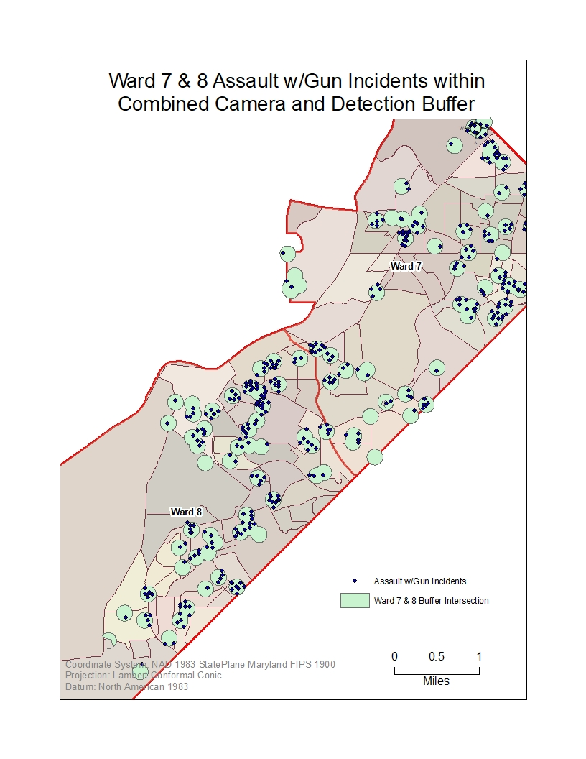
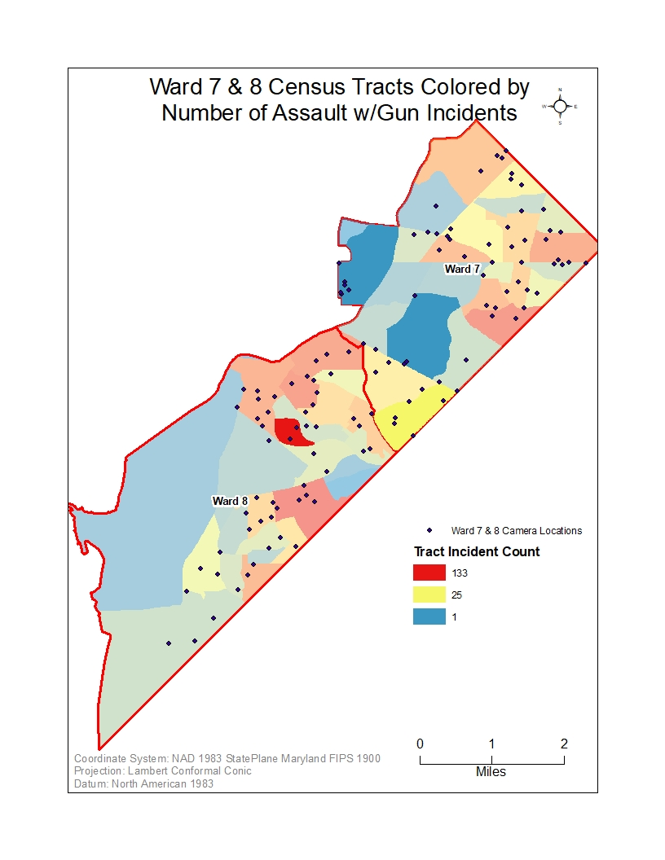
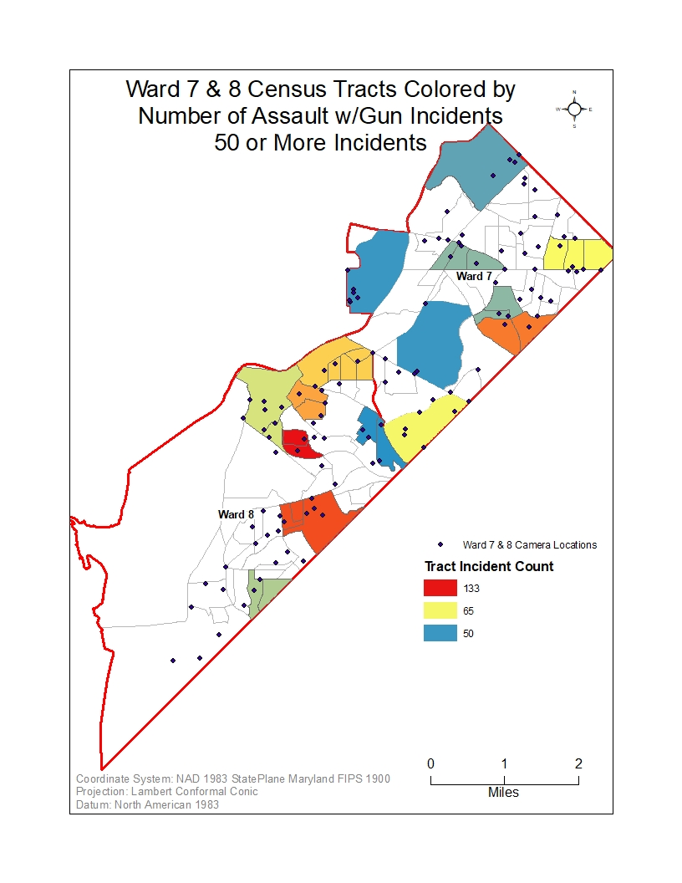
Methodology
3
250 m Buffer
Target Tract
Gunfire Detects
Buffer Intersection
4
CCTV locations
500 ft Buffer
Target Ward
Buffering and Intersection Series

Slide 19
Methodology
CCTV
GDT
No CCTV
No GDT
Target Tract
Compare to
Control Tract
Similar Demographics

Slide 20
Expected Outcome
When used together as part of a policing program, closed circuit television
and gunfire detection technology will reduce crime in a target area when
examined using GIS/spatial technology.

Slide 21
Potential Conferences
Multiple Events Per Year
International Association of Chiefs Of Police
Commission on Accreditation for Law Enforcement Agencies, Inc. March 2021
Annual Events
National Sheriffs’ Association June 2021
*The Association of Law Enforcement Emergency Response Trainers Sept 2021
National Association for Civilian Oversight of Law Enforcement
*National Interdiction Conference
*International Association of Law Enforcement Intelligence Analysts

Slide 22
Questions?

Slide 23
References
Aguilar, J. R. (2013). Gunshot location systems the transfer of the sniper detection technology from military to civilian applications.
Proceedings - International Carnahan Conference on Security Technology. https://doi.org/10.1109/CCST.2013.6922061
Alpers, P. A. (2020, January 20). District of Columbia — Gun Facts, Figures and the Law. Sydney School of Public Health.
GunPolicy.org. (P. Alpers, Ed.) Syndey, New South Wales, Australia. Retrieved April 11, 2020, from
https://www.gunpolicy.org/firearms/region/district-of-columbia
Armitage, R., Smyth, G., & Pease, K. (1999). Burnley CCTV Evaluation. Crime Prevention Studies, 10, 225–249.
https://pdfs.semanticscholar.org/9dd5/25b028df1fef693d59c30b1f41a72079f2b2.pdf
Ashenfelter, D. (1991, April 29). Washington is murder capital for second year. The Baltimore Sun.
(T. Alatzas, Ed.) Baltimore, Maryland, United States: Trif Alatzas. Retrieved February 26, 2020, from
https://www.baltimoresun.com/news/bs-xpm-1991-04-29-1991119021-story.html
Bieler, S., & La Vigne, N. (2014). Close-Range Gunfire around DC Schools . Washington, D.C.: Urban Institute.
Retrieved February 28, 2020, from
https://www.urban.org/sites/default/files/publication/22906/413216-close-range-gunfire-around-dc-schools.pdf
College of Policing. (2013). The effects of CCTV on crime. What works briefing.
Farrington, D., & Welsh, B. (2008). Effects of closed circuit television surveillance on crime. In Campbell Systematic Reviews.
Gerell, M. (2015). Hot Spot Policing With Actively Monitored CCTV Cameras: Does it Reduce Assaults in Public Places?
International Criminal Justice Review. https://doi.org/10.1177/1057567716639098
J. Ditton and E. Short. (1999). Yes , it works , no , it doesn’t: comparing the effects of open- street CCTV in two adjacent Scottish
towne centres. Crime Prevention Studies, 10, 201–223.

Slide 24
References
La Vigne, N. G., Lowry, S. S., Markman, J. A., & Dwyer, A. M. (2011). Evaluating the Use of Public Surveillance Cameras for
Crime Control and Prevention.
https://www.researchgate.net/publication/280090022_Evaluating_the_Use_of_Public_Surveillance_Cameras_for_Crime_Control_and_Prevention-_A_Summary/citation/download
La Vigne, N. G., Thompson, P. S., Lawrence, D. S., & Goff, M. (2019). Implementing Gunshot Detection Technology. October.
Leighton, W. K., & Maximino, M. (2014). The effect of CCTV on public safety: Research roundup. Journalist’s Resource.
https://journalistsresource.org/studies/government/criminal-justice/surveillance-cameras-and-crime/
Mazerolle, L., Watkins, C., Rogan, D., & Frank, J. (1999). Random gunfire problems and gunshot detection systems.
National Institute of Justice: Research in Brief, 1–8. https://www.ncjrs.gov/pdffiles1/nij/179274.pdf
Metropolitan Police Department. (2020, January 6). CCTV - Neighborhood-Based Cameras. Retrieved February 22, 2020, from
Metropolitan Police Department: https://mpdc.dc.gov/page/cctv-neighborhood-based-cameras
Metropolitan Police Department. (nd). Closed Circuit Television (CCTV) for Your Home or Business. Retrieved February 26, 2020, from
Metropolitan Police Department: https://mpdc.dc.gov/page/closed-circuit-television-cctv-your-home-or-business
National Institute of Justice. (2003). CCTV : Constant Cameras Track Violators. NIJ Journal, 249.
Pao, M. (2020, February 28). How D.C. Is Addressing An Ongoing Spike In Gun Violence. WAMU 88.5 American University Radio.
Washington, District of Columbia, United States. Retrieved February 12, 2020, from
https://wamu.org/story/20/02/28/how-d-c-is-addressing-an-ongoing-spike-in-gun-violence/
Piza, E. L. (2018a). The crime prevention effect of CCTV in public places: a propensity score analysis. Journal of Crime and Justice,
41(1), 14–30. https://doi.org/10.1080/0735648X.2016.1226931

Slide 25
References
Piza, E. L. (2018b). The History, Policy Implications, and Knowledge Gaps of the CCTV Literature: Insights for the Development of
Body-Worn Video Camera Research. International Criminal Justice Review. https://doi.org/10.1177/1057567718759583
Piza, E. L., Caplan, J. M., & Kennedy, L. W. (2014). CCTV as a tool for early police intervention: Preliminary lessons from nine
case studies. Security Journal, 30(1), 247–265. https://doi.org/10.1057/sj.2014.17
Piza, E. L., Welsh, B. C., Farrington, D. P., & Thomas, A. L. (2019). CCTV surveillance for crime prevention: A 40-year systematic
review with meta-analysis. Criminology and Public Policy, 18(1), 135–159. https://doi.org/10.1111/1745-9133.12419
Ratcliffe, J. H., Taniguchi, T., & Taylor, R. B. (2009). The crime reduction effects of public CCTV cameras: A multi-method spatial
approach. Justice Quarterly, 26(4), 746–770. https://doi.org/10.1080/07418820902873852
Reid, A. A., & Andresen, M. A. (2012). The impact of closed-circuit television in a car park on the fear of crime: Evidence from a
victimization survey. Crime Prevention and Community Safety, 14(4), 293–316. https://doi.org/10.1057/cpcs.2012.7
Renda, W., & Zhang, C. H. (2019). Comparative analysis of firearm discharge recorded by gunshot detection technology and
calls for service in Louisville, Kentucky. ISPRS International Journal of Geo-Information, 8(6). https://doi.org/10.3390/ijgi8060275
Sivarajasingam, V., & Shepherd, J. P. (1999). Effect of closed circuit television on urban violence. Journal of Accident and
Emergency Medicine, 16(4), 255–257. https://doi.org/10.1136/emj.16.4.255
Vilalta, C. J., Sanchez, T. W., Fondevila, G., & Ramirez, M. (2018). A descriptive model of the relationship between police CCTV
systems and crime. Evidence from Mexico City. Police Practice and Research, 20(2), 105–121.
https://doi.org/10.1080/15614263.2018.1473770
Watkins, C., Mazerolle, L. G., Rogan, D., & Frank, J. (2002). Technological approaches to controlling random gunfire: Results of
a gunshot detection system field test. In Policing. https://doi.org/10.1108/13639510210429400

Slide 26
References
Ways, B., & C. Pearson, B. (2018). Evaluating the Effectiveness of CCTV in Baltimore, Maryland. In Spatial Analysis, Modelling
and Planning. https://doi.org/10.5772/intechopen.79076
Welsh, B. C., & Farrington, D. P. (2003). Effects of closed-circuit television on crime. Annals of the American Academy of
Political and Social Science, 587, 110–135. https://doi.org/10.1177/0002716202250802

