Slide 1
Determining Success of the
Neighborhood Stabilization Program in Jacksonville, FL
A Response to the Housing Collapse During the Great Recession

Slide 2
Determining Success of the Neighborhood Stabilization Program in Jacksonville, FL
Background to NSP and Jacksonville’s socioeconomics
Rationale for project
Goals, Objectives & Hypothesis
Jacksonville’s NSP Funding and the East-Springfield Neighborhood
Literature Review
Methodology
Expected Results
Project Timeline

Slide 3
Background to NSP
Home values went down nationally by 31% from early 2006 to early 2009
Part of the Housing and Economic Recovery Act (HERA) in 2008
Goal - bring qualified buyers back to neighborhoods suffering from heavy foreclosure and associated blight, thus stopping the trend of decline
U.S. Department of Housing and Urban Development (HUD) funded local governments nearly $7 billion to stabilize neighborhoods hit hardest by housing crisis.
This funding occurred in three phases, referred to as NSP1, NSP2 & NSP3

Slide 4
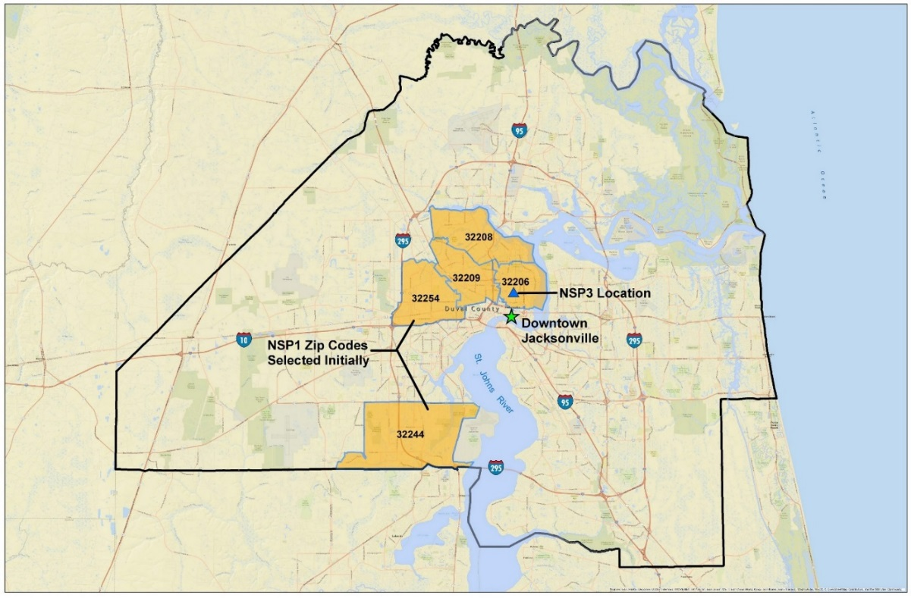
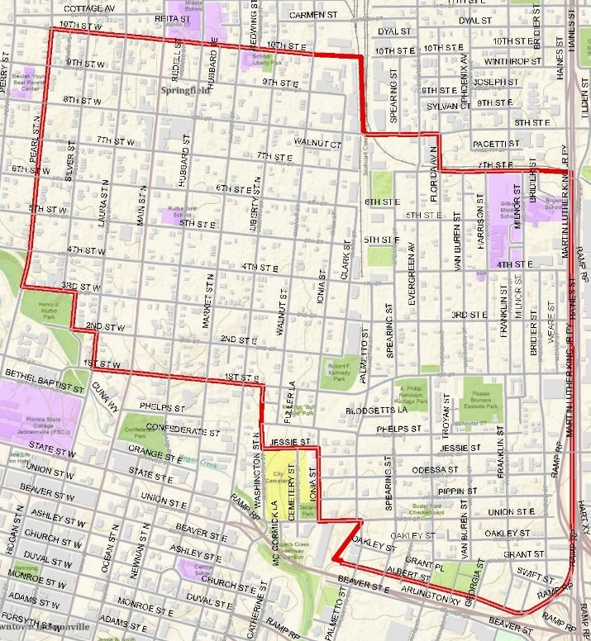
Jacksonville’s
Foreclosure Crisis
& NSP Target Areas
Received $22.4 million from HUD during NSP1
Selected 5 target zip codes during NSP1
_____________________________________________
City jumped to #17 in nation in foreclosures by 2010
Received $4.75 million from HUD during NSP3
Selected the East-Springfield neighborhood for NSP3
NSP 3 within 32206 zip-code
East-Springfield neighborhood
NSP 1 in orange
Jacksonville, Florida

Slide 5
Rationale for Project
There is much analysis on the struggles local governments faced implementing the NSP in their cities, but not much on the actual outcomes or results of it
No post-recession analysis has been done in Jacksonville, Florida - a call for more place-based evaluations in various urban neighborhoods (Fraser & Oakley, 2015)
Is there a relationship between the size of NSP funding and neighborhood effect? (Joice, 2011)
There could be lessons learned in housing funding policy
Probably will not be the last housing crisis or need for public funding for housing programs

Slide 6
City’s Goal
City wanted to provide diversified mixed-income opportunities in East-Springfield neighborhood, but not create gentrification (Dayatra Coles, 2018)
Project’s Goals and Objectives
Determine if target neighborhoods receiving NSP funding changed in comparison to similar neighborhoods not receiving NSP funding
Look for trends in recovery to suggest change is a result of NSP policy
Determine if there is a measurable effect on the neighborhoods receiving NSP funding as a function of investment amount or method it was distributed
Look for a correlation between the City’s goal of providing mixed-income housing to a recovery from the recession and if gentrification played a part for any found success
Project’s Hypothesis
NSP neighborhoods with more diversified median incomes will have greater measurable success in recession recovery than other NSP tracts

Slide 7

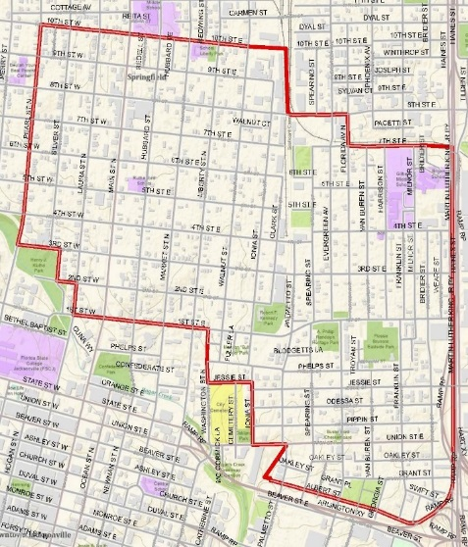
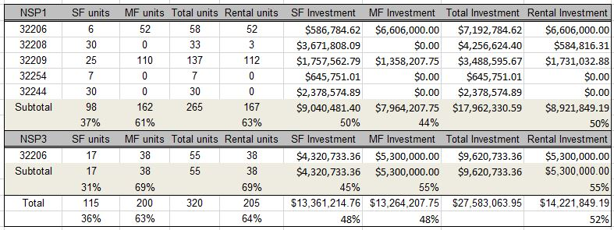
Jacksonville NSP1 & NSP3 Funding
Investment Size/ Type Comparison
NSP1 funding more spread out based on reaction to foreclosures; HUD guidelines more loosely defined
NSP 3 funding more concentrated; goals more structured
Jacksonville’s NSP investments, received from Dayatra Coles, 2018

Slide 8
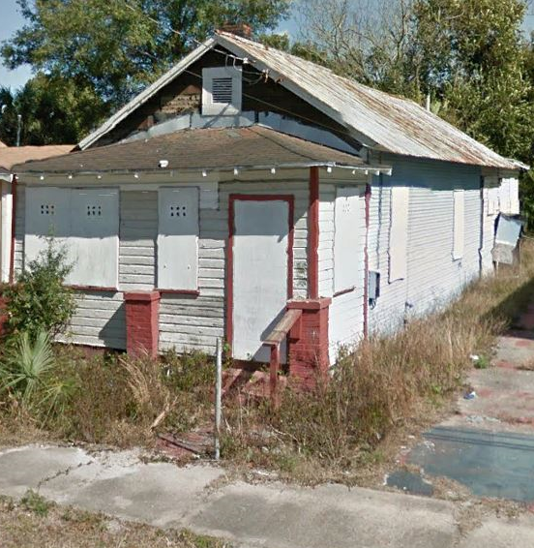
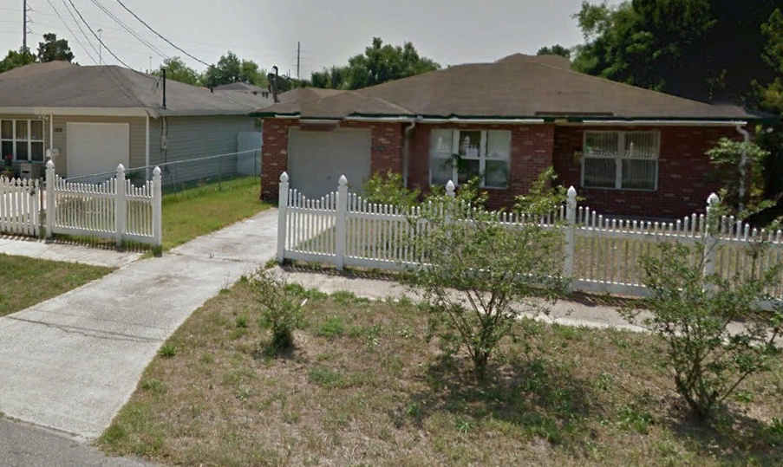
EAST-SPRINGFIELD NEIGHBORHOOD
Reasons for NSP Selection
Negative factors
Large drop in home value prices
Large increase in foreclosures
Decline in population due to disinvestment/ foreclosures
High rate of poverty, unemployment & vacated homes
Neighborhood blight
East neighborhood
East neighborhood boarded up house GoogleEarth (Feb, 2016)
East neighborhood before single-family renovation – $121.6k GoogleEarth (April, 2011)

Slide 9
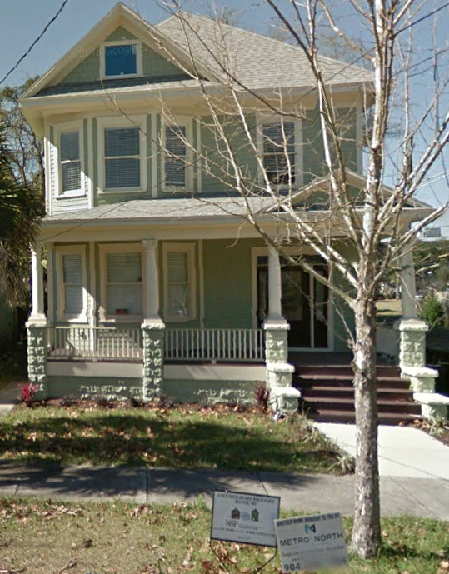
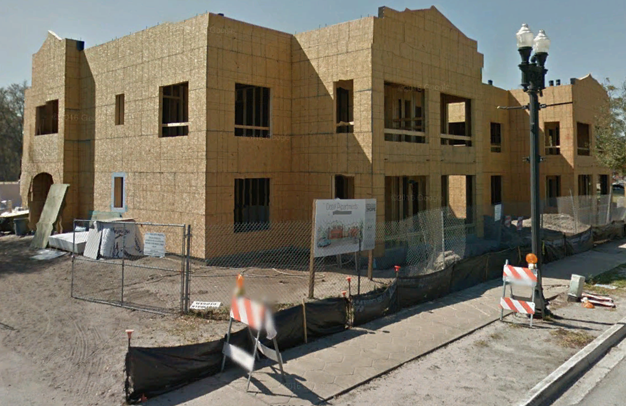
EAST-SPRINGFIELD NEIGHBORHOOD
Reasons for NSP Selection
Positive factors
Close proximity to downtown Jacksonville
Springfield part of a designated Historic District
Variety of housing types
Some of oldest houses in city
Housing rehabilitation and redevelopment
Springfield neighborhood
Springfield Single-Family Renovation – $358.5k GoogleEarth (Feb, 2016)
Springfield multi-family (mixed-income) new development (14 dwelling units) – $2.2 million, GoogleEarth (March, 2016)

Slide 10
Literature Review
Debate over policy towards mixed-income neighborhoods in urban centers
- Urban “exuberant diversity” – Jean Jacobs, 1961
- “Right to the City” – Henri Lefebvre, 1968 (Duke, 2009)
- “Positive gentrification” (Chaskin & Joseph, 2013); a way to increase value of
disinvested, but once prominent urban neighborhoods (Defilippis & Fraser, 2010)
Debate over gentrification
- Demand for development with amenities raises housing costs, causing
displacement (Hwang & Lin, 2016)
- No empirical evidence to prove displacement (Freeman, 2005)
- Socioeconomic change in a neighborhood facilitates recovery from recession
(Hyra & Rugh, 2016)

Slide 11
Methodology
Data and Analysis Time Periods
Primary data source: U.S. Census Bureau (NHGIS.org)
- Census 1990 & 2000; ACS (5-year) 2006-2010 & 2012-2016
Three time periods will be compared
- Census 1990 to 2000 (sets baseline trends)
- Census 2000 to ACS 2006-2010 (compare if baseline trends continue)
- ACS 2006-2010 to ACS 2012-2016 (look for change in during recovery)
NSP 1 & NSP 3 Property Spreadsheet: Received from City of Jacksonville
Most of the City of Jacksonville “parcel” layers dating back to 2004
(Still looking for detailed foreclosure data for analysis periods)

Slide 12
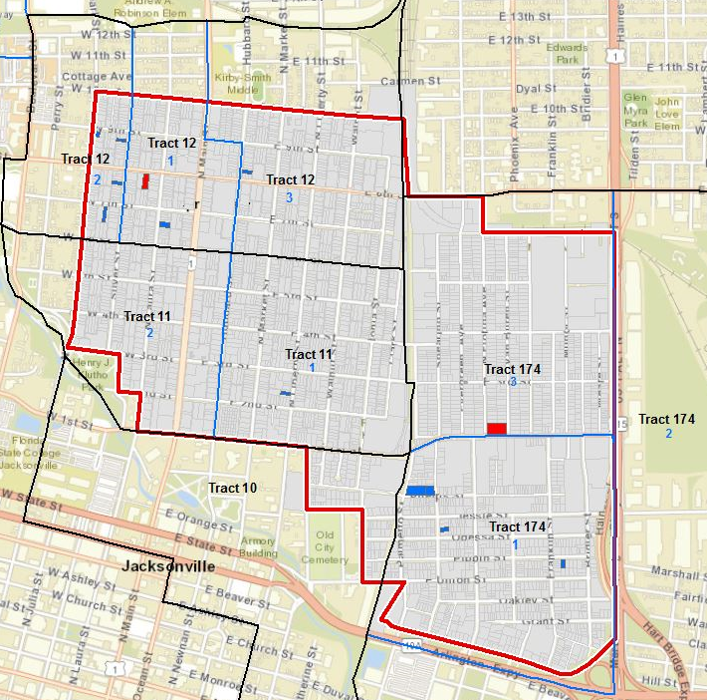
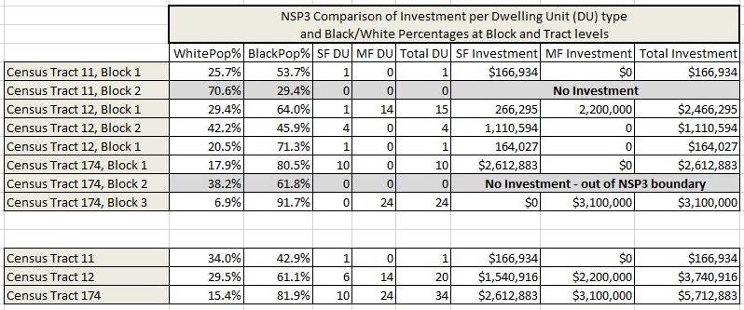
Defining a NSP “Neighborhood”
For analysis purposes, a NSP neighborhood will be a census tract or block containing a NSP property
Neighborhood aggregate size?
Tract Margins of Error for ACS data are normally less than blocks
To find better comparable “neighborhoods”, blocks may still be better to use for areas with more racial and economic diversity

Slide 13
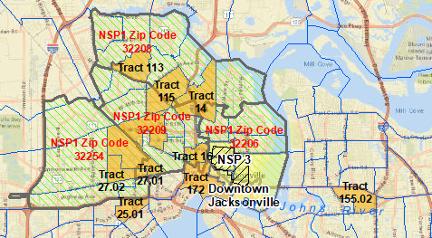
Finding Comparable (Non-NSP) Neighborhoods
Look for an Socioeconomic Index formula that produces similar standardized values for all NSP census tracts; create a composite index score from values
Index components: Median housing value, Median Income, Race/Ethnicity, Tenure (owner vs renter occupied), Education Attainment, & Vacant Housing
Find census tracts having comparable index values to NSP composite index value
Use ACS 2006-2010 estimated data for finding comparable tracts
Example of Socioeconomic Index
Median Housing Value +
Median Income +
Vacant Housing Unit % +
Black Population % +
Renter Occupied Housing % +
People with College Degree % / 6

Slide 14
A Socioeconomic Thumbnail-View of Jacksonville
Median Home Values %
Median Income %
Vacant Housing %
Renter Occupied Housing %
Black Population %
College Degree Attainment %
Source Data: ACS 2006-2010

Slide 15
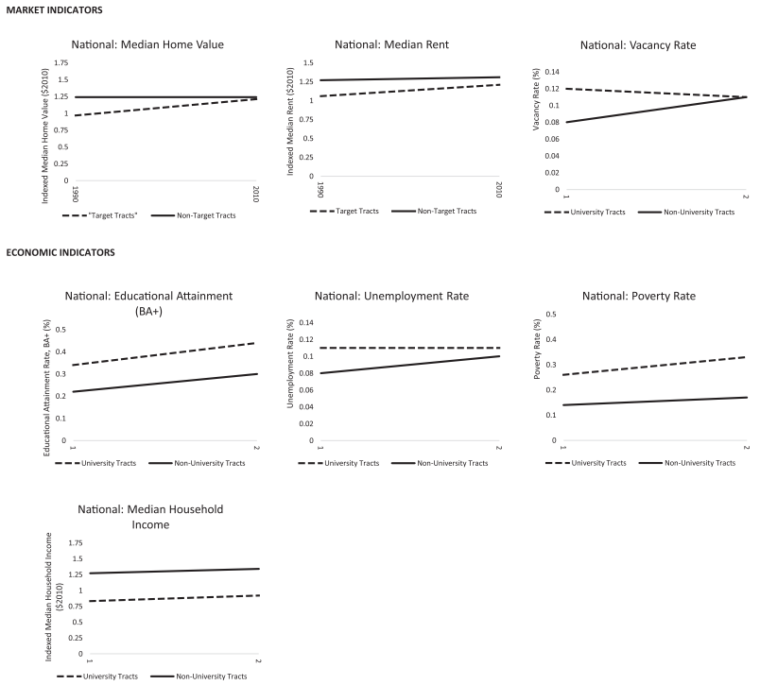
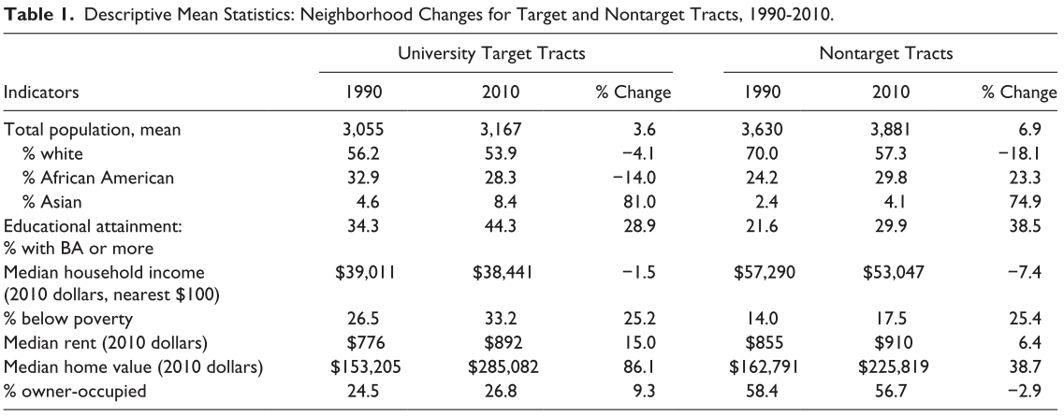
Method for Detecting Neighborhood Change
Create trend line graphs using an analysis of variance (F-test) on each component of socioeconomic index to determine any significant change between NSP & non-NSP tracts
Utilize descriptive table for comparative analysis of change
Looking for steep post-recession change to indicate any NSP policy effect
(Ehlenz, 2017)
Example of descriptive table & statistical analysis of variance (ANOVAR) trend lines testing market and economic indicators for University and non-University neighborhoods (Ehlenz, 2017)

Slide 16
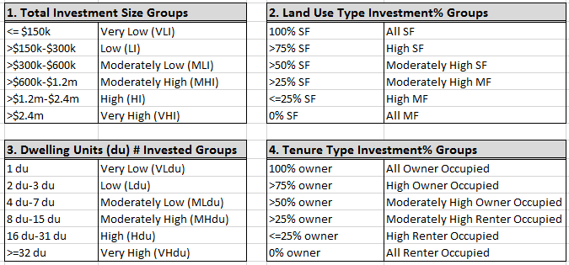
Detecting NSP Change as a Function of Investment
No literature found analyzing the size or method of investment effect caused by NSP investment size or type
Classify all NSP tracts into six groups on four investment categories: total investment, land use type, number of dwelling units and tenure type
Using post-recession F-test analysis on each socioeconomic component, create 6 statistical trend lines for each category to understand how NSP investment implementation may have influenced change in each neighborhood differently
Utilize descriptive and cross-tabulation tables to visualize differences of change

Slide 17
Testing Neighborhood Income Diversity
Socioeconomic change in a neighborhood may facilitate recovery from recession (Hyra & Rugh, 2016)
Assign each tract a household income group (based on HUD’s income groupings)
- Extremely low-income (ELI): households earning income not more than 30% of AMI (≤30%)
- Very low-income (VLI): households earning income not more than 50 percent of AMI (31%-50%)
- Low-income (LI): Households earning income not more than 80 percent of AMI (51%-80%)
- Moderate income (MI): Households earning income now more than 120 percent of AMI (81%-120%)
- Middle income (UI): Households earning income not more than 165 percent of AMI (121%-165%)
- High income (HI): Households earning income above 165 percent of AMI (>165%)
Create diversity groups from household income groups
DIVERSITY GROUP Income Group Mix Defining Minimum Threshold
- High Diversity 1 group = 33.3%, 4 groups = 16.7%, 1 group = 0%
- Moderate Diversity 1 group = 50%, 3 groups = 16.7%, 2 groups = 0%
- Low Diversity 1 group = 66.7%, 2 groups = 16.7%, 3 groups =0%
- Not Diverse NA
Use same post-recession statistical analysis methods to test differences of change on each socioeconomic component for all four diversity groups
Based on methodology from “Income Diversity Within Neighborhoods and Very Low-Income” (Galster, et al., 2008)

Slide 18
Expected Results
Expect a challenge in finding a Socioeconomic Index having similar values for all NSP tracts
Expect similar changes of NSP and non-NSP neighborhoods from 1990-2000
Expect measurable changes between NSP and non-NSP tracts during post-recession period; enough to indicate NSP policy may have had an effect
Expect statistically significant change of NSP neighborhoods at a certain size of investment or investment type
Expect to find high diversified income neighborhoods to have recovered more statistically than low diversified income neighborhoods

Slide 19
Project Timeline
Present at American Association of Geographers (AAG) Conference – Washington D.C. in April 2019
Call for abstracts starts this August
Download all needed census datasets (source NHGIS.org)
Determine best Socioeconomic Index to use to find comparable tracts
Wrap up project analysis by end of year
Revise paper in early 2019; goal is to publish it in professional journal
May create a story-board for publishing on Web

Slide 20
Determining Success of the
Neighborhood Stabilization Program in Jacksonville, FL
__________________________
grs5118@psu.edu
QUESTIONS?
A Response to the Housing Collapse During the Great Recession

