Slide 1
Spatial Family Tree – A System Built from Open Source Tools to Geographically Display Genealogical Data
Ian Scott
Pennsylvania State University
MGIS Capstone Project
Advisor: Professor Jan Wallgrün

Slide 2
Inspiration

Slide 3
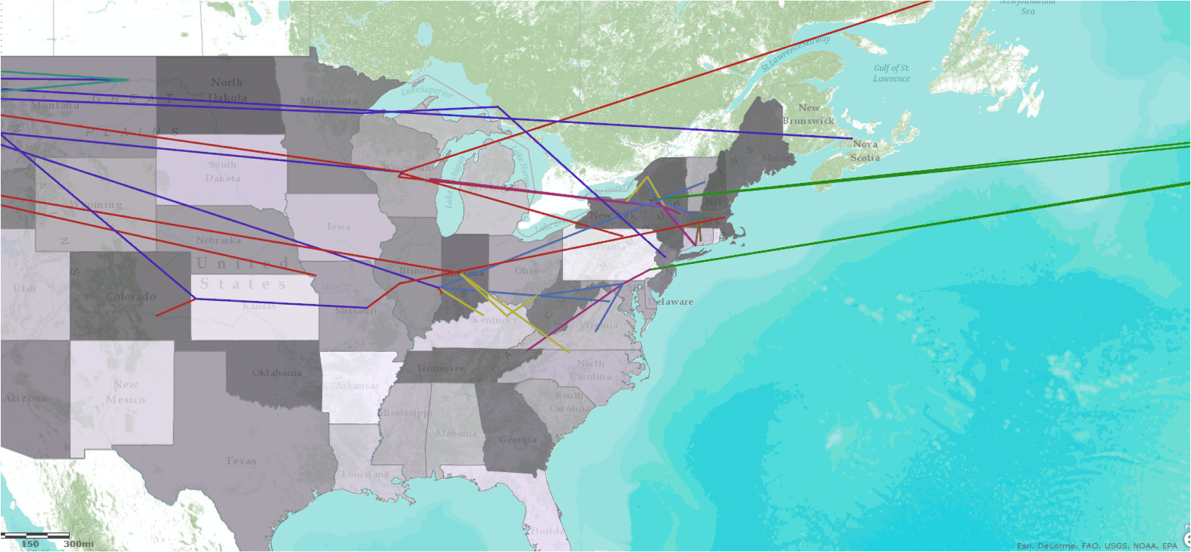
Inspiration
GEOG 897C Final Project (http://ianscottgeog897cfinal.weebly.com/)
I noticed my ancestors tended to move often and I could not find a satisfactory system to visualize that
Used ArcGIS tools hosted on Amazon Cloud to display spatial family tree
The desire for this project is to automate the process and crowd source more data

Slide 4
Project Goal
The goal of this project is to create a system from open source tools to process, store, and spatially visualize family tree data.

Slide 5
Survey of Existing Technology

Slide 6
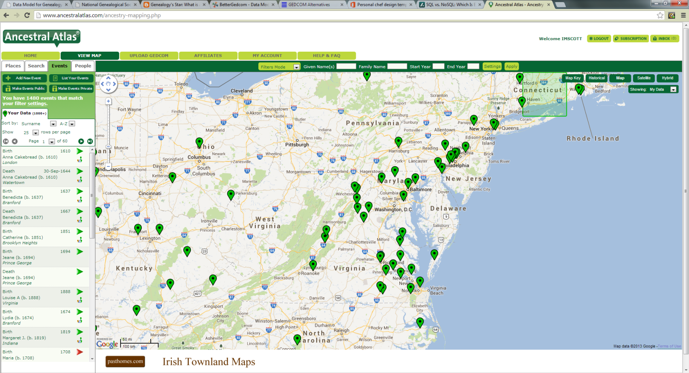
Existing Systems
Ancestral Atlas (http://www.ancestralatlas.com)
Closest existing system to project goal
Uses Google maps as a plugin
Slow
Best features are behind a pay wall

Slide 7
Existing Systems
Map Your Ancestors (www.mapyourancestors.com)
Uses Google maps as a plugin
Provides simple “Ancestry Map” and “Life Map”
Appears to be abandoned

Slide 8
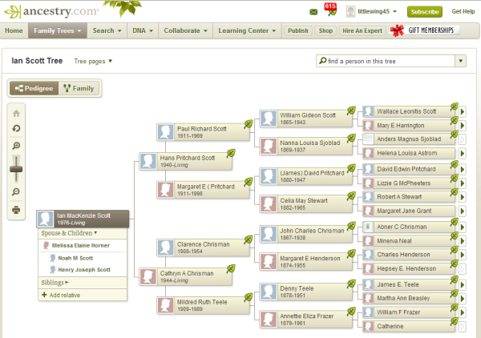
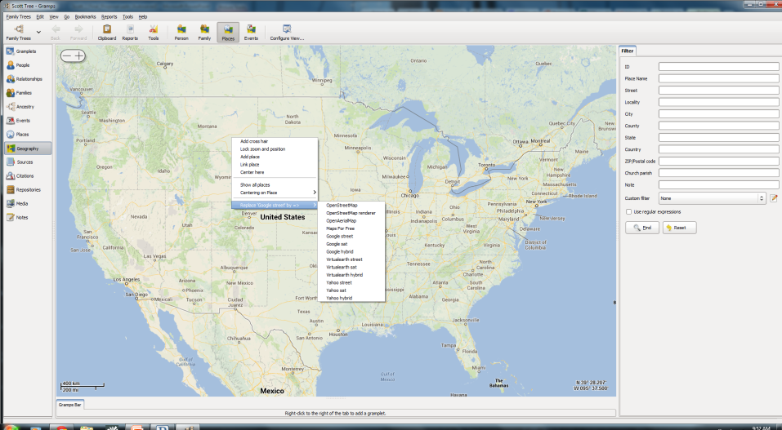
Existing Systems
Non-Geographic Focus
Ancestry.com/Family Tree Maker
Gramps

Slide 9
Existing Solutions
Existing Data Models
GEDCOM (Genealogical Data Communications)
Serial file format designed in 1980’s for genealogical data exchange
De facto genealogical data file
Version 5.5.1 (Oct 99) last update

Slide 10
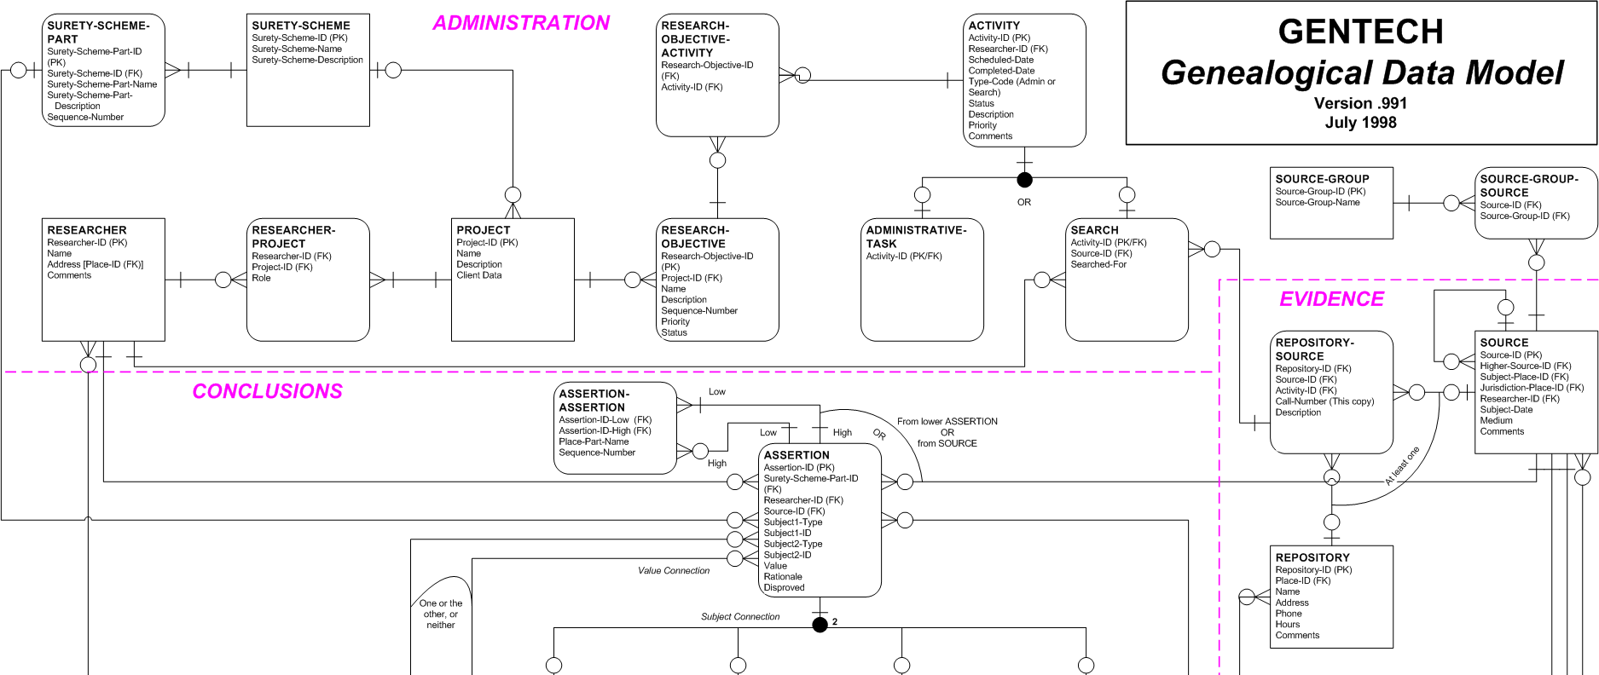
Existing Solutions
GENTECH Genealogical Data Model
Model based on genealogical research process
Not generally used as basis for software
Version 1.1 (May 2000) last update

Slide 11
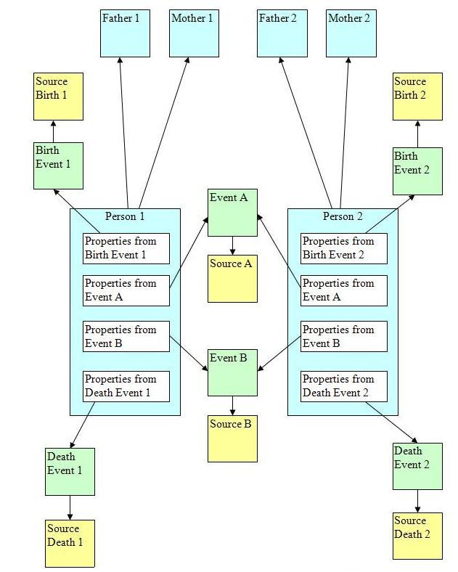
Existing Solutions
STEMMA(Source Text for Event and Ménage MApping)
Personal project of Tony Proctor
Designed to be more general
Most modern
Actively Maintained

Slide 12
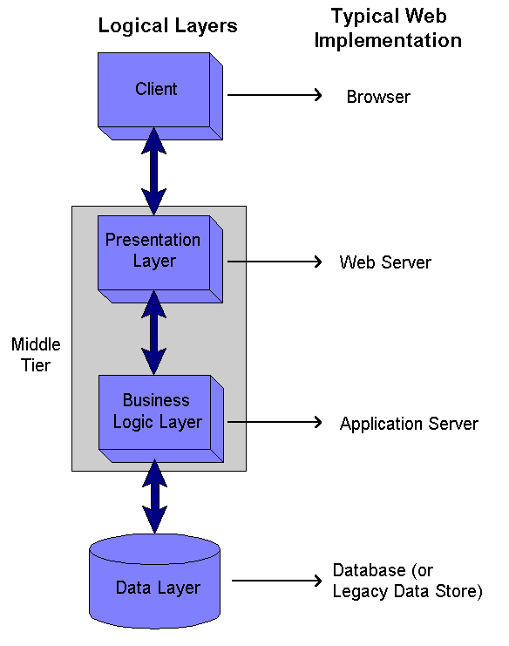
Existing Solutions
Web Application Components
Figure from: http://securesoftwaredev.com/tag/java/

Slide 13
Existing Solutions
Web Application Frameworks
Provide building blocks for web applications
Examples:
Django
Rails
Play
GIS Web Frameworks
Provide GIS specific functionality
Can be used with a more general Web Framework
Examples:
GeoMajas
MapFish
OpenLayers

Slide 14
Existing Solutions
Databases
GEDCOM flat file
Read from GEDCOM file
Inefficient and not scalable
SQL RDBMS (Oracle, PostGres, etc…)
Relational table structure
High data integrity
NoSQL (MongoDB, CouchDB, etc…)
Non-Relational
Several different approaches
More flexible
Less data integrity

Slide 15
Project Requirements

Slide 16
Requirements
Focus on 3 Data Elements
Family connection
Location data
Time
More Flexible Model Than Existing
Care more about spatial data and visualization than data integrity and genealogical research.
Handle multiple relationship types
Simple privacy handling
Design for Everyone on Earth
Thousands of concurrent users
Billions of records
Flexible family definitions to handle cultural differences

Slide 17
Requirements
Data Entry
User Entry
File Import
GEDCOM
Data Processing
Creating Data From Input
Life Lines (Spatial Objects)
Family Connections
Finding Ambiguities
Duplicate entries
Multiple parents
Time line errors (parents and children do not overlapped)

Slide 18
Requirements
GIS Specific Tasks
Geocoding
User’s enter placenames/addresses
Files contain non-standard placenames
Global placenames
Limited by access to placename web services
Google – 2500 per day (must use Google Maps)
Yahoo – No free usage
Open Street Map (Nominatim)– Politely asked to keep small
Geonames – 30,000 per day
Creating Spatial Objects
Spatial Query
Spatial Display

Slide 19
Requirements
Spatial Focused Display
Open Source Geospatial Tools
Display, Query, and Navigate
Spatially
Temporally
Genealogically

Slide 20
Project Proposal

Slide 21
Project Proposal
Theme:
“Build for Performance and Scalability!”
Data Model
Use STEMMA data model
Most modern
Most flexible
Can be implemented with JSON which directly lines up with DB and Web tools

Slide 22
Project Proposal
Database
Use NoSQL Document Style DB
Provides the most flexibility
Easiest to achieve expected performance
JSON focused storage
Choice:

Slide 23
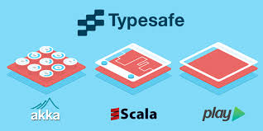
Project Proposal
Web Application Components
Typesafe Stack
Scala
Play
Akka
Javascript Libraries
OpenLayers
Bootstrap

Slide 24
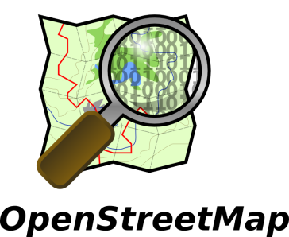
Proposed System Diagram
External
Systems
Map
Tiles
Client Layer
JSON
Middle Tier
Placename
Service
JSON
Data Layer

Slide 25
Validation
Test Data
Use my own data for design and build
Ultimate goal would be to go live and crowd source data
Generate random test data if needed
Load Testing
http://www.neotys.com/ or similar free tool
Validation Criteria
Data in excess of one million records
No mapping performance lags with 1,000 concurrent users

Slide 26
Administrative

Slide 27
Schedule
Schedule
Start Implementation
Finish Data Layer
Finish Client Layer
1/1/2014
2/21/2014
4/6/2014
2013
Nov
Dec
Jan 2014
Feb
Mar
Apr
2014
11/13 - 1/14
Learn/Configure Chosen Tech
1/14 - 1/14
Establish Data Model in MongoDB
1/14 - 2/14
Develop GEDCOM data import
1/14 - 3/14
Develop Middle Tier
2/14 - 4/14
Develop Client Layer

Slide 28
Potential Conferences
AAG Annual Meeting, Tampa FL, 8-12 Apr (http://www.aag.org/annualmeeting)
PA GIS Conference, State College PA, 5-7 May (http://www.pagisconference.org/Pages/default.aspx)
OGRS Symposium, Finland, 10-13 Jun (http://2014.ogrs-community.org/)
FOSS4G 2014, Portland OR, 8-13 Sep (http://2014.foss4g.org/)
Open to Suggestions! …

Slide 29
References
Inspiration
Scott, I. (2012, September 17). GEOG 897C Final Project - Ian Scott. Retrieved October 25, 2013, from http://ianscottgeog897cfinal.weebly.com
Existing Systems
Strahan, A., Cullingford, R., & Francis, N. (2006). Ancestral Atlas. Retrieved October 25, 2013, from http://www.ancestralatlas.com
Map Your Ancestors. (2005). Retrieved October 25, 2013, from http://www.mapyourancestors.com
Data Models
Family History Department The Church of Jesus Christ of Latter-day Saints. (1999, October). The GEDCOM Standard Draft Release 5.5.1 [PDF]. Retrieved from https://devnet.familysearch.org/docs/ gedcom/ged551.pdf
Anderson, R. C., Barkley, P., Booth, R., Holsclaw, B., Velke, R., & Wylie, J. V. (2000, May). Genealogical Data Model Phase 1 [Microsoft Word]. Retrieved from http://members.ngsgenealogy.org/GENTECH_Data_Model/Description_GENTECH_Data_Model_1.1.doc
Proctor, T. (2013, June). STEMMA® Data Model [PDF]. Retrieved from http://stemma.parallaxview.co/ downloads
Chosen Technology
The Open Source Geospatial Foundation. (n.d.). OpenLayers: Free Maps for the Web. Retrieved October 25, 2013, from http://openlayers.org/
Bootstrap. (n.d.). Retrieved October 25, 2013, from http://getbootstrap.com/
Typesafe Reactive. (n.d.). Retrieved October 25, 2013, from http://typesafe.com/platform
MongoDB. (n.d.). Retrieved October 25, 2013, from http://www.mongodb.org/

