Slide 1
The Effects of a River Restoration Project on the Water Quality in the San Antonio River
Rebecca Segura
Advisor: Corina Fernandez
7/16/2021
PSU - GEOG 596A

Slide 2
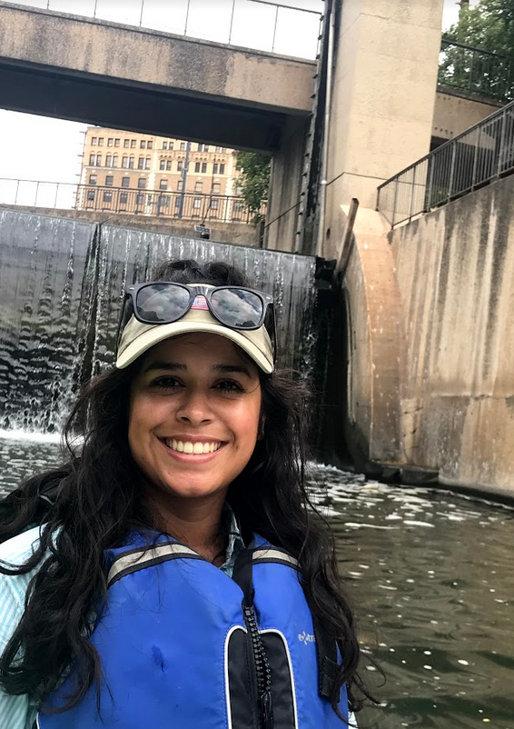
Howdy, Y’all!
I’m Rebecca Segura!
Born & raised in San Antonio, Tx
Work at the San Antonio River Authority
GIS Analyst
Notes:
Support Utilities and Real Estate Department
Note the River Authority treats sewer water. We do not supply drinking water to the city.

Slide 3
Outline
Introduction
  Background & Importance
  Goals and Objectives
Study Area & Data
  Location
  DEM, Land Cover, E. Coli
Methods
  Workflow
  Watershed Delineation
  Landscape Assessment
  Water Quality Analysis: E. Coli
Expected Results
Implications & Future Research
Timeline
Acknowledgments
References

Slide 4
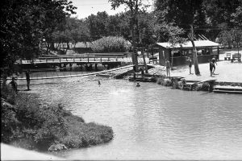
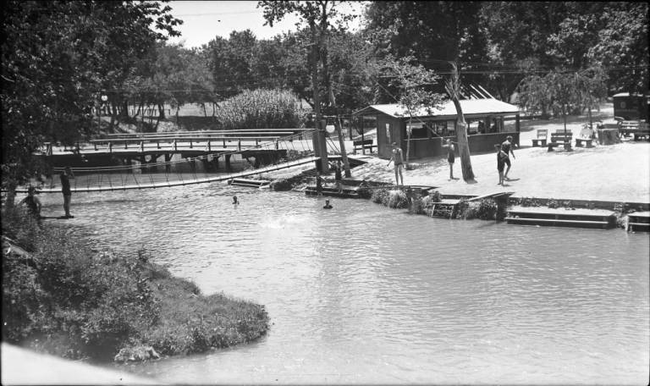
Background & Importance
1920s
Lambert Beach Swimming Pool at Brackenridge Park on the San Antonio River.
Photo: UTSA Libraries Special Collections

Slide 5
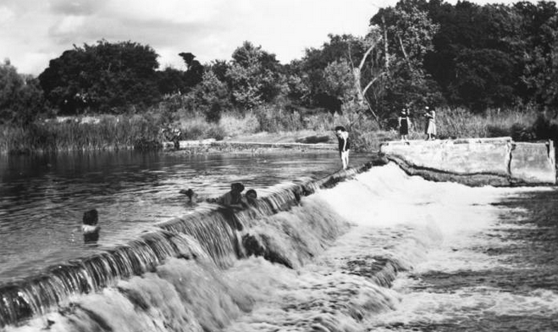
Background & Importance
1920s
Swimming in the San Antonio River on the South Side at the Rio Vista Dam.
Photo: UTSA Libraries Special Collections

Slide 6
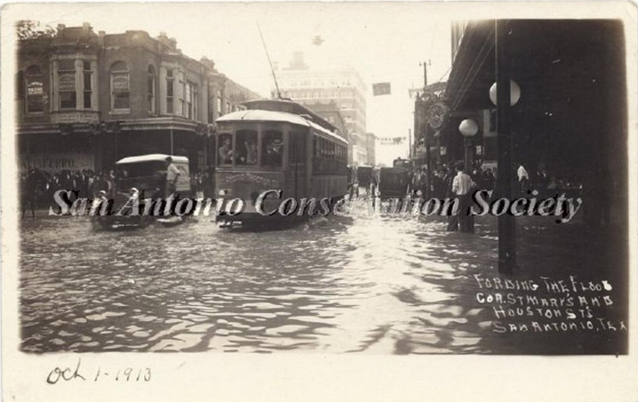
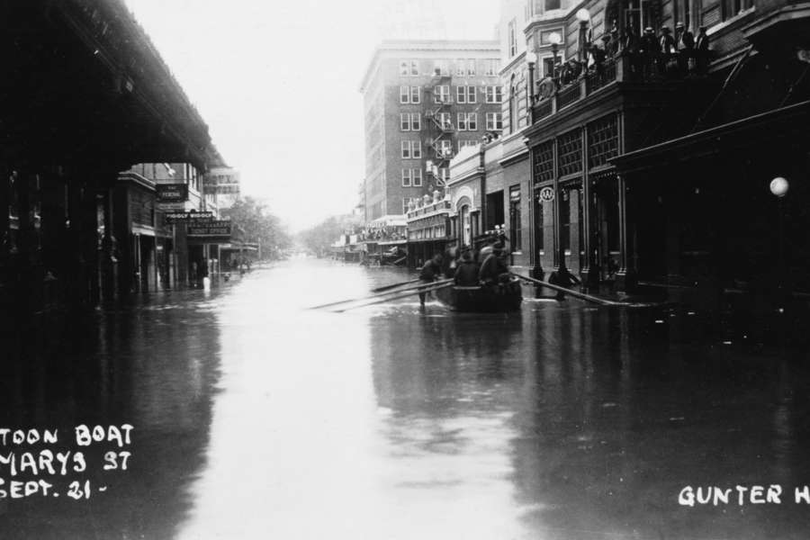
Background & Importance
Historic Flood Events – 1946, 1954
Photo : San Antonio River Authority
Photo : San Antonio River Authority
Notes:
San Antonio History of flooding –
Series of floods in 1954 and a flood in1946 caused significant damage and took the lives of four people
Led US Congress to authorize the US Army Corps of Engineers to improve the severe flooding events with San Antonio and other local entities like Bexar County

Slide 7
San Antonio Channel Improvement Project (SACIP) – 1950s-1970s
31 miles channels improved
Left: Pre-channelization at Roosevelt Park near the Lonestar Brewery, circa 1955. Right: Post-channelization at Roosevelt Park near the Lonestar Brewery circa 2007.
Photos courtesy of San Antonio River Authority
Notes:
The San Antonio Channel Improvement Project project improve flood control along 31 miles of the San Antonio River and its tributaries. This involved realignment and channelization of the river system to move flood waters quickly away from urbanized areas.

Slide 8
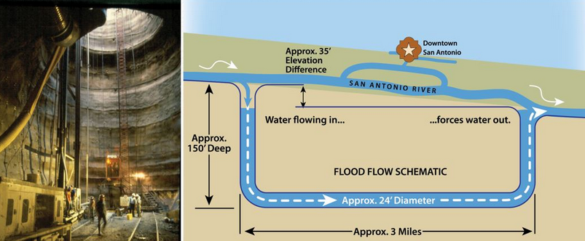
San Antonio Channel Improvement Project (SACIP) – 1980s-1990s
Photo : San Antonio River Authority
Two underground tunnels divert floodwater
Can move 3 million gallons of water per minute
Notes:
Engineers constructed the inlet structure to direct water from the San Antonio River into the tunnel and it consists of a 120-foot-long intake which includes rotating racks to collect trash before it can enter the tunnel. The River Authority provided landscaping, an aerating water feature, disinfection, and recirculation pumps to recirculate water from the tunnel and into the river to supplement flow during dry periods.
the tunnel outlet structure directs discharge from the tunnel shaft into the San Antonio River. The outlet structure measures 230 feet across the front and water features are included to enhance the appearance of the outlet structure.
the 3-mile long tunnel uses gravity to bypass floodwaters under downtown San Antonio. The inlet structure is about 30 feet higher than the outlet structure, which allows gravity to push water through the tunnel and out of the outlet structure safely into the river channel of the Mission Reach segment
What happens when the water comes out of tunnel?
In 1999, the San Antonio River Tunnel project won the State of Texas Outstanding Civil Engineering Achievement Award from the American Society of Civil Engineers; it also received a national-level Award of Merit. A year later, it was one of four projects to receive the Federal Design Achievement Award from the National Endowment for the Arts (NEA), as well as an achievement award from the American Society of Civil Engineers in recognition of the San Antonio River Tunnel Inlet Site.

Slide 9
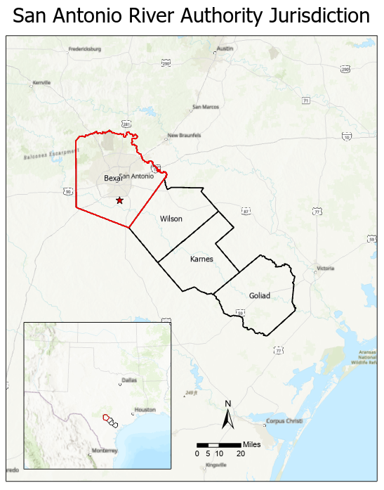
Location Map
Notes:
Texas, San Antonio, Segments

Slide 10
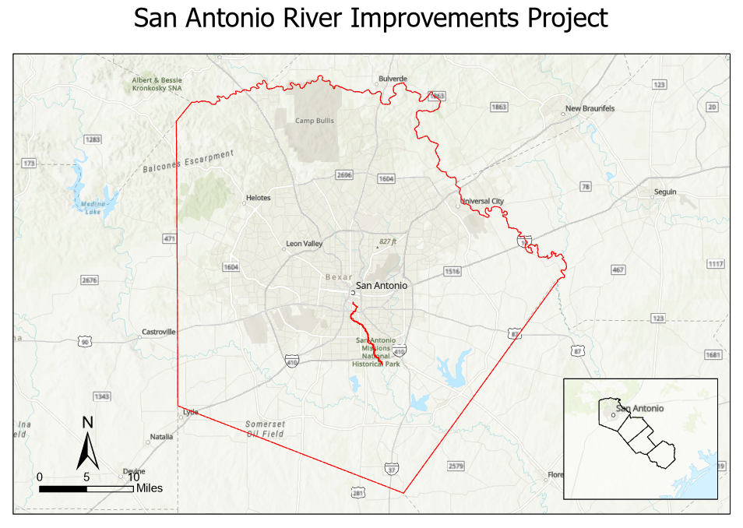
Location Map
Notes:
Texas, San Antonio, Segments

Slide 11
San Antonio River Improvements Project (SARIP) – 1998 - 2013
Benefits of SARIP
  Ecosystem Restoration
  Flood Damage Reduction
  Culture
  Economic Development
Photo : San Antonio River Authority
Notes:
Transform and enhanced the recreational amenities and improvements along the river
The project was a $384.1 million investment that addressed flood control, amenities, ecosystem restoration, and recreational improvements along 13 miles of the San Antonio River.
SITE MAP

Slide 12
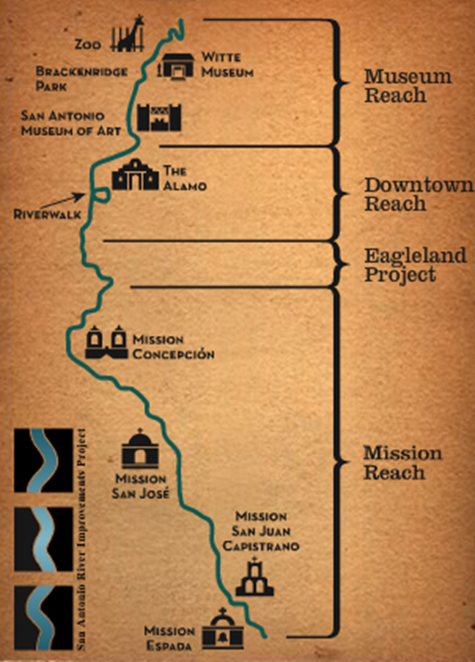
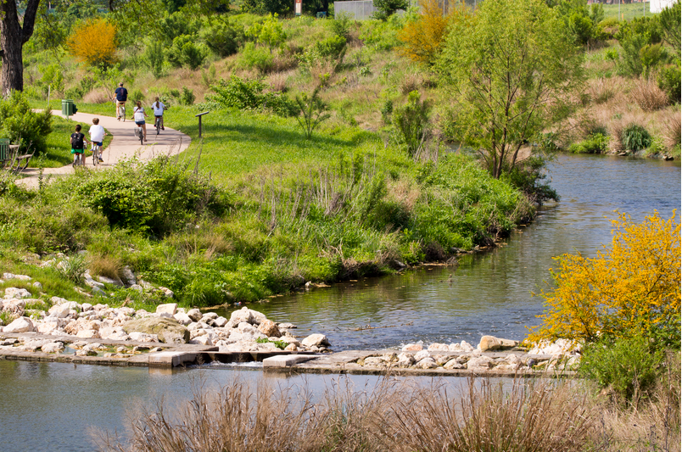
Mission Reach – *Study Area*
Photos : San Antonio River Authority
8-mile-long reach
Restored ~ 334 acres of Riparian Woodland
Restored ~ 113 acres of Aquatic Habitat
Restored Historical Connections
Notes:
The revitalization of Mission Reach began in August of 2008 and was completed in October of 2013. The 8-mile-long reach along the San Antonio River includes the restoration of approximately 334 acres of riparian woodland habitat & 113 acres of aquatic habitat.

Slide 13
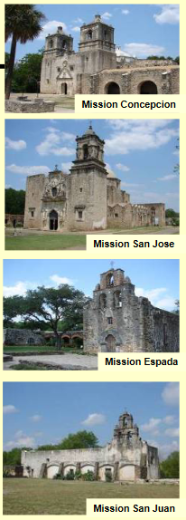
Mission Reach – *Study Area*
Photos : San Antonio River Authority
8-mile-long reach
Restored ~ 334 acres of Riparian Woodland
Restored ~ 113 acres of Aquatic Habitat
Restored Historical Connections
Notes:
Historical connections were made to four of the five historic missions in the San Antonio Missions National Historical park hence mission reach. The missions were established during the Spanish Colonial period 300 years ago. - Another history lesson that we don’t have time for today

Slide 14
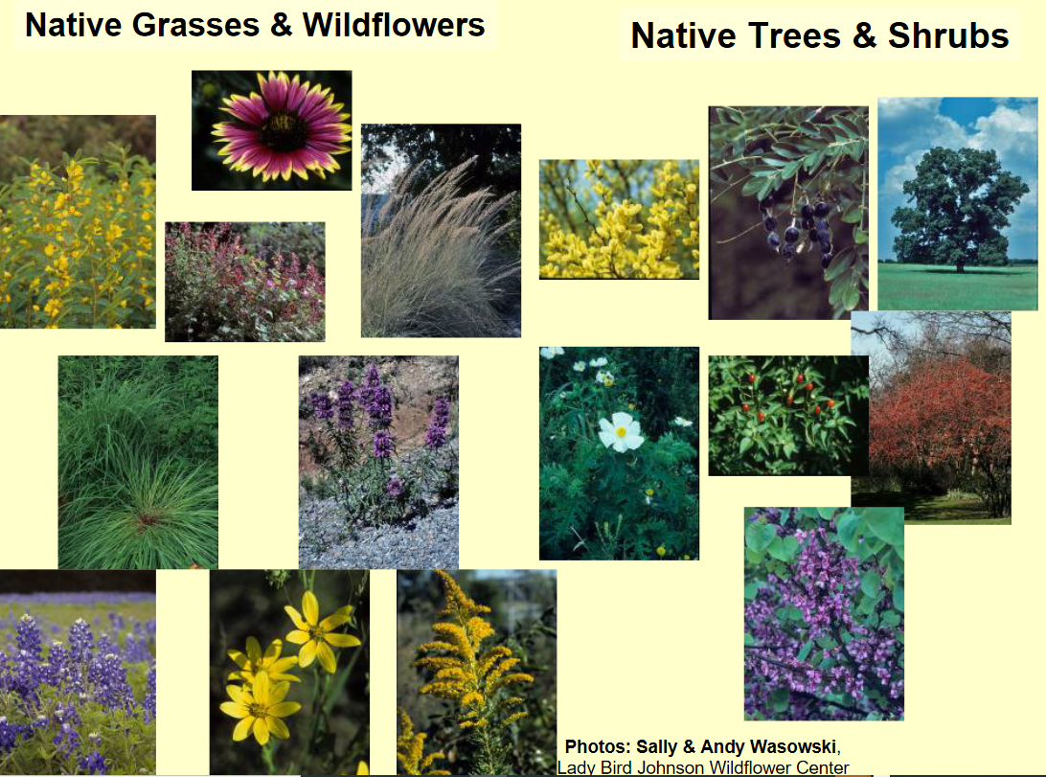
Riparian Vegetation
Benefits of Riparian Vegetation
  Roots grow deep into soil
  Stabilizes the banks
  Prevents erosion
  Filter out pollution
Riparian or riverbank vegetation
  Over 20,000 Young Trees
  39 native tree and shrub species
  60 Native grasses
Notes:
The 8-mile-long reach along the San Antonio River was designed to restore the ecosystem by planting riparian vegetation. The native vegetation was specifically chosen to be planted along the river since their roots grow deep into the soil, stabilizing the banks, and preventing erosion. The tall native grasses also function as a filter by catching any pollution from stormwater runoff.
This includes the planting of over 20,000 young trees and shrubs, 39 native tree and shrub species, over 60 native grass and wildlife species
https://www.sariverauthority.org/about/history/san-antonio-river-improvements-project

Slide 15
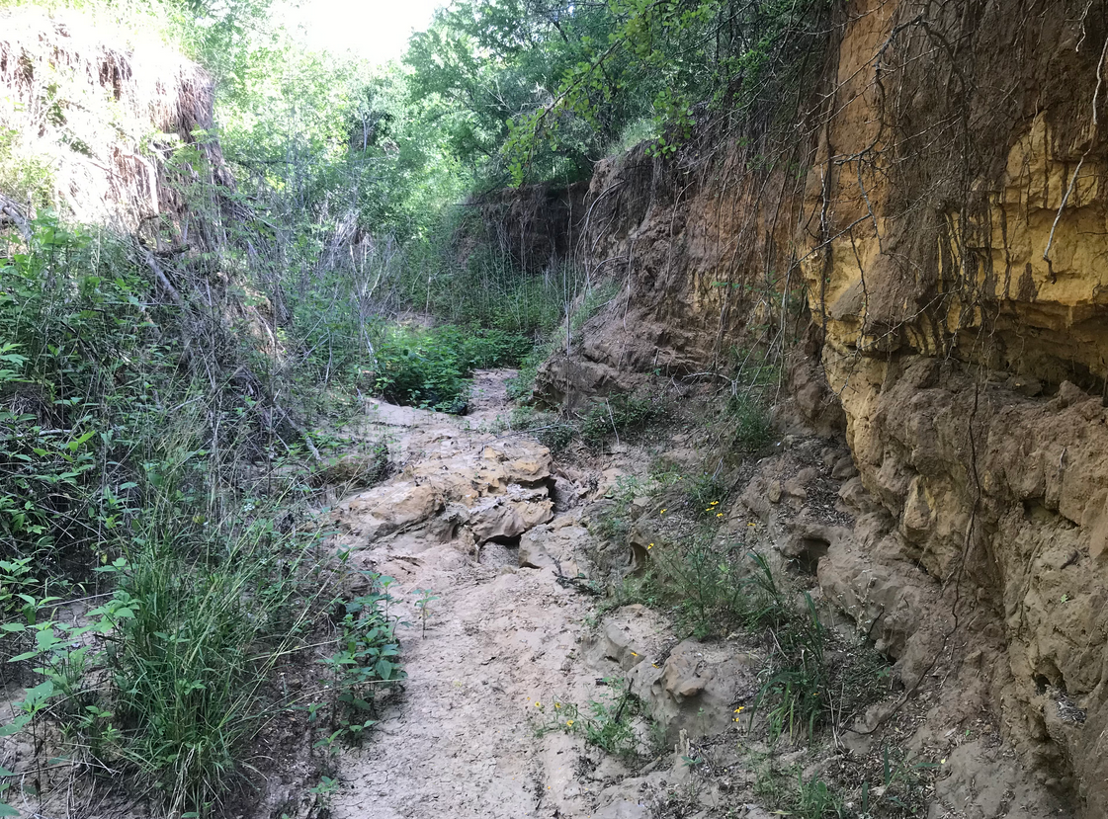
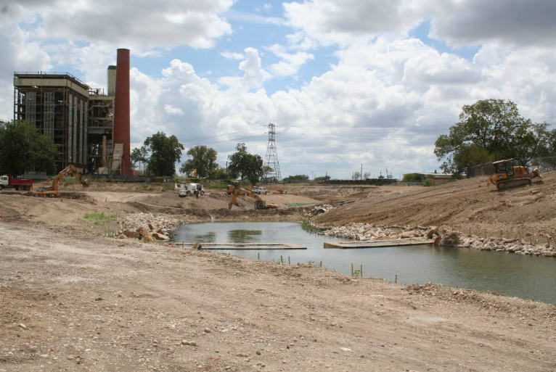
Before & During Construction
Construction began in August 2008
Completed in October 2013
Photos : San Antonio River Authority

Slide 16
Why is this analysis important?
Mission Statement: Committed to Safe, Clean, Enjoyable Creeks and Rivers
SACIP - Safe
  Address flooding issues
SARIP - Enjoyable
  Restores river back to natural habitat
  Reconnects San Antonio and wildlife to a renewed and restored river
Clean
  Water Quality - E. coli bacteria levels
Notes:
When E. coli is present in water, it can indicate that the water is contaminated by fecal matter. Exposure to E. coli can lead to serious illnesses

Slide 17
Goals
Analyze the water quality before and after the river restoration to see if it has affected the water quality (E. coli) over time
Communicate, educate, and raise awareness to the San Antonio community on how the restoration project has impacted the ecosystem and water quality through these findings.

Slide 18
Objectives
Landscape Assessment
  Comparative analysis within the different contributing areas
Analyze the Spatial & Temporal Variability of E. coli in the San Antonio River using a two-way ANOVA test
  Spatial Variability
  Temporal Variability
Notes:
Landscape composition – descriptive; characterization of landscape; percentages of landscape within the contributing area or area of interest
The ANOVA test will essentially test to see if there are significant differences among the E. coli mean values.

Slide 19
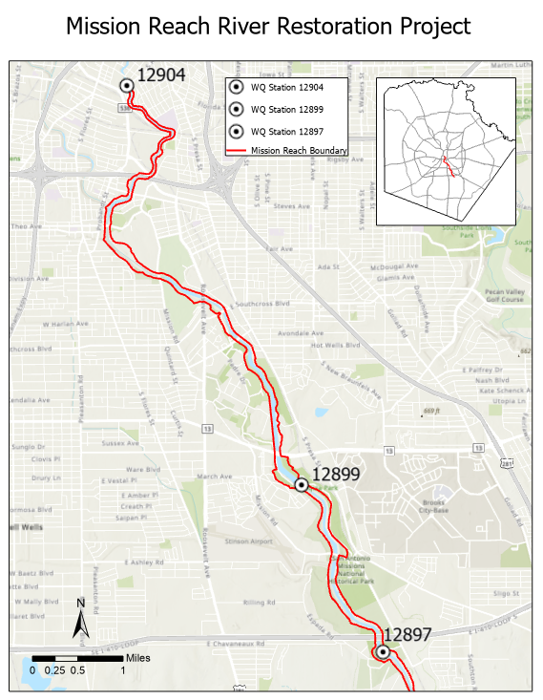
Study Area
Notes:
WQ stations – samples follow guidelines set in place by Texas Commission of Environmental Quality, Texas’ environmental agency
The study area is located along the urban ecosystem restoration project, Mission Reach within Bexar County
Samples are analyzed at a lab at the River Authority location that is TCEQ accredited. The samples are collected every month throughout the year and are surface water samples. The

Slide 20
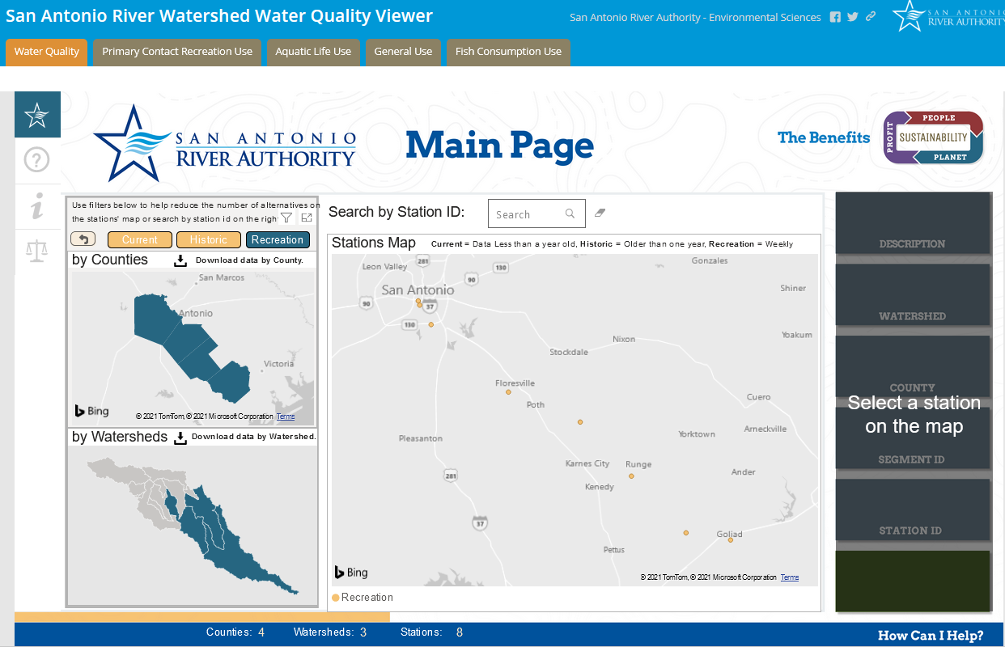
Input Data – E. coli
Notes:
EXPLAIN E. Coli data collection
Sampling covered a year across the dry and wet seasons....
Water samples were obtained from surface water sources....
E. coli counts were determined using the most probable number method (MPN)...
The E. coli counts were determined using the most probable number method which estimates the presence of bacteria in the water sample.

Slide 21
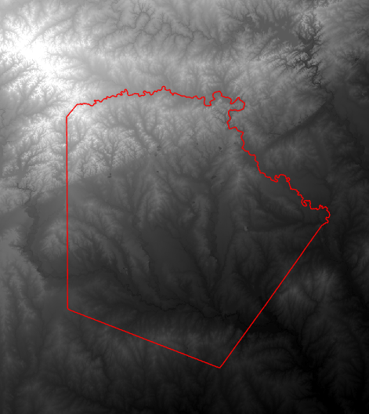
Input Data
DEM – National Elevation Dataset
USGS
30-Meter Resolution
Notes:
In order to assess the land cover within the contributing areas, a watershed was delineated in ArcPro.
Used for the delineation of the contributing areas which will be used in the Landscape Analysis

Slide 22
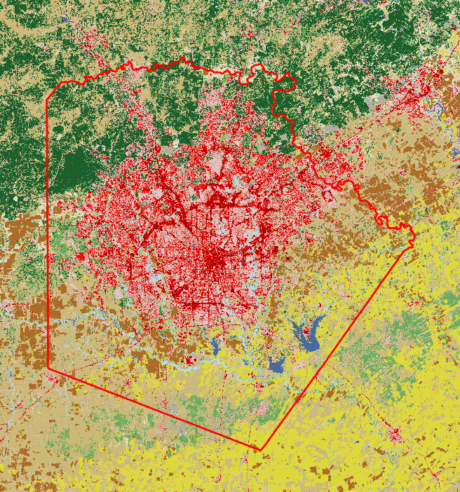
Input Data
Land Cover –
National Land Cover Dataset
USGS
Created by Multi-Resolution land Characteristics (MRLC) Consortium group

Slide 23
Temporal & Spatial Variation Methods Overview
Watershed Delineation
Landscape Assessment
Water Quality Analysis of E. Coli - ANOVA
  Temporal
    Pre/ Post Restoration Project
    Wet/Dry Season
  Spatial
    3 monitoring stations

Slide 24
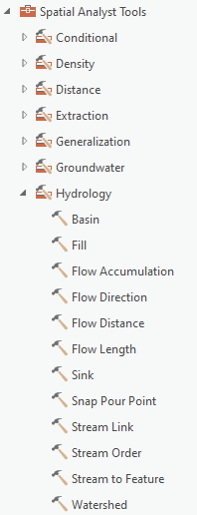
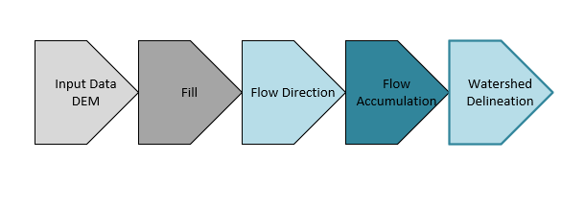
Watershed Delineation Workflow
Notes:
The watershed delineation used a common method for delineating watersheds. The delineation can be calculated with the DEM and using the Hydrography toolbox in ArcPro.
ADD STEPS DEM → FILL DEM → FLOW DIRECTION → FLOW ACCUMULATION → WATERSHED DELINEATION
RASTER OUTPUTS
How does e. coli enter the water? 4 main sources – sewage overflows, sewer not working properly, polluted stormwater runoff

Slide 25
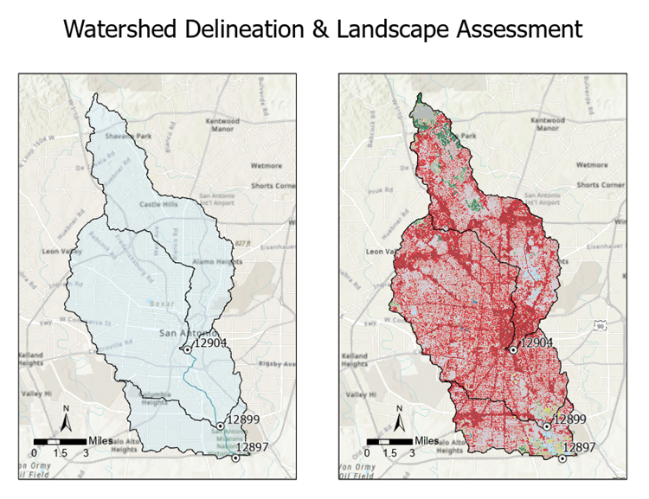
Watershed Delineation
Identify the landscape within the contributing areas
Landscape Assessment
Notes:
Watershed Delineation will be useful in identifying the land use types within the contributing areas
How does e. coli enter the water? 4 main sources – sewage overflows, sewer not working properly, polluted stormwater runoff so identifying what land types are contributing and impacting the water quality in the river will be useful in this analysis

Slide 26
Landscape Assessment
4 Main Sources of E. Coli
  Sewer overflows
  Sewer not working properly
  Polluted stormwater runoff
  Agricultural runoff
Source: CDC, NCEZID, DFWED
Notes:
Why level 1?
The landscape assessment, the contributing areas will be analyzed to see how the contributing areas differ between watersheds and how these differences in landscape within each watershed impact the water quality.
,
Why don’t study the sources?
Explain why landscape is important –
Future analysis near wwtp

Slide 27
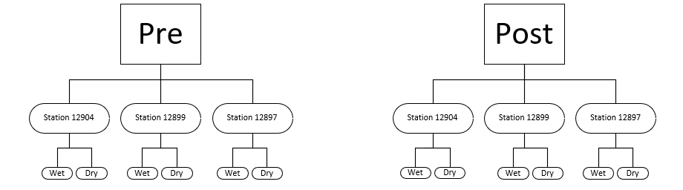
Spatial & Temporal Variability - ANOVA
Pre/ Post River Restoration
3 Different Monitoring Stations
Wet & Dry Seasons
  Previously determined by ANOVA
2005
2008
2014
2020
Notes:
Explain gap again 2009-2013 – when restoration project started and completed; There wouldn’t be sufficient data that would reflect the E. coli concentration during construction
* ADD IN GRAPHIC OF TESTS

Slide 28
Precipitation & Temperature Data
 | Jan | Feb | Mar | Apr | May | Jun | Jul | Aug | Sep | Oct | Nov | Dec | Annual
2000 | 0.05 | 0.08 | 0.03 | 0.04 | 0.12 | 0.25 | 0.01 | 0.01 | 0.09 | 0.18 | 0.29 | 0.05 | 0.1
2001 | 0.09 | 0.03 | 0.09 | 0.08 | 0.08 | 0.11 | 0.02 | 0.25 | 0.14 | 0.07 | 0.15 | 0.11 | 0.1
2002 | 0.01 | 0.02 | 0.04 | 0.13 | 0.07 | 0.05 | 0.55 | 0.02 | 0.23 | 0.25 | 0.07 | 0.08 | 0.13
2003 | 0.03 | 0.08 | 0.02 | 0.01 | 0 | 0.1 | 0.26 | 0.05 | 0.31 | 0.06 | 0.01 | 0 | 0.08
2004 | 0.07 | 0.06 | 0.08 | 0.17 | 0.06 | 0.32 | 0.02 | 0.04 | 0.06 | 0.31 | 0.32 | 0 | 0.13
2005 | 0.07 | 0.09 | 0.06 | 0 | 0.1 | 0.03 | 0.07 | 0.04 | 0.05 | 0.04 | 0.01 | 0 | 0.05
2006 | 0.01 | 0.02 | 0.04 | 0.05 | 0.12 | 0.05 | 0.05 | 0 | 0.14 | 0.11 | 0.03 | 0.08 | 0.06
2007 | 0.14 | 0 | 0.23 | 0.15 | 0.11 | 0.22 | 0.38 | 0.22 | 0.04 | 0.02 | 0.01 | 0.01 | 0.13
2008 | 0.01 | 0.01 | 0.06 | 0.03 | 0.02 | 0 | 0.12 | 0.16 | 0.02 | 0.01 | 0 | 0.01 | 0.04
2009 | 0.01 | 0.02 | 0.08 | 0.07 | 0.05 | 0.02 | 0.02 | 0.01 | 0.21 | 0.38 | 0.07 | 0.06 | 0.08
2010 | 0.14 | 0.16 | 0.07 | 0.12 | 0.14 | 0.14 | 0.12 | 0 | 0.31 | 0.01 | 0.01 | 0.02 | 0.1
2011 | 0.09 | 0.02 | 0 | 0 | 0.03 | 0.05 | 0.03 | 0 | 0.1 | 0.11 | 0.06 | 0.09 | 0.05
2012 | 0.13 | 0.19 | 0.1 | 0 | 0.32 | 0 | 0.12 | 0.08 | 0.24 | 0.08 | 0.01 | 0.01 | 0.11
2013 | 0.09 | 0 | 0.03 | 0.09 | 0.43 | 0.07 | 0.02 | 0.03 | 0.12 | 0.09 | 0.05 | 0.02 | 0.09
2014 | 0.01 | 0.02 | 0.03 | 0.02 | 0.16 | 0.18 | 0.1 | 0 | 0.06 | 0.06 | 0.24 | 0.04 | 0.08
2015 | 0.12 | 0.02 | 0.1 | 0.25 | 0.28 | 0.21 | 0 | 0.01 | 0.08 | 0.25 | 0.09 | 0.05 | 0.12
2016 | 0.04 | 0.05 | 0.11 | 0.21 | 0.29 | 0.08 | 0.01 | 0.16 | 0.21 | 0.01 | 0.06 | 0.2 | 0.12
2017 | 0.09 | 0.13 | 0.07 | 0.1 | 0.06 | 0.01 | 0.01 | 0.19 | 0.09 | 0.01 | 0.02 | 0.13 | 0.08
2018 | 0.01 | 0.07 | 0.13 | 0.01 | 0.03 | 0.02 | 0.16 | 0.02 | 0.56 | 0.21 | 0.06 | 0.08 | 0.11
2019 | 0.05 | 0.02 | 0.01 | 0.12 | 0.11 | 0.18 | 0 | 0.01 | 0.05 | 0.13 | 0.02 | 0.02 | 0.06
2020 | 0.06 | 0.04 | 0.05 | 0.1 | 0.19 | 0.03 | 0.01 | 0.03 | 0.1 | 0.01 | 0.05 | 0.03 | 0.06
2021 | 0.03 | 0.05 | 0.02 | 0.2 | 0.2 | M | M | M | M | M | M | M | 0.1
Mean | 0.06 | 0.05 | 0.07 | 0.09 | 0.13 | 0.1 | 0.1 | 0.06 | 0.15 | 0.11 | 0.08 | 0.05 | 0.09
Max | 0.14 | 0.19 | 0.23 | 0.25 | 0.43 | 0.32 | 0.55 | 0.25 | 0.56 | 0.38 | 0.32 | 0.2 | 0.13
 | 2010 | 2012 | 2007 | 2015 | 2013 | 2004 | 2002 | 2001 | 2018 | 2009 | 2004 | 2016
Min | 0.01 | 0 | 0 | 0 | 0 | 0 | 0 | 0 | 0.02 | 0.01 | 0 | 0 | 0.04
 | 2014 | 2007 | 2011 | 2005 | 2003 | 2008 | 2015 | 2006 | 2008 | 2016 | 2008 | 2004
Data obtained from the National Oceanic Atmospheric Administration

Slide 29
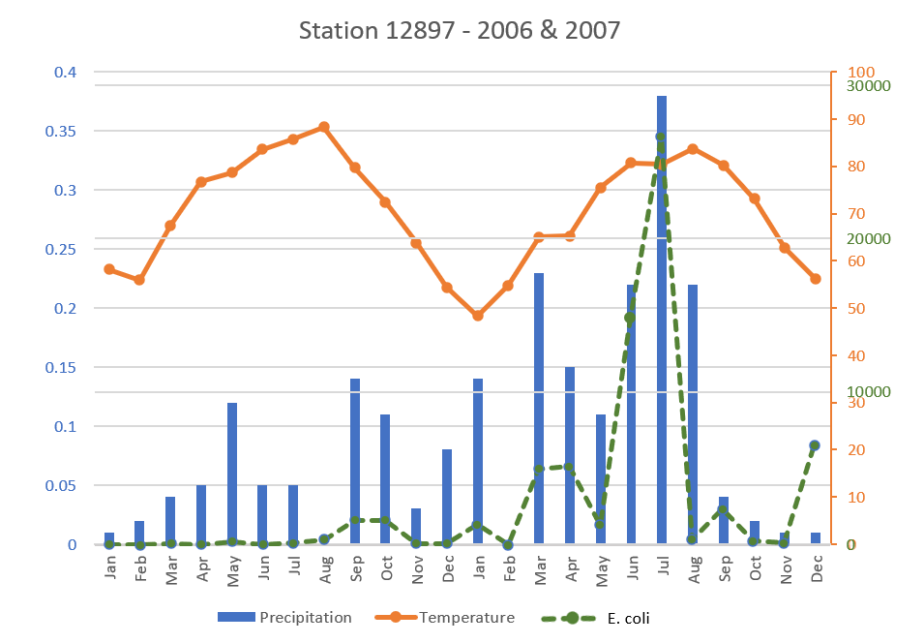
Seasonal Variation
Comparative Analysis
Wet
  April - August
Dry
  September – March
Notes:
What are the normal levels? Draw a line for levels
Add units ; Add line for recreational level
Average of data per month
How to differentiate wet/dry seasons? References on other studies for ecoli wet – April-August dry – Sept-March
If there is too much variation year by year, future analysis
Periods may change a bit according to database results

Slide 30
Water Quality Analysis: Ecoli
Analysis of Variance - ANOVA
Descriptive Stats
Summary Statistics - Station 12897
Mean | 2839.73125
Standard Error | 1236.512085
Median | 297.6
Mode | 1612.5
Standard Deviation | 6057.647337
Sample Variance | 36695091.26
Kurtosis | 10.95310871
Skewness | 3.200280134
Range | 26642.75
Minimum | 12.25
Maximum | 26655
Sum | 68153.55
Count | 24
Notes:
The ANOVA test will essentially test to see if there are general differences among the E. coli mean values.
Descriptive Stat on stations will be calculated in Excel to understand how the E. coli concentrations are distributed over time. The ANOVA test must meet certain assumptions before running a test. So a normality assessment will also occur before running the ANOVA test to see if the distribution of values violates the assumptions.

Slide 31
Expected Results
Landscape Assessment
  Describe & characterize the landscape within the contributing areas
Water Quality Analysis of E. Coli - ANOVA
  Significant differences between pre and post
  Significant differences between the upstream water quality station and downstream water quality station
Notes:
Importance of landscape – different effects on wq; composition of landscape
Main Idea of project; find if there are any significant differences between pre & post
I expect post project will give lower levels of e. coli

Slide 32
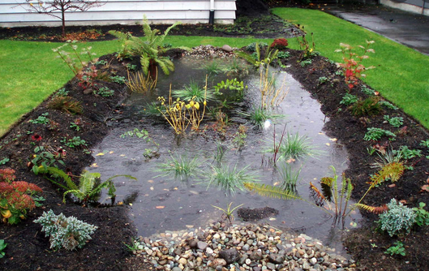
Implications
Educate community through a Story map
Implement LID features
  LID feature or low impact development features are systems that can be built to help replicate the natural processes for infiltrating storm water, resulting in healthier water quality
Photo: Nature Conservancy in Washington

Slide 33
Future Analysis
Continue to monitor and analyze the river through the two-way ANOVA test
Apply methodology to other segments of the river
Expand to other water quality parameters
  Landscape, pH salinity, sunlight intensity, turbidity, nitrates
Notes:
Turbidity, nitrates,

Slide 34
Timeline
June – July: Acquire Data & Watershed Delineation
August - September: Acquire Data & Clean E.coli Data
October – December: Identify wet & dry seasons, Landscape Assessment, Tabulate Area Tool, Calculate Percentage of Landscape within Contributing Areas
January – March : Prep data for Two-way ANOVA test, Perform ANOVA test
April – July : Create Story Map/Dashboard, Project Write-Up
Notes:
Follow up on Timeline

Slide 35
Acknowledgments
Corina Fernandez
San Antonio River Authority
Notes:
This research project has been supported by Corina Fernandez through her 15 + years of experience in water resources modeling specifically in water quality and watershed management. Her expertise has been greatly appreciated throughout the development of this project.
I would also like to acknowledge my coworkers at the San Antonio River Authority. My colleagues have given me insight into past, present, and future research that has been conducted on the San Antonio River as well as background knowledge on the San Antonio River Improvement Project.

Slide 36
Literature Review – Water Quality Analysis
Many parameters can be considered such as
  Landscape, pH salinity, sunlight intensity, rainfall
Statistical investigations into indicator bacteria concentrations in Houston metropolitan watersheds.
  E. coli concentrations were less sensitive to temperature variations and more influenced by rainfall
Escherichia Coli Survival in Waters: Temperature Dependence
  Survival rate of E. coli depending on the temperature
Spatial Variability of Escherichia Coli in Rivers of Northern Coastal Ecuador
  Higher concentrations of E. coli were associated with increased turbidity
Notes:
- Several studies have been conducted on water quality that have produced significant results specifically on E. coli.
-When analyzing E. coli concentrations many parameters can be considered such as the nearby landscape, pH salinity, streambed resuspension, and sunlight intensity.
-a study on bacteria concentrations in Houston, Texas found that bacteria concentrations “were less sensitive to temperature variations and more strongly influenced by rainfall events” and “the more urban watersheds had higher concentration
-In contrast One study analyzed the survival rate of E. coli depending on the temperature of the water which concluded that E. coli inactivation rates differed between temperature changes of the water.
-

Slide 37
References
“About Us.” Headquarters U.S. Army Corps of Engineers. Accessed July 14, 2021. https://www.usace.army.mil/about/.
Blaustein, R.A., Y. Pachepsky, R.L. Hill, D.R. Shelton, and G. Whelan. “Escherichia Coli Survival in Waters: Temperature Dependence.” Water Research. Pergamon, November 6, 2012. https://www.sciencedirect.com/science/article/pii/S0043135412007415.
“Clean Rivers Program.” Clean Rivers Program | San Antonio River Authority. Accessed July 14, 2021. https://www.sariverauthority.org/public-services/environmental-sciences/clean-rivers-program.
“Data Management Reference Guide (DMRG) for Surface Water Quality Monitoring.” Texas Commission on Environmental Quality. Accessed July 14, 2021. https://www.tceq.texas.gov/waterquality/data-management/dmrg_index.html.
Desai AM;Rifai H;Helfer E;Moreno N;Stein R; (n.d.). Statistical investigations into indicator bacteria concentrations in Houston metropolitan watersheds. Water environment research : a research publication of the Water Environment Federation. https://pubmed.ncbi.nlm.nih.gov/20432648/.
“E. Coli.” Mayo Clinic. Mayo Foundation for Medical Education and Research, October 10, 2020. https://www.mayoclinic.org/diseases-conditions/e-coli/symptoms-causes/syc-20372058.
“History.” History | San Antonio River Authority. Accessed July 14, 2021. https://www.sariverauthority.org/about/history.
“How Fill Works.” How Fill works-ArcGIS Pro | Documentation. Accessed July 14, 2021. https://pro.arcgis.com/en/pro-app/latest/tool-reference/spatial-analyst/how-fill-works.htm.
“How Flow Direction Works.” How Flow Direction works-ArcGIS Pro | Documentation. Accessed July 14, 2021. https://pro.arcgis.com/en/pro-app/latest/tool-reference/spatial-analyst/how-flow-direction-works.htm.
Li, Xiaoping, Liquan Zhang, and Zheng Zhang. “Soil Bioengineering and the Ecological Restoration of Riverbanks at the Airport Town, Shanghai, China.” Ecological Engineering. Elsevier, January 4, 2006. https://www.sciencedirect.com/science/article/pii/S0925857405002272?casa_token=hWLJgX8NgUcAAAAA%3AwhoottN-cgcH7uuFs_dWh8f5O26QmDl_3spOtK0rcJ-3XMt4BHVTOzZ663HqyZQhpDxAjdo.
Mehta, Anam. “The San Antonio Flood of 1921.” Story Map Series, July 7, 2021. https://sara-tx.maps.arcgis.com/apps/MapSeries/index.html?appid=3a4ca132222e41589e6f41eebfe6d36d.

Slide 38
References
Ngoye, Elizabeth, and John F. Machiwa. “The Influence of Land-Use Patterns in the Ruvu River Watershed on Water Quality in the River System.” Physics and Chemistry of the Earth, Parts A/B/C. Pergamon, October 1, 2004. https://www.sciencedirect.com/science/article/pii/S1474706504001652?via%3Dihub.
Rao, Gouthami, Joseph N. S. Eisenberg, David G. Kleinbaum, William Cevallos, Gabriel Trueba, and Karen Levy. “Spatial Variability of Escherichia Coli in Rivers of Northern Coastal Ecuador.” MDPI. Multidisciplinary Digital Publishing Institute, February 13, 2015. https://www.mdpi.com/2073-4441/7/2/818.
Scott, Suzanne. “The Mission Reach: Bringing Life and Pride Back to the Southside.” San Antonio Report, October 7, 2016. https://sanantonioreport.org/the-mission-reach-bringing-life-and-pride-back-to-the-southside/.
Texas Administrative Code. Accessed July 14, 2021. https://texreg.sos.state.tx.us/public/readtac$ext.TacPage?sl=R&app=9&p_dir=&p_rloc=&p_tloc=&p_ploc=&pg=1&p_tac=&ti=30&pt=1&ch=307&rl=7.
“The San Antonio River Improvements Project.” The San Antonio River Improvements Project | San Antonio River Authority. Accessed June 3, 2021. https://www.sariverauthority.org/about/history/san-antonio-river-improvements-project.
Vega, Marisol, Rafael Pardo, Enrique Barrado, and Luis Debán. “Assessment of Seasonal and Polluting Effects on the Quality of River Water by Exploratory Data Analysis.” Water Research. Pergamon, February 23, 1999. https://www.sciencedirect.com/science/article/pii/S0043135498001389?casa_token=hLuF2ADnkV0AAAAA%3Ax71A0hQ6btx_C9H1D-qH_7cpE2aC19Qkl_Lksd-Ip2_6JeiUtFBhe-FsgYNJCgptYgQ5G9M.
Wohl, Ellen, Stuart N. Lane, and Andrew C. Wilcox. “The Science and Practice of River Restoration.” AGU Journals. John Wiley & Sons, Ltd, August 24, 2015. https://agupubs.onlinelibrary.wiley.com/doi/full/10.1002/2014WR016874.

