Slide 1
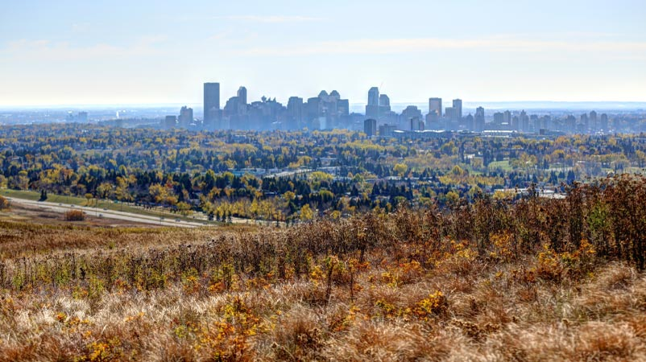
Public Trees and Socioeconomic Inequality in the City of Calgary
MGIS Program
Advisor: Dr. Patrick Kennelly
Presenter: Carlos A. Serpas

Slide 2
Presentation Agenda
1. Project Background
2. Project Objectives
3. Project Methodology
4. Anticipated Results
5. Project Timeline
6. Presentation Venue
Figure 1: Presentation Agenda

Slide 3
Part I
1. Project Background
2. Project Objectives
3. Project Methodology
4. Anticipated Results
5. Project Timeline
6. Presentation Venue

Slide 4
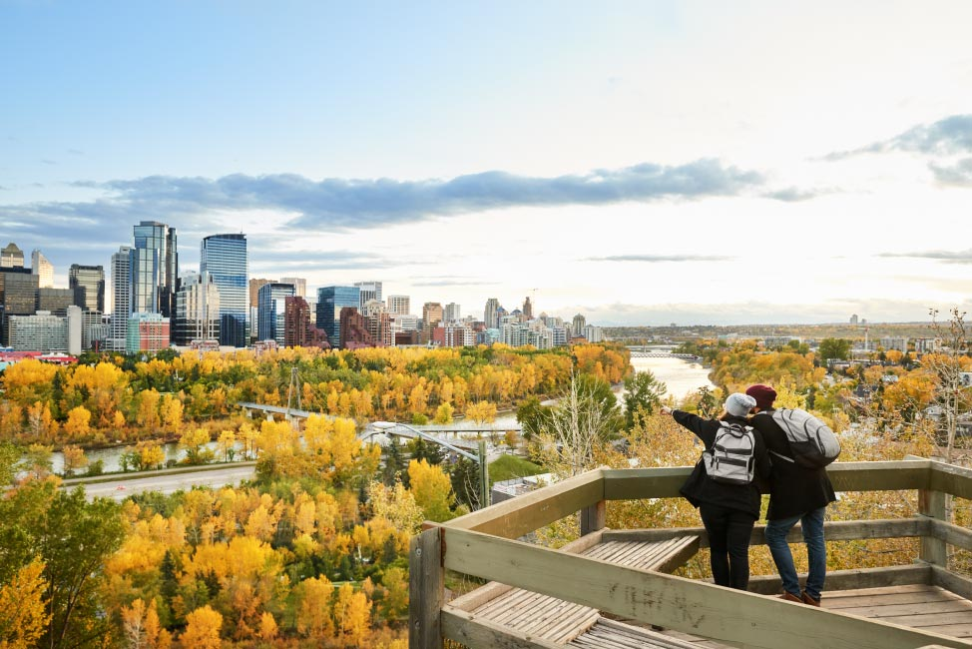
Background: Project Topic
Main topics
  Environmental equity
  The urban forest
  Distribution of public trees
The topic of environmental justice has received considerable attention.
(Astell-Burt et al., 2014; Landry & Chakraborty, 2009, Potestio et al., 2009; Smoyer-Tomic et al., 2004).
Figure 2: A view of the city center in Calgary.
Image source: https://www.pods.com/blog/2021/12/calgary-neighbourhoods/

Slide 5
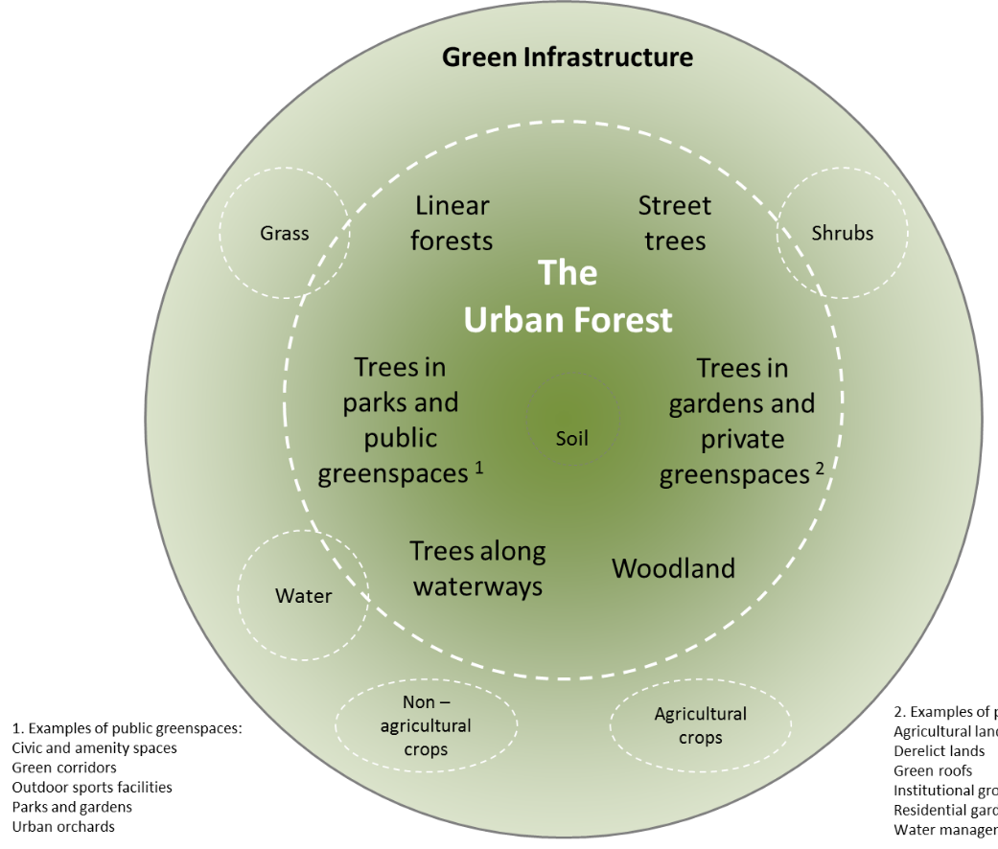
Background: Project Importance
The urban forest is an extremely important environmental amenity.
What is the urban forest?
“All the trees in the urban realm..”
(Davies & Doick, 2017; Nowak, 1994)
Urban forests provide tangible and intangible benefits to urban dwellers.
Figure 3: The urban forest components.
Image source: Davies & Doick, 2017.

Slide 6
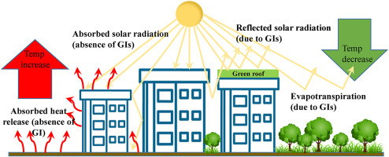
Background: Urban Forest Benefits
Reduce the impact of stormwater runoff (Livesley et al., 2016)
Ameliorating effect on warmer and dryer city climate (Salmond et al., 2016)
Positive impact on health risk factors of urban dwellers (Takano et al., 2002; Potestio et al., 2009).
Positive impact on residential property values (Donovan & Butry, 2011)
Crime rate reduction (Troy et al., 2012)
Image source:
Tiwari et al., 2021
Figure 4: Green infrastructure (GI) and heat island formation.

Slide 7
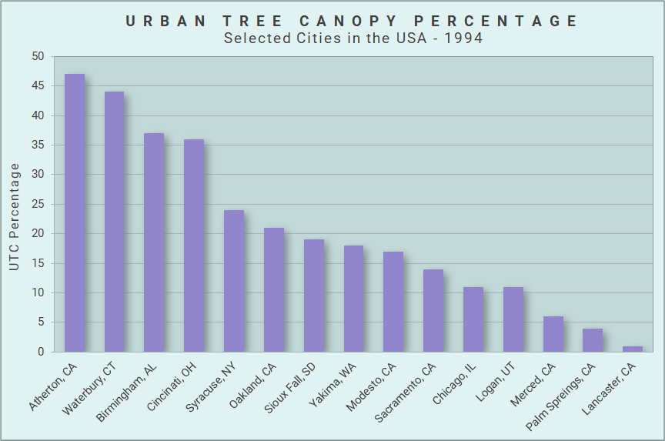
Background: Urban Tree Canopy Distribution
What is the typical distribution of urban tree canopy (UTC) in a city?
Figure 5: Distribution of UTC percentage by city in the USA (Nowak, 1994) .

Slide 8
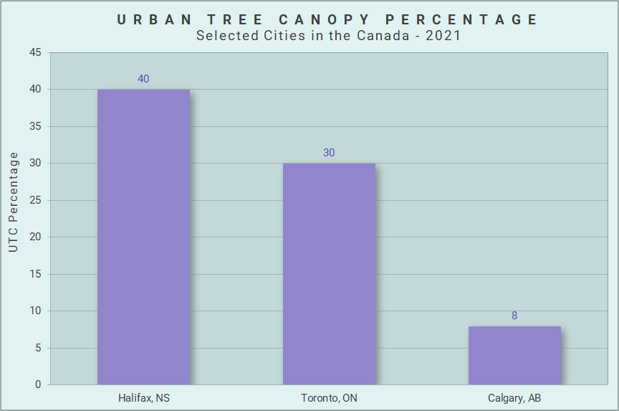
Background: Urban Tree Canopy Distribution (cont.)
What is the typical distribution of urban tree canopy (UTC) in a city?
Figure 6: Distribution of UTC percentage by city, in Canada
(Alexander et al., 2014; Lambert, 2021; McGovern et al., 2016).

Slide 9
Background: UTC Distribution and Social Inequality
The distribution of UTC within a city may vary considerably from one neighbourhood to the next.
Several studies have found strong correlates between the distribution of UTC and different socioeconomic variables.
Figure 7: Relationship between UTC and race in Sacramento (Schwarz et al., 2015)

Slide 10

Background: Socioeconomic Variables
Most commonly used socio-economic variables
Single variable studies: Income or poverty line
(Astell-Burt et al., 2014; Green et al., 2017).
Multivariable studies: Income, education level, household tenure (Krafft & Fryd, 2016; Schwarz et al., 2015; Tooke et al., 2010)
Composite variables and indexes - Gini index
(Luck et al., 2009; Nyelele & Kroll, 2020; Volin et al., 2020)
Figure 8: Graph representing different variables.
Image source: https://www.ghostranch.com/blog/clip-art-tbt-graphs

Slide 11
Background: Demographic Variables
Most commonly used demographic variables
Race: Percentage of African Americans
Ethnicity: Percentage of Hispanics
  (Koo et al., 2019; Landry & Chakraborty, 2009; Schwarz et al., 2015; Nyelele & Kroll, 2020)
Figure 8: Graph representing different variables.
Image source: https://www.ghostranch.com/blog/clip-art-tbt-graphs

Slide 12
Background: Quantifying UTC Distribution
How were measures of UTC obtained?
High-resolution satellite imagery or aerial photography of public and private property.
(Green et al., 2017; Volin et al., 2020; Walton et al., 2008)
High-resolution satellite imagery only for trees on the public right-of-way. (Landry & Chakraborty, 2009)
Figure 9: High-resolution imagery of Calgary.
Image source: https://maps.calgary.ca/CalgaryImagery/Imagery/

Slide 13
Part II
1. Project Background
2. Project Objectives
3. Project Methodology
4. Anticipated Results
5. Project Timeline
6. Presentation Venue

Slide 14
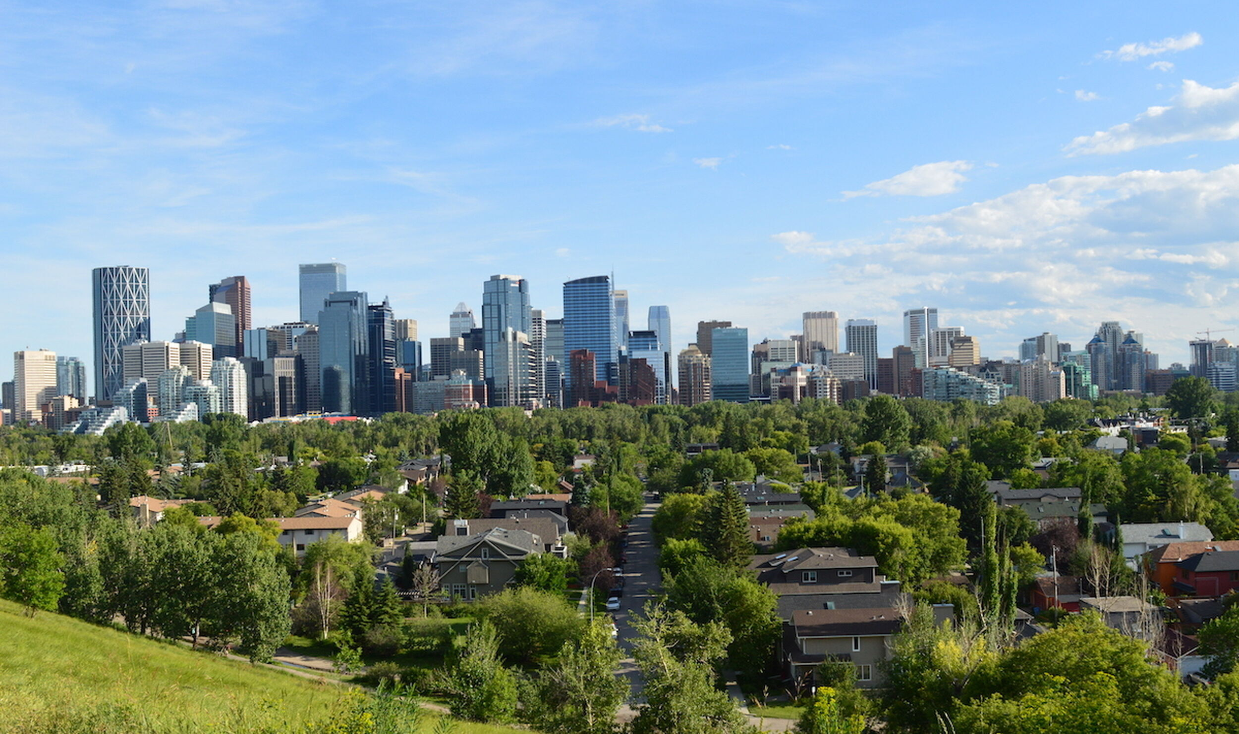
Objectives: Research Questions
What is the distribution of public trees in the residential communities within the city of Calgary?
Can the distribution of trees be explained by the socioeconomic disparities that exist within the city?
Figure 10: A residential community in Calgary.
Image source: https://www.sprawlcalgary.com/calgary-urban-forest

Slide 15
Objectives: The Study Area - Calgary, Alberta
Calgary
Map source: ArcGIS Pro – World Street Map: ESRI, FAO, NOAA, USGS, EPA
Figure 11: Location of the study area - 51° north and 114° west.

Slide 16
Objectives: The Study Area – Main Characteristics
Important Characteristics
Third largest city in Canada:
1.3 million people
(Statistics Canada, 2022)
Total area: 848.2 Sq. Km. - similar to San Diego, CA.
The second largest Canadian city in terms of social inequality
(Townsend et al., 2018)
Figure 12: Calgary city boundary.
Map source: ArcGIS Pro – Light Gray Canvas – Esri Canada, Esri, Garmin, Garmin, SafeGraph, METI/NASA, USGS, EPA, USDA, NRCan, Parks Canada.

Slide 17
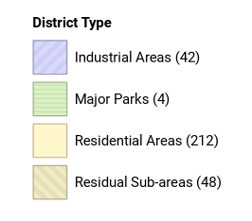
Objectives: The Study Area - Administrative Units
The enumeration units in the study area are “community districts”.
Only the residential community districts will be included in the study.
A total of 202 residential community districts will be included.
Figure 13 shows the
base map layer.
Administrative Units in Calgary
Figure 13: Administrative units in Calgary.

Slide 18
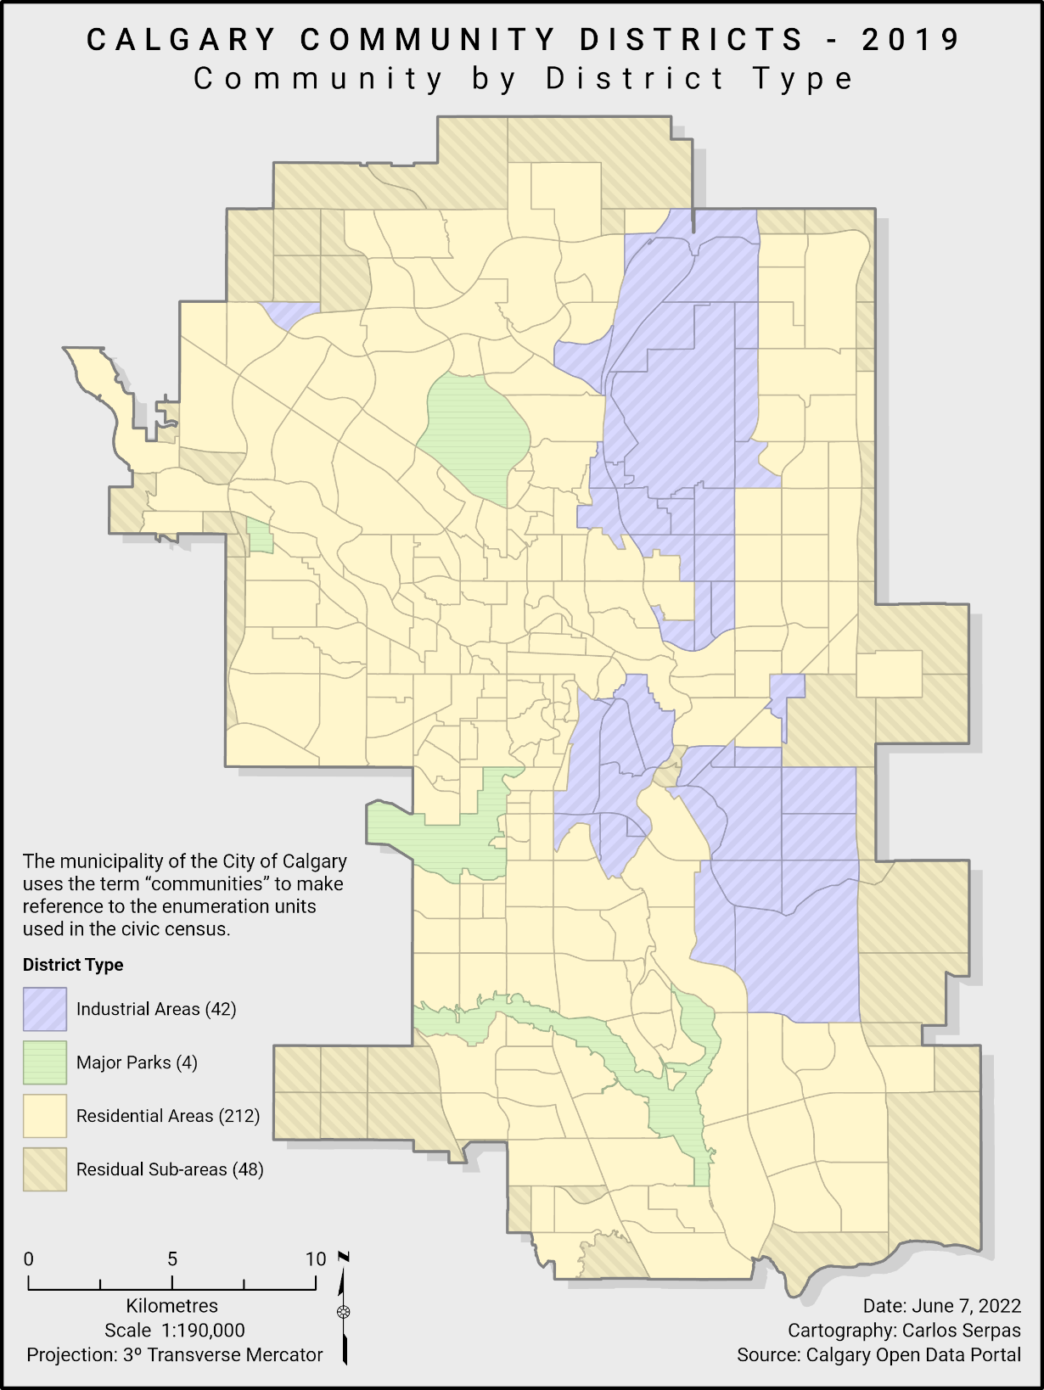
Figure 13a:
This is a complete layout
of the map in the previous
slide.

Slide 19
Objectives: Alternative Enumeration Units
Geographic areas used in the Canadian census:
Provinces
Census Divisions
Census Subdivisions
Census Tracts
Dissemination Areas
Census Blocks
Figure 14: Geographic entities used in the Canadian census.
Image source: https://www12.statcan.gc.ca/census-recensement/2016/ref/dict/figures/f1_1-eng.cfm

Slide 20
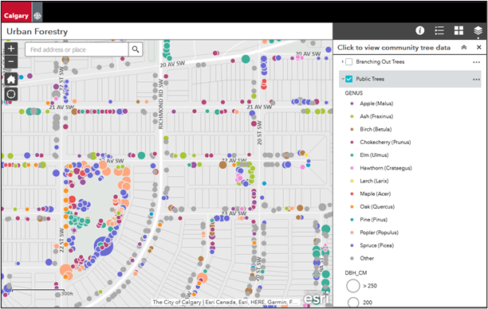
Objectives : Obtaining the Tree Distribution Data
How to obtain a measure of tree distribution?
Figure 15: Web map application showing the city-owned trees in Calgary.
Image source: https://maps.calgary.ca/TreeSchedule/

Slide 21
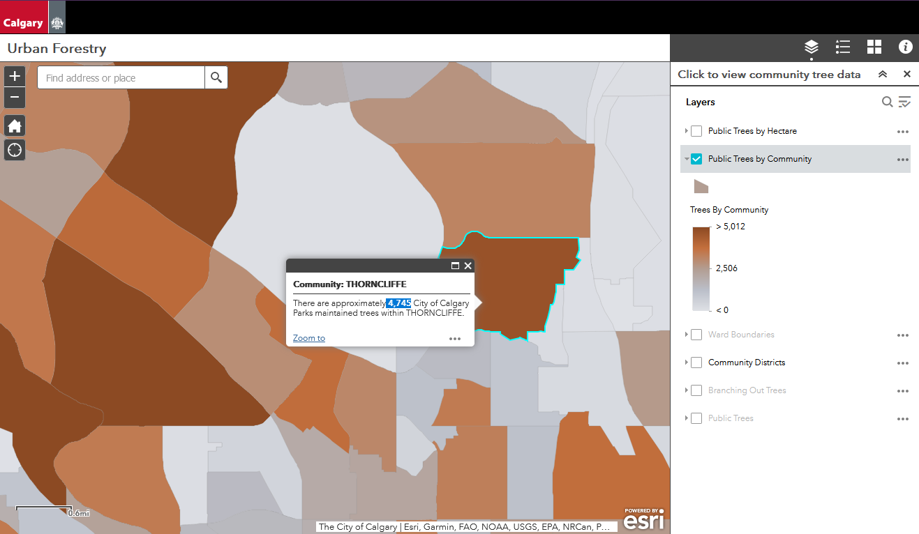
Objectives: Tree Distribution Data - Alternate Dataset
In case the data is not available to the public.
Figure 16: Web map application used to obtain the alternate dataset.
Image source: https://maps.calgary.ca/TreeSchedule/

Slide 22
Objectives: Tree Data - Spatial Distribution
The spatial distribution of trees is shown in Figure 17.
Characteristics of the distribution:
  443,057 trees
  Minimum number: 131
  Maximum number: 9,193
  Mean: 2,193
  Standard Deviation: 1,564
Public Tree Distribution in Calgary
Figure 17: Public tree distribution in Calgary.

Slide 23
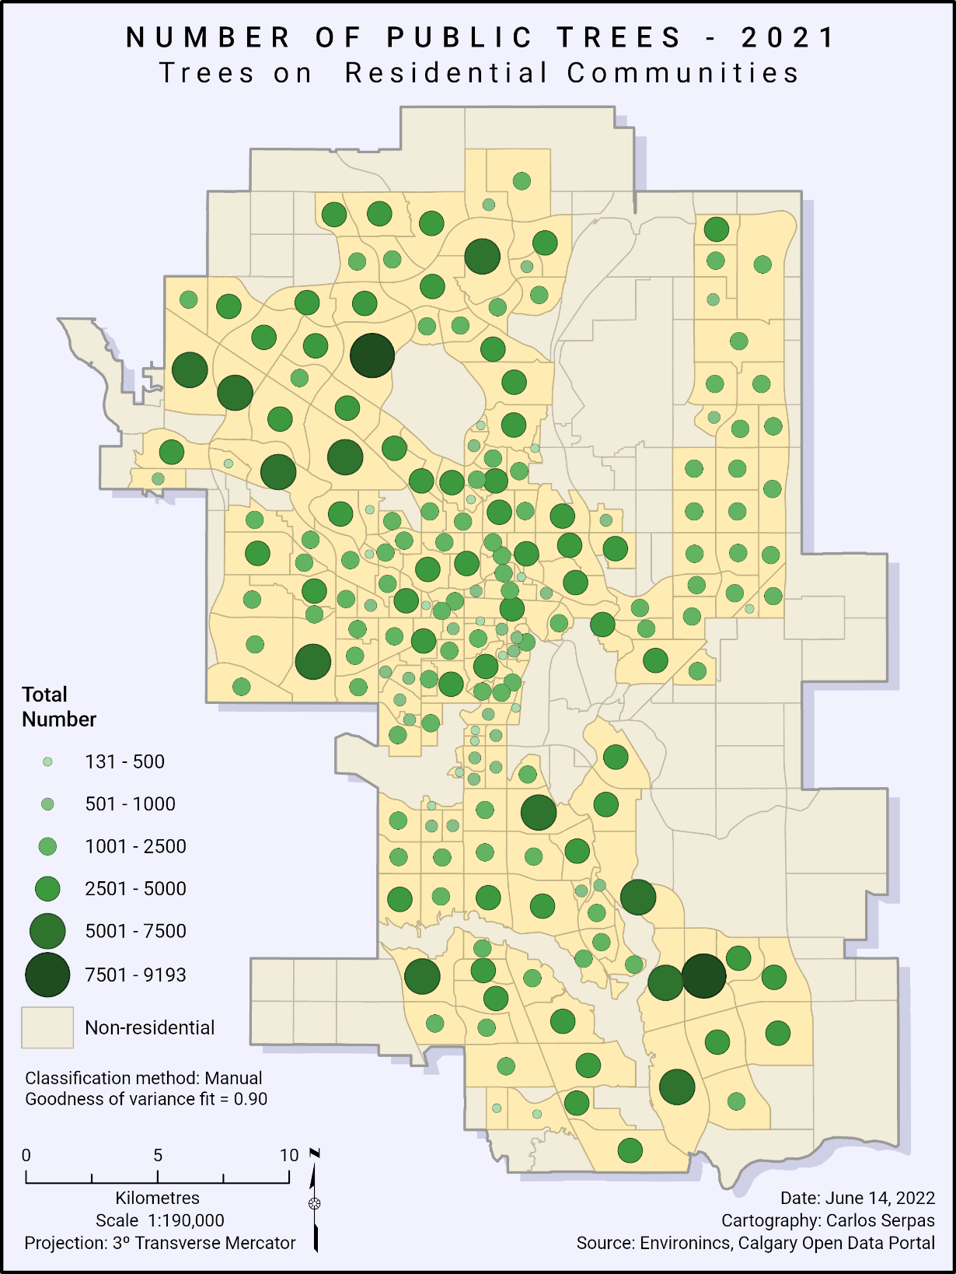
Figure 17a:
This is a complete layout
of the map in the previous
slide.

Slide 24
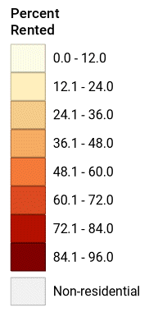
Objectives : Obtaining the Socioeconomic Data
Important socioeconomic variables:
  Median household income
  Household tenure
  (owned vs rented houses)
  Number of visible minorities
Percent of Rented Households
Figure 18: Percent of rented households in Calgary.

Slide 25
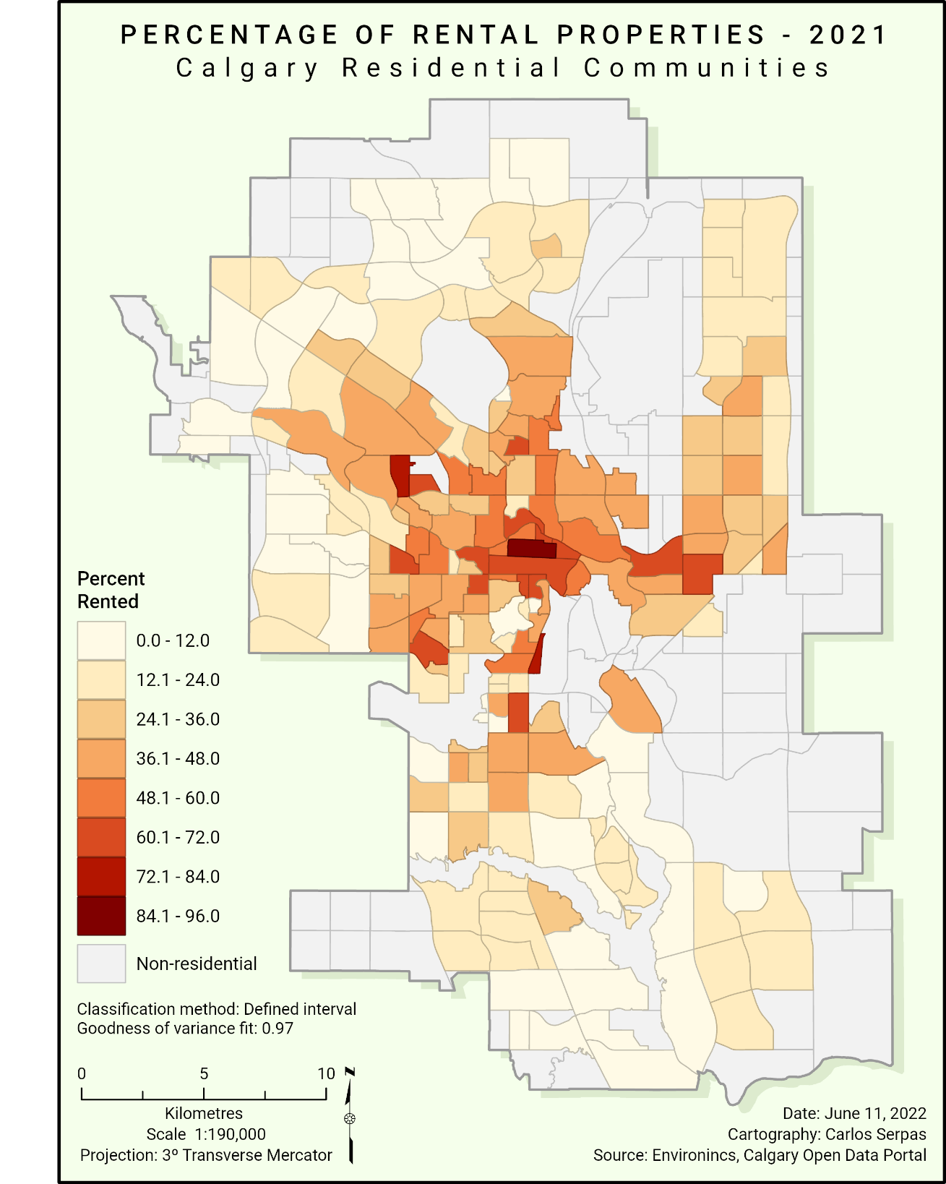
Figure 18a:
This is a complete layout
of the map in the previous
slide.

Slide 26
Part III
1. Project Background
2. Project Objectives
3. Project Methodology
4. Anticipated Results
5. Project Timeline
6. Presentation Venue

Slide 27
Methodology: General Methods
Data capture, manipulation, and preliminary data analysis
Download shapefiles and relevant data
Data scrubbing and manipulation
Geodatabase design and data integration
Preliminary data analysis and visualization
Figure 19: Methods for performing preliminary data analysis.

Slide 28
Methodology: Methods for Each Set of Variables
Analysis of Data on Public Trees
Public Trees
Standardize Data
by Community District
Statistical Analysis
Spatial Analysis:
Spatial Autocorrelation
Analysis of Socioeconomic and Demographic Variables
Socioeconomic
Variables
Standardize Data
by Community District
Statistical Analysis
Spatial Analysis:
Spatial Autocorrelation
Figure 20: Methods for analyzing each set of variables.

Slide 29
Methodology: Modelling Spatial Relationships
The objective is to determine the relationship between the distribution of public trees and relevant socioeconomic indicators.
Public Trees
Possible Methods for Examining Relationships
Multivariate Analysis:
Correlation
Multivariate Analysis:
Regression
Multivariate Analysis:
Spatial
Regression
Socioeconomic variables
Income
Household tenure
Visible Minorities
Other variables
Figure 21: Methods for analyzing spatial relationships.

Slide 30
Part IV
1. Project Background
2. Project Objectives
3. Project Methodology
4. Anticipated Results
5. Project Timeline
6. Presentation Venue

Slide 31
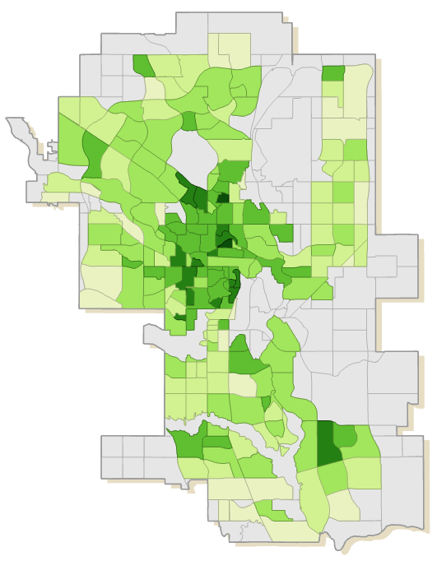
Expected Results: Tree Data
A priori assumptions:
There is an uneven distribution of public trees throughout the city.
Public Tree Density in Calgary
Figure 22: Public tree density in Calgary.

Slide 32
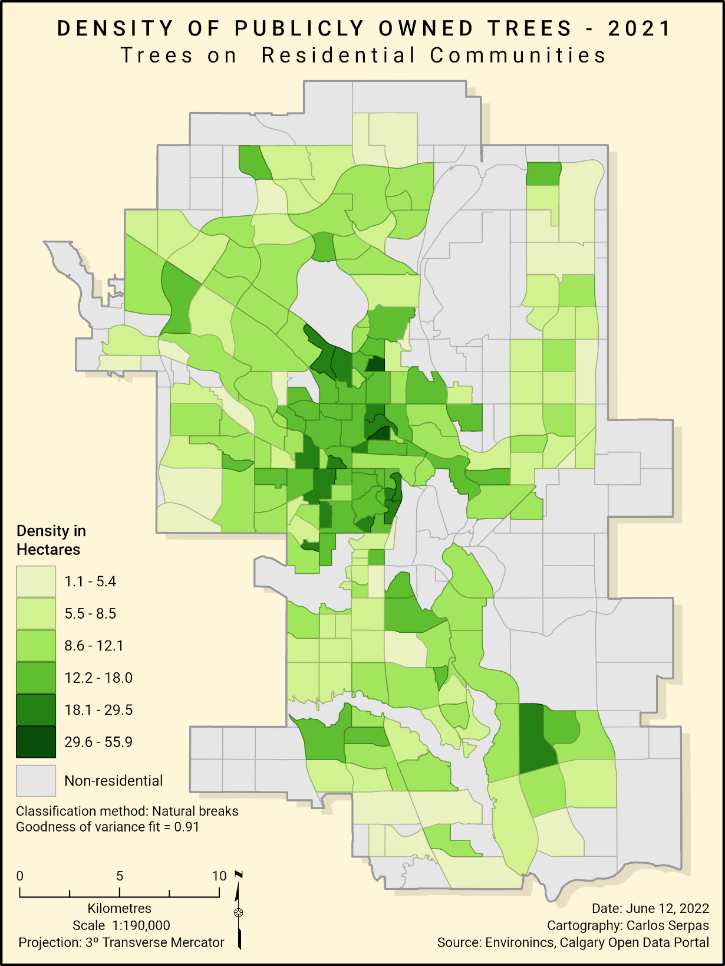
Figure 22a:
This is a complete layout
of the map in the previous
slide.

Slide 33
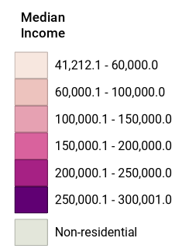
Expected Results: Socioeconomic Variables
A priori assumptions:
There is substantial socioeconomic inequality throughout the city.
Median Household Income in Calgary
Figure 23: Median household income in Calgary.

Slide 34
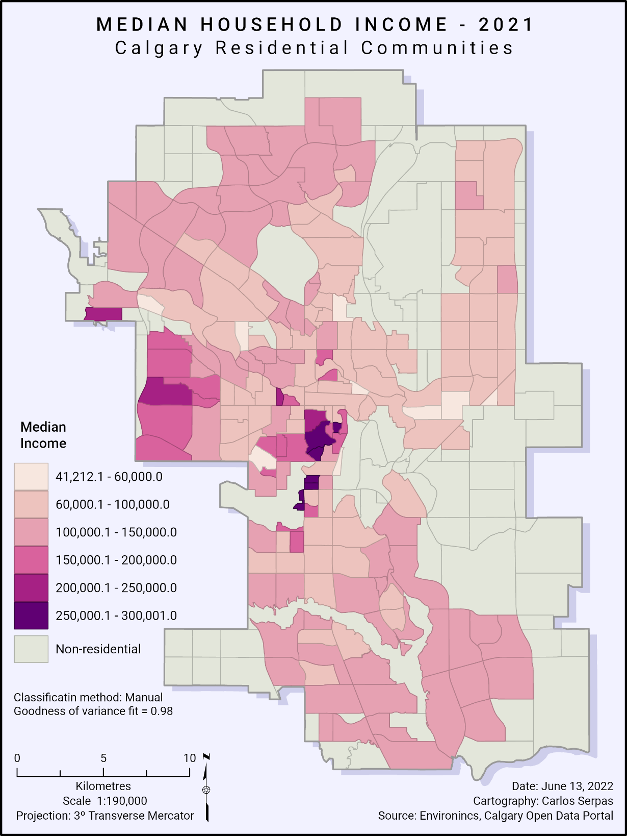
Figure 23a:
This is a complete layout
of the map in the previous
slide.

Slide 35
Part V
1. Project Background
2. Project Objectives
3. Project Methodology
4. Anticipated Results
5. Project Timeline
6. Presentation Venue

Slide 36
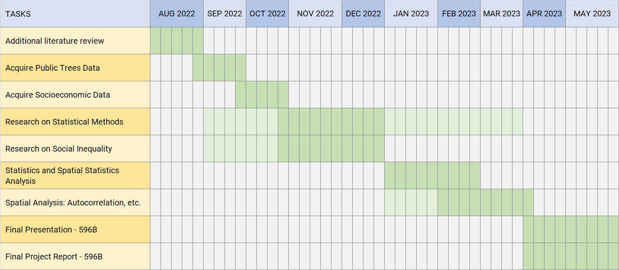
Project Timeline: Schedule
The course GEOG 596B will be completed in the summer of 2023.
Figure 24: Project Schedule

Slide 37
Part VI
1. Project Background
2. Project Objectives
3. Project Methodology
4. Anticipated Results
5. Project Timeline
6. Presentation Venue

Slide 38

Presentation Venue: ESRI Education Summit 2023
The intention is to present this project at the ESRI Education Summit.
The summit usually takes place in June or July.
2023

Slide 39
References
Alexander, C., & McDonald, C. (2014, June 9). Urban forests: the value of trees in the city of Toronto. TD Economics, 1-4. https://economics.td.com/urban-forests-toronto
Astell-Burt, T., Feng, X., Mavoa, S., Badland, H. M., & Giles-Corti, B. (2014). Do low-income neighbourhoods have the least green space? A cross-sectional study of Australia’s most populous cities. BMC Public Health, 14 (1), 1-11. https://doi.org/10.1186/1471-2458-14-292
Conway, T. M., & Bourne, K. S. (2013). A comparison of neighborhood characteristics related to canopy cover, stem density and species richness in an urban forest. Landscape and Urban Planning, 113, 10–18. https://doi.org/10.1016/j.landurbplan.2013.01.005
Davies, H. J. & Doick, K. J. (2017) Are all urban forests equally beneficial? Institute of Chartered Foresters. https://www.charteredforesters.org/urban-forest-equally-beneficial
Doick, Kieron & Davies, Helen. (2016). What are urban forests and how beneficial are they? The ARB Magazine. 48-50. https://www.researchgate.net/publication/311582274_What_are_urban_forests_and_how_beneficial_are_they/link/584ec31408aeb989252c982b/download
Donovan, G. H., & Butry, D. T. (2011). The effect of urban trees on the rental price of single-family homes in Portland, Oregon. Urban Forestry and Urban Greening, 10 (3), 163–168. https://doi.org/10.1016/j.ufug.2011.05.007
Gauvin, L., Robitaille, É., Riva, M., Mclaren, L., Dassa, C., & Potvin, L. (2007). Conceptualizing and operationalizing neighbourhoods: The conundrum of identifying territorial units. Revue Canadienne de Santé Public, 98 (1), 18-26. https://www.jstor.org/stable/41994835
Greene, C. S., Robinson, P. J., & Millward, A. A. (2018). Canopy of advantage: Who benefits most from city trees? Journal of Environmental Management, 208, 24–35. https://doi.org/10.1016/j.jenvman.2017.12.01

Slide 40
References
Koo, B. W., Boyd, N., Botchwey, N., & Guhathakurta, S. (2019). Environmental equity and spatiotemporal patterns of urban tree canopy in Atlanta. Journal of Planning Education and Research, 42 (2), 1-16. https://doi.org/10.1177/0739456X19864149
Krafft, J., & Fryd, O. (2016). Spatiotemporal patterns of tree canopy cover and socioeconomics in Melbourne. Urban Forestry and Urban Greening, 15, 45–52. https://doi.org/10.1016/j.ufug.2015.10.011
Lambert, T. (2021, May). The importance of Calgary’s urban forest. Avenue Calgary, 28-33. https://issuu.com/redpointmedia/docs/a-05-21-digital
Landry, S. M., & Chakraborty, J. (2009). Street trees and equity: Evaluating the spatial distribution of an urban amenity. Environment and Planning A: Economy and Space, 41 (11), 2651–2670. https://doi.org/10.1068/a41236
Livesley, S. J., McPherson, E. G., & C. Calfapietra (2016). The Urban Forest and Ecosystem Services: Impacts on Urban Water, Heat, and Pollution Cycles at the Tree, Street, and City Scale. Journal of Environmental Quality, 45 (1), 119-124. DOI: 10.2134/jeq2015.11.0567
Luck, G. W., Smallbone, L. T., & O’Brien, R. (2009). Socio-economics and vegetation change in urban ecosystems: Patterns in space and time. Ecosystems, 12 (4), 604–620. https://doi.org/10.1007/s10021-009-9244-6
McGovern, M., & Pasher, J. (2016). Canadian urban tree canopy cover and carbon sequestration status and change 1990–2012. Urban Forestry & Urban Greening, 20, 227-232. https://doi.org/10.1016/j.ufug.2016.09.002
Nyelele, C., & Kroll, C. N. (2020). The equity of urban forest ecosystem services and benefits in the Bronx, NY. Urban Forestry and Urban Greening, 53, 1-13. https://doi.org/10.1016/j.ufug.2020.126723

Slide 41
References
Nowak, D. J. (1994). Understanding the structure of an urban forest. Journal of Forestry, 92 (10), 1994. 42-46. https://www.nrs.fs.fed.us/pubs/8921
Peckham, S. C., Duinker, P. N., & Ordóñez, C. (2013). Urban forest values in Canada: Views of citizens in Calgary and Halifax. Urban Forestry and Urban Greening, 12 (2), 154–162. https://doi.org/10.1016/j.ufug.2013.01.001
Potestio, M. L., Patel, A. B., Powell, C. D., McNeil, D. A., Jacobson, R. D., & McLaren, L. (2009). Is there an association between spatial access to parks/green space and childhood overweight/obesity in Calgary, Canada? International Journal of Behavioral Nutrition and Physical Activity, 6, 1-10. https://doi.org/10.1186/1479-5868-6-77
Salmond, J, Tadaki, M., Vardoulakis, S., Arbuthnott, K., Coutts, A., Demuzere, M., Dirks, K., Heaviside, C., Lim, S., Macintyre, H., McInnes, R., & Wheeler, B. (2016). Health and climate related ecosystem services provided by street trees in the urban environment. Environmental Health, 15 (1), 95-111. https://doi.org/10.1186/s12940-016-0103-6
Schwarz, K., Fragkias, M., Boone, C. G., Zhou, W., McHale, M., Grove, J. M., O’Neil-Dunne, J., McFadden, J. P., Buckley, G. L., Childers, D., Ogden, L., Pincetl, S., Pataki, D., Whitmer, A., & Cadenasso, M. L. (2015). Trees grow on money: Urban tree canopy cover and environmental justice. PLoS ONE, 10 (4), 1-17. https://doi.org/10.1371/journal.pone. 0122051
Smoyer-Tomic, K. E., Hewko, J. N., & Hodgson, M. J. (2004). Spatial accessibility and equity of playgrounds in Edmonton, Canada. The Canadian Geographer, 48 (3), 287-302. https://doi.org/10.1111/j.0008-3658.2004.00061.x
Statistics Canada (November 17, 2021). Dictionary, census of population, 2021: Census tract (CT). Retrieved from: https://www12.statcan.gc.ca/census-recensement/2021/ref/dict/az/Definition-eng.cfm?ID=geo013
Statistics Canada (February 9, 2022). Canada’s fastest growing and decreasing municipalities from 2016 to 2021. Retrieved from: https://www12.statcan.gc.ca/census-recensement/2021/as-sa/98-200-x/2021001/98-200-x2021001-eng.cfm

Slide 42
References
Takano, T., Nakamura, K., & Watanabe, M. (2002). Urban residential environments and senior citizens longevity in megacity areas: the importance of walkable green spaces. Journal of Epidemiology and Community Health, 56 (12), 913-918. https://jech.bmj.com/content/jech/56/12/913.full.pdf
The City of Calgary (n.d.). [Urban forestry web map application]. Retrieved June 11, 20200 from https://maps.calgary.ca/TreeSchedule/
The City of Calgary (May 18, 2022). Community district boundaries. Retrieved from https://data.calgary.ca/Base-Maps/Community-District-Boundaries/surr-xmvs
Tiwari, A., Kumar, P. Kalaiarasan, G., & Ottosen, T. B. (2021). The impacts of existing and hypothetical green infrastructure scenarios on urban heat island formation. Environmental Pollution, 274, 1-14. https://doi.org/10.1016/j.envpol.2020.115898
Tooke, T. R., Klinkenberg, B., & Coops, N. C. (2010). A geographical approach to identifying vegetation-related environmental equity in Canadian cities. Environment and Planning B: Planning and Design, 37 (6), 1040–1056. https://doi.org/10.1068/b36044
Troy, A., Grove, J. M., & O'Neil-Dunne, J. (2012). The relationship between tree canopy and crime rates across an urban–rural gradient in the greater Baltimore region. Landscape and Urban Planning, 106 (3), 262-270. https://doi.org/10.1016/j.landurbplan.2012.03.010
Townshend, I., Miller, B., & Evans, L. (2018) Socio-Spatial Polarization in an Age of Income Inequality: An Exploration of Neighbourhood Change in Calgary’s “Three Cities”. Neighbourhood Change Research Partnership, University of Toronto. Retrieved from http://neighbourhoodchange.ca/?s=Socio-Spatial+Polarization+in+an+Age+of+Income+ Inequality%3A

Slide 43
References
Volin, E., Ellis, A., Hirabayashi, S., Maco, S., Nowak, D. J., Parent, J., & Fahey, R. T. (2020). Assessing macro-scale patterns in urban tree canopy and inequality. Urban Forestry and Urban Greening, 55, 1-8. https://doi.org/10.1016/j.ufug.2020.126818
Walton, J. T., Nowak, D. J., & Greenfield, E. J. (2008). Assessing urban forest canopy cover using airborne or satellite imagery. Arboriculture & Urban Forestry, 34 (6), 334-340. https://www.nrs.fs.fed.us/pubs/jrnl/2008/nrs_2008_walton_002.pdf

Slide 44

Questions

