Slide 1
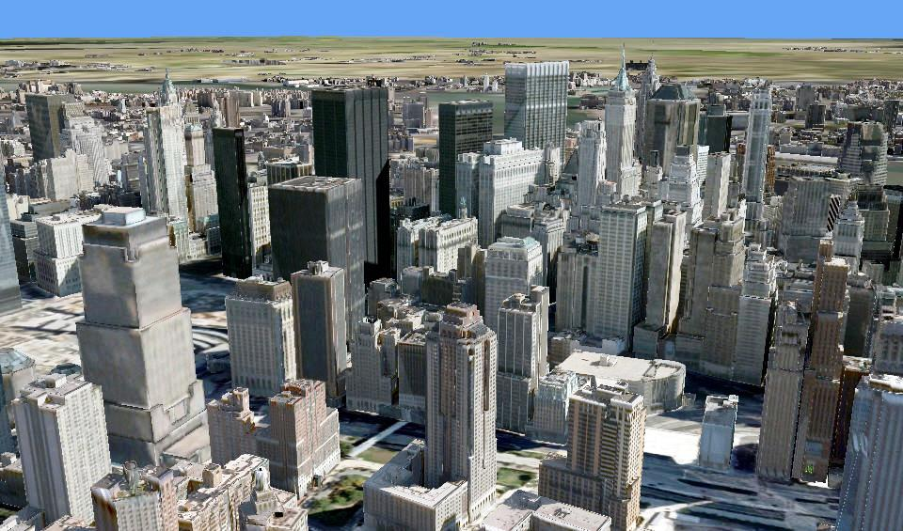
Leveraging GIS for Projecting Data in Virtual Earth
Jason Setzer – Penn State University

Slide 2
Contents
MGIS Capstone Presentation
Introduction
Project Background
Production Overview
Problem Description
Tackling the Problem – Model Registration
Conclusions/Results
Jason Setzer – Penn State University
Notes:
Introduction of self, quick career background, team info

Slide 3
Introduction
Jason Setzer – MGIS Candidate
Completed my undergraduate degree at Louisiana State University
I’ve worked in the Mapping/GIS industry since 1997
I work at Microsoft as Program Manager – Production Planning Lead
I joined MS at the inception of the 3D Virtual Earth campaign where I lead as small team who uses GIS to manage the 3D buildings content of VE, including vendor outsourcing, quality control, landmark modeling, etc.
Jason Setzer – Penn State University
Notes:
Introduction of self, quick career background, team info

Slide 4
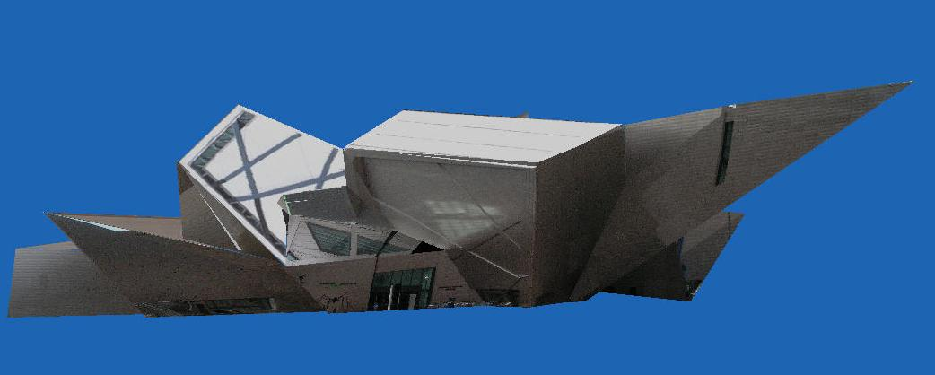
What Is Virtual Earth?
“The Microsoft Virtual Earth platform is an integrated set of services that provides quality geospatial data, rich imagery, cutting-edge technology, and dependable performance…”
– Microsoft 2008
Among its many data offerings, the heart of the VE experience centers on photorealistic 3D textured buildings.
Jason Setzer – Penn State University
Notes:
Quick synopsis of what VE is

Slide 5
Where Does GIS Fit IN?
Microsoft is a Software Company
The model for Virtual Earth was to first create a highly automated software solution that could be used to produce the desired content for multiple cities.
The VE design team consists largely of developers, testers, and program managers – experts in process management, software development, and even 3D modeling.
Jason Setzer – Penn State University
Notes:
Microsoft Software Dev point of view – Design a system paradigm.

Slide 6
Where Does GIS Fit IN?
Despite the strength of the software development culture there remained some what of an unfamiliarity with industry practices relative to:
Mapping
GIS
Photogrammetry
Geo-Spatial Project Management
This is where I enter the picture: with the task of taking internal software tools and applying GIS production workflows and project management approaches for the purposes of Virtual Earth content creation.
Jason Setzer – Penn State University
Notes:
Remote sensing shortcomings

Slide 7
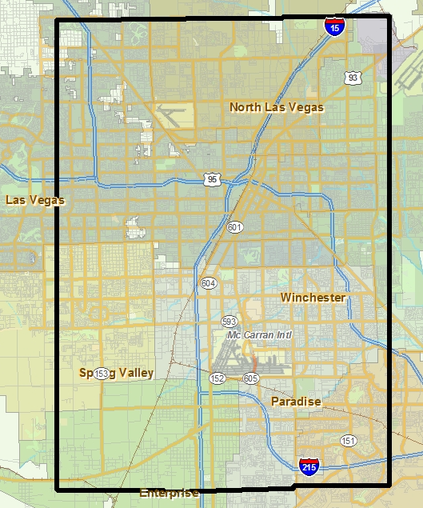
Production Overview
In Microsoft’s VE Production Group
project areas and priorities are determined by factors like:
Population
Income
Connectivity
Online Search Usage
Ambitious goals include producing hundreds of world wide cities with full 3D textured building models.
Jason Setzer – Penn State University
Notes:
Production Overview – Choosing project areas – State 100 cities in the first year

Slide 8
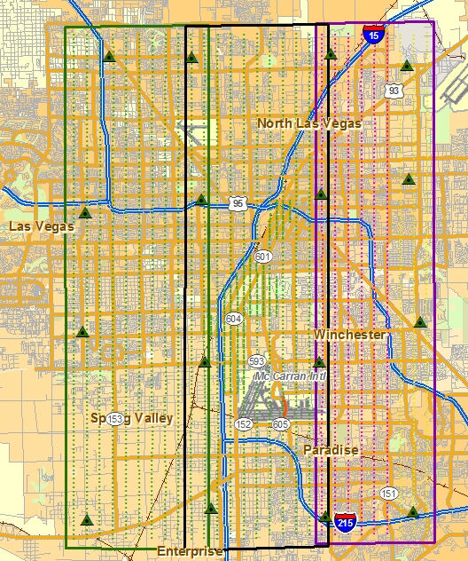
Production Overview
Production commences upon the receipt of:
Aerial Imagery
Surveyed Ground Control
Digital Elevation Data
The bundle adjustment precisely calculates the exterior orientation of each image in the project.
A required input to 3D textured building production are digitized rooftop outlines.
Modeling and creation of rooftop DXFs is undertaken at the completion of an aerial bundle.
Jason Setzer – Penn State University
Notes:
Production Overview – necessary components of 3D textured buildings pipeline: roofline DXFs

Slide 9
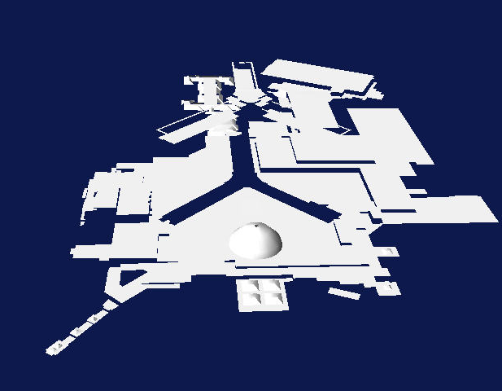
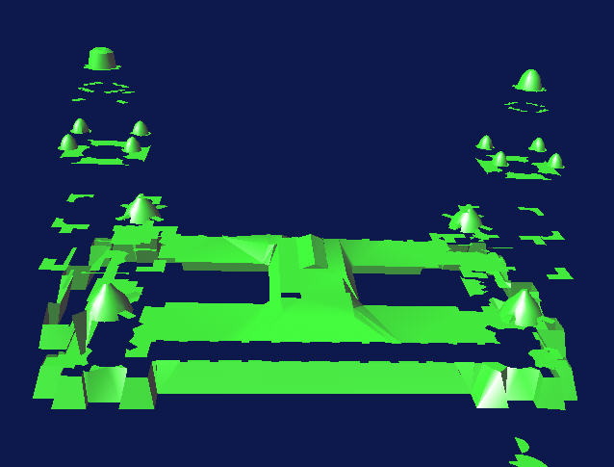
Building PipeLine
Vendors digitize roof tops of buildings from stereo images and deliver the compiled models as TIN’ed DXF files.
Jason Setzer – Penn State University
Notes:
Operation of Buildings Pipeline: Buildings Completer

Slide 10
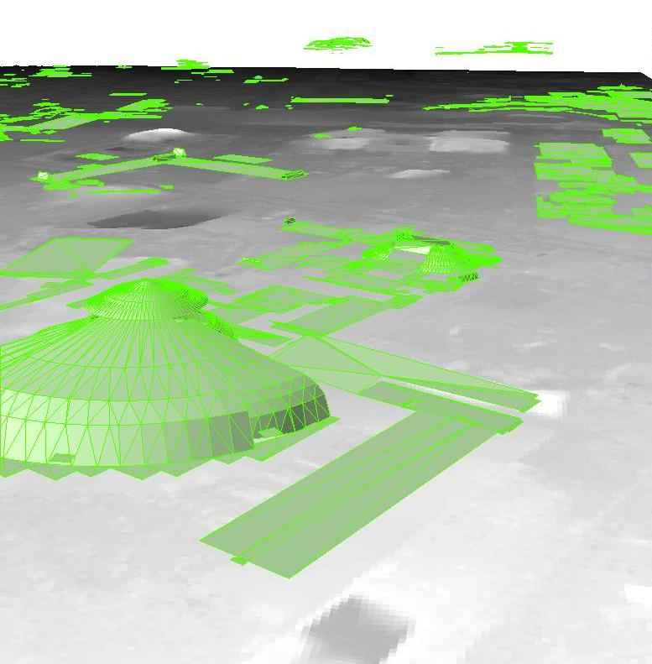
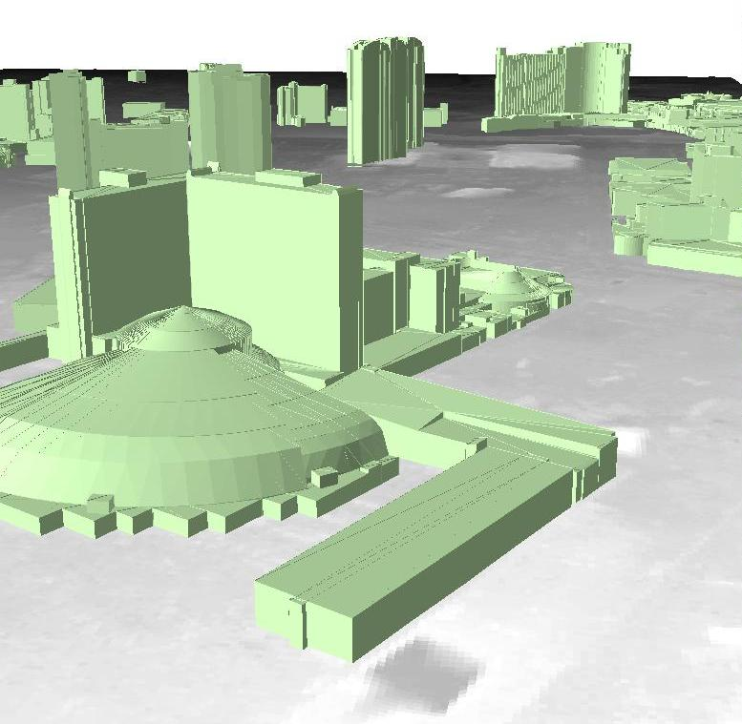
Building PipeLine
The rooftop DXFs are extruded to a terrain model to add buildings walls and complete the geometry.
Jason Setzer – Penn State University
Notes:
Operation of Buildings Pipeline: Extrude to DEM

Slide 11
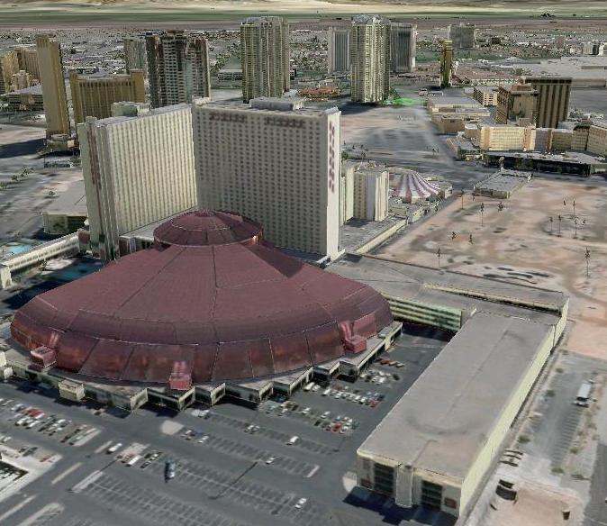
Building PipeLine
Textures for each facet are derived from aerial imagery to complete the photo textured final product.
Jason Setzer – Penn State University
Notes:
Operation of Buildings Pipeline: Texture Generator

Slide 12
Model Registration
“A problem frequently encountered in photogrammetric work is conversion from one rectangular coordinate system to another. This is because photogrammetrists commonly determine coordinates of unknown points in convenient arbitrary rectangular coordinate systems.” -Wolf and Dewitt, Elements of Photogrammetry
The Virtual Earth building texturing pipeline was built to use a local arbitrary coordinate system: Local Space Rectangular (LSR)
LSR offers an advantage of smaller coordinate values and file sizes
It also offers a convenient means of avoiding the implication of earth curvature when constructing the 3D models.
However, the “arbitrary” definition of an LSR coordinate system is not available to any C.O.T.S. reprojection utilities and changes with each project area.
Jason Setzer – Penn State University
Notes:
Fundamental Limitation: LSR Coordinate System

Slide 13
Model Registration
Version 1
The V1 vendor modeling criteria:
Compile everything greater than 3 stories
V1 Limitations:
All data is in DXF format
All data is in LSR coordinates
Extremely difficult to reference a specific file/building
Jason Setzer – Penn State University
Notes:
Building Compilation Management – Version 1 – Overview

Slide 14
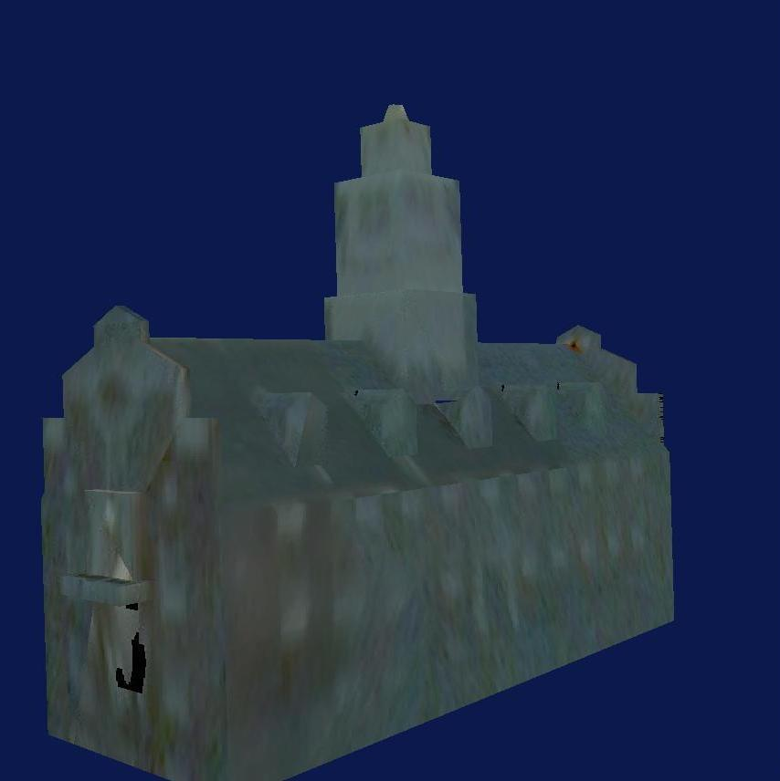
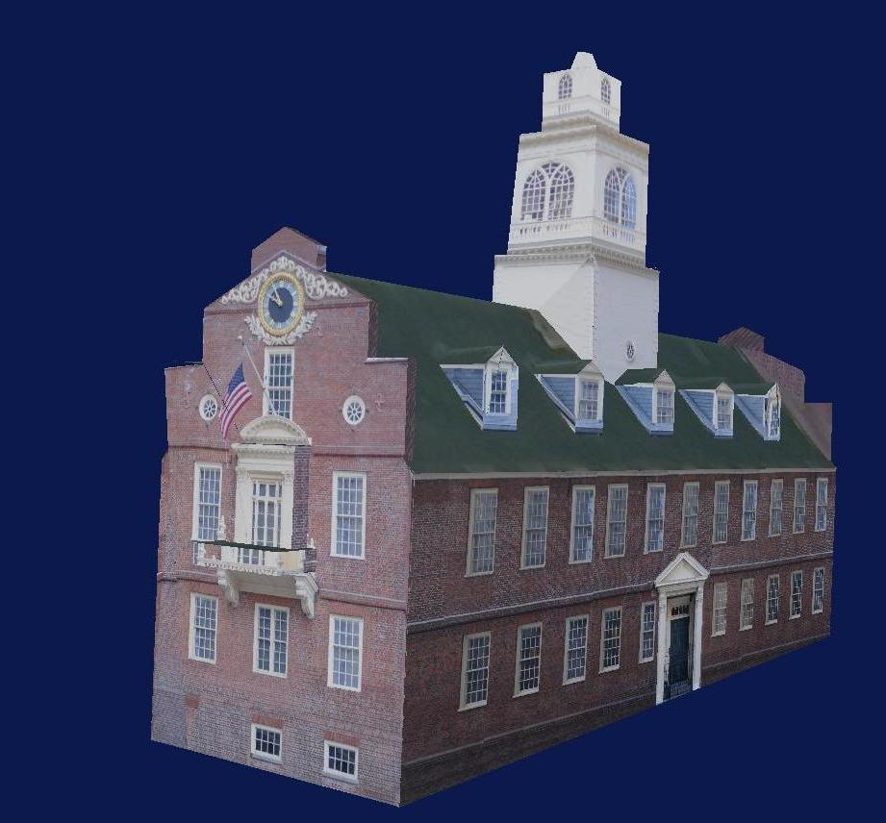
Model Registration
Version 1 Summary
“Wow that building looks bad, should we have it recompiled?”
“I don’t know, is it a really important one?”
“Hey, this building keeps failing in processing, can we abandon it?”
“I don’t know, is it significant?”
“So, did that really important landmark turnout OK?”
“Which file was it again?”
-Anyone working at Microsoft’s Boulder, Colorado office circa 2006.
Jason Setzer – Penn State University
Notes:
Building Compilation Management – Version 1, Quotes

Slide 15
Model Registration
“One man’s convenience is another man’s grief.” – Author Unknown
Despite the design convenience of building the 3D Textured Buildings pipeline to use arbitrary local space coordinates, there was fallout in terms of:
Quality:
Verifying the completeness of vendor deliverables.
Evaluating the severity/significance of buildings that have failed processing.
Ensuring that important landmarks, which are often the most complex and problematic, are included in the final data set.
Making sure that what is being invoiced corresponds with what is delivered and is desired.
Jason Setzer – Penn State University
Notes:
Building Compilation Management – Version 1, Practical Problems

Slide 16
Model Registration
Custom Tool
Requirements:
Convert DXFs to shapefile format
Full 3D representation of the tri-surface
Simplified Footprint
Nodes only version
Must retain original file name as an attribute
Optional height above DEM reference
Use GeoTrans as coordinate conversion engine to support at a minimum:
UTM
Geodetic
HAE heights
MSL heights
Response/Feedback:
Developer resources are maxed for several release cycles
Doesn't immediately impact fiscal year production goals
Other bugs/”must have” features taking precedence.
Jason Setzer – Penn State University
Notes:
Compilation Summary Tool Req. – then Manhattan Situation

Slide 17
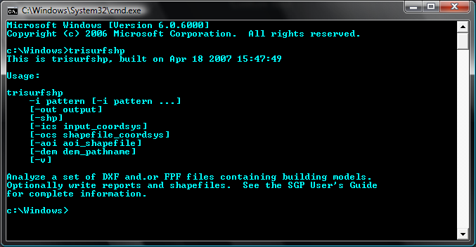
Model Registration
TriSurfShp.exe
Jason Setzer – Penn State University
Notes:
The resulting TriSurfShp tool

Slide 18
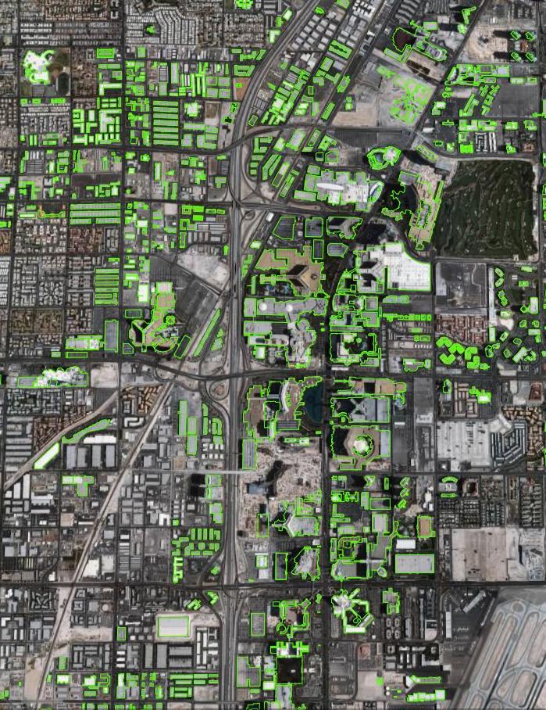
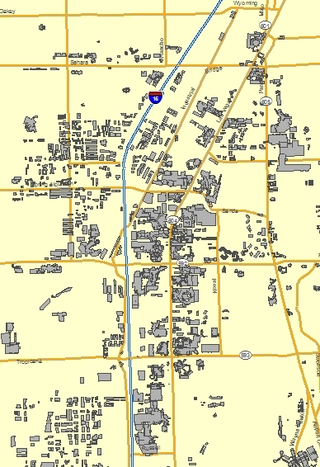
Model Registration
Version 2
Now Practical to:
Assess the completeness of deliverables.
Identify buildings which have failed processing.
Verify that essential buildings are in the data set.
Jason Setzer – Penn State University
Notes:
Version 2: TriSurfShp in action

Slide 19
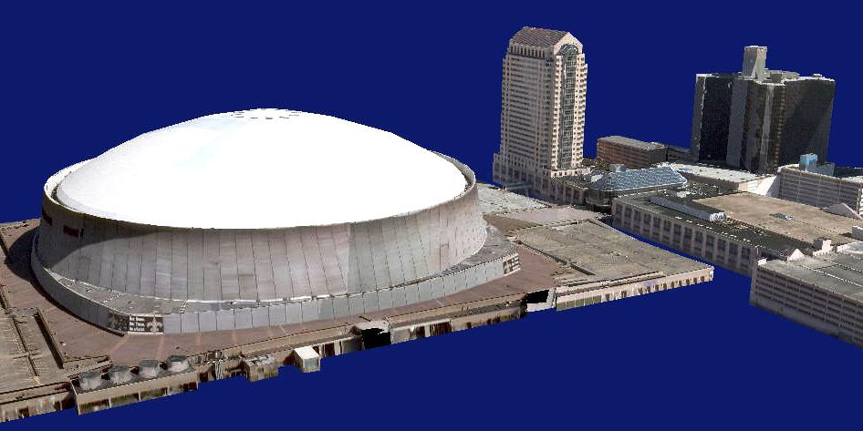
Model Registration
Version 2 Summary
Gains resulting from the TriSurfShp tool were significant, yet its impact was mainly limited to management and QC of received data.
The reverse problem of converting “guide” data, intended for use by vendors, into the unique LSR coordinate systems remained.
Jason Setzer – Penn State University
Notes:
Version2 Summary – Great for managing incoming data, alleviating processing bottlenecks.
TriSurfShp did not deal with the problem of managing vendor effort / create guide data

Slide 20
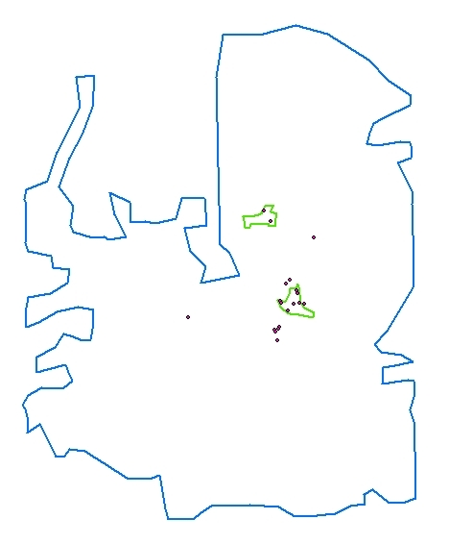
Model Registration
Program Management
To accomplish these objectives, it was decided to:
Delineate a compilation boundary
Create limited “priority” areas for regions that require more thorough treatment
Provide an exact spatial location for landmark type buildings that need highly detailed modeling
If a means to convert them to LSR could be devised…
Jason Setzer – Penn State University
Notes:
Unaddressed need to provide compilation boundary, priority areas, or landmark locations.

Slide 21
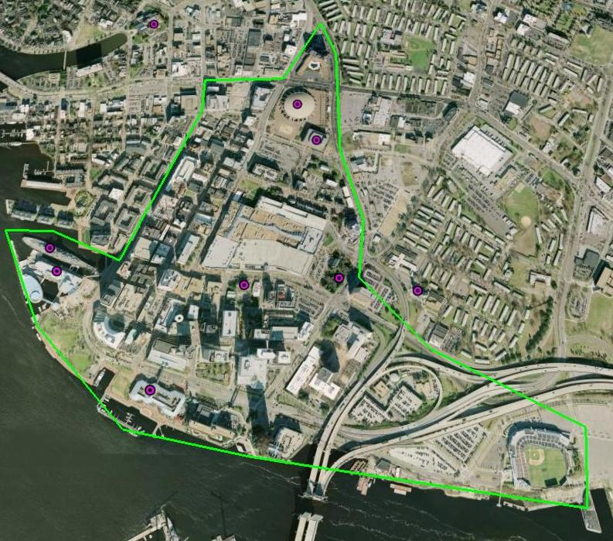
Model Registration
Program Management
Landmarks:
More popular structures are often the “landing zone” or “entry point” for VE users, especially new ones. Making a strong first impression furthers interest in the product, leading to return visits, and hopefully loyal customers.
Virtual Earth landmarks are models compiled to an even higher level of detail than general buildings. The locations of such structures are also explicitly flagged for vendors.
Jason Setzer – Penn State University
Notes:
Priority Buildings- drive the compilers right to landmarks (more experienced photogrammetrists).

Slide 22
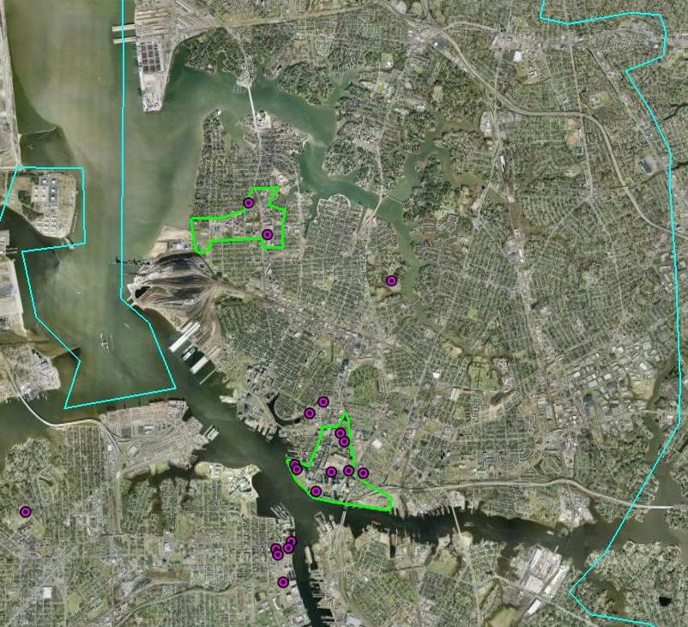
Model Registration
Program Management
Priority AOIs:
Priority areas, which require the most modeling time as100% of structures are typically compiled, are created. They consist of…
Downtown cores
Medical campuses
Sports Facilities
Tourist zones
Universities
Major commercial/retail zones
Office Parks
Jason Setzer – Penn State University
Notes:
Priority AOIs- drive the compilers right to most important areas

Slide 23
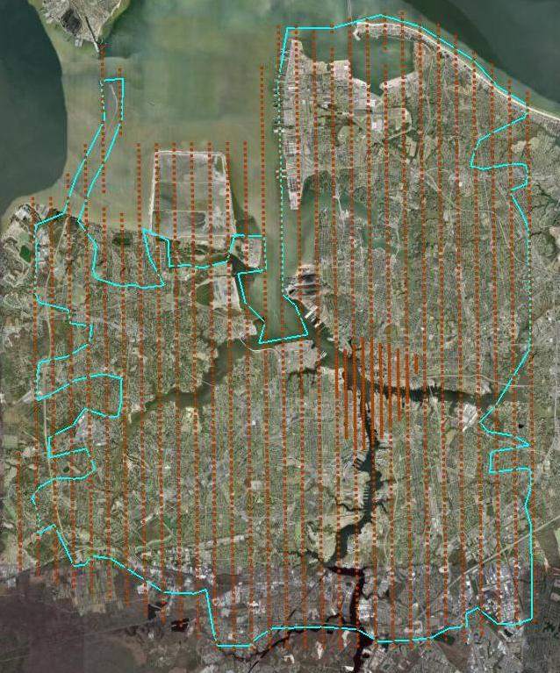
Model Registration
Program Management
Compilation Boundary:
A building compilation boundary layer is digitized in UTM coordinates using the VE orthomosaic data and basemap data.
The boundary, improves vendor efficiency by eliminating the unnecessary setting of stereo models void of desirable features.
Jason Setzer – Penn State University
Notes:
Compilation Boundary: 2200 images/1100 stereo pairs. 500 images outside this boundry where modeling was not necessary/250 pairs.
90 seconds to load a model * 250 6.25 hrs!

Slide 24
Model Registration
Layer Conversion
To make landmark locations, priority areas, and compilation boundaries useful for vendors – they have to be converted in to the arbitrary LSR system in which the 3D models are built.
A workflow to do this was put together using ArcMap’s Spatial Adjustment tool.
It involves using the LSR camera exterior orientations used in building modeling along with the a UTM version of the camera positions obtained from the processing database.
The two coordinate sets are read in to ArcMap as an event-theme and used as the basis of a spatial transformation.
image | "x" | "y" | "z" | "omega" | "phi" | "kappa"
3027 | 353.053 | -14854.8 | 1672.488 | -1.69954 | 0.173874 | 0.018355
3028 | 356.021 | -15079.8 | 1671.919 | 0.653404 | 2.79099 | -5.51859
3029 | 359.098 | -15304.9 | 1671.316 | 1.359212 | 2.628491 | 12.16826
3030 | 362.134 | -15530 | 1670.742 | 1.314728 | -0.0943 | -0.5394
3031 | 365.08 | -15755.3 | 1670.333 | -0.3132 | -0.16165 | 2.287559
image | "x" | "y" | "z" | "omega" | "phi" | "kappa"
3027 | 373881.2 | 4087620 | 1689.848 | -1.82975 | 0.197893 | -0.83454
3028 | 373880.8 | 4087395 | 1689.809 | 0.558779 | 2.77848 | -6.37274
3029 | 373880.5 | 4087170 | 1689.743 | 1.259717 | 2.605576 | 11.31451
3030 | 373880.2 | 4086945 | 1689.716 | 1.172694 | -0.11497 | -1.39226
3031 | 373879.8 | 4086720 | 1689.861 | -0.45732 | -0.15806 | 1.434492
LSR
UTM
Jason Setzer – Penn State University
Notes:
Version 3 – Made possible by arc GIS spatial transformation routine

Slide 25
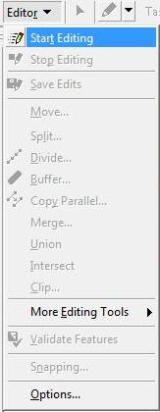
Model Registration
UTM to LSR
In ArcMap, bundle adjusted camera positions are plotted as event themes.
An editing session is started for the desired features (landmark locations, priority areas, and compilation boundaries) to transform.
Jason Setzer – Penn State University
Notes:
V3: Translating data from LSR to UTM

Slide 26
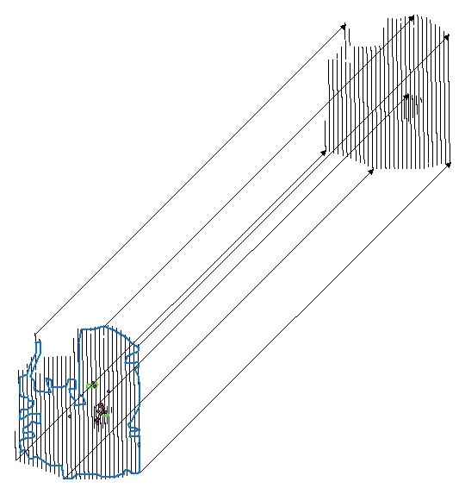
Model Registration
UTM to LSR
Displacement links are made from the UTM image coordinates to the synonymous LSR positions.
Verticie snapping is enabled on the image event theme nodes to allow for precise selection of points.
Jason Setzer – Penn State University
Notes:
V3: Translating data from LSR to UTM – Displacement links

Slide 27
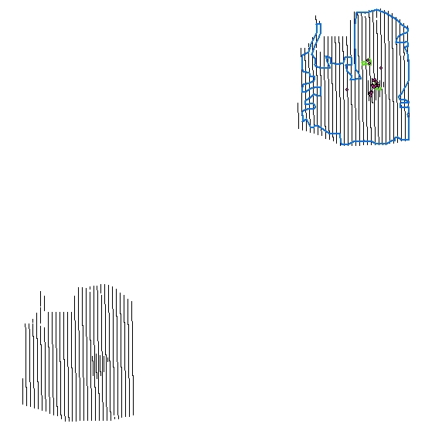
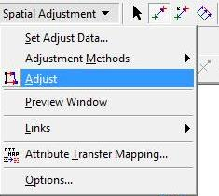
Model Registration
UTM to LSR
Once the “Adjust” command is executed, layers are transformed to their new positions.
An affine-transformation is adequate to accurately translate the UTM features to the LSR coordinate system.
Vendors now have guide data to help them in the modeling process.
Jason Setzer – Penn State University
Notes:
V3: Translating data from LSR to UTM via affinetransformartion

Slide 28
Model Registration
UTM to LSR and back
The same layers which are provided as modeling guides to vendors, are also used to verify the correctness and completeness of delivered data.
They are used to make sure:
Priority areas are completely modeled
That all landmark buildings are compiled
Excessive compilation of unnecessary data is not submitted.
Jason Setzer – Penn State University
Notes:
Not a stretch to say the added ability to get data into Local Space Rectangular was a tremendous improvement in controlling vendor effort. Compilation output actually doubled!

Slide 29
Conclusions
Resulting Effects
In the first year of the Virtual Earth Program, production goals were both aggressive and ambitious.
An output of at least 100 cities in the first year was the top-line, non-negotiable goal for the organization.
Manual rooftop compilation proved to be THE largest bottle neck of the entire process.
From the beginning, the buildings compilation effort was behind the curve.
Without the development of TRISURFSHP and the LSR conversion work flow, reaching the 100 city target would not have been accomplished.
Jason Setzer – Penn State University

Slide 30
Conclusions
Resulting Effects
To be certain, many people, processes, and innovations are to be credited with the achieving the 1st year Virtual Earth goals.
TriSurfShp
UTM-LSR
Among them, stands the advent of geo-spatial registration methods for data in LSR coordinates as a significant part of realizing the VE production objectives.
Jason Setzer – Penn State University

Slide 31
Leveraging GIS for Projecting Data in Virtual Earth
Jason Setzer – MGIS Candidate
http://maps.live.com
Mark Gahegan - Advisor
Thank You!
Jason Setzer – Penn State University
Notes:
When building this capstone presentation, I was advised that I would have to detail some unique contributions I have personally made to GIS. I’d like to think that using GIS in creative, slightly non-standard ways, to overcome challenges of a demanding high profile mapping campaign like VE is that contribution.

