Slide 1
Improving Numerical Weather Prediction Using Analog Ensemble
Presentation by: Mehdi Shahriari
Advisor: Guido Cervone

Slide 2
Research Questions
How to use Analog Ensemble for probabilistic weather prediction?
What is the uncertainty associated with wind power estimates?
How to use Analog Ensemble (AnEn) to downscale wind estimates?

Slide 3
Part 1
Numerical Weather Prediction

Slide 4
Introduction
Numerical Weather Prediction
Deterministic weather prediction
A single estimate of the future value of a variable
Probabilistic weather prediction
Provides an uncertainty for each of the different outcomes
Monte Carlo approximation

Slide 5
Shortcomings of Current Methods
Deterministic Weather Prediction
Only provides a single value estimate
Could be highly impacted by the initial conditions
Probabilistic Weather Prediction
Computationally expensive
Depends on the initial and boundary conditions

Slide 6
Analog Ensemble
Estimates the probability distribution of a predictand variable over the training period given values of related variables:
p (y | x)
Where:
y is the unknown variable (predictand)
x is the known variables (predictors)

Slide 7
Advantages of AnEN
Requires a single forecast of the predictand
Quantifies the uncertainty associated with the prediction
Computationally efficient

Slide 8
Analog Ensemble Approach
1) A point in the verification period is selected and analogs in the training period are searched for and the best matching estimates are chosen as analogs
$\left\|F_{t},A_{t^{′}}\right\|=\sum_{i=1}^{N_{v}}{\frac{w_{i}}{σ_{f_{i}}}}\sqrt{\sum_{j=−\tilde{t}}^{\tilde{t}}{{(F_{i,t+j}−A_{i,t^{′}+j})}^{2}}}$ (Delle Monache, Nipen et al. 2011)
$F_{t}:deterministic forecast at time t$
$A_{t^{′}}:an Analog at past time t^{′}$
$N_{v}:number of analog variables$
$$w_{i}:weight for each variable$$
$A_{t^{′}}:an Analog at past time t^{′}$
$$σ_{f_{i}}:standard deviation of a variable$$
$$\tilde{t}:half the number of additional times over which the metric is computed$$

Slide 9
Analog Ensemble Approach
2) Select the observation (value of the predictand) corresponding to each selected analog from the training period
3) This selected group will be the ensemble prediction for the point in the verification period

Slide 10
AnEn schemata
ANALOG TRAINING PERIOD
VERIFICATION PERIOD
1
PREDICTORS
2
OBSERVATIONS
3
ENSEMBLE PREDICTIONS

Slide 11
Verification Methods
Compare estimated values with the observed values
Rank histogram
Spread- skill relationship
Reliability and Sharpness Diagram
Continuous Ranked Probability Score (CRPS)

Slide 12
Statistical Consistency
An ensemble is statistically consistent if its members are indistinguishable from the observations (Vanvyve, Delle Monache et al. 2015)
Rank Histogram
Create N + 1 bins (N is the number of ensemble members)
Rank observations based on their value with respect to the ensemble members
Determine which of the ranked bins the observation falls into
Create a histogram of percentage of occurrence for each bin

Slide 13
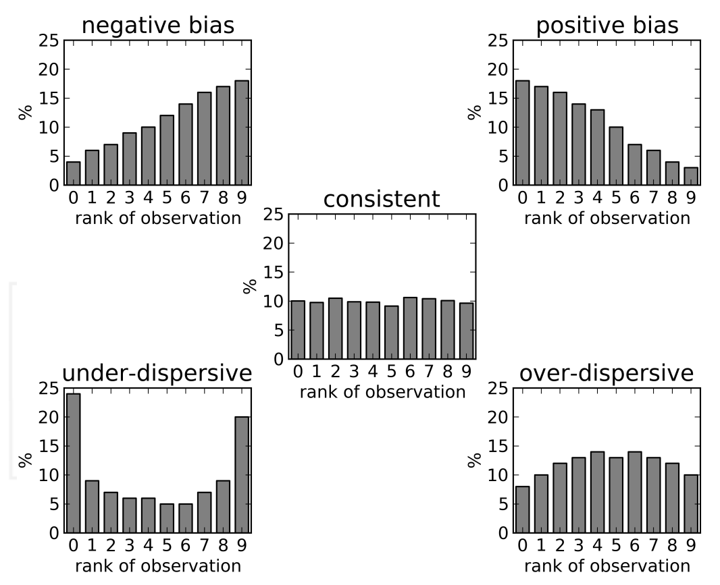
Rank Histogram
source: Ensemble Forecasting (Callado et. Al. 2013)

Slide 14
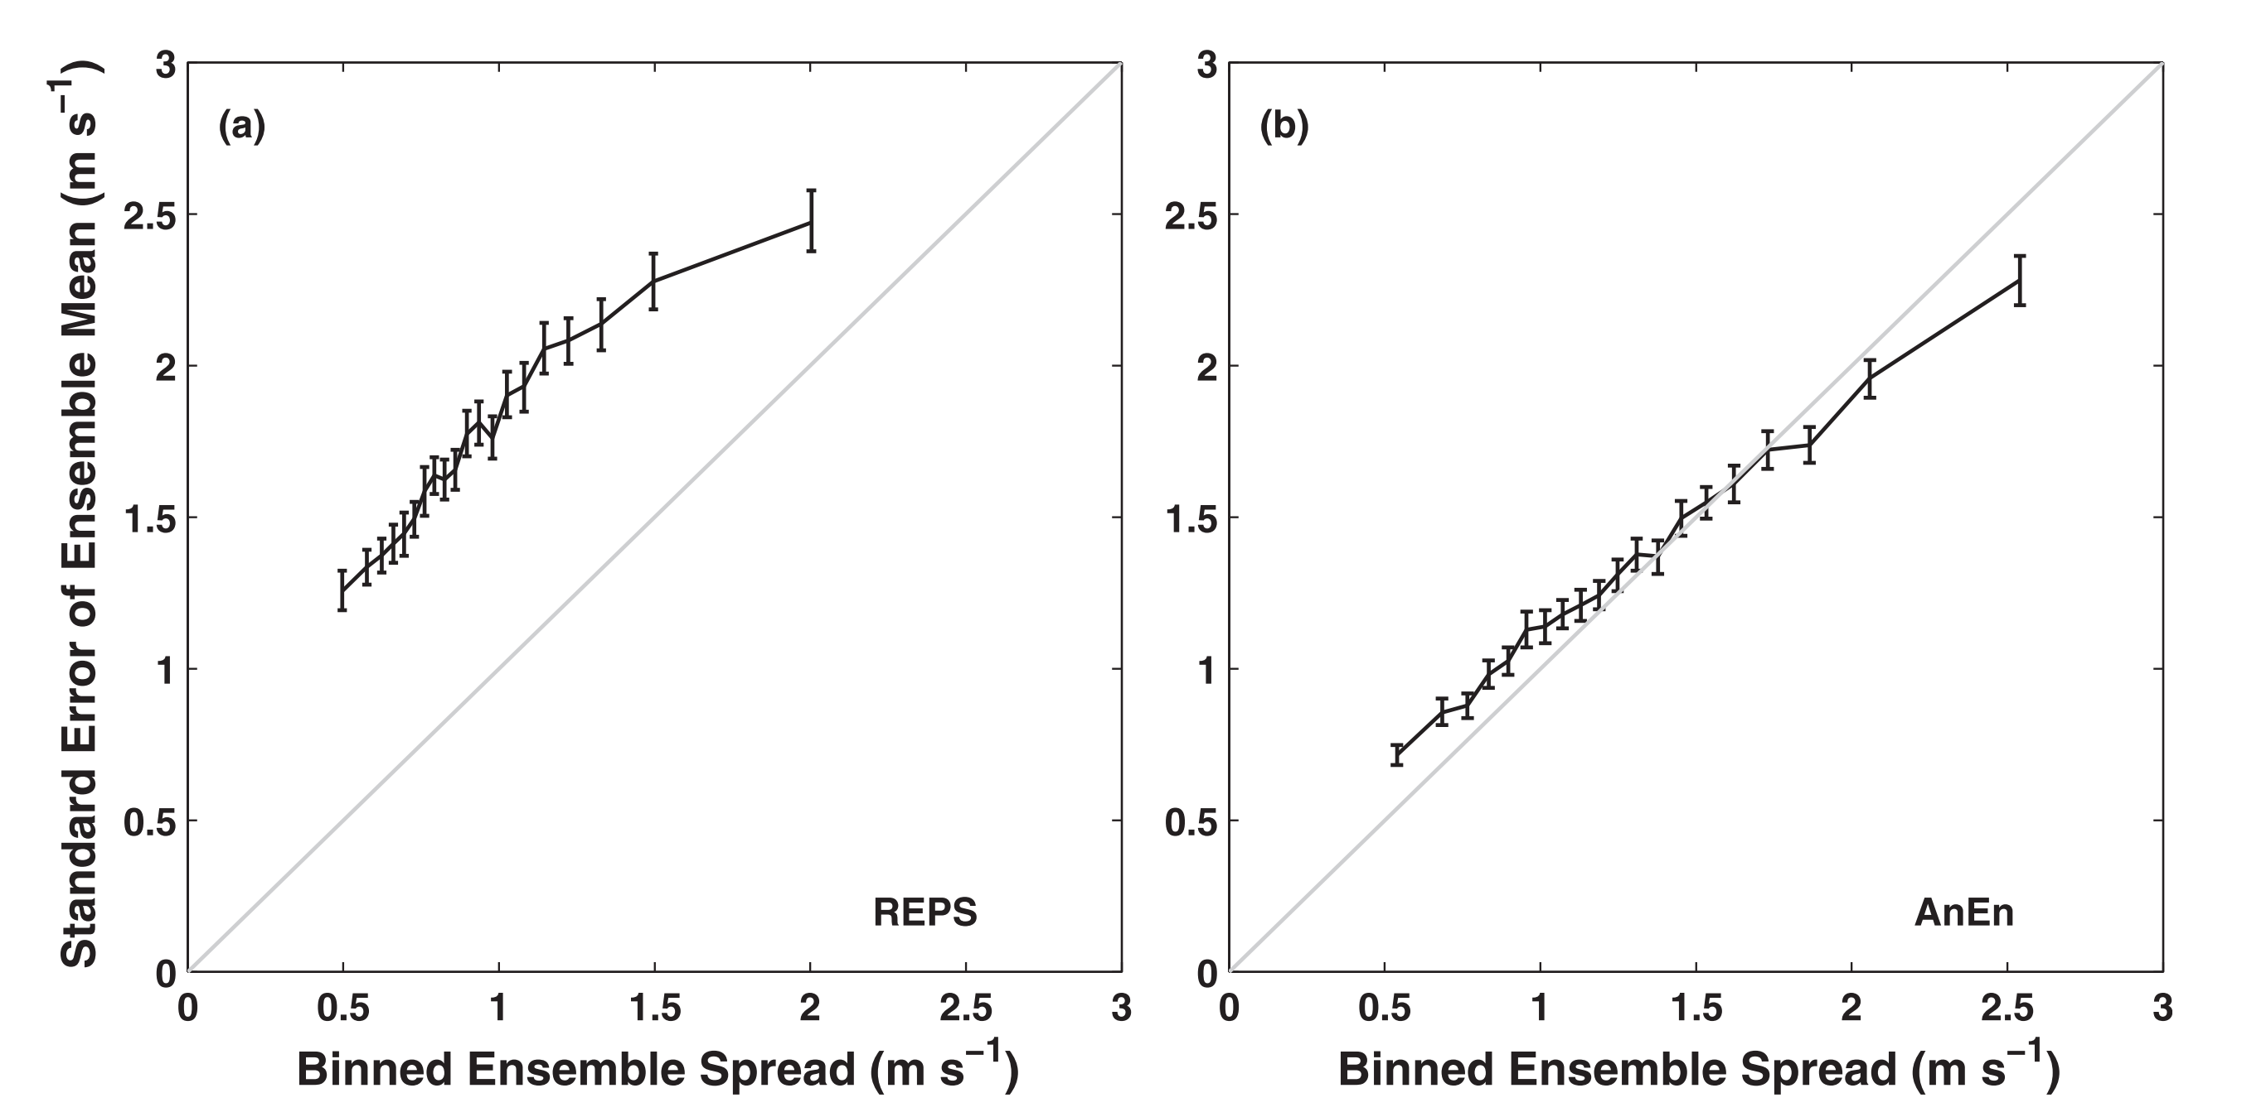
Spread-Skill Relationship
Source: (Delle Monache, Eckel et al. 2013)

Slide 15
Data
Predictand
Wind Speed
Predictors:
Temperature
Pressure
Geopotential Height
U-component
V-component
Boundary Layer Height

Slide 16
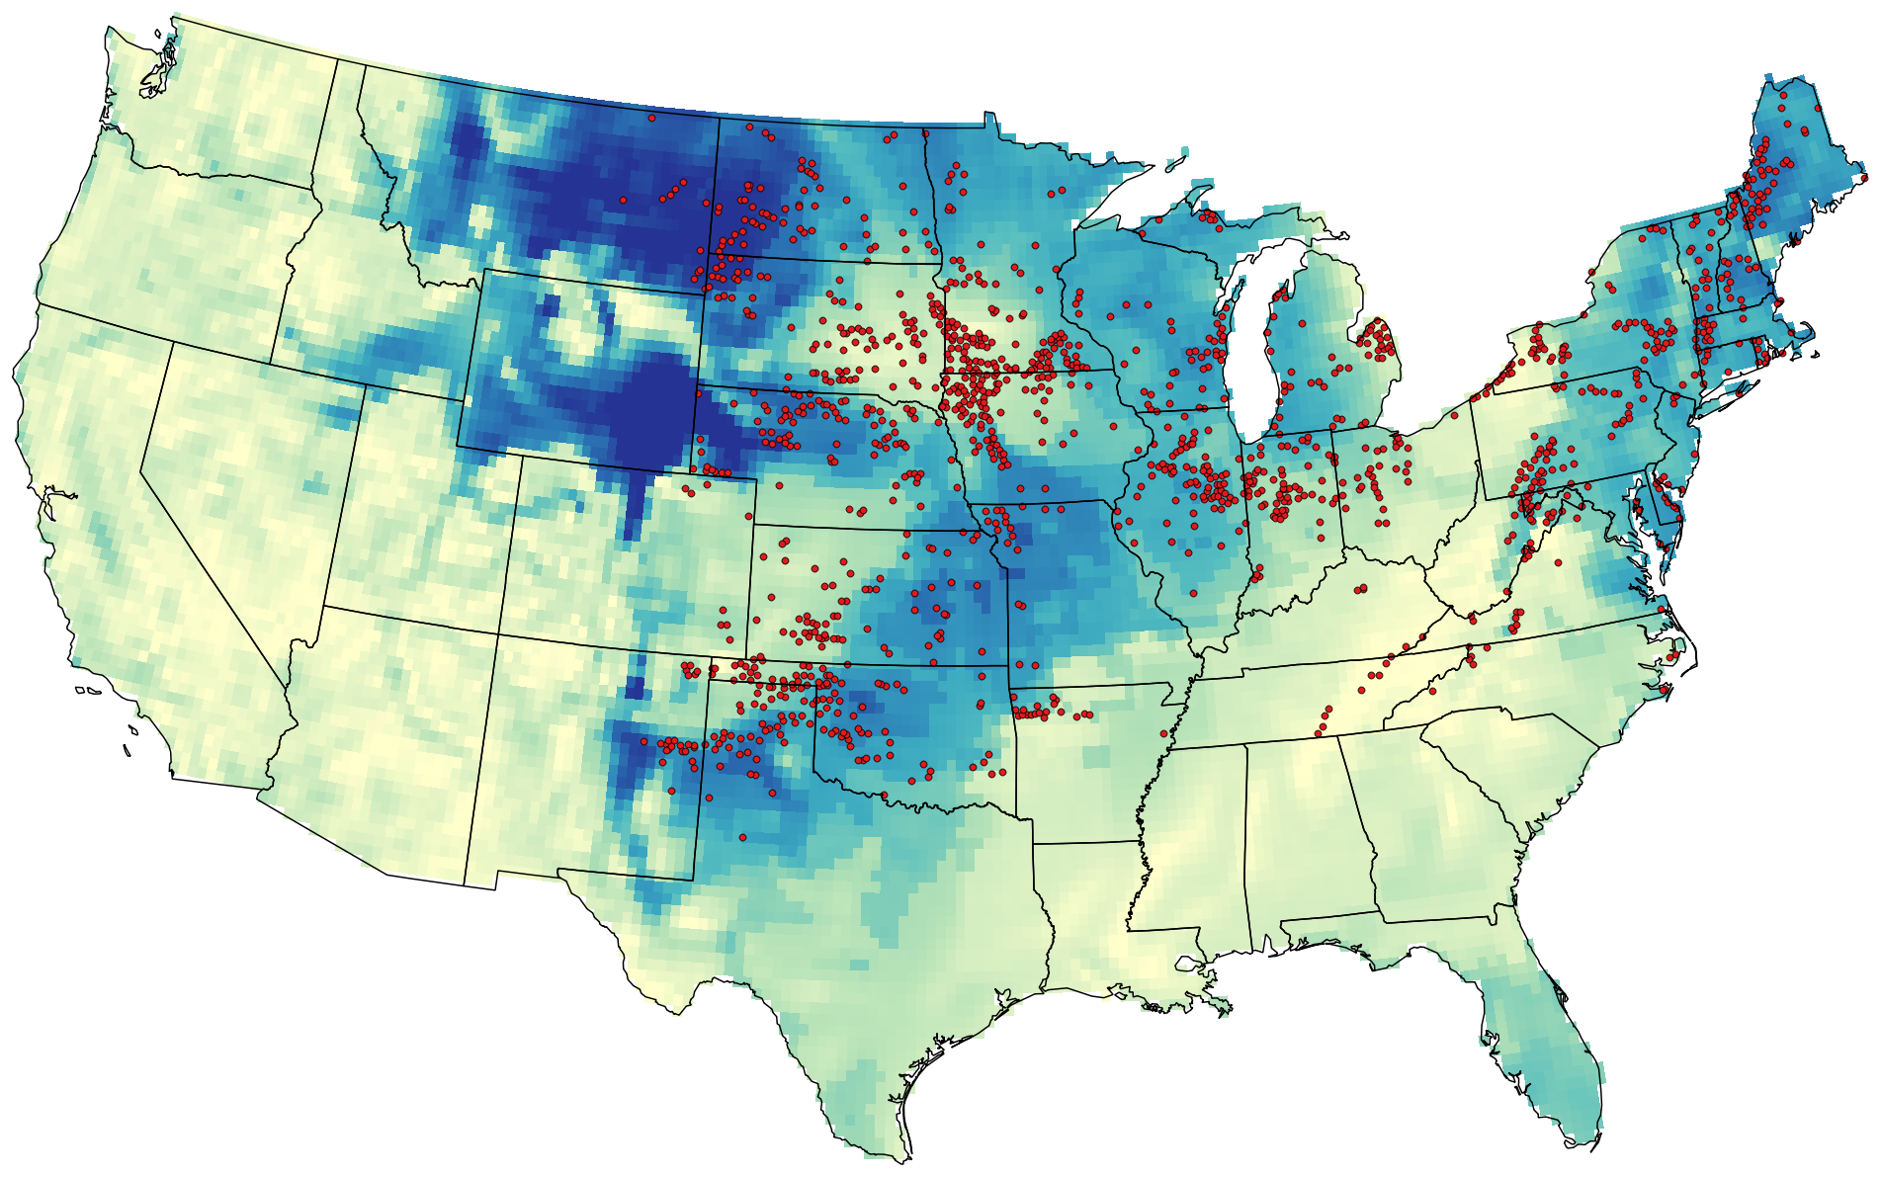
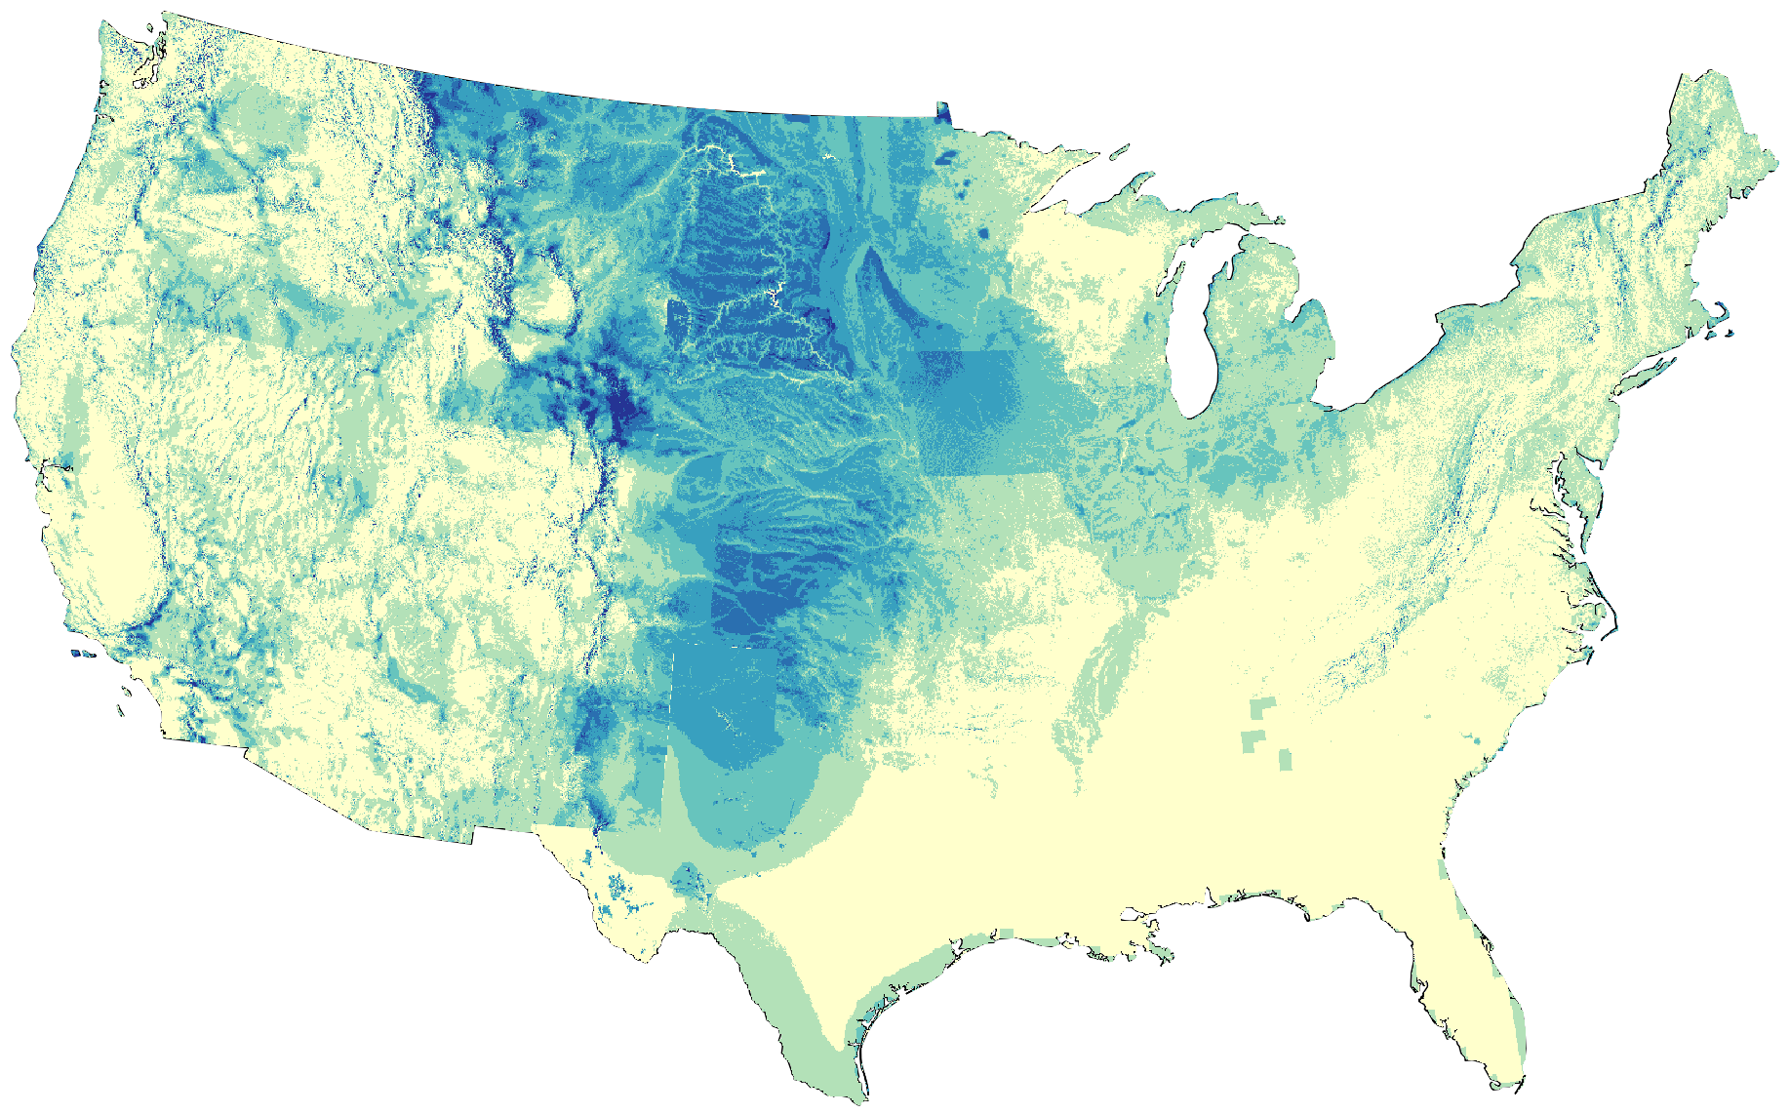
Wind Speed Estimates
Data: NREL Wind Power Class (Mai, Sandor et al. 2012)

Slide 17
Probability Index
Determine a probability index for each grid (point)
Associate each wind farm with a probability index
Determine which farms are associated with higher uncertainty
Find how the uncertainty is related to other factors such as topography, land cover and wind resources

Slide 18
Part 2
Downscaling

Slide 19
Global Climate Models
Global Climate Models simulate climate system
Project future climate variability and change
Investigate human impact on the climate
Study climate sensitivity under different scenarios
Produce results at coarse spatial resolution

Slide 20
Downscaling
Coarse data from GCMs are not suitable for regional and local scales
Downscaling: A technique to use data at global scales to make predictions at local scale
Dynamical downscaling: use data from a GCM as initial and boundary conditions to run a local climate model
Statistical downscaling: use data from past to build a relationship between a GCM and a local climate model and use it for future projections

Slide 21
Current Methods
Statistical downscaling
Reduce global models’ biases
Computationally inexpensive
Stationarity assumption
Fields are not physically consistent
Dynamical downscaling
Provides consistency among all meteorological variables
Too computationally expensive

Slide 22
Analog Ensemble for Downscaling
Capable of producing high-resolution regional climate projections
Quantifies uncertainty associated with the downscaling method
Computationally efficient

Slide 23
AnEN for Downscaling
ANALOG TRAINING PERIOD
DOWNSCALING PERIOD
PREDICTORS
OBSERVATIONS
ENSEMBLE PREDICTIONS

Slide 24
Data
Data at global scale for period A
Data at local scale for period A
Data at global scale for period B
Training Period
Downscaling Period

Slide 25
Conclusion
Incorporate AnEn to Improve numerical weather prediction
Estimate potential wind power production and the uncertainty associated with the estimates
Use downscaling to make predictions at local scale

Slide 26
Thank You!

Slide 27
References:
Alfons Callado, Pau Escribà, José Antonio García-Moya, Jesús Montero, Carlos Santos, Daniel Santos-Muñoz and Juan Simarro (2013). Ensemble Forecasting, Climate Change and Regional/Local Responses, Dr Pallav Ray (Ed.), InTech, DOI: 10.5772/55699. Available from: http://www.intechopen.com/books/climate-change-and-regional-local-responses/ensemble-forecasting
Delle Monache, L., et al. (2013). "Probabilistic weather prediction with an analog ensemble." Monthly Weather Review 141(10): 3498-3516.
Delle Monache, L., et al. (2011). "Kalman filter and analog schemes to postprocess numerical weather predictions." Monthly Weather Review 139(11): 3554-3570.
Mai, T., et al. (2012). Renewable electricity futures study. executive summary, National Renewable Energy Laboratory (NREL), Golden, CO.
Vanvyve, E., et al. (2015). "Wind resource estimates with an analog ensemble approach." Renewable Energy 74: 761-773.

