Slide 1
AMBUSH VULNERABILTY MODEL DEVELOPMENT
John William Shinsky
john.w.shinsky2.civ@mail.mil

Slide 2
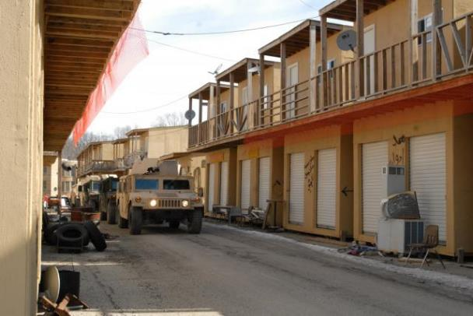
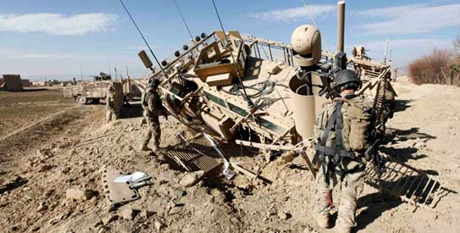
Problem Statement
Is line-of-sight enough to analyze a vehicles vulnerability to an attack?
Speed?
Continuous line-of-sight?
Kill Chain Sequence Time?
Goal: Improve current methodology to incorporate vehicle speed, target acquisition time, and continuous line-of-sight to better analyze a moving target.

Slide 3
Current Model
Current AMSAA Model: Overhead Angle of Attack Model
Original Problem: Locate and characterize overhead firing opportunities
Programming Language: Python uisng ArcGIS
Viewshed for each point
LIDAR
Compute viewshed and point summaries at each individual point
Route Points
Excel Summary Table

Slide 4
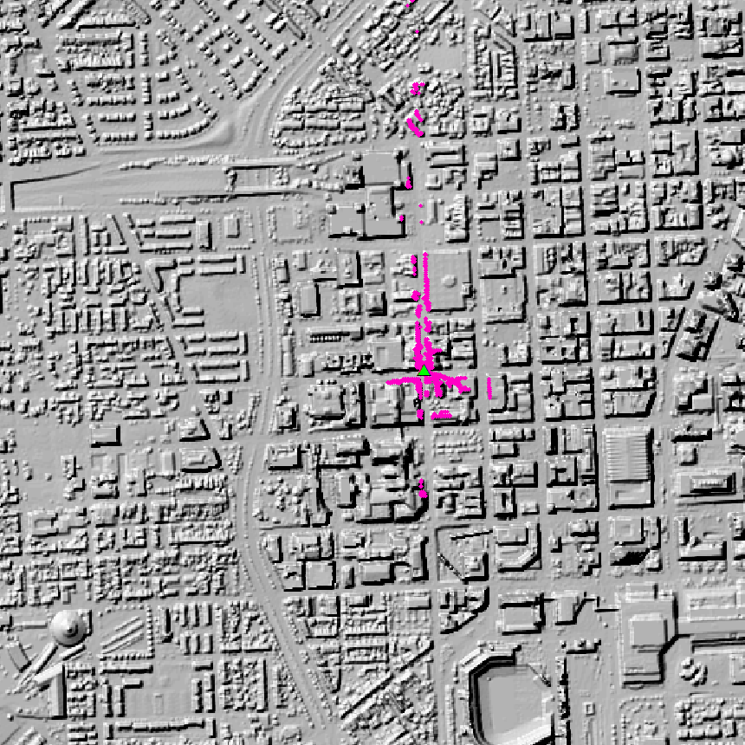
Viewshed Analysis
0:7,000
Identifies every point the vehicle can see and be seen by a 2m tall firer above the vehicle (>1° angles).

Slide 5
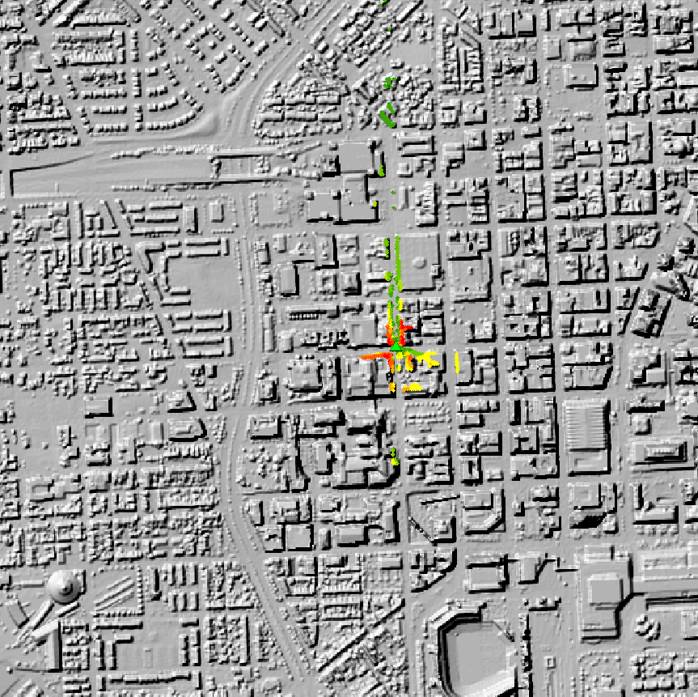
Angle and Distance Calculation
Green = 1-7°
Yellow = 7-14°
Red = 14-80°
0:7,000
Angle and distance are calculated for every visible point (>1° angles).
Higher angles represent a threat from a higher vantage point.

Slide 6
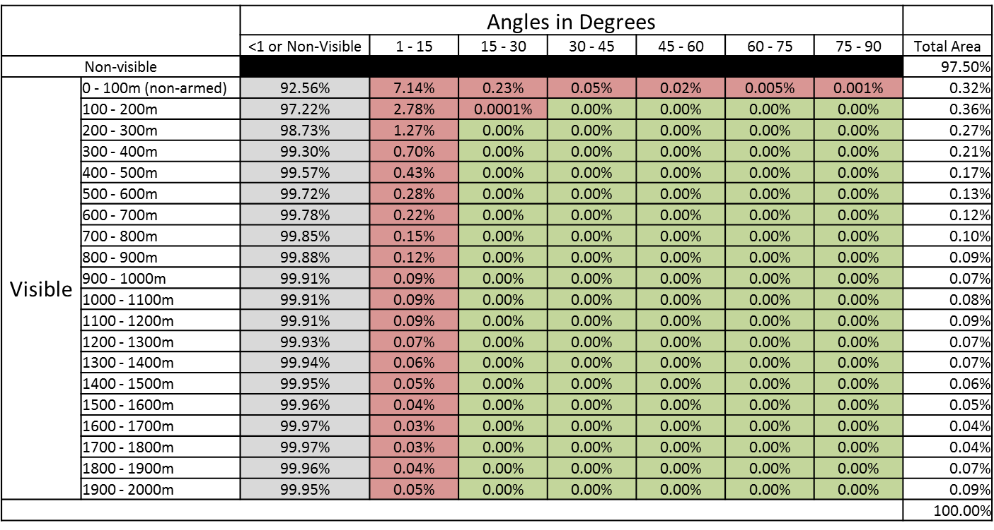
Statistical Aggregation
Threat occurrences over total firing opportunities
Averaged over all route points.
Table for distribution.

Slide 7
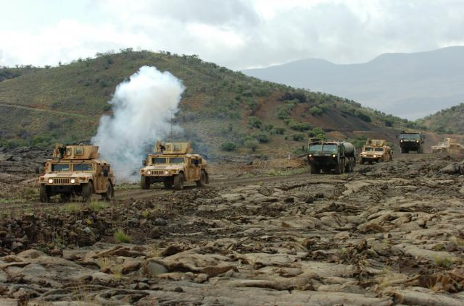
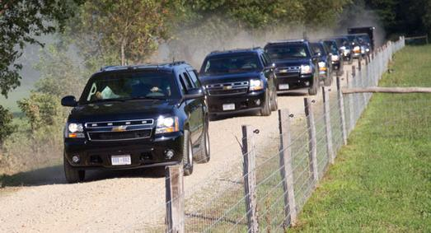
Key Limitations
Static Minimum Range
Static Maximum Range
Requires Route Points
Stationary Target
Statistical Aggregation
Weapons Systems
Different Vehicles
Operational Usage
Non Military Usage

Slide 8
Proposed Model
Proposed Model: Ambush Vulnerability Model
Problem: Locate attack threat positions for a moving target
Programming Language: Python using ArcGIS
LIDAR
Compute viewshed at individual point
Compare to last viewshed to establish continuous line of sight
Add all line of sight rasters to get a final raster showing all viable threats
Final Viable Threat Map
Route
Split route into evenly spaced points
Vehicle Length
Repeat For Next Point
Vehicle Speed
Determine how many route points must be visible for a viable threat
Find locations that have had line of sight for the specified number of points
Target Acquisition Time
Iterative Multiple Viewshed Analysis

Slide 9
Proposed Methodology
Kill Chain Sequence Time (Acquire, Aim, Fire, Hit)
Multiple Viewshed Analysis
Minimum Range
Maximum Range
Sample Distance
Vehicle Speed

Slide 10
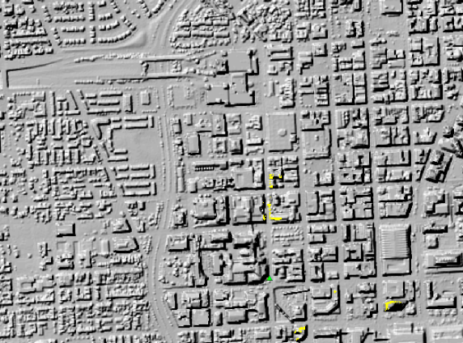
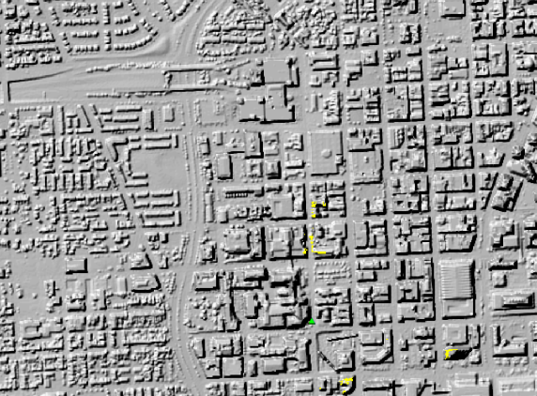
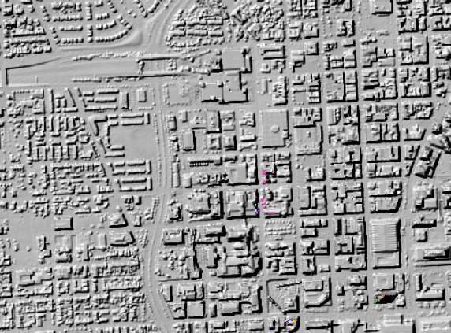
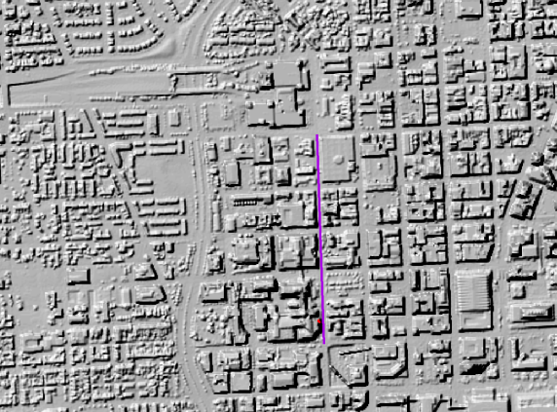
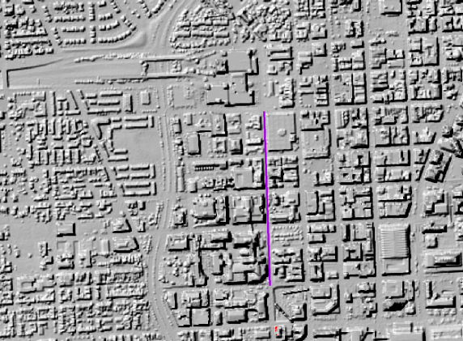
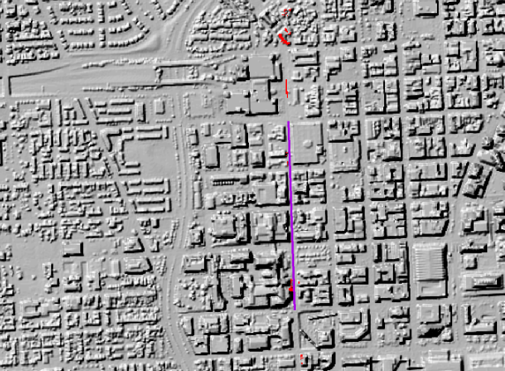
Multiple Viewshed Analysis
0:5,000
0:5,000
0:5,000
Previous Viewshed
Current Viewshed
Line Of Sight Raster
Factor In User Defined Kill Chain Sequence Time
0:5,000
0:5,000
0:5,000
1st Viable Threat Raster
+ 2nd + 3rd + ...
n^{th} Viable Threat Raster
All Threats Final Output

Slide 11
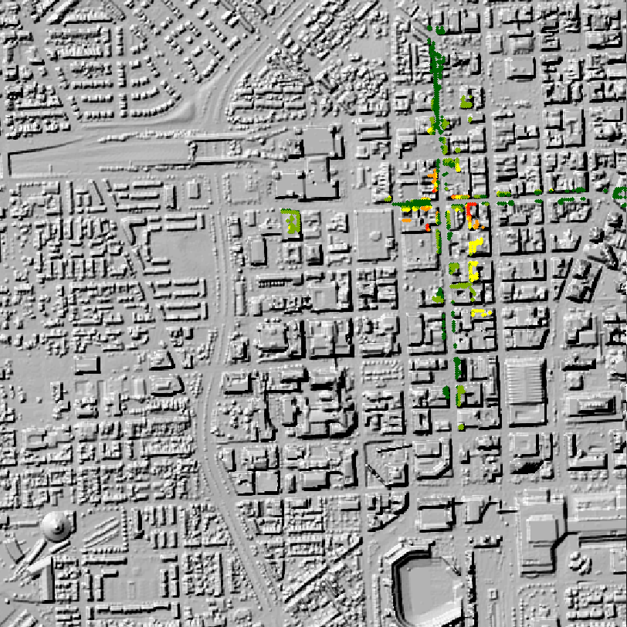
Expected Results
Drastic decrease in the number of threat locations.
Firing opportunities on side streets will not be as viable of a threat
Problem areas will be points along the road and on top of nearby buildings

Slide 12
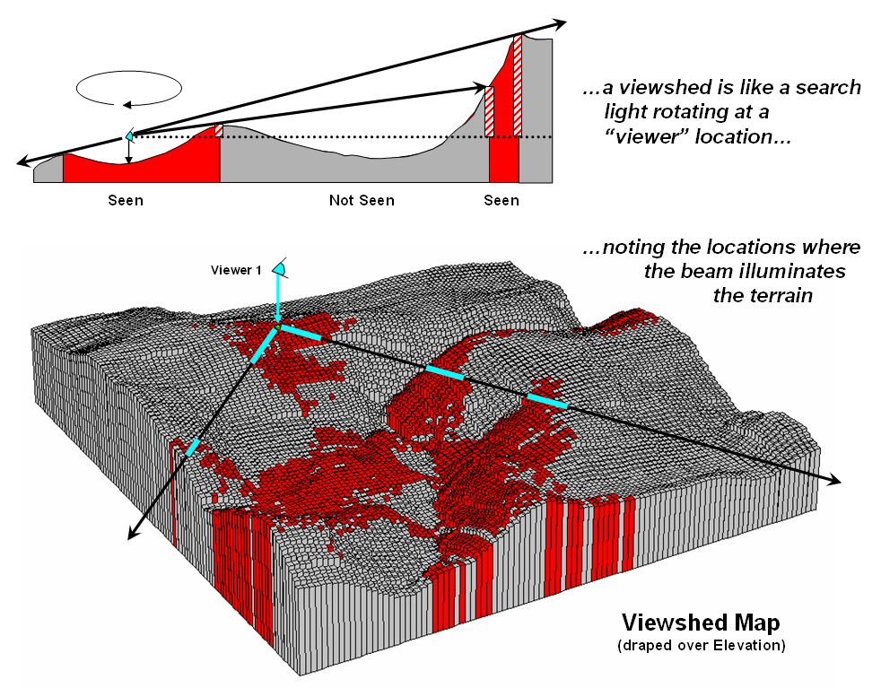
Literature Review
Weapons Fan Algorithm (Guth, 2003)
US Naval Academy
Uncertainty in Viewshed Analysis (Raehtz, 2011)
Michigan State University
Cumulative Viewshed Analysis (Wheatley, 1995)
University of Southampton
Archaeology (Ruggles, 1993)
University of Leicester

Slide 13
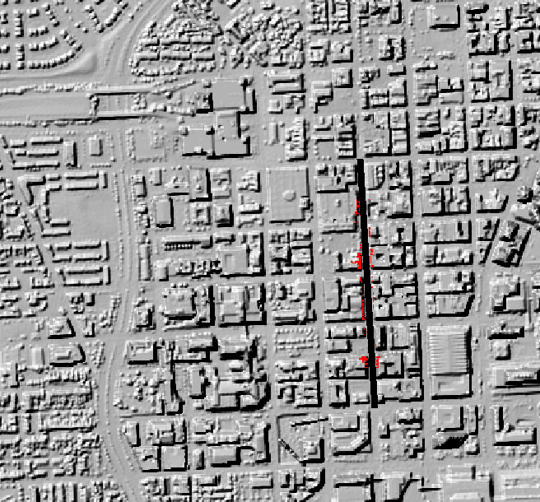
Conclusion
The proposed model will allow for a larger range of applications.

Slide 14
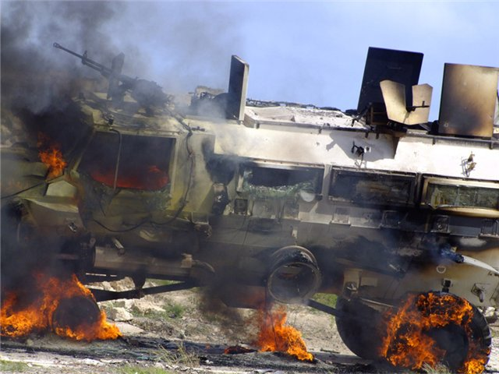
Questions
The ability to determine the threat of an overhead attack to a moving target gives the model the capability to be useful for operational planning
The proposed model also allow the capability of non military uses

Slide 15
References
Guth, P.L. (2003). Ambush Movies and the Weapons Fan Algorithm: Military GIS Operations and Theory, in Proceedings of the International Conference on Military Geology and Geography, June 15-18, 2003, West Point NY.
Guth, P.L. (2004). The Geometry of Line-of-Sight and Weapons Fan Algorithms: in Caldwell, D.R., Ehlen, J., and Harmon, R.S., eds., Studies in Military Geography and Geology, Dordrecht, The Netherlands, Kluwer Academic Publishers, chapter 21, p.271-285.
Raehtz, S.M. (2011). Accounting for Uncertainty in Viewshed Analysis of IED Ambush Sites in Afghanistan. Michigan State University. Retrieved August 20, 2014, from http://etd.lib.msu.edu/islandora/object/etd%3A1141
Ruggles, C.L.N., Medyckyj-Scott D.J., and Gruffydd A. (1993). Multiple Viewshed Analysis Using GIS and Its Archaeological Application: a Case Study in Northern Mull, in: Andresen, J., T. Madsen and I. Scollar (eds.), Computing the Past. Computer Applications and Quantitative Methods in Archaeology. CAA92. Aarhus University Press, Aarhus, pp. 125-132.
Wheatley, D. (1995). Cumulative Viewshed Analysis: A GIS-Based Method for Investigation Intervisibility, and its Archaeological Application. In Lock & Stancic (Eds.), Archaeology and Geographical Information Systems, 171-186. Taylor and Francis: London.

