Slide 1
Modeling the Impact of Climate Change on Zika Virus Transmission Suitability for the Continental United States
David Siders
Advisor: Justine Blanford
GEOG 596A
Pennsylvania State University – World CAmpus
Notes:
Thank you Justine/Beth
Good evening to everyone who has stayed on the line to hear my presentation; I hope to continue the quality level of the capstone presentations we’ve seen so far this evening from Steven and Angelo.
My name is David Siders, and for my capstone project I chose to research Zika Virus.
Fortunately, my advisor, Justine Blanford, is knowledgeable on arboviruses, and encouraged me to take her GIS for Health Analysis course this fall, which was tremendously helpful and which I highly recommend to anyone in the program.
Through a bit of trial and error I narrowed my research to modeling the impact of climate change on Zika virus transmission suitability for the continental United States.
To be a bit more clear when I say transmission suitability I am specifically referring to the environmental and biological suitability for transmission between vectors, meaning the mosquitoes that carry the virus, and humans. It is important to clarify that this does not necessarily mean risk, however the results of my research could be used to help assess risk.

Slide 2
Personal Background
13 years of experience in a variety of different GIS Roles
Lead GIS Engineer for the MITRE Corporation that operates 7 of the U.S. Governments Federally Funded R&D Centers working primarily with:
DoD & IC
DHS & DOJ
FAA
HHS, FDA, CDC
Previously have worked at:
The National Guard Bureau – Explosive Site Safety
Dewberry – GIS Analyst/Developer on a variety of Flood Mapping Projects
PSU MGIS Student since 2013
Notes:
We have a lot of ground to cover in this presentation so I will make this brief. I have been a GIS practitioner in various and increasingly complex roles for the last 13 years.
I currently work as a Lead GIS Engineer at the MITRE Corporation in McLean, VA developing experimental programs and systems. We operate 7 of the US Governments Federally Funded Research and Development Centers, with a focus on systems engineering and integration.
My department is the company’s lone GIS focused department, of which 5 employees are current Penn State World Campus or State College Students or Alumni.
Previously I have worked with the National Guard Bureau and Dewberry as an analyst and programmer.

Slide 3
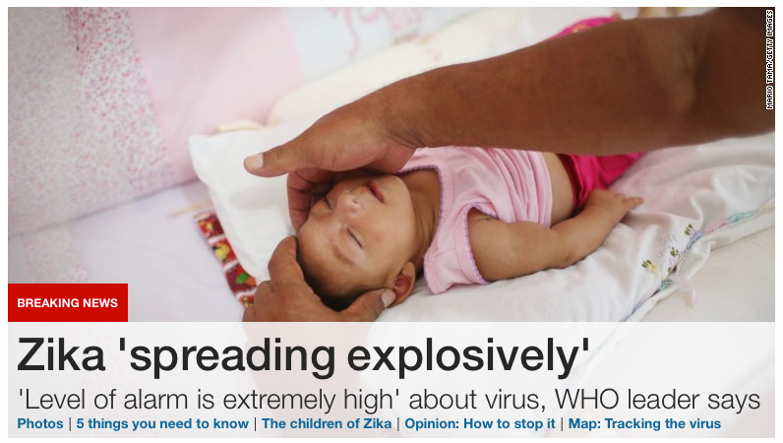
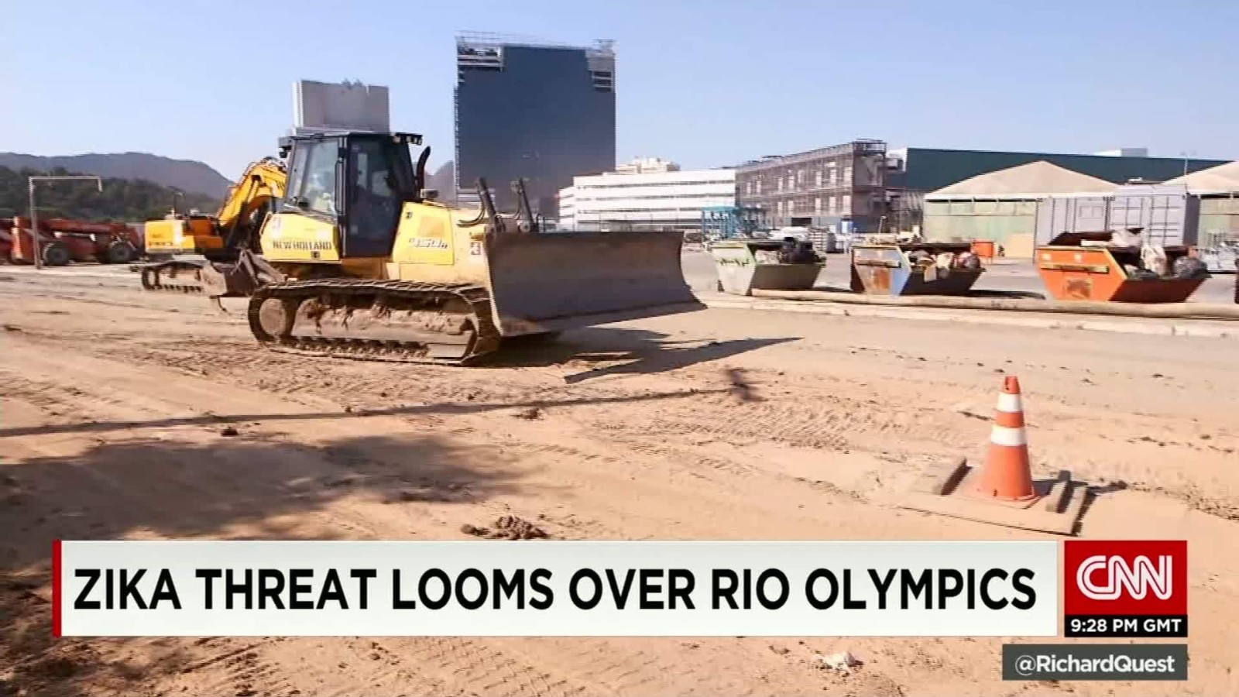
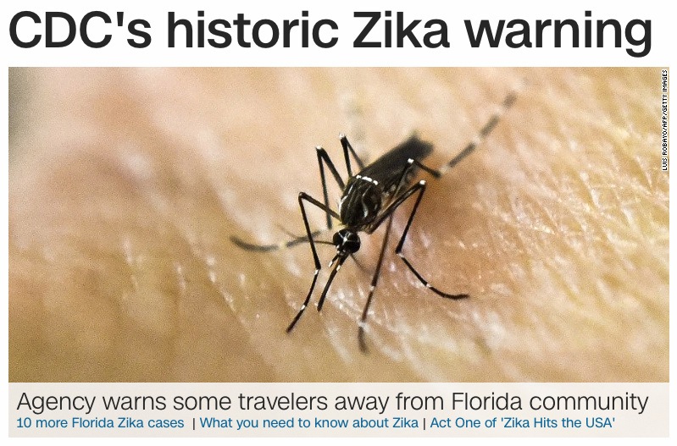
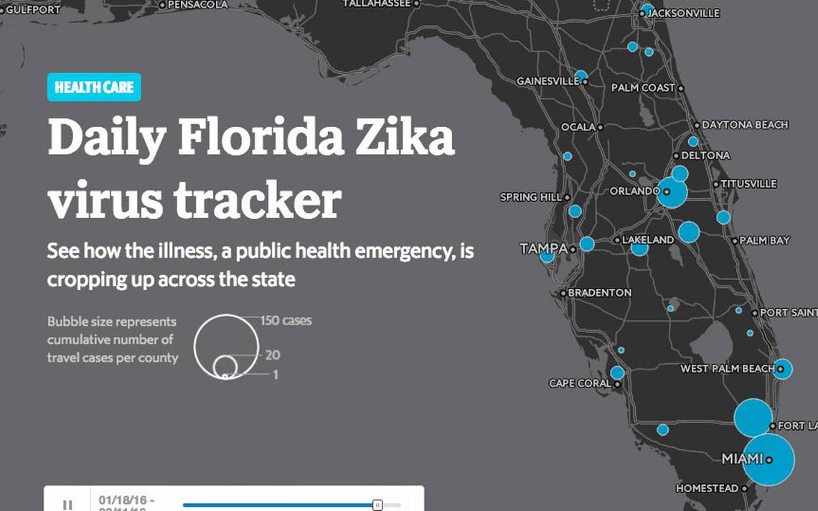
Project Purpose
Zika Virus (ZIKV) gained global notoriety in 2015 with the outbreak in Brazil
Rapid spread through South America, Latin America, and the Caribbean by vectors
Believed to cause Microcephaly & Guillain-Barre Syndrome
Imported cases of ZIKV have been reported in all but 5 States in the U.S. as of July, 2016¹
On July 29th the CDC confirmed the first case of local ZIKV in South Florida²
Before 2014, ZIKV was a relatively unknown arbovirus, with only limited research on its spread and effects
Only recently have the transmission dynamics of the virus become understood enough to model the spatial range of a potential epidemic
Climate change is expected to expand the range of arbovirus vectors, bring tropical viruses and diseases to more temperate climates, like the continental United States ³
Notes:
Let’s start by talking about the project purpose. I would have my doubts that any of you have not heard about the Zika Virus in the last year, let a lone the last several months. The virus became well known in 2015 as it flourished to epidemic levels in Brazil and now is considered a pandemic in South America, Latin America, and the Caribbean.
Zika virus has received such notoriety because of two conditions that are being linked to it
The first is microcephaly, a condition where babies of pregnant women who contracted the virus are born with smaller than average brains, many dying within one year
The second is Guillian-Barre Syndrome, where the infected person’s own immune system attacks it’s peripheral nervous system, potentially causing paralysis.
All but 5 states in the US have confirmed imported cases of ZIKV and on July 29th of this year the CDC confirmed local transmission of ZIKV by mosquitoes in Florida. There has been limited research on the virus because previous outbreaks were small and intermittent until, in 2007, larger outbreaks began in the Pacific before the current range expansion into the Americas.
In response to the current outbreak the epidemiological community has responded with volumes of new data and findings, the results of which are enabling researchers to model the current transmission suitability. My capstone project will attempt to extend that research by modeling potential transmission suitability for a variety of future scenarios.

Slide 4
Overview
Project Background
Literature Review
ZIKV & Similar Flaviruses
Aedes genus mosquitoes
Transmission Dynamics
Epidemiological Triad
Transmission Risk Research
Research Objective & Data
Methodology
Outcomes
Timeline
References
Notes:
So, here is an overview of the topics I will cover in this presentation.
First we will cover the virus itself, then we will establish its link to its vectors, the Aedes genus mosquitoes, then we will explore the environmental & biological factors that influence transmission of the virus, before finally exploring how all of those factors fit into the epidemiological triad of Zika Virus.
I will then discuss how I intend to use this data to research the future transmission suitability of Zika in the US, before wrapping up by discussing how I will produce and share my findings.

Slide 5
ZIKV: Spread & Symptoms
Member of the Flavivirus genus of viruses⁴
Spread primarily as a arbovirus through mosquito vectors⁵:
Aedes aegypti – Primary Vector
Aedes albopictus – Secondary Vector
Can also be spread Sexually, Congenitally, & through Blood Transfusions⁶.
Only 20-25% of people infected by ZIKV become symptomatic
Symptoms include: Fever, Rash, Headache, Muscle Pain, and Conjunctivitus⁶
Grown research attributing ZIKV to:
Microcephally⁷
Guillain-Barre Syndrome⁸
No known cures or anti-viruses⁶
Notes:
Zika is a member of the Flavivirus genus of viruses, which also includes Dengue Fever, Japanese Encephalitis, and Yellow Fever viruses.
The primary way to contract the virus is through the infected bites from the Aedes aegypti or Aedes albopictus mosquitoes, called vectors. Aedes aegypti is the primary vector of the virus and Aedes albopictus is the secondary vector.
Zika Virus can also be contracted via sexual activity, passed congenitally through pregnancy to an infant, and, as of recently, through blood transfusions.
Only about ¼ of the people who contract the virus actually show symptoms, making this especially dangerous because those people may unknowingly pass the virus on to other mosquitoes who bite them or infect other people.
There are no known cures or anti-viruses for Zika, however, it has been reported by the CDC that after healing from an infection a person will develop some level of immunity.

Slide 6
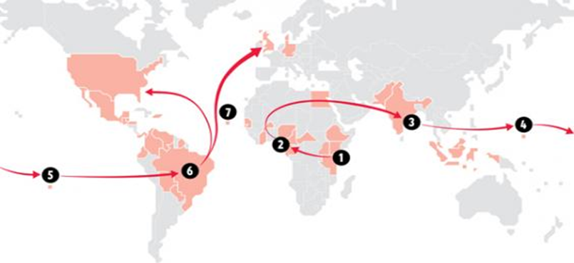
ZIKV: History
Discovered in 1947 in the Zika Forest of Uganda⁶
First known human case in 1952⁶
Intermittent outbreaks in Africa and Asia until⁹:
Yap Islands Outbreak - 2007
French Polynesia Outbreak - 2014
Easter Islands Outbreak – 2014
Arrives Brazil – 2014/2015⁹
United States - 2016²
Notes:
Zika Virus has been around for longer than most people are aware of. It was first discovered accidentally, in Uganda in 1947 by researchers working on the Yellow Fever virus. The virus had its first human case in 1952 when it is thought that a young girl contracted the virus from an Aedes africanus mosquito.
Intermittent small outbreaks occurred in Africa and Asia until 2007 when outbreaks occurred in the Yap Islands and again in 2014 in the French Polynesian islands. Notably, the Yap Island outbreak infected 73% of the population aged three or older, which was troubling to public health researchers, the CDC, and WHO.
The virus appeared in Chile’s Easter Islands in 2014 before it migrated to Brazil sometime in late 2014 or early 2015. Some researchers believe an infected person or persons traveling from a ZIKV hotspot traveled to Brazil for the FIFA World Cup, initiating the Brazil outbreak.
The virus quickly spread to the rest of South America, Latin America, and the Caribbean,.
Imported cases of ZIKV began being reported in the continental United States in 2016, with locally transmitted cases occurring in Florida since late July.

Slide 7
ZIKV: Similar Flaviviruses
Dengue Fever/Dengue Hemorrhagic Fever¹⁰
Potentially Deadly virus discovered in the 18th century, spread by Aedes genus mosquito
390 Million cases since 1970
Potential to affect 30-54.7% of the global population
Has recently been reported in Florida, Texas, and Hawaii
Chikungunya¹¹
Crippling virus discovered in 1952 in Tanzania, spread by Aedes genus mosquito
Has affected 1.38 Million people in Latin America, the United States, and the Caribbean as of 2016
~700k of those cases occurred in 2015, mostly in Colombia
Yellow Fever & West Nile Virus
Notes:
While Zika is not fully understood yet, it is notably similar to other viruses spread by Aedes genus mosquitoes, like Dengue Fever and Chikungunya. Both of which have seen recent range expansion into North America and Europe, a situation that public health officials and epidemiologist find troubling.
Dengue fever is an arbovirus with four serotypes that independently only cause mild and temporary symptoms, however, when two or more of the serotypes have been contracted a person can suffer from the deadly condition Dengue Hemorrhagic Fever, that causes uncontrollable internal bleeding. The virus has affected nearly 400 million people since 1970, and is capable of affecting 30-50.4% of the global population under present climatic conditions. It does have a presence in the United States with outbreaks occurring in Hawaii, Texas, and Florida.
Chikungunya virus is a crippling virus that can leave its victims permanently contorted and disfigured. It was discovered in 1952 in Tanzania and is also spread by the Aedes genus mosquito. It has affected 1.4 million people in Latin America, South America, and the Carribean; with roughly half of those cases occurring in 2015, mostly in Colombia. Some cases have recently occurred in the United States.
Other similar arboviruses spread by Aedes genus mosquitoes are the well known West Nile Virus, and the fellow flavivirus, Yellow Fever.

Slide 8
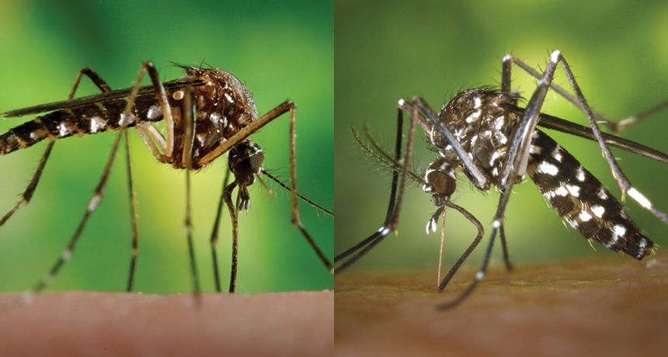
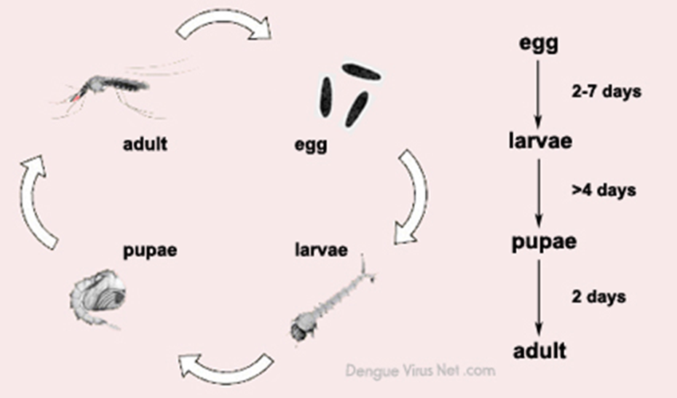
Aedes Genus Mosquitoes
8 – 14 Days from egg to Adult^{12,13}
Live from 14 – 40 days as an Adult^{12,13}
Only Females bite¹⁴
Blood meal required to produce eggs¹⁴
A. aegypti actively bite in the hours after dawn and before dusk¹⁵
A. albopictus actively bite throughout the day¹⁶
Biting increases with temperature and relative humidity¹⁴
Fly near the ground
Generally only travel 200-400 meters from where they emerge as adults^{16,17}
Small in size:
A. aegypti: 4-7 mm¹⁸
A. albopictus: 6-10 mm
Aedes aegypti
Aedes albopictus
Aedes Genus Lifecycle
Notes:
Before we go any further on the virus, which we will revisit, let’s talk about the basic biology of the vectors that spread it, A. aegypti and A. albopictus.
Beginning with the lifecycle of the mosquitoes, A. aegypti takes 9-12 days to mature from the egg stage to adulthood, where it will live for another two to four weeks. A. albopictus can take 8-14 days to mature to adulthood, where it will live four to six weeks.
Both sexes of each species are able to feed on fruit, vegetables, and plant nectar. However, it’s only the female mosquito that actually bites humans and animals. The protein in the bloodmeal is required for the female mosquito to produce eggs.
A. aegypti bite in the early hours after dawn and in the pre-dusk hours while A. albopictus bites throughout the day. The mosquitoes are low fliers, preferring to fly near the ground; consequently most people who are bit by them are bit on the ankles and legs.
Female mosquitoes can sense carbon dioxide and human sweat in the air which is one of the ways they seek out a host to feed on. The females generally don’t fly further than 200-400 meters from where they matured to adulthood.
Both mosquitoes are very small, with A. aegypti being the smaller mosquito on average.

Slide 9
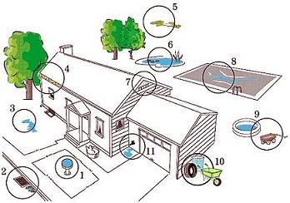
Aedes Genus Mosquitoes
A. aegypti are urban & peri-urban dwellers ¹⁸
Generally live in and around homes
Females lay their eggs in containers that contain water
A. albopictus are found in rural environments and the forested fringe of suburban areas¹⁷
Females lay their eggs in or near stagnant water sources outdoors, preferably near flowers
Eggs can survive 8-12 months under the right conditions
25% Mean Monthly Relative Humidity¹⁹
200 mm annual rainfall²⁰
Notes:
Understanding the environment of the Aedes genus mosquito helps in modeling their distribution and their interaction with human activity spaces.
A. aegypti are urban & peri-urban dwellers, generally living in and around human dwellings. Females lay their eggs in artificial containers that contain water such as bird baths, under a leaky faucet, or indoors in something as innocuous as a flower vase.
A. albopictus are found in rural environments and the forested fringe of suburban areas. Females lay their eggs in or near stagnant natural water sources outdoors, preferably near flowers
Eggs can survive 8-12 months under the right conditions where there is >=25% Mean Monthly Relative Humidity and more than 200 mm annual rainfall. These are important to note as these environmental constraints bound suitability for survival of the vector, which is the primary mode of virus transmission.

Slide 10
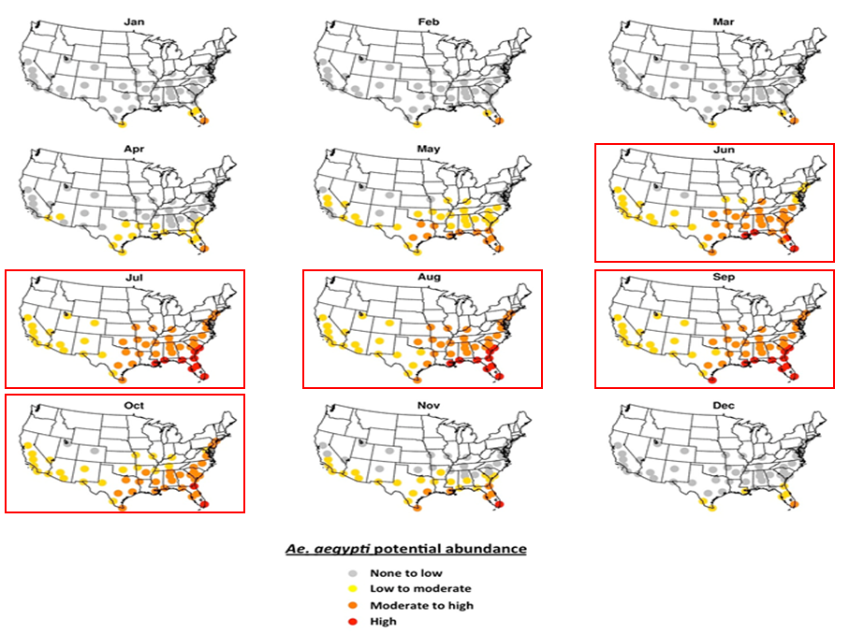
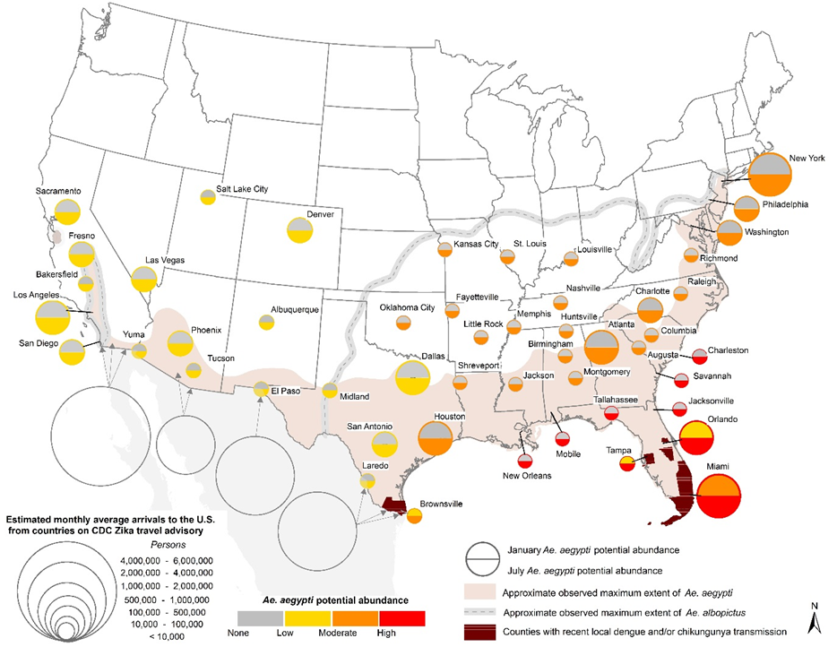
Aedes Genus Distribution
Both vectors are found in North America²¹
A. albopictus has the greatest spatial range in the United States²¹
50 cities in the U.S. were found to have a low to moderate population of A. aegypti for at least 5 months of the year²²
Aedes aegypti
Aedes albopictus
Notes:
[Click] At a global level the Aedes genus mosquitoes have a distributed presence through the equatorial tropics and sub-tropics, and more recently have begun migrating into temperate latitudes. These maps were made by Kraemer in 2015, and are important for understanding areas that are potentially suitable for the Zika vectors. A. albopictus, commonly referred to as the Asian Tiger Mosquito, only arrived in the United States in the 1980s, now maintaining the largest presence of both mosqutioes.
[Click]
Mongahan, et al. researched the presence of both mosquitoes in 50 cities in the continental United States finding that all 50 cities had some seasonal presence of the mosquitoes.
[Click]
Deconstructing their findings by month, he found that all 50 cities have Aedes genus mosquitoes present at a low to moderate level for at least 5 consecutive months of the year. They also found that it took three months for the mosquitoes to establish a sustained, albeit seasonal, presence; another important environmental constraint in modeling transmission suitability.

Slide 11
ZIKV Transmission Dynamics - IIP/EIP
Incubation Periods
Intrinsic: 3-12 days ²⁴
Extrinsic
A. aegypti: 5-15 days¹⁸
A. albopictus: 7-10 days²³
Both are shorter with higher temperature & relative humidity
Mosquitoes are viremic for life²⁵
Humans are viremic for 2-7 days²⁵
Notes:
To model ZIKV for future climate scenarios I needed to understand the environmental and biological constraints that bound conditions for transmission, knowns as transmission dynamics.
The first critically important constraint is the time it takes for the virus to develop in the host or vector, at which point symptoms may appear and viremia begins. The intrinsic incubation period is the time it takes to develop in the host, which in this case is are humans. The extrinsic incubation period is the time that it takes to develop in the vector, or the mosquitoes.
The ranges shown here are directly affect by temperature and relative humidity. Higher temperatures and relative humidity will shorten both incubation periods, amplifying the virus in the bloodstream.
Once the virus has developed in the vector it becomes viremic for the rest of its life, able to infect anyone it bites. Humans are viremic for a period of 2-7 days, at which point a mosquito may contract the virus if it bites the person. Studies have shown that the virus can be detected up to 188 days after infection as RNA in seminal fluid, which is why the CDC advises to abstain from sexual activity for 6 months after confirming an infection.

Slide 12
ZIKV Transmission Dynamics - Temps
ZIKV transmission to humans²⁶
Substantial: 23-32ºC
Peaking: 27-29ºC
A. aegypti²⁶
Peaks: 29ºC
Zero: below 14-18ºC and above 34-35ºC
A. albopictus²⁶
Peaks: 26ºC
Zero: below 11-16ºC and above 28-32ºC
Virus cannot live in temperatures above 60ºC²⁷
Notes:
The second environmental factor that constrains transmission of the virus between the vector and host is temperature. Mordecai, et al., identified temperature as the most important factor in transmission of ZIKV, an assertion that further reinforces the research of Messina, et al., Fischer, et al., and Craig.
In their research they found, overall, transmission to humans from vectors to be substantial between 23-32ºC, peaking between 27-29ºC.
A. aegypti has the higher range for transmission, with the virus able to be transmitted between 14-18ºC and 34-35ºC, peaking at 29ºC.
A. albopictus has the lower range for transmission, with the virus able to be transmitted between 11-16ºC and 28-32ºC, peaking at 26ºC.
These temperatures are a function of both biological processes and the mosquitoes physical tolerance to temperature changes. A. albopictus has increased tolerance to lower temperatures, which is one important reason it is the more prevalent species in North America.

Slide 13
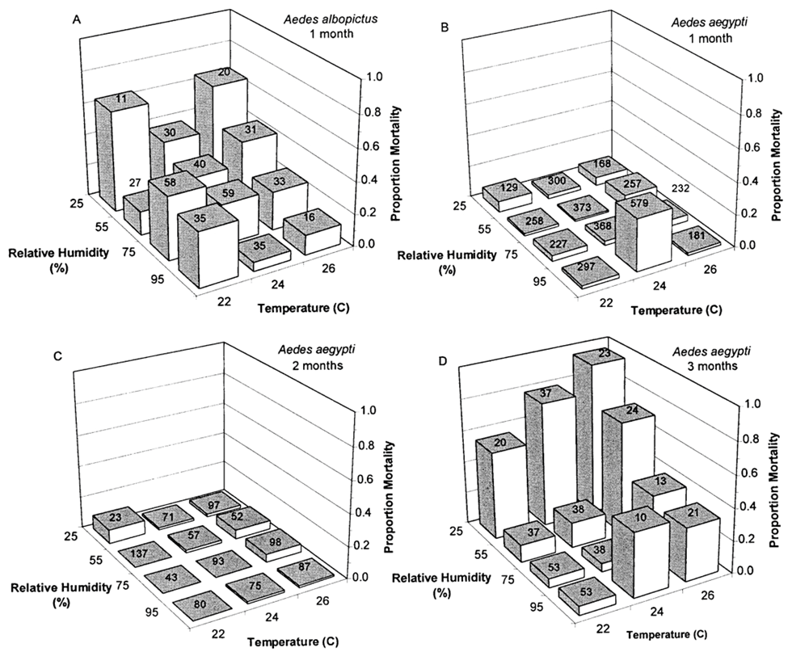
ZIKV Transmission Dynamics - Precip
Precipitation is necessary for vector presence
Required for oviposition
Indirectly tied to vegetation that A. albopictus feeds on
Minimum of 200 mm annual rainfall required for vector survival and competence²⁰
Increases relative humidity(RH), preventing desiccation of eggs and adult vector
High mortality of A. albopictus when RH below 25% for one month¹⁹
High mortality of A. aegypti when RH below 25% for three months¹⁹
Notes:
The third, albeit indirect but critically important, environmental constraint to transmission is precipitation and, to a slightly less extent, relative humidity. While precipitation does not expressly change the dynamic of transmission between a vector and a host it does affect the presence of the vector, and relative humidity which may affect transmission.
Remembering that A. albopictus is not a domestic species, precipitation influences its presence more than it does for A. aegypti. Precipitation fills containers and natural pools with the water necessary for female mosquito to oviposit, the technical term for laying eggs. Because A. albopictus is the most sensitive to rainfall, its annual precipitation requirement of 200 mm will be the constraint for both vectors in this study.
Higher precipitation is can also be associated with the presence of the flowering and fruit-bearing vegetation that female mosquitoes use to feed themselves in the absence of blood meals.
While prolonged arid conditions can completely eradicate the mosquito, conversely, torrential conditions only temporarily disrupt the mosquitos presence.
Relative Humidity has shown to have an effect on vector survival and competence. A. albopictus eggs are the most sensitive to dessication when not submerged, experiencing high mortality below 25% relative humidity for a period of only a month. A. aegypti experience high mortality when relative humidity is below 25% for a period of 3 months.
Studies have also linked relative humidity to biting behavior and transmission suitability of ZIKV.

Slide 14
ZIKV Transmission Cycle/Season
Transmission cycle – time it takes for a mosquito to reach adult hood, contract the virus, become infectious, and bite a host, infecting them
Sum of:
The time that a virus takes to achieve viremia in a host (3-12 Days) (Petersen, 2016) (Loos, 2014)
The period of viremia in an infected host (1-7 Days) (CDC, Zika Virus, 2016)
The time it takes for a female mosquito to develop to an adult
A. aegypti: 8-14 days ¹³
A. albopictus: 9-12 days¹²
The lifespan of a vector minus the extrinsic incubation period of the virus in the vector
A. aegypti: (14-28 days)¹⁸ – (5-15 days)¹⁸
A. albopictus: (30-40 days)²⁸ – (7-10 days)²³
Transmission Cycle Period
A. albopictus: 34-61 days
A. aegypti: 21-46 days
Transmission season = time for vector to achieve sustained presence (3 months)²² + Transmission Cycle Period (21-46 days, 34-61 days) = 4 to 5 months
Notes:
Understanding the vector lifecycle, temperature, rainfall, and RH constraints on the vector allow the transmission cycle to be established. The arbovirus transmission cycle is the time it takes for a mosquito to reach adulthood, become infectious, and then bite a host, passing the virus along (Weaver, 2004).
For the purposes of this study an assumption of the most prolonged transmission cycle will be used, which is the scenario of an imported case of ZIKV into an area where either mosquito is present, which is the sum of the following:
The intrinsic incubation period of a host
The period of viremia in an infected human host
The time it takes for a female mosquito to achieve adulthood
The lifespan of the female mosquito minus the extrinsic incubation period of the virus in the vector
This resulted in the total transmission cycle for each vector, which was found to be 34-61 days for A. albopictus and 21-46 days for A. aegypti.
A transmission season will be defined as the time it takes for either mosquito population to achieve a sustained presence, which was found to be 3 months, plus the transmission cycle of the ZIKV. Think of the transmission season as a window of opportunity for an outbreak to occur.
A. aegypti has a transmission season of approximately 4 months, while A. albopictus has a transmission season of approximately 5 months.

Slide 15
ZIKV: Epidemiological Triad
Virus: Zika Virus
Extrinsic Incubation Period:
A. aegypti 5-15 days, A. albopictus 7-10 days
Intrinsic Incubation Period: 3-12 days in humans
Suitable Transmission Temperatures:
A. aegypti: (14-18ºC ) – (34-35ºC), peaking at 29ºC
A. albopcitus: (11-16ºC) – (28-32ºC), peaking at 26ºC
Defines the most critical factors to virus transmission
Interrupting one of the factors of the triad will stop the spread of the virus
What
AGENT
Aedes Genus
Mosquito
VECTOR
Who
HOST
Where
ENVIRONMENT
Hosts: Humans, non-human reservoirs in North America have not been established yet
Exposure Behavior:
A. albopictus bites during daytime hours, in the outdoors near vegetated areas
A. aegypti bites in the post-dawn and pre-dusk hours directly in or near by human dwellings
Climate: >= 200 mm annual precipitation. High mortality for A. albopictus < 25% monthly relative humidity and <25% for A. for three months. Temperature between 11-40ºC. Oviposit in or adjacent to stagnant water containers or pools.
Environment:
Areas below 2000 meters elevation
A. aegypti – urban, peri-urban, and suburban areas
A. albopictus – rural areas and forested suburban fringe
Notes:
The epidemiological triad is an important tool for epidemiologist who use it to define the critical factors for a sustained outbreak of a disease.
The four components that make up an epidemiological triad for the ZIKV are:
The vector or intermediate host itself
The Agent, or virus, and its critical attributes, such as extrinsic and intrinsic incubation periods, and transmission suitability temperature ranges
The Host, which can be the primary hosts which are organisms directly affected by the virus and reservoir hosts that carry the virus but do not exhibit symptoms. This includes the activity space of the hosts where they can contract the virus.
Finally, the Environment, which can be defined as the climactic and environmental factors that influence a vectors presence and biting behavior.
The underlying concept of the epidemiological triad is that an interruption to one of the primary factors can help slow or stop the spread of the virus. For example, installing and actively using screens on windows and doors, using air conditioning, using a mosquito repellent, and emptying water containers within 200-400 meters of your activity space (be it your home, school, workplace, or recreational area) will greatly reduce a vectors presence and the potential for infection.

Slide 16
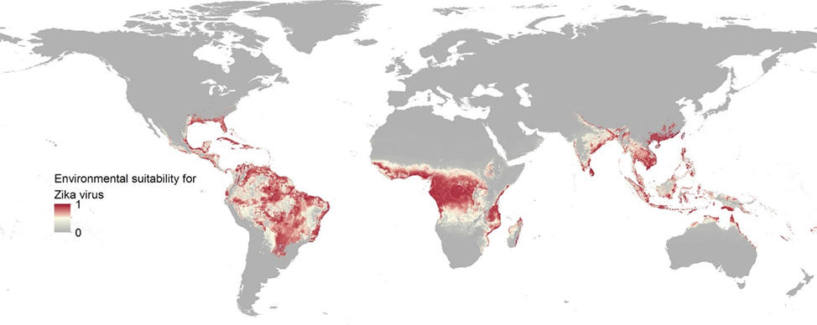
Modeling Current ZIKV Environmental Suitability
Messina, et al., studied current conditions to model global ZIKV transmission suitability²⁹
Used a boosted regression tree analysis to identify constraints for environmental factors and gradient boosting to produce their map²⁹
Temp suitability for transmission to humans from A. aegypti
Temp suitability for transmission to humans from A. albopictus
Minimum Relative Humidity
Annual Cumulative Precipitation
Enhanced Vegetation Index (EVI)
Urban vs Rural Habitats (Land Use)
Notes:
Now that we have an understanding of how the virus is spread we can evaluate similar studies for methodology for modeling arbovirus transmission suitability.
This year (2016) Messina, et al., published their findings that outline the current environmental suitability for ZIKV transmission across the globe. To calculate this information they chose to model ZIKV on a mix of known environmental suitability factors for Dengue and explanatory environmental covariates found around georeferenced ZIKV occurrences, which are:
Temp suitability for transmission to humans from A. aegypti & A. albopictus
Minimum Relative Humidity
Annual Cumulative Precipitation
Enhanced Vegetation Index (EVI)
Urban vs Rural Habitats (Land Use)
This study represents a good baseline for modeling future ZIKV transmission suitability against. The environmental factors listed in bold represent data that exists or can be created from future climate scenarios data. Both EVI and Land Use on the other hand are harder to predict, and while some models do exist for them in the future, there are many assumptions built into them that would reduce the efficacy of modeling future transmission suitability.

Slide 17
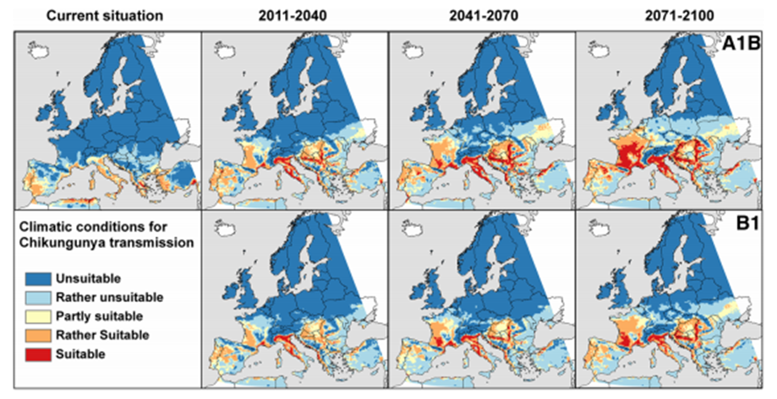
Modeling Future Chikungunya Environmental Suitability
Fischer, et al., modeled future transmission suitability using climate models³⁰
A1B Scenario – Increased emissions scenario
B1 Scenario - Sustainable emissions scenario
Researched environmental factors to constrain model³⁰:
Annual mean temperature
Annual Precipitation
Precipitation of the coldest and warmest quarters
Altitude
Notes:
In 2013, Fischer, et al., in response to an unprecedented outbreak in Italy, sought to understand the potential spread of Chikungunya throughout Europe in the future using climate change scenarios from the Intergovernmental Panel on Climate Change’s (IPCC) AR4 models, produced in 2007. Specifically they used two of the AR4 models:
The A1B, high emissions, scenario that shows the highest temperature increase, and
The B1, sustainable emissions, scenario that show the lowest temperature increase
They researched environmental factors that they believed to have an impact on the transmission suitability of Chikungunya
Annual mean temperature
Annual Precipitation
Precipitation of the coldest and warmest quarters
Altitude
They ran their model 100 times with a mixture of 70% training data and 30% testing data, averaging the results to produce the map seen here
The found both the minimum and maximum models expand the areas of transmission suitability northward. Interestingly as the threat moves northward areas in southern Europe and northern Africa become less suitable over time because the temperatures are too high for prolonged/sustained vector presence

Slide 18
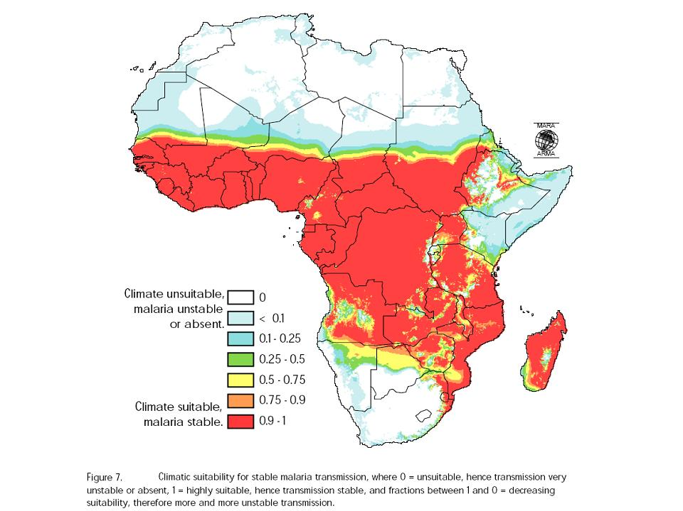
Modeling Malaria Transmission Suitability
Craig, et al., developed a fuzzy logic model of malaria transmission suitability³¹
Used two constrained environmental factors³¹:
Mean Temperature
Annual Rainfall
Evaluated transmission suitability seasons to produce an annual Malaria transmission suitability surface³¹
Notes:
In 1999 Craig, Snow, and le Sueur modeled malaria transmission in Sub-Saharan Africa using a fuzzy logic model. They were able to compute monthly transmission suitability using mean temperatures and annual rainfall as the environmental constraints, which where determined by examining cases of malaria throughout the different climates across the continent.
The monthly transmission suitability surfaces were used to develop transmission seasons, which were created for each month by comparing the values of 5 consecutive months, beginning that month, and taking the maximum suitability value at each location to produce the surface. Craig defined a transmission season as the time required for the vector to reach a sustained abundance at a location and complete a transmission cycle of the virus.
To complete the analysis all transmission season surfaces were compared, taking the minimum value at each location to produce an annual transmission suitability surface, as seen here. Surface values above zero indicate the presence of at least one transmission season where there was some degree of transmission suitability. This study showed an effective way to model transmission suitability, but I believe it could be improved upon, using data similar to what Messina used.

Slide 19
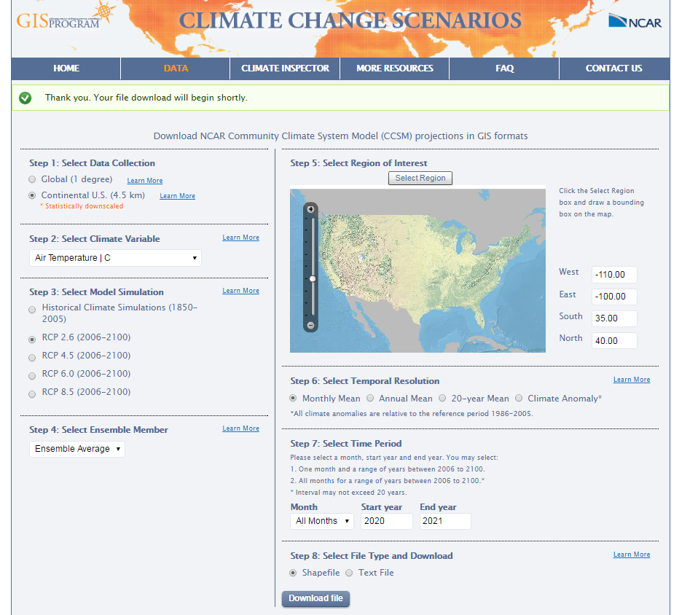
Research Objectives & Data Sources
Model ZIKV Transmission Suitability for the continental United States
For 2016, 2020, 2025, 2030, 2040, and 2050
Using the fuzzy logic model employed by Craig, et al.³¹
For both the B1 and A1B climate scenarios from the IPCC’s AR5 model (2013) for North America
Data sources:
United State’s National Center for Atmospheric Research (NCAR)³²
Monthly Mean Near Surface Temperature - 4.5 km resolution
Monthly Mean Precipitation – 4.5 km resolution
Near Surface RH – 1 degree resolution
ASTER V2 GDEM – 30 meter resolution Digital Elevation Model³³
Notes:
Now that there is an understand of ZIKV, the vectors that spread it, the transmission dynamics of the virus, and established methodology to analyze transmission suitability, a research objective and methodology can be defined.
For my capstone research I will be drawing primarily on the methodology of Craig, Snow, and le Sueur to evaluate transmission suitability for the continental United States for current and future scenarios, through 2050, using the variables Messina, et al., employed in their study and the climate models that Fischer, et al. employed in their study.
My data sources will be the 4.5 km high resolution dataset from the National Center for Atmospheric Research (NCAR). Similar to Fischer I will include altitude as a variable, with my data source being the ASTER V2 GDEM 30 meter resolution Digital Elevation Model.

Slide 20
Methodology
Rescale Climate Data: using a simple sigmoidal fuzzy membership curve
$$y= \cos^{2}\left[\frac{x−U}{S−U}∗ \frac{π}{2}\right]$$
Temperature Suitability
Relative Humidity (RH) Suitability
A. aegypti where S=25, U=95 for the 3 preceding months
A. albopictus where S=25, U=95 for the preceding month
Rainfall Suitability for Transmission where U=0 and S=200
Altitude Suitability for Vectors where S=-85 (lowest altitude in the continental United States, in meters) and U=2000
 | Increasing Curve |  | Decreasing Curve |  | Suitability
Species | U (ºC) | S (ºC) | S (ºC) | U (ºC) | Some Risk (ºC) | Increased Risk (ºC) | High Risk (ºC)
aegypti | 18 | 27 | 29 | 34 | 18-23,32-34 | 23-27,29-34 | 27-29
A. albopictus | 18 | 25.5 | 26.5 | 28 | 16-23 | 23-25.5,26.5-28 | 25.5-26.5
Notes:
Following the methodology utilized by Craig, Snow, and le Sueur, can be broken down into the following steps.
Rescale Climate Data: The pertinent climate data outlined by Messina, et al., will need to be rescaled to between 0 (unsuitable transmission conditions) and 1 (suitable transmission conditions) using a simple sigmoidal fuzzy membership curve. This will be done for temperature suitability for each vector as seen in the table, then relative humidity suitability for each vector, then rainfall suitability, and finally altitude suitability.

Slide 21
Methodology (Continued)
Compute ZIKV transmission suitability for each month
Take maximum temperature suitability value for either vector
Take maximum RH suitability value for either vector
Take minimum of the climatic variables (Temp, RH, Precip, Altitude) at each location
Compute ZIKV transmission seasons – For each month, at each location, compare the transmissions suitability values of that month and the next three months, taking the maximum value to calculate the transmission season
Combine transmission seasons surfaces to create an annual ZIKV transmission suitability surface – For each location, compare the 12 ZIKV transmission suitability surfaces, taking the minimum value,
Notes:
Second, I’ll compute monthly transmission suitability of the dynamic climatic variables for each location by first identifying the maximum value of temperature suitability values between the vectors, then identifying the maximum value of the relative humidity suitability values for the vectors, the rainfall suitability value, and the altitude suitability value, taking, of those, the minimum value to establish the monthly suitability for Zika transmission.
Third, I’ll compute the transmission seasons. Craig, Snow, and le Sueur defined a, ‘Transmission Season,’ as the time window that was, ‘long enough for vector populations to increase and for the transmission cycle to be completed’ (Craig, 1999). Monaghan, et al., established that it takes three months for A. aegypti and A. albopictus to reach a moderate abundance in the continental United States (Monaghan, 2016). The transmission cycle for A. aegypti is 21-46 days while the transmission cycle for A. albopictus is 34-61 days; because of the variability in transmission cycle ranges for the purposes of this study the transmission cycle will be one month. The transmission season will be four months, which will be determined for each month by taking the highest monthly transmission suitability value spanning the chronological four-month period at each location.
Finally, I’ll combine the transmission season surfaces to create an annual transmission suitability surface by taking the minimum value for each location from any of the transmission season surfaces for that year.

Slide 22
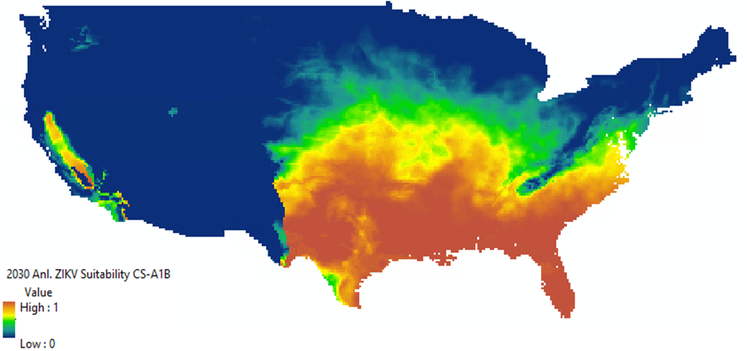
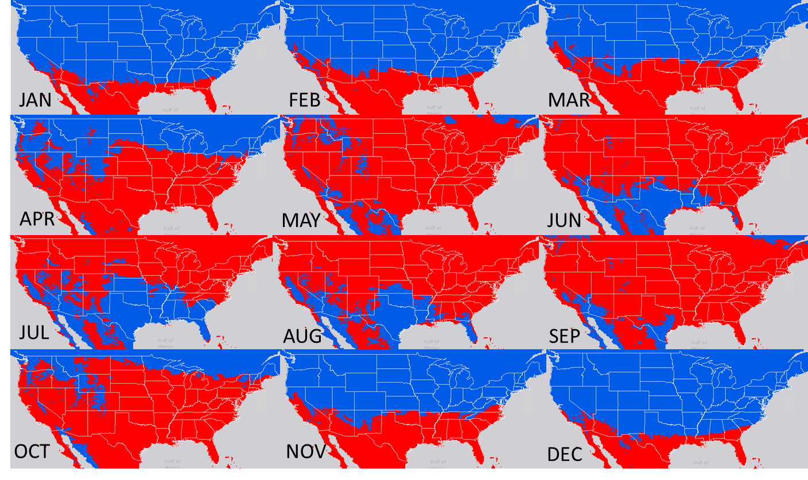
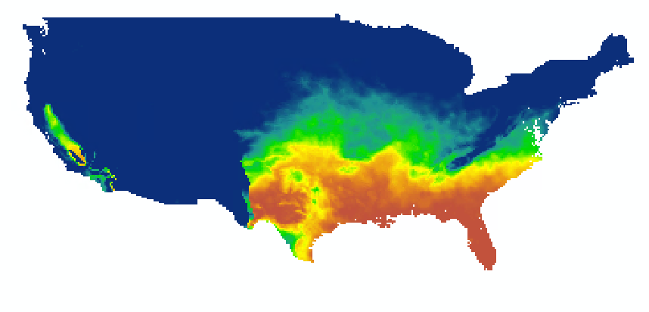
Expected Outcomes
Annual Transmission Suitability Maps
Analytical Time Series for Anomalous Findings
2030 A1B Transmission Suitability
2050 A1B Transmission Suitability
Notes:
The expected outcome for the research will be Annual ZIKV Transmission Suitability Maps for each year, for both climate scenarios.
If there are anomalous findings, I will deconstruct the analysis to identify what environmental variable(s) are contributing the their result.
Finally a detailed interpretation and write-up of my findings will be produced.

Slide 23
Research Timeline to Completion
Data Collection & Preprocessing – November 2016
Data Analysis – December 2016
Draft Report & Presentation – January 2017
Finalize Report & Presentation – February 14th, 2017
Submit Final Abstract – February 23rd, 2017
Notes:
Read slide

Slide 24
Conference Timeline
American Association of Geographers Annual Meeting –Boston: April 5-9, 2017
The timeline for preparing for that meeting is as follows:
October 27, 2016: abstract submission deadline
November 17, 2016: session organization deadline
February 23, 2017: deadline for submitting poster abstracts
February 23, 2017: abstract and session editing deadline
April 5 - 9, 2017: AAG 2017 Boston Annual Meeting
Notes:
Read slide

Slide 25
QUESTIONS?

Slide 26
References
CDC. (2016, Juy 13). Zika virus disease in the United States, 2015-2016. Retrieved from Centers for Disease Control and Prevention: http://www.cdc.gov/zika/geo/united-states.html
Goldschmidt, D. (2016, July 29). Florida health officials confirm local Zika transmission. Retrieved from CNN.com: http://www.cnn.com/2016/07/29/health/florida-health-officials-confirm-local-zika-transmission/
McMichael, A. W. (2006). Climate change and human health: present and future risks. Lancet, 860-869. doi:10.1016/S0140-6736(06)
Dasgupta, S. R.-S.-D. (2016, April 22). Patterns in Zika Virus Testing and Infection, by Report of Symptoms and Pregnancy Status — United States, January 3–March 5, 2016. Retrieved from Centers for Disease Control and Prevention : http://www.cdc.gov/mmwr/volumes/65/wr/mm6515e1.htm
Hahn, M. E. (2016, June). Reported Distribution of Aedes (Stegomyia) aegypti and Aedes (Stegomyia) albopictus in the United States, 1995-2016 (Diptera:Culicidae). Journal of Medical Entomology.
WHO. (2016, July 15). Zika Virus. Retrieved from World Health Organization: http://www.who.int/mediacentre/factsheets/zika/en/
CDC. (2016, July 15). CDC Concludes Zika Causes Microcephaly and Other Birth Defects. Retrieved from Centers for Disease Control and Prevention: http://www.cdc.gov/media/releases/2016/s0413-zika-microcephaly.html
CDC. (2016, July 15). Zika and Guillain-Barre Syndrome. Retrieved from Centeres for Disease Control and Prevention: http://www.cdc.gov/zika/about/gbs-qa.html
Hennessey M, F. M. (2016, January 22). Zika Virus Spreads to New Areas — Region of the Americas. MMWR Morb Mortal Wkly Rep, pp. 55-58. Retrieved 7 15, 2016, from http://www.cdc.gov/mmwr/volumes/65/wr/mm6503e1.htm#suggestedcitation
WHO. (2016, April). Media centre - Dengue and severe dengue. Retrieved from World Health Organization: http://www.who.int/mediacentre/factsheets/fs117/en/
WHO. (2016, April). Media centre - Chikungunya. Retrieved from World Health Organization: http://www.who.int/mediacentre/factsheets/fs327/en/
Hawley, W. (1988). The biology of Aedes albopictus. Journal of the American Mosquito Control Association, 1-40
Oxitec. (2013, December 13). Life cycle of Aedes aegypti. Retrieved from www.prezi.com: https://prezi.com/5a5gamxqg-tb/life-cycle-of-Aedes-aegypti/
CDC. (2012, September 27). Mosquito Life-Cycle. Retrieved from Centers for Disease Control and Prevention: http://www.cdc.gov/dengue/entomologyecology/m_lifecycle.html
DengueVirusNet. (2016). Aedes aegypti. Retrieved from Dengue Virus Net: http://www.denguevirusnet.com/Aedes-aegypti.html
CDC. (2016). Dengue and the Aedes albopictus mosquito. Retrieved from Centers for Disease Control and Prevention: http://www.cdc.gov/dengue/resources/30jan2012/albopictusfactsheet.pdf
WHO. (2016). Dengue Control - The Mosquito. Retrieved from World Health Organization: http://www.who.int/denguecontrol/mosquito/en/
Zettel, C. K. (2008, May). Aedes Aegypti. Retrieved from Featured Creatures: http://entnemdept.ufl.edu/creatures/aquatic/Aedes_aegypti.htm
Juliano, S. O. (2002). Desiccation and thermal tolerance of eggs and the coexistence of competing mosquitoes. National Institute of Health, Oecologia, 458-469. doi: doi:10.1007/s004420100811
Proestos, Y. ,. (2015, February 16). Present and future projections of habitat suitability of the Asian tiger mosquito, a vector of viral pathogens, from global climate simulation. Philosophical Transactions of the Royal Society | Biological Sciences, 1-17. doi:DOI: 10.1098/rstb.2013.0554
Kraemer, M. S. (2015, June 30). The global distribution of the arbovirus vectors Aedes aegypti and Ae. albopictus. Retrieved from eLIFE: https://elifesciences.org/content/4/e08347
Monaghan, A. M. (2016). On the Seasonal Occurrence and Abundance of the Zika Virus Vector Mosquito Aedes Aegypti in the Contiguous United States. PLOS | Current Outbreaks. Retrieved from http://currents.plos.org/outbreaks/article/on-the-seasonal-occurrence-and-abundance-of-the-zika-virus-vector-mosquito-Aedes-aegypti-in-the-contiguous-united-states/
Wong, P.-S. L.-Z.-S.-C.-H. (2013). Aede(Stegomyia) albopictus (Skuse): A Potential Vector of Zika Virus in Singapore. PLOS | Neglected Tropical Diseases.
Petersen, E. W. (2016, March). Rapid Spread of Zika Virus in The Americas - Implications for Public Health Preparedness for Mass Gatherings at the 2016 Brazil Olympic Games. Internation Journal of Infectious Diseases, 44, 11-15.
LaBeaud, D.A.(2016, October 27). Zika Virus Infection: An overview. UpToDate.com. Retrieved from http://www.uptodate.com/contents/zika-virus-infection-an-overview
Mordecai, E. C. (2016, July 15). Temperature determines Zika, dengue and chikungunya transmission in the Americas. Retrieved from bioRxiv: http://biorxiv.org/content/biorxiv/early/2016/07/15/063735.full.pdf
Musso, D. G. (2016). Zika Virus. Retrieved from American Society for Microbiology | Clinical Microbiology Reviews.
Hartman, K. (2011). Aedes albopictus. Retrieved from Animal Diversity Web: http://animaldiversity.org/accounts/Aedes_albopictus/
Messina, J. K. (2016, April 19). Mapping global environmental suitability for Zika virus. eLIFE. doi:http://dx.doi.org/10.7554/eLife.15272
Fischer, D. T. (2013). Climate change effects on Chikungunya transmission in Europe: geospatial analysis of vector's climatic suitability and virus' temperature requirements. International Journal of Health Geographics, 12(51).
Craig, M. S. (1999). A Climate-based Distribution Model of Malaria Transmission in Sub-Saharan Afric. Parasitology Today, 15(3), 105-111.
NCAR (2016). Climate Change Scenarios. Retrieved from https://gisclimatechange.ucar.edu/gis-data-ar5
NASA(2016). EOSDIS. Retrieved from http://reverb.echo.nasa.gov/reverb/#utf8=%E2%9C%93&spatial_map=satellite&spatial_type=rectangle

