Slide 1
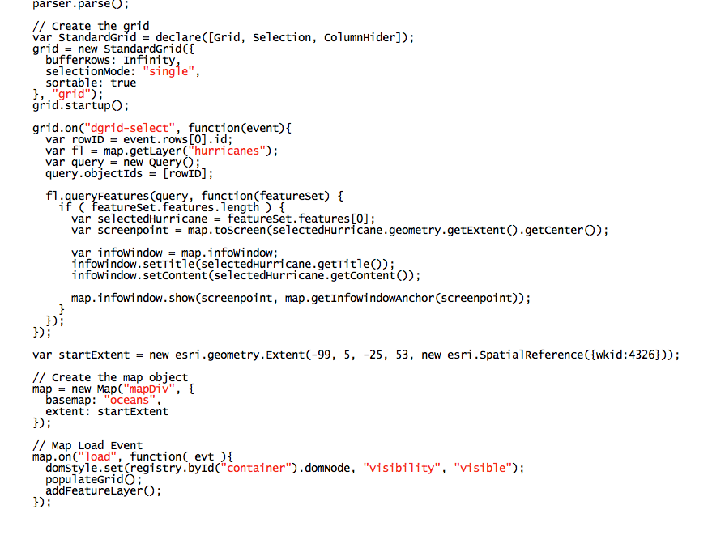
Assessing the Value of STEM The Geographic Distribution of Return on Investment for Science, Technology, Engineering, and Math College Degrees in the US
Advisor: Jim Detwiler Jackie Silber GEOG 596a – Summer 2017

Slide 2
Agenda
Background
Literature Review and Comparable Web Applications
Data Sources
Analysis Methodology
Technology Stack
Testing
Conclusion

Slide 3
Background
STEM: Science, Technology, Engineering, Math
2006: American Competitiveness Initiative introduced new standards for STEM
2016: $1 Billion in private investment for STEM education
Bi-Partisan support for STEM

Slide 4
Background
Knowledge-based economy
BLS predicts 9 million new STEM-related occupations between 2012 and 2022
“We cannot solve our problems with the same thinking we used when we created them.” – Albert Einstein

Slide 5
Background
College is expensive
Not all STEM jobs created equal
Predicted job availability varies by geography

Slide 6
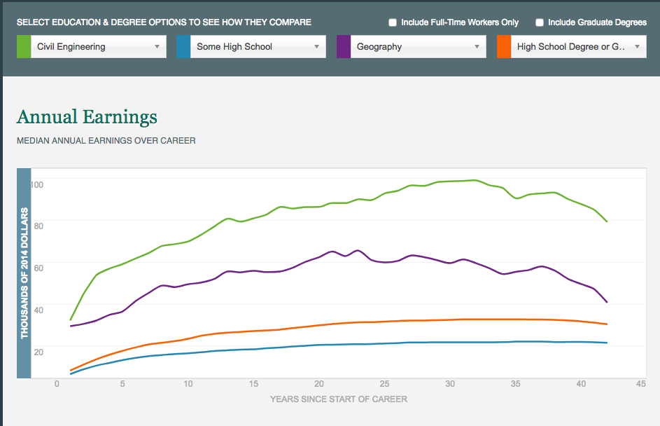
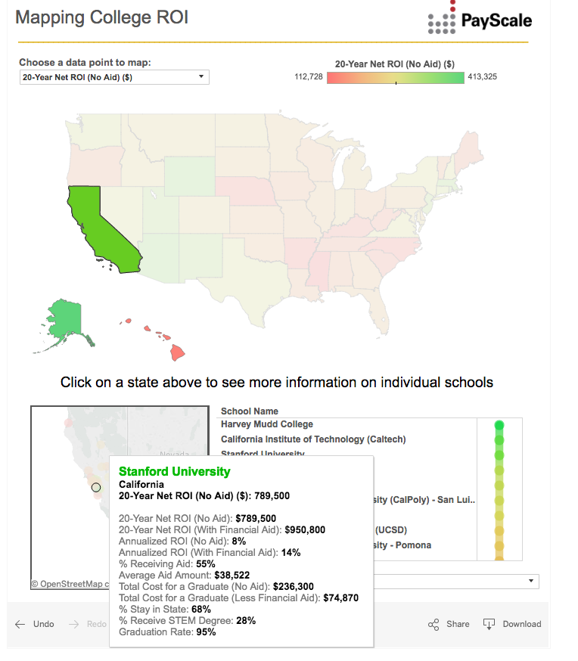
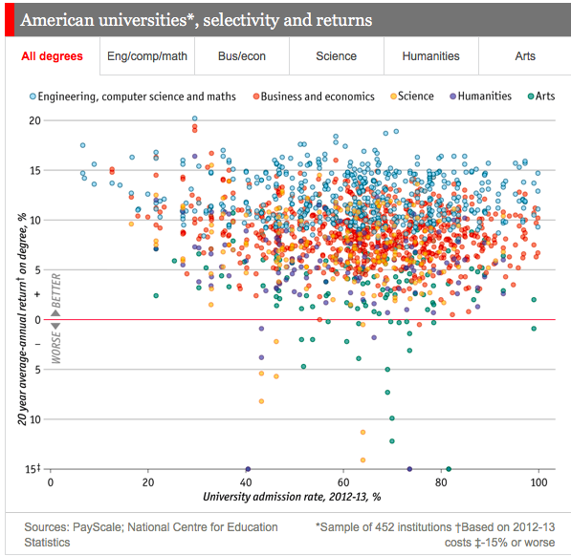
Lit Review

Slide 7
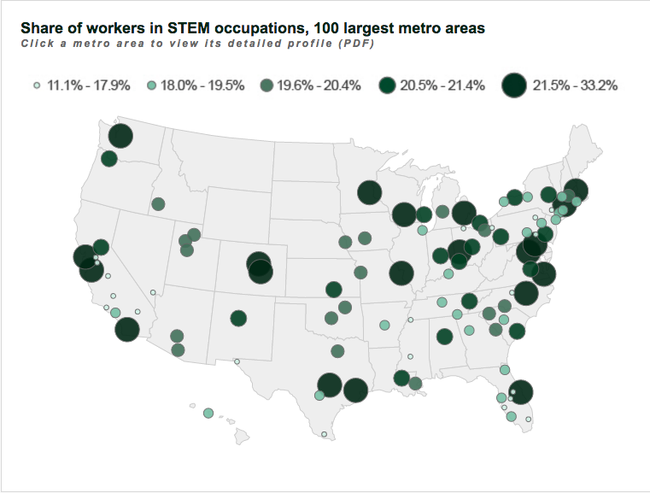
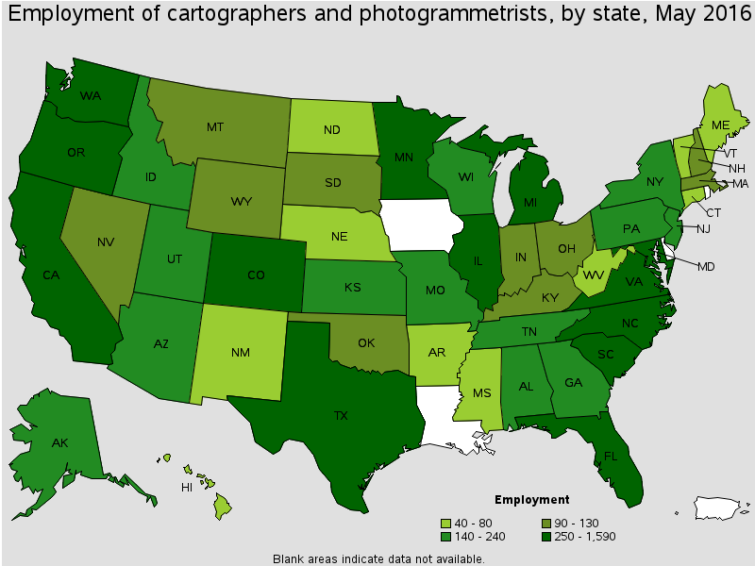
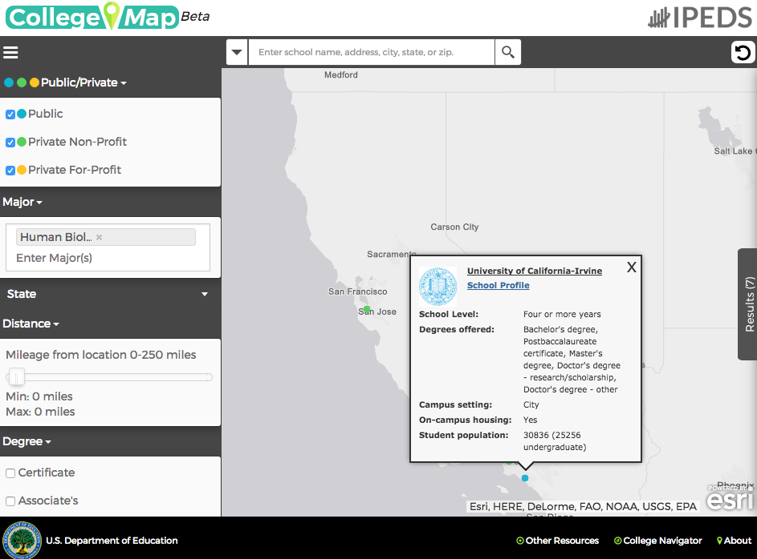
Lit Review

Slide 8
Lit Review Summary
 | Geographic Distribution | Annual Earnings | Estimated ROI | Cost of Tuition | Job Opportunities (Current/Projected) | Degrees Conferred by Major
Hamilton Report | -- | ✓ | -- | -- | -- | --
Payscale | ✓ | -- | ✓ | ✓ | -- | --
The Economist | -- | -- | ✓ | -- | -- | --
Brookings Institute | ✓ | -- | -- | -- | ✓ (Current) | --
BLS | ✓ | ✓ | -- | -- | ✓ (Current) | --
NCES | ✓ | -- | -- | ✓ | -- | ✓

Slide 9
Questions an App Should Answer
Do the early career earnings justify the tuition?
How does the ROI in my field compare to other states?
Is there a surplus or deficit of graduates for the current job market in my state?
Notes:
Image Source: https://openclipart.org/detail/77269/whatboy

Slide 10
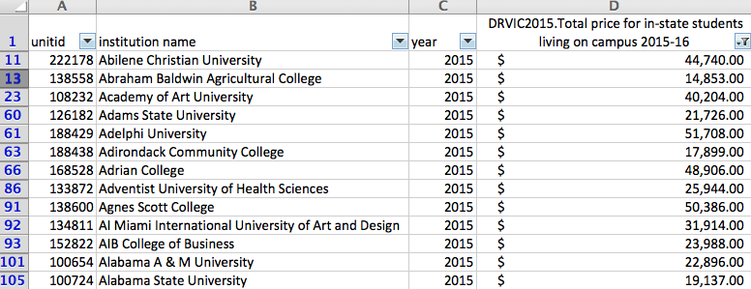
Data Sources
College Tuition
Notes:
Image Source: http://www.stickpng.com/img/electronics/monitors/mac-apple-monitor

Slide 11
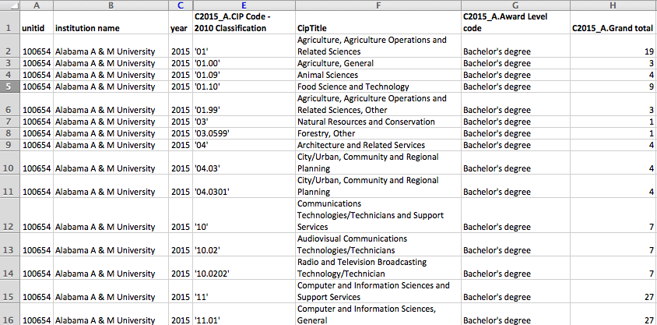
Data Sources
Conferred Degrees
Notes:
Image Source: http://www.stickpng.com/img/electronics/monitors/mac-apple-monitor

Slide 12
Data Sources
Defining STEM
Bureau of Labor Statistics: 2010 Standard Occupational Classification System
U.S. Immigration and Customs: Enforcement STEM Designation Degree Program List

Slide 13
Data Sources
Employment Salaries

Slide 14
Data Sources
Employment Projections

Slide 15
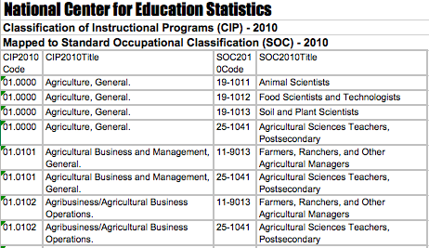
Data Sources
Tying Majors to Occupations

Slide 16
ROI Methodology
Starting Salary for Cartography Major in CA | $44,000
Peak Salary for Cartography Major in CA | $109,000
Annual Salary Increase over a 43 year Career | $1,500
Year 1 | $45,500
Year 2 | $47,000
Year 3 | $48,500
Year 4 | $50,000
Year 5 | $51,500
Year 6 | $53,000
Year 7 | $54,500
Year 8 | $56,000
Year 9 | $57,500
Year 10 | $59,000
Total 4-Year Tuition at CSUN | $84,000
Simplified Return on Investment (ROI) | 70%

Slide 17
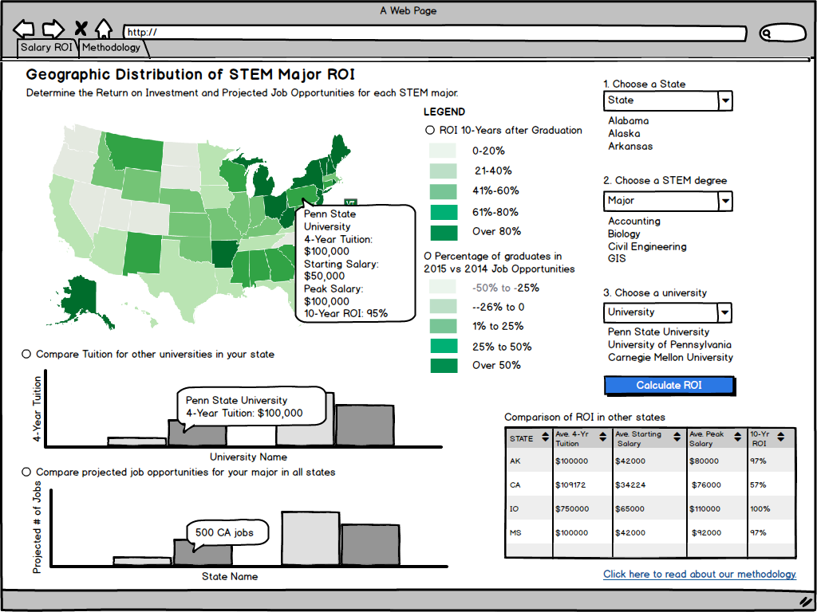
Interface
Tying It All Together

Slide 18
Technology Stack
HTML
CSS
JavaScript
jQuery UI
Google Maps API
Python
Flask
Ajax
MySQL
D3
JSON

Slide 19
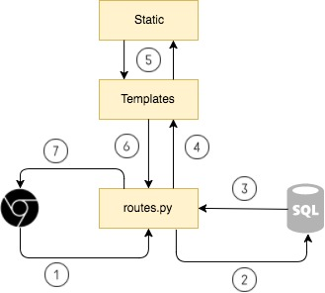
Request-Response Cycle

Slide 20
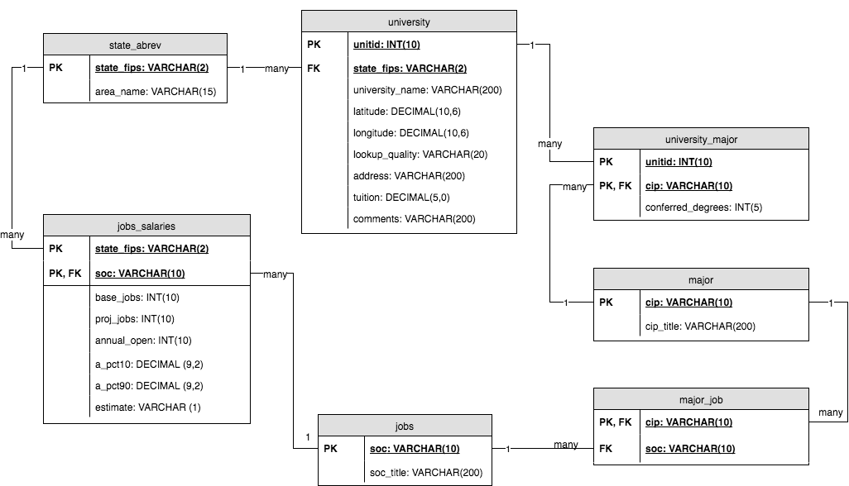
Database Design

Slide 21
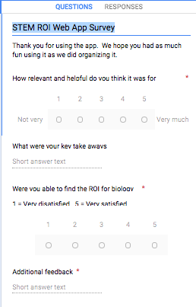
User Evaluation Testing
Three testers
Evaluate app using provided workflow
Feedback captured through Google Forms
Notes:
Image Source: http://www.stickpng.com/img/electronics/iphones/iphone-7-mockup

Slide 22
Timeline
Web app under development now
Abstract accepted at GIS in the Rockies (September 20-21)
Waiting to hear back from:
Association of Pacific Coast Geographers (October 25-28) and
California STEAM Symposium (December 10-11)
Notes:
And the development of this app is quite rapid.
In fact, I have been working on the front-end interface and back-end database development for the past few weeks.

Slide 23
Conclusion
Know Before You Go
Contact Info: jms1272@psu.edu
Notes:
Image Source: https://openclipart.org/detail/193065/graduation-hat

