Slide 1
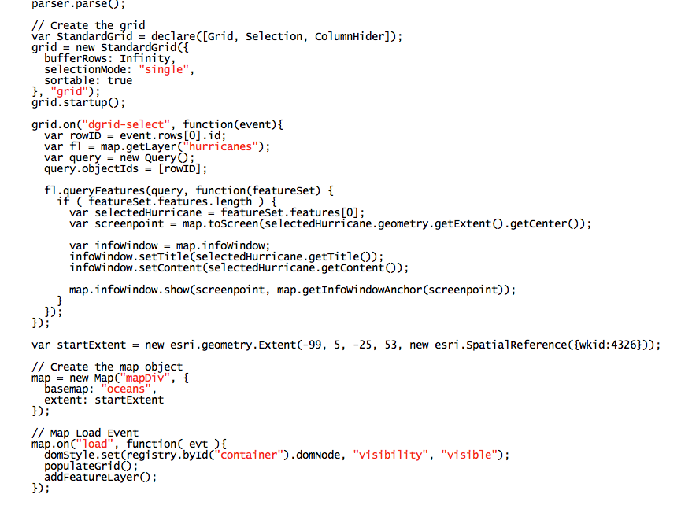
Assessing the Value of STEM Geographic Distribution of Science, Technology, Engineering, and Math Degree Return on Investment
Jackie Silber Pennsylvania State University MGIS Candidate Capstone Advisor: Jim Detwiler

Slide 2
“An investment in knowledge pays the best interest.”
Ben Franklin
Background
Lit Review
Data Sources
Methodology
Technology Stack
Testing Results
Conclusions
Questions
Demo
Notes:
Image Source: https://digitalcollections.nypl.org/items/510d47d9-4c9b-a3d9-e040-e00a18064a99

Slide 3
Not all STEM jobs created equal
Predicted job availability varies by geography
Background
Lit Review
Data Sources
Methodology
Technology Stack
Testing Results
Conclusions
Questions
Demo

Slide 4
Do the early career earnings justify the tuition?
How does the ROI in my field compare to other states?
Is there a surplus or deficit of graduates for the current job market in my state?
Background
Lit Review
Data Sources
Methodology
Technology Stack
Testing Results
Conclusions
Questions
Demo
Notes:
Image Source: https://openclipart.org/detail/77269/whatboy

Slide 5
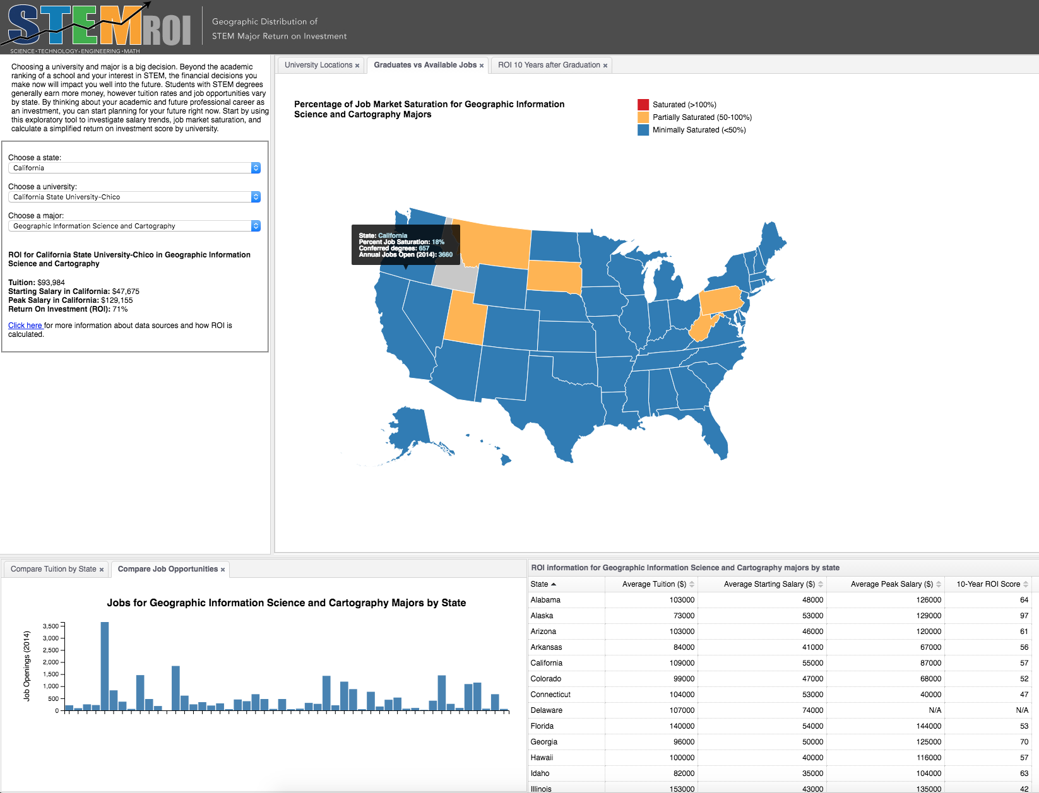
Background
Lit Review
Data Sources
Methodology
Technology Stack
Testing Results
Conclusions
Questions
Demo

Slide 6
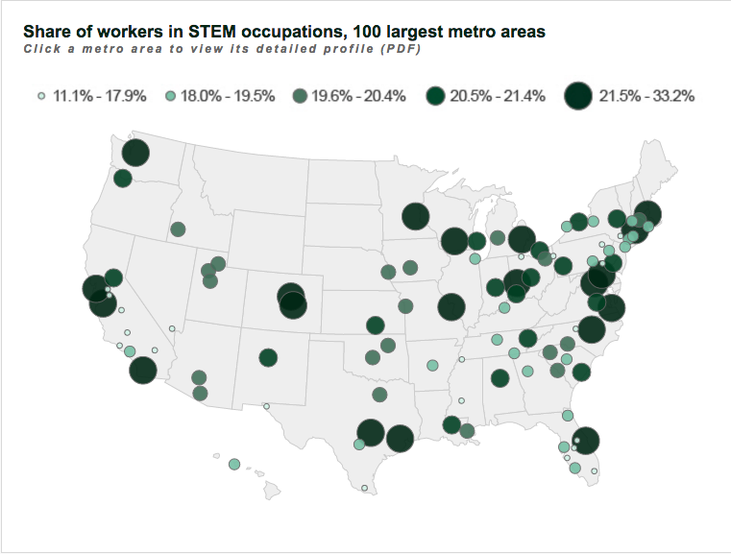
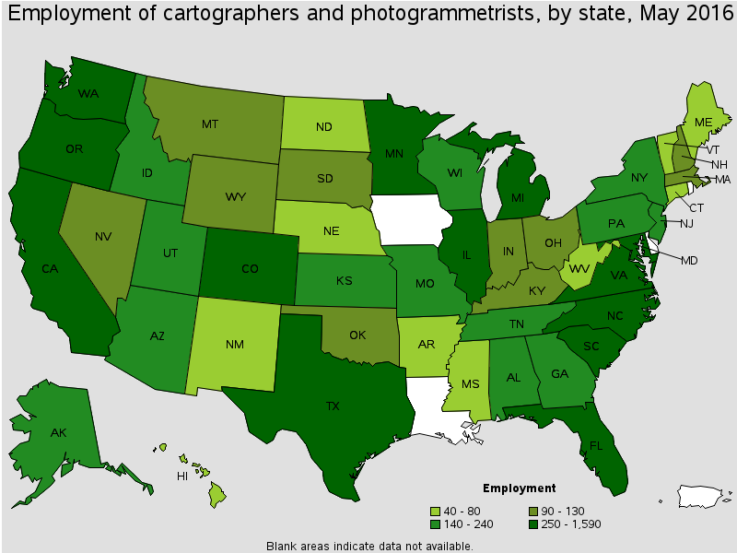
Brookings Institute
Re-defined STEM to include non-traditional, blue-collar jobs
Definition of STEM is fluid
Bureau of Labor Statistics
Current employment and salaries at state and locals
Projected employment data not available at local level
Background
Lit Review
Data Sources
Methodology
Technology Stack
Testing Results
Conclusions
Questions
Demo

Slide 7
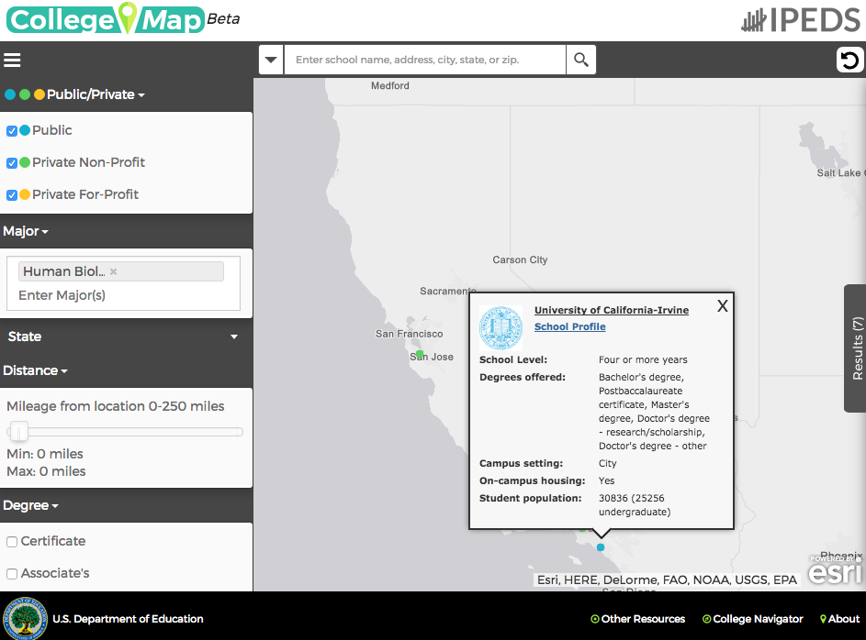
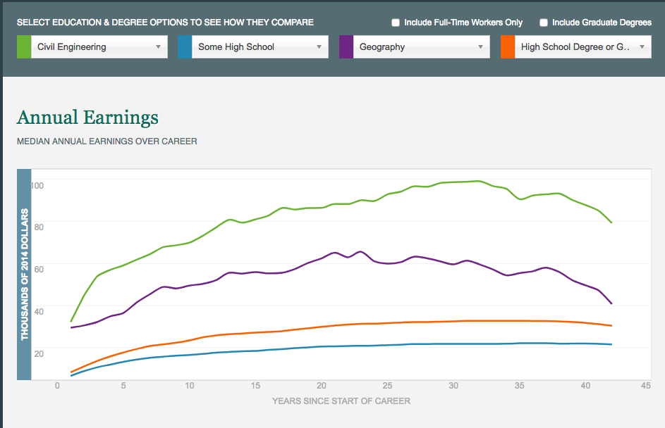
National Center for Education Statistics
Interactive map showing tuition, majors, and conferred degrees
Link to employment projections
The Hamilton Report
Compare annual lifetime earnings by STEM major
Missing geographic component
Background
Lit Review
Data Sources
Methodology
Technology Stack
Testing Results
Conclusions
Questions
Demo

Slide 8
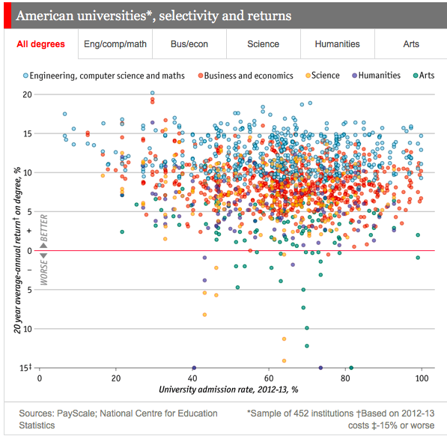
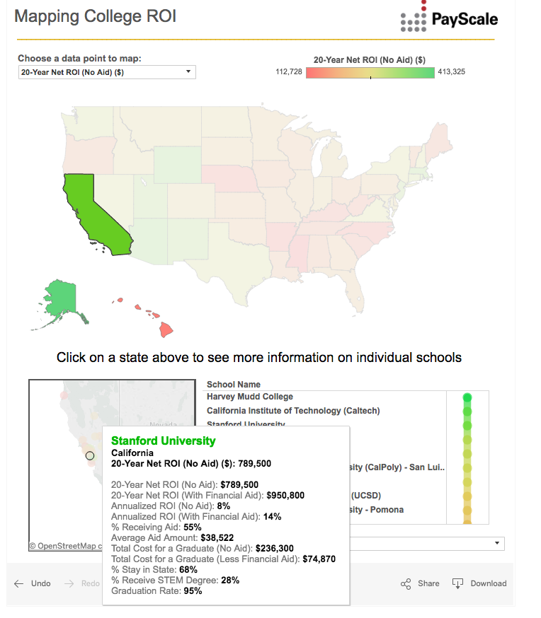
The Economist
20-year ROI vs university admission rate
Missing geographic component
Payscale.com
Detailed 20-ROI calculations for each university
Does not include employment projections
Background
Lit Review
Data Sources
Methodology
Technology Stack
Testing Results
Conclusions
Questions
Demo

Slide 9
 | Geographic Distribution | Annual Earnings | Estimated ROI | Cost of Tuition | Job Opportunities (Current/Projected) | Conferred Degrees by Major
Hamilton Report | -- | ✓ | -- | -- | -- | --
Payscale | ✓ | -- | ✓ | ✓ | -- | --
The Economist | -- | -- | ✓ | -- | -- | --
Brookings Institute | ✓ | -- | -- | -- | ✓ (Current Only) | --
BLS | ✓ | ✓ | -- | -- | ✓ (Current Only) | --
NCES | ✓ | -- | -- | ✓ | -- | ✓
Background
Lit Review
Data Sources
Methodology
Technology Stack
Testing Results
Conclusions
Questions
Demo

Slide 10
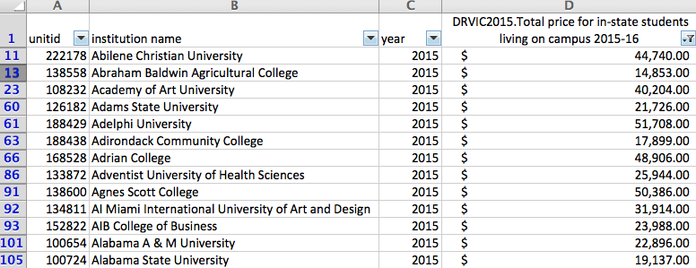
College Tuition
Background
Lit Review
Data Sources
Methodology
Technology Stack
Testing Results
Conclusions
Questions
Demo
Notes:
Image Source: http://www.stickpng.com/img/electronics/monitors/mac-apple-monitor

Slide 11
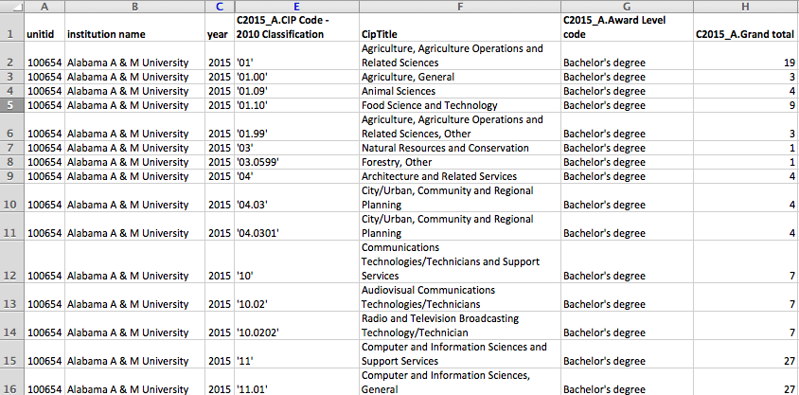
Conferred Degrees
Background
Lit Review
Data Sources
Methodology
Technology Stack
Testing Results
Conclusions
Questions
Demo
Notes:
Image Source: http://www.stickpng.com/img/electronics/monitors/mac-apple-monitor

Slide 12
Defining STEM
Bureau of Labor Statistics: 2010 Standard Occupational Classification System
U.S. Immigration and Customs: Enforcement STEM Designation Degree Program List
Background
Lit Review
Data Sources
Methodology
Technology Stack
Testing Results
Conclusions
Questions
Demo

Slide 13
Employment Salaries
Background
Lit Review
Data Sources
Methodology
Technology Stack
Testing Results
Conclusions
Questions
Demo

Slide 14
Employment Projections
Background
Lit Review
Data Sources
Methodology
Technology Stack
Testing Results
Conclusions
Questions
Demo

Slide 15
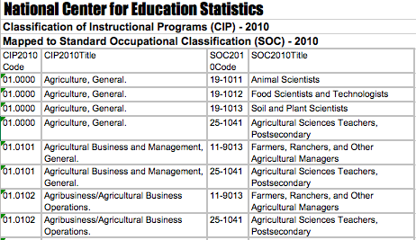
Tying Majors to Occupations
Background
Lit Review
Data Sources
Methodology
Technology Stack
Testing Results
Conclusions
Questions
Demo

Slide 16
ROI Methodology
Starting Salary for GIS & Cartography Major in CA | $47,000
Peak Salary for GIS & Cartography Major in CA | $130,000
Annual Salary Increase over a 43 year Career | $1,930
Year 1 | $48,930
Year 2 | $50,860
Year 3 | $52,790
Year 4 | $54,720
Year 5 | $56,650
Year 6 | $58,580
Year 7 | $60,510
Year 8 | $62,440
Year 9 | $64,370
Year 10 | $66,300
Total 4-Year Tuition at CSUN | $84,000
Simplified Return on Investment (ROI) | 79%
Background
Lit Review
Data Sources
Methodology
Technology Stack
Testing Results
Conclusions
Questions
Demo

Slide 17
HTML
CSS
JavaScript
jQuery UI
Google Maps API
Python
Flask
Ajax
MySQL
D3
JSON
Background
Lit Review
Data Sources
Methodology
Technology Stack
Testing Results
Conclusions
Questions
Demo

Slide 18
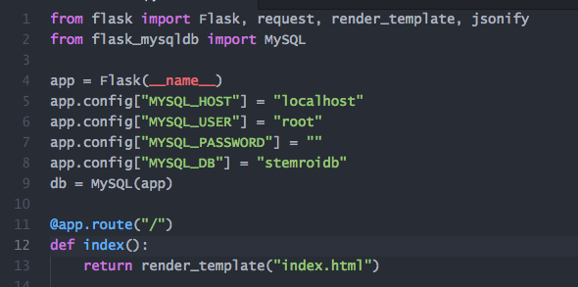
Flask Microframework
Background
Lit Review
Data Sources
Methodology
Technology Stack
Testing Results
Conclusions
Questions
Demo

Slide 19
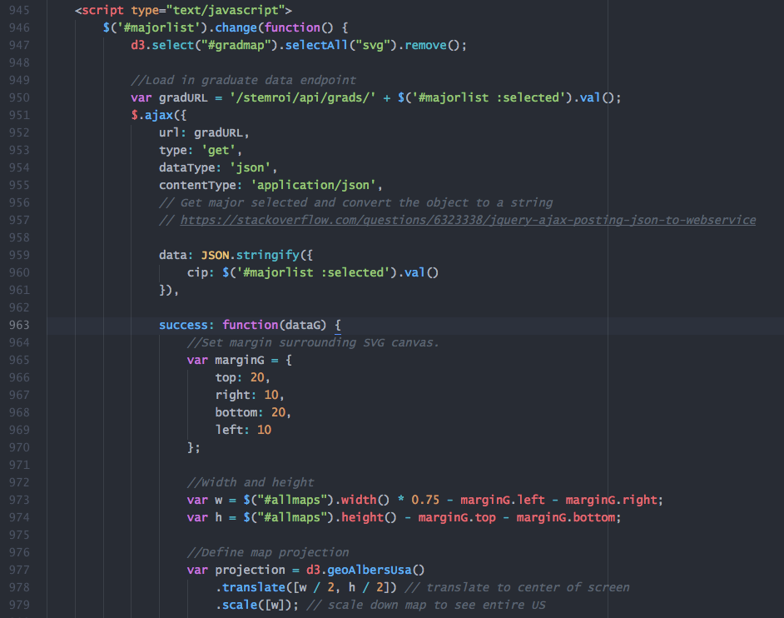
D3 Library
Background
Lit Review
Data Sources
Methodology
Technology Stack
Testing Results
Conclusions
Questions
Demo

Slide 20
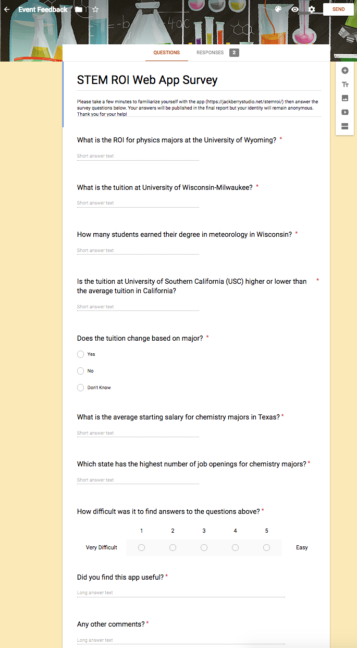
User Evaluation Testing
Three testers
Evaluate app using provided workflow
Feedback captured through Google Forms
Background
Lit Review
Data Sources
Methodology
Technology Stack
Testing Results
Conclusions
Questions
Demo
Notes:
Image Source: http://www.stickpng.com/img/electronics/iphones/iphone-7-mockup

Slide 21
Future Direction
Projected salaries at the local level
Sort programs by rankings
Calculate ROI based different school / job location
Optional ROI based on out-of-state tuition rate
Background
Lit Review
Data Sources
Methodology
Technology Stack
Testing Results
Conclusions
Questions
Demo

Slide 22
If you’d like to try it out for yourself, visit: https://jackberrystudio.net/stemroi
Background
Lit Review
Data Sources
Methodology
Technology Stack
Testing Results
Conclusions
Questions
Demo
Notes:
Image Source: https://openclipart.org/detail/193065/graduation-hat

