Slide 1
Geospatial Web App Development for The Center for Louisiana Studies Archive
Blake Simon
Penn State University
GEOG 596A
Advisor: Kristen Jordan

Slide 2
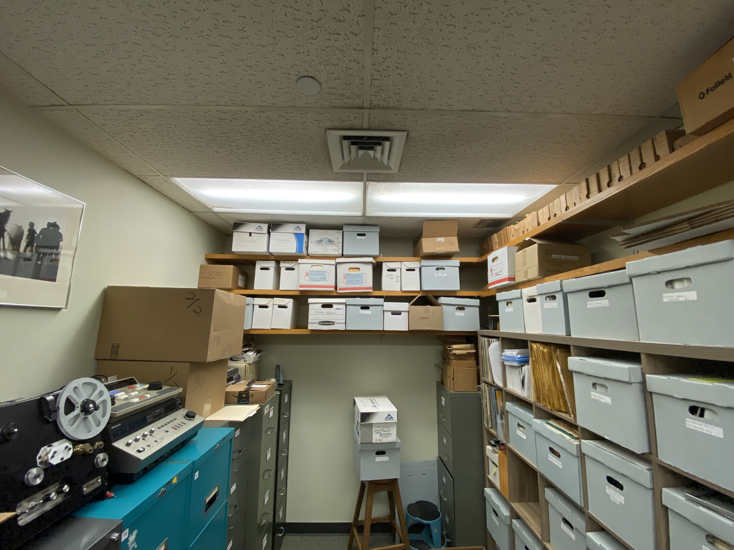
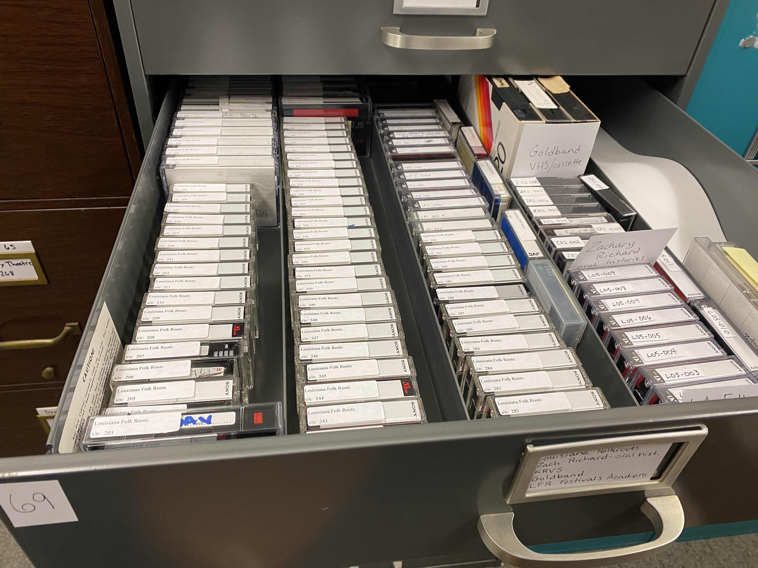
The University of Louisiana at Lafayette Center for Louisiana studies
Over 30,000 audio recordings, video recordings, and images
Between 1934 and present day
Preservation of Louisiana cultural resources

Slide 3
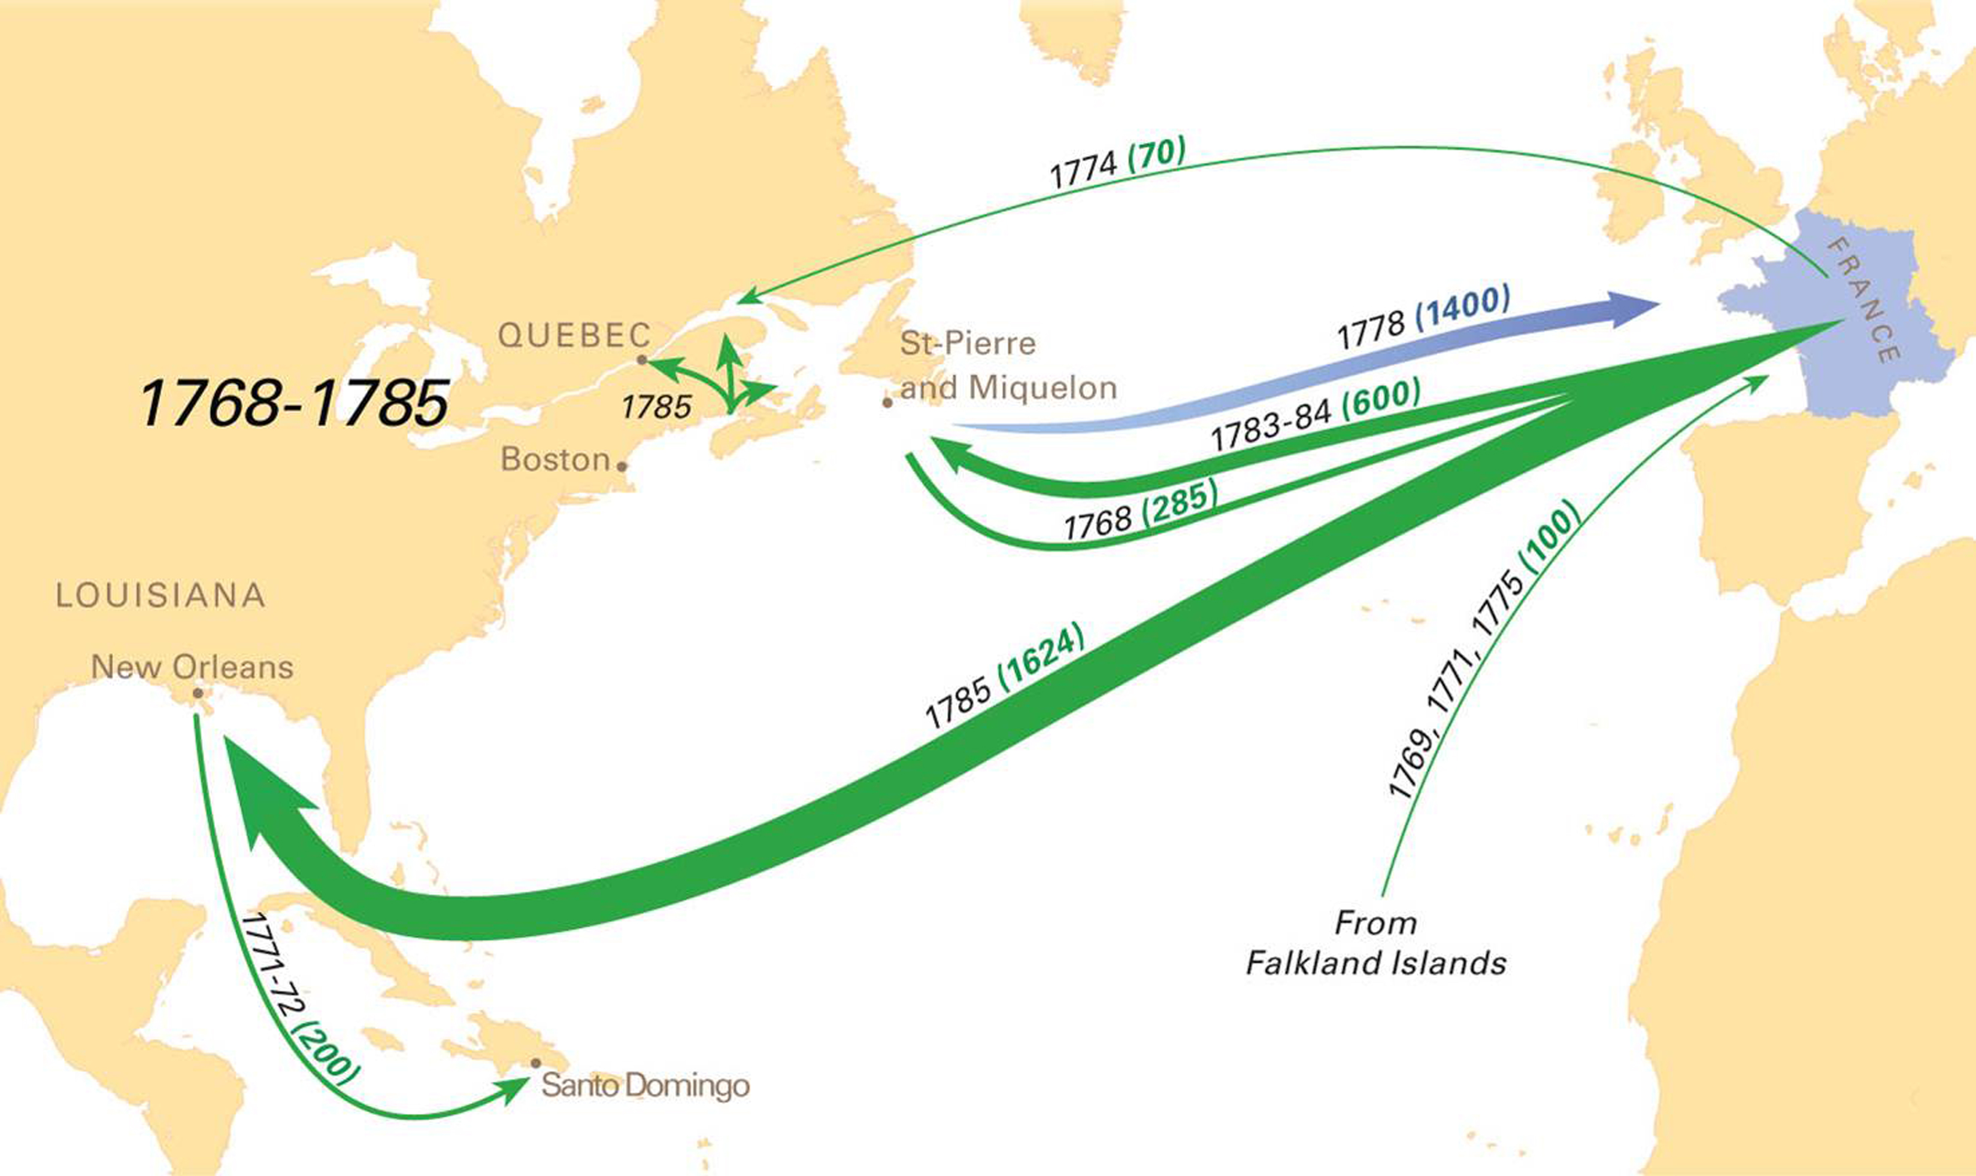
Cajun music
Cajun music
Researchers use the archives
Professional musicians
University of Maine

Slide 4
Cajun Culture influenced by food and environment

Slide 6
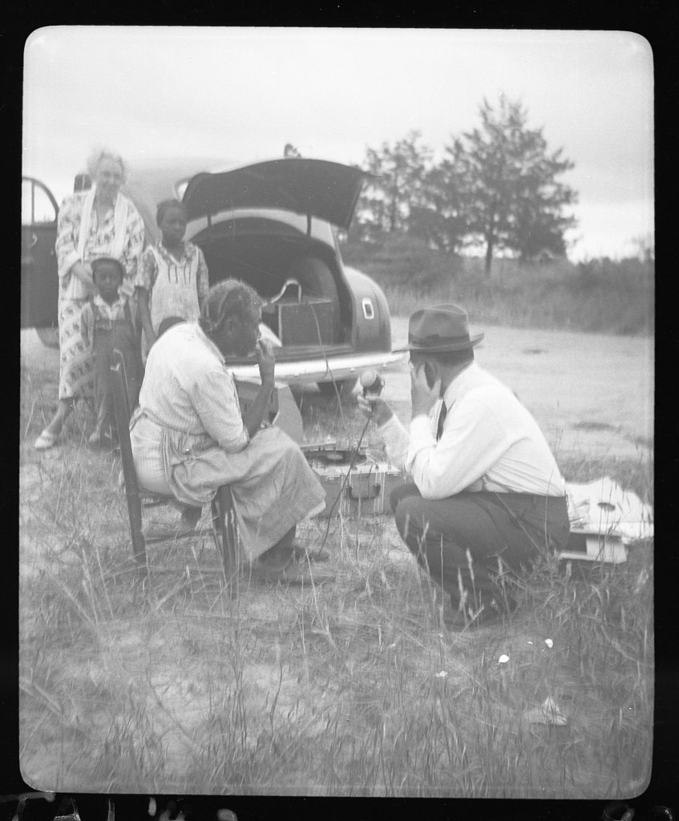
Alan Lomax

Slide 7
Current problem & Existing Database
Not interactive or interesting in only text
Hosted on Drupal platform
Accessed by the public through the University’s website
Geospatial component

Slide 8
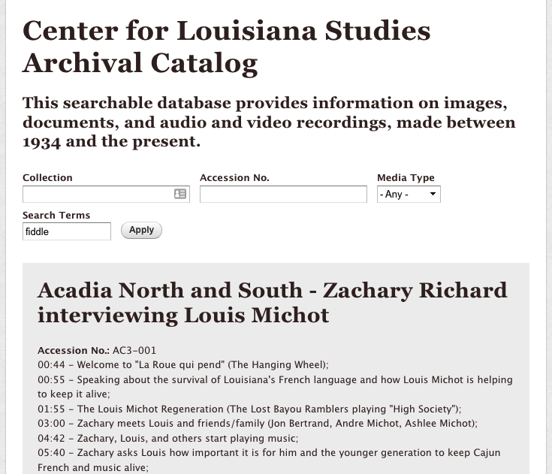
Current user interface

Slide 9
Goals and objectives
General Goals The Center has for this project:
Develop a geospatial Archive Data System
Long lasting with little maintenance

Slide 10
Goals and objectives
Specific Goals The Center has for this project:
Export current database
Creation of a Data Entry Web Application
Creation of an Archive Data Mapping/Querying Web Application
Creation of website to hold and link to applications

Slide 11
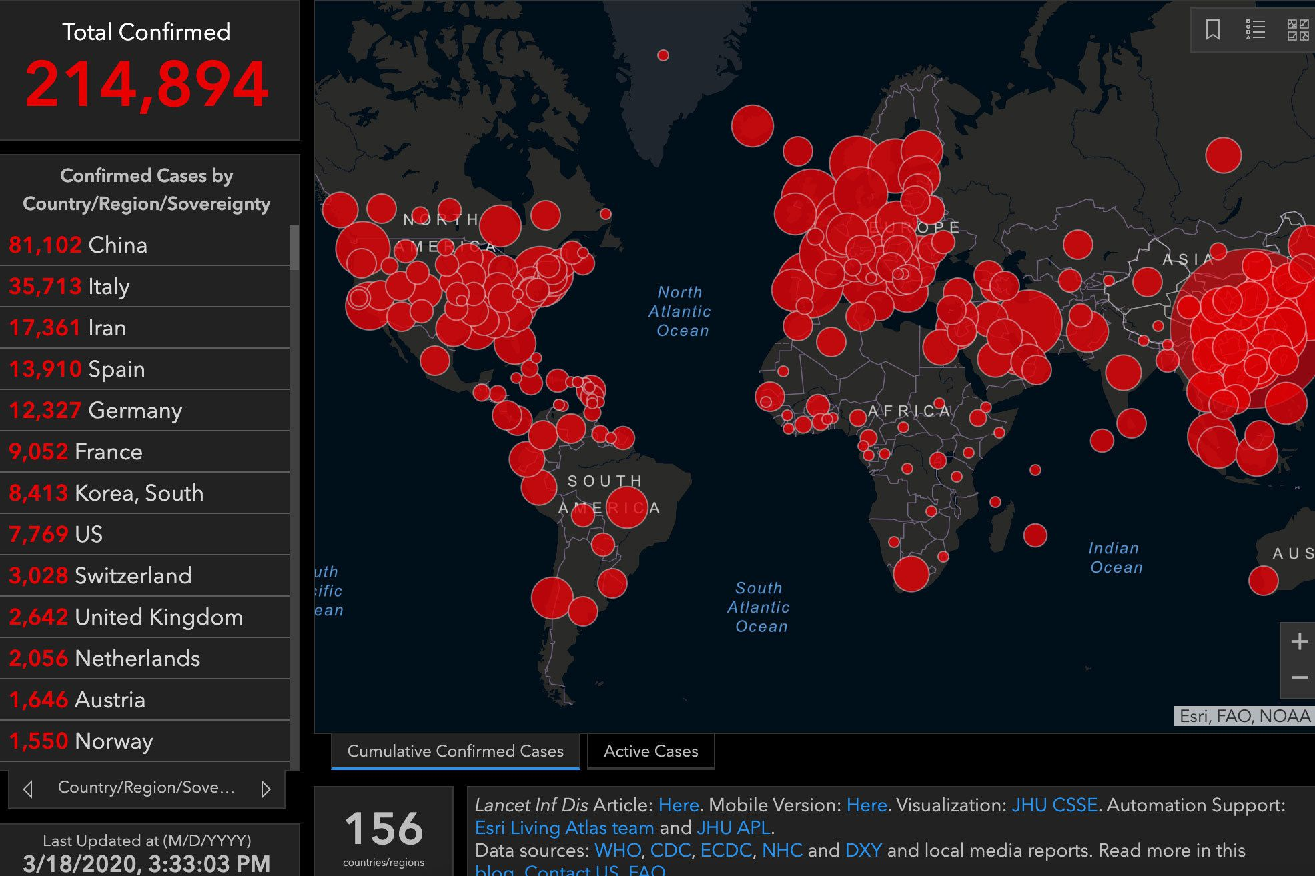
Choice of Development Software and Hosting Platform
Many choices for web mapping tools
The University currently has an ESRI subscription
ArcGIS Online scalability

Slide 12
Proposed Methodology
Multiple web applications working together
3 ArcGIS Online applications
Backup
Capstone development

Slide 13
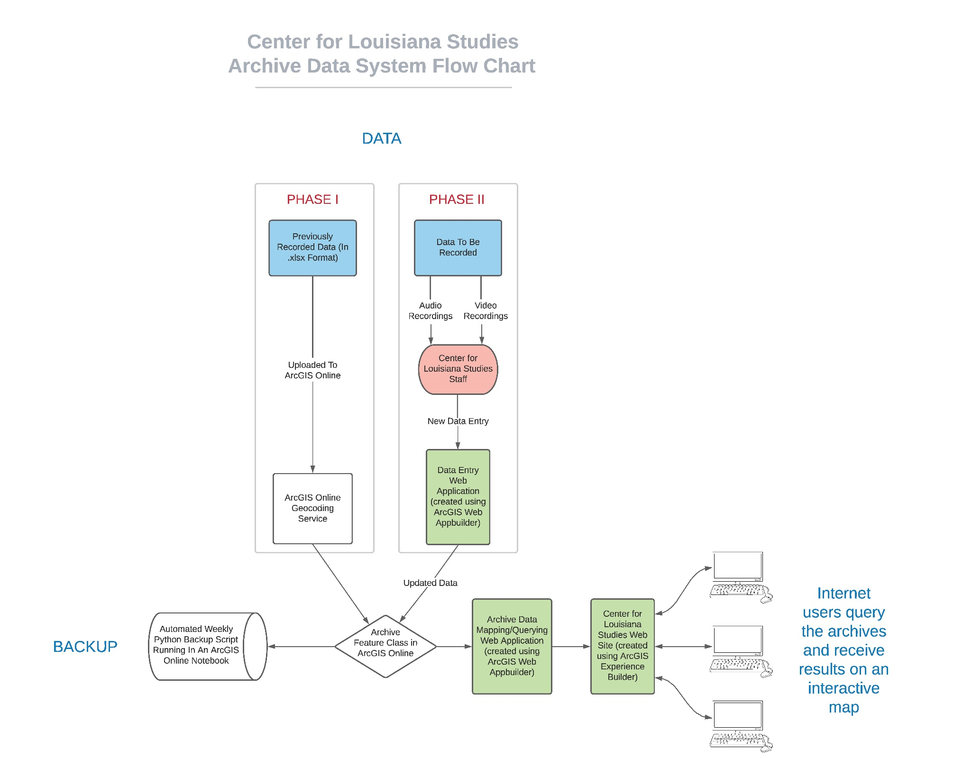
Proposed Methodology

Slide 14
Data – Phase I
Database currently in MySQL database
Export in Excel or CSV format
Data cleaning
Upload to ArcGIS Online as a hosted feature layer
Geocode the data

Slide 15
Data – Phase II
New data needs to be constantly entered by staff
Data Entry Web Application using Application Builder
Edit Widget
Security – force login by staff

Slide 17
Backup
Why is a backup needed?
Weekly backup
Python

Slide 18
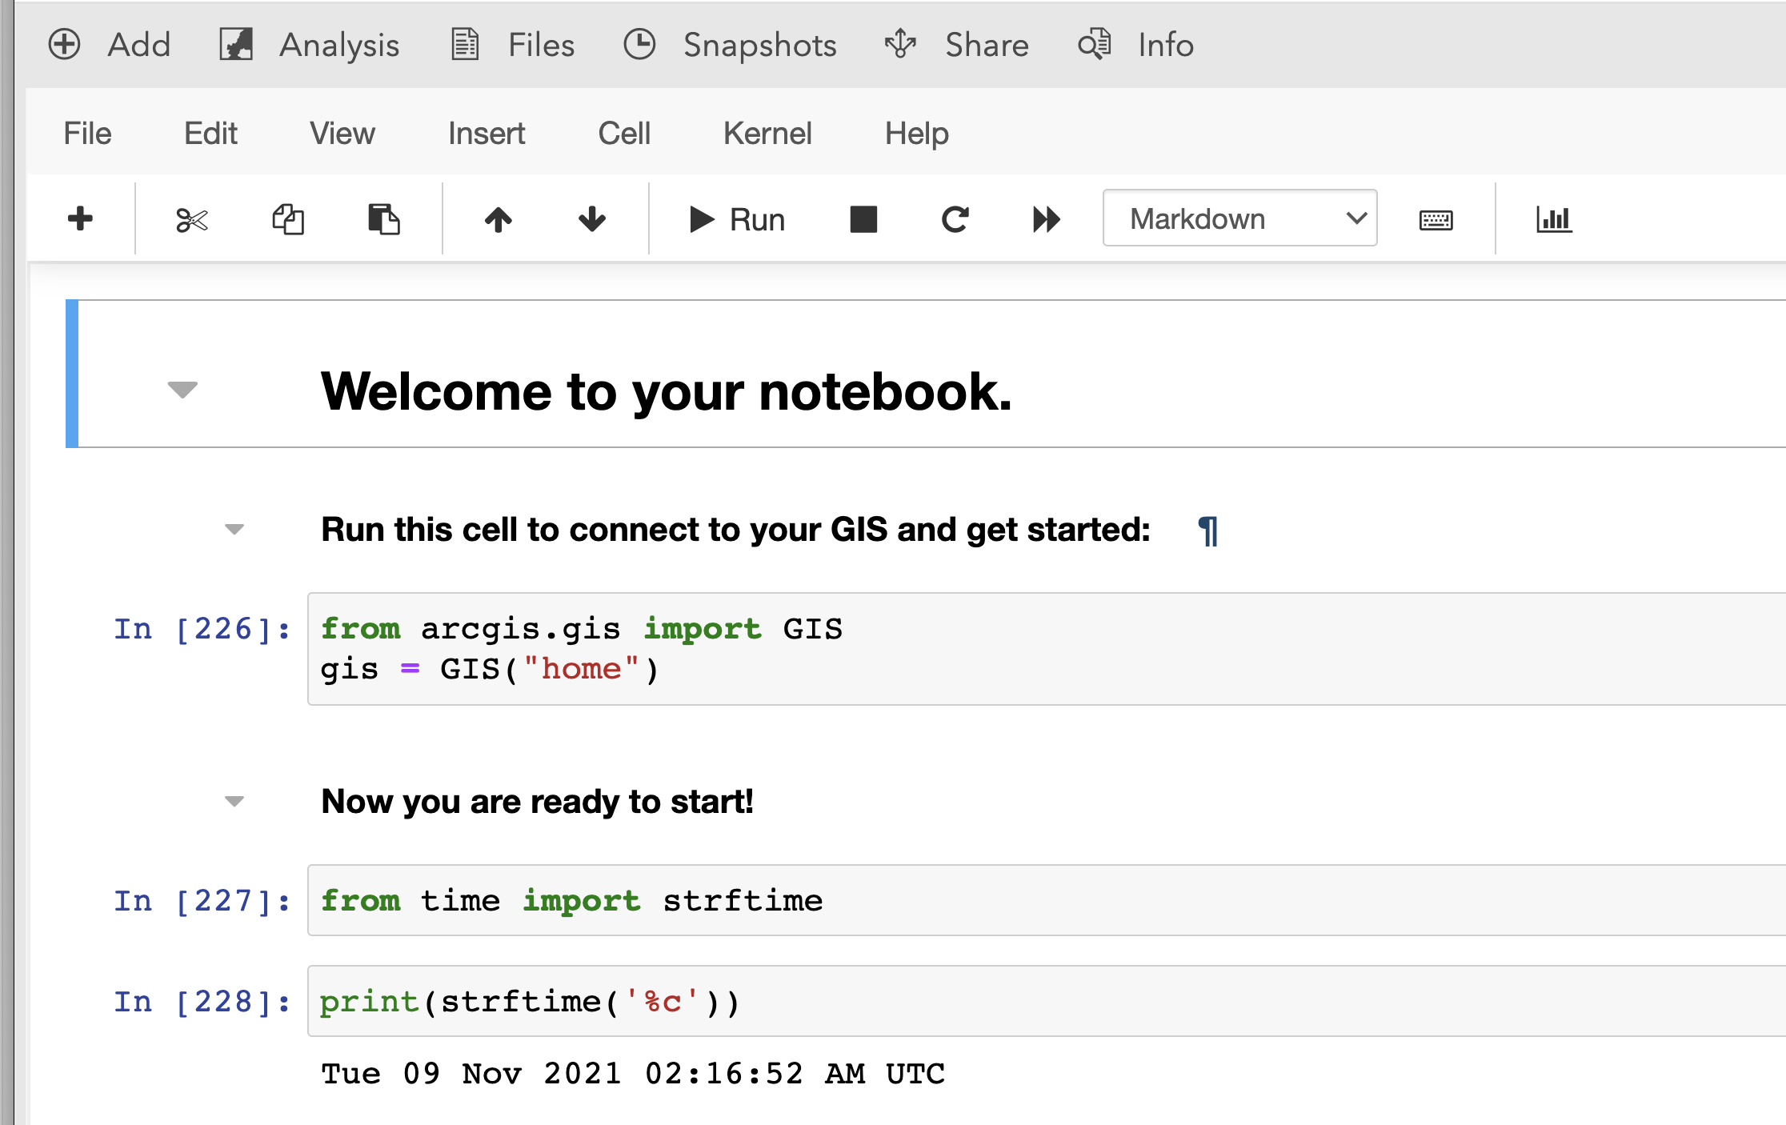
Backup
ArcGIS Notebooks

Slide 19
Archive Data Mapping/Querying Web Application
Web application that can search through data using both simple and complex queries
Results displayed as points
Query Widget in ArcGIS Web Appbuilder

Slide 23
Center for Louisiana Studies Website
Experience Builder
Built using React and TypeScript
JavaScript 3.x vs. 4.x
Embed Widget
Embed HTML, CSS, JavaScript

Slide 26
Project Timeline
December & January – meeting and data cleanup
February – Data Entry Web Application, Python Backup, Archive Data Mapping/Querying Web Application development
March – Update meeting, changes based on feedback, website development

Slide 27
Project Timeline
April – Meeting to review website, changes based on feedback
May – Final preview meeting, publish data and applications, schedule Python backup script
Present at conference – TBD – based on work and conference schedule.

Slide 28
anticipated results
Change how people consume this data
Better understanding of data
Spatial connections
Choice of ArcGIS Online enables functionality into the future

