Slide 1

Reducing Operational Overhead by Optimally Siting Facilities Within a Service Territory
Jacqueline Sinclair - MGIS Student
GEOG596a- Capstone project proposal
Michelle Zeiders - Graduate Advisor
May 6, 2019
Dutton e-Education Institute / Department of Geography
College of Earth and Mineral Sciences

Slide 2
Project Motivation
Employed By San Miguel Power Association (SMPA) as a GIS Analyst
Opportunities
  Demonstrate the value and versatility of the cooperative’s GIS investment
  Lend credibility to the GIS department
Project Recommended by SMPA Management as a means to reduce operational overhead
Project Goals Align with the Cooperative Mission For providing Safe, Reliable, cost-effective Power
Notes:
Project Motivation
I’ve been employed with SMPA for 13 years and look for opportunities to support business objectives with the use of GIS
The GIS has historically been underutilized at the cooperative and its capabilities have not generally been well understood by decision-makers.
Many organizational changes have resulted in the recent purchase of an enterprise solution for integrating customer information, billing, asset management, outage management, and GIS.
GIS is now a central and highly visible aspect of the integrated system and this project was suggested by SMPA management to help reduce operational overhead costs.

Slide 3
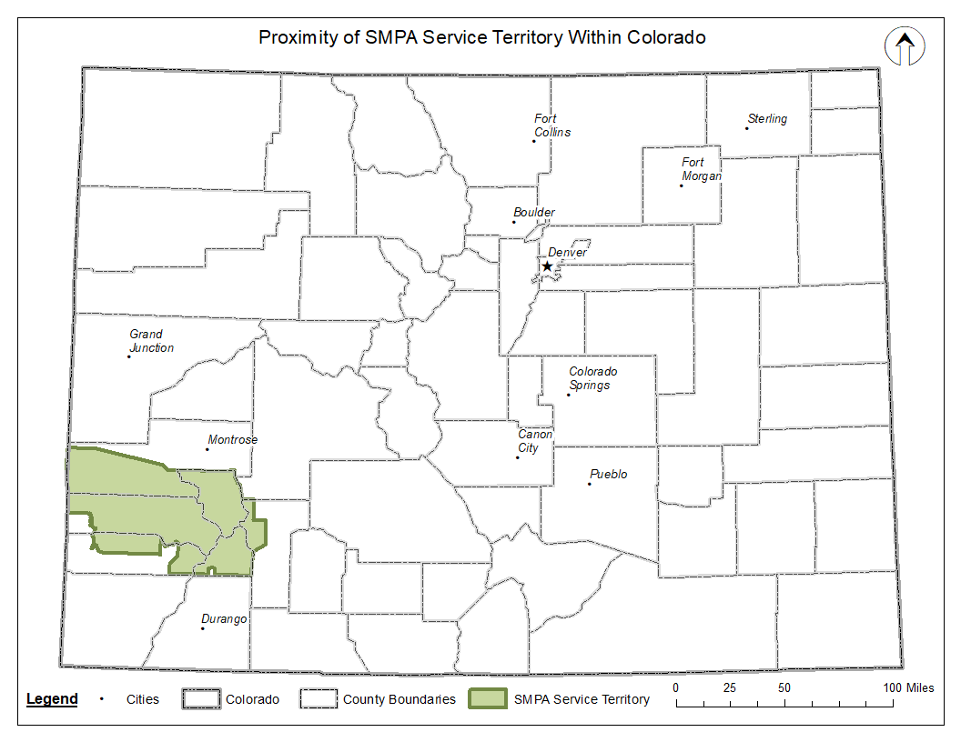
Background
SMPA Serves approximately 13,500 members
The service territory Spans approximately 3,690 square miles
Notes:
SMPA is a small rural electric distribution cooperative located in southwest Colorado, serving approximately 13,500 consumer members and consisting of parts of seven rural counties.

Slide 4
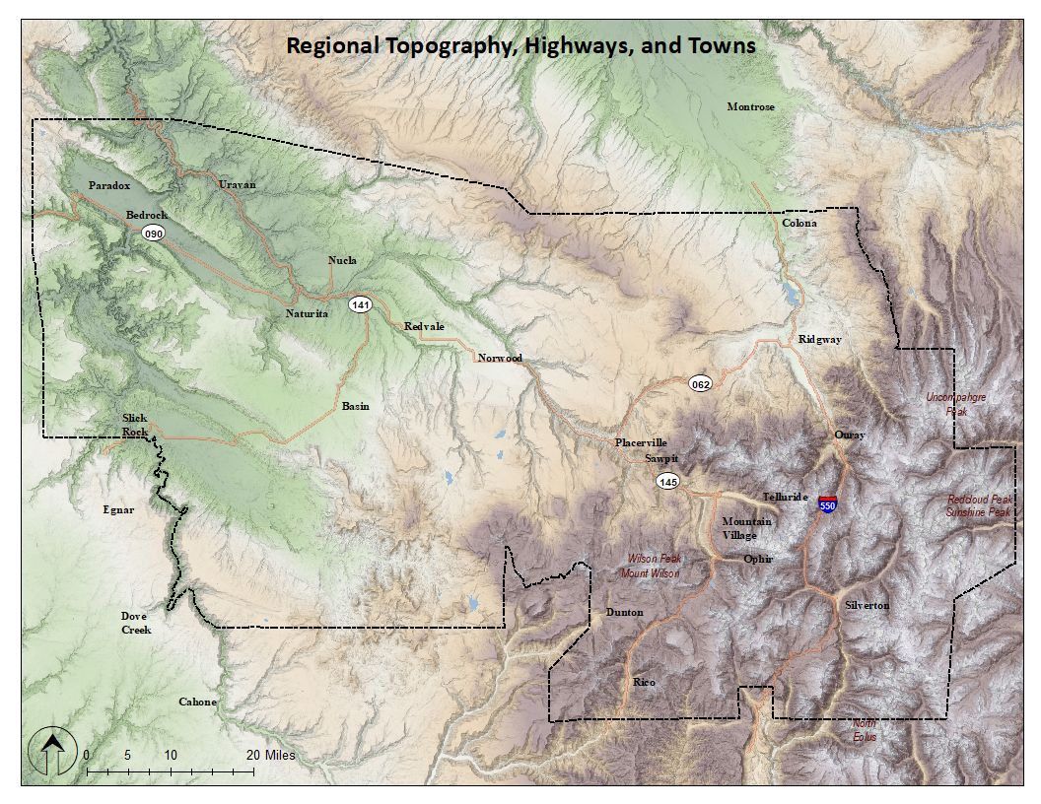
Regional Topography
Notes:
Much of the terrain is mountainous and remote
The regional topography can cause long travel times to service locations particularly when accessed over dirt and gravel roads.
Several of the consumer communities experience fluctuating populations due to prevalent tourism (specifically Silverton, Telluride, and Mountain Village)
This results in high-account turnover or changes in the status of active services requiring meter access by SMPA operations personnel to disconnect and reconnect service.
Furthermore, travel to some locations is often complicated by weather, affecting road and terrain conditions which can pose safety issues for the lineman.

Slide 5
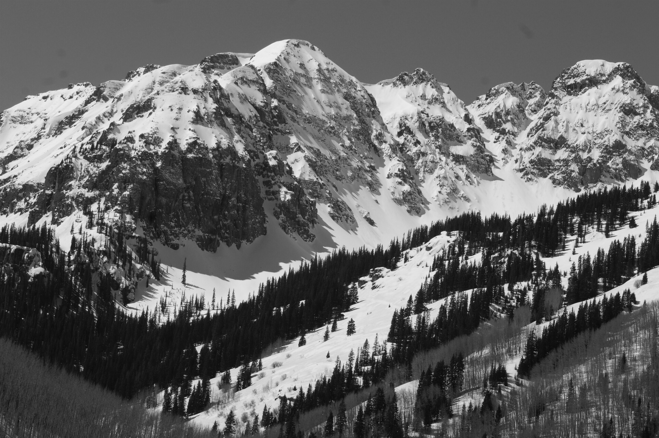
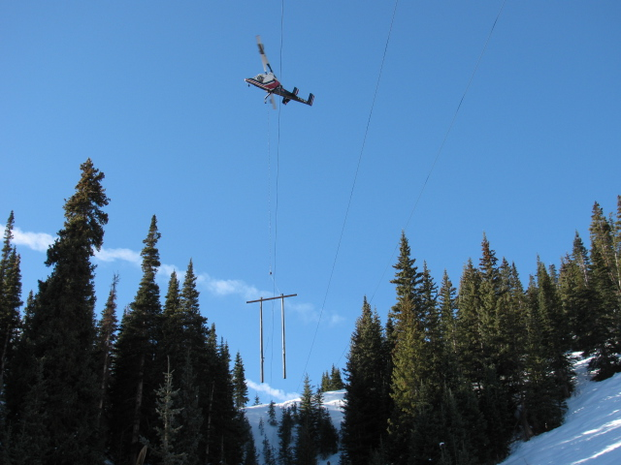

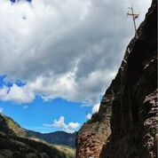
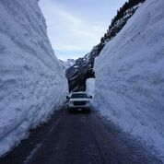
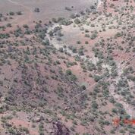
Snapshots
Notes:
Here’s an idea of the terrain in our territory. The photo in the lower right is on the west end and shows the dichotomy of the landscape.

Slide 6
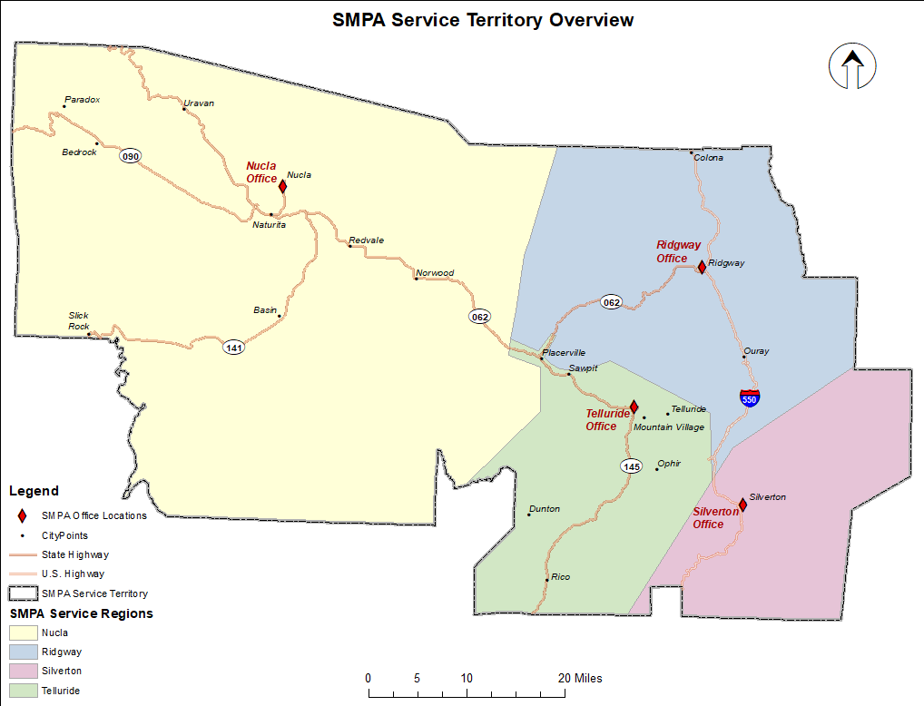
SMPA Study Area
Notes:
The project study has been restricted to the service territory boundary in order to maintain a consistent geographic extent for analysis.
Some organizational agreements exist for providing power to sites outside of our territory boundary, these locations may be further evaluated on a case-by-case basis.
The service territory is divided among four service areas. Each service area has a central office location for staff, crews, and equipment.
The service areas delineate crew operational responsibilities, essentially partitioning the territory into 4 distinct work areas.

Slide 7
List of Abbreviations/Definitions/Terminology
SMPA- San Miguel Power Association
SD- Service Disconnect (meter)
Service location and meter location are used interchangeably.
DNP- Disconnect for non-payment
CIS- Customer Information System
ODBC- Open Database Connectivity
ER- Entity Relationship
CAIC- Colorado Avalanche Information Center
USGS- United States Geologic Survey
GCDB- Geographic Coordinate Database
BLM- Bureau of Land Management
PLSS- Public Land Survey System
USFS- United States Forest Service
CGS- Colorado Geological Survey
NOAA- National Oceanic Atmospheric Administration
CDOT- Colorado Department of Transportation
GCDB- Geographic Coordinate Database
MCDE- Multi-Criteria Decision Evaluation
LCP- Least Cost Path
DEM- Digital Elevation Model
Notes:
Most of these will be familiar to you but I want to point out that you will be hearing SD meters a lot, those are Service Disconnect meters. I will also be using service location (or service point) and meter location interchangeably in reference to the physical location where a consumer connects to the electrical distribution system.

Slide 8
Project Purpose
The primary goal of the project is to Optimally site Service Disconnect (SD) Meters at existing service locations.
SD Meters enable Member Services Personnel to remotely Disconnect and Reconnect Service at the meter site from the office
  Save skilled man-hours and travel costs
  Spares administrative time for coordinating, scheduling, and dispatching linemen to manually perform disconnects and reconnect services.
  Improving customer service with quicker reconnect times
  Mitigates extended and sometimes hazardous travel
SD meters are cost-prohibitive for system-wide deployment
Notes:
The primary purpose and goal of the project is to optimally site Service Disconnect (SD) Meters at existing service locations
SD meters have additional functionality over typical meters in that office personnel have the ability to remotely disconnect and reconnect service at the site location.
The cost of SD meters is prohibitive for system-wide deployment, identifying the most optimal installation sites conserves the cooperative’s investment.
SD meters provide the benefits of saving money on skilled man-hours and travel costs while improving customer service with quicker reconnect times.
The use of SD meters also mitigates extended and sometimes hazardous travel to and from service locations and spares administrative time for coordinating, scheduling, and dispatching linemen to manually perform disconnect and reconnect services.

Slide 9
Project Objectives
Identify SD meter candidates using Customer account Data
  Use qualitative customer criteria and meter information to identify account locations for meter exchange/SD installation candidacy.
Identify sd meter candidates based on access constraints
  Service locations that are remote, difficult to access, or where travel is impeded due to seasonal or hazardous conditions
Notes:
The project objectives include:
Identifying SD meter candidates using customer account data
This is based on qualitative customer criteria and meter information that have been defined by SMPA management
SD meter candidates will be also be identified based on access constraints
These may be service locations that are remote, difficult to access due to poor road conditions, or where travel is impeded due to seasonal or hazardous conditions

Slide 10
Two-fold analysis
Multi-criteria Considerations
Customer Data- CIS
Access Impedances- GIS
High turnover service locations
  Seasonality- disconnect seasonally due to inactivity, typically remote
  Rentals
Disconnect for non-payment (DNP) accounts
  The number of disconnects within the last year
  Credit history
Exclude current “opt-outs”, incompatible meter bases, current SD locations.
Travel Distance
Road Surface Types
Seasonal Precipitation
Flood Sites
Landslide Areas
Avalanche Areas
DEM (slope)
Notes:
The project essentially consists of a two-fold analysis to determine a final, but distinct set of locations that are candidates for SD meter exchange.
The first analysis will be querying the CIS to isolate accounts that meet the specific criteria for SD installation and mapping them.
Criteria include:
High turnover service locations, those that experience frequent disconnect-reconnect activity
These might be seasonal locations that annually disconnect due to inactivity and are typically remote service locations
Rentals, where account ownership often changes requiring the meter to be inactive for a short duration
Disconnect for non-payment (DNP) accounts
The number of disconnects within the last year and the customer’s credit history will be captured for later evaluation
Other exclusionary criteria from the CIS data are:
Current “opt-out” accounts where customers have opted to incur a monthly surcharge to avoid having automated meter reading equipment installed.
Non-compatible services, meters must be of a certain type for the collar to accommodate an SD meter for exchange
and any current SD meter locations
A geographic analysis of the service territory to model factors that impact the accessibility of existing services will identify the remaining candidate SD meter locations.
Component GIS data consists of a road network with surface type attributes to assess distances and accessibility from office locations to meter locations within a given service region.
Other geographic data pertinent to the analysis are the slope of the terrain, seasonal precipitation and snowfall accumulation data, as well as known hazardous areas.
These include flood sites, landslide areas, and avalanche paths.

Slide 11
Literature Review
What are the appropriate software and methods used for developing cost surfaces and accessibility models?
How does multi-criteria decision evaluation (MCDE) apply within a GIS for optimally siting facilities?
What insights are there to be gained from previous electrical-industry related applications of GIS cost surface analysis?
Notes:
The purpose of this literature review was to gain insight on the use of GIS for accessibility studies and siting facilities.
I looked for literature that might answer questions about the most appropriate software and methods used, how multi-criteria decision evaluation applies within a GIS, and any insights that might be gained in previous industry-related cost surface analysis projects.

Slide 12
Research Summary
GIS-based approaches are effective for performing cost surface analysis, evaluating accessibility models, and have exceeded solutions derived from non-GIS based approaches. Consistent methodologies include:
  Performing Kriging to interpolate point based spatiotemporal values
  Merging terrain and impedances (criteria) into one accumulated raster friction surface
  Creating least cost paths (LCP) to evaluate accessibility
A GIS for MCDE provides a flexible platform to derive repeatable results using localized criteria for optimization.
  Calibrated weighting and ranking of criteria.
The application of GIS cost surface analysis provides solutions for routing power lines and estimating cost to provide service.
Notes:
Previous work pointed to the effectiveness of GIS-based approaches for performing cost surface analysis, evaluating accessibility models, and providing what were regarded as more optimal results.
Prevalent methodology for developing and analyzing cost surfaces involve merging isolated impedances (or criteria) into one accumulated friction surface . This requires converting data to raster for analysis.
Performing Kriging to interpolate point based spatiotemporal values such a precipitation.
And creating a LCP from a source to a destination to identify routes of least resistance over the friction surface as an evaluative measure of accessibility.
It was clear in the reading that the complexity of a cost surface and data requirements are driven by project goals. Goals, in turn, define selection parameters, criteria and methodologies
Creating cost surfaces with consideration to a project’s purpose helps to clarify data requirements, the analysis process, and reasoning for chosen methods.
The use of multi-criteria in GIS for solution-oriented decision making comes into play when analyzing a range of geographic problems like modeling movement across a surface, suitability analysis, and optimally siting facilities.
GIS platforms provide an effective and accurate way to derive repeatable results with mechanisms for optimizing those results using localized criteria parameters , weighting and ranking factors.
There are no hard and fast rules regarding calibrating criteria but the reasoning and values should be documented as part of the analysis process and consistent among features
Previous work in the electrical industry demonstrates the capacity of GIS for providing solutions to industry related problems. Cost surface analysis has been used to optimally route power lines and estimate the cost of providing power to specific locations.

Slide 13
CIS
ER Diagram
Notes:
A comprehensive view of all the related tables and attributes that have been extracted from the CIS to participate in the criteria selection is shown here in an entity relationship diagram.
The scale and depth of the customer data analysis can be appreciated in this overview where the large arrows represent process query activities and the table relationships are mapped using black arrows.
As an aside, thank God for GEOG868!

Slide 14
Project CIS Data and Analysis
SMPA Customer Information System Tables and Attributes for Analysis
Table Name | Table Description/Purpose | Key Fields
BI_CONSUMER | Customer data | BI_ACCT BI_CUST_NBR BI_PER_ACCT
BI_PERSONAL | Customer information | BI_CUST_NBR BI_ACCT
BI_AR | Account and service tie | BI_ACCT BI_TYPE_SRV
BI_TYPE_SERVICE | Service information | BI_ACCT BI_TYPE_SRV BI_SRV_STAT_CD
BI_MTR_SRV | Meter and service location information | BI_ACCT BI_SRV_LOC_NBR BI_MTR_NBR
tbl_Service_Status | Service code and description lookup | Service Status
BI_MTR_INV | Meter type information | BI_MTR_NBR
BI_SRV_LOC | Service location information | BI_SRV_LOC_NBR
CC_PY_ACCT | Credit history information | BI_ACCT
BI_SO_MASTER | Service order information, account activities | BI_SO_NBR BI_SO_TYPE_CD
BI_SO_TYPE_REF | Service order description | BI_SO_TYPE_CD
BI_SO_DET | Service order/account tie | BI_SO_NBR
Notes:
The required CIS tables to perform the customer data queries using aforementioned criteria are shown in this summary table. Tables with customer identifier information, credit history, account and service order activities, and meter type are extracted from the Oracle CIS database in full.
Listed tables have been brought into MS Access and joined using the field keys in column three. Since one customer can have multiple accounts, compound keys were necessary in some instances to maintain a one-to-one table relationship during the join process and review all the customer accounts.
Table color coding represents groups of CIS tables that were initially joined for query (or a series of selection statements) and result in pared down tables containing attributes that satisfy the criteria.

Slide 15
CIS Criteria Workflow
CIS Oracle database
ODBC connection
Import tables to Microsoft Access
Perform joins and queries in Access
Import final table into ArcGIS Geodatabase
Create Event Theme using coordinate values
SELECTION STATEMENT EXAMPLE:
SELECT qry_Consumer_Info.BI_CUST_NBR, qry_Consumer_Info.BI_ACCT, qry_Consumer_Info.BI_SRV_LOC_NBR, qry_Consumer_Credit_Rating.Credit_Rating, qry_Consumer_Info.BI_FORMAT_NAME, qry_Consumer_Info.BI_ADDR1, qry_Consumer_Info.BI_CITY, qry_Consumer_Info.BI_MTR_NBR, qry_Consumer_Info.BI_REMOTE_INTER_DISC_TYPE, qry_Consumer_Info.BI_AMR_TYPE, qry_Consumer_Info.BI_MTR_FORM_NBR, qry_Consumer_Info.BI_SRV_STAT_CD, qry_Consumer_Info.[Service Status Description], qry_SO_Discconnect_Totals.Disconnect_Frequency, qry_Consumer_Info.BI_X_COORD, qry_Consumer_Info.BI_Y_COORDFROM (qry_Consumer_Info RIGHT JOIN qry_SO_Discconnect_Totals ON qry_Consumer_Info.BI_ACCT = qry_SO_Discconnect_Totals.BI_ACCT) LEFT JOIN qry_Consumer_Credit_Rating ON qry_SO_Discconnect_Totals.BI_ACCT = qry_Consumer_Credit_Rating.BI_ACCTWHERE (((qry_Consumer_Info.BI_REMOTE_INTER_DISC_TYPE) Is Null) AND ((qry_Consumer_Info.BI_AMR_TYPE)="DCSI") AND ((qry_Consumer_Info.BI_MTR_FORM_NBR) In ("2S","12S")) AND ((qry_Consumer_Info.BI_SRV_STAT_CD)<21));
Notes:
The initial query tables were subsequently joined in a final inquiry to produce a list of meter locations meeting all the account criteria. Important identifier and descriptive information was retained along with location XY’s. Locations have been mapped for eventual use in field installation tracking application.
An example of one of the queries is shown in the background graphic illustrating how lengthy the selection statements were.
This process was validated by SMPA’s Information Technology Manager for query construction integrity and assurance that accounts within the resulting selection set met the customer criteria.

Slide 16
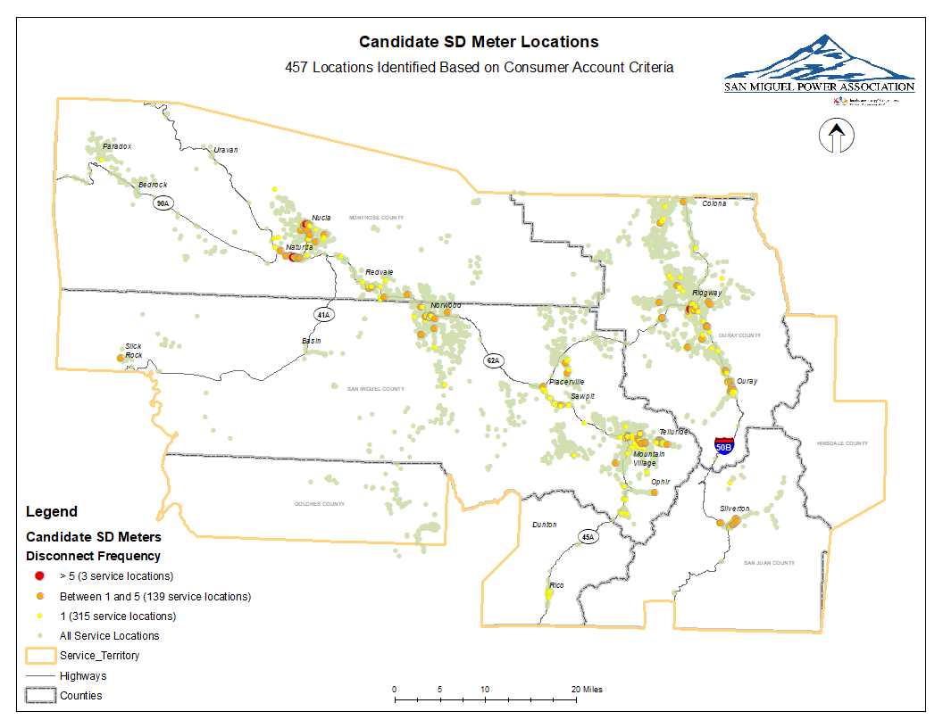
CUSTOMER Criteria- Preliminary Results
Notes:
The customer analysis revealed 457 service locations that are candidates for SD meter exchange. These locations will be reviewed to ensure that accounts are still active and have not had an SD meter installed during the course of this project. Target meters will be scheduled for prioritization upon project completion.

Slide 17
GIS Data
Geographic Datasets Collected:
Name | Description | Type | Resolution or Study Area | Year | Source
National Elevation Data | USDA/NRCS | TIF raster image | 30 m | 2016 | Geospatial Data Gateway
 |  |  |  |  | https://datagateway.nrcs.usda.gov/
Precipitation Data | Past Weather by Zip Code, table of base stations with XY coordinates, monthly precipitation, and snowfall accumulation | CSV | Zip Codes intersecting SMPA Service Territory | 3/1/2018-3/1/2019 | National Oceanic and Atmospheric Administration (NOAA) https://www.climate.gov/maps-data/dataset/past-weather-zip-code-data-table
Precipitation Data | Past Weather by Zip Code, table of base stations with XY coordinates, long-term average monthly precipitation, and snowfall accumulation | CSV | Zip Codes intersectingSMPA Service Territory | 2010 | National Oceanic and Atmospheric Administration (NOAA) https://www.climate.gov/maps-data/dataset/past-weather-zip-code-data-table
Landslides | Colorado Geologic Survey Landslide Inventory | Esri Shapefile, polygon | Colorado, compiled from 24k maps | 2015 | CGS
 |  |  |  |  | http://coloradogeologicalsurvey.org/geologic-hazards/landslides/maps/
Colorado Avalanche Paths | Mapped avalanche paths | Esri Shapefile, | Colorado | 2018 | Colorado Avalanche Information Center
Combined Roads, | CDOT Roads with surface type attributes | Esri shapefile, vector | Colorado | 2016, 2018, 2018 | Colorado Information Marketplace
Major Roads, and Highways |  |  |  |  | https://data.colorado.gov/browse?q=road%20surface%20type&sortBy=relevance
RoadCoreFS | USFS Roads with surface type attributes | Esri Shapefile, vector | National | 2019 | USFS
 |  |  |  |  | https://data.fs.usda.gov/geodata/edw/datasets.php?xmlKeyword=Road
BLM_CO_UFO_GTLF | BLM Roads with surface types | Esri Geodatabase, vector | Colorado Uncompahgre Field Office | 2019 | BLM
 |  |  |  |  | https://catalog.data.gov/dataset?tags=transportation&metadata_type=geospatial&tags=road
Flood Sites | USGS Peak Discharge Sites | Esri Shapefile, points | Colorado | 2015 | USGS
 |  |  |  |  | https://cwscpublic2.cr.usgs.gov/projects/coflood/COFloodMap.html
Streams & Lakes | CDOT water feature data | ESRI shapefile, vector | Colorado | 2019 | CDOT
 |  |  |  |  | https://data.colorado.gov/Water/Streams-in-Colorado/x238-vje7
CO_PLSS_FirstDivision | Public Land Survey System Sections (GCDB) | ESRI shapefile, polygon | State of Colorado | 2018 | BLM
 |  |  |  |  | https://catalog.data.gov/dataset/blm-colorado-plss-first-division
NOTE: Will retrieve county GIS road data and aerial imagery for further road network compilation and recent precipitation averages.
Notes:
The data for cost surface analysis has been collected and is shown here.
The 30m DEM will be used to generate a slope surface, road data with surface types will be integrated into a final road network for use in distance and cost distance analysis from office locations to service points.
The remaining data represent other seasonal access impedances and will be accounted for in summer and winter models.
Seasonal average point precipitation data will be interpolated for use in the summer and winter models along with flood sites, landslide areas and avalanche paths.
SMPA GIS data is not shown on this list and is comprised of the SMPA service territory boundary, service regions, office locations, and current active service points.

Slide 18
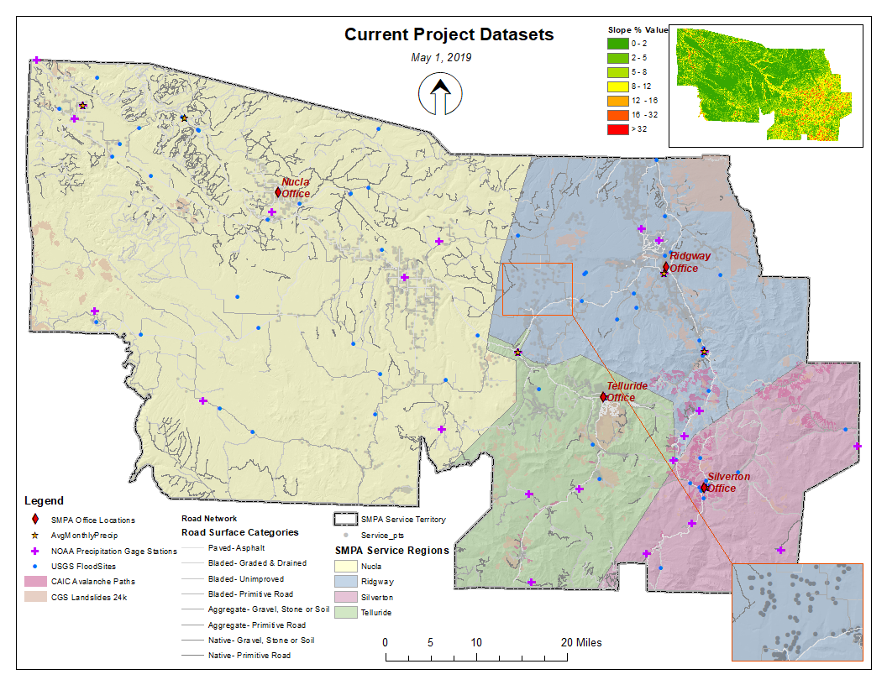
GIS Data Map
Notes:
The current data for the study have been coregistered, and clipped or masked.
The a slope surface was created and will be reclassified according to the slope degree shown in the top right inset map.
Preliminary rasterization of the road network for cost distance analysis revealed that roads have been insufficiently represented, shown in the inset in the lower right. I will need to gather county GIS road data and add missing available roads, consulting aerial imagery to categorize the surface type.

Slide 19
Regional Average Precipitation
National Oceanic and Atmospheric Administration (NOAA). 2019. Normals Monthly. Retrieved from https://www.climate.gov/maps-data/dataset/past-weather-zip-code-data-table
Notes:
47% of the average precipitation occurs during the winter months and early Spring.
53% of the average precipitation falls within late Spring and early Fall with a pea of 23% of the total, occurring in August and September.

Slide 20
Regional Average snowfall
National Oceanic and Atmospheric Administration (NOAA). 2019. Normals Monthly. Retrieved from https://www.climate.gov/maps-data/dataset/past-weather-zip-code-data-table
Notes:
84% of the average snow accumulation occurs during the winter months with peak accumulation occurring in late Spring.
2018 was a drought year but contains far more regional gage station points than were available in the Normals datasets provided by NOAA. Monthly averages were only available up to 2010. After review, I’ve determined to revisit the available data and try to retrieve more current regional values to calculate seasonal averages.
Seasonal average point precipitation data will be interpolated using Kriging for use in the summer model along with flood sites and landslide areas.
Seasonal average snow accumulation data points will be interpolated using Kriging for use in the winter model with avalanche paths.
The data is provided in csv format and requires a good deal of reformatting.

Slide 21
Feature Ranks and Weights
Data Set | Category Description | Rank (Reclassification) | Friction Weight (% of Influence)
Roads | Surface Type
 | Paved- Asphalt | 1 | 50%
 | Bladed- Graded & Drained | 2
 | Bladed- Unimproved | 3
 | Bladed- Primitive Road | 4
 | Aggregate- Gravel, Stone or Soil | 5
 | Aggregate- Primitive Road | 6
 | Native- Gravel, Stone or Soil | 7
 | Native- Primitive Road | 8
 | Off-road | 9
Slope | Slope % |  | 15%
 | 0-2 | 1
 | 2-5 | 2
 | 5-8 | 3
 | 8-12 | 4
 | 12-16 | 5
 | 16-32 | 6
 | >32 | 7
Summer Model:
Precipitation | Inches of Rain |  | 15%
 | 0 -1 in | 1
 | 1 -2 in | 2
 | 2 -3 in | 3
 | > 3 in | 4
Flood Sites | TRUE | 8 | 10%
Landslide Area | TRUE | 8 | 10%
Winter Model:
Snowfall | Inches of Snowfall Accumulation
 | 0 - 2 | 1 | 20%
 | 2- 5 in | 2
 | 5 - 10 in | 3
 | 10 - 15 in | 4
 | 15 - 20 in | 5
 | 20 - 25 in | 6
 | > 25 in | 7
Avalanche Path | TRUE | 8 | 15%
Notes:
Cost Surface Analysis Feature Weights and Ranking
The roads and slope data heave been consistently ranked and weighted among the two cost surface models.
Road surface types will have a significant impact on crews being able to access service locations as will slope and have been given the lion’s share of the weight factor as shown in column four.
Summer model features include precipitation, flood sites, and landslide areas.
Winter model features include snowfall accumulation and avalanche areas.

Slide 22
GIS Analysis Methodology
Convert to Raster
  DEM- Spatial Analyst>Surface>Slope
  Roads- per surface type 8, Conversion>To Raster
  Precipitation- Spatial Analyst>Interpolation>Kriging
  Snow-Spatial Analyst>Interpolation>Kriging
  Landslides- Conversion>To Raster
  Flood Sites- Conversion>To Raster
  Avalanche Paths- Conversion>To Raster
Reclassify- Spatial Analyst>Reclass
Combine Raster- Spatial Analyst>Map Algebra
  Roads, reclassify as combined
Cost Surface- Spatial Analyst>Overlay Weighted Overlay
  Summer Model
    Slope, Roads, Precipitation, Flood Sites, Landslides
  Winter Model
    Slope, Roads, Snow, Avalanche Paths
Cost Distance- Spatial Analyst> Distance>Cost Distance
  Summer Model, Each Office Location and Service Region
  Winter Model, Each Office Location and Service Region
Evaluate Final Seasonal Cost Surfaces
  Identify service points that fall within the most costly cells
    SD Meter Candidates
Notes:
All input datasets will be converted to raster using conversion or spatial analyst tools including surface slope and kriging for precipitation and snow data. These data will be reclassified according to friction ranks.
Road data with surface types will be need to be recombined into a final raster to retain ranks among the differing surface types, greatly affecting the ease of travel.
Two seasonal models will be created with the use of weighted overlay combing the participating raster layers.
Cost distance will be run on the seasonal models for each service region and the corresponding office location to reveal the accumulated cost for each cell from the corresponding office.
Evaluating the final seasonal cost surfaces to identify candidate SD locations will be a visual inspection as I explore options for quantifying corresponding cost values to each of the 13,500 service locations.

Slide 23
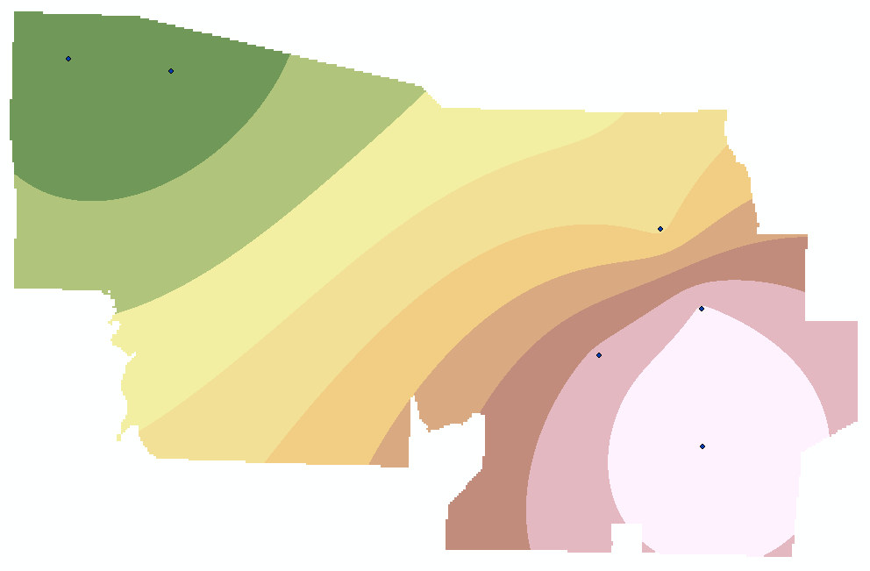
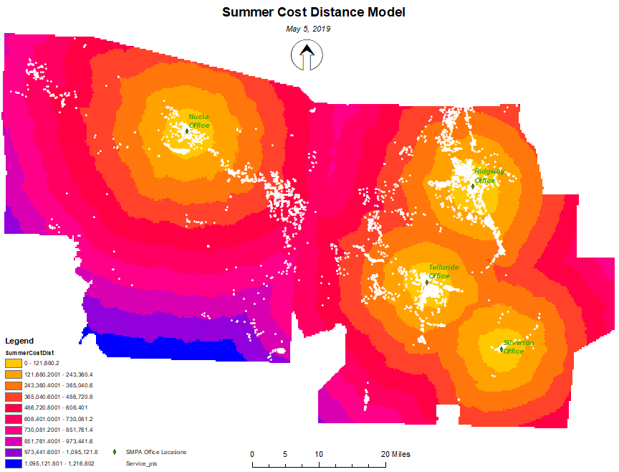
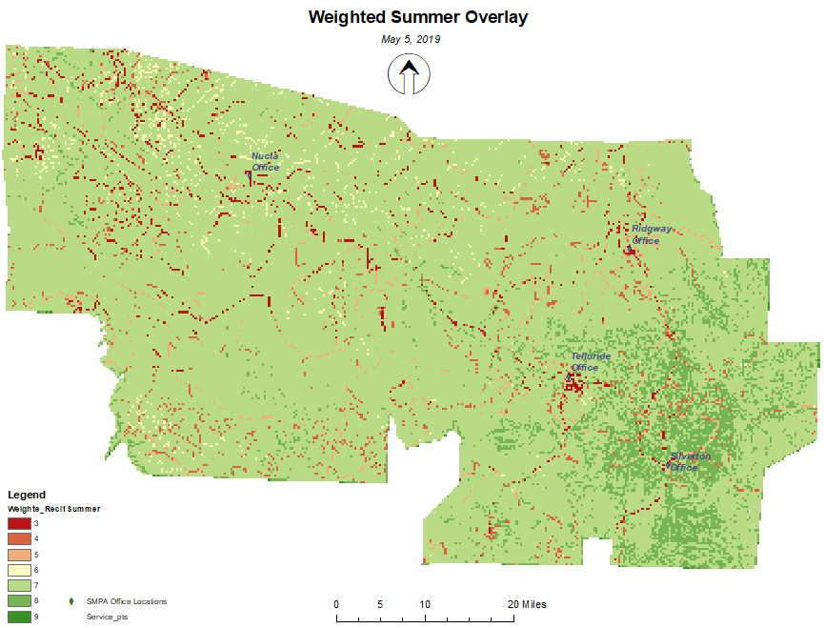
proof of concept - Preliminary Summer Analysis
Kriging Average Precipitation
Notes:
Preliminary results of the summer model data are shown here as a proof of concept. The product of Kriging the average precipitation data are displayed before reclassification. The weighted overlay contains the reclassified slope, roads, landslides and flood sites with the % influence discussed previously. The final cost distance raster with service points shown in white is displayed on the right.

Slide 24
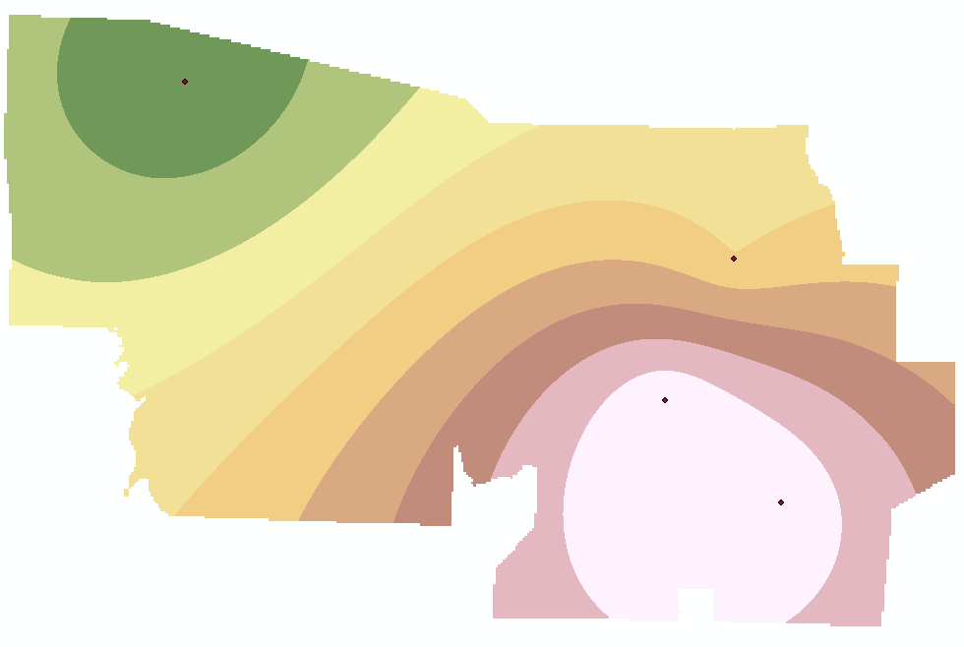
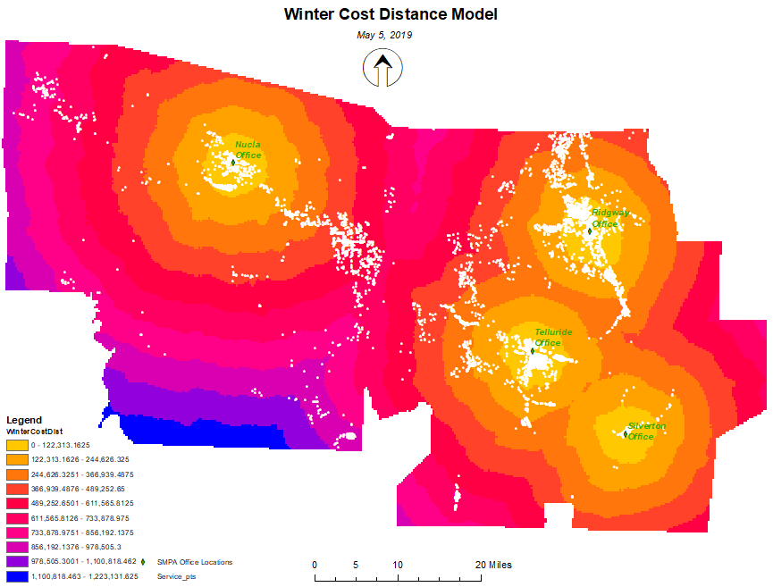
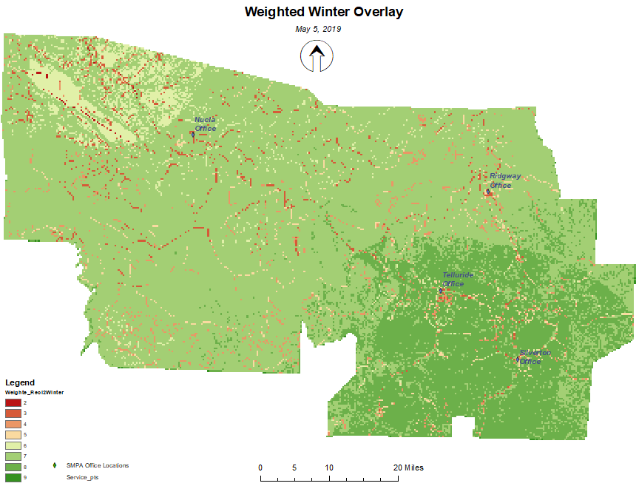
proof of concept - Preliminary Winter Analysis
Kriging Average Snow
Notes:
The average snow accumulation data have been processed with Kriging and are displayed before reclassification. The weighted overlay contains the additional reclassified avalanche path data, slope and road network rasters according to the weights provided in the earlier table. The final cost distance raster with service points shown in white is displayed on the right.
The summer and winter cost distance models are very similar and I would expect a greater variation once the more dense precipitation/snowfall data points are collected from NOAA and processed.
After review of the preliminary analysis, I believe the results will be more meaningful if the cost distance was run at a geoprocessing extent of each individual service region and its corresponding office location.

Slide 25
Expected Outcomes
A large number of service locations are expected to identified for SD Exchange through the GIS analysis process
Duplicate identification of service locations is expected between the customer queries and spatial analysis processes
  Some customer criteria regarding disconnect frequency are a function of remote and seasonal account locations.
Notes:
I expect that the bulk of service locations identified for SD exchange will be the result of the CIS analysis.
Duplicate identification of service locations is also expected between the customer queries and spatial analysis process
This is due to the fact that some customer criteria regarding disconnect frequency are a function of being remote account locations.

Slide 26
Verification and Exchange Implementation
duplicate service locations identified through the CIS and cost surface analysis processes will be Removed.
The service locations that are selected using geographic analysis will be reviewed by operations personnel t
  Reasonable quantity
  Exchange location candidates are warranted.
targeted locations will be cross-checked with the current customer account status and meter information to ensure that accounts are still active and have not had an SD meter installed during the course of this project.
locations will be prioritized for scheduling meter exchanges.
Deliverables are for SMPA consumption only. No consumer data will be shared externally as a result of this project.
Notes:
Duplicate service locations identified through the CIS and cost surface analysis processes will be removed from the GIS selection set.
The service locations that are selected using geographic analysis will be reviewed by operations personnel to ensure that meters under consideration for an SD upgrade are of a reasonable quantity and that exchange location candidates are warranted.
Upon the completion of the final analysis and before SD meter installation occurs, targeted locations will be cross-checked with the current customer account status and meter information to ensure that accounts are still active and have not had an SD meter installed during the course of this project. It is likely that locations will be prioritized for scheduling meter exchanges.
It is important to note that project deliverables are for SMPA consumption only. No consumer data will be shared externally as a result of this project.

Slide 27
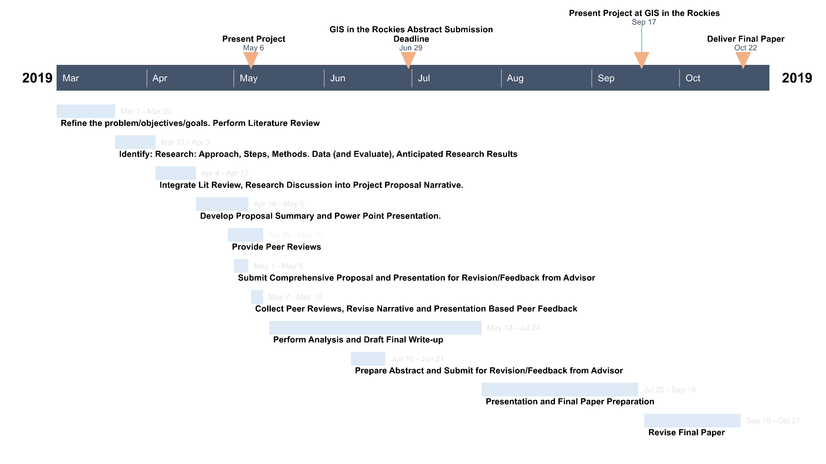
Capstone Project Timeline
Notes:
The project timeline is shown here, with the final analysis is to be completed within the next month. The hope is that I will be presenting at GIS in the Rockies in the Fall.

Slide 28
References
Bagli, S., Geneletti, D., & Orsi, F. (2011). Routeing of power lines through least-cost path analysis and multicriteria evaluation to minimise environmental impacts. Environmental Impact Assessment Review, 31(3), 234-239. doi:10.1016/j.eiar.2010.10.003
Blanford, J., Kumar, S., Luo, W., & MacEachren, A. M. (2012). It's a long, long walk: accessibility to hospitals, maternity and integrated health centers in Niger. International Journal of Health Geographics, 11(24). doi:10.1186/1476-072X-11-24
Gietl, R., Doneus, M., & Fera, M. (2007). Cost distance analysis in an alpine environment: comparison of different cost surface modules.
Greenberg, J. A., Rueda, C., Hestir, E. L., Santos, M. J., & Ustin, S. L. (2011). Least cost distance analysis for spatial interpolation. Computers & Geosciences, 37(2), 272-276. doi:10.1016/j.cageo.2010.05.012
Howey, M. C. L. (2007). Using multi-criteria cost surface analysis to explore past regional landscapes: a case study of ritual activity and social interaction in Michigan, AD 1200–1600. Journal Of Archaeological Science, 34(11), 1830-1846. doi:10.1016/j.jas.2007.01.002
Jacyna-Gołda, I., & Izdebski, M. (2017). The Multi-criteria Decision Support in Choosing the Efficient Location of Warehouses in the Logistic Network. Procedia Engineering, 187, 635-640. doi:10.1016/j.proeng.2017.04.424
Kosyakov, S. V., & Sadykov, A. M. (2016). GIS-based cost distribution analysis of new consumer connections to an urban power grid. Geo-spatial Information Science, 18(4), 183-192. doi:10.1080/10095020.2015.1128696
Masson, D., & Frei, C. (2014). Spatial analysis of precipitation in a high-mountain region: exploring methods with multi-scale topographic predictors and circulation types. Hydrology and Earth System Sciences, 18(11), 4543-4563. doi:10.5194/hess-18-4543-2014
Notes:
Here is the list of my current references.

Slide 29
References
McHarg, I. L. (1969). Design with nature. Garden City, NY: The Natural History Press.
National Center for Atmospheric Research Staff (Eds). (2014, November 5). The Climate Data Guide: Precipitation Data Sets: Overview & Comparison table. Retrieved from https://climatedataguide.ucar.edu/climate-data/precipitation-data-sets-overview- comparison-table
Pfau, L., & Blanford, J. I. (2018). Use of Geospatial Data and Technology for Wilderness Search and Rescue by Nonprofit Organizations. The Professional Geographer, 70(3), 434-442. doi:10.1080/00330124.2018.1432367
Sumathi, V. R., Natesan, U., & Sarkar, C. (2008). GIS-based approach for optimized siting of municipal solid waste landfill. Waste Management & Research, 28(11), 2146-2160. doi:10.1016/j.wasman.2007.09.032
Viljoen, D. (2000). Evaluating the cost of moving across a raster image. Retrieved from http://elearning.algonquincollege.com/coursemat/viljoed/gis8746/concepts/cost/
Wu, J., Zhang, F., Pan, Y., Li, W., Cao, G., & An, Y. (2018). Spatio-temporal trend analysis of precipitation in Guizhou province based on GIS technology. IOP Conference Series: Earth and Environmental Science, 121. doi:10.1088/1755- 1315/121/5/052033
Yuan, M. (1996). Temporal GIS and spatio-temporal modeling. Paper presented at the Proceedings of Third International Conference Workshop on Integrating GIS and Environment Modeling, Santa Fe, NM.

Slide 30
Questions?
Notes:
That about sums it up. Any questions?

