Slide 1
Visualizing Land Use Changes based on Historic Images of Brevard County, Florida
Marnie Sippel, MGIS Candidate
Penn State University GEOG 596A
May 5, 2014
Advisor: Dr. Jay Parrish

Slide 2
Capstone Presentation Overview
Project Objective
Study Area
Historic Aerial Photo Sources & Years
Research of Potential Software for the County
Methodology for determining Land Use Changes
Project Challenges
Web Deployment
Project Timeline

Slide 3
Project Objectives
Research potential software for Brevard County to utilize on County-wide historic aerial project and make a recommendation for the software.
Test potential software on small study area (6 x 6 miles).
Produce a user guide to be used by other county GIS volunteers to develop countywide historic aerial layers.
Manually determine land change usage from 1943 to 2007 for my study area. (1943, 1969, 1983, 2007)

Slide 4
Study Area

Slide 5
Study Area
Source: Brevard County Property Appraiser Office https://www.bcpao.us/

Slide 6
Study Area

Slide 7
Historic Aerial Photos Sources/Years
1943 – University of Florida
1958 – University of Florida
1969 – University of Florida
1979 – University of Florida
1983 - Florida Department of Transportation
1993 - Florida Department of Transportation
2007 – Brevard County
2012 - Florida Department of Transportation

Slide 8
University of Florida
Flight Path Map with link to Photo

Slide 9
Florida Dept of Transportation
Thankfully, FTP downloads with Township and Range numbers are available by request

Slide 10
Research of Potential Software
ESRI - ArcMap
Exelis - ENVI
Intergraph - ERDAS Imagine
Clark University- IDRISI
PCI GeoMatics – Historic Airphoto Processing
Blue Marble - Global Mapper

Slide 11
ArcMap Automatic Georeferencing

Slide 12
ArcMap - Manual Georeferencing
At least 12 control points

Slide 13
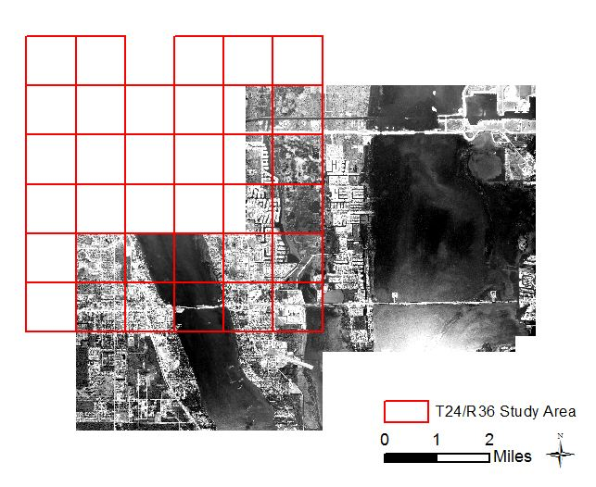
Flight Path Overlap
Multiple Photos Needed for Study Area

Slide 14
ArcMap Workflow
For each of the selected 7 years:
Clip Photos
Georeference photos for study area
Mosaic photos into one file per year
Land Use Analysis for 4 years (1943, 1969, 1983, 2007):
Digitize each land use type
Assign land use type as an attribute
Dissolve feature class per year based on classification
Summarize land classification types per year
Determine percent change from decade to decade

Slide 15
Methodology for determining Land Use Change
Manual Classification of digitized polygons
Personal judgment/bias
Scale and Accuracy of digitization process
Classifications:
Developed Land – residential, streets, industrial, non-natural areas
UnDeveloped Land – green areas, natural areas
Water – man-made or natural bodies of water that are not the river
River

Slide 16
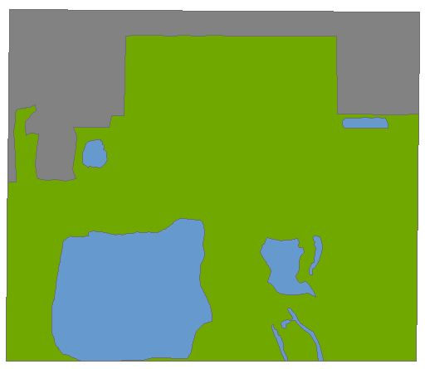
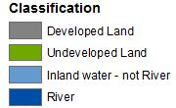
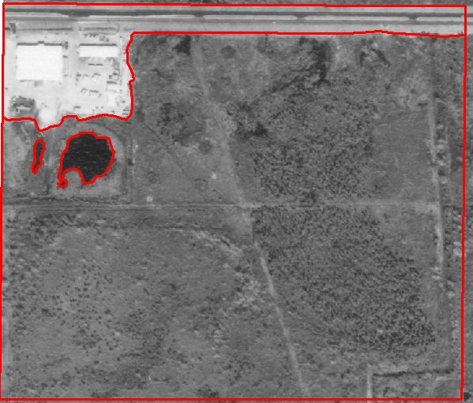
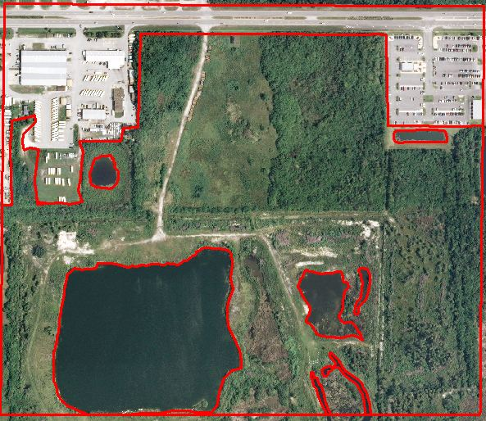
Final ArcMap
1969
Developed Land = 13%
Undeveloped Land = 86%
Inland Water = 1%
2007
Developed Land = 20%
Undeveloped Land = 64%
Inland Water = 16%
1969
2007

Slide 17
Better Workflow?
Exelis - ENVI
Intergraph - ERDAS Imagine
Clark University- IDRISI
PCI GeoMatics – Historic Airphoto Processing
Blue Marble - Global Mapper
……that is the question.

Slide 18
Project Challenges
An enormous amount of manual labor to georeference the whole county for each year.
Quality Control and Assurance of digitization process.
Bias when visually digitizing land use.
Enlist students/volunteers to assist with digitization process on 3 tiles in each time period. Compare differences in classification to assess accuracy of classification levels.
Are Orthorectified photos necessary?

Slide 19
Web Deployment
Publish map service and deploy through ArcGIS Server on EC2 as a tiled cache.
Use ArcGIS Viewer for Flex to create online map.
Include Time Slide bar for users to change photo images by year.

Slide 20
Anticipated Results
A paper that supports the recommendation of software for the Brevard County historic aerial photo project.
Development of a “user-manual” for County volunteers to continue the historic aerial photo project.
Development of a sample website to demonstrate to the County the potential visualization of land use changes.
Land Use Analysis: expectation of seeing a significant increase in developed land from 1943 to 2012.

Slide 21
Project Timeline
May
Test/Analyze Software options
June
Georeference photos of study area for each time period
July
Manual Classification of study area
August
Analysis of Land Change
Deploy website with disclaimers
Develop User’s Guide
September/October
Presentation

Slide 22
Presentation Possibilities
Central Florida GIS Workshop Sept 15 – 16, 2014
Orlando, FL
Abstract Due: July 1
South Florida GIS Expo Oct 2 -3, 2014
West Palm Beach, FL
Abstract Due: date not published yet
Applied Geography Conference Oct 15 – 17, 2014
Atlanta, GA
Abstract Due: June 6

Slide 23
Acknowledgements
Dr. Jay Parrish, Advisor
Brevard County Dept of Natural Resources, FL

Slide 24
Sources
Brevard County Department of Natural Resources (2014). http://www.brevardcounty.us/NaturalResources/Home
Brevard County Property Appraiser (2014). https://www.bcpao.us/
DiBiase, David (2014). GEOG 482: Nature of Geographic Information. Chapter 8, pg. 19. Classifying Landsat Data for the National Land Cover Dataset. Retrieved from https://www.e-education.psu.edu/natureofgeoinfo/c8_p19.html
ESRI ArcGIS Resources. (2012, June 20). How time is supported in spatial data. Retrieved from:
http://resources.arcgis.com/en/help/main/10.1/index.html#/How_time_is_supported_in_spatial_data/005z00000004000000/
ESRI ArcGIS Resources. (2013, Dec 17). ArcGIS Viewer for Flex. Retrieved from:
http://resources.arcgis.com/en/help/flex-viewer/concepts/index.html#//01m30000003n000000
ESRI Video. (2014). Improved Georeferencing Workflows in ArcGIS 10.1. Retrieved from: http://video.esri.com/watch/1924/improved-georeferencing-workflows-in-arcgis-101
Florida Department of Transportation. (1996 – 2014). Surveying & Mapping, Get Aerials. Data Retrieved from: http://www.dot.state.fl.us/surveyingandmapping/aerial_get.shtm

Slide 25
Sources
Florida Geographic Data Library. (2014) FGDL Metadata Explorer: Search & Download Data. Retreived from: http://www.fgdl.org/metadataexplorer/explorer.jsp
Multi-Resolution Land Characteristics Consortium (2014, Apr 11). National Land Cover Database 2011. Retrieved from: http://www.mrlc.gov/nlcd11_leg.php
University of Florida, George A Smathers Libraries (2004 – 2013). Aerial Photography: Florida, Flights By County. Data Retrieved from: http://ufdc.ufl.edu/aerials/all/table
USGS (1976). Anderson, et. al. Geological Survey Professional Paper 964. A Land Use and Land Cover Classification System For Use with Remote Sensor Data. Retrieved from: http://landcover.usgs.gov/pdf/anderson.pdf
USGS Land Cover Institute (2012, Dec). NLCD Land Cover Class Definitions. Retrieved from: http://landcover.usgs.gov/classes.php
Potential Software:
ESRI- http://www.esri.com/
ENVI - https://www.exelisvis.com/ProductsServices/ENVI/ENVI.aspx
ERDAS Imagine - http://www.hexagongeospatial.com/products/ERDAS-IMAGINE/Details.aspx
IDRISI - http://www.clarklabs.org/
PCI GeoMatics HAP - http://www.pcigeomatics.com/software/production-workflows
Global Mapper - http://www.bluemarblegeo.com/products/global-mapper.php

Slide 26
Questions

