Slide 1
Examining the Effects of Physical Barriers on Healthcare Accessibility in the West Bank
James Skoryanc

Slide 2
OVERVIEW
Background
Historical context
Healthcare system
Implications
Obstacles to Healthcare Accessibility
Analysis
Key questions
Relevant methods
Data
Timeline

Slide 3
BACKGROUND

Slide 4
HOW DID WE GET HERE?
Arab-Israeli War (Six Day War): Israel defeats Arab coalition and takes over Gaza, East Jerusalem, and most of the West Bank
Results in Israeli control over Palestinian-occupied territories and refugee crisis
Oslo II signed
West Bank divided into Areas A, B, and C
June 1967
September 1995
Second Intifada
Increased restriction on Palestinians in the West Bank
New Israeli settlements
Barrier construction begins
Oslo Accord signed
Palestinian Authority (PA) established to assume temporary governing body in the West Bank and Gaza
September 1993
2002-2005
Notes:
https://history.state.gov/milestones/1993-2000/oslo
https://www.britannica.com/event/Six-Day-War

Slide 5
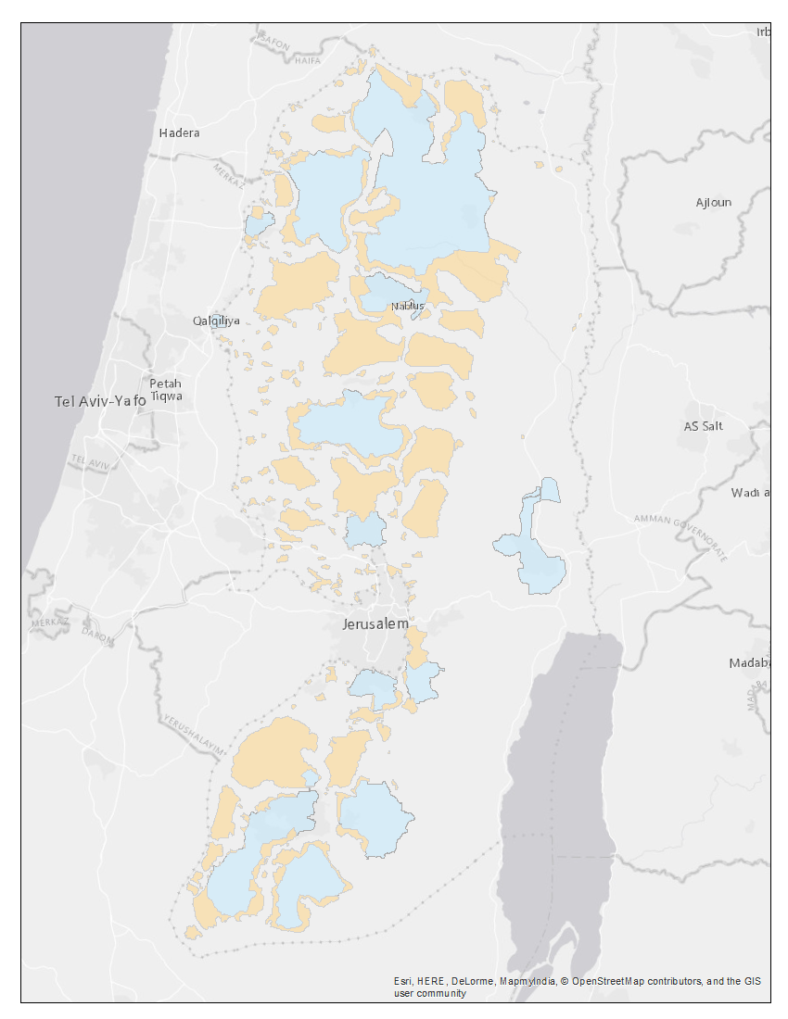
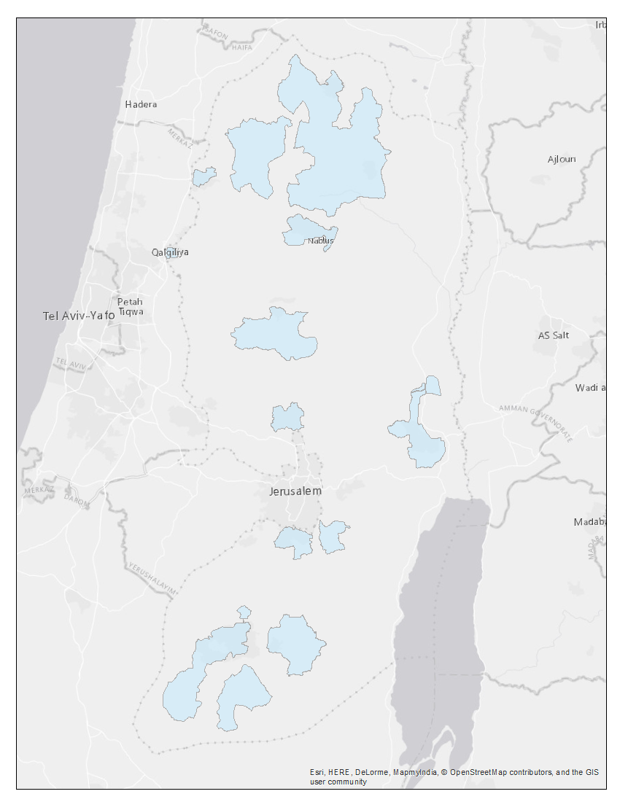
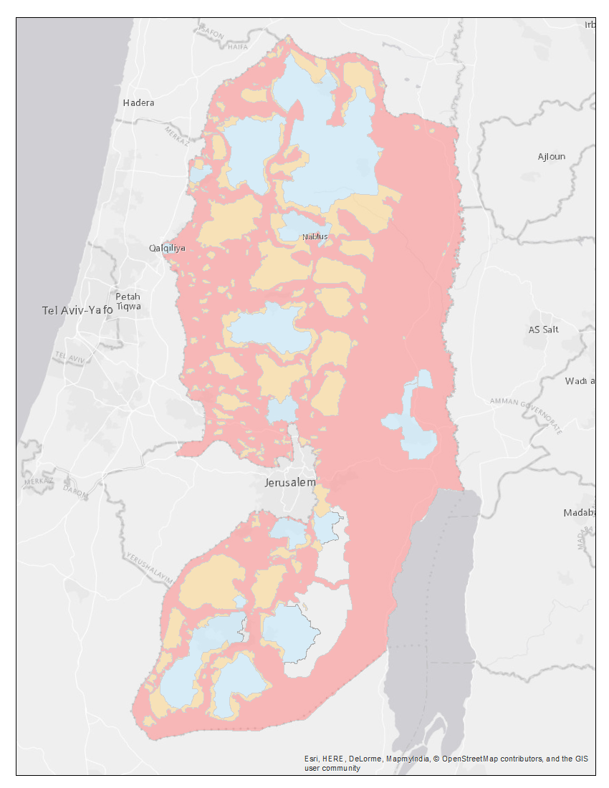
ADMINISTRATIVE AREAS
Area A
Includes most cities and urban centers
Fully administered by the Palestinian Authority
No Israeli settlements
Area B
Includes many Palestinian villages
Administered by the Palestinian Authority but secured by Israeli Defense Forces
No Israeli settlements
Area C
Fully administered by Israel
Palestinians prohibited from constructing buildings without permit
Notes:
* Need to figure out transitions between maps

Slide 6
HEALTHCARE PROVIDERS
United Nations Relief and Works Agency (UNRWA)
43 facilities serve more than 475K Palestinian refugees
Majority of resources concentrated in Area C
Public Hospitals
Concentrated in large towns in Area A and East Jerusalem
Inconsistent service and capacity
Notes:
https://www.unrwa.org/activity/health-west-bank

Slide 7
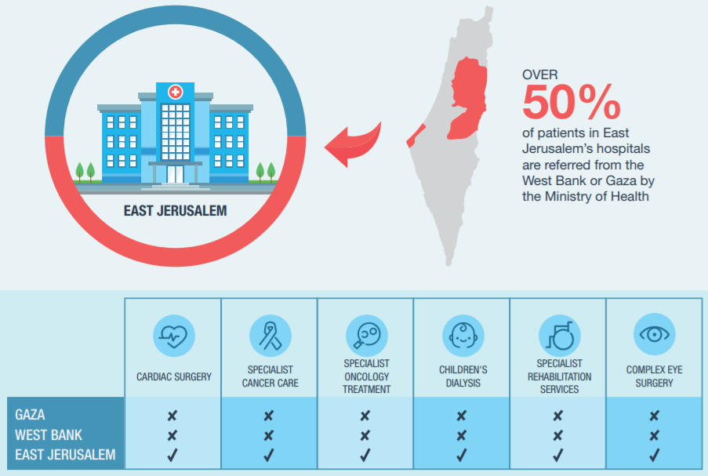
SYSTEM OF REFERRALS
Around 45K referrals in 2016, most to East Jerusalem
Permits are required to travel between the West Bank and East Jerusalem
https://www.map.org.uk/downloads/map-ch1--access-to-healthcare.pdf
Notes:
https://www.map.org.uk/downloads/map-ch1--access-to-healthcare.pdf

Slide 8
OBSTACLES

Slide 9
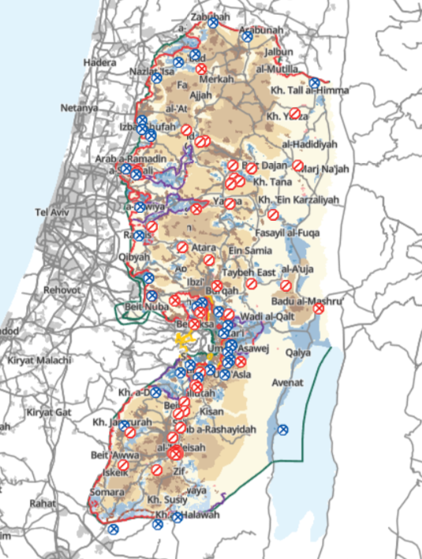
CHECKPOINTS AND ROAD CLOSURES
Network of checkpoints located throughout the West Bank inhibits freedom of movement
Road closures are commonly instituted as security measures
Barrier between the West Bank and Israel still under construction
https://www.btselem.org/map
Notes:
https://www.btselem.org/map

Slide 10
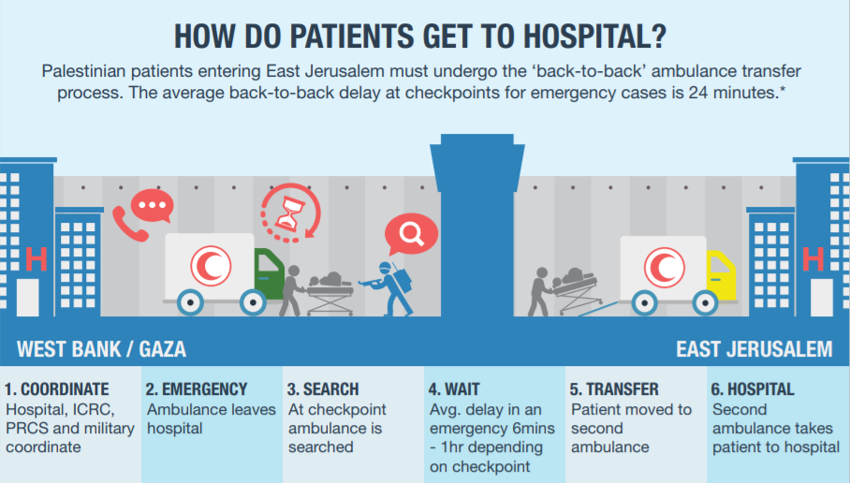
AMBULANCE SCREENING
Particularly important given reliance on specialty services in East Jerusalem
Image by The White Canvas; thewhitecanvas.co.uk
Notes:
https://www.map.org.uk/downloads/map-ch1--access-to-healthcare.pdf
Image by The White Canvas; thewhitecanvas.co.uk

Slide 11
ANALYSIS

Slide 12
PROPOSED ANALYSIS
Analysis of accessibility across the West Bank without obstacles
Analysis of accessibility across the West Bank with obstacles
Comparison of the two outputs to reveal effect of obstacles generally and locally
What obstacles hinder accessibility the most?
What populations are affected the most?
Analysis of accessibility of Israeli settlements in the West Bank

Slide 13
POPULAR METHODS
Cost Surface Analysis
Accessibility expressed as travel time to nearest facility
Does not consider availability (demand, choice)
Useful for large, undeveloped areas
Two Step Floating Catchment Areas
Accessibility expressed as ratio of providers to served population
Considers distance and availability
Ineffective in rural areas with few facilities

Slide 14
METHODS: TWO STEP FLOATING CATCHMENT AREA
Obstacles
Lines
Polygons
Obstacles
Lines
Polygons
Roads
Lines
Facilities
Points
Population
Points
Roads
Lines
Network Analyst
Network Analyst
Catchment
Travel Time From Facilities
Catchment
Travel Time From Population Centers

Slide 15
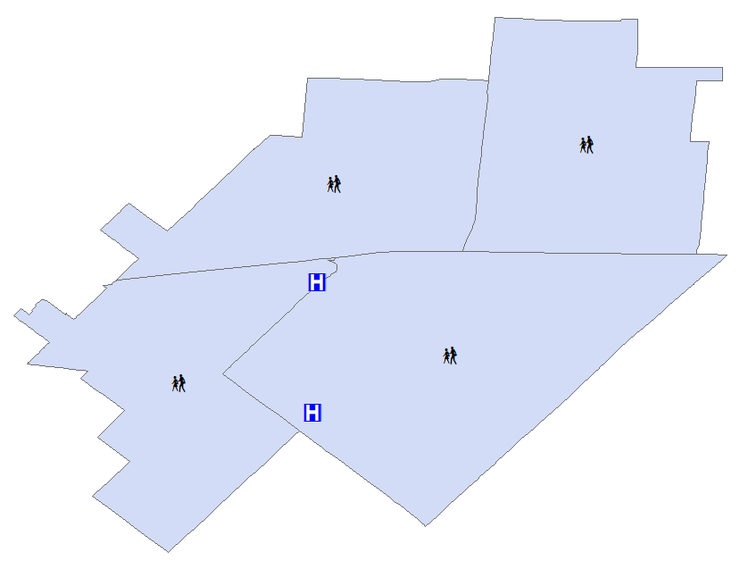
METHODS: TWO STEP FLOATING CATCHMENT AREA
Step 1 (Supply)
Create catchments around healthcare facilities
Sum population within each catchment
Calculate provider-population ratio
1 physician
-----------------
2,000 people
0.0005

Slide 16
METHODS: TWO STEP FLOATING CATCHMENT AREA
Step 2 (Demand)
Create catchments around population centers
Sum provider-population ratios from step 1 from each healthcare facility within catchment
0.0005
+ 0.0005
0.001

Slide 17
METHODS: FCA FAMILY
2SFCA
E2SFCA
M2SFCA
0%
0%
20%
50%
100%
100%
100%
0%
0%

Slide 18
DATA
Description | Data Currency | Source | URL
Aggregated medical facility data pulled from users and OSM | 2018 | OSM | https://healthsites.io/#country-data
OSM roads shapefile | 2018 | HDX / OSM | https://data.humdata.org/search?ext_geodata=1&groups=pse&q=&ext_page_size=25
Population, income, etc. statistics similar to census bureau | 2017 | PCBS | http://www.pcbs.gov.ps/site/lang__en/507/default.aspx
Current state of resources provided by the UN | 2018 | UNRWA | https://www.unrwa.org/resources
Current and historical information regarding health services initiatives | 2018 | WHO | http://www.emro.who.int/countries/pse/index.html
Country-wide population data as raster surface | 2015 | WorldPop | https://energydata.info/dataset/palestine--population-density-2015

Slide 19
MILESTONES
Capstone Proposal
Conduct Analysis
Present -
Venue TBD
July
Aug
Sep
Oct
Nov
Dec
Jan
Feb
Mar
Apr
May
Collect & Structure Data
Finish Final Report
Graduate

Slide 20
REFERENCES
Au, V., Plachkinova, M., & Bhaskar, R. (2015). Assessing Healthcare Accessibility Algorithms : A Comprehensive Investigation of Two-Step Floating Catchment Methodologies Family. Twenty-First Americas Conference on Information Systems, 1–12. Retrieved from aisel.aisnet.org
B’tselem. (n.d.). [Interactive map showing temporary and permanent checkpoints located in the West Bank]. Retrieved 25 June 2018 from https://www.btselem.org/map
Delamater, P. L. (2013). Spatial accessibility in suboptimally configured health care systems: A modified two-step floating catchment area (M2SFCA) metric. Health and Place, 24, 30–43. https://doi.org/10.1016/j.healthplace.2013.07.012
Kanuganti, S., Sarkar, A. K., & Singh, A. P. (2016). Evaluation of access to health care in rural areas using enhanced two-step floating catchment area (E2SFCA) method. Journal of Transport Geography, 56, 45–52. https://doi.org/10.1016/j.jtrangeo.2016.08.011
McGrail, M. R., & Humphreys, J. S. (2009). Measuring spatial accessibility to primary care in rural areas: Improving the effectiveness of the two-step floating catchment area method. Applied Geography, 29(4), 533–541. https://doi.org/10.1016/j.apgeog.2008.12.003
Medical Aid for Palestinians. (2017). Access to Healthcare, Health Under Occupation: Chapter 1. Retrieved June 25, 2018 from https://www.map.org.uk/downloads/map-ch1--access-to-healthcare.pdf
United States Department of State. (n.d.). The Oslo Accords and the Arab-Israeli Peace Process. Retrieved June 25, 2018 from https://history.state.gov/milestones/1993-2000/oslo

Slide 21
QUESTIONS?

