Slide 1
Mobile Visualization of Underground Electric Infrastructure with Augmented Reality and GIS
Jason Snyder
Advisor – Cyle Vogt
Geog 596A
May 2, 2022

Slide 2
Overview
Analysis of the current underground electric utility locating and verification of assets with a utility Geographic Information System (GIS).
Can GIS mobile mapping software, integrated with Augmented Reality, increase safety, location awareness, and data quality assurance?

Slide 3
Underground utility locating
Call Before You Dig – Dial 811
Call811.com
https://dpcoftexas.org/home-owners-and-811/
https://dpcoftexas.org/home-owners-and-811/

Slide 4
Underground utility locating
Locating tickets generated from 811 database
Locator utilizes electromagnetic and ground penetrating radar equipment to assess the location of underground utilities in the area
https://magnuselectric.com/index.php/services/specialty/underground-locating/

Slide 5
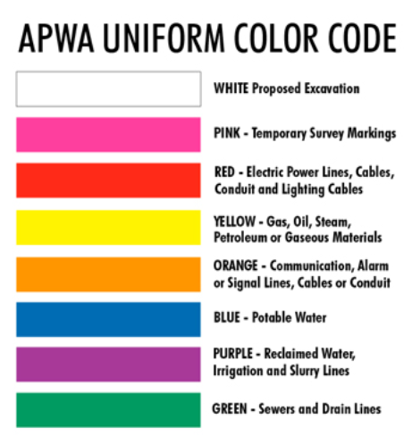
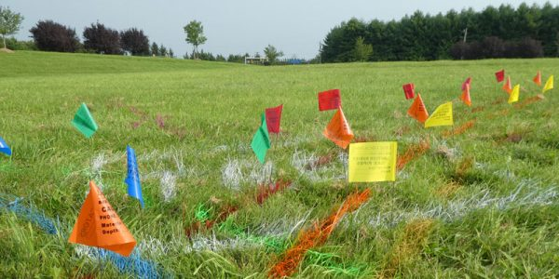
Underground utility locating
https://www.linelocators.com/about-us/
https://www.acsunderground.com/underground-utility-locating/

Slide 6
Underground utility locating
In the U.S., an underground utility strike from excavation occurs every 60 seconds (Su et. al., 2013)
Recent estimates by the Common Ground Alliance’s DIRT report from 2019 put the cost of utility damage from excavation at roughly $30 billion in the United States alone (Dig Different, 2020)

Slide 7
Electric Utility GIS
In GIS for Enhanced Electric Utility Performance, Meehan (2013) states that “the main purpose of modeling the distribution GIS is to improve the awareness of location, condition, and relationship of the entire distribution system, including structural elements.”
https://tadviser.com/index.php/Product:Smallworld_Electric_Office

Slide 8
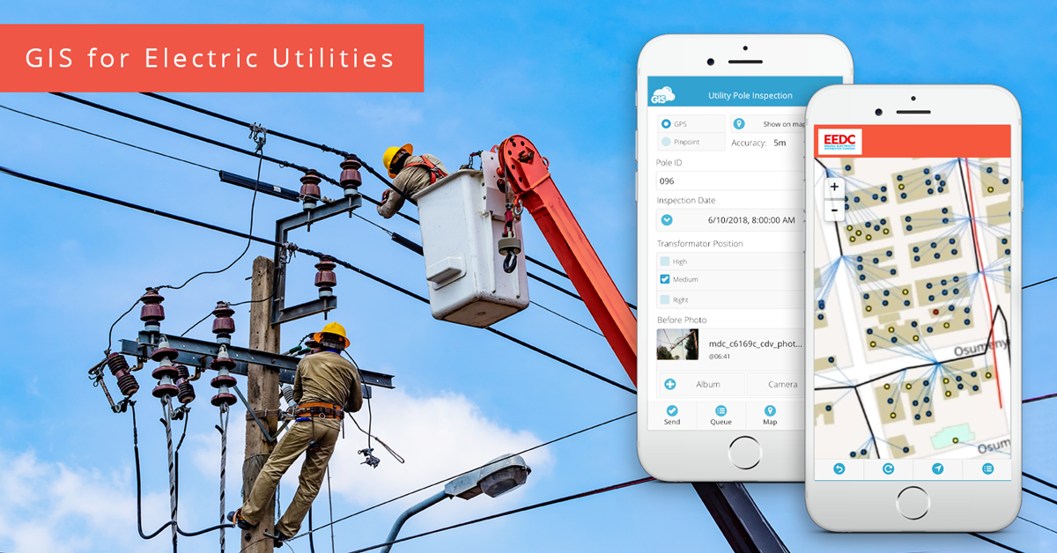
Mobile Electric Utility GIS
Updates on assets and infrastructure can be made in real time and communicated back to the control center and GIS team
https://www.giscloud.com/blog/gis-for-electric-utilities/#pid=1

Slide 9
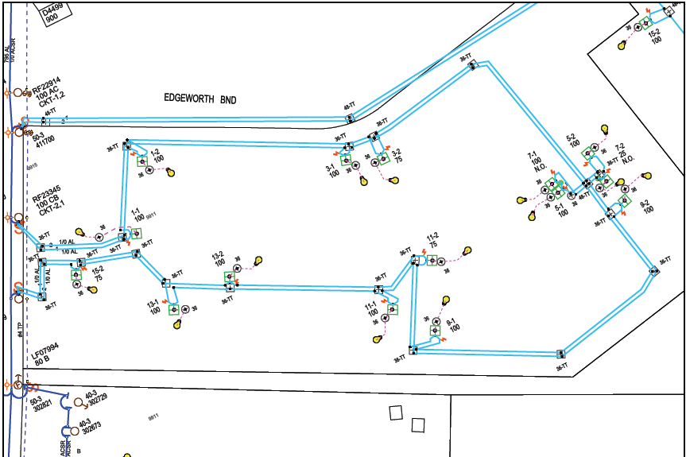
Electric Utility GIS example

Slide 10
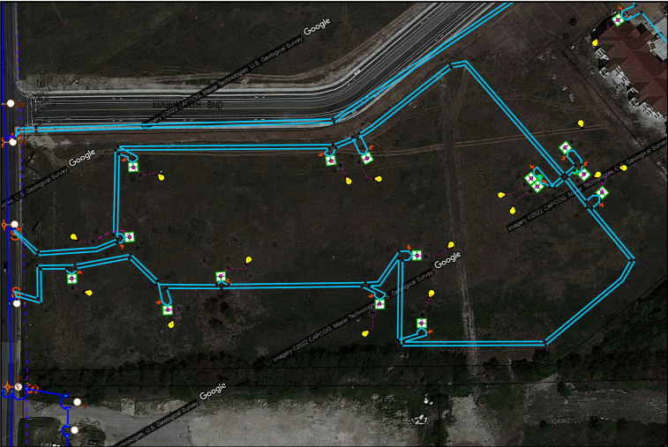
Electric Utility GIS example

Slide 11
Electric Utility GIS example

Slide 12
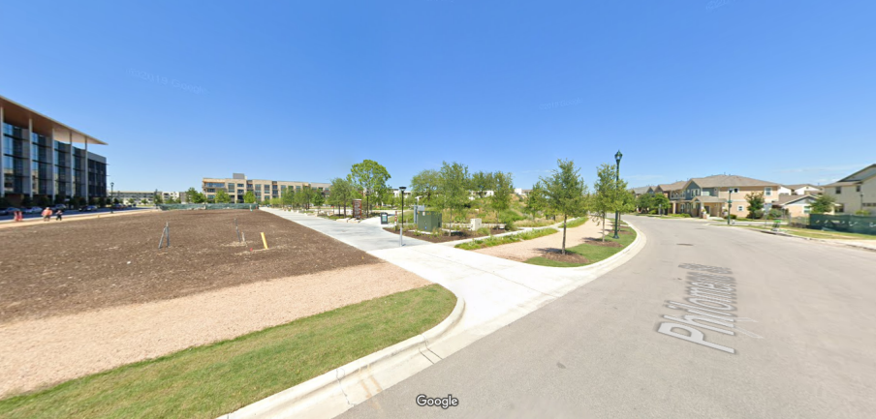
Streetview Underground Electric Utility
https://www.google.com/maps/@30.3001134,-97.7034771,3a,83.1y,68.19h,88.96t/data=!3m6!1e1!3m4!1sgKm2xEve9cJYiG0ayfITHQ!2e0!7i16384!8i8192

Slide 13
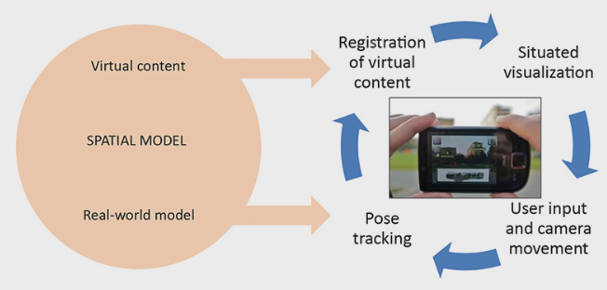
Augmented Reality (AR)
Uses the camera and GPS of a mobile device
Overlaps virtual environment into view of physical environment
Schmalstieg, 2016
Schmalstieg, 2016

Slide 14
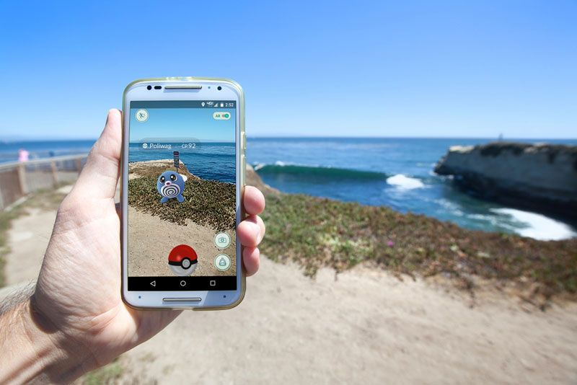
Augmented Reality (AR)
https://www.pokemon.com/us/pokemon-video-games/pokemon-go/
https://www.livescience.com/34843-augmented-reality.html

Slide 15
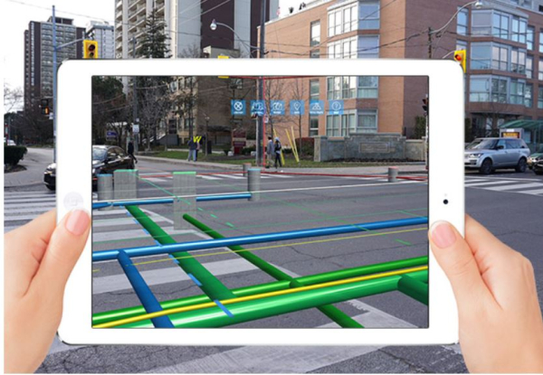
Augmented Reality (AR) for Underground Utilities
https://geospatial.blogs.com/geospatial/2020/08/study-shows-augmented-reality-improves-productivity-of-underground-utility-locators.html

Slide 16
Objective
Design prototype mobile mapping application
Incorporate Augmented Reality
Field testing and feedback

Slide 17
Methodology
Survey
Wireframe prototype
Electrical GIS data developed into Augmented Reality
Field test Augmented Reality application

Slide 18
Survey
Prior research on design and development has determined that an approach planned around the user’s needs will typically lead to a successful integration and deployment of an application (Tomlinson, 2013)
Electric Service Delivery work groups:
One Call Locators
Control Center Operators
GIS Services
Distribution Electricians
Electrical Service Designers

Slide 19
Survey
Interface layout
Usability standards
Scenarios that AR could improve
Usage of current mobile GIS software (EO Web)
Advantages/disadvantages
Improvements

Slide 20
Wireframe
Survey results driven design
Tool for utilizing Augmented Reality
Low fidelity design for discussion and feedback

Slide 21
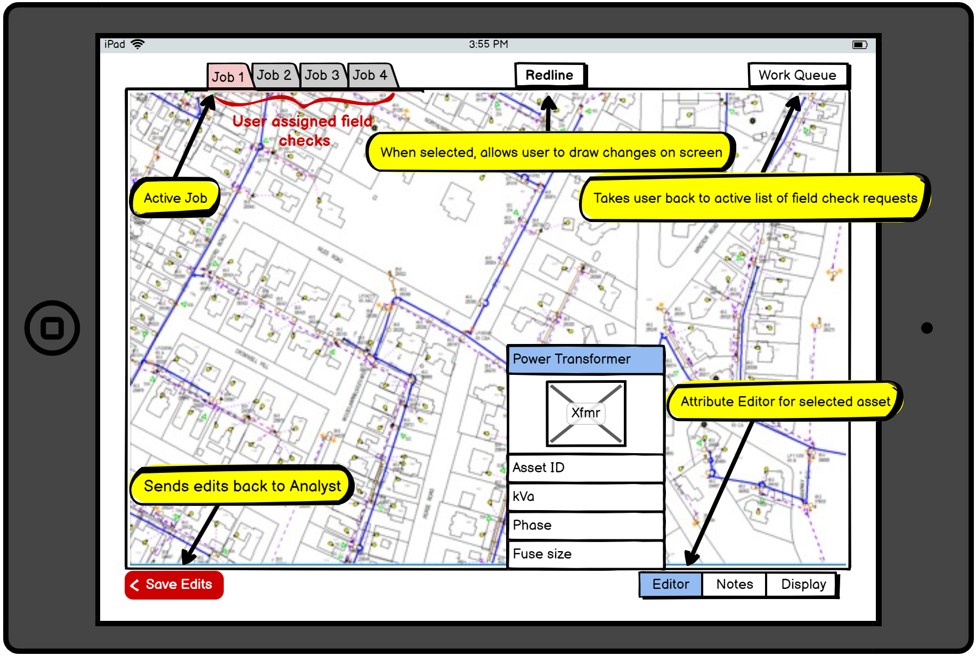
Wireframe
Example of a wireframe prototype for a mobile mapping application
Designed by Jason Snyder using Balsamiq for Geog 583

Slide 22
Augmented Reality application
Potential products for design and implementation
ARToolKit
Unity
ARKit
ArcGIS CityEngine

Slide 23
Field Testing of AR application
Looking to include One Call locators and GIS field team to test and provide feedback of the use of augmented reality mobile system (possibly 6 participants)
Potential to include office personnel if time permits
Report on application functionality, challenges, and usability
Short questionnaire for field testers to provide comments

Slide 24
Data
Underground electrical test scenarios using test data in Electric Office
Data can be exported in multiple formats and/or imported into ArcGIS Pro
Multiple scenarios to be created in the same test location to avoid having to travel to multiple locations
At minimum, one scenario will be necessary to field test

Slide 25
Data
Results and feedback of survey from electrical professionals
AR mobility design suggestions
Analysis of current mobility software
Response from field testers on AR application

Slide 26
Anticipated Results
Successful development of a prototype AR mobile application for underground electrical inspection
AR capabilities in a GIS mobility application
Analysis on the complexities of integrating AR
Results of survey and application testing feedback for improvements or challenges with using AR use in underground electrical locating

Slide 27
Timeline
Research tools of Augmented Reality
Develop survey
Initiate contact with participants and collect survey results
May
September
October
December
Create sample datasets
Wireframe prototype application
Field testing and results
Customize AR field application
Final report and presentation

Slide 28
Potential Conference
DistribuTECH 2023
February 7-9, 2023. San Diego, CA
Present Online, December 2022

Slide 29
References
Adascalitei, I., & Baltoi, I. (2018). The influence of augmented reality in construction and integration into smart city. Informatica Economica, 22(2/2018), 55-67. https://doi.org/10.12948/issn14531305/22.2.2018.06
Dig Different. (2020). Annual Report Reveals Increase in Excavation-Related Damages to Utilities. Digdifferent.com. https://www.digdifferent.com/online_exclusives/2020/10/annual-report-reveals-increase-in-excavation-related-damages-to-utilities
Meehan, B. (2013). GIS for enhanced electric utility performance. Boston, Artech House.
Schmalstieg, D. (2016). Augmented Reality: Principles and Practice. Addison-Wesley Professional.
Su, X., Talmaki, S., Cai, H., & Kamat, V. R. (2013). Uncertainty-aware visualization and proximity monitoring in urban excavation: A geospatial augmented reality approach. Visualization in Engineering, 1(1), 1-13. https://doi.org/10.1186/2213-7459-1-2
Tomlinson, R. (2013). Thinking About GIS: Geographic Information System Planning for Managers. Esri Press. https://ebookcentral.proquest.com/lib/pensu/detail.action?docID=3238278#
Wikipedia contributors. (2022, April 18). Pokémon Go. In Wikipedia, The Free Encyclopedia. Retrieved 14:31, April 24, 2022, from https://en.wikipedia.org/w/index.php?title=Pok%C3%A9mon_Go&oldid=1083445366

Slide 30
Questions?

Slide 31
Thank You!

