Slide 1
Designing an Open Source Web Application for Visualizing Aquifers
Mitchell Sodek
Advisor: Dr. Pat Kennelly
Penn State University
AAG Conference San Francisco, CA April 2016

Slide 2
Project Proposal
Develop an open source web-based mapping application that will generate user customized aquifer data in a graphical format.

Slide 3
Objectives
Utilize open source software to create a responsive web map design that functions within a browser on any device
Create custom stratigraphic column and cross section graphs generated from grid cell elevation values representing the various aquifer layers
Develop a simple, powerful, and user friendly interface/experience for a wide number of public users
Employ a design that can be easily duplicated and one that is scalable for additional data and features

Slide 4
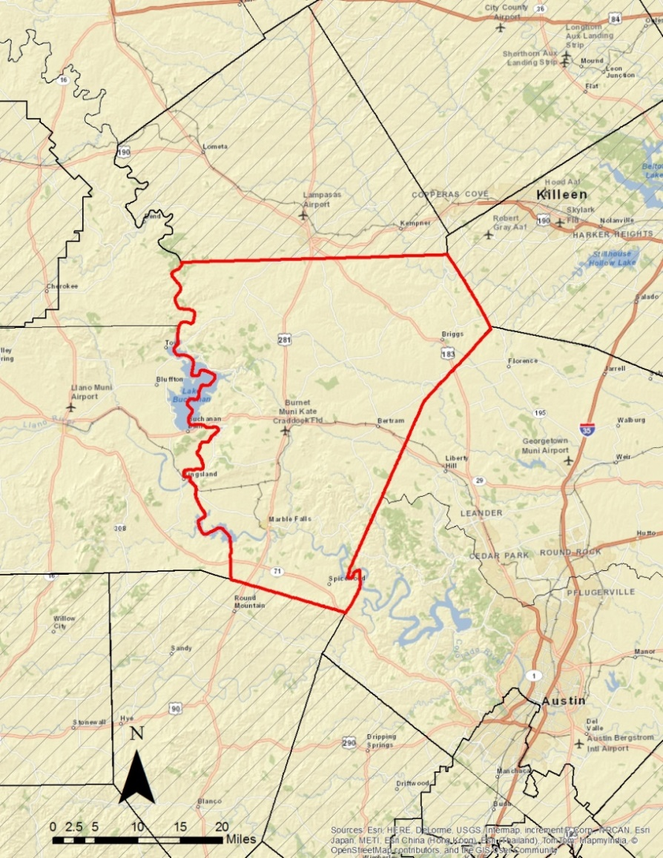
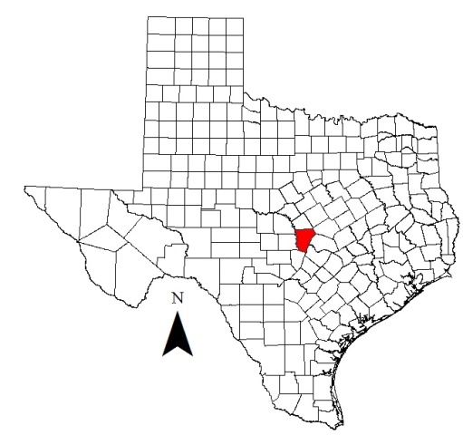
Project Area
Central Texas Groundwater Conservation District
Burnet County
pop 50,000
1,021 sq. miles
6 aquifers -> sub-aquifers

Slide 5
What is an Aquifer?
A saturated permeable geologic unit that can transmit significant quantities of water (Freeze and Cherry, 1979)
May be bounded by impermeable layer(s)
Wells, springs, seeps, pits, lakes, creeks, and rivers are fed by aquifers
Surface
Aquifer 1
Confined
Layer
Aquifer 2
Aquifer 3
Source: Regional District of Nanaimo

Slide 6
Who Needs Aquifer Data?
Groundwater District
Public
Vital for managing an aquifer
Multiple aquifers overly each other
Production assigned by aquifer
New wells can be designed with greater accuracy
Educating the general public
Well owners want to know from which aquifer they produce
New proposed well owners want to know the depth and cost
Drought contingency plans

Slide 7
Current Challenges
Aquifer data exist but are not easily attainable for the public
A professional is needed to compile data, analyze, and interpret the results
Specialized software is needed to visualize the underlying aquifers

Slide 8
Cross Sections
Widely used in the hydrogeologic sciences
Vertical axis is elevation values
Horizontal axis is distance along the cross-sectional line often using the map’s scale
Stratigraphic column –same data but for single point location
Source: Texas Water Development Board 2009,

Slide 9
Subsurface Layers
Multiple Raster Layers
Source: Texas Water Development Board
Llano Uplift and Northern Trinity Groundwater Availability Models
Format: Raster, Shapefile Grid
Resolution: ¼ mile x ¼ mile
Raster value represents bottom of layer/top of next
TWDB Llano Uplift Model Update

Slide 10
Methodology
1300’
1150’
1100’
1050’
900’
For a given point, each raster contains one z (elevation) value that corresponds to the bottom of that layer
A stratigraphic column or cross section can then be formed
800’
700’
500’
400’

Slide 11
Project Framework
PostgreSQL/PostGIS
Spatial database
Geoserver
Web Map Service
WFS
WMS
Leaflet
Front end mapping platform
Lightweight
Javascript plugin tool library

Slide 12
GeoJSON Grid
¼ mile grid cells
Each cell contains property values for the various aquifer layers
Served as GeoJSON to leaflet using Web Feature Service.
Used onEachFeature to extract data on click

Slide 13
Leaflet
Leaflet GeoJSON
onEachFeature option is used to attach a popup to features when they are clicked
function onEachFeature(feature, layer) {
// does this feature have a property named popupContent?
if (feature.properties && feature.properties.popupContent) { layer.bindPopup(feature.properties.popupContent); } }

Slide 14
Highcharts
Basic Area Chart
Parsefloat the geoJSON string argument into a floating point number
Tooltip hover over graph to display value of each layer
Establish a minimum threshold value equal to bottom of last layer

Slide 15
Prototype
Zoom Controls
Layer Control
Geolocation
Geocoding Address
Draw Polyline
Popup Stratigraphic Column
GeoJSON Outline

Slide 16
Polyline Cross Section
L.GeometryUtil plugin
interpolateOnLine(map, latlngs, the)
Returns the coordinate of the point located on a line at the specified ratio of the line length.

Slide 17
Challenges
Opportunities
Wide user group
Keep design simple
Offer help screen
Coding
Javascript
CSS
Highchart
Graphics display
Screen size
Printable
Easily duplicated for other areas
Location services using GPS from mobile devices
Framework built for other data sets
Wells
Water levels
Water quality
Brackish water

Slide 18
References
Central Texas Groundwater Conservation District, Maps, Retrieved on June 16, 2015 from http://www.centraltexasgcd.org/maps-2/
Final Report on the Update of the Trinity/Woodbine Groundwater Availability Model, November 3, 2014, Intera.
Freeze, R. A., & Cherry, J. A. (1979). Groundwater.
High Plains Aquifer System-Water Levels Time Series, Retrieved on June 12, 2015 from http://hpasgam.intera.com/
Highway 1431 to Kingsland to Marble Falls, (N.D.) Morelock Retrieved on March 31st, 2016 from http://geology.uprm.edu/Morelock/1431K.htm
Minnesota Geological Survey, Online Map Services, Retrieved on June 15, 2015 from http://www.mngs.umn.edu/service.htm
Regional District of Nanaimo, Watersheds and Aquifers 101, Retrieved on July 16, 2015 from http://www.rdn.bc.ca/cms.asp?wpID=2415
Texas Water Development Board, 2009, “Groundwater Availability Model for the Hill Country Portion of the Trinity Aquifer System, Texas”
The Edwards Aquifer Website, Gregg Eckhardt, Retrieved on June 17, 2015 from http://www.edwardsaquifer.net/geology.html
United States Department of Energy Hanford Site, Annual Reports, Retrieved on June 12, 2015 from http://higrv.hanford.gov/Hanford_Reports/Cross_Section_Tool/
United States Geological Survey Texas Science Center, Texas Geology Web Map Viewer, Retrieved on June 5, 2015 from http://txpub.usgs.gov/dss/texasgeology/

Slide 19
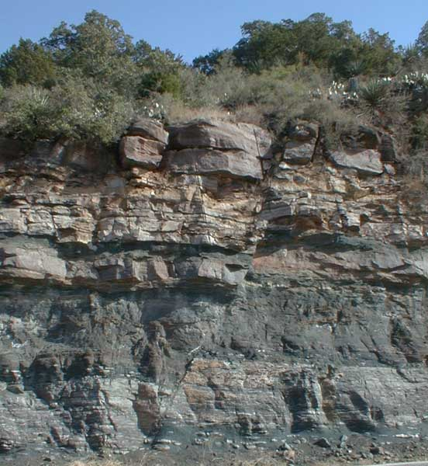
Questions?
NTGAM
Morelock UPRM Geology department

