Slide 1
Mapping Dinétah Pueblitos using Post-Processed Kinematic GPS Data from an sUAS Platform
John South
Advisor: Karen Schuckman

Slide 2
Capstone Statement
In the Dinétah between 1692 and 1745, Navajo families lived in small structures called pueblitos. Over the half-century of their construction, these structures were used for housing, food storage, and defense against opposing Indian tribes. They are a short, but important link in the history of the Navajo people.
Preservation archaeologists are focused on protecting these sites from risks that could hasten their deterioration or destruction. It is difficult to clearly observe these structures from publicly available satellite imagery due to their diminutive size. However, using a rotary sUAS, and accurate geotagging technology, 2 and 3-dimensional imagery of a pueblito can be produced that would provide archaeologists with insight on physical and temporal changes to the structures.
For the capstone, I will explore the technologies, processes, and software necessary to produce 2 and 3-dimensional models of an example pueblito. I will examine the successes and difficulties of acquiring the equipment, preparing for the field activities, and acquiring the data in the field. The goal will be to produce 2 and 3-dimensional models with less than 2 cm/pixel horizontal spatial resolution and less than 6.5 cm vertical accuracy. These models would be sufficient for archaeologists to assess changes in the pueblitos.

Slide 3
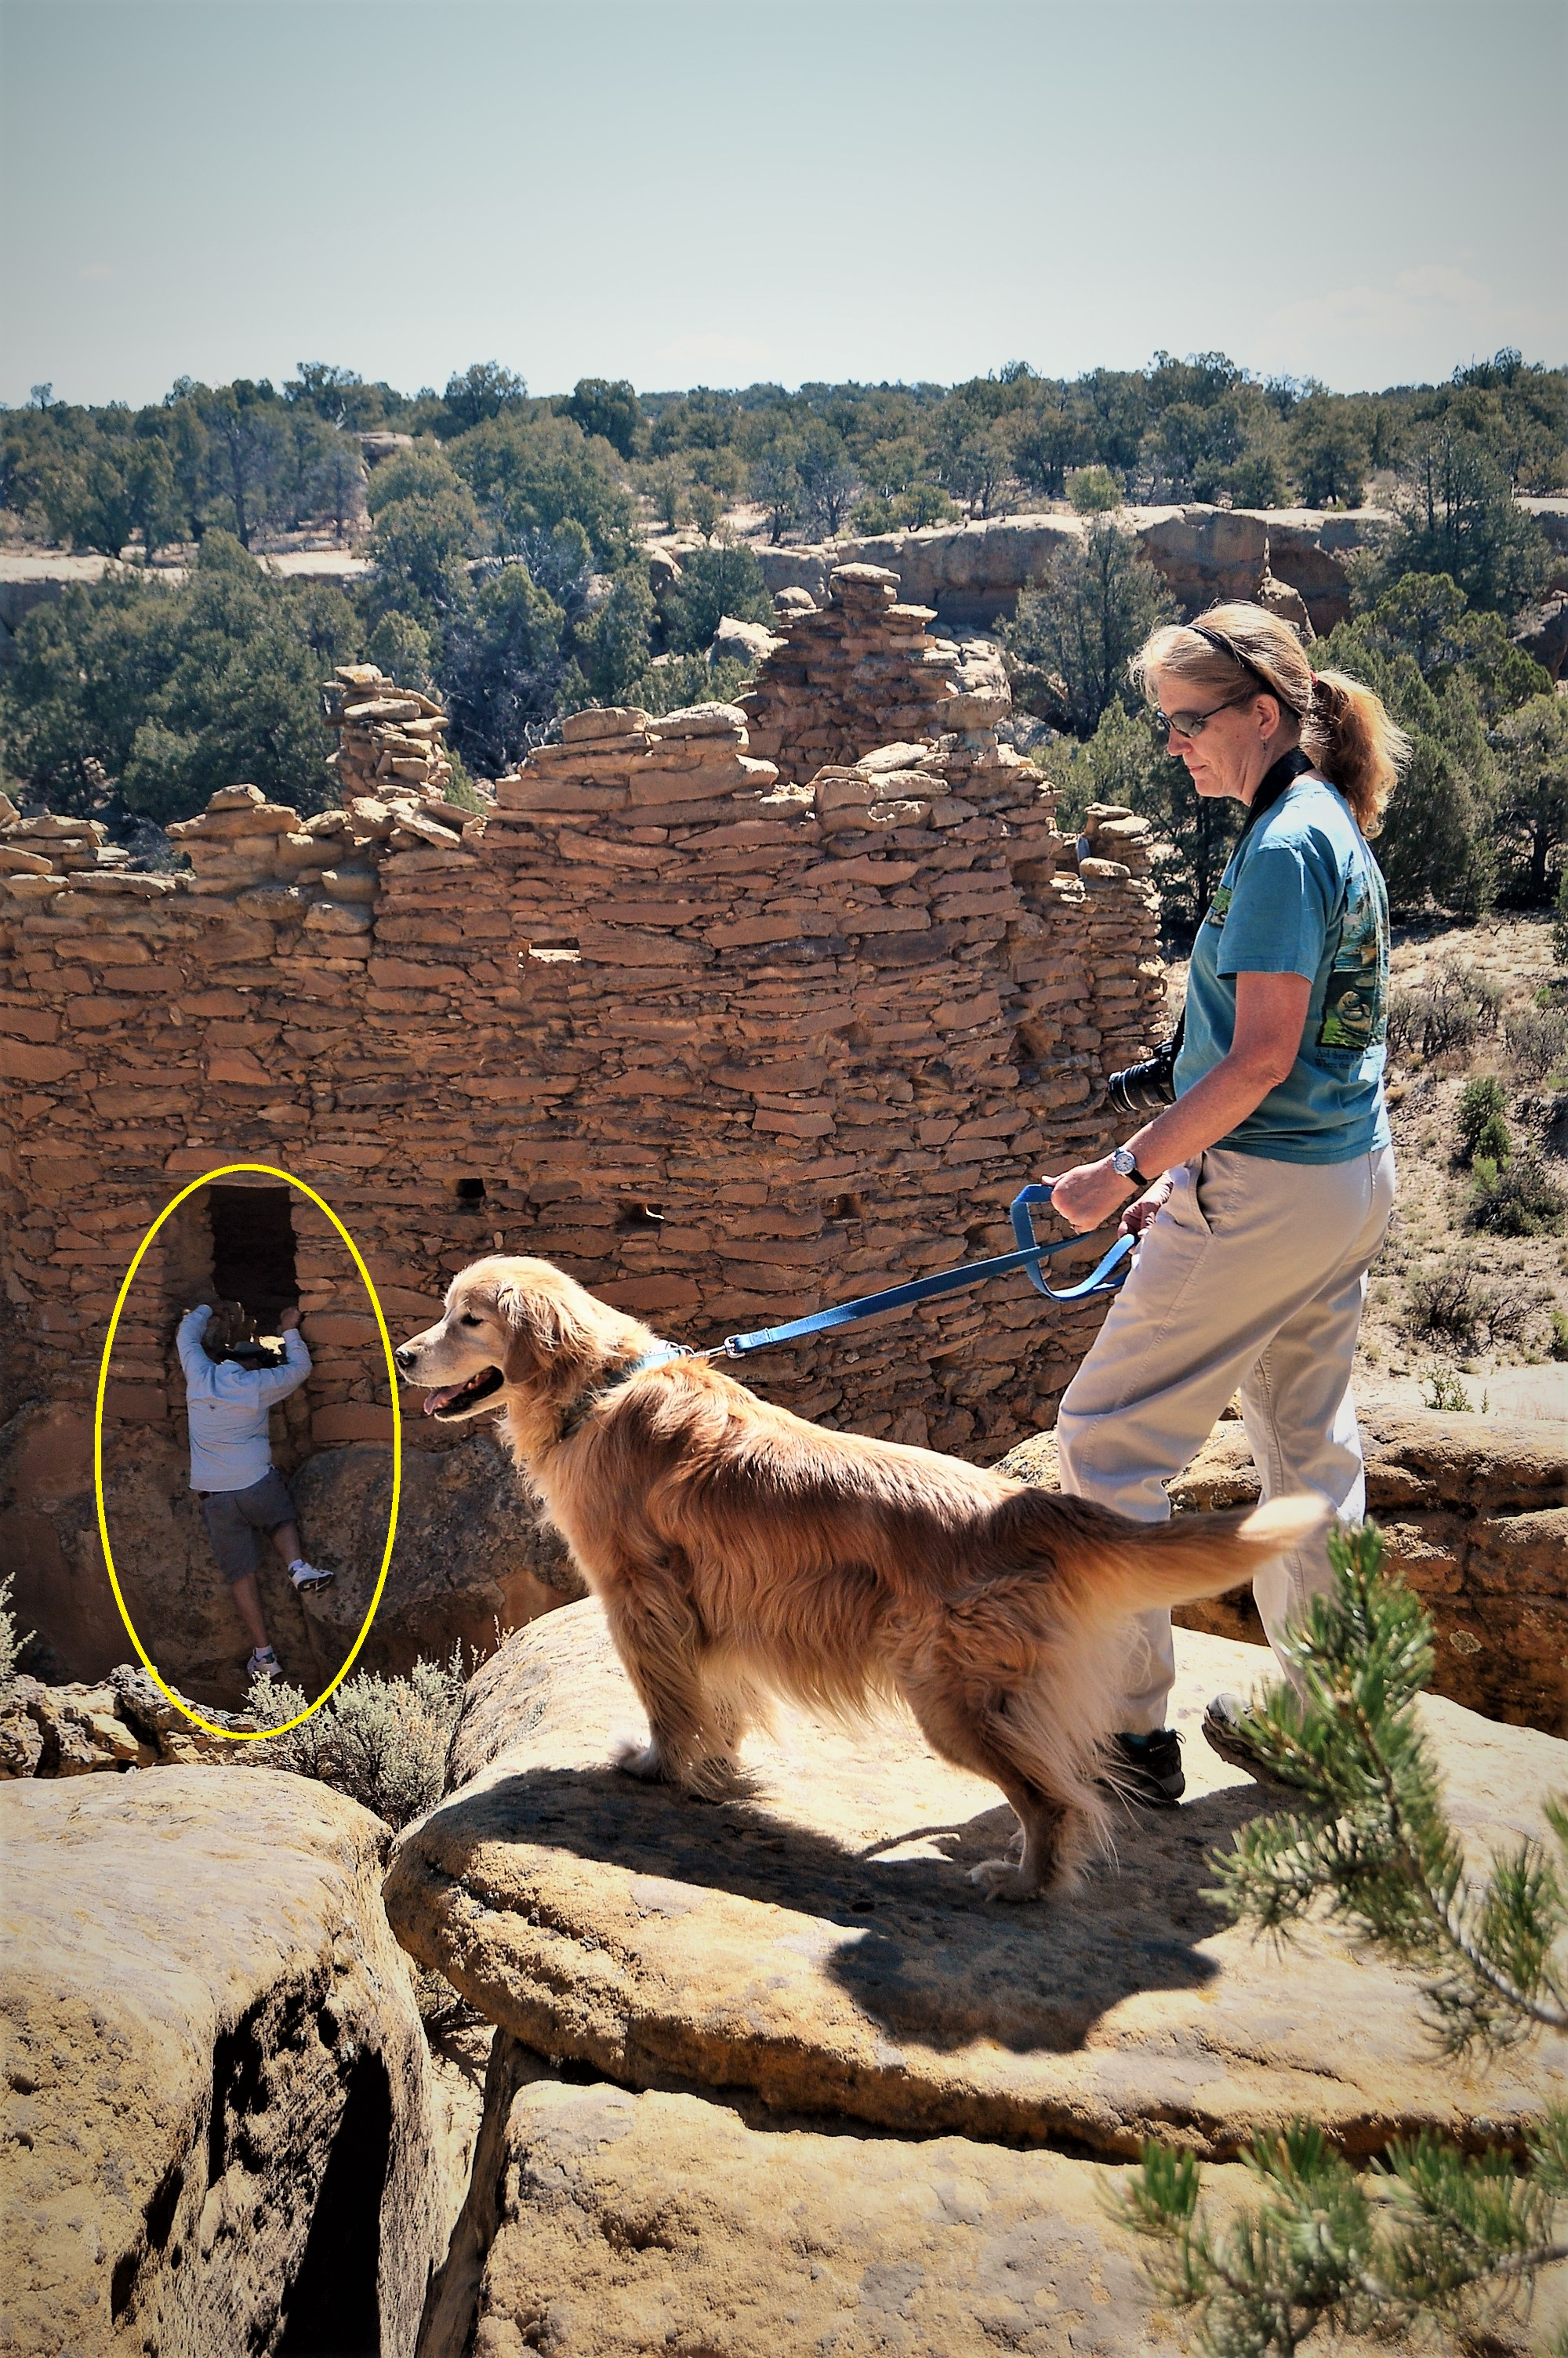
Risks to the Pueblitos
Access using oil field roads
Weather
Vandalism
Artifact hunters
Tourist pressure
New drilling projects

Slide 4
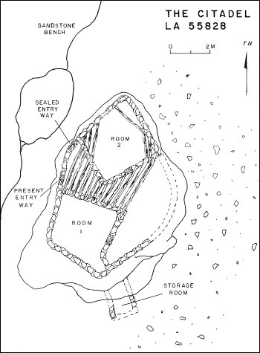
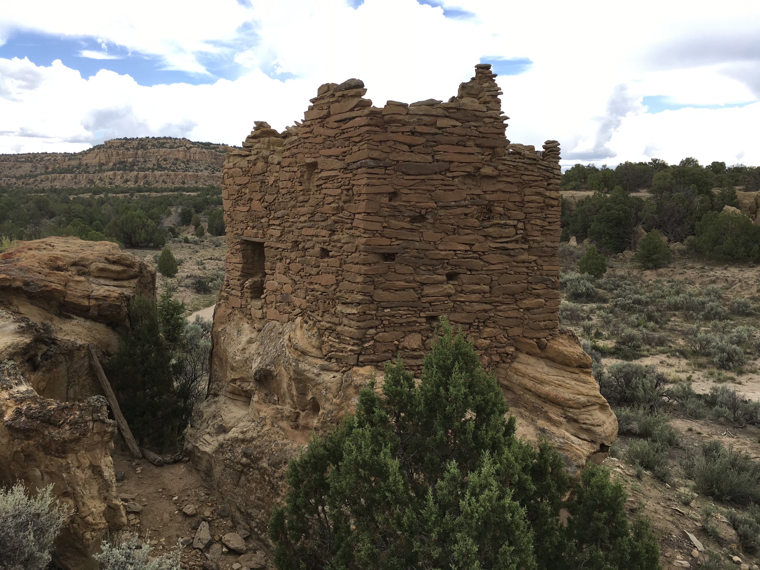
Site selected for capstone project
The Citadel (LA55828)
Built after 1688 (type of architecture suggests early 1700s)
Defensively appears much better designed than many sites
Can see a long distance across the east and southeast directions
Guarded by larger boulders on the west and northwest sides

Slide 5
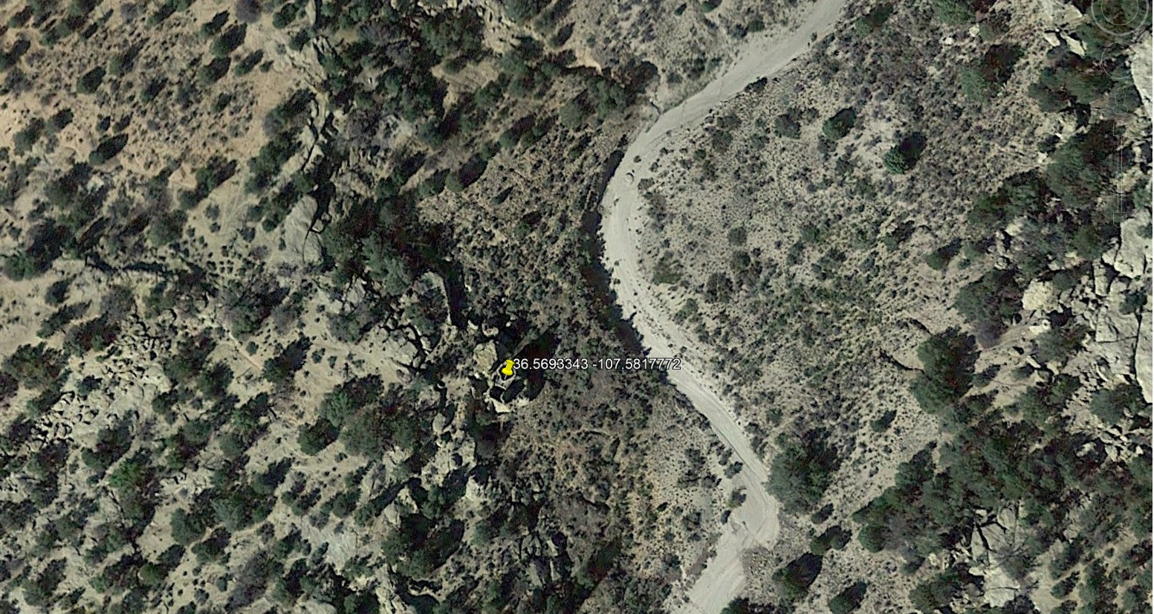
Site selected for capstone project

Slide 6
Workflow
Preparation
Research and select sUAS
Practice using equipment
Practice processing data
Prepare for field activities
In the field
Set GCPs, capture location of GCPs
Establish Base Station
Prepare sUAS for flight
Capture images
In the office
Download flight data and images
Process the data
Build 2 and 3-dimensional models
Generate DSM and DTM

Slide 7
Risks Anticipated in the Project
Weather hindering access to the sites
Altitude impacting physical activity
Access roads are difficult driving
Difficulty in placing GPS ground check points (GCPs)
Obtaining a sufficient data set to show results
Unforeseen operational issues, such as the lack of wireless service
Insufficient computing resources to build the 3-dimensional models

Slide 8
Mitigation efforts to minimize risk
Day 1: Pace GCPs and occupy the point to acquire GPS data
Locate the GCPs where there are clear views of the sky
Occupy the points for at least 25 minutes to gather enough GPS data
Day 2: Image Capture
Field test the completeness and quality of images
Download the images from the drone
Day 3: Field Processing of Data
Qualitative assessment of data quality

Slide 9
Preparation Work
Selecting the type of aircraft to used to capture the data
Initially interested in LiDAR from an sUAS platform
Due to cost considerations, switched to image capture with geotagging
Ordered the aircraft
While waiting for aircraft to arrive
Practiced using the mission planning software with Phantom 4 Pro
Acquired Remote Pilot Certification (Part 107)
Researched the geotagging hardware (AirGon’s Loki unit)
Purchased the iGage i3gs GPS-GNSS receiver

Slide 10
Why the AirGon sUAS Platform
Familiarity with DJI aircraft (experienced with DJI Phantom Pro 4)
Cost
Solution
DJI Inspire 2
Zenmuse X4S camera (20 megapixels)
Loki (geotagging)
Ease of using the included software (ASPSuite)
Training and support

Slide 11
Final Preparation Work
Practiced assembling and flying the aircraft
Following the workflow, practiced:
Capturing images at a local airfield
Capturing ground control point location data (using the GPS-GNSS receiver)
Establishing a base station as a reference point
Downloading data from all of the hardware
Practiced pulling the data into Photoscan for processing

Slide 12
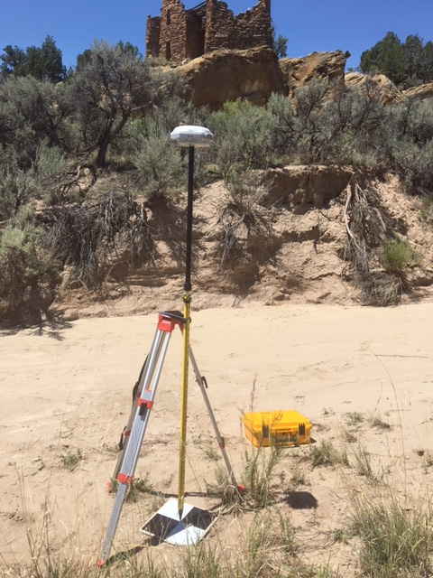
Field days
Finding the site was a challenge
After locating the site, established eight ground control points
Difficult to identify locations for GCPs
No intersecting roads or paths
Measured distance from nearby identifiable landmarks
Occupied each point for at least 25 minutes

Slide 13
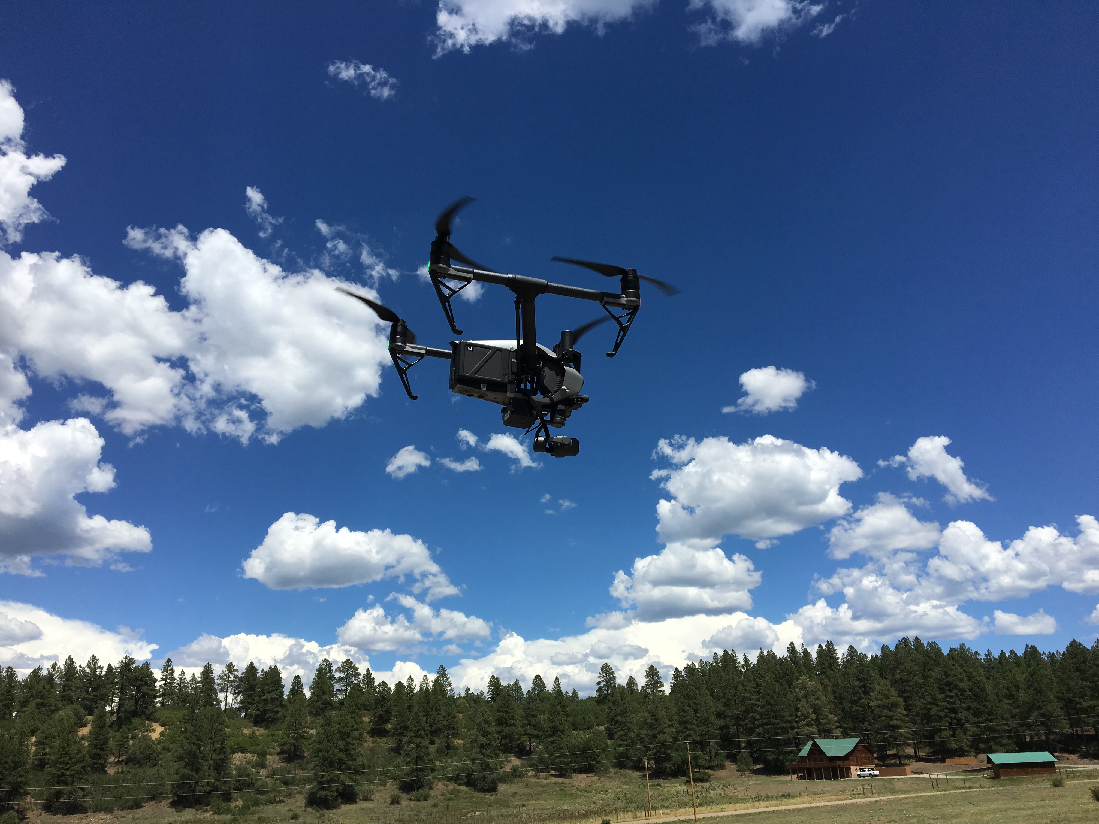
Field Days
Data capture was not as clean as practiced
For each launch, sUAS disconnected from the mission software
After several relaunches, determined waypoints were loaded to the drone
Images were being captured

Slide 14
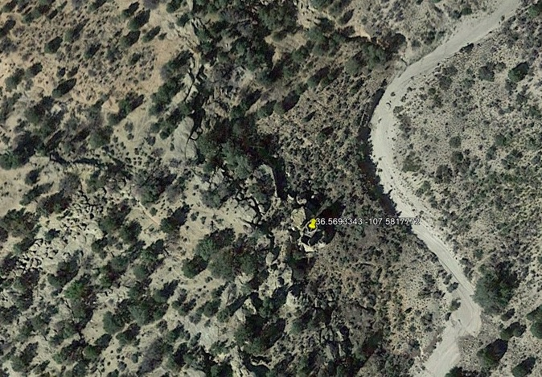
Field Days
Flew four missions in different orientations
Two missions flown with camera pointed at nadir but tracking 90º to each other
Two missions flown tracking 180º to each other but with the camera at a 45º angle
Camera lens vertical – west to east
Camera lens vertical – south to north
Camera lens 45º – west to east
Camera lens 45º – east to west

Slide 15
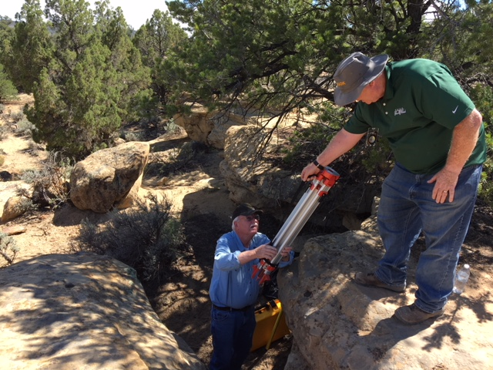
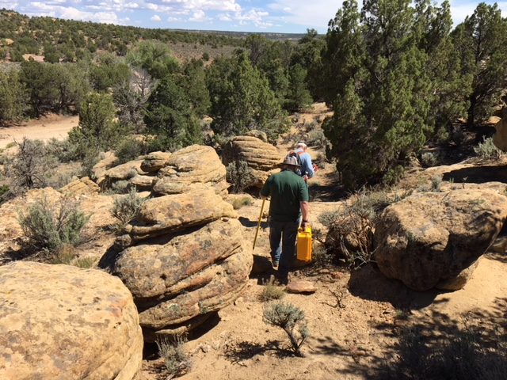
Lessons learned
Determine the route to the site before heading into the field
Roads are very rough
Travel time off paved highway is significant (1 hr 45 min)
No roads are marked and they all look the same
Prepare for rugged terrain at the site
Practice paid off
Never determined why the sUAS was disconnecting
Because of practice, was able to determine that waypoints were being loaded
Was able to complete the data acquisition
Practice until the workflow is almost second nature

Slide 16
Lessons learned
Establish checklists
Equipment needs to be packed and in which container
Operating procedures
Packing the vehicle
Research the equipment needed for the field work
Determine your goal
Determine budget
Take advantage of training that the vendors offer
Talk with the vendors directly if you have an issue

Slide 17
Next steps
Process the images through the designated work flow
Create an orthorectified 2-dimensional map of the ruins
Planimetric details of the sites
Match with planimetric drawings of earlier archaeologists
Create 3-dimensional model of the ruins
Directional cross-sections of the site
Digital surface model
Digital terrain model
Conference

Slide 18
Wrap-up
The pueblitos are fragile remnants of an important period in the history of the Navajo
A cost effective, portable, and repeatable means of acquiring accurate 2 and 3-dimensional imagery of the ruins will assist preservation archaeologists in determining physical and temporal changes to the sites.
The capstone will examine the feasibility of producing imagery with horizontal spatial resolution of less than 2 cm /pixel and within a horizontal accuracy of 4.0 cm and a vertical accuracy of less than 6.5 cm
The selected archaeological site is typical of a large number of the pueblitos. Working at this site will provide insight on the processes, hardware, and software needed to build out 2 and 3-dimensional models that can cost effectively assist preservation archaeologists in determining physical and temporal changes to a pueblito.

