Slide 1
What Drives Place-Based Development in Maryland? An Examination of 1980-2020
Kyle Sowder
Advisor: Dr. Stephen A. Matthews

Slide 2
Overview
What is considered development?
Preliminary population analysis
Background
Maryland features
Factors that can influence populations
Goals and objectives
Proposed methodology
Timeline
Anticipated results
Notes:
Here is an overview of my presentation. First, I am going to go over what is considered development and what will be considered measurable results for population growth. I will also show you a preliminary population analysis which sparked my interest in this project. I want to see where the population of Maryland has shifted to over time and what caused that movement.
Then I’ll give a bit of background on Maryland as a state and what makes it unique geographically as well as get into some of the major sources of employment.
I will walk through the goals and objectives for the project, proposed methodology. A timeline, with checkpoints and estimated completion date. As well as the anticipated results and outcomes from my research.

Slide 3
Background
Various factors lead to the development of once rural areas
Development/Growth:
Increase in housing or change in housing type
Increase in employment or types of employment
Economic diversification
Not all growth is ‘natural’
Notes:
Change in housing type:
Change from single family homes on several acres of land, townhome communities, to high rise apartment buildings with 100’s of residents.
Increase in employment:
Did new employers move into the area? Did certain employers close their doors?
Economic Diversification: What kind of jobs are there? Manufacturing? Healthcare? Services?
Not all growth is natural:
Was there any outside political or financial incentives to development in the area. One example would be Columbia, MD. A planned community made up of 10 self contained villages. Included a Mall, College, Hospital, Grocery ect, in theory everything someone would need to live and work in the community.
Various factors lead to the development of once rural areas
What is development? What kinds of growth am I interested:
Housing, Employment, Economic diversification? (Explain each of these)
How do places develop? Is there a spatial pattern?
What external factors lead to the development of these areas? What cause the ‘people’ to want to move there?
Not all growth is natural. Areas such as Columbia were planned utopias. (Explain the success and why)
-Did the planned growth of this area spark traditional hierarchical growth in areas adjacent?

Slide 4
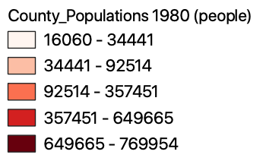
1980 Population by County
Notes:
Let’s take a look at 1980. Where are the people and where aren’t they. Most are populated in Baltimore City however, relatively speaking, most of the surrounding counites are evenly populated. With a divide coming from the Chesapeake Bay,
NIH, Montgomery county's largest employer, Walter Reed 2nd Largest
Washington Business Journal 2020. https://www.bizjournals.com/washington/news/2020/01/31/national-institutes-of-health-floats-additions-to.html
https://commerce.maryland.gov/Documents/ResearchDocument/MajorEmployersInMontgomeryCounty.pdf
https://commerce.maryland.gov/Documents/ResearchDocument/MajorEmployersInPrinceGeorgesCounty.pdf
Not shown, Andrews Air force base 17,500
Nasa Goddard, 10,000 Contractors and Civil servants.
Growth rate by county: https://mdpgis.mdp.state.md.us/population_growth/ Map/graphic

Slide 5
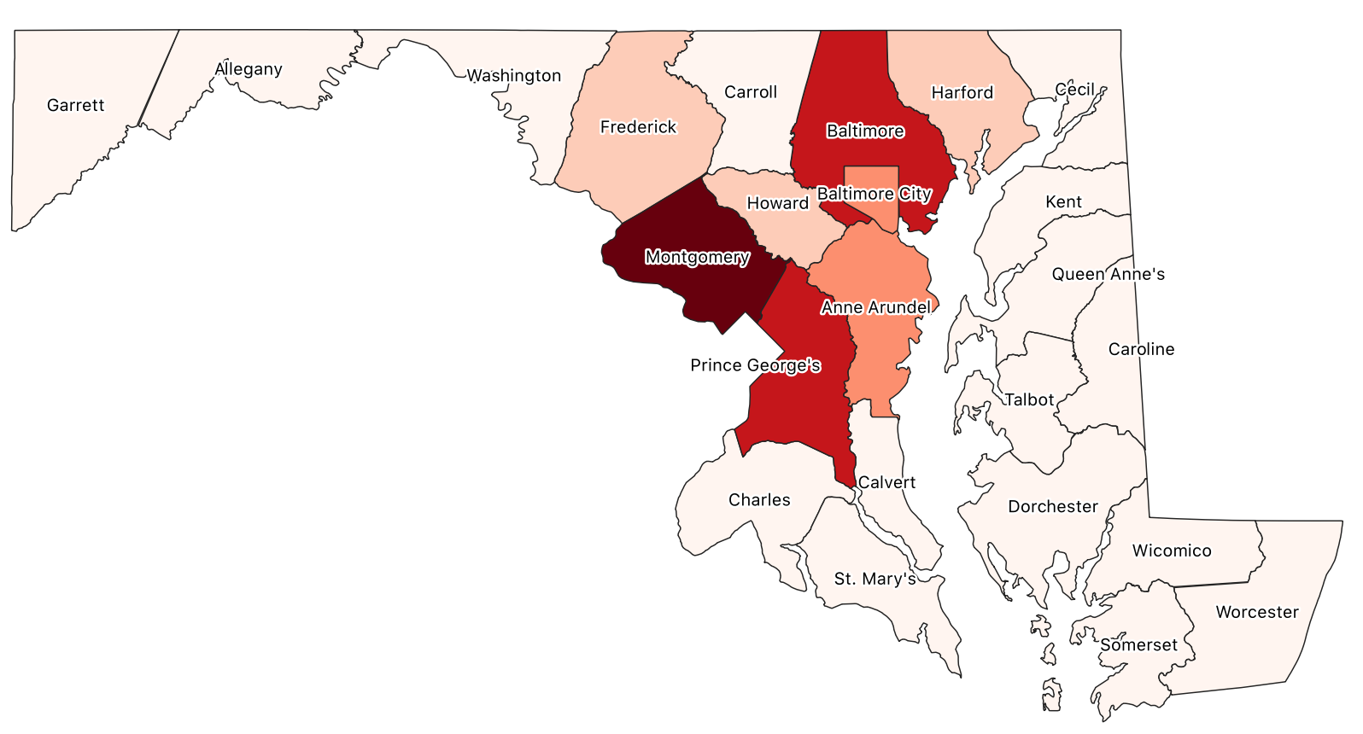
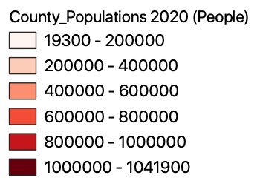
2020 Population by County (est.)
Notes:
Fast forward to the estimated 2020 population, you start to see more clustering along the I-95 corridor between Baltimore City and Washington D.C. People moving out of the city and into the counties to the south and west. Based on these two figures alone, I would estimate the rural counties on the east coast of MD, as well as on in the mountainous western counties had a population gain along the lines of the state average over 40 years. They don't seem to contain any outliars that would suggest a drastic population shift.

Slide 6
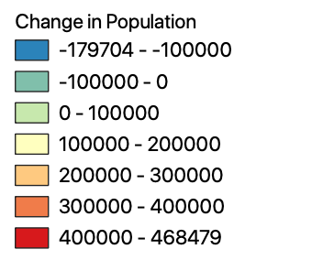
Change in Population
Notes:
And with a quick analysis of the difference in population over the 40 year period, this would appear to be correct. A mild increase to those counties lying to the east of the bay and out west in the mountains. Meanwhile there was a noticeable decrease in the population of Baltimore City. As well as an above average increase in Montgomery, Howard, Anne Arundel and Prince Georges’ counties.
Baltimore city had the largest decrease, MC with the largest increase
Howard, AA, and PG all increasing substantially as well.
What caused the population in Baltimore city to drop so substantially.
~~~~~~~~~~~
NIH, Montgomery county's largest employer, Walter Reed 2nd Largest
Washington Business Journal 2020. https://www.bizjournals.com/washington/news/2020/01/31/national-institutes-of-health-floats-additions-to.html
https://commerce.maryland.gov/Documents/ResearchDocument/MajorEmployersInMontgomeryCounty.pdf
https://commerce.maryland.gov/Documents/ResearchDocument/MajorEmployersInPrinceGeorgesCounty.pdf
Not shown, Andrews Air force base 17,500
Nasa Goddard, 10,000 Contractors and Civil servants.
Growth rate by county: https://mdpgis.mdp.state.md.us/population_growth/ Map/graphic

Slide 7
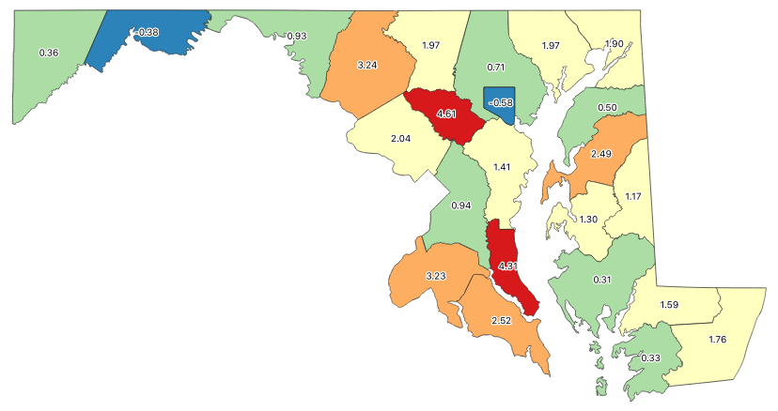
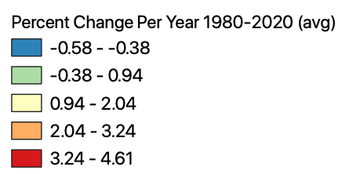
Change in Population
Notes:
So, what sort of change is considered substantial? Or statistically significant compared to the overall growth of the rest of the state.
MD 1980 4,122,547. 2020: 5,993,350 68.7% percent increase in 40 years. 1.7% per year. Looking at this map you can see the counties that went above and beyond this rate of growth.
Howard county and calvert county exceeding 4% year over year.
~~~~~~~~~~~
NIH, Montgomery county's largest employer, Walter Reed 2nd Largest
Washington Business Journal 2020. https://www.bizjournals.com/washington/news/2020/01/31/national-institutes-of-health-floats-additions-to.html
https://commerce.maryland.gov/Documents/ResearchDocument/MajorEmployersInMontgomeryCounty.pdf
https://commerce.maryland.gov/Documents/ResearchDocument/MajorEmployersInPrinceGeorgesCounty.pdf
Not shown, Andrews Air force base 17,500
Nasa Goddard, 10,000 Contractors and Civil servants.
Growth rate by county: https://mdpgis.mdp.state.md.us/population_growth/ Map/graphic

Slide 8
Background
Maryland is a unique area:
Chesapeake Bay watershed
Proximity to 2 major metropolitan areas
Train access:
Philadelphia: 1h
NYC: 2h 15m
3 international airports
Notes:
Unique Area, With Mountains to the west, the bay at its center, and the Atlantic ocean to the east, there can be a number of geographic factors that could influence development. Consequently Chesapeake Bay watershed encompasses nearly the entire state of Maryland.
Maryland contains both The DC and Baltimore metro areas and is beneficial due to access of both job markets. It is not uncommon to have households with some member working in or near Baltimore, with others in or near Washington DC.
Located in the northeast corridor. By train, an individual can access Philadelphia by Amtrak train service in just over an hour, or NYC in just over 2 hours. Global companies and travel enthusiasts have access to 3 major international airports. Baltimore Washington International, Reagan National, and Washington Dulles.
It comes as no surprise that many government entities and global companies have chosen MD as their headquarters. Here are some of the top employers in the area by number of workers.
NIH, Montgomery county's largest employer, Walter Reed 2nd Largest
Washington Business Journal 2020. https://www.bizjournals.com/washington/news/2020/01/31/national-institutes-of-health-floats-additions-to.html
https://commerce.maryland.gov/Documents/ResearchDocument/MajorEmployersInMontgomeryCounty.pdf
https://commerce.maryland.gov/Documents/ResearchDocument/MajorEmployersInPrinceGeorgesCounty.pdf
Not shown, Andrews Air force base 17,500
Nasa Goddard, 10,000 Contractors and Civil servants.
Growth rate by county: https://mdpgis.mdp.state.md.us/population_growth/ Map/graphic

Slide 9
Background
Maryland is a unique area:
Defense, science and health employment specialties.
National Institute of Health (NIH)- 20,0000+
University of Maryland- 18,000+
Andrews Air Force Base- 17,000+
Food and Drug Administration (FDA)- 13,000+
Naval Support Activity (Medical) Walter Reed- 11,000
NASA Goddard- 10,000+
Marriott International- 5,500
Lockheed Martin- 4,000
Notes:
Che
NIH, Montgomery county's largest employer, Walter Reed 2nd Largest
Washington Business Journal 2020. https://www.bizjournals.com/washington/news/2020/01/31/national-institutes-of-health-floats-additions-to.html
https://commerce.maryland.gov/Documents/ResearchDocument/MajorEmployersInMontgomeryCounty.pdf
https://commerce.maryland.gov/Documents/ResearchDocument/MajorEmployersInPrinceGeorgesCounty.pdf
Not shown, Andrews Air force base 17,500
Nasa Goddard, 10,000 Contractors and Civil servants.
Growth rate by county: https://mdpgis.mdp.state.md.us/population_growth/ Map/graphic

Slide 10
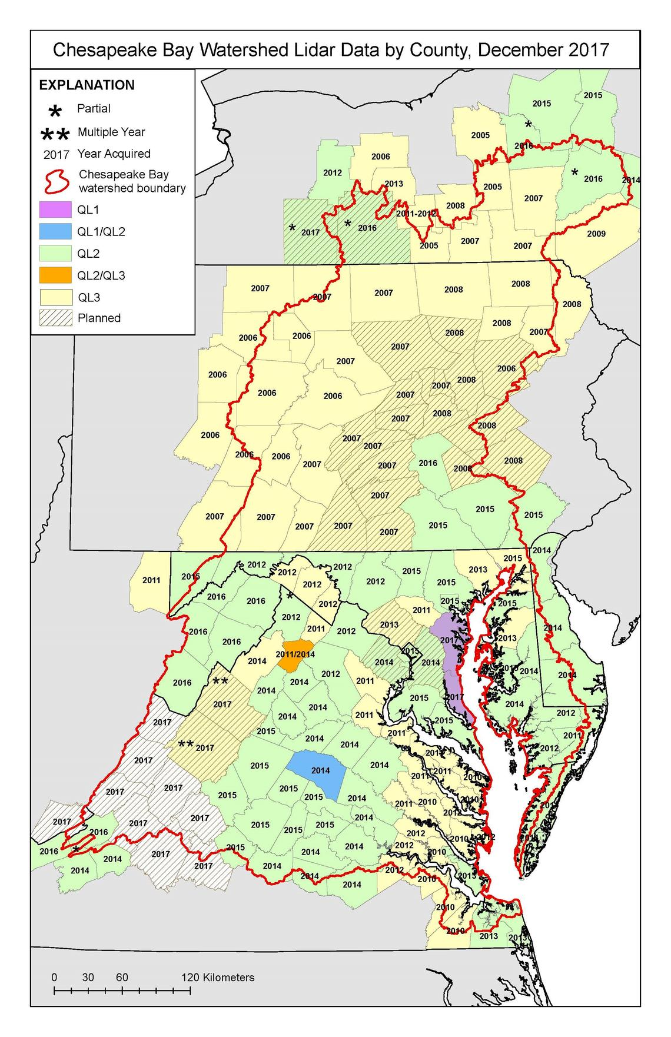
Chesapeake Bay Watershed
Notes:
https://www.usgs.gov/media/images/map-december-2017-chesapeake-bay-watershed-lidar-data-county
Here you can see how the Chesapeake bay watershed encompasses nearly the entire state of Maryland. Its unique geography leads to many environmental and ecological concerns whenever new development is undertaken in the area. The health of the Chesapeake bay and its cleanup effort has been a primary focus of both the Chesapeake Bay Foundation as well as the EPA since around 1983 when major cleanup efforts began.
Increased development and more impervious surfaces can increase the amount of toxic runoff that leaches into the bay and must be monitored. I am interested to see how public policy changes over the last 40 years has effected the methods of development as well as the health of the bay. One example of this would be the ”Rain tax” that levees funding from the amount of impervious surfaces on someone's property.
https://www.cbf.org/how-we-save-the-bay/chesapeake-clean-water-blueprint/the-history-of-bay-cleanup-efforts.html
https://www.cbf.org/about-cbf/locations/maryland/issues/stormwater-fees.html#where-fee

Slide 11
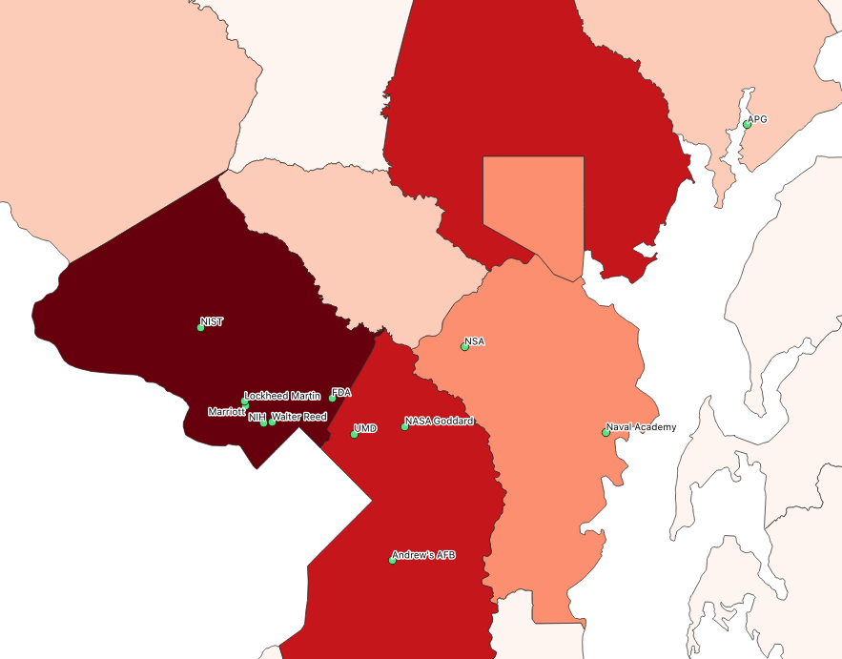
Top Employers
Notes:
Just to put it in perspective where some of these large places of employment are located. Beginning at the north we have Aberdeen proving grounds, on the bay there is the US Naval Academy,
NIH, Montgomery county's largest employer, Walter Reed 2nd Largest
Washington Business Journal 2020. https://www.bizjournals.com/washington/news/2020/01/31/national-institutes-of-health-floats-additions-to.html
https://commerce.maryland.gov/Documents/ResearchDocument/MajorEmployersInMontgomeryCounty.pdf
https://commerce.maryland.gov/Documents/ResearchDocument/MajorEmployersInPrinceGeorgesCounty.pdf
Air force base 17,500
Nasa Goddard, 10,000 Contractors and Civil servants.
Growth rate by county: https://mdpgis.mdp.state.md.us/population_growth/ Map/graphic

Slide 12
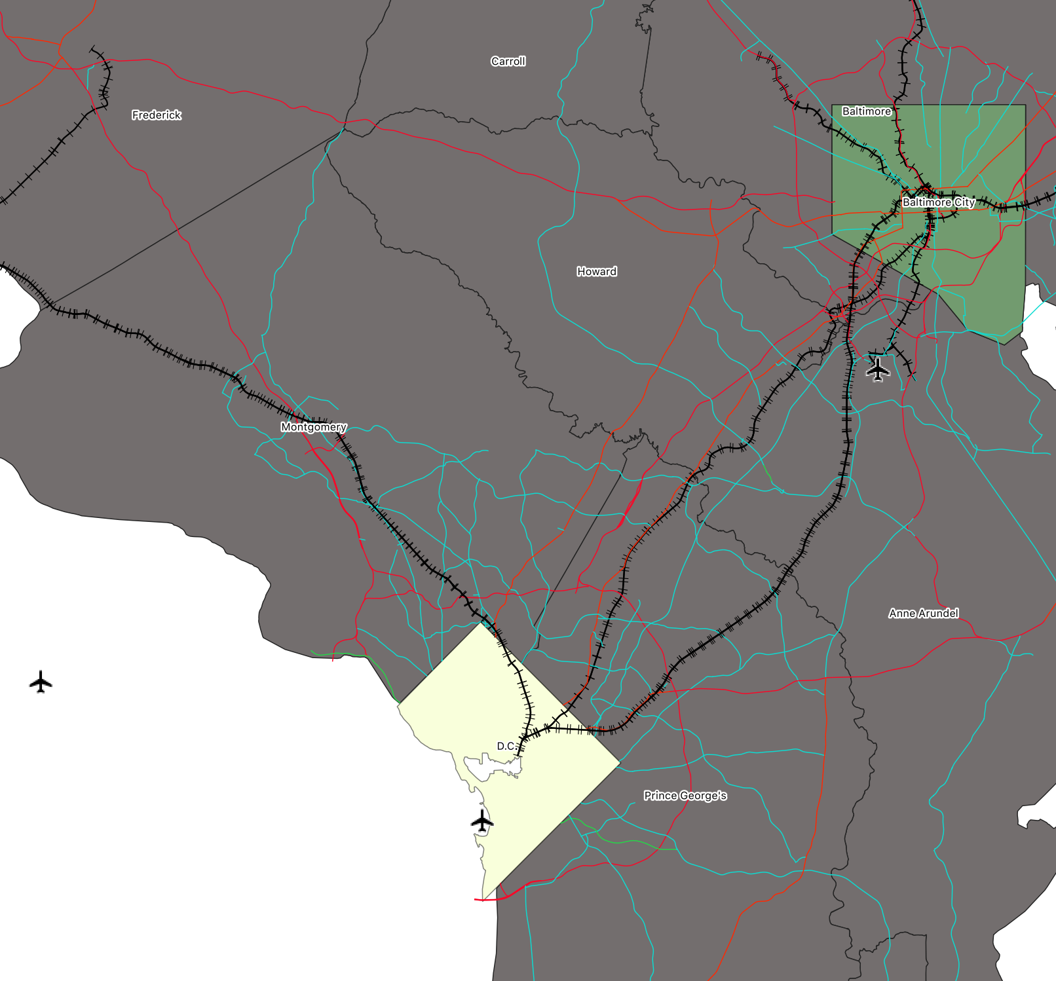
Highways and Rail
Notes:
With this population they are going to need to get around. There is an extensive network of state and local highway systems that link the 2 cities and their associated suburbs.
I270 Expansion project in MC
Marc and Amtrak lines between DC and Baltimore.. 29, 295, 95, 1, links between DC and Baltimore. (could possible add another slide with a zoom in of this)

Slide 13
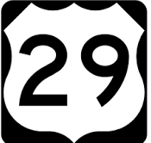
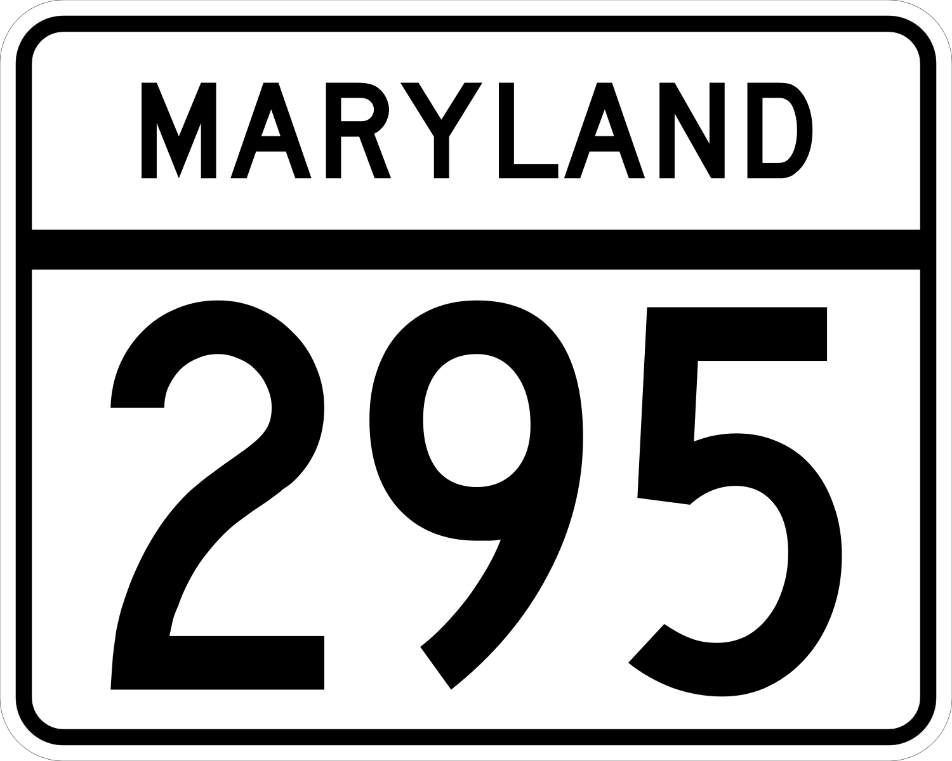
Road Links
Notes:
Major Routes, 95, 295, 1, and 29. All with access to the capital beltways and the first 3 having access to Baltimore beltway as well.
Amtrak and Marc train lines. Marc daily ridership is between 36-40k on a weekday.

Slide 14
D.C. Metro
Notes:
DC metro lines expand deep into the MD suburbs giving commuting options for those living in MD and working in DC or vice versa.
As of February 2020. An average of over 650K people rode the DC metro every day. With about half of that ridership on the weekends.
The Washington Metropolitan Area Transit authority as a great data portal, and I anticipate using station ridership numbers to determine commute values in the surrounding MD areas.
91 total stations in the DC metro system. 26 of which are in MD
https://www.wmata.com/initiatives/ridership-portal/Rail-Data-Portal.cfm

Slide 15
Goals and Objectives
Identify specific areas in Maryland that have stimulated and accelerated growth over the average for the rest of the state
Conclude as to why these areas developed or declined so quickly
Growth in workforce/change in talent base?
Government influence (policy, taxes, zoning)
Land values as a result? Or a contributing factor?
Notes:
Identify specific areas in Maryland that have stimulated and accelerated growth over the average for the rest of the state. Not just on the county level as shown in the beginning of this presentation but on a smaller scale. I would like to determine which. Census tracts specifically, are there particular neighborhoods that saw significant growth or decline. This will also require analysis on a much smaller timeframe than the initial 40 year timespan. Some instances might be visible in 10-15 years.
Conclude as to why these areas developed more quickly.
Be able to identify the spatial relationship of the developed areas to the factors that influenced them.
Did a new class of workforce move into the area to fill employment opportunities? Did state or local government policy change have a negative or positive effect. (this can be elections, local laws, zoning.)
Did property values go up or down, Was this a result of the population shift? Or the policy change? Or both?

Slide 16
Goals and Objectives
Determine spatial dependency and heterogeneity
Do some variables effect some populations but not others?
Are there certain areas where this effect is stronger?
Notes:
-Are there any spatial dependencies? Did a employment rise in one area cause an adjacent area to have substantial housing growth? Why the adjacent area? (Taxes? Schools?, Real estate prices/values, access to transportation)

Slide 17
Proposed Methodology
LISA: Local Indicators of Spatial Autocorrelation
Local Moran’s I in Pandas, GeoDa
Local Bivariate Relationships tool in ArcGIS
Identify areas of spatial dependence
Notes:
There are multiple variables that intertwine with one another. It is important to realize that they all can effect each other as well as the ‘result’ (growth/decline) of an area.
~~~~~~~~~~~~~~~~~~~~~~~~~~~
S:
Spatial Economic Analysis (looking for spatial dependencies) Observations are not independent of one another. (one data point may effect another in a separate category). Standard statistical tests do not apply and are flawed in this use case. Observations are not random and independent.
Also consider spatial regimes models or geographically weighted regression to examine spatial heterogeneity. Outcome would be a measure of growth compare do different year spans.
Map of Y variable. Look at ESDA methods. (Local Moran’s I) Then bivariate statistical analysis.
LISA, Local Indicators of Spatial Association

Slide 18
Proposed Methodology
Primary challenge: There are many different variables that can lead to growth or decay
Identify clusters of similar growth
Work backwards to determine what each of these areas may have in common
Maximum Entropy Method
Notes:
The primary challenge here besides the amount of data collection is going to be the amount of variables. There are many different things that can lead to the growth or decay of a population. In order to accomplish this effectively, I believe I am going to need to identify clusters of similar growth using the methods I mentioned earlier, then work backwards from there to determine what each of them have in common with one another.
I would like to possibly utilize some form of Maximum Entropy Method: In a sense, I would like to be able to determine the point (or points) in space at which variables are having the most influence on an area.

Slide 19
Timeline
June 2020
Data Acquisition:
Census Population, Real Estate prices, Demographics, Employment Rates.
July–Aug.
Research Various Spatial Econometric methods to determine the best way to quantify change
September
Perform analysis using determined methods
October
Analyze results, determine if adjustments need to be made.
November
Re-run analysis. Assemble results.
Dec. 2020
Draw conclusions. Virtual Presentation, Journal Article
Notes:
Beginning in June with data acquisition. Starting points being: Census population data, real estate prices and trends, and employment rates.
July and August I expect to research which methods of analysis are going to be the most effective at quantifying the changes I am looking for.
September I will be performing the analysis and collecting additional data if needed.
October, analyze results and make adjustments.
November, implement adjustments and get new results if needed.
December, organize results and draw conclusions.

Slide 20
Anticipated Results
Clustered growth along the 270 corridor, Columbia and North Baltimore areas
Stimulated by transportation infrastructure
Overall population trends (suburbanization)
Employment trends (industry and manufacturing -> goods and services)
Highlight local areas of growth that lead to improvements in infrastructure
Discover both the successes and shortcomings as a result of uneven development
Notes:
So what am I expecting to see from this project.
Based on preliminary research. There is a clustering to the growth of development as defined earlier. (Increase in housing or change in housing type/
Increase in Employment or types of employment/ Economic Diversification). There are multiple variables at work here and it is important to discover which ones weigh in the most.
Stimulated by transportation infrastructure and access to transportation.
-Metro, Major Highway expansion
Employment trends (industry and manufacturing -> goods and services)
GM shutting down Baltimore plants. Outsourcing manufacturing, increase in goods, services, bars, restaurants, IT support. Etc.
Highlight local areas of growth that lead to improvements in infrastructure. New campuses headquarters.
Manufacturing being outsourced, boom of service related jobs
Discover both the successes and shortcomings as a result of uneven development.
There are always going to be winners and losers as a result.

Slide 21
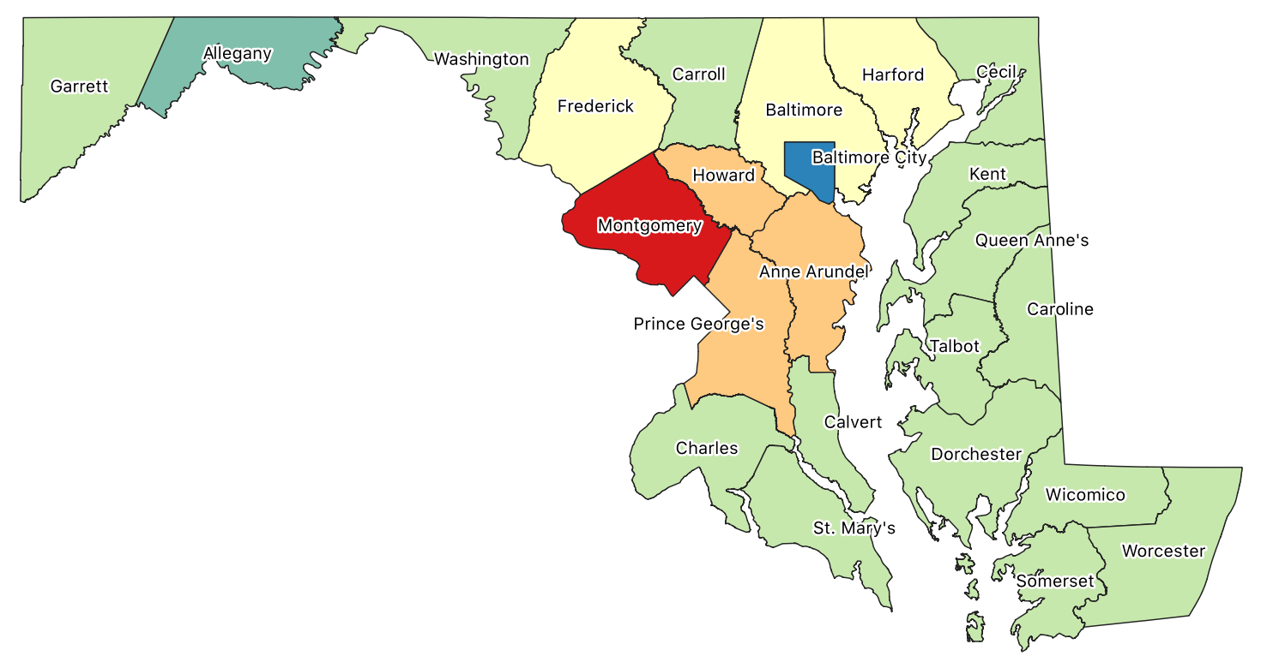
Questions?
Notes:
I would like to thank you all for your time, and Dr. Stephen Matthews for supplying his knowledge and experience as I designed this project.
I appreciate your feedback and will take any questions you have.

