Slide 1
Walking for Leisure
Validating an Urban Design Qualities Audit Instrument
George W. Sprehn
Adviser: Kelleann Foster
GEOG 596A
Spring II 2013

Slide 2
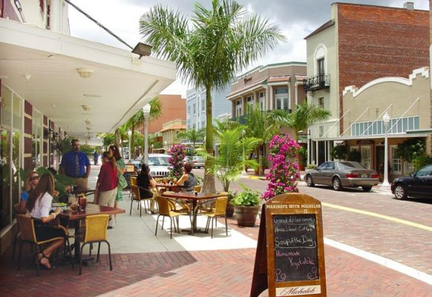
Outline
Introduction
  Study area
  Urban redevelopment
  Project objectives
  Hypothesis
Background research
  Streetscape
  Walkability
  Spatial assessment tools
Methodology
  Street segments
  Audit selection
  Audit implementation
Spatial analysis
Expected results
Timeline
Photo: Miller and Dunham 2013
Sidewalk dining on First Street

Slide 3
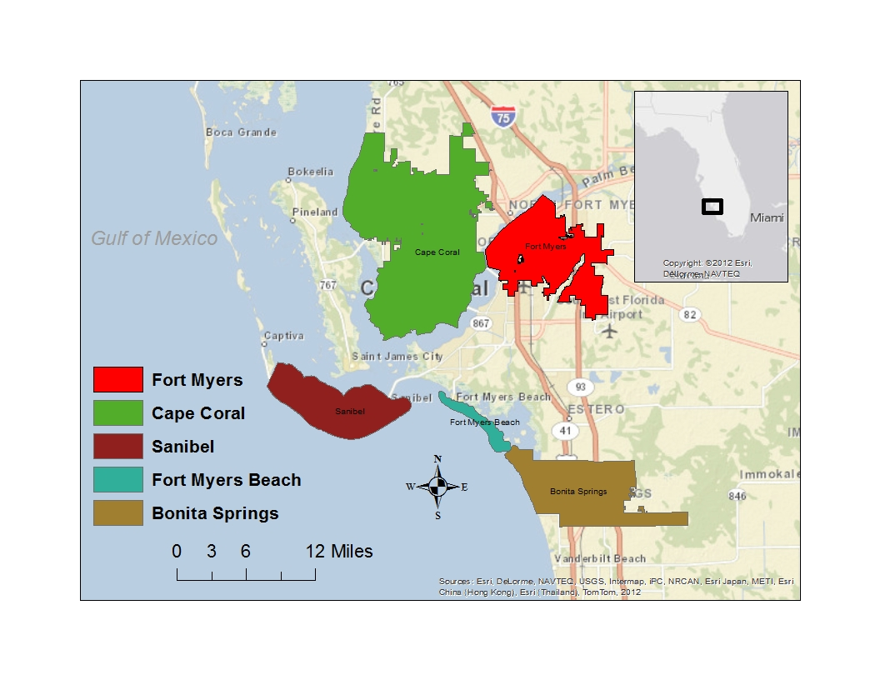
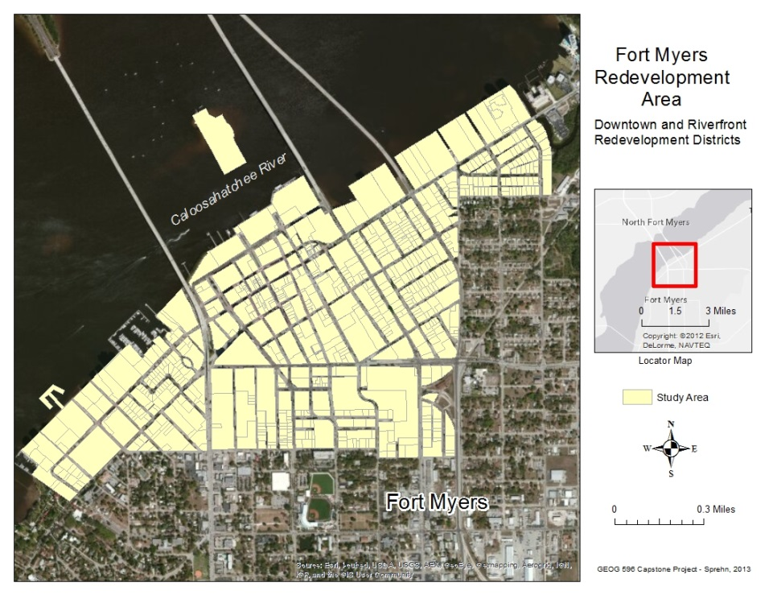
Introduction
Study Area:
Downtown Historic and
River Districts
Lee County
Fort Myers
Florida

Slide 4
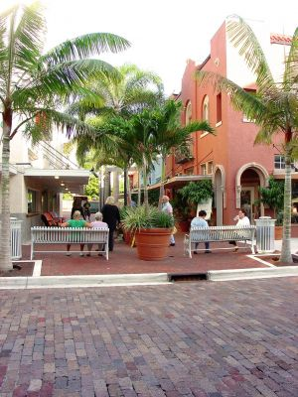
Introduction
Urban redevelopment:
54-block utilities and streetscape
$60 million ($12.5 million streetscape)
International award
5 state awards
Project Objectives:
Rate the walkability of the redevelopment
area of downtown Ft. Myers
Identify a measurement tool
Measure walkability
Validate the tool
Develop Hypothesis:
The measurement tool is substantiated by the
variable quality of the built environment
Photo: Miller and Dunham 2013
Plaza de Leon
Photo: Miller and Dunham 2013

Slide 5
Background Research
Initial Research Topics
Streetscape
Walkability
Spatial assessment tools

Slide 6
Background Research
Initial Research Topics
Streetscape
Walkability
Spatial assessment tools
Streetscape
Accessibility
Pleasurability
Perceived safety from traffic
Perceived safety from crime
(Day et al. 2006)

Slide 7
Background Research
Initial Research Topics
Streetscape
Walkability
Spatial assessment tools
Streetscape
Accessibility
Pleasurability
Perceived safety from traffic
Perceived safety from crime
(Day et al. 2006)
Walkability
Pedestrian performance and preferences
Quality of environment
Quantity of pedestrians
Comfort and safety
Land use and streetscape factors
(Lo, 2009)

Slide 8
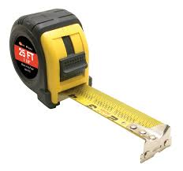

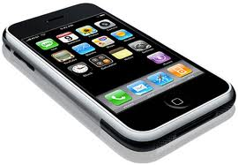
Background Research
Initial Research Topics
Streetscape
Walkability
Spatial assessment tools
Streetscape
Accessibility
Pleasurability
Perceived safety from traffic
Perceived safety from crime
(Day et al. 2006)
Walkability
Pedestrian performance and preferences
Quality of environment
Quantity of pedestrians
Comfort and safety
Land use and streetscape factors
(Lo, 2009)
Spatial assessment tools
Assess urban design qualities
Measure features
Scale to street-level variables
Enable GIS
Enable PDA
(Ewing and Handy 2009)

Slide 9
Background Research
(Ewing & Handy 2009)

Slide 10

Methodology
Determine spatial assessment tool
Identify evaluation segments
Implement the assessment tool
Spatial analysis
A. Determine spatial assessment tool (audit instruments)
NEWS – Neighborhood Environment Walkability Survey
SPACES – Systematic Pedestrian and Cycling Environment Scan
PEDS – Pedestrian Environment Data Scan
Irving-Minnesota Inventory
Active Living Research (ALR) Audit Tool

Slide 11
Methodology
Active Living Research (ALR)
Audit Tool
Table 1. Perceptual qualities
adaptability distinctiveness intricacy richness
ambiguity diversity legibility sensuousness
centrality dominance linkage singularity
clarity enclosure meaning spaciousness
coherence expectancy mystery territoriality
compatibility focality naturalness texture
comfort formality novelty transparency
complementarity human scale openness unity
complexity identifiability ornateness upkeep
continuity imageability prospect variety
contrast intelligibility refuge visibility
deflection interest regularity vividness
depth intimacy rhythm
(Ewing & Handy, 2009)
Urban Design Qualities
1. imageability
2. enclosure
3. human scale
4. transparency
5. complexity
Panel of experts
Operationalize qualities
Objective measures
Subjective perceptions
Street segments

Slide 12
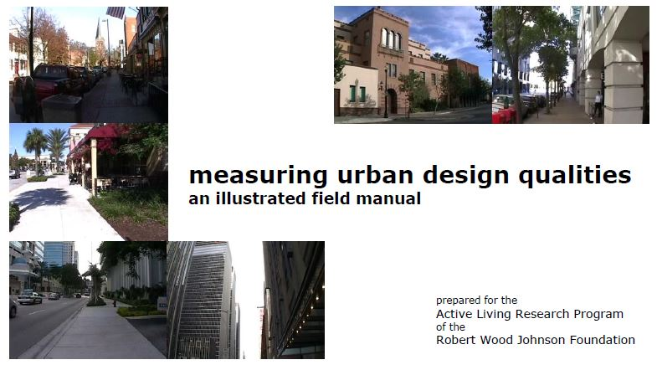
Methodology
Active Living Research (ALR) Audit Tool

Slide 13
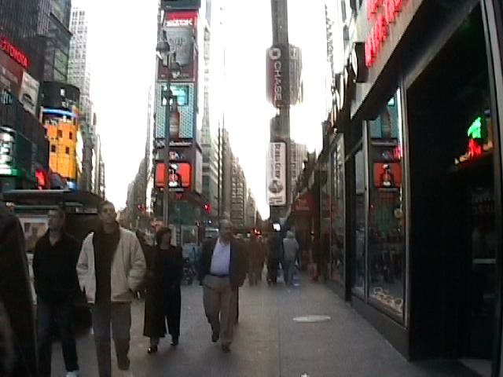
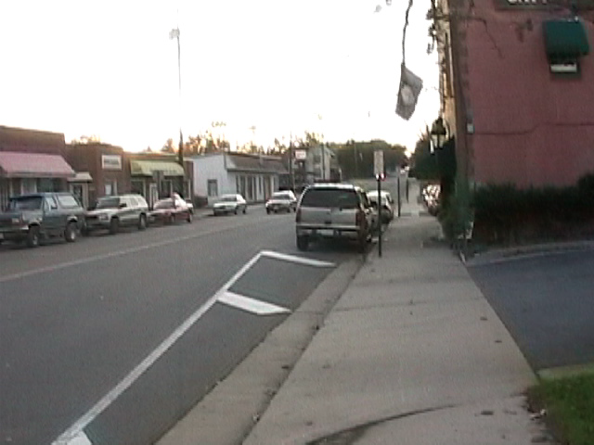
1. Imageability – sense of place
HIGH
LOW

Slide 14
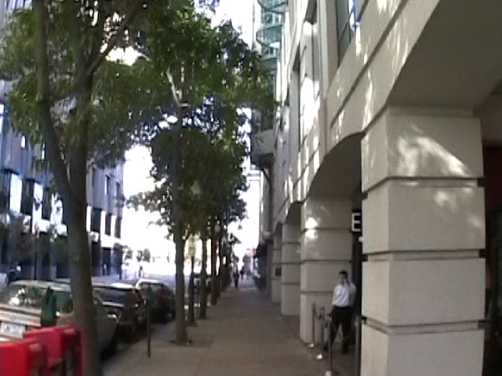
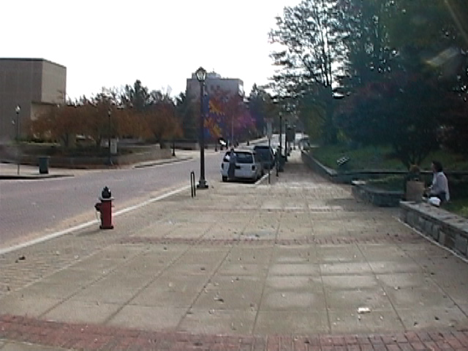
2. Enclosure – room-like quality
HIGH
LOW

Slide 15
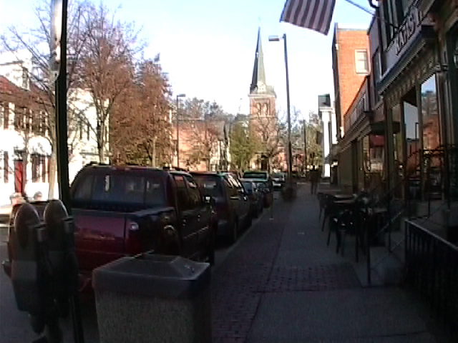
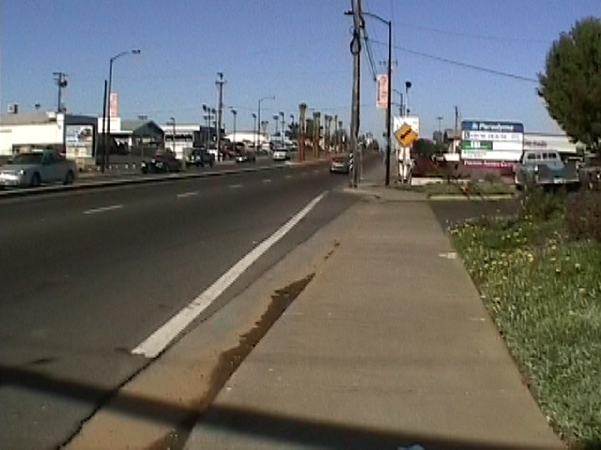
3. Human Scale – human proportions
HIGH
LOW

Slide 16
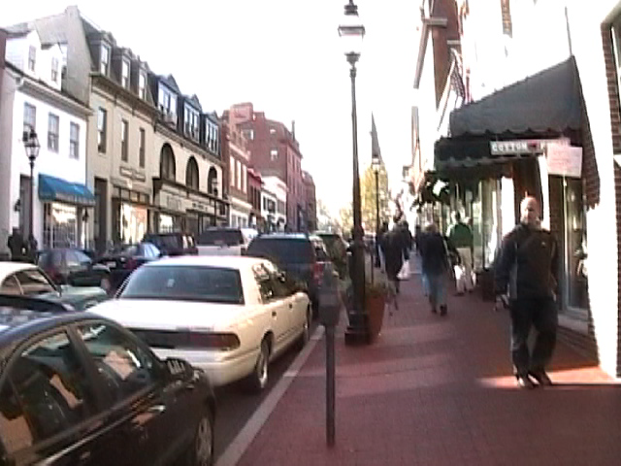
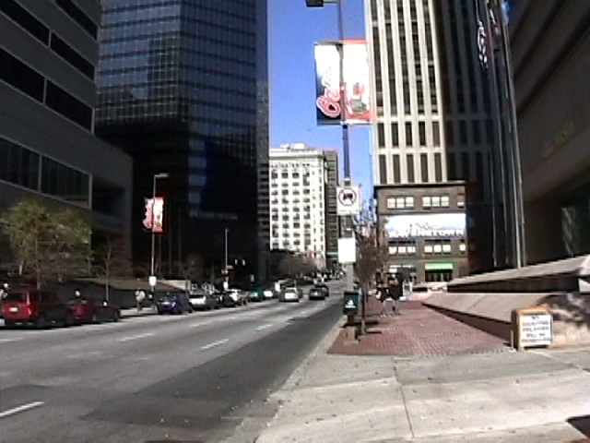
4. Transparency – continuous exposure
HIGH
LOW

Slide 17
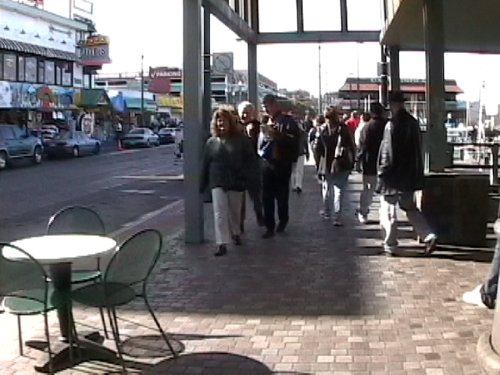
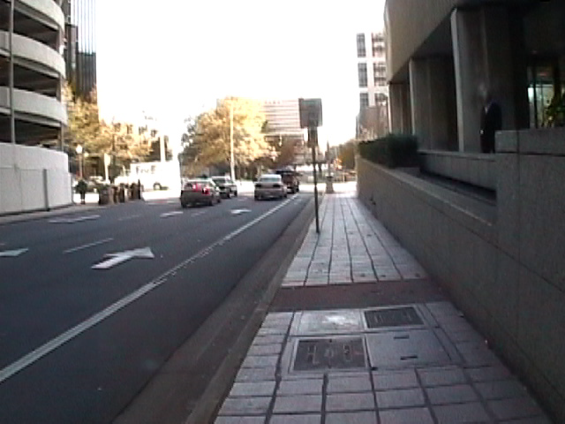
5. Complexity – visual richness
HIGH
LOW

Slide 18
2. Enclosure – room-like quality
Scoring Demonstration
HIGH
LOW

Slide 19
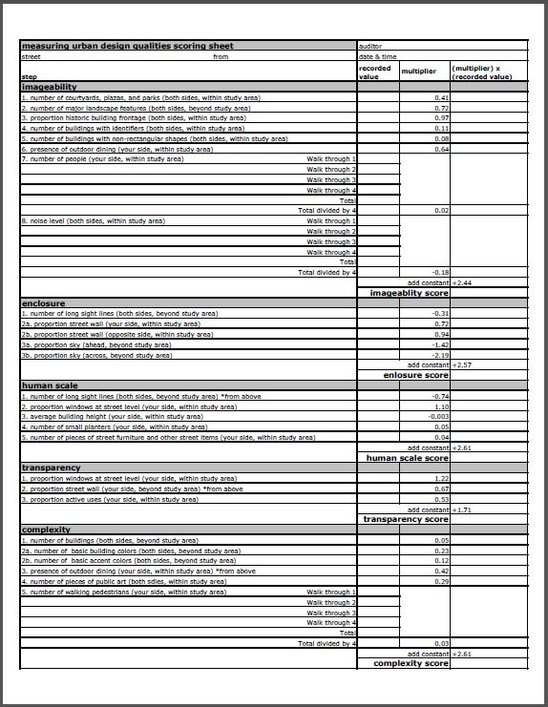
Scoring Sheet

Slide 20


Scoring Sheet Detail
Recorded Values
Multiplier
Constant
= Walkability Score

Slide 21
Methodology
Proposed Approach
Determine spatial assessment tool
  Subjective/objective
  ALR Audit Tool
B. Identify evaluation segments
  Select 9 street segments
  Subjective observations
  High, Medium, Low quality
C. Implement the assessment tool
  ALR Audit Tool
  Objective measurements
Photo: Miller and Dunham 2013
D. Spatial analysis
  Overall walkability scores
  Urban design qualities
  ALR Tool validation
street segment: about one block in
length, 300 feet or about 120 paces

Slide 22
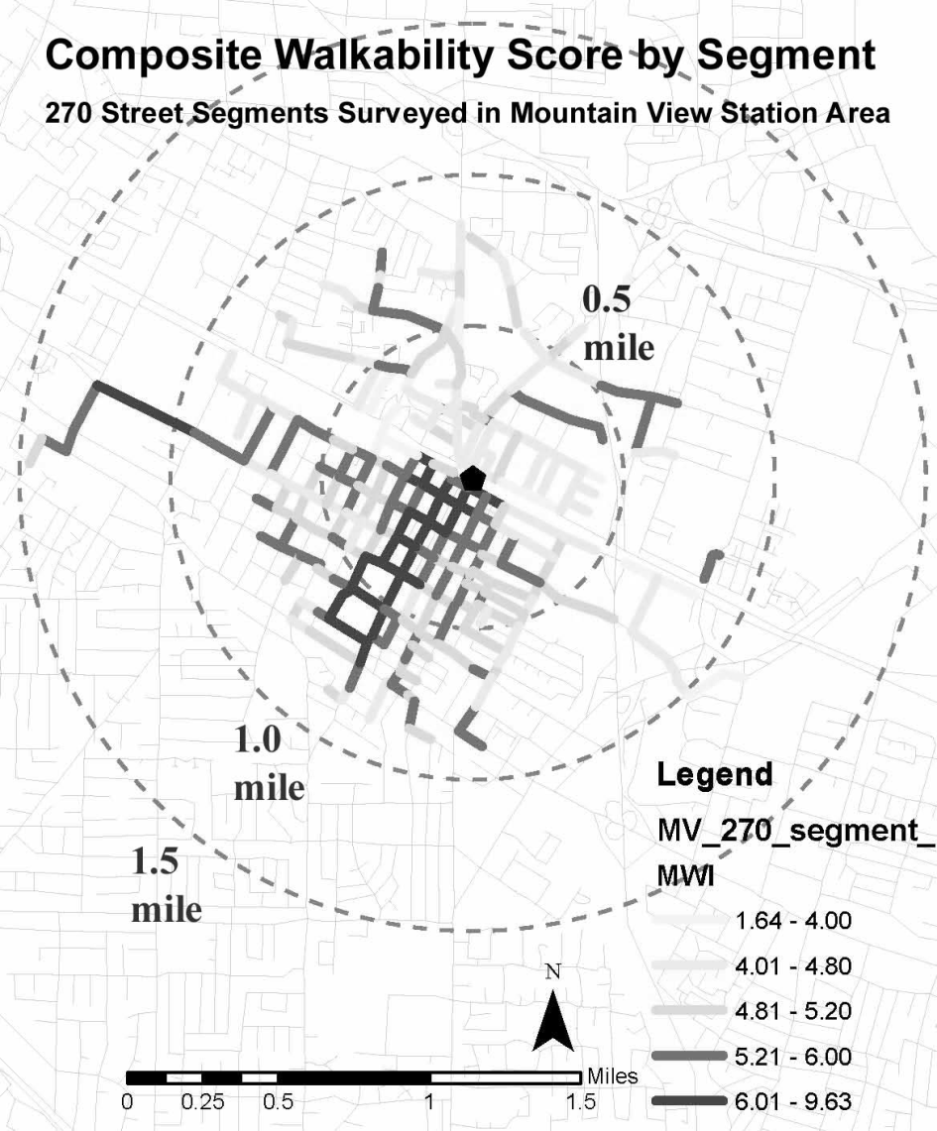
Methodology
D. Spatial analysis
  Overall walkability scores
  Urban design qualities
  ALR Tool validation
This diagram by Park and Kang (2011) is
what I have in mind to show the walkability
ratings. Color-coded segments would
indicate the values of the five urban qualities
each mapped separately for analysis.
(Park and Kang, 2011)

Slide 23

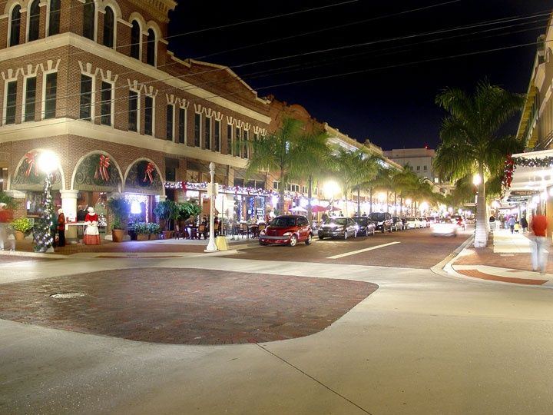
Expected Results
Project objectives
Measure walkability
Assess urban design qualities
Validate the audit tool
2. Assess urban design qualities
Active Living Research Audit Tool
  Imageability
  Enclosure
  Human scale
  Transparency
  Complexity
1. Measure walkability
3. Validate the audit tool
Photo: Miller and Dunham 2013
(Park and Kang, 2011)
First Street – Fort Myers FL

Slide 24
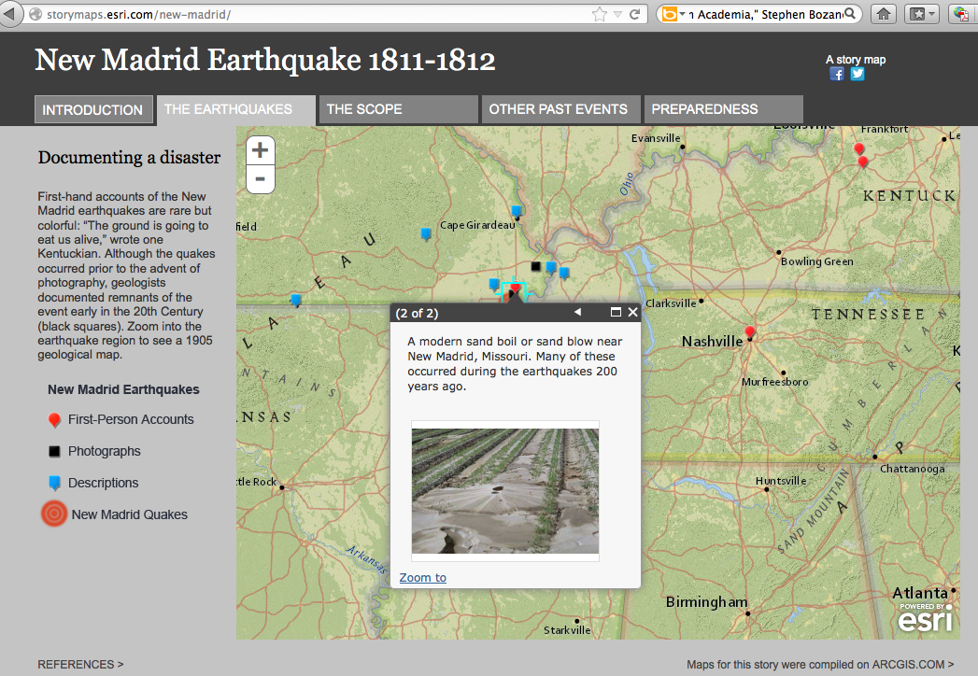
Expected Results
ESRI Story Map concept
Showcase
Urban quality tabs
  Imageability
  Enclosure
  Human scale
  Transparency
  Complexity
Templates
Pop-ups
Maps
Interactive
Story line
http://storymaps.esri.com/home/

Slide 25
Timeline
May
  Peer review presentation
  Audit preparation
    Final design elements
    Training
June
  Administer Audit
  Upload audit results
July
  Spatial analysis
  Write up
October: Presentation
GIS Expo – W. Palm Beach FL
and Story Map

Slide 26
Thank you
Introduction
Background
Methodology
Analysis
Expected Results
Timeline
Advisers
Kelleann Foster, Department of Landscape Architecture
Dr. Douglas Miller
Beth King
John A. Dutton e-Education Institute
College of Earth and Mineral Sciences
Pennsylvania State University

Slide 27
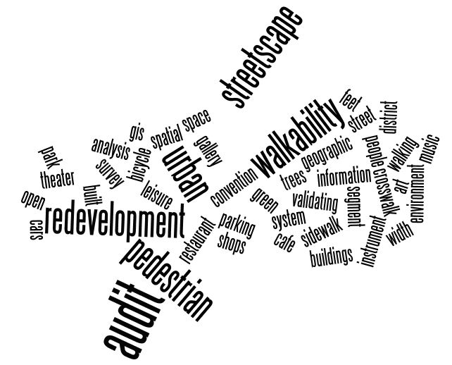
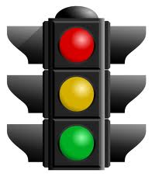
Questions and Answers

