Slide 1
Maryland Education equity: How gis can be used to visualize education performance and analyze local variation
Lyndsay Springer
Penn State University
May 7th, 2019
Notes:
NOTE: Want a different image on this slide? Select the picture and delete it. Now click the Pictures icon in the placeholder to insert your own image.

Slide 2
OVERVIEW
Introduction
Background
Research Questions
Research Methods
Measuring Performance in Maryland
Visualization of Other Variables
Data Sources & Software
Challenges & Limitations
Anticipated Results
Conference Information
References
Notes:
Pics from Green Street Academy

Slide 3
INTRODUCTION
U.S. students consistently rank below most other industrialized nations (DeSilver, 2017)
The need for education “improvement”
Policy vs. poverty
Maryland puts emphasis on equity through Thornton Plan funding formula
Notes:
When compared with their peers from around the world, U.S. students consistently rank around the middle of all nations, and below most other industrialized nations. (DeSilver, 2017). There have been many efforts to “improve” education in America, but what does this really mean? More testing? Better teachers? Many politicians and educators have emphasized education “improvement” through policy changes and budget reform, however
much of the research for education performance is inherently tied to socioeconomic status of the students and the neighborhood markers in which the school resides.
Maryland State Department of Education (MSDE) has established educational equity as a critical priority. MSDE has vowed to identify gaps in educational equity, “highlight them and work with the school to eliminate them” (Karen Salmon, State Superintendent of Schools)
Using the state of Maryland as a case study, this project aims to examine the equity of Maryland’s public school performance. Specifically, funding formula, known as the Bridge to Excellence in Public Schools Act (or Thornton Plan) passed in 2002. This project aims to show how GIS can be used to visualize and analysis equity in Maryland K-12 educational performance indicators.

Slide 4
BACKGROUND
Federal:
Elementary and Secondary Education Act of 1965 (ESEA)
No Child Left Behind (2001) and current extensions
Higher Education Act of 1965 and current extensions
Maryland State:
Educational equity as a critical priority
Thornton Funding Plan (2002)
Increase transparency through the “Maryland School Report Cards” and Financial Data releases
Lots of data; little analysis

Slide 5
BACKGROUND
What is the Achievement Gap?
Why does it persist?
Notes:
Achievement gap persists – driven by socioeconomic status and racial/demographic categories.
Waldo Tobler’s First Law of Geography

Slide 6
RESEARCH QUESTIONS
How can GIS be used to visualize and compare school performance and administrative data spatially?
Why do some areas (urban and rural) have an apparent low degree of spatial autocorrelation of K-12 schools in Maryland (in violation of Tobler’s First Law of Geography)?
Notes:
The need for more local analysis –
“Presumably, once unusually effective (or ineffective) schools and teachers have been identified, further investigation is required to determine the specific practices that may be responsible” the authors note that this research approach is often time consuming and expensive.
Toblers Law: “everything is related to everything else, but near things are more related than distant things”

Slide 7
RESEARCH METHODS
Exploratory visualization of the distribution of school performance metrics in relation to socio-economic variables (aggregated to census tracts) for the years: 2010, 2014, and 2018
Quantification of the spatial autocorrelation distribution of identified school performance metrics - Testing Tobler’s first law
Moran’s I – measure of similarity
Geary’s C – measure of dissimilarity
Qualitative analysis of schools by visiting two anomalous pairs of urban and rural school settings
On-site photographs
interview data
Notes:
From the aggregate of county level – using GIS to visualize large amounts of variable data and analyze the complex relationship between socioeconomic indicators/ school resources and educational outcomes.
Started by examining performance measurements at the county level. Maryland is geographically a small and

Slide 8
MEASURING PERFORMANCE IN MARYLAND
Math and Science
HSA Algebra Tests
HSA Biology
State Tests
PARCC
MSA
Graduation Rates
Dropout Rates

Slide 9
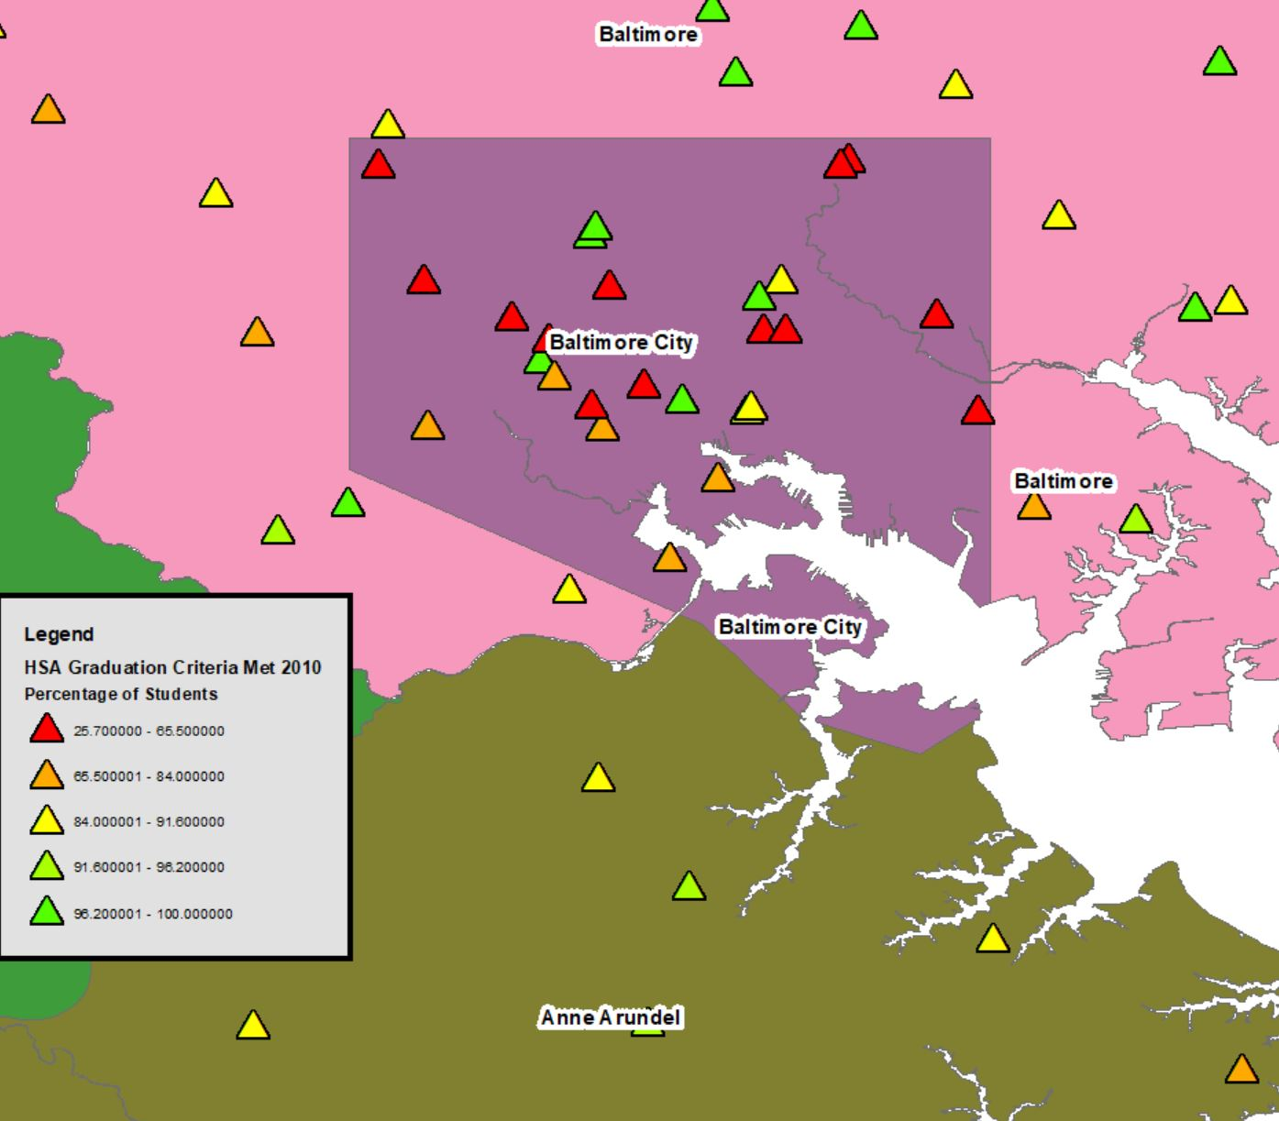
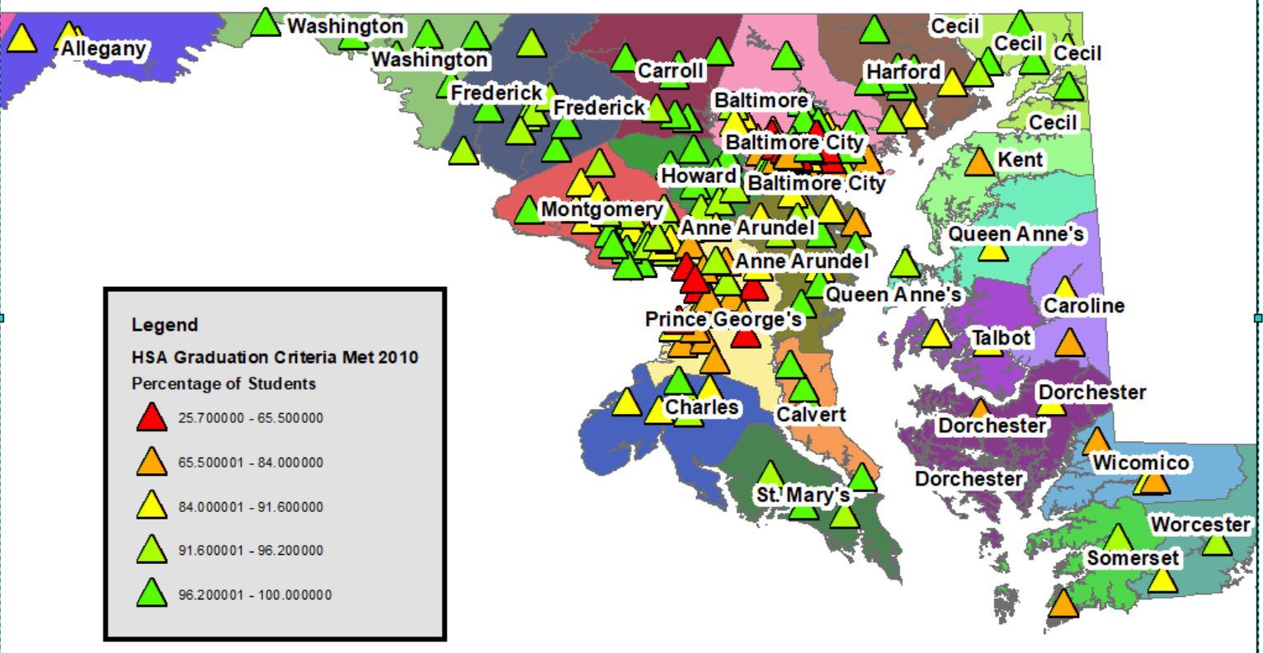
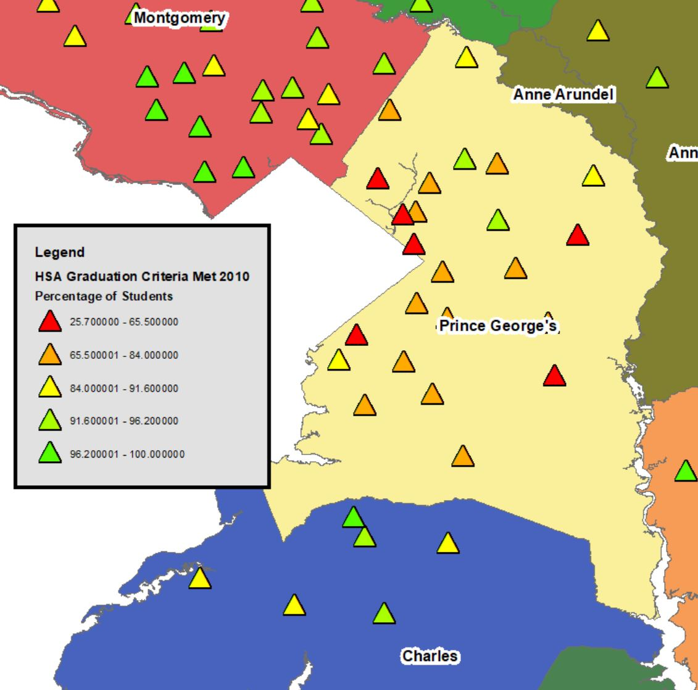
MEASURING PERFORMANCE IN MARYLAND
Notes:
2010 HSA Data: High School Assessments (HSA) are end of course tests for high school levels. Passing the HSAs are a graduation requirement.
HSA Algebra: Advanced Percent; Proficient Percent; Basic Percent
HSA Biology: Advanced Percent; Proficient Percent; Basic Percent
HSA English: Advanced Percent; Proficient Percent; Basic Percent
HSA Grade 12 results: Percentage of Students Taking All 4 Teats and Passing all - “PERCSTUD_2” SHAPEFILE: HAS_Grad_Coded
Point out Local Variation within Balt City and PG

Slide 10
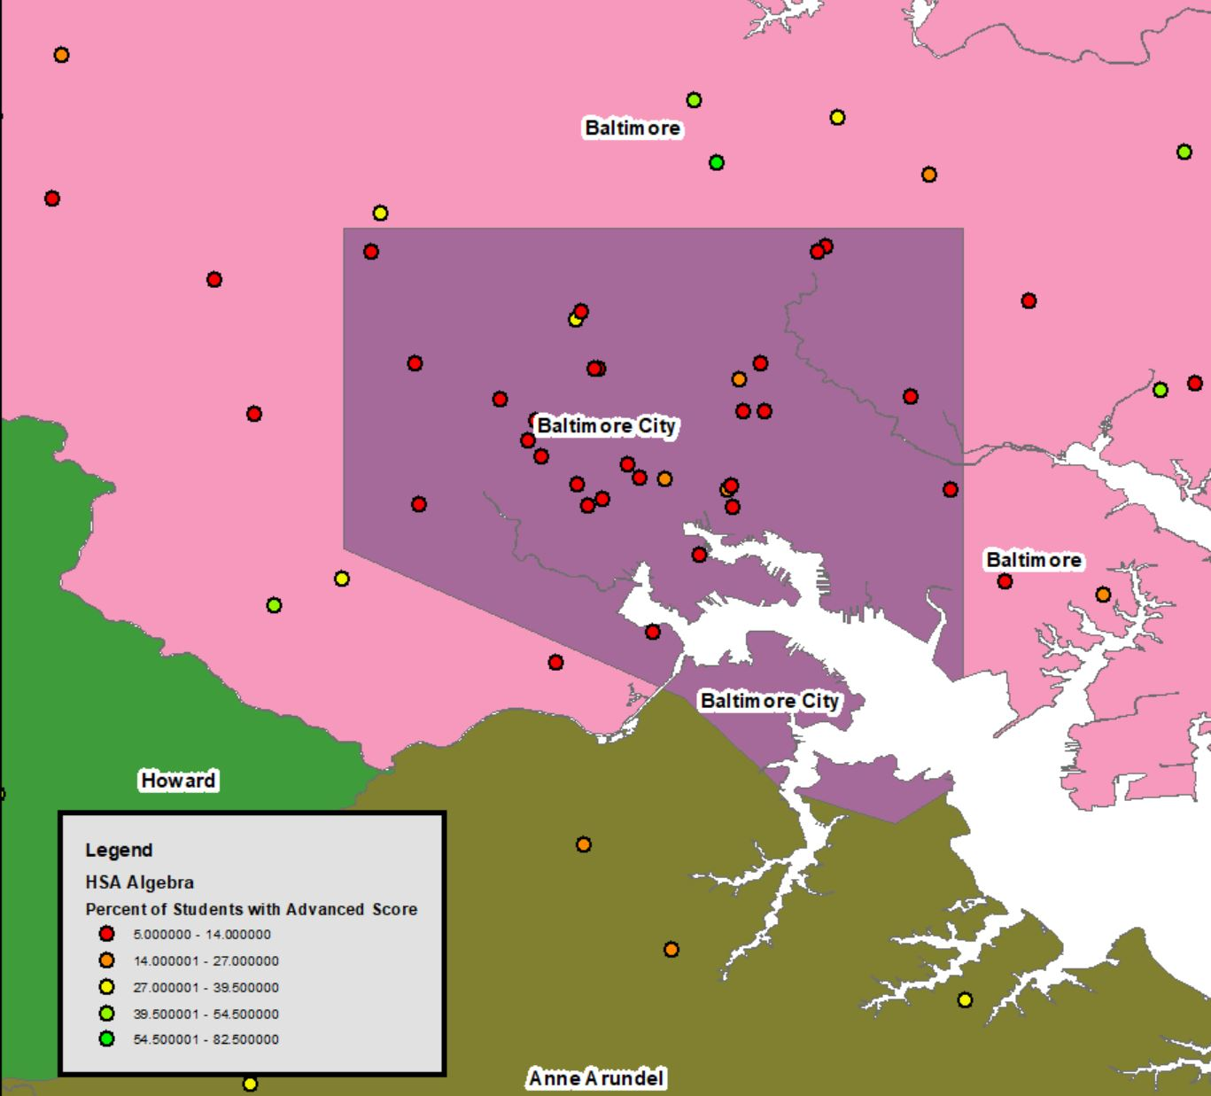
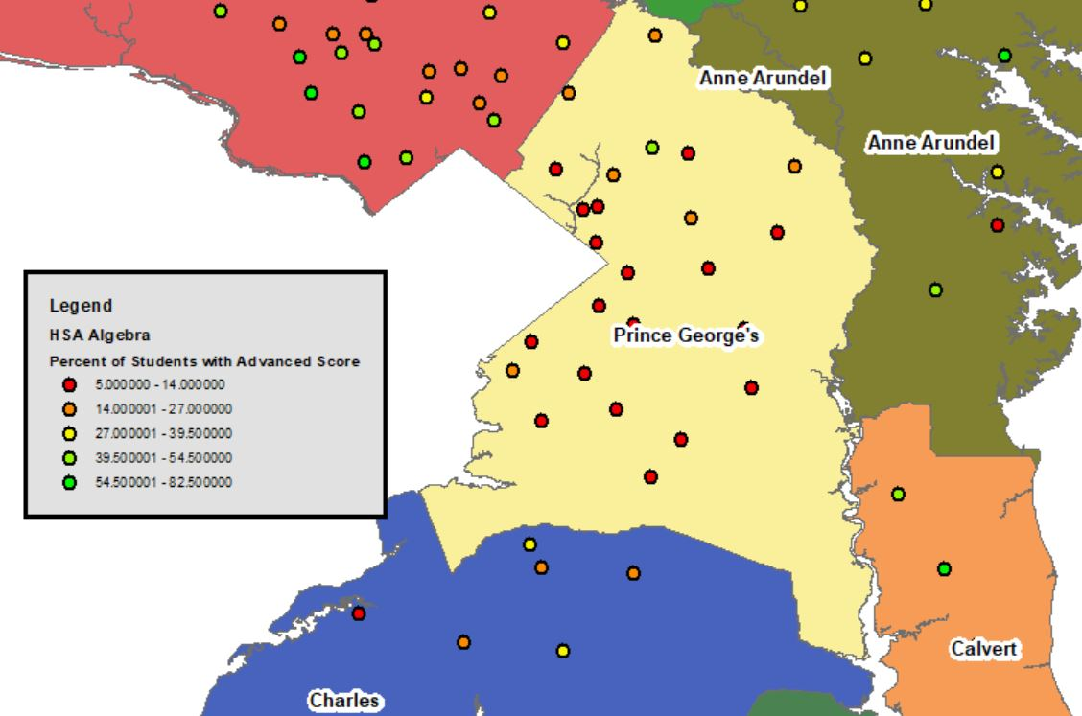
MEASURING PERFORMANCE IN MARYLAND
Notes:
HSA Data: High School Assessments (HSA) are end of course tests for high school levels. Passing the HSAs are a graduation requirement.
HSA Algebra: Advanced Percent; Proficient Percent; Basic Percent
HSA Biology: Advanced Percent; Proficient Percent; Basic Percent
HSA English: Advanced Percent; Proficient Percent; Basic Percent
HSA Grade 12 results: Percentage of Students Taking All 4 Teats and Passing all - “PERCSTUD_2” SHAPEFILE: HAS_Grad_Coded
Point out Local Variation within Balt City and PG

Slide 11
VISUALIZATION OF OTHER VARIABLES
By Census Tract:
Poverty Data:
Socioeconomic Status
Demographics Distribution:
Race
Unemployment
Household Variables

Slide 12
DATA SOURCES & SOFTWARE
Education Data:
Maryland State Department of Education (MSDE) School Report Cards
Financial expenditure report
Socioeconomic Data:
U.S. Census
American Community Survey (ACS)
Software:
ArcGIS Desktop
GeoDa
Notes:
IMAGE: https://en.wikipedia.org/wiki/ArcGIS
Esri’s ArcGIS Desktop and Spatial Analyst Toolbox
Esri’s Story Map: https://www.iowaview.org/tag/esri-story-map/

Slide 13
CHALLENGES & LIMITATIONS
Scaling issues with aggregated Census Data and actual location of school pairs
School pairs at varying and inconsistent distances
Analysis of Rural School pairs
Notes:
-Census Tracts limits local analysis of school neighborhoods.
-Some anomalous school pairs are extremely close (<300m Euclidean) while others are comparatively further away (~2500m) which may introduce variation due to proximity
-As part of this study, I wanted to identify anomalous pairs for rural communities as well, however their differences are not as significant or consistent over time in all performance measures. This is something I plan to explore more.
-Can generalizations be made about data

Slide 14
ANTICIPATED RESULTS
Visualized trends appear consistent with other research:
Expenditures per pupil are not significantly related to student performance outcomes
Lower Student to Teacher ratio is positively related to performance outcomes
Teachers with more experience/qualifications is positively related to performance outcomes
Socioeconomic status continues to be the most significant indicator of student performance
Localized variation (low autocorrelation) may be unexplainable or may be partially explained by a combination of variables and indicators

Slide 15
CONFERENCE SCHEDULE
2019 Education Summit @ Esri User Conference
Session Title: Informing School Administration Through GIS
Date: Sunday, July 7, 2019
Time: 2:30 PM - 3:30 PM
Room: Marriott - Pacific Ballroom 17
Notes:
Visualized Trends

Slide 16
REFERENCES
Ávila, A. M. (2017, March). Trends in Maryland Public Schools: English Language Learner Enrollment. Retrieved from https://education.umd.edu/research/centers/mep/research/k-12-education/trends-maryland-public-schools-english-language-learner
Braun, H. I., Wang, A., Jenkins, F., & Weinbaum, E. (2006). The Black-White achievement gap: Do state policies matter? Education Policy Analysis Archives, 14. doi:10.14507/epaa.v14n8.2006
Brown, D. G. (2009). Closing the achievement gap: A study of minority achievement compared to the achievement of their Caucasian counterparts in Nassau county school districts since the enactment of no child left behind (Order No. AAI3352021). Available from PsycINFO. (622077895; 2009-99190-061). Retrieved from http://ezaccess.libraries.psu.edu/login?url=https://search-proquest-com.ezaccess.libraries.psu.edu/docview/622077895?accountid=13158
Burdick-Will, J., Keels, M., & Schuble, T. (2013). Closing and Opening Schools: The Association between Neighborhood Characteristics and the Location of New Educational Opportunities in a Large Urban District. Journal of Urban Affairs, 35(1), 59-80. doi:10.1111/juaf.12004
Cobb, C. D., & Glass, G. V. (1999). Ethnic Segregation in Arizona Charter Schools. Education Policy Analysis Archives, 7, 1. doi:10.14507/epaa.v7n1.1999
Davis, T., & Oakley, D. (2013). Linking Charter School Emergence to Urban Revitalization and Gentrification: A Socio-Spatial Analysis of Three Cities. Journal of Urban Affairs, 35(1), 81-102. doi:10.1111/juaf.12002
DeSilver, D. (2017, February 15). U.S. students' academic achievement still lags that of their peers in many other countries. Retrieved January 23, 2018, from http://www.pewresearch.org/fact-tank/2017/02/15/u-s-students-internationally-math-science/
Frankenberg, E., Siegel-Hawley, G., & Wang, J. (2011). Choice without Equity: Charter School Segregation. Education Policy Analysis Archives, 19, 1. doi:10.14507/epaa.v19n1.2011
Gulosino, C., & Dentremont, C. (2011). Circles of influence: An analysis of charter school location and racial patterns at varying geographic scales. Education Policy Analysis Archives, 19, 8. doi:10.14507/epaa.v19n8.2011 ---- Racial segregation in NJ charter schools using GIS for spatial analysis
Lubienski, C., & Lee, J. (2016). Geo-spatial analyses in education research: The critical challenge and methodological possibilities. Geographical Research, 55(1), 89-99. doi:10.1111/1745-5871.12188
Mulvenon, S., Wang, K., McKenzie, S., & Airola, D. (2006, January). Case Study: Using Geographic Information Systems for Education Policy. Retrieved September 28, 2018, from https://www.researchgate.net/publication/234717255_Case_Study_Using_Geographic_Information_Systems_for_Education_Policy_Analysis
Sohoni, D., & Saporito, S. (2009). Mapping School Segregation: Using GIS to Explore Racial Segregation between Schools and Their Corresponding Attendance Areas. American Journal of Education, 115(4), 569-600. doi:10.1086/599782
Waldron, J. R., Croninger, R., & Sunderman, G. L. (2017, October). Does School Composition Matter? Estimating the Relationship between Race, Socioeconomic Status, and Achievement in Maryland Public Schools, 2015-2016. Retrieved from https://education.umd.edu/research/centers/mep/research/k-12-education/does-school-composition-matter-estimating-relationship
Yoon, E., & Lubienski, C. (2017). Thinking Critically in Space: Toward a Mixed-Methods Geospatial Approach to Education Policy Analysis. Educational Researcher, 47(1), 53-61. doi:10.3102/0013189x17737284
Zhang, H. & Cowen, D. J. (2009). Mapping Academic Achievement and Public School Choice Under the No Child Left Behind Legislation. Southeastern Geographer, 49(1), 24-40. doi:10.1353/sgo.0.0036
Notes:
Need to add

Slide 17
QUESTIONS?

