Slide 1
Examining juvenile food insecurity and socioeconomic conditions in Clermont County, Ohio
Ric Stamm, MGIS Candidate
Dr. Alexis R. Santos, Director of Graduate Studies, Applied Demography

Slide 2
Topic structure
5W Halo Report |  | Study in Depth
How is the Study Relevant? |  | Purpose
Where is Clermont County? |  | Research Questions
Why is Clermont County Important? |  | Data Sources
How can Risk be Reduced? |  | Sample Data
What is the Ultimate Goal? |  | Methodology
When is the Need the Greatest? |  | International Application
Who is My Audience? |  | Future Research
Who is Affected?
Notes:
Explain the 5W Halo report
The 5W Halo frames the problem space
The Study in Depth supplies the information to educate the local businesses, policy makers and interested parties
Not only is there a problem, but we offer a solution that can benefit everyone involved

Slide 3
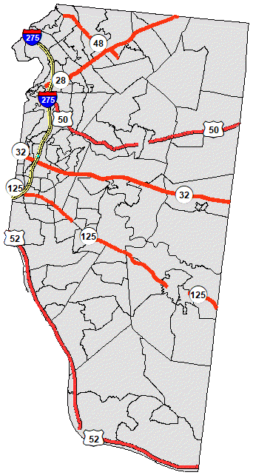
Where is Clermont County?
Notes:
Verbalize citations
Divided north and south by the S.R. 32 Business Corridor which includes the western portion of S.R. 125 and the I-275 loop
Rest of the county is stagnant and under-developed
______________________________________
http://gis.clermontcountyohio.gov/

Slide 4
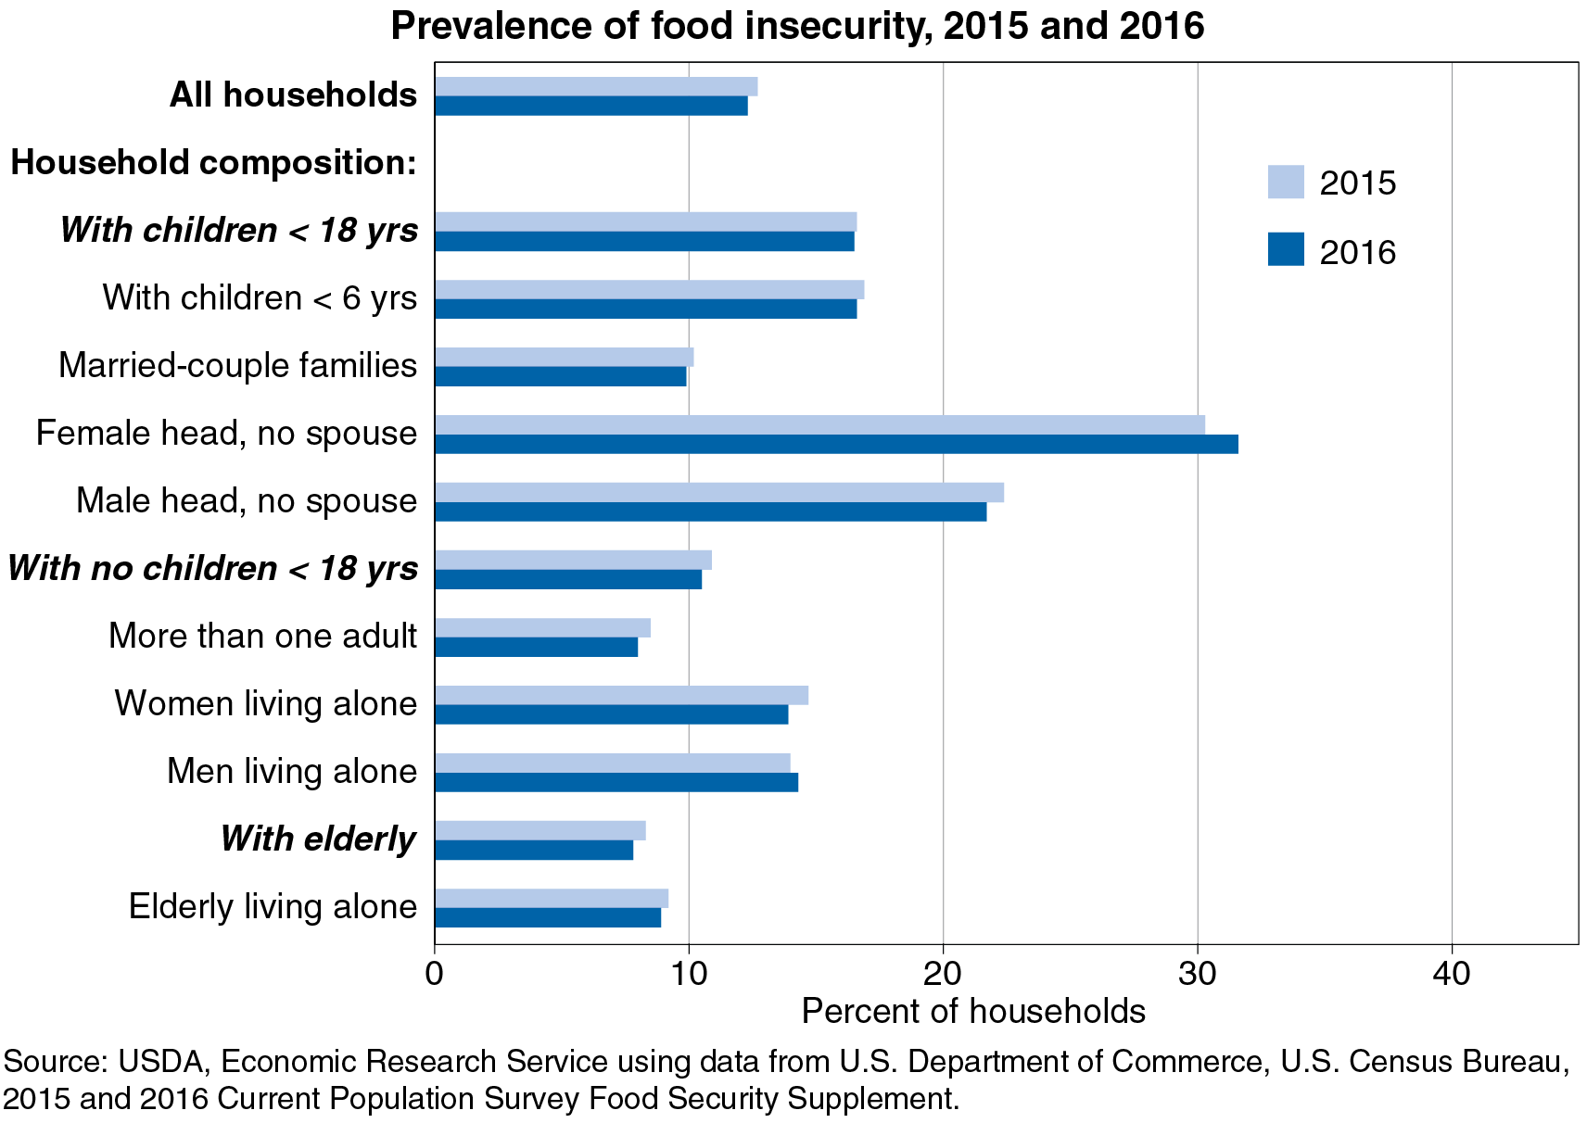
How is the Study Relevant?
United States
13.3M children live in households that are considered food insecure (Feeding America, 2017)
22% of U.S. households in low-income urban areas live 0.5 to 1 mile from a supermarket with no access to a vehicle (Mulangu & Clark, 2012)
4.4% of U.S. households in rural areas live more than 1 mile from the supermarket with no access to a vehicle (Mulangu & Clark, 2012)
Notes:
Verbalize citations
What is food insecurity? commodity existence, accessibility (vehicle, combined trips or temporal; or walking distance); economic)
What is walking distance? 1 mile
What is driving distance? 10 minutes (buffer zone around home and combined trips), complicated by MTUP (modifiable temporal unit problem)
Mulangu, et al (2012) “increases in obesity and chronic diseases associated with poor diets have led to concerns that some low-income and rural communities still lack access to affordable and nutritious foods”
___________________________________________________________________________________________________________
Graph from USDA ERS, 2016. https://www.ers.usda.gov/publications/pub-details/?pubid=84972

Slide 5
How is the Study Relevant?
Ohio
43% of Ohio’s population is rural (5.21M Ohioans, 1.98M households)
24% (or 475,095 rural Ohio households) of rural Ohioans households do not live within a 10-minute drive of a retail grocery store of any size
8.8% (or 174,201 rural households) live within driving distance of a retail grocery store, but do not own or have access to a vehicle
3% (or 59,389 rural Ohio households) live more than 1 mile from a supermarket AND do not have access to a vehicle
Notes:
Verbalize citations
Retail grocery store – IGA, local co-op, little or no competition
Supermarket – typically 45,000 sq ft and associated within a competitive area
_______________________________________________________________________________________________
Mulangu, et al (2012) – 1,979,561 rural / 4,627,893 total households; 5,209,819 rural people

Slide 6
How is the Study Relevant?
Clermont County
Public and Private Schools
 | County |  |  | Inside the SR 32 Business Corridor |  |  | Outside the SR 32 Business Corridor
 | 55 Schools |  |  | 16 Schools |  |  | 39 Schools
School Year Ending | Total Enrollment | % Free Meals | % Reduced Price Meals | Total Enrollment | % Free Meals | % Reduced Price Meals | Total Enrollment | % Free Meals | % Reduced Price Meals
2000 | 24,292 | 12.6% | 5.4% | 9,817 | 10.3% | 3.7% | 14,475 | 14.2% | 6.5%
2010 | 29,714 | 30.3% | 5.5% | 10,866 | 28.6% | 5.9% | 18,848 | 31.3% | 5.3%
2013 | 29,496 | 33.7% | 5.6% | 10,920 | 33.6% | 6.2% | 18,576 | 33.8% | 5.3%
2014 | 29,002 | 34.0% | 5.5% | 10,662 | 33.6% | 6.0% | 18,340 | 34.2% | 5.2%
2015 | 28,692 | 32.4% | 5.8% | 10,572 | 32.4% | 6.6% | 18,120 | 32.5% | 5.4%
2016 | 29,871 | 31.1% | 5.4% | 11,374 | 30.1% | 5.9% | 18,497 | 31.7% | 5.1%
Notes:
Verbalize citations
Highlight the differences in 2000-2010
__________________________________________________________________________________________________________________________________________________________________________________________________________________________________________________________________
Ohio Department of Education (2000-2017) – Data for Free and Reduced Price Meal Eligibility, http://education.ohio.gov/Topics/Other-Resources/Food-and-Nutrition/Resources-and-Tools-for-Food-and-Nutrition/MR81-Data-for-Free-and-Reduced-Price-Meal-Eligibil

Slide 7
Why is Clermont County important?
Historic Background
Named by French explorers in the 1600s – “Clear Mountain” seen over the thick Ohio River fog
Home to Native American – Shawnee, Miami, Delaware, Mingo, Ottawa, Cherokee, Wyandot
Decreed in 1800 to reward Virginian military veterans with land bounties (old-growth forest)
Westernmost and 7th oldest county in Ohio in 1800, 11th oldest in the Northwest Territory
Major North American wine region in the 19th century
State Route 32 Business Corridor – Industrial expansion into a rural county
Home to 197,363 residents (2010 census) in 460 square miles – 437 people/sq mile
54 public schools in 18 school districts service 29,714 students (Ohio Dept of Ed, 2010)
Future Farmers of America, Boys & Girls Clubs of America, Boy Scouts, Girl Scouts

Slide 8
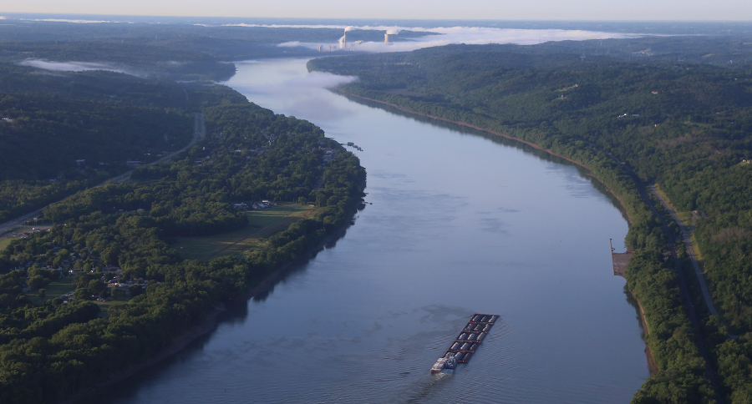
Notes:
Verbalize citations
Overhead New Richmond, looking SSE, Ohio on left, Kentucky on right, Zimmer electric plant in Moscow, Ohio. I live in upper left corner of photo
Largest barge load that travels the Ohio River to fit TVA locks & dams
Appalachian foothills start in Clermont County and run east into the Alleghany Mountain chain
Hill tops 840-900’; river 485’ upper pool, 465’ lower pool
____________________________________________________________________________________________________________________
Ohio River – http://media2.wcpo.com/photo/2016/06/24/WCPO_Beckjord_5_1466771242770_41027085_ver1.0_900_675.jpg

Slide 9
Why is Clermont County important?
Many Risks
Higher ratios of free and reduced price school lunches inside and outside the S.R. 32
Levels of poverty, vehicle accessibility, inter-county migration for households with children
Businesses attempting to expand/grow into unskilled, under-invested communities
Businesses not investing in their communities for long-term success
Notes:
Don’t want to create an ecological fallacy in blaming the business corridor for the increased food insecurity, but further analysis will tell

Slide 10
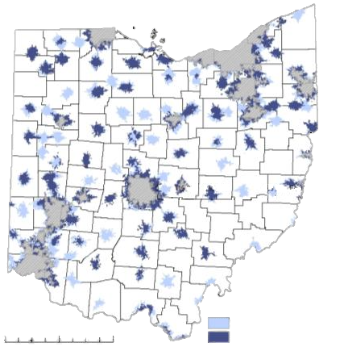
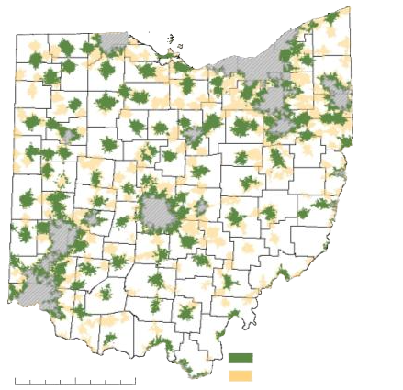
Why is Clermont County important?
Within a 10-Min Drive of:
Only 1 Large Supermarket
2 or More Large Supermarkets
Within a 10-Min Drive of:
Large Supermarket
Fast Food, No Large Supermarkets
0 20 40 80 Miles
0 20 40 80 Miles
Notes:
Verbalize citations
______________________
Mulangu, et al (2012)

Slide 11
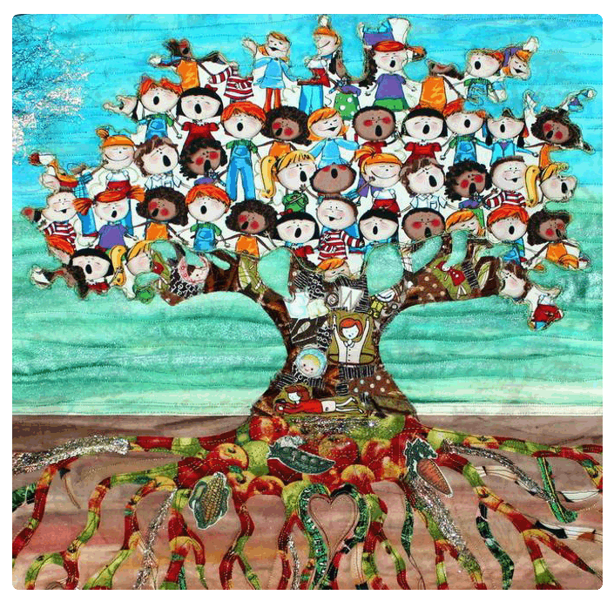
How to Reduce Risk?
Business
School Children
Goal
Risk
Collaboration
Community
School Programs
Food Security
Resilience
Funded
Notes:
Verbalize citations
Local businesses have skin in the game
Business corridor is isolating and solidifying socioeconomically depressed areas north and south in the county
Communities are at risk
Businesses can fail
Must take a holistic approach
Goal collaboration
Businesses can partner with philanthropic organizations (Safetynet Alliance, Inter Parish Ministries, NGOs such as Empower Youth and Salvation Army, “under-the-radar” groups)
Share the burden
Generate greater results (even for their own children)
Immediate reason
Feed the kids!
Protect the children’s health (physical & mental health)
Long term reasons
Education system is bolstered
Redirect funding to other school programs
Refuel the business and community interests of Clermont County
Community resilience
Stronger/healthier future workforce
Increased standard of living
Stronger communities promote patronization
________________________________________________________________________________________________________________________________________________________________
Childhood Food Security - http://djiqd110ru30i.cloudfront.net/upload/452018/project/94830/full_9195_94830_LocalFoodsGrowStrongCommunities_5.jpg
Strong Community – https://cdn.evbuc.com/eventlogos/85131895/fblogo.jpg
Business Risk - http://4.bp.blogspot.com/--4P3mXeLXQo/TfBUrJK3hZI/AAAAAAAAAF8/2a84XLPZB5E/s1600/business-risk-concept-pic.jpg
Community Collaboration - http://recruitmentdad.com/wp-content/uploads/2010/10/community-building.jpg
School Funds - http://www.education.vic.gov.au/PublishingImages/school/parents/primary/prepemail.jpg

Slide 12
What is the Goal?
School Children
Community
Resilience
Business
Success
Food Security
Notes:
Verbalize citations
Immediate – feed the kids
Long term #1 – stronger communities, increased standard of living
Long term #2 – invigorated patronage, business success
Long term #3 – businesses reinvest in the youth
The goal is cyclic and self-perpetuating
_____________________________________________________________________________________________________________________________________
Business Success – http://theaposition.com/robertfagan/wp-content/uploads/sites/33/2011/05/business-success.jpg
http://mattmayberryonline.com/wp-content/uploads/2013/04/Improve-Business-Success-Rate-620x465.jpg

Slide 13
What is available in the summer?
Blanchester
Early Jun – Mid Aug
Lunch – T/Th
Loveland
Mid Jun – Mid Aug
Lunch – M-F
Goshen
Early Jun – Mid Jul
Lunch – M-F
Batavia
Early Jun – Early Aug
Lunch – M-F
Supper – W
Williamsburg
Mid Jun – Early Aug
Supper – W
Bethel
Early Jun – Early Aug
Lunch – T/Th
Felicity
Jun – Late Aug
Breakfast – M-F
Lunch – M-F
Notes:
Verbalize citations
2 of 7 Summer food supports are within the Business Corridor (Batavia, the county seat, and Williamsburg, rejuvenating)
2 of 7 are outside the county borders (Loveland, Blanchester)
_________________________________________________________________________________________________________________________________
Ohio Dept of Ed – http://education.ohio.gov/Topics/Other-Resources/Food-and-Nutrition/Summer-Food-Service-Program

Slide 14
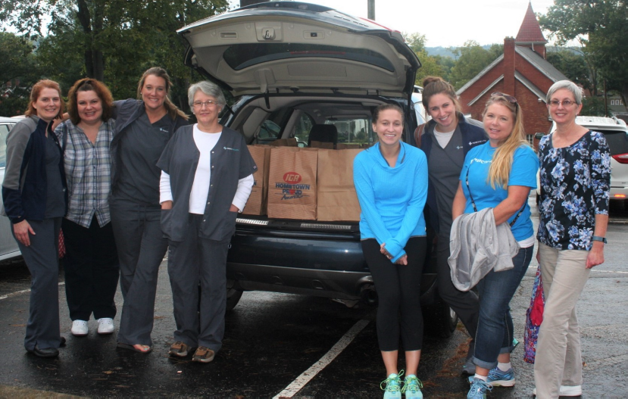
When is the need the greatest?
Greatest
Inclement weather breaks
Summer vacation
Scheduled school breaks
Weekends
Philanthropic groups not observing food desert criteria
“Below the Radar” philanthropic groups
Need
“Power Pack” Ladies
Least
Notes:
Food Desert – Area where vegetable and fruit accessibility (existence, transport, economic) is not available within walking or driving distance
Goshen S.D. distributes Weekend “Power Packs” to the free/reduced price eligible students
Bethel-Tate S.D. distributes “Tiger Pacs” (Mirones, 2011)
UnPack’d Pop-Up Picnic program, Summer Rural Delivery Meals (Reiber, 2016), Empower Youth, etc.
Philanthropic groups – “Power Pack” Ladies

Slide 15
Who is my audience?
Why?
Local Businesses
Ownership/Management
Employees
State & Local government
NGOs
School Boards & PTOs
Reduce business risk
Resources/networking, synergistic effect
Community investment and reward
Policy makers
Philanthropic collaboration
Championship the cause
Notes:
Local businesses can encourage employee participation with perks

Slide 16
Who is Affected?
Characteristics?
The kids
Pre-school to 6th Graders
7th Graders to High School Seniors
The families
Secondary resources
Healthier families
Refocus family priorities
The community
Strengthen communal fabric
Raise standard of living
Local Businesses
Stronger workforce
Community patronage
Less susceptible to peer pressure
More easily embarrassed or ashamed by peers
Family income unburdened
Food desert criteria recognized
Redirect resources to strengthen the family
Stronger families foster stable communities
Communal sense of ownership and control
Healthier and higher self-esteem
Higher standard of living increases buying power

Slide 17
Purpose
To study the main determinants and significant associations between socioeconomic and demographic characteristics and juvenile food insecurity in Clermont County, Ohio.

Slide 18
Research Questions
Are there correlations between socio-economic factors in the community and food insecurity among children of school age in Clermont County?
If correlations exist, can they be used as predictors in other regions to determine requirements for school food assistance programs and business collaboration to fill the shortfalls?

Slide 19
Data Sources
Study Range 2013-2015
Lookback Data to 2000
Ohio Department of Education, http://education.ohio.gov/Topics/Other-Resources/Food-and-Nutrition
Data for Free and Reduced Price Meal Eligibility by School
Summer Food Service Programs
Clermont County GIS, http://gis.clermontcountyohio.gov/
Base Map
Geographic Layers
American Community Survey, https://www.census.gov/programs-surveys/acs/
Vehicle Accessibility by Household by Census Tract
Inter-County Migration by Household by Census Tract
Poverty by Household with Children by Family Type by Children’s Ages by Census Tract
U.S. Census Bureau TIGER/Line, https://www.census.gov/geo/maps-data/data/tiger.html
Decennial Household with Children by Family Type by Children’s Ages by Census Block
Decennial Poverty by Household with Children by Family Type by Children’s Ages by Census Tract
Notes:
Add data source titles (e.g., 2010 decennial SF-1)

Slide 20
Clermont County Households
2015 Total
Est.
52,934
92.5% At or Above Poverty
7.5% Below Poverty
49,263
3,973
Married Couple
Legend
Married Couple
Total
Children / No Children
40,064
16,426 / 23,638
1,610
1,094 / 516
Ratio Kids/No Kids
2.1:1
0.7:1
Male Householder
Female Householder
Male Householder
Female Householder
3,326
1,889 / 1,437
5,873
3,640 / 2,233
444
395 / 49
1,919
1,650 / 269
1.3:1
1.6:1
8.1:1
6.1:1
ACS 5-Year Estimate (2010-2015)
Notes:
Explain well what is presented here
Sample data
Sampling errors in the total numbers of the ACS 5-yr Estimates

Slide 21
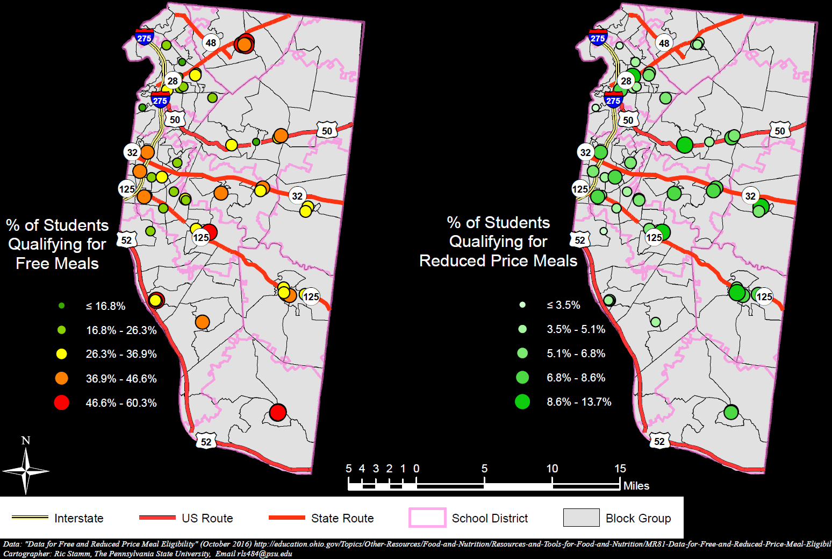
Local Indicators of a Nationwide Problem
Increased
Free and Reduced Price School Meals in Clermont County (Business Corridor highlighted)
2015-2016 school year
Notes:
Verbalize citations
Criteria for free lunch? Criteria for reduced price lunch?
Talk a lot about patterns that appear.
Why are these outcomes as they are?
Are they predictable based upon the independent covariants?
______________________________________________________________________
Clermont County spatial data - http://gis.clermontcountyohio.gov/

Slide 22
Methodology
Correlations
Pearson r to study correlations
Regression Analysis
GeoDa for regression
Three significance levels: 90%, 95% and 99%
Notes:
Verbalize citations
Pearson product-moment correlation coefficient r
Coefficient of Determination r²
Standard Error of the Estimate s_{Y·X}
To determine the goodness of fit of the regression:
Pearson’s r – independent variables (socioecomomic/demographic factors: childhood poverty, vehicle accessibility, inter-county migration) versus the response variable (school lunch assistance)
Regression – validate models of predictability, generate “heat” maps at 3 levels
Standard deviations ( 1, 68%; 2, 95%; 3, 99.7% confidence intervals)
______________________________________________________
GeoDa logo – https://spatial.uchicago.edu/software

Slide 23
International Application
Clermont County is a contemporary, predictive socioeconomic model of the dynamics experienced when business expansion invades an under-developed region
Australia – Do food banks, etc. give governments an excuse to neglect food insecurity within their jurisdictions? (Rose & Booth, 2017)
Africa – “The desire for convenience, driven by urbanisation and nutrition transition has increased the consumption of highly processed, less nutritious foods.” (Vilakati, 2016)
America – 14% of U.S. households (48M, 1-in-7 people) in 2014 experienced hunger while wondering if a next meal was in their future (Cohen & Zagorsky, 2016)
Notes:
Verbalize citations
Bow-wave/wake effect - The stressors are concentrated into areas of under-development which causes a worse than normal condition surrounding of the business expansion. A squeezed, compressed bow-wave precedes the progress and a wake follows it. If progress stagnates, the deprecated bow-wave and wake remain.
Though Clermont is the study area, this research has application for other counties, parishes or larger regions where progress imposes an unintentional threat to the surrounding environment
“Hungry children are more likely to be sick and developmentally impaired. In other words, hungry children do not live up to their potential.” (Cohen, Zagorsky: 2016)
Many articles from The Conversation (https://theconversation.com/us/topics/food-insecurity-5704) address food insecurity.
_____________________________________________________________________________________________________________________________________________________________________________________________________
“Successful Failures”, Australia - https://theconversation.com/successful-failures-the-problem-with-food-banks-86546
“The desire for convenience”, Africa – https://theconversation.com/why-the-african-food-basket-should-be-full-of-beans-and-other-pulses-60207
“U.S. is a land of plenty, so why do millions of Americans still go hungry?” – https://theconversation.com/u-s-is-a-land-of-plenty-so-why-do-millions-of-americans-still-go-hungry-55791
Cincinnati, the business push, is child poverty rich, http://www.citybeat.com/news/article/13003319/a-growing-hunger – second to Detroit (2015).
Cincinnati, 3rd to Detroit (2014), http://www.cintishares.org/snap/CS-CintiSNAP/FAQ.html.
Cincinnati, https://www.cincinnati.com/story/opinion/contributors/2016/08/15/helping-hungry-kids-now-and-later/88626936/.

Slide 24
Future Research
Enhance food security with an emphasis on children
Community gardens managed by the children and their mentors
Family nutrition education to combat obesity, diabetes, and heart disease
After-school physical activity, educational, or extension/self-sufficiency programs
Effectiveness of “Breakfast in the Classroom” to remove peer-pressure stigma and increase participation among eligible students
Notes:
Verbalize citations
____________________________________________________________________________________________________________________________
Breakfast in the Classroom – https://theconversation.com/should-schools-provide-free-breakfast-in-classrooms-57468

Slide 25
Previous Studies
“Identifying and Measuring Food Deserts in Rural Ohio”
Mulangu & Clark (2012)
“Examining the role between the residential neighborhood food environment and diet among low-income households in Detroit, Michigan”
LeDoux & Vojnovik (2014)
“U.S. is a land of plenty, so why do millions of Americans still go hungry?”
Cohen & Zagorsky (2016)

Slide 26
Summary
Using 5W Halo, we defined the problem space – Who, What, Where, When, Why and How
Opportunity was discovered that encourages a cyclic support system for:
The children
The community
Local business
Clermont County is important because it can provide a model solution for other regions where:
The community is rural overall
Businesses are expanding into the area
Risk to community and business must be reduced in order for all to survive
Goals are multi-faceted:
Short term: juvenile nutrition for physical and mental health
Long term: community resilience, business success and holistic progress
Interested parties
Policy changers and champions
Benefactors
How the Study in Depth shall be conducted

Slide 27
References
Anselin, L. (Producer). (2017, 2017-11-10). GeoDa. [graphic] Retrieved from https://spatial.uchicago.edu/software
Building Strong Communities. (2014, 2017-10-29). [graphic] Retrieved from https://www.eventbrite.com/e/building-strong-community-fundraiser-tickets-10984040561#
Business Risk Concept. [Graphic] Retrieved from http://4.bp.blogspot.com/--4P3mXeLXQo/TfBUrJK3hZI/AAAAAAAAAF8/2a84XLPZB5E/s1600/business-risk-concept-pic.jpg
Clermont County GIS. (2017). Clermont County Shapefile Layers. Retrieved from: http://gis.clermontcountyohio.gov/
Cohen, J. H., & Zagorsky, J. L. (2016). U.S. is a land of plenty, so why do millions of Americans still go hungry? Retrieved from The Conversation website: https://theconversation.com/u-s-is-a-land-of-plenty-so-why-do-millions-of-americans-still-go-hungry-55791
Coleman-Jensen, A., Rabbitt, M. P., Gregory, C. A., & Singh, A. (2017). Household Food Security in the United States in 2016. Retrieved from https://www.ers.usda.gov/publications/pub-details/?pubid=84972
Community Building. (2010, 2017-10-29). [Graphic] Retrieved from http://recruitmentdad.com/wp-content/uploads/2010/10/community-building.jpg
Community Shares of Cincinnati. (2014, 2014-01-20). SNAP Out of It! Challenge. Retrieved from http://www.cintishares.org/snap/CS-CintiSNAP/FAQ.html
Corcoran, S., & Schwartz, A. E. (2016). Should schools provide free breakfast in classrooms? Retrieved from The Conversation website: https://theconversation.com/should-schools-provide-free-breakfast-in-classrooms-57468
Data for Free and Reduced Price Meal Eligibility. (2017). Retrieved from: http://education.ohio.gov/Topics/Other-Resources/Food-and-Nutrition/Resources-and-Tools-for-Food-and-Nutrition/MR81-Data-for-Free-and-Reduced-Price-Meal-Eligibil
Department of Education and Training. (Producer). (2017, 2017-10-29). Starting Primary School. [graphic] Retrieved from http://www.education.vic.gov.au/PublishingImages/school/parents/primary/prepemail.jpg
Fagan, R. (Producer). (2011, 2017-10-30). Business Success. [graphic] Retrieved from http://theaposition.com/robertfagan/coaching/business-coaching/3696/six-quick-tips-to-business-success
Feeding America. (2017). Poverty and Hunger Fact Sheet. Retrieved from http://www.feedingamerica.org/assets/pdfs/fact-sheets/poverty-and-hunger-fact-sheet.pdf

Slide 28
References
LeDoux, T. F., & Vojnovic, I. (2014). Examining the role between the residential neighborhood food environment and diet among low-income households in Detroit, Michigan. Applied Geography, 55, 9-18. doi:10.1016/j.apgeog.2014.08.006
Mirones, A. (2011). School Aide works to feed kids [Press release]. Retrieved from www.wcpo.com/news/school-aide-works-to-feed-kids
Mulangu, F., & Clark, J. (2012). Identifying and Measuring Food Deserts in Rural Ohio. Journal of Extension, 50(3), 1-9.
Ohio Department of Education. (2017). Summer Food Service Program Clickable Map. Retrieved from http://education.ohio.gov/Topics/Other-Resources/Food-and-Nutrition/Summer-Food-Service-Program
Ohio River. (2016, 2017-12-07). [Aerial photo] Retrieved from http://media2.wcpo.com/photo/2016/06/24/WCPO_Beckjord_5_1466771242770_41027085_ver1.0_900_675.jpg
Ohio River Fog. (2013, 2017-11-09). Retrieved from http://www.crh.noaa.gov/images/lmk/weather_photos/may9_2013/leavenworth_fog_wade_bell1_med.JPG
PersimonDreams (Producer). (2017-10-29). Local Foods Grow Strong Communities. Retrieved from https://www.craftsy.com/quilting/project/local-foods-grow-strong-communities/94830
Reiber, K. (2016). Helping hungry kids, now and later. Cincinnati.com. Retrieved from Cincinnati.com website: https://www.cincinnati.com/story/opinion/contributors/2016/08/15/helping-hungry-kids-now-and-later/88626936/
Rose, N., & Booth, S. (2017). 'Successful failures' - the problem with food banks. Retrieved from The Conversation website: https://theconversation.com/successful-failures-the-problem-with-food-banks-86546
Swartsell, N. (2015). A Growing Hunger. Retrieved from CityBeat website: http://www.citybeat.com/news/article/13003319/a-growing-hunger
Vilakati, N. (2016). Why the African food basket should be full of beans and other pulses. Retrieved from The Conversation website: https://theconversation.com/why-the-african-food-basket-should-be-full-of-beans-and-other-pulses-60207

Slide 29
Questions or Comments
Notes:
______________________________________
Question Mark – https://images2.alphacoders.com/438/438356.png

