Slide 1
Performing GEOINT in the Dark: A Prediction of Proto-State Control Using Nighttime Light Patterns
GEOG596A – Capstone Proposal
Dan Steiner
MGIS – GEOINT Option
DMS6551@psu.edu
Adviser: Dr. Todd S. Bacastow
December 19, 2017

Slide 2
Outline
Concepts
Background
Research Objectives
Methodology
Anticipated Results
Research Problem
Timeline

Slide 3
Research Problem
Thesis: There is a (hypothesized) relationship between where a militant secessionist group controls power generation and nighttime electricity use.
Using ISIS in Syrian cities to test the hypothesis and method.
The method examines this problem through an inductive approach.
Notes:
Significance: If the method is valid, it can be used to understand and predict human patterns in denied areas such as North Korea; Yemen; or several countries in Africa: Chad, Burundi, Eastern Mauritania.

Slide 4
Purpose
Design a method to evaluate:
1. Geospatial Event Information
Open Sourced Imagery
Crowdsourced Identification of Places
2. Analyzed in Geospatial Preference Modeling
3. To determine the likelihood that similar events may occur in other places

Slide 5
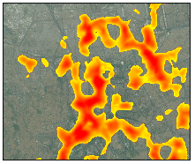
Data and Methods
Satellite Imagery
Radiance
Change Detection
Social Media
Crowdsourcing Geospatial Information
Tomnod Campaign (Maxar Technologies/Radiant Solutions, fmr Digital Globe)
Geospatial Preference Modeling
aka Predictive Analytics
Statistical Likelihood of an Event or Relationship
Signature Analyst (Maxar Technologies/Radiant Solutions, fmr Digital Globe)

Slide 6
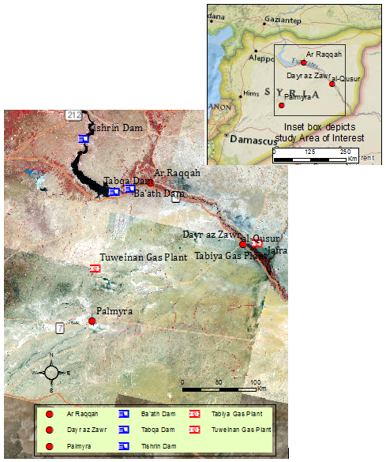
Background - Geography
Map of Syria &
Area of Interest
Landsat scenes:
March – June 2016,
descending day
Notes:
Power generation: Tabqa Dam, Ba’ath Dam
Cities: Ar Raqqah, Dayr az Zawr
Oil & Gas production: Tuweinan, Tabiya facilities

Slide 7
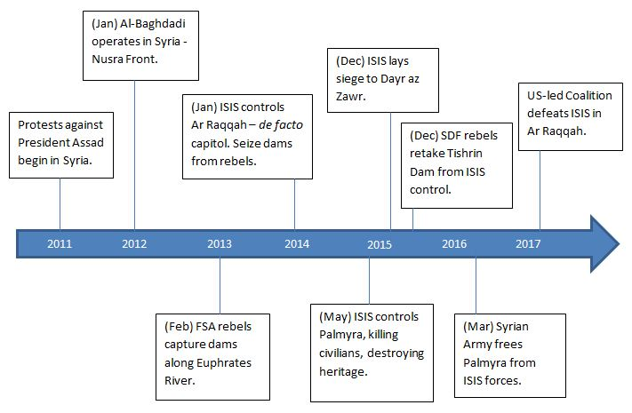
Background – Timeline of Syrian Turmoil

Slide 8
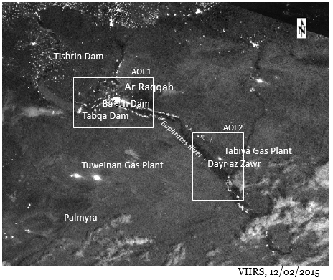
Background - VIIRS
Visible Infrared Imaging Radiometer Suite (VIIRS)
NASA/NOAA Partnership Suomi Satellite Program
Day/Night Band (0.7μ)

Slide 9
Assumptions
Militant group controls utility infrastructure in a manner different than before gaining control.
Power generation and distribution can be judged using nighttime illumination.
The control by militant groups extends to other places.
Similar places can be predicted using inductive methods or Bayesian approach to analysis.

Slide 10
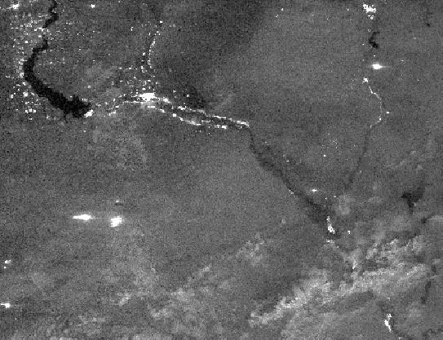
Methodology

Slide 11
Workflow to Complete the Capstone
Research
Literature Review
GEOINT Assessment
Imagery Change Detection
Study Results
Initial Report
Imagery Selection & Acquisition
Geospatial Predictive Modeling
Tomnod Campaign
Signature Analyst
Presentation
Final Report

Slide 12
Workflow

Slide 13
Workflow

Slide 14
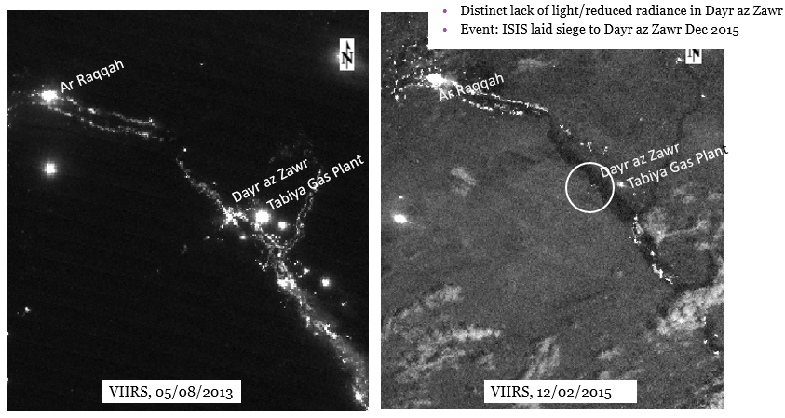
Anticipated Results – Imagery Change Detection

Slide 15
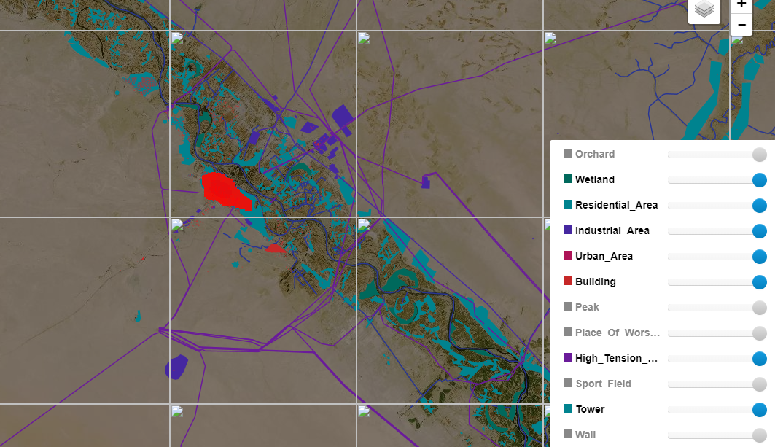
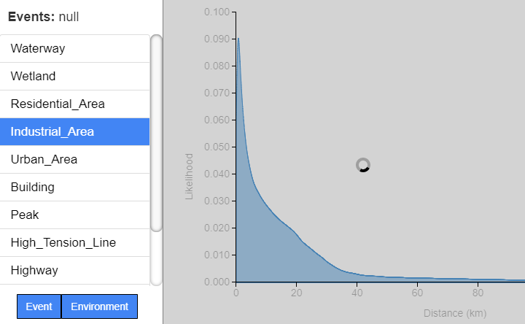
Anticipated Results – Geospatial Preference Modeling
Heat Map
Statistical Curves
Notes:
Finally an Assessment

Slide 16
Timeframe
Research
GEOINT Assessment
Draft Report
Presentation & Feedback
Final Report
GEOG596A … GEOG596B
Dec 2017
Jan - Mar 2018
Apr – May 2018

Slide 17
Acknowledgments
For guidance, suggestions of research direction, support, and explanations of context.
Maxar Technologies/Radiant Solutions
Todd Bacastow, Ph.D., PSU, Adviser
Steve Handwerk, PSU
Dennis Bellafiore, Ph.D., PSU

Slide 18
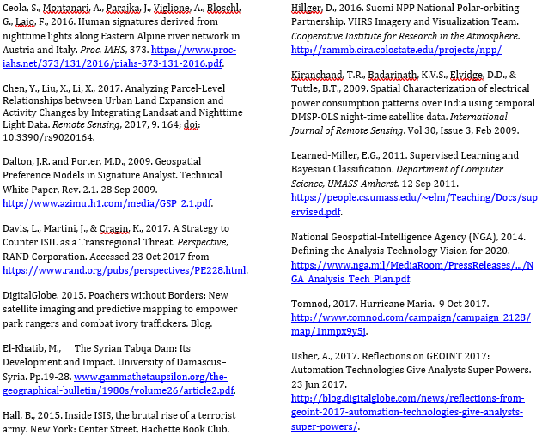
References

Slide 19
Questions?

