Slide 1
Comparing OpenStreetMap User Contributions between the United States and Europe
Jeremy Stratman
Advisor: Dr. Jan Wallgrün
GEOG 596A: Individual Studies - Peer Review
05/07/14

Slide 2
Outline
Background
Literature Review
Project Objectives
Methodology
Anticipated Results
Proposed Timeline
Conferences & Journals
Questions
References

Slide 3
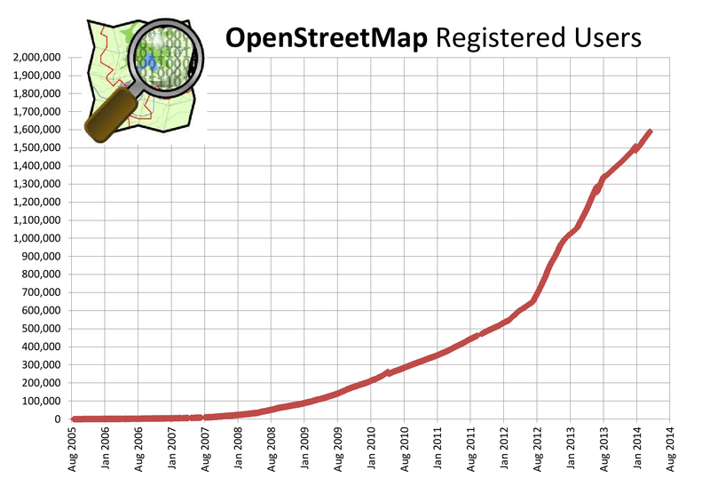
Background
“Wiki” concept developed in 1995, went mainstream via Wikipedia in 2001
Crowd-sourced Mapping is nothing new, but success of Wikipedia paved way for “geo-wiki” concepts
OpenStreetMap (OSM) founded in 2004, within the UK where Ordnance Survey datasets were proprietary
Called “Wikipedia of Maps” by Steve Coast, Founder
Unsettled terminology:
VGI
PGIS/PPGIS
Collaborative Mapping
Image: http://wiki.openstreetmap.org/wiki/Stats

Slide 4
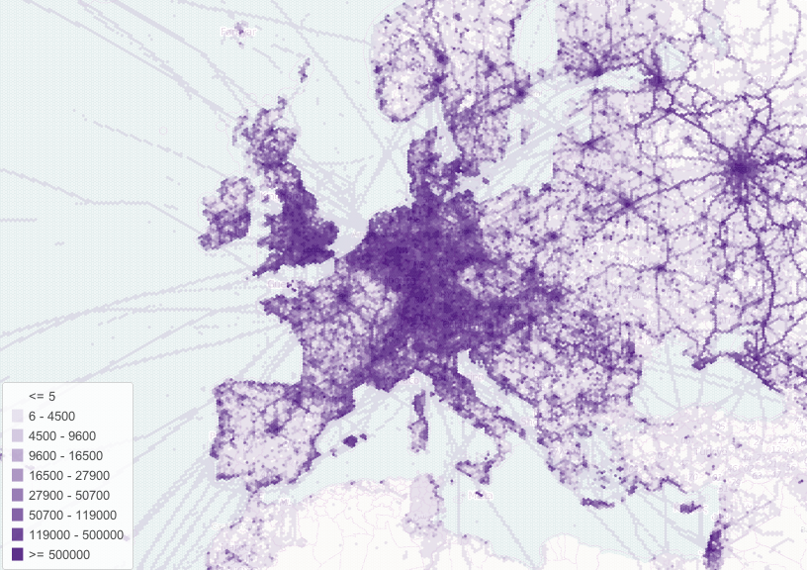
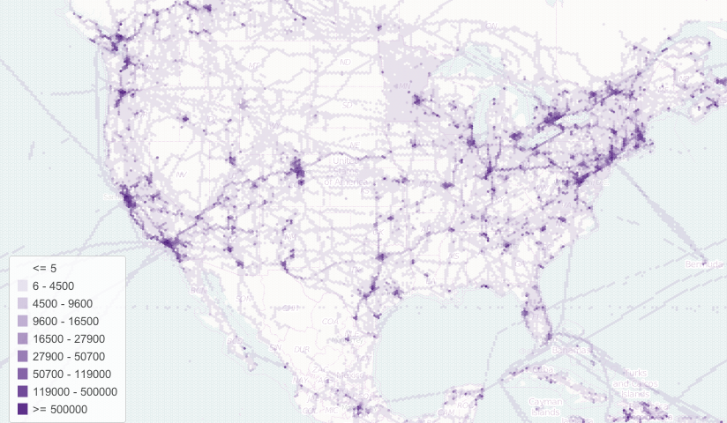
Literature Review – OSM Communities
European Community
Founded in Europe due to lack of freely available GIS data [10]
OSM community mostly focused on new data creation [20]
US Community
Free GIS data readily available in most locations [18]
Start of OSM community centered on modifying and expanding upon mass data imports [12]
Number of OpenStreetMap GPS Points as of April 2012 in Europe and the United States
(© Pascal Neis, neis-one.org)
Images: http://resultmaps.neis-one.org/osmgps.html

Slide 5
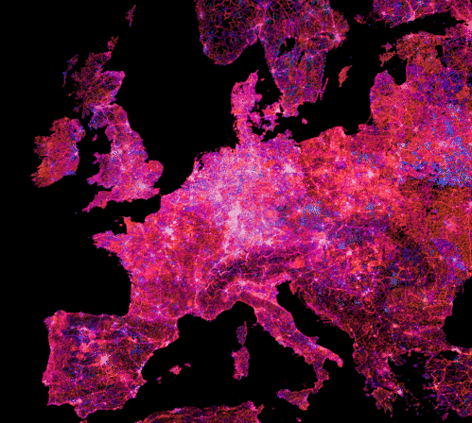
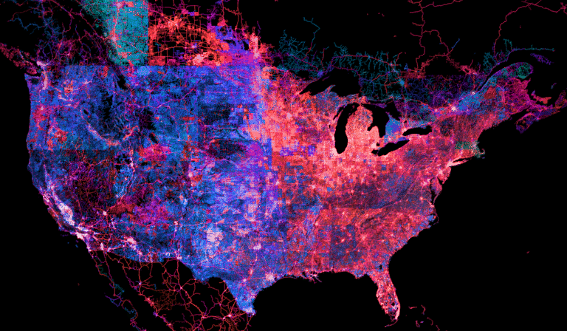
Literature Review – OSM Communities
European Community
Very active communities in urban areas [20]
Generally high quality data [8]
US Community
Activity generally low to moderate [20]
Quality of data varies greatly [14]
Currency of OpenStreetMap data as of 2013; Cooler shades are older than Warmer shades
(© Mapbox)
Images: https://www.mapbox.com/osm-data-report/

Slide 6
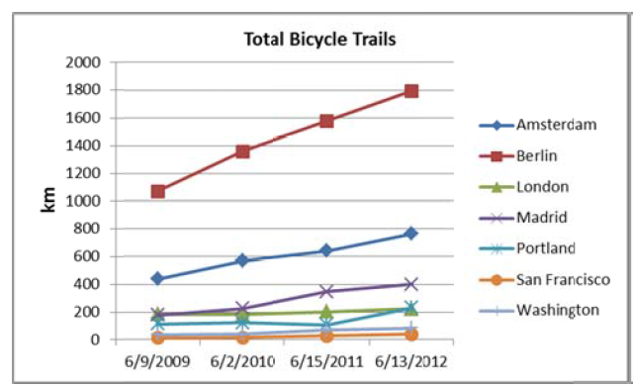
Literature Review – OSM Communities
So what direct comparisons between US and Europe exist?
Previous studies are quite limited, focusing only on:
Specific data types between US and European cities (cycling features) [4]
One US city compared internationally across data types (Los Angeles) [14]
Impact of mass imports on US communities (no direct comparisons) [12]
None include temporal comparisons of community development and contribution behaviors
One temporal study did review impact of Mapping Parties on participation over time, but only in London [5]
Total Bike Areas [4]
Average Senior Mapper Activity Timeframe and Contributions per Urban Area [14]

Slide 7
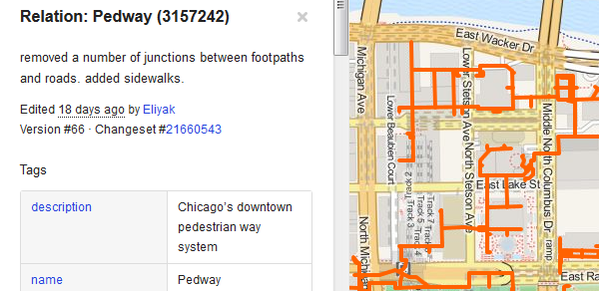
OpenStreetMap Data Structure
Elements:
Data is made up of Nodes, Ways, Relations
Node = Point
Way = Ordered list of nodes
Open Way (Line)
Closed Way (Line)
Area (Polygon)
Relation = List of nodes, ways, and/or other relations
Tags provide attribute data through key/value pairs
Output File Types
XML is the primary format
Changesets
“Full History Dump”
Images: http://wiki.openstreetmap.org/wiki/Elements

Slide 8
Project Motivation & Objective
Motivation:
Enhance the success of outreach efforts to help increase OpenStreetMap participation in the United States
Objective:
Determine differences in contribution behavior of US and European users in comparable cities, measuring:
Maturity of data inputs over time
Spatial Characteristics of User Contributions
Non-Spatial Characteristics of User Contributions

Slide 9
Methodology
Preparation
Choose cities
Download/Import/Prepare Data
Execution
Query the data against established metrics
Compare and Analyze Data
Develop Results

Slide 10
Preparation
Choose 18 cities, 9 each in US and Europe
Rural areas too variable and less comparable
Vary size: 3 large, 3 medium, 3 small
OSM Community must exist in each
Download and Import Data
“Full History Dump” ~52gb and Changesets ~800mb
Extract regions and import to PostGIS
Preparatory Queries
Identify mass imports and user locations
Image: http://postgis.net/

Slide 11
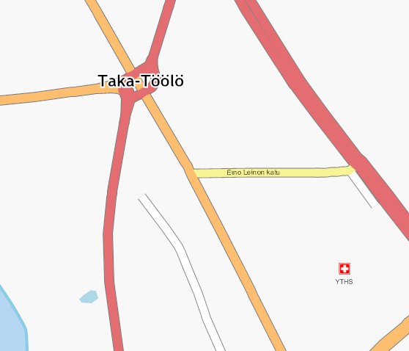
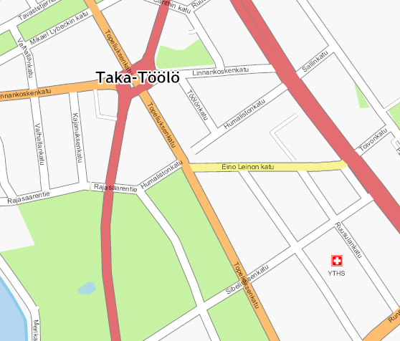
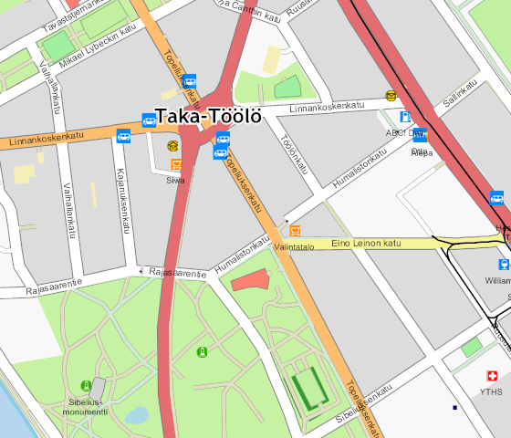
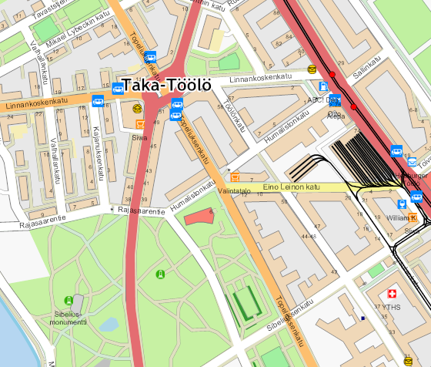
Measure Maturity Over Time
(Very) Basic
Basic
Intermediate
Maturity of Data
Spatial and attribute metrics indicative of:
Basic maturity
Intermediate maturity
Advanced maturity
Sample yearly 2005-2014
Advanced
Images: http://wiki.openstreetmap.org/wiki/Completeness_example

Slide 12
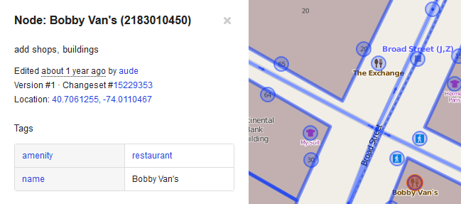
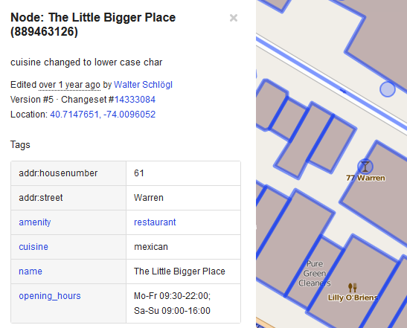
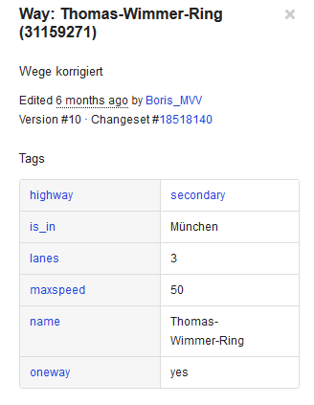
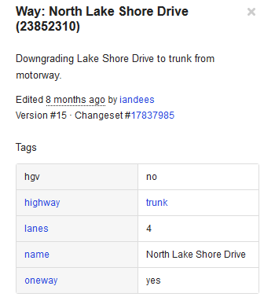
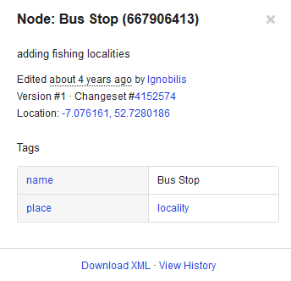
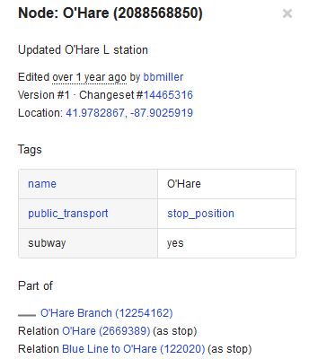
Examples of Attribute Maturity Metrics
POIs:
Roads:
Basic
Intermediate
Advanced
Public Transport:
Images: http://openstreetmap.org

Slide 13
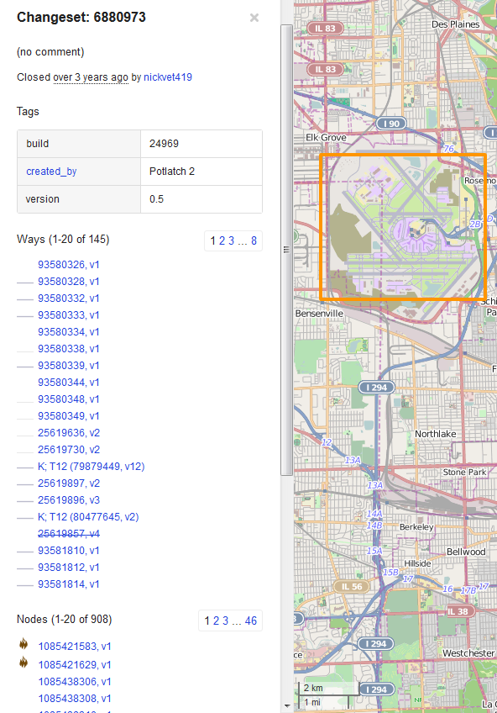
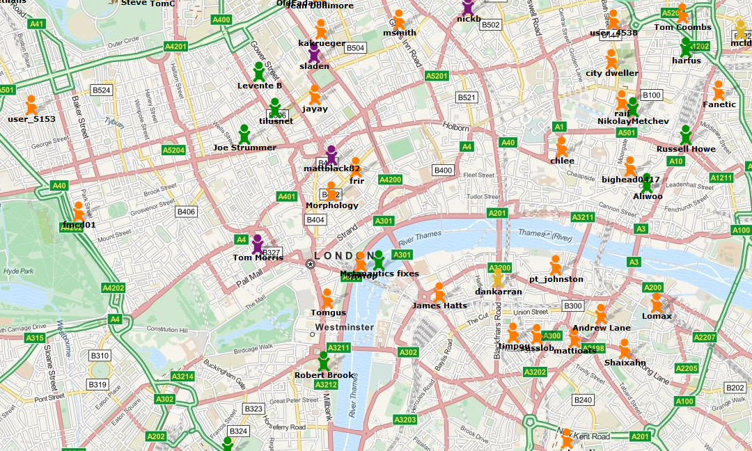
Spatial Characteristics of User Contributions
Locality of contributors to the city
Spatial extent of contributions of users from the city
Changeset size
Map of estimated OSM User Locations (© Pascal Neis, neis-one.org)
Images: http://wiki.openstreetmap.org/, http://resultmaps.neis-one.org/oooc

Slide 14
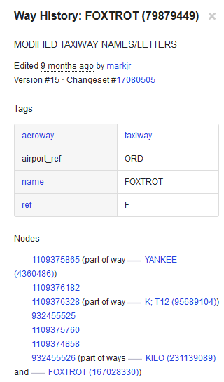
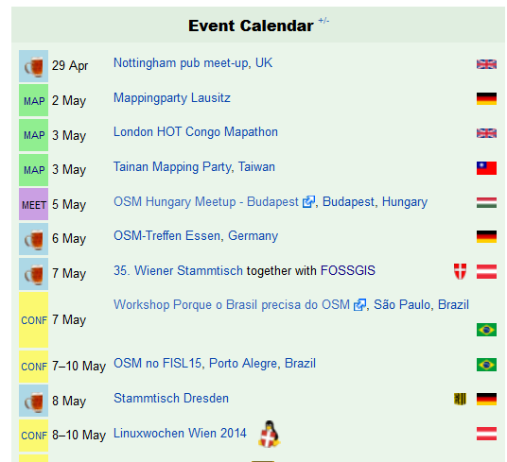
Non-Spatial Characteristics of User Contributions
Types of contributions
Sample monthly, by total edits and by feature type:
New features created (v1)
Spatial edits of existing features
Attribute-only edits of existing features
Community events
Mapping Parties, social events, etc.
Images: http://openstreetmap.org

Slide 15
Anticipated Results
Queries produce spatial and non-spatial data to facilitate analysis of metrics spatially and temporally
End Products:
Conclusions about what is actually different as well as similar in the nature of user contributions between communities
Initial proposals for how to more effectively expand OSM in the US based upon the results
Limitations:
Communities operate differently due to the open nature of OSM; there are few rules and no established progression
User locations is only estimated

Slide 16
Proposed Timeline
June - July 2014
Set up Linux partition with PostGIS, OSM-History-Splitter, all other tools
Download data for a small region and test methodology
Choose cities
August 2014
Run all queries
September - October 2014
Compare/Analyze Data
Develop Results

Slide 17
Conferences & Journals
10/8/14 - NACIS Annual Meeting; Pittsburgh, PA
Abstracts due 5/31/14
4/21/15 - Association of American Geographers (AAG) Annual Meeting; Chicago, IL
No date for abstracts published, December 2014 likely
Journals:
Transactions in GIS
Cartographica
Future Internet
Many Others…

Slide 18
References
Corcoran, P. and Mooney, P. (2013). "Characterising the metric and topological evolution of OpenStreetMap network representations." The European Physical Journal Special Topics 215(1), 109-122.
Girres, JF. and Touya, G. (2010). "Quality Assessment of the French OpenStreetMap Dataset." Transactions in GIS, 14(4), 435-459.
Goodchild, M. (2007). "Citizens As Sensors: The World Of Volunteered Geography." GeoJournal, 69(4), 211-221.
Hochmair, H. H., Zielstra, D., & Neis, P. (2013, January). "Assessing the completeness of bicycle trails and designated lane features in OpenStreetMap for the United States and Europe." In Proceedings of the Ninety-second Annual Meeting of the Transportation Research Board.
Hristova D., Quattrone G., Mashhadi A., and Capra L. (2013). "The life of the party: Impact of social mapping on openstreetmap." In Proceedings of the AAAI International Conference on Weblogs and Social Media(ICWSM2013). Association for the Advancement of Artificial Intelligence (AAAI).
Mashhadi, A., Quattrone, G., Capra, L., & Mooney, P. (2012). "On the accuracy of urban crowd-sourcing for maintaining large-scale geospatial databases." In Proceedings of the Eighth Annual International Symposium on Wikis and Open Collaboration. ACM.
"MaZderMind/osm-history-splitter." (n.d.). GitHub. Retrieved April 13, 2014, from https://github.com/MaZderMind/osm-history-splitter
Mondzech, J., and Sester, M. (2011). "Quality analysis of OpenStreetMap data based on application needs." Cartographica: The International Journal for Geographic Information and Geovisualization, 46(2), 115-125.
Mooney, P., and Corcoran, P. (2012). "Characteristics of heavily edited objects in OpenStreetMap." Future Internet, 4(1), 285-305.
Neis, P., Zielstra, D., and Zipf, A. (2011). "The street network evolution of crowdsourced maps: OpenStreetMap in Germany 2007–2011." Future Internet, 4(1), 1-21.
Neis, P., and Zipf, A. (2012). "Analyzing the contributor activity of a volunteered geographic information project—The case of OpenStreetMap." ISPRS International Journal of Geo-Information, 1(2), 146-165.
Zielstra, D., Hochmair, H. H., and Neis, P. (2013). "Assessing the Effect of Data Imports on the Completeness of OpenStreetMap–A United States Case Study." Transactions in GIS, 17(3), 315-334.
Fan, H., Zipf, A., Fu, Q., and Neis, P. (2014). "Quality assessment for building footprints data on OpenStreetMap." International Journal of Geographical Information Science, (ahead-of-print), 1-20.
Neis, P., Zielstra, D., and Zipf, A. (2013). "Comparison of volunteered geographic information data contributions and community development for selected world regions." Future Internet, 5(2), 282-300.
Neis, P., & Zielstra, D. (2014). "Recent Developments and Future Trends in Volunteered Geographic Information Research: The Case of OpenStreetMap." Future Internet, 6(1), 76-106.
Stephens, M. (2013). "Gender and the geoweb: Divisions in the production of user-generated cartographic information." GeoJournal, 78(6), 981-996.
"Wiki History." (n.d.). Wiki History. Retrieved April 10, 2014, from http://c2.com/cgi/wiki?WikiHistory
Willis, N. (2007, October 11). "OpenStreetMap project imports US government maps." Linux.com. Retrieved March 27, 2014, from http://archive09.linux.com/feature/119493
Yasseri, T., Quattrone, G., and Mashhadi, A. (2013). "Temporal analysis of activity patterns of editors in collaborative mapping project of OpenStreetMap." In Proceedings of the 9th International Symposium on Open Collaboration (p. 13). ACM.
Zielstra, D., and Zipf, A. (2010). "A comparative study of proprietary geodata and volunteered geographic information for Germany." In 13th AGILE international conference on geographic information science (Vol. 2010).

Slide 19
Questions?

