Slide 1
Hydrographic Surveying to Identify the Geographic Distribution of Sediments and Subaqueous Soils in Clopper Lake.
MGIS Candidate: Collin Strine-Zuroski
Advisor: Dr. Jay Parrish

Slide 2
Clopper Lake
Located in Seneca Creek State Park in Montgomery County, MD.
Dam built in 1975.
Lake Created for Recreation and Flood Control.
86.70 Acres.

Slide 3
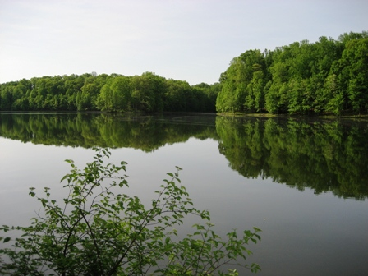
Clopper Lake: Then and Now
1974
2010
*Photos Courtesy of Gaithersburg, Then and Now: http://www.gaithersburghistory.com. Pictures are reproduced here for educational purposes only.

Slide 5
Outline:
Goals
Mapping Sediment Deposits
Bathymetric Mapping
Sub-Bottom Profiling
Data Analysis
Sediment Calculations
Mapping Subaqueous Soil
Landform Identification
Boolean Overlay
Additional Analysis
Timeline

Slide 6
Goals:
Map the geographic distribution of sediment deposits that have accumulated in the lake.
Identify the location of potential subaqueous soils capable of supporting plant life.

Slide 7
Mapping Sediment Deposits:

Slide 8
Mapping Sediment Deposits:

Slide 9
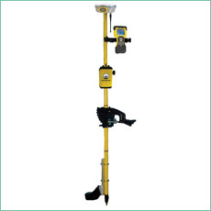
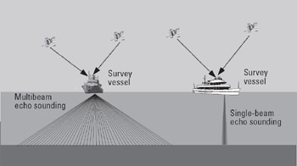
Creating Bathymetric Contours:
Hydrolite-TM Single Beam, Sonar Transducer
Figure 2
Figure 3
Figures 2 and 3 acquired from http://www.globalspec.com/reference/66292/203279/10-10-gps-for-seafloor-mapping and http://www.seafloorsystems.com/hydrolite_tm.html respectively, and have been reproduced here for educational purposes only.

Slide 10
Choosing a Survey Vessel:

Slide 11
Choosing a Survey Vessel:

Slide 14
Bathymetric Data
39,013 Data Points
Transducer Draft (0.85 feet) added to all raw depth soundings.

Slide 16
Calculations
63,819,030.011 Cubic Feet of Water
1,465.08 Acre Feet of Water
Mean Depth=15.97 Feet
Deepest Point= 44.92 feet

Slide 17
Historic Bathymetric Contours

Slide 18
Historic Bathymetric Contours

Slide 20
Sediment Calculations:

Slide 22
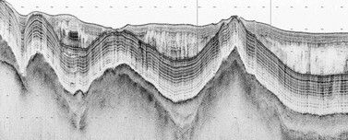
Sub-Bottom Profiling
Method for imaging marine sediment layers.
Active acoustic sensor (10Khz).
A portion of the induced acoustic signal penetrates the lake bottom and a small portion is reflected back each time it reaches the boundary of two layers with different acoustic impedance.

Slide 23
Field Work

Slide 26
Seamless Elevation Model

Slide 27
Seamless Elevation Model

Slide 28
Subaqueous Soils (SAS)
Soils that form in shallow water environments and are capable of supporting plant life.
Usually found in water less that 2.5meters (8.20 feet) deep**.
Found in both fresh and saltwater environments.
Relatively new field of Pedology (soil science).
Important distinction between subaqueous and submerged soils.

Slide 29
Surrounding Area Soil Types

Slide 32
Potential Additional Analysis:
Side Scan Sonar
Image Existing Plant Life in lake.
Determine if areas with depths greater than 2.5 meters are currently supporting plant life.
Images Courtesy of: http://texasfishingforum.com/forums/ubbthreads.php/topics/3143150/LOWRANCE_SIDE_IMAGING_ANNOUNCE and are reproduced here for educational purposes only.

Slide 33
Timeline:
4-6 Weeks
Continue to process data and identify the distribution of Subaqueous soils in the lake.
Complete side-scan survey to produce a more comprehensive map of existing aquatic plants.
Refine report and produce final presentation.
Final Presentation
2-4 Weeks
Sept/Oct

Slide 34
Special Thanks To:
Exploration Instruments
Seafloor Systems, Inc.
Hypack, Inc.
URS Corporation
Dr. Jay Parrish
Dr. Patrick Drohan

Slide 35
References:
Bradley, M.P. and M.H. Stolt. (2002). “Evaluating methods to create a base map for a subaqueous soil Inventory”. Soil Sci., 167: 222-228.
Rabenhorst, Martin C. "Case Study: Soil Mapping in Chincoteague Bay Maryland." N.p., n.d. Web. 12 June 2012<http://nesoil.com/sas/16_Rabenhorst_Soil_Mapping_Chincoteague_Bay_MD.pdf>.
Rubinstein, Michael I. "LIDAR FOR SUBAQUEOUS AND TERRESTRIAL SOIL LANDSCAPE." University of Maryland, n.d. Web. 5 June 2012
Turenne, Jim. "Subaqueous and Submerged Soil Information Sheet." Subaqueous and Submerged Soil Information Sheet. N.p., n.d. Web. 24 May 2012. <http://nesoil.com/sas/sasinfo.htm>.
USDA-FSA-APFO Aerial Photography Field Office (2010). NAIP09 - National Agricultural Imagery Program 2009 1 meter Nat Color. Salt Lake City, Utah. URL: <http://dnrweb.dnr.state.md.us/gis/data/>
U.S. Department of Agriculture, Natural Resources Conservation Service (2006). Digital General Soil Map of U.S. Tabular digital data and vector digital data. Fort Worth, Texas. URL:<http://SoilDataMart.nrcs.usda.gov/>

Slide 36
Questions?
Contact Information:
Collin Strine-Zuroski
cps170@psu.edu
Collin.strine.zuroski@gmail.com
(412) 335-0294

