Slide 1
GEOG 596A Capstone Project Proposal
Species vulnerability to climate and land use changes in Saguaro National Park’s
Rincon Mountain District
by Kim Struthers
Advisor – Justine Blanford

Slide 2
Capstone Overview

Slide 3
Saguaro National Park
Sonoran
Desert
°
Tucson
Madrean
Sky
Island
Complex
Source: Monahan et al. 2013

Slide 4
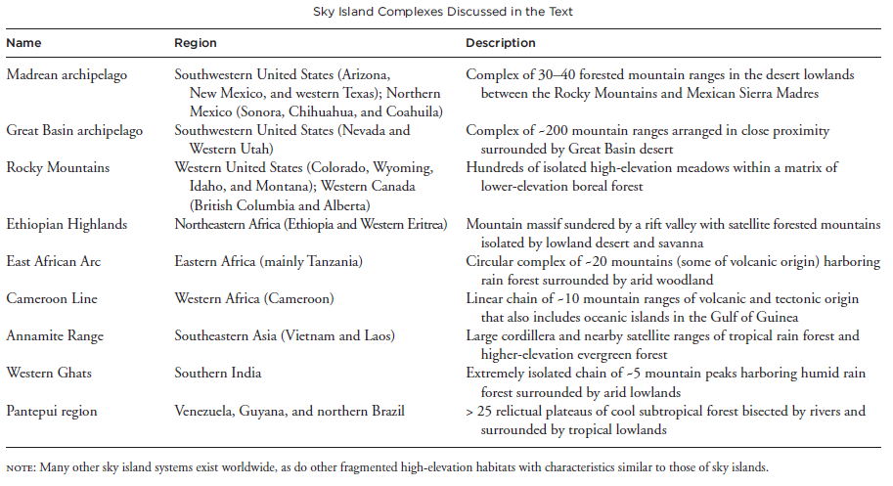
Sky Islands
20 sky island complexes in the world each with a distinct origin, spatial arrangement, age, and climate history.
Source: McCormack, Huang, Knowles, 2009

Slide 5
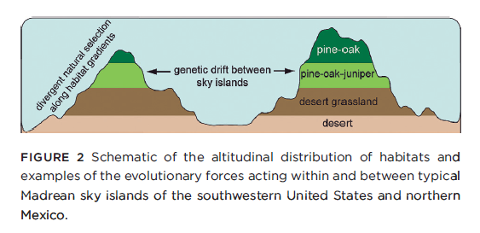
Sky Islands
High-elevations are separated by lowlands.
Source: McCormack, Huang, Knowles, 2009
Geographical isolation is one of the major drivers of speciation as exemplified by species on islands.
Important regions to conserve: high species diversity
Provide a window into: Evolutionary Processes

Slide 6
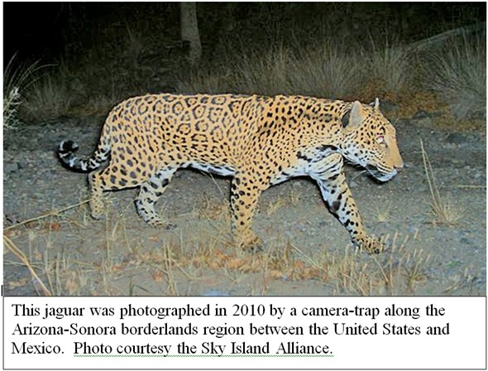
Madrean Sky Island Complex
Total area is a little over 10 million acres, and Rincon Mountain is one of the forested islands within this complex.
Source: Coe et al. 2012

Slide 7
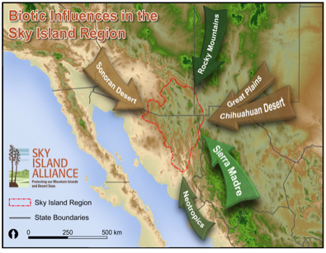
Madrean Archipelago
Located in southeastern Arizona and southwestern New Mexico, and northwest Mexico (Sonora and Chihuahua)
Situated between four major ecosystems: the Sierra Madres and Rocky Mountains and the Sonoran and Chihuahuan Deserts.
Connects North America’s two largest deserts and is a ‘stepping stone’ between two major mountain ranges.
Map Source: Sky Island Alliance 2014

Slide 8
Stacked Biomes
Figure Credit: NPS Sonoran Desert I&M

Slide 9
“Megadiversity”
The convergence of weather patterns, flora and faunal realms, and climatic conditions create a “megadiversity” center resulting in:
“greater species richness, greater endemism, more clinal variation, more biogeographical specialties, and unique cultivars compared to other inland terrains” (Warshall 1995).
Source: SW GAP Project 2011
High number of federally protected areas along the border—including national wildlife refuges, wilderness areas, national monuments, riparian national conservation areas, and national parks in Mexico and the United States (SIA 2011).
2005 Madrean pine-oak woodland designated biological hotspot.
Source: Patrick-Birdwell et al. 2013

Slide 10
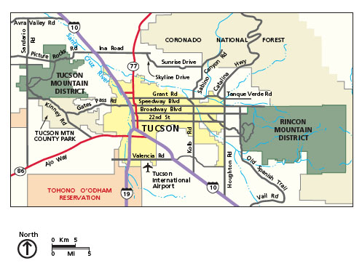
Study Area
Saguaro National Park’s two districts are separated by the city of Tucson, Arizona.
Saguaro General Management Plan

Slide 11
Climate Change at Saguaro NP
Temperature is rising and is predicted to rise.
Monahan and Fisichelli (2014)

Slide 12
Climate Change: Predicted Shifts in Vegetation
Different climate change scenarios predict different vegetation responses.
Temperature increase is most likely the climate variable that will change.
Shifts in communities to higher elevations will result in an increase in certain vegetation types while others decrease.
Figure Credit: NPS Sonoran Desert I&M

Slide 13
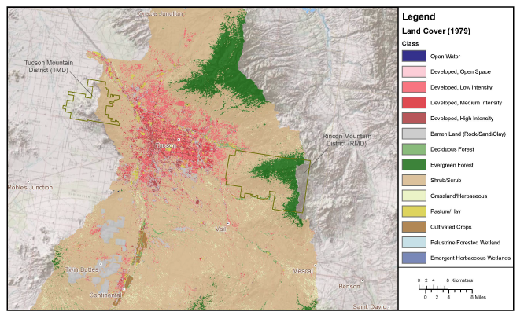
Land Cover/Use Change at Saguaro NP
1979
2009
Landcover
Source: Monahan et al. 2013
Arizona is predicted to be the second fastest growing state in the U.S between 2000-2030, increasing by 109% (U.S. Census Bureau 2012).
Saguaro NP, located in Pima County, Arizona, contains the largest population within the four counties surrounding the park (Monahan et al. 2012).
Population is expected to quadruple by 2030 as Tucson and Phoenix developments expand (Monahan et al. 2012).

Slide 14
Impacts to Species
The higher elevation vegetation communities are expected to diminish as temperature increases reducing available habitat for some species.
Species that are not able to adapt may become extirpated from my study area.
Increased urbanization will create barriers and fragmentation, which may lead to predation and less food sources and cover further reducing species habitat quality and movement patterns.
Photo Credit: Sonoran Desert NPS

Slide 15
Study Site
City of
Tucson, Arizona
Many ecological processes that support the survival needs are within 15-40-km of a species’ location (Clark 1985; Wiens 1989).
As a result, my study site is Rincon Mountain District plus a 30 km buffer, encompassing lands outside the park’s jurisdiction for analyses.

Slide 16
Study Objectives
Assess species vulnerability to climate change.
Spatially assess species habitat areas relative to predicted climate and land use changes.
Identify areas with highest species vulnerabilities to guide research, park management, and conservation efforts.

Slide 17
Species distribution in CURRENT
climate and land use
Species distribution in FUTURE climate and land use for years
2030, 2060, and 2090
Vulnerability Assessment
Develop species vulnerability scores (SAVS)
(scores will be assigned spatially at the end)
GIS Analyses
Map species distribution (SWReGAP)
TBD Model
Land use Change 2030, 2060, 2090 (SERGoM Models)
Climate-Vegetation Change
Refine distribution by eliminating habitat areas that are impacted by roads
Reclassifiy map of species distribution into vegetation communities
using SWReGAP land cover (USGS 2005)
These are
the same output.
Assess future changes with current (reclassified) species distribution maps

Slide 18
Assess Species Vulnerability or Resilience to Climate Change
Use the same methods as used by Davison et al. (2011)
Limitations: different species will be assessed (except for one)
Advantages: Add to evaluation of species in the Sky Island Region
Source: Adapted from Coe et al. 2012

Slide 19
System for Assessing Vulnerability of Species (SAVS)
Index that captures species vulnerability to climate change exposure, sensitivity, and adaptive capacity.
Figure Credit: Coe et al. 2011

Slide 20
SAVS Questionnaire
Assesses species vulnerability or resilience through a series of 22 questions that are scored.
Scores range from a
positive = vulnerable to climate change
negative = resilient to climate change.
0= no affect.
Uncertainty = 1
Figure Credit: Bagne et al. 2011

Slide 21
Species Vulnerability Scores
Overall
By Category
Species
Figure Credit: NPS Davison et al. 2011

Slide 22
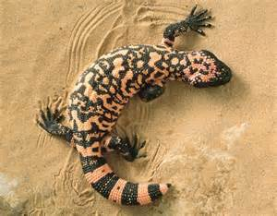
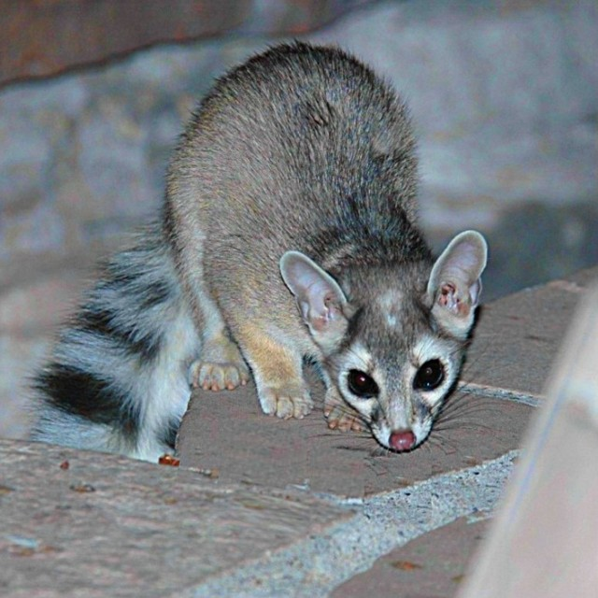
Species Assessed
Species selected based on protection status (i.e., state or federally threatened, endangered, or species of concern).
Amphibians, reptiles, birds, and mammals.
Total 48 protected species between 2006 and 2014 in RMD
Select 8-12 species for next analysis.
Don Swann
savenaturesavehuman.com
Lowland leopard frog
(Rana yavapaiensis )
Gila monster
(Heloderma suspectum )
Utah Birds
moenkopiriverworks.com
Northern goshawk
(Accipiter gentilis)
Ring-tailed cat
(Bassariscus astutus )

Slide 23
GIS Analyses
Distribution of species under current climate and land use
and
Future distribution of species with change in climate and land use

Slide 24
Species distribution in CURRENT
climate and land use
Species distribution in FUTURE climate and land use for years
2030, 2060, and 2090
Develop species vulnerability scores (SAVS)
(scores will be assigned spatially at the end)
GIS Analyses
Map species distribution (SWReGAP)
TBD Model
Land use Change 2030, 2060, 2090 (SERGoM Models)
Climate-Vegetation Change
Refine distribution by eliminating habitat areas that are impacted by roads
Reclassifiy map of species distribution into vegetation communities
using SWReGAP land cover (USGS 2005)
These are
the same output.
Assess future changes with current (reclassified) species distribution maps

Slide 25
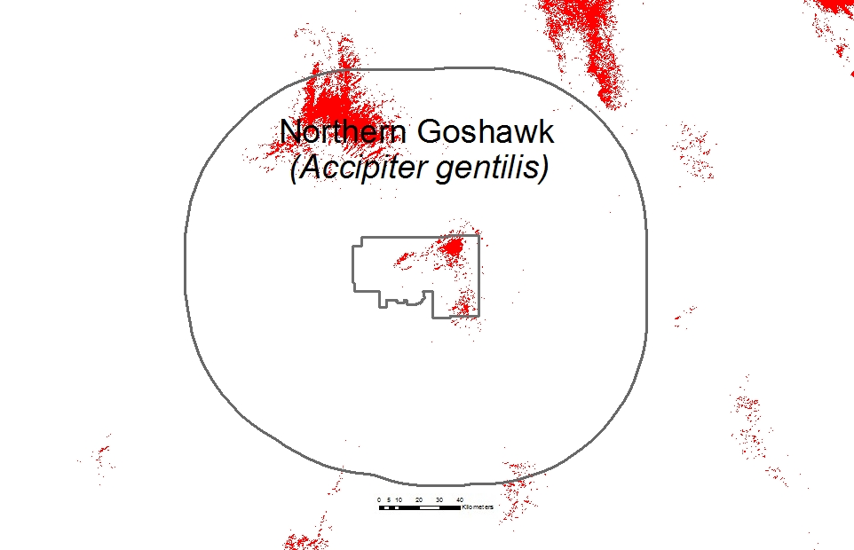
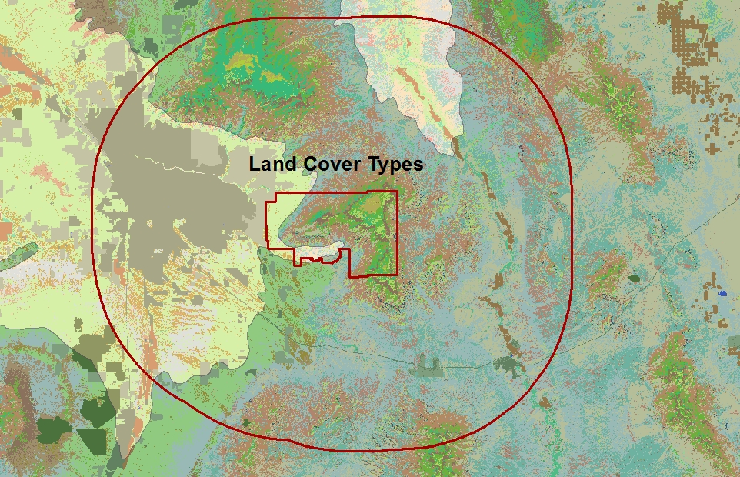
Species distribution in current climate
and land use
SWReGAP Model for Northern Goshawk
Map species distribution (SWReGAP)
Refine distribution by eliminating habitat areas that are impacted by roads
Distribution Model
Reclassify Model
Into Land Cover Types
USGS (2005) Land Cover Data
Reclassify species distribution models into current
land cover types (vegetation) using USGS (2005) land cover data
Land Cover
Types

Slide 26
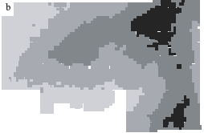
Climate-Vegetation Change Model Example
Future distribution of species based on changes in climate and land use
TBD Model
Land use Change 2030, 2060, 2090 (SERGoM Models)
Climate-Vegetation Change
Current climate
Example of current vegetation
with current climate.
Assess future changes with current species distribution maps
Future climate
Example of vegetation change
with 3 degree Celsius increase
In future.
Kupfer et al. 2005
Some species habitat areas will increase, decrease or remain unchanged based on the predictive veg-climate change model results.

Slide 27
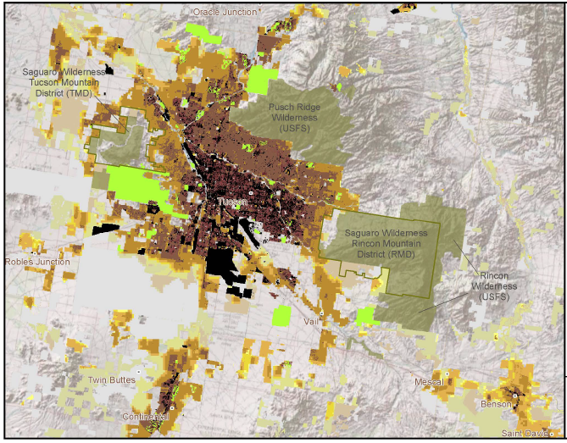
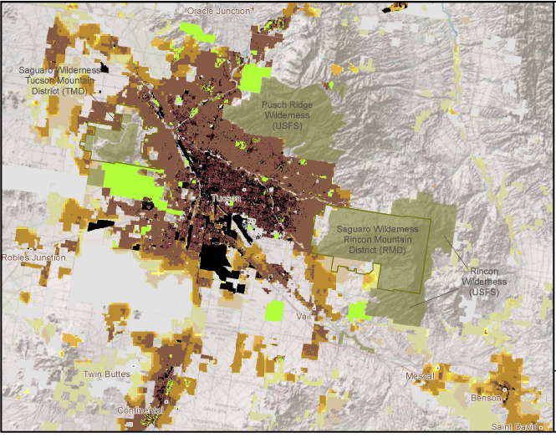
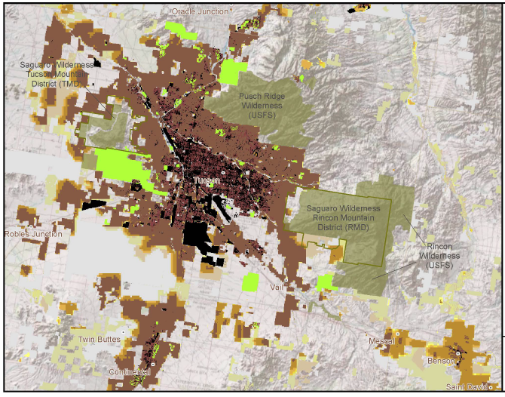
Future distribution of species based on changes in climate and land use
TBD Model
2030
Land use Change 2030, 2060, 2090 (SERGoM Models)
Climate-Vegetation Change
2060
Assess future changes with current species distribution maps
Land Use Change
2090
Monahan et al. (2013)

Slide 28
Future distribution of species based on changes in climate and land use
Current
Distribution
Map
TBD Model
Land use Change 2030, 2060, 2090 (SERGoM Models)
Climate-Vegetation Change
Example Map Only-Not an Actual Output
Assess future changes with current species distribution maps
Future
Distribution
Map (changes
shown in boxes)

Slide 29
How Can Results be Applied?
Preparing for a New Era of Change

Slide 30
Project Timeline
Develop predictive vegetation response model to climate change temperature increase – mid January 2015
Species vulnerability assessments – mid February 2015
Habitat models adjusted for roads and assigned species vulnerability scores – mid March 2015
Projected housing density change effects to habitat – end March 2015
Assessment of high priority areas – mid April 2015
Assessment of conservation areas – early May 2015
Paper or presentation to be determined – May 2015

Slide 31
References
Bagne KE, Friggens MM, Finch DM (2011) A system for assessing vulnerability of species (SAVS) to climate change. General Technical Report RMRS-GTR-257. Fort Collins, CO: U.S. Department of Agriculture, Forest Service, Rocky Mountain Research Station.
Clark, W.C. (1985) Scales of climate impacts. Climatic Change, 7, 5-27.
Coe SJ, Finch DM, Friggens MM (2011) An assessment of climate change and vulnerability of wildlife in the Sky Islands of the southwest. General Technical Report RMRS-GTR-XXX. Fort Collins, CO: U.S. Department of Agriculture, Forest Service, Rocky Mountain Research Station.
Davison, J.E., S. Coe, D. Finch, E. Rowland, M. Friggens, and L.J. Graumlich. 2011. Bringing indices of species vulnerability to climate change into geographic space: an assessment across the Coronado National Forest. Biodiversity Conservation 21: 189-204.
Kupfer, J.A., J. Balmat, and J.L. Smith. 2005. Shifts in the potential distribution of sky island plant communities in response to climate change. USDA Forest Service Proceedings RMRS-P-36. Pages 485-490.
McCormack, J.E. Huang, H. and Knowles, L.L. (2009) "Sky Islands" Encyclopedia of Islands. University of California Press: Berkeley, CA.
Monahan, W. B., J. E. Gross, L. K. Svancara, and T. Philippi. 2012. A guide to interpreting NPScape data and analyses. Natural Resource Technical Report NPS/NRSS/NRTR—2012/578. National Park Service, Fort Collins, Colorado.
Monahan, W. B., D. E. Swann, and J. A. Hubbard. 2013. Landscape dynamics of Saguaro Na­tional Park. Natural Resource Report NPS/NRSS/NRR—2013/615. National Park Service, Fort Collins, Colorado.
Monahan, W.B. and N.A. Fisichelli. 2014. Climate Exposure of US National Parks in a New Era of Change. PLoS ONE 9(7): e101302. doi:10.1371/journal.pone.0101302.
National Park Service. n.d. General Management Plan Saguaro National Park, Arizona. U.S. Department of the Interior. 403 p.
National Park Service [NPS] SODN. 2014a. Sonoran desert ecosystem. Available at http://science.nature.nps.gov/im/units/sodn/sonoran.cfm#biome (accessed August 29, 2014).
Patrick-Birdwell, C. and S. Avila-Vilegas, J. Neeley, and L. Misztal. et al. 2012. Mapping and Assessing the Environmental Impacts of Border Tactical Infrastructure in the Sky Island Region in Gottfried, Gerald J.; Ffolliott, Peter F.; Gebow, Brooke S.; Eskew, Lane G.; Collins, Loa C., comps. 2013. Merging science and management in a rapidly changing world: Biodiversity and management of the Madrean Archipelago III; 2012 May 1-5; Tucson, AZ. Proceedings. RMRS-P-67. Fort Collins, CO: U.S. Department of Agriculture, Forest Service, Rocky Mountain Research Station.

Slide 32
References
Pima County Association of Governments. n.d. Population growth. Avaialble at http://www.pagnet.org/tabid/36/default.aspx(accessed Spetember 14, 2014).
Sky Island Alliance. 2011 skyislandalliance.org (accessed November 1, 2011).
SWReGAP (2011) SWReGAP animal habitat models. Available at http://fws-nmcfwru.nmsu.edu/swregap/habitatreview/instructions.htm. (accessed October 1, 2014).
Theobald, D.M. 2005. Landscape patterns of exurban growth in the USA from 1980 to 2020. Ecology and Society 10:32. (online) http://www.ecologyandsociety.org
United States Census Bureau. 2012. Table 1: Ranking of census 2000 and projected 2030 state population and change.Available at http://www.census.gov/population/projections/data/state/projectionsagesex.html(accessed October 12, 2014).
United States Geological Survey National Gap Analysis Program. 2005. Southwest Regional GAP Analysis Project—Land Cover Descriptions. RS/GIS Laboratory, College of Natural Resources, Utah State University.
Warshall, P. 1995. The Madrean Sky Island Archipelago: A planetary overview. In: DeBano, L.H., P.F. Folliott, A. Ortega-Rubio, G. Gottfried, R.H. Hamre, and C.B. Edminster, tech. coords. Biodiversity and management of the Madrean Archipelago: The Sky Islands of south­western United States and northwestern Mexico. 1994 Sept. 19-23; Tucson, AZ. Gen. Tech. Rep. RM-GTR-264. Fort Collins, CO: U.S. Department of Agriculture, Forest Service, Rocky Mountain Forest and Range Experiment Station. 669p.
Wiens, J.A. (1989) Spatial scaling in ecology. Functional Ecology, 3, 385-397.

Slide 33
Acknowledgements
Thank you to Justine Blanford for her advisement.

Slide 34
Questions?
“We simply need that wild country available to us [and other species]
Even if we never do more than drive to its edge and look in. For it
can be a means of reassuring ourselves of our sanity as creatures.
a part of the geography of hope.” Wallace Stegner
View of Rincon Mountain
Photo Credit: Sonoran Desert NPS

