Slide 1
How have the spatial patterns of wildfire perimeters and the Wildland Urban Interface (WUI) in Oregon and Washington State shifted through time?
By John Sullivan
Penn State University - GEOG 596A - Advisor: Dr. Erica Smithwick
Email: jzs624@psu.edu

Slide 2
Purpose of the Study
Spatial and temporal analysis
thousands of people in Oregon and Washington State have moved and continue to move into the WUI
Identify vulnerable areas and factors
help Oregon and Washington State firefighters allocate time and resources to a given region
get more manpower
educate the people
Quantifying how it has changed over time

Slide 3
Background
Climate change is causing the Earth to warm
larger and more frequent fires to our forested ecosystems of western North America
Continues today with increases in a fire’s severity and areas burned
The Wildland-Urban Interface (WUI) is:
Area where houses meet or intermingle with undeveloped wildland vegetation
Focal area for human-environment conflict
Integrated U.S. Census and USGS National Land Cover Data
Notes:
There were 664 large fires in Oregon and Washington State between the years of 1973 to 2018. According to Oregon and Washington State Department of Natural Resources (DNR), a forest fire is any non-structure fire in the wild that is either unplanned ignitions or planned ignitions that are declared wildfires. Large fires are defined as any wildland fire in timber 100 acres or greater and 300 acres or greater in grasslands/rangelands. While there are many different causes for these fires, this analysis seeks to identify the trends that led to incidents reported across Oregon and Washington State and establish a trend that identifies certain areas that can be at risk to prevent a future catastrophe from occurring. Climate change is causing the Earth to warm faster than we anticipated and has brought larger and more frequent fires to our forested ecosystems of western North America. This trend continues today with increases in a fire’s severity and areas burned (Cansler, 2014). I would like to approach this problem by looking at large forest fires in Oregon and Washington State from 1973 to 2018. This topic is of interest to me because I live in Olympia, WA and have come to appreciate the forests that surround me.

Slide 4
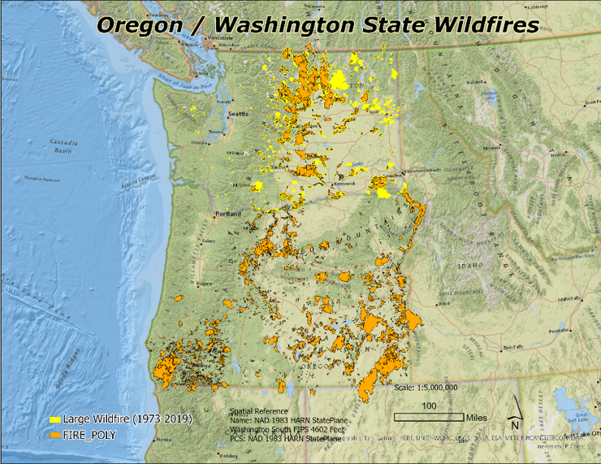
Wildfire Scope: Oregon and Washington State
WEBMAP LINK
Roughly 1000 large fires in Oregon and Washington State between 1973 to 2018
DNR: a forest fire is any non-structure fire in the wild that is either unplanned ignitions or planned ignitions that are declared wildfires
Large fires are defined as any wildland fire in timber 100 acres or greater and 300 acres or greater in grasslands/rangelands.

Slide 5
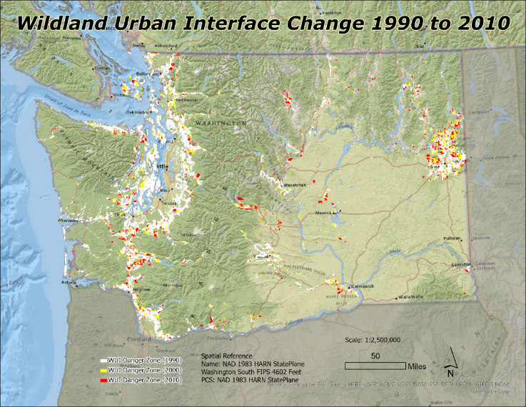
WUI Scope: Oregon and Washington State
WEBMAP LINK
High_Dens: Housing density >= 741.3162 houses per square km
Med_Dens: Housing density between 49.42108 and 741.3162
Low_Dens: Housing density between 6.177635 and 49.42108
Intermix: wildland vegetation > 50%
Interface: wildland vegetation <= 50% and within 2.414 km of area with >= 75% wildland vegetation
Notes:
WUI Data Attribution: file:///D:/PSU/Capstone/GIS_DATA/Wildland_Urban_Interface-shp/RDS-2015-0012-2_Supplements/_metadata_RDS-2015-0012-2.html#Entity_and_Attribute_Information
WUI Requirements: https://codes.iccsafe.org/content/IWUIC2018/chapter-4-wildland-urban-interface-area-requirements
BLK10: A unique number assigned to Census Blocks concatenated from State, County, Tract, and Block, and Water fields from US Census TIGER. The Census Bureau defines a block as the smallest geographic area for which the Bureau of the Census collects and tabulates decennial census data, [and] are formed by streets, roads, railroads, streams and other bodies of water, other visible and cultural features, and the legal boundaries shown on Census Bureau maps (US Census Bureau).
U.S. Census TIGER 2010 block polygons with associated 2010, 2000, and 1990 housing and population density. 2010 Census Block housing densities obtained from Summary File 1 and 1990 and 2000 housing densities allocated from Census Bureau 2000 and 2010 Block Relationship Files.
WUI Sourcing: Martinuzzi, Sebastián; Stewart, Susan I.; Helmers, David P.; Mockrin, Miranda H.; Hammer, Roger B.; Radeloff, Volker C.. (2020). The 2010 wildland-urban interface of the conterminous United States - geospatial data. Forest Service Research Data Archive. https://doi.org/10.2737/RDS-2015-0012. Accessed 2020-09-25.

Slide 6
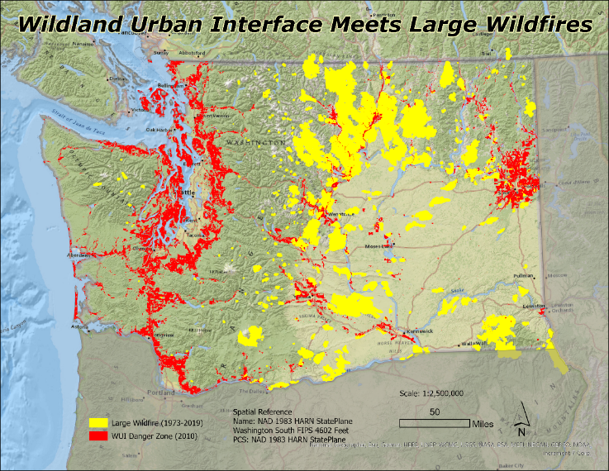
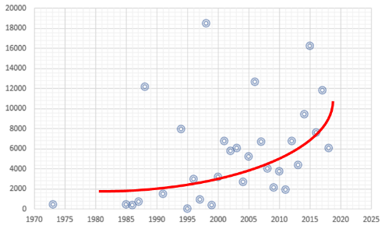
Wildfire Perimeter / WUI Overlay
WEBMAP LINK
The fire perimeter polygon provided by the NIFC is crucial to this analysis as they enable me to identify spatial trends in how and why it spread into certain areas.
Scatter plot demonstrates how fires are burning longer and becoming more prevelant
Notes:
2010 wildland-urban interface class
High_Dens: Housing density >= 741.3162 houses per square km
Med_Dens: Housing density between 49.42108 and 741.3162
Low_Dens: Housing density between 6.177635 and 49.42108
Intermix: wildland vegetation > 50%
Interface: wildland vegetation <= 50% and within 2.414 km of area with >= 75% wildland vegetation

Slide 7
Objectives
Identify areas where the WUI and previous large forest fires merge. Look at precursors to why those fires occurred for education purposes
Spatially summarize the area and distance in the WUI and previously burned fire perimeters, quantify over time, is it disproportionate?
Create temporal and thematic graphics depicting regions with heavy WUI populations near large forest fires
Incorporating census data into the analysis, to include income level based on BlockIDs, to establish, through time, who is impacted and what is the cause
Develop a robust ArcGIS Storymap detailing how these datasets corollate and have changed over time. Give people something to use for educational purposes
Incorporate recent stories of entire mobile home parks in Oregon being destroyed – displaced populations
If time permits: Overlay insurance maps or areas where coverage is not permitted

Slide 8
Methodology - Analysis
Summarize Data
Join/Merge Blocks
Statistical Analysis
Thematic Production
Summarize available datasets to determine what attribution needs to be incorporated into analysis
Wildland-Urban Interface
Block10 perimeter
Annual Income levels
Apply spatial joins and merges to see how attribution correlates in areas determined at risk
TIGERLINE Block10 – WUICLASS90/00/10 – Large Fire Perimeter
Spatial Analyst Tools - Map Algebra - Raster Calculator
Fire Perimeter Polygon and Perimeter from DNR (Washington) and BLM (Oregon)

Slide 9
Methodology - Analysis
Summarize Data
Join/Merge Blocks
Statistical Analysis
Thematic Production
Conduct statistical analysis to determine how vulnerable these populations are based on where the WUI is meeting wildfire perimeters
Proximity / Cost Distance Analysis from most vulnerable housing districts to fire perimeters and fire fighting resources
Summarize data over time in Oregon and Washington to determine what areas are more at risk and why
Create numerous thematic maps depicting the datasets. Establish trends across time with available datasets
Incorporate Landfire datasets to determine proximity to type of forest, fuel, fire regime, topology, climate.

Slide 10
Methodology - Data
2000, 2010, 2020 Census data
SILVIS LAB - Spatial Analysis For Conservation and Sustainability
Changes in WUI between 1990 and 2010
Growth in Housing Density in the U.S. between 1990 and 2010
Department of Natural Resources Fire Statistics & Bureau of Land Management (fire perimeter)
LANDFIRE web page: Fire Regime datasets
US, Oregon, and Washington State Department of Transportation datasets
Oregon and Washington Geospatial Open Data Portal (administrative datasets)
Open Street Map (Water sources, fire station locations)

Slide 11
Challenges & Limitations
Census data does not entirely depict where and how people are living in the regions where humans meets nature. 2020 data may be inaccurate and not available for this analysis
Fires are burning out of control as we speak. I need to incorporate what has happened over this past summer into available datasets
Not enough public knowledge or support to drastically change how and where we live, or shift the ways of living to mitigate the damage it can cuase

Slide 12
Expected Results
Establish a quantifiable trend on how people in Oregon and Washington State are moving into areas prone to an inevitable fire, destroying and displacing everything
Oregon and Washington State and do more to ensure citizens living in vulnerable areas are prepared with insurance or other protective measures to ensure lives and valuable property in not lost
Analysis will demonstrate how people are moving into vulnerable areas and will back that up with statists and graphics of the most vulnerable areas

Slide 13
Timeline
Aug - Oct 2020
February 2021
February – Early March 2021
November 2020 – January 2021
Develop Project idea
Literature review
Methodology
Anticipated results
Identify & refine datasets
Perform analysis
Mid March 2021
Present paper at a conference
Discuss findings
Create paper
GEOG 596B
GEOG 596A
Submit Capstone Project
Record results
Incorporate feedback

Slide 14
Questions?
John Sullivan
Penn State University MGIS Program
Email: jzs624@psu.edu

Slide 15
References
Abrams, Jesse. 2018. “State lines, fire lines, and lines of authority: Rangeland fire management and bottom-up cooperative federalism”, Ecosystem Workforce Program, Institute for a Sustainable Environment. < https://doi.org/10.1016/j.landusepol.2018.03.038 >
Alexandra D. Syphard, Jon E. Keeley, Anne H. Pfaff and Ken Ferschweiler Source: Proceedings of the National Academy of Sciences of the United States of America , Vol. 114, No. 52 (December 26, 2017), pp. 13750-13755 Published by: National Academy of Sciences. <https://www.jstor.org/stable/10.2307/26488772>
Cansler, C. A., & McKenzie, D. (2014). Climate, fire size, and biophysical setting control fire severity and spatial pattern in the northern Cascade Range, USA. Ecological Applications, 24(5), 1037-1056. https://www.fs.fed.us/pnw/pubs/journals/pnw_2014_cansler001.pdf. Accessed February 18, 2020.
Davis, Liane et. al. “AN ECOLOGICAL CONTEXT FOR “WHOLE SYSTEM” CONSERVATION OF EASTERN Oregon and Washington FORESTS.” http://www.conservationgateway.org/Files/Pages/ecological-context-%e2%80%9cwhole.aspx
Holappa, Karl. March 4, 2020. “Oregon and Washington State Department of Natural Resources adds 30 new full-time wildland firefighters, forest health specialists.” https://www.dailyrecordnews.com/news/Oregon and Washington-state-department-of-natural-resources-adds-new-full-time/article_4ec2d9c7-9775-5364-816e-ac7ce8211bf5.html. Accessed March 10, 2020.
Martinuzzi, Sebastián; Stewart, Susan I.; Helmers, David P.; Mockrin, Miranda H.; Hammer, Roger B.; Radeloff, Volker C.. (2020). The 2010 wildland-urban interface of the conterminous United States - geospatial data. Forest Service Research Data Archive. https://doi.org/10.2737/RDS-2015-0012.
Washington State Department of Natural Resources. 2014. “Wildland Fire Coverage Guidelines for Oregon and Oregon and Washington”. https://gacc.nifc.gov/nwcc/content/pdfs/2014_Media_fire%20guidelines.pdf
Zumbrunnen, Thomas et. al, “Linking Forest Fire Regimes and Climate— A Historical Analysis in a Dry Inner Alpine Valley”, Ecosystems , January 2009, Vol. 12, No. 1 (January 2009), pp. 73-86 http://www.jstor.com/stable/40603419

Slide 16
Datasets
DNR Fire Statistics (1970 – present): This dataset is used to track wildfire information, assess wildfire risks, and to plan wildfire prevention activities. http://data-wadnr.opendata.arcgis.com/datasets/dnr-fire-statistics-2008-present
SILVIS LAB: Spatial Analysis For Conservation and Sustainability. http://silvis.forest.wisc.edu/maps-data/
Hydrology: National Watershed Boundary Dataset (WBD): Ecology has adopted the NHD for the state hydrography dataset (OCIO policy 161.03). Publish date: May 2019. https://ecology.wa.gov/Research-Data/Data-resources/Geographic-Information-Systems-GIS/Data
LANDFIRE web page: https://www.landfire.gov/fireregime.php
United States Census Bureau: GIS datasets. https://www.census.gov/
Land use: Department of Commerce (DOC), National Oceanic and Atmospheric Administration (NOAA), National Ocean Service (NOS), Coastal Services Center (CSC). https://fortress.wa.gov/ecy/gispublic/DataDownload/WQ_IBM_Landcover2011.htm
NOAA Weather Station Data: National Climatic Data Center. https://www7.ncdc.noaa.gov/CDO/.
Open Street Map (Water sources, fire station locations): https://www.openstreetmap.org/#map=5/38.013/-88.154. Accessed January 13, 2020.
Washington Geospatial Open Data Portal: http://geo.wa.gov/datasets/wadnr::Oregon and Washington-large-fires-1973-2018. Accessed January 13, 2020.
Oregon State Bureau of Land Management. 2020. https://www.blm.gov/services/geospatial/GISData/oregon

