Slide 1
Introductions
GEOG 596A Peer Review
Lawrence Svien
Resource Conservationist
Natural Resources Conservation Service
Advisor – Jay Parrish Ph.D., P.G
Additional thanks to Karen Schuckman C.P., P.L.S., MGIS Instructor 497D LiDAR

Slide 2
Project Description
Determine if historical surveys of a floodplain can be replicated using modern LiDAR data. And it’s implications on characterizing the changes in the geomorphology of a river floodplain.

Slide 3
Presentation
History of Watershed
Characterization of the Watershed
Data Availability
Methodology
Anticipated Outcomes
Concerns
Similar Projects
Timeline

Slide 4
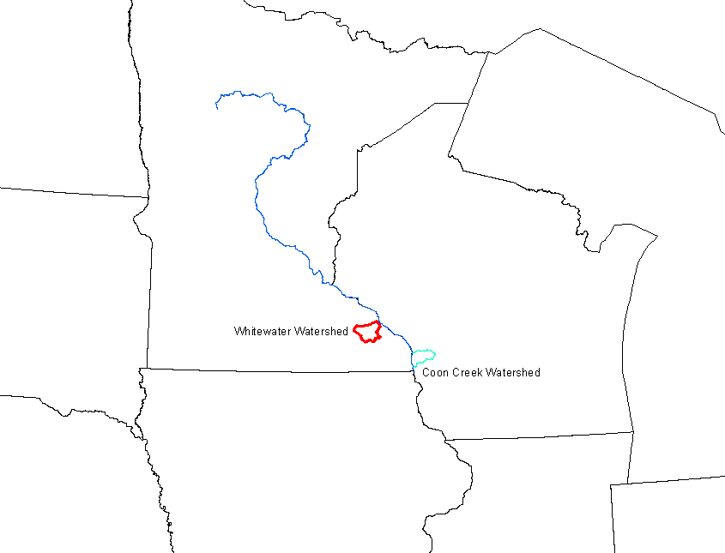
Watershed Description and Characterization
Location
SE Minnesota
Drainage area 321 Mi²
Approx 24 Mi long

Slide 5
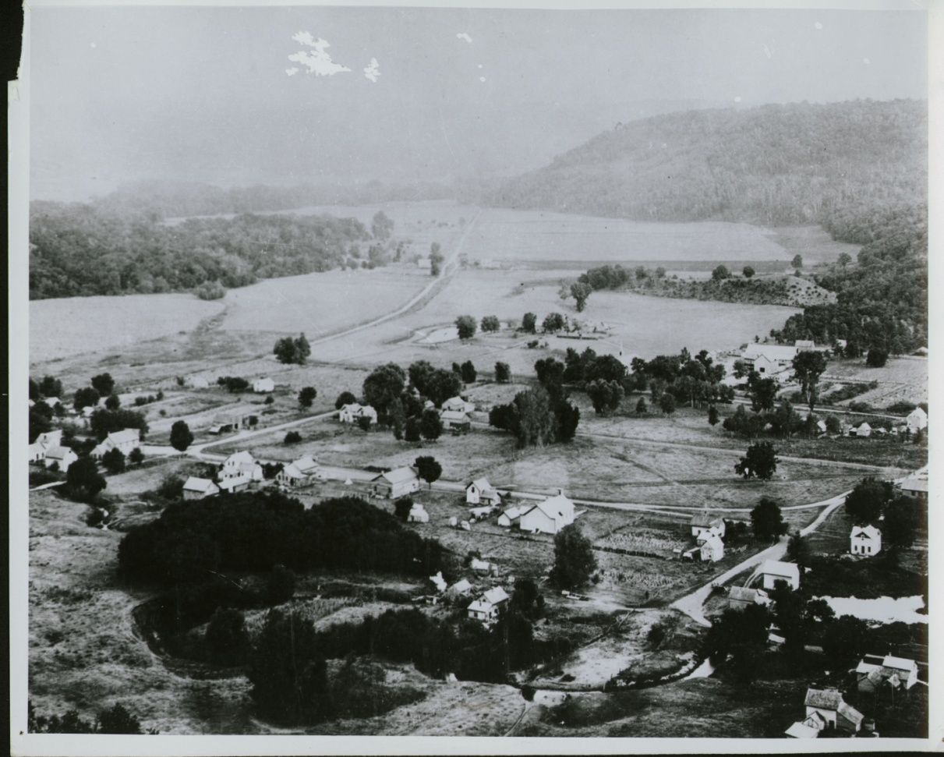
History of the Whitewater Valley
The Town of Beaver – 1880’s
Early settlement
Beaver Story
Rapid expansion of acres being farmed
Poor to no conservation practices
Clearing of hillsides for grazing livestock
Winona County Historical Society

Slide 6
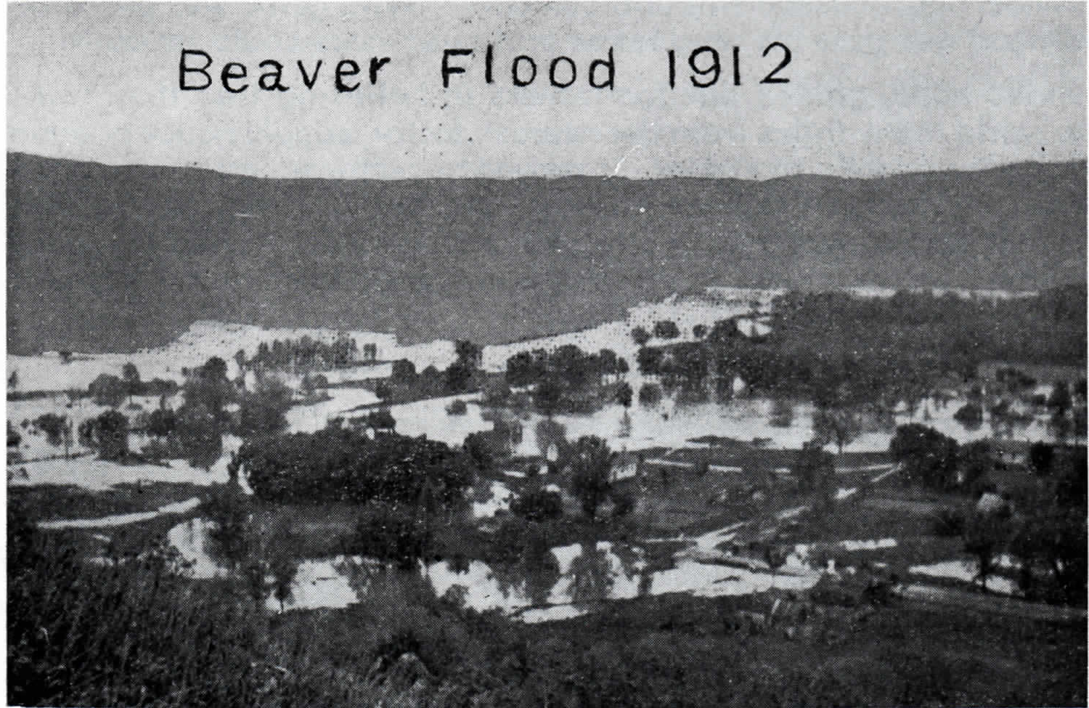
Winona County Historical Society

Slide 7
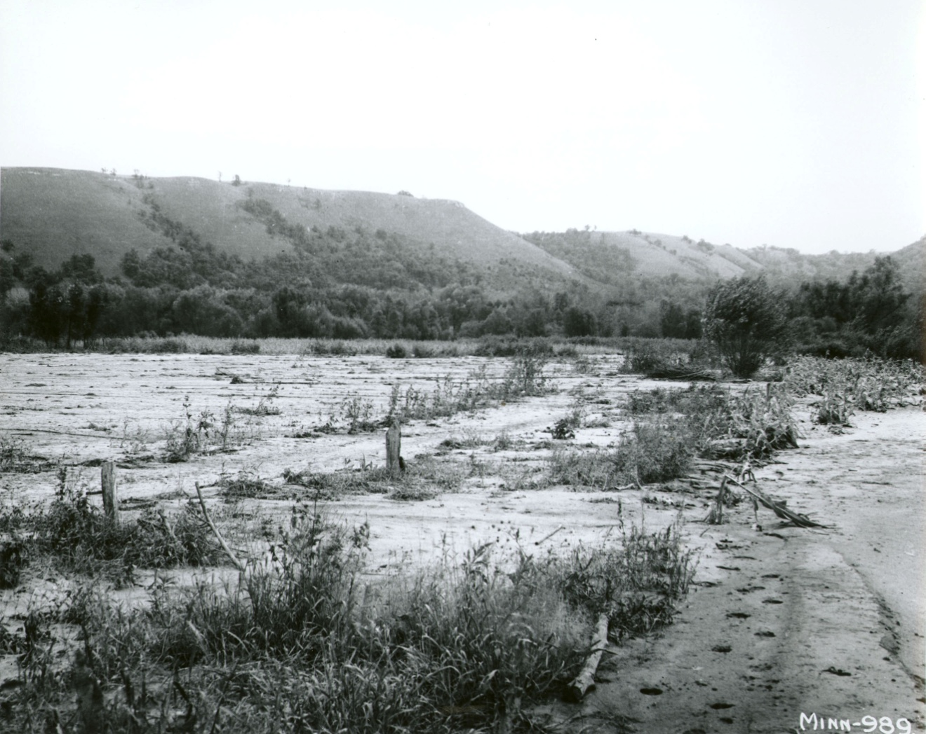
Flood Events
In 1938 Beaver and the Whitewater valley were flooded 28 times in one year
Note cleared hillsides in background
USDA Soil Conservation Service
Notes:
Bridges were washed out and had to be repeatedly rebuilt, highway ditches and culverts became perpetually clogged with sediment and debris; repair and maintenance costs were out of control.
Elba, which was one time on high ground survives now only because of dikes to keep out the flood waters.
in 1938 the Whitewater River flooded 28 times. 1931 the Izaak Walton League of Minnesota, with the support of various local organizations, petitioned the Conservation Commission to establish a game preserve in the Whitewater River Valley . In 1932 the new Department of Conservation purchased the first parcel of land.

Slide 8
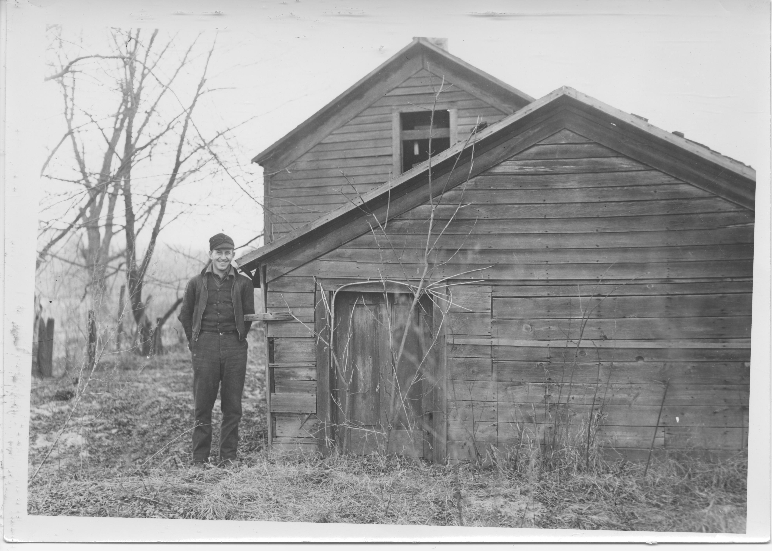
Storm Damage and Sediment
Whitewater River Project
Notes:
The farm land was no longer productive and the farmers were relieved that the State of Minnesota would buy their land, even at a loss. In 1930 workers tearing down the old barn at Crystal Springs discovered the cattle had actually been standing on the hayloft floor; the entire first story was buried under sediment.

Slide 9
Damage cont.
Whitewater River Project
Notes:
Some of the historical documents relate how a ridge top farm that was purchased for $50K in 1916 was sold to the state in 1946 for $5K. The farmer believed the frost had heaved up rocks and gravel. He did not realize that his planting corn up and down the hills led to the loss of all the top soil.
Note the man standing on the side of the gully.

Slide 10
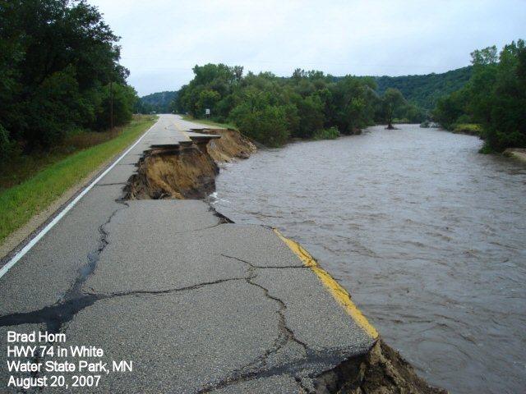
Modern Flood Events
July 1978, and again in August 2007
Both were + 15” rainfall events in less than 24 hours
Millions of $ in damage and loss of 6 lives

Slide 11
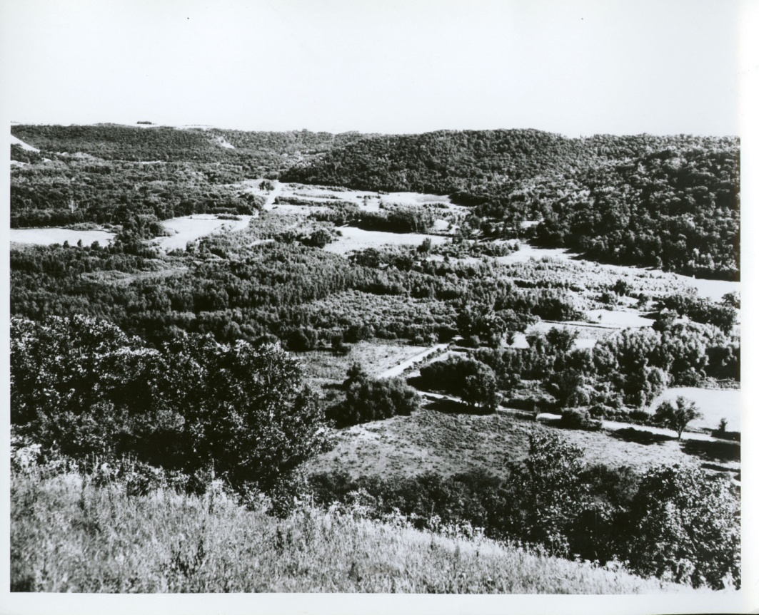
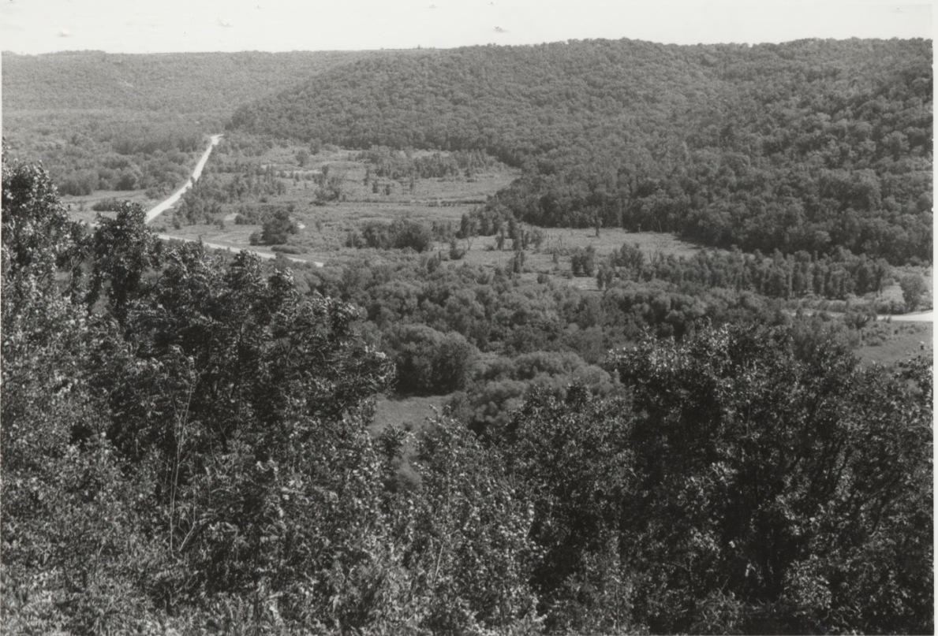
Wildlife Management Area
1980
1949
Notes:
So the state began to purchase property in the Whitewater Valley beginning in the late 30’s By 1960 most of the acquisitions had been completed
By 1980 Notice the restoration of woodland to the side slopes and the valley floor reverting back to a woodland cover. An interesting development is because of the large buildup of the valley floor with sediment the vegetation is moving away from bottomland hardwoods to a more grassland cover.

Slide 12
Vegetation
Pre-settlement
Trended from the east maple-basswood forest along the Mississippi River to the oak openings and barrens to prairie in the west
Present
The uplands plateaus are predominantly agricultural. The steep side slopes of the valley are oak dominated woodlands. The floodplains are a mixture of wetland savannah sloughs with willow and hydrophitic grasses such as reed canarygrass and sedges.
Reed canarygrass (Phalaris arundinacea L) is a tall, dense, fast growing, invasive grass that is difficult to displace once established.
Notes:
Significant loss of animal agriculture in the past 15 years. Used to be predominantly dairy but very little remains. Mostly row crop corn and soybeans. Loss of forage crops on the landscape.

Slide 13
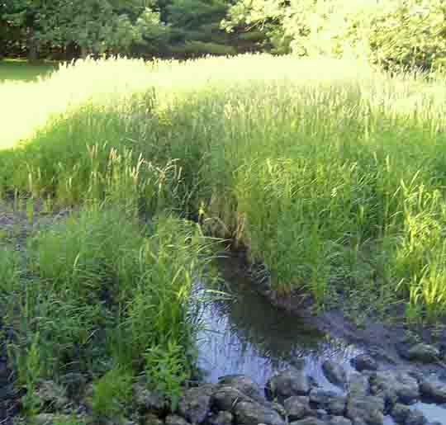
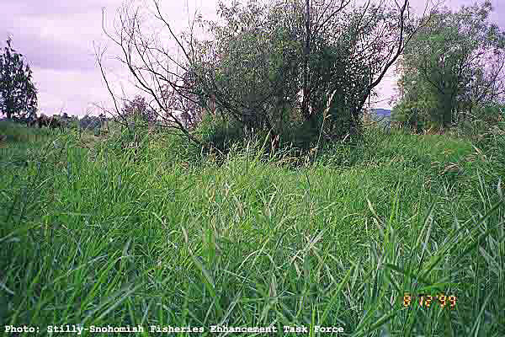
Vegetation cont.
Notes:
Examples of heavy reed canary grass stands in riparian zones. Even in senesce it continues to form a dense upright stand, difficult to walk through and see the ground.
Similar to

Slide 14
Present
Geology
A combination of layers sedimentary rock of limestone, dolomite limestone, shale and sandstone.
This area lays in the SE MN karst region
The uplands are comprised mostly of loess soils covering the rolling uplands. Loess soils by their physical nature are very erosive and are transported easily.

Slide 15
Valley Floor Buried in Sediment
In the lower portions of the valley the bottomland soils are now buried by several feet of modern sediment.
Dr. Happ’s soil boring logs indicated that in 1939 sediment layers varied in depth from 5 feet to more than 20 feet.
Notes:
Here is an example of Dr. Happs notes on soil profiles. This was done both in 1939 and 1964.

Slide 16
Data Availability
Stafford Happ x-sections 1939 & 1960
Winona SWCD PL-566 Application 1993
X-sections again surveyed
The points file of the x-section end points GPS derived survey in 2009
NRCS Geospatial Data Gateway
Watershed boundary
General shapefiles
LMIC Server
Stream centerline
AgNPS Data
Notes:
Watershed boundaries
Roads
Government boundaries
State, county, local

Slide 17
Data Availability cont.
Historical Administrative Documents
1993 PL-566 application and supporting documentation.
Survey Data 1994
Total Station surveys
PLGR data
Limits on accuracy
Notes:
GPS had become operational in 1994. so the system was not totally functional at the time.
we were using the Rockwell Military units. Single Channel receiver. Not real good in trees. Took long time to lock on. Used encrypted Y band. User didn’t wait for signal lock, moved to open location to speed up lock and took location there.

Slide 18
Historical Data
Stafford Happ x-sections 1939 & 1960
1939-1940 Hundreds of valley sedimentation ranges with permanent monuments were established, surveyed, bored, described, photographed and otherwise documented in stream basins scattered throughout the United States. Whitewater was one of them
1960 Happ revisited sites when already eligible for retirement and recovered many of the monument cross sections.
1979’s Continued the Minnesota and Wisconsin work he began early in his career at his own expense
Notes:
USDA National Sedimentation Laboratory and direct, from there, the Valley Sedimentation resurvey efforts on the Whitewater River in Minnesota, Beaver and Coon Creeks in Wisconsin, and the Yazoo River and its tributaries in Mississippi. Happ accepted the challenge and, once back in Oxford, not only directed the marginally-funded resurvey project, he performed many of the resurveys himself. Stafford worked on the Valley Sedimentation resurveys while at Oxford for the next 5 years, retiring in June of 1970 (officially). While there, he had supervised or personally made the recovery of hundreds of monumented cross sections, resurveyed them all and prepared reports on the preceding 30 years of sedimentation in the valleys. Often at his own expense, he continued the Minnesota and Wisconsin work.

Slide 19
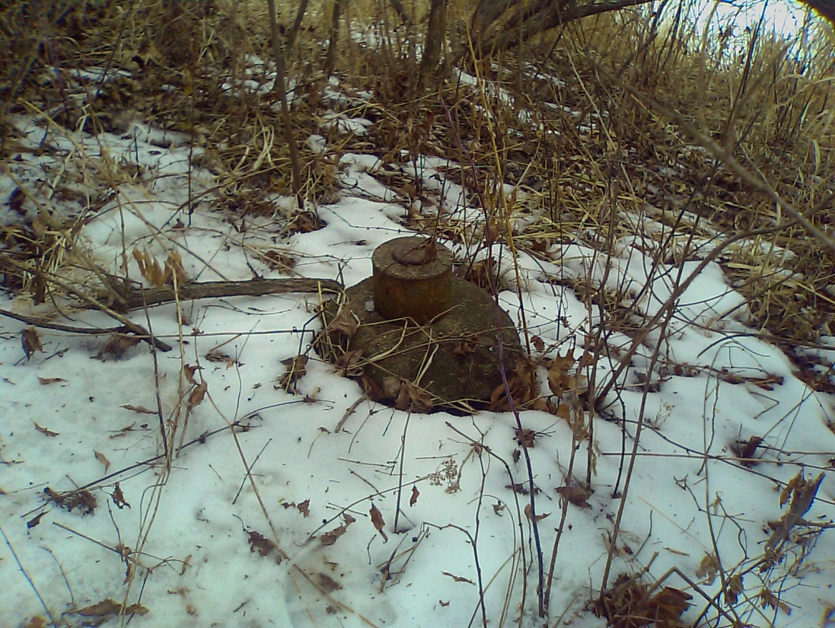
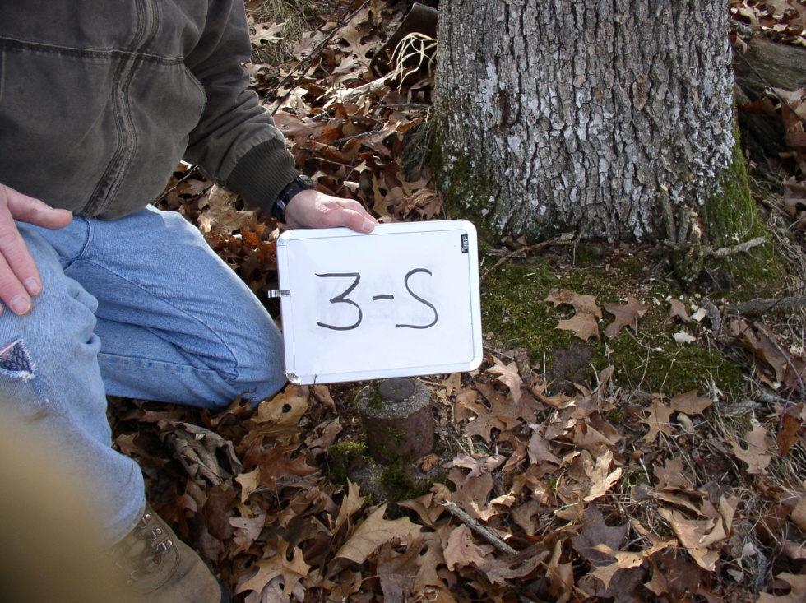
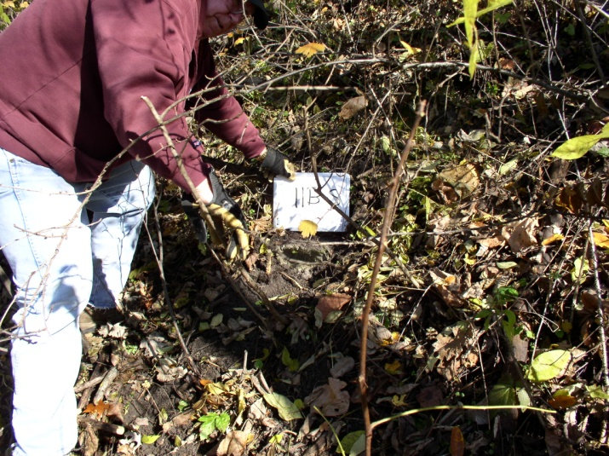
Happ Survey Data 1939, 1960
Notes:
It has been over 20 years ago since some of the monuments were located. Effort now is to locate them with Survey grade GPS or total stations and firmly establish the coordinates of them
Only one person is left from the 1992 and he came into it late.

Slide 20
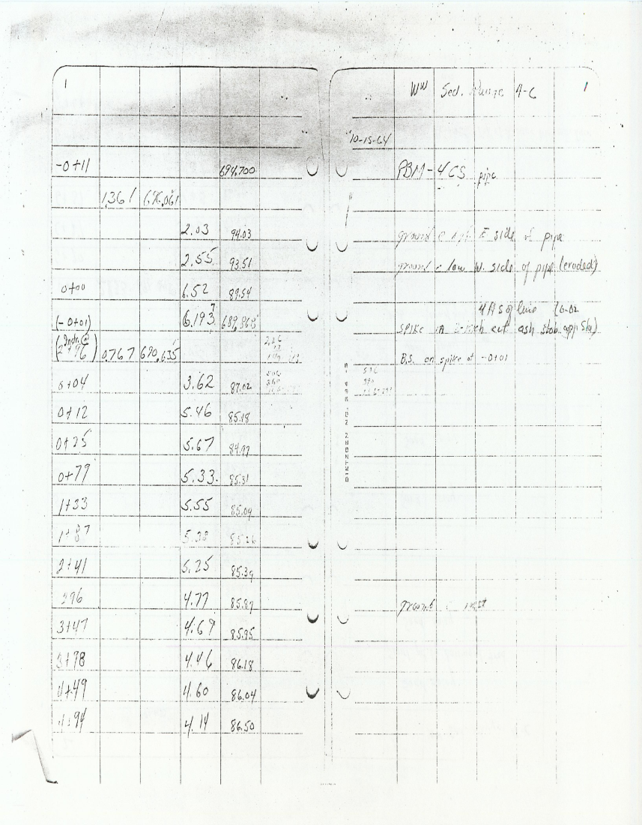
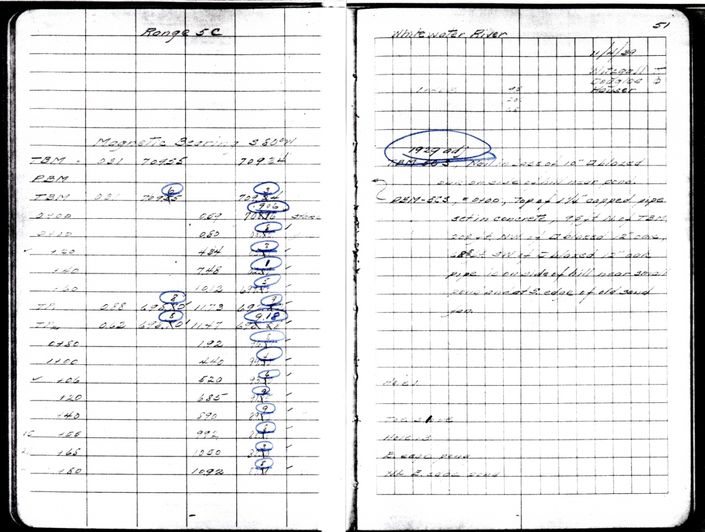
Sample Survey Notes
Notes:
Sample of notes that are archived. We have photo copies that I later scanned into PDF’s for historical purposes. Also to distribute to other people active in the WW projects.

Slide 21
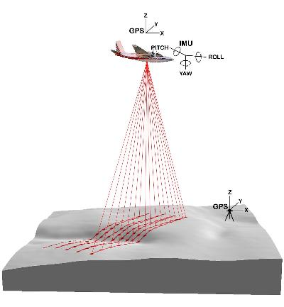
LiDAR Collect 2008
MN DNR License holder
Collected Fall 2008
November leaf off.
Deliverables
Classified LAS Points files
1 meter resolution DEM.
2 foot contours
Edge of water breaklines
Required Z accuracy 18 cm
A derived 3 meter DEM from the LIDAR data was produced after delivery in 2009
USDA Forest Service
Notes:
Because of the sever flooding in 2007 The state of MN devoted funds to collect LiDAR data in 10 SE counties to aid in the recovery effort.
MN Department of Natural Resources is the license holder and is posted in public domain of DNR server and linked by the Minnesota Geospatial Information Office
A contract was awarded to Aerometric, Inc. and data collection was conducted in November 2008. Data started flowing in to the DNR for QA/QC starting in April 2009. Products delivered included one-meter resolution DEMs, two-foot contours, edge-of-water breaklines and LAS points. Required vertical accuracy was 18 centimeters (a bit more than 7 inches) as measured using methodologies outlined by the National Standard for Spatial Data Accuracy (NSSDA).

Slide 22
ASPRS/NSSDA Accuracy ranges
Assessed Accuracy
4 returns/pulse
RMSE 0.106m – 0.161m
ASPRS/NSSDA Accuracy(z) (95% CI): ± 0.207-0.315
.88 - .99 points/m²
Flightline Overlap 200 – 220 meters
Notes:
ASPRS/NSSDA (American Society of Photogrammetry and Remote Sensing/National Standard for Spatial Data Accuracy) Accuracy(z) = 1.9600*RMSE(z) (Normally Distributed Error)
ASPRS has developed the LAS standard for LiDAR data files
FEMA also has a standard for LiDAR data files that recognizes Sawgrass which I believe that reed canary grass acts much like sawgrass.

Slide 23
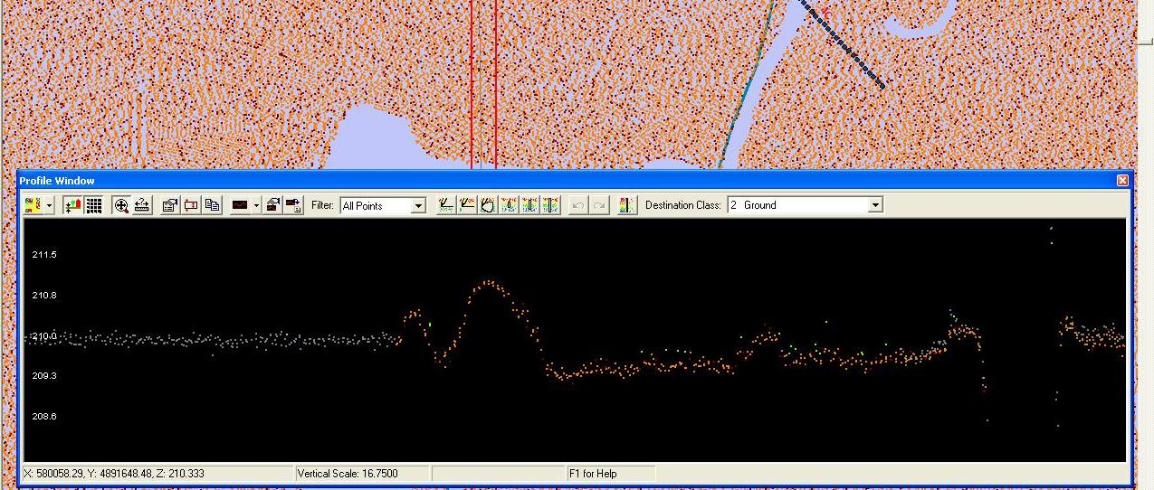
Methodology

Slide 24
Transpose Historical data into Excel
Year1939 | Point1939 | Z1939 | X1939 | Sta1939 | Year1964 | Point1964 | Z1964 | X1964 | Sta1964 | Year1994 | Point1994 | Z1994 | X1994 | Sta1994
Range 4C | 1 | 690.3 | 0 | 23200 | Range 4C | 1 | 694.0 | -11 | 23200 | Range 4C | 1 | 694.2 | -10.8 | 23200
 | 2 | 685.1 | 12 | 23200 |  | 2 | 693.5 | -10.9 | 23200 |  | 2 | 685.6 | 12.4 | 23200
 | 3 | 685.1 | 20 | 23200 |  | 3 | 689.5 | 0 | 23200 |  | 3 | 685.6 | 193.4 | 23200
 | 4 | 685.1 | 38 | 23200 |  | 4 | 687.0 | 4 | 23200 |  | 4 | 685.9 | 247.4 | 23200
 | 5 | 685.1 | 40 | 23200 |  | 5 | 685.2 | 12 | 23200 |  | 5 | 686.3 | 309.9 | 23200
 | 6 | 685.2 | 60 | 23200 |  | 6 | 685.0 | 25 | 23200 |  | 6 | 686.3 | 371.9 | 23200
 | 7 | 685.2 | 80 | 23200 |  | 7 | 685.3 | 79 | 23200 |  | 7 | 686.6 | 454.7 | 23200
 | 8 | 685.2 | 90 | 23200 |  | 8 | 685.1 | 133 | 23200 |  | 8 | 685.4 | 465.4 | 23200
 | 9 | 685.3 | 100 | 23200 |  | 9 | 685.3 | 187 | 23200 |  | 9 | 686.8 | 502.0 | 23200
 | 10 | 685.3 | 120 | 23200 |  | 10 | 685.4 | 241 | 23200 |  | 10 | 686.9 | 556.2 | 23200
 | 11 | 685.3 | 140 | 23200 |  | 11 | 685.9 | 296 | 23200 |  | 11 | 687.6 | 617.7 | 23200
 | 12 | 685.3 | 160 | 23200 |  | 12 | 686.0 | 347 | 23200 |  | 12 | 681.6 | 626.3 | 23200
 | 13 | 685.2 | 187 | 23200 |  | 13 | 686.2 | 398 | 23200 |  | 13 | 680.3 | 629.2 | 23200
 | 14 | 685.2 | 200 | 23200 |  | 14 | 686.0 | 449 | 23200 |  | 14 | 680.4 | 629.8 | 23200
 | 15 | 685.3 | 220 | 23200 |  | 15 | 686.5 | 494 | 23200 |  | 15 | 677.9 | 630.9 | 23200
 | 16 | 685.2 | 240 | 23200 |  | 16 | 687.2 | 498 | 23200 |  | 16 | 677.6 | 641.9 | 23200
 | 17 | 685.5 | 260 | 23200 |  | 17 | 686.2 | 510 | 23200 |  | 17 | 677.9 | 661.2 | 23200
 | 18 | 685.6 | 280 | 23200 |  | 18 | 687.6 | 526 | 23200 |  | 18 | 679.2 | 676.5 | 23200
 | 19 | 685.7 | 290 | 23200 |  | 19 | 686.3 | 532 | 23200 |  | 19 | 680.4 | 689.2 | 23200
 | 20 | 685.8 | 300 | 23200 |  | 20 | 686.5 | 536 | 23200 |  | 20 | 679.7 | 689.5 | 23200
 | 21 | 685.7 | 320 | 23200 |  | 21 | 686.0 | 539 | 23200 |  | 21 | 685.0 | 699.5 | 23200
 | 22 | 686.0 | 340 | 23200 |  | 22 | 687.0 | 552 | 23200 |  | 22 | 684.8 | 724.3 | 23200
 | 23 | 686.1 | 360 | 23200 |  | 23 | 686.2 | 564 | 23200 |  | 23 | 683.2 | 745.7 | 23200
 | 24 | 686.1 | 380 | 23200 |  | 24 | 687.3 | 576 | 23200 |  | 24 | 687.7 | 759.3 | 23200
 | 25 | 686.1 | 390 | 23200 |  | 25 | 687.5 | 587 | 23200 |  | 25 | 687.0 | 796.0 | 23200
 | 26 | 686.1 | 400 | 23200 |  | 26 | 687.1 | 593 | 23200 |  | 26 | 686.0 | 856.0 | 23200
 | 27 | 686.2 | 420 | 23200 |  | 27 | 688.2 | 602 | 23200 |  | 27 | 685.5 | 1005.8 | 23200
 | 28 | 686.3 | 440 | 23200 |  | 28 | 687.4 | 620 | 23200 |  | 28 | 684.9 | 1018.7 | 23200
 | 29 | 685.7 | 460 | 23200 |  | 29 | 687.5 | 627 | 23200 |  | 29 | 685.4 | 1078.4 | 23200
 | 30 | 685.2 | 469 | 23200 |  | 30 | 687.0 | 637 | 23200 |  | 30 | 684.8 | 1145.2 | 23200
 | 31 | 685.8 | 475 | 23200 |  | 31 | 687.5 | 647 | 23200 |  | 31 | 685.1 | 1160.1 | 23200
 | 32 | 686.0 | 480 | 23200 |  | 32 | 687.8 | 660 | 23200 |  | 32 | 685.2 | 1221.6 | 23200
 | 33 | 686.1 | 500 | 23200 |  | 33 | 680.1 | 666 | 23200 |  | 33 | 685.2 | 1288.4 | 23200
 | 34 | 686.3 | 520 | 23200 |  | 34 | 676.6 | 677 | 23200 |  | 34 | 684.7 | 1346.9 | 23200
 | 35 | 685.9 | 540 | 23200 |  | 35 | 676.0 | 679 | 23200 |  | 35 | 685.0 | 1389.9 | 23200
 | 36 | 685.7 | 560 | 23200 |  | 36 | 675.9 | 685 | 23200 |  | 36 | 683.8 | 1397.2 | 23200
 | 37 | 686.4 | 583 | 23200 |  | 37 | 675.6 | 689 | 23200 |  | 37 | 683.9 | 1405.9 | 23200
Notes:
What I have is scanned copies of the photocopies of the 39 survey notes. Some are not quite legible. Don’t know where original are.
Also the 1994 data was recorded in International Feet so all coordinates in x y and z have to be converted.

Slide 25
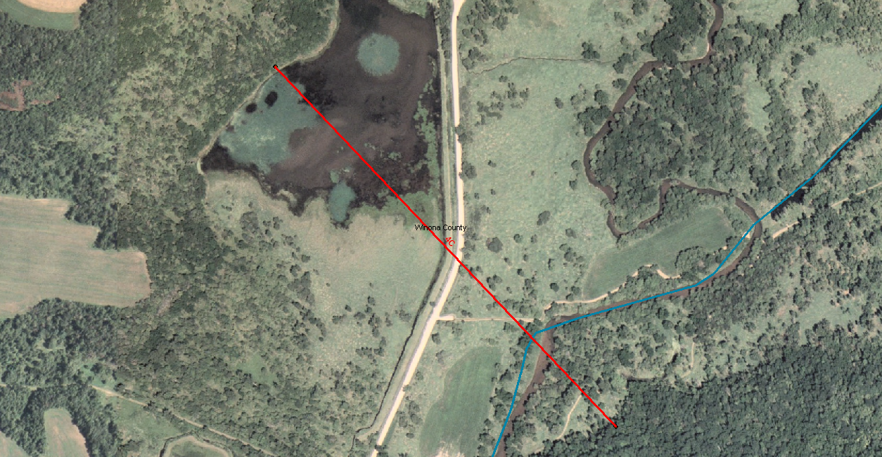
Create X-section lines
Notes:
Create the x-section lines from the endpoints

Slide 26
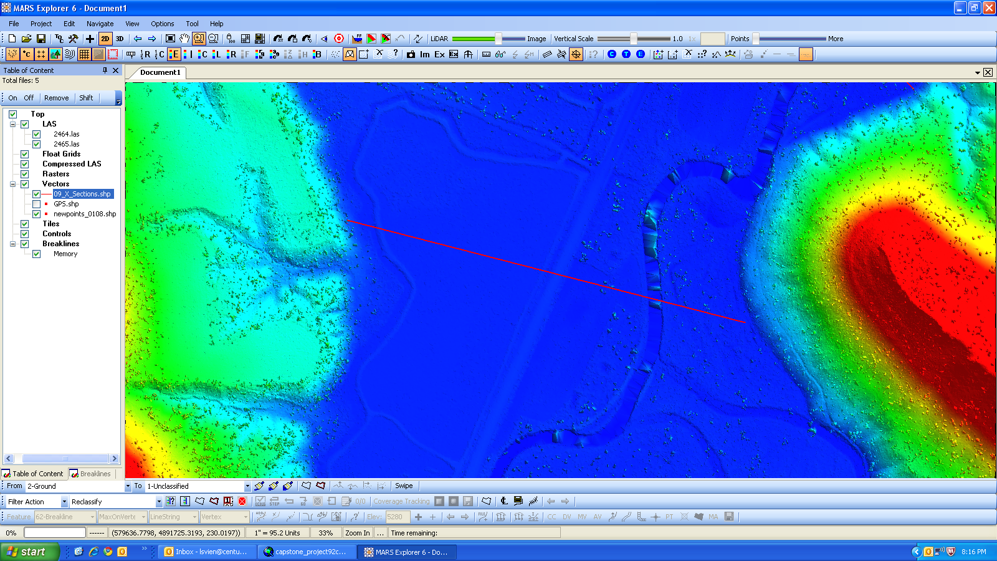
MARS Explorer
Notes:
MARS Explorer – MerricK and Company
LIDAR points within LAS files can also be exported to new LAS files. This is useful when isolating a smaller dataset from a large dataset for an analysis project, or tiling raw flight line data in preparation for a LIDAR project. LIDAR points from many LAS files can also be consolidated into larger LAS files

Slide 27
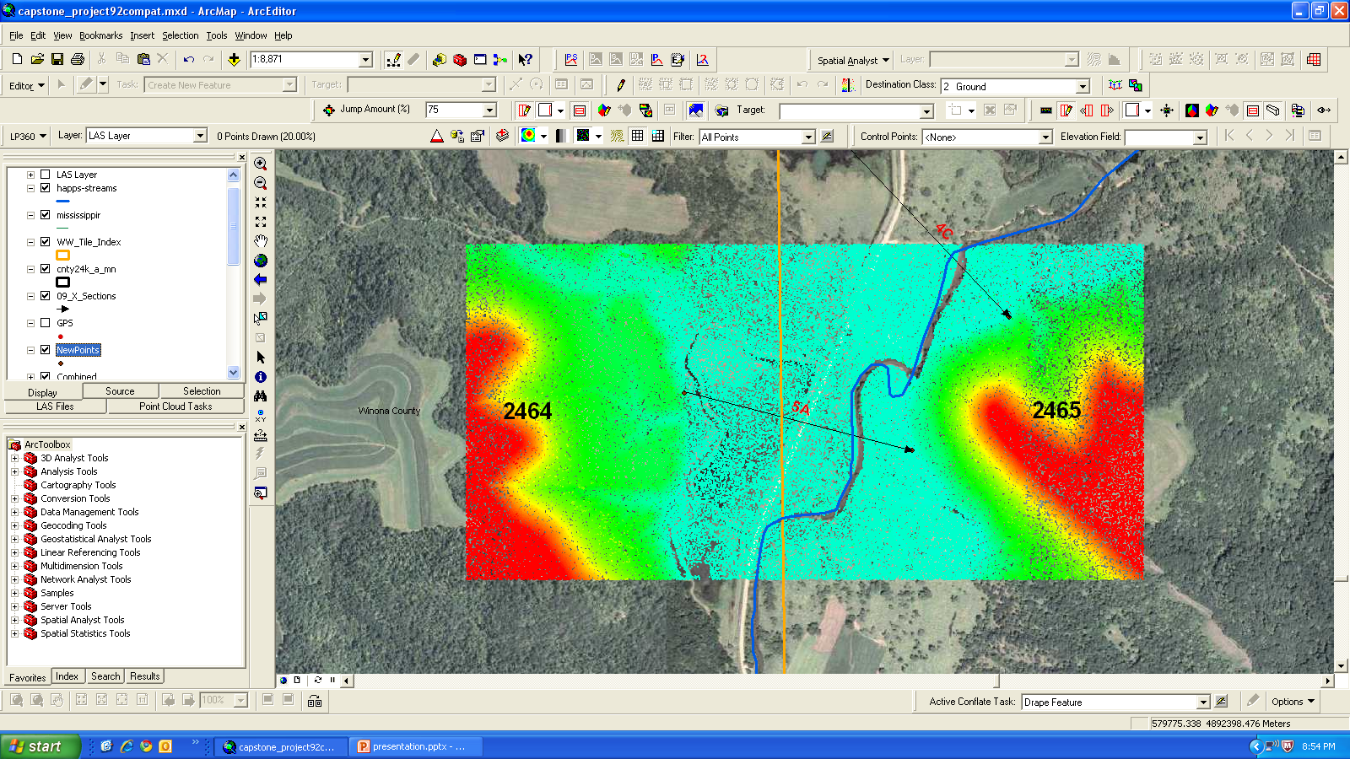
LP360
Notes:
LP360 – Qcoherent
LP 360 is a software package add-on to ArcMap. Licensed but very powerful and can do many LiDAR manipulation tasks.
Merge las point files and cut them down to manageable size. Here I merged two las tiles as seen in the orange boundary and then exported only the extent that I need for that x-section.

Slide 28
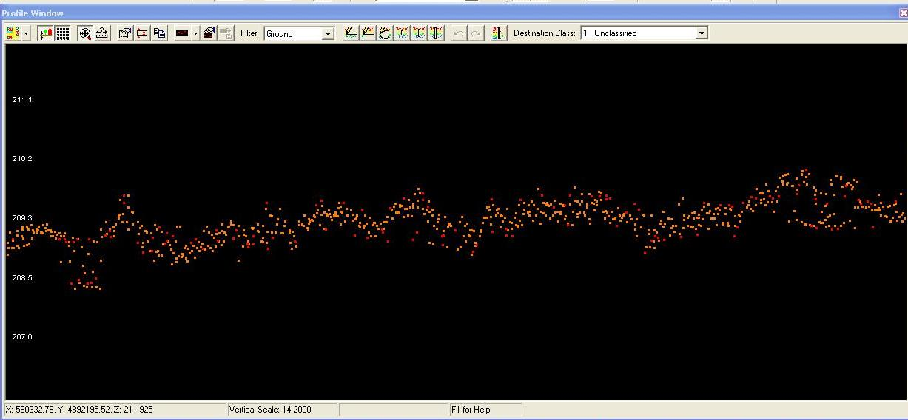
Re-classify LiDAR points along centerline
Notes:
Because of the heavy vegetation in the flood plain especially in the lower main branch I intend to re-classify the LiDAR point cloud along the cross section lines.
Here are the points along one of the x-section lines and 5 meters on each side of the line

Slide 29
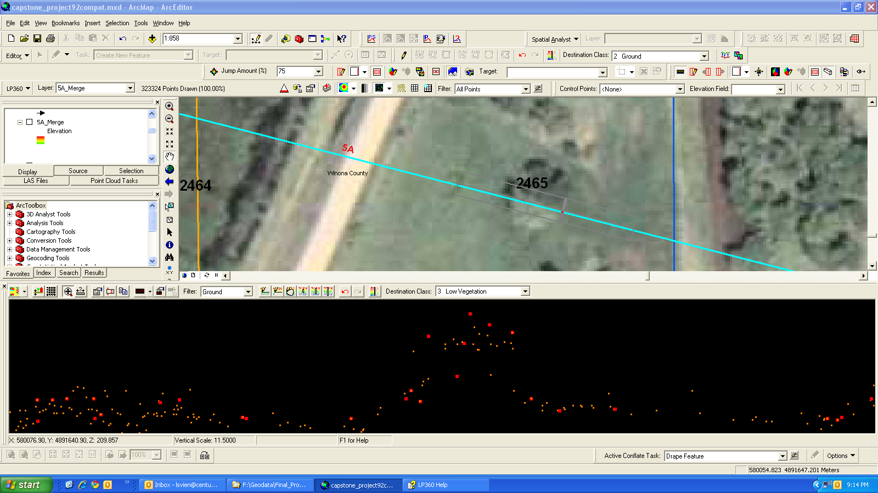
Vegetation Challenges
Notes:
The bold red dots are keypoints for ground and other ground points. You can see that the vertical is widely spread and needs to be reclassified. The clump of trees in the 2465 shows in the middle of the screen.

Slide 30
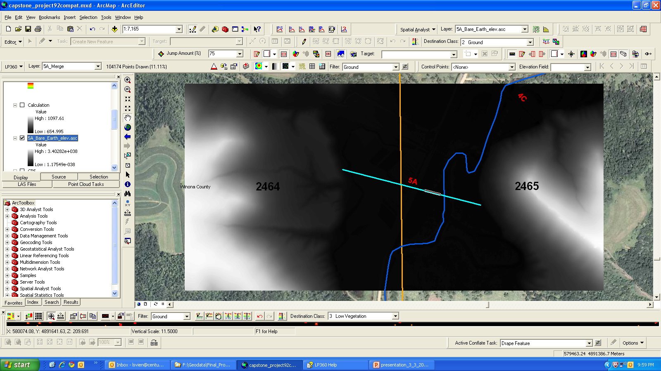
ARCMap Spatial Analysis Raster Creation
Notes:
Conversion of LiDAR point cloud to ASCI grid. 1 meter cells. This is where joining and clipping the LiDAR cloud down pays off in processor time.
Inverse distance weighting was used to create the raster.
Need to convert from meters in Elevation to feet.

Slide 31
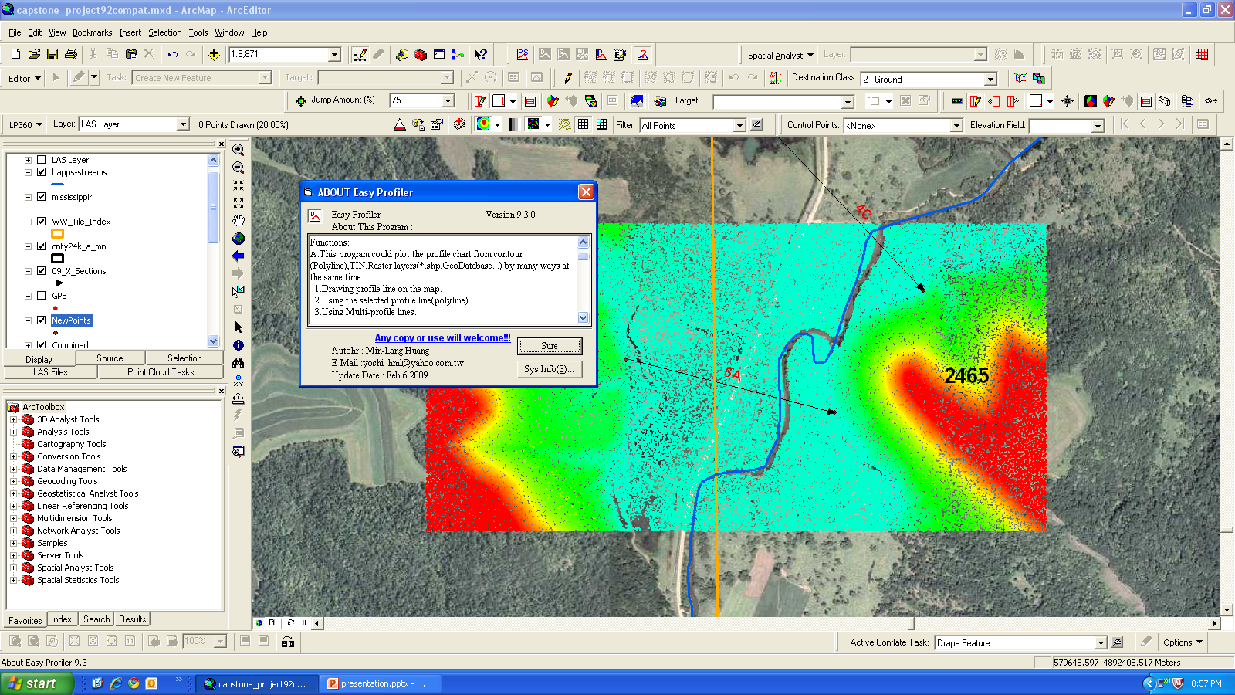
EZ Profiler
Notes:
EZ profiler is used to create a series of points along the cross section line. Output can be sent to excel spreadsheet to graphing program or AutoCAD.

Slide 32
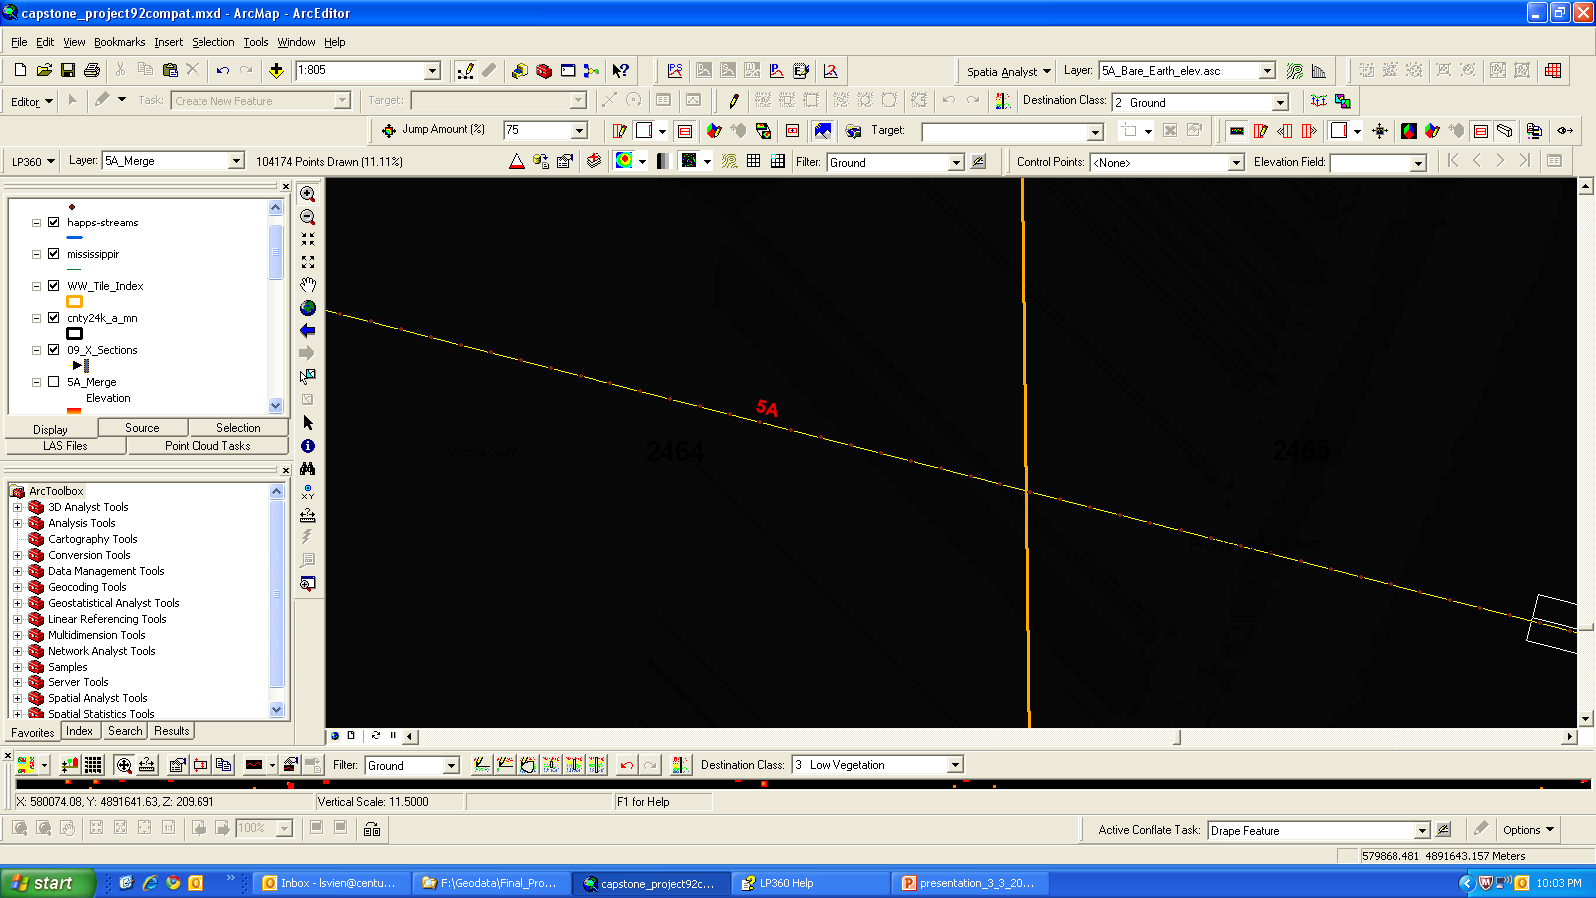
EZ Profiler
Notes:
Probably a little difficult to see the points.
EZ Profiler has placed a series of evenly spaced points along the line and calculated the Z value from the DEM at that point.
Can do evenly spaced distance or number of points along a line.

Slide 33
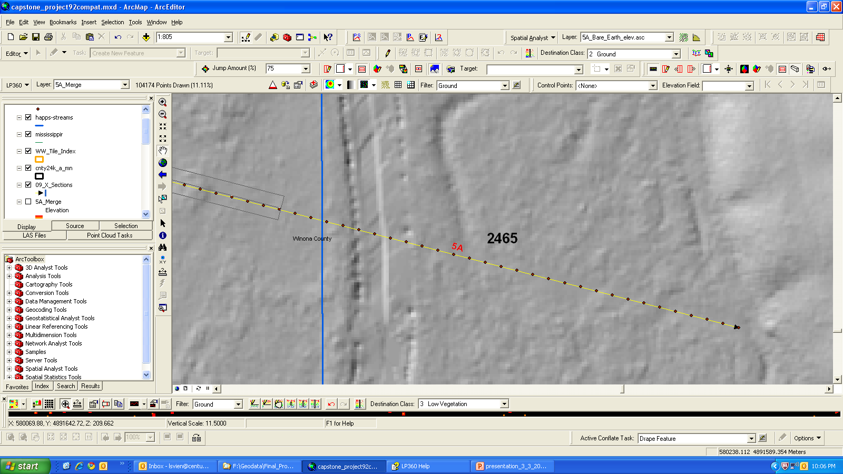
DEM Hillshade
Notes:
Hillshade of DEM. Smoother along line where manual reclassification has been done.
Note the points along the line by EZ Profiler.

Slide 34
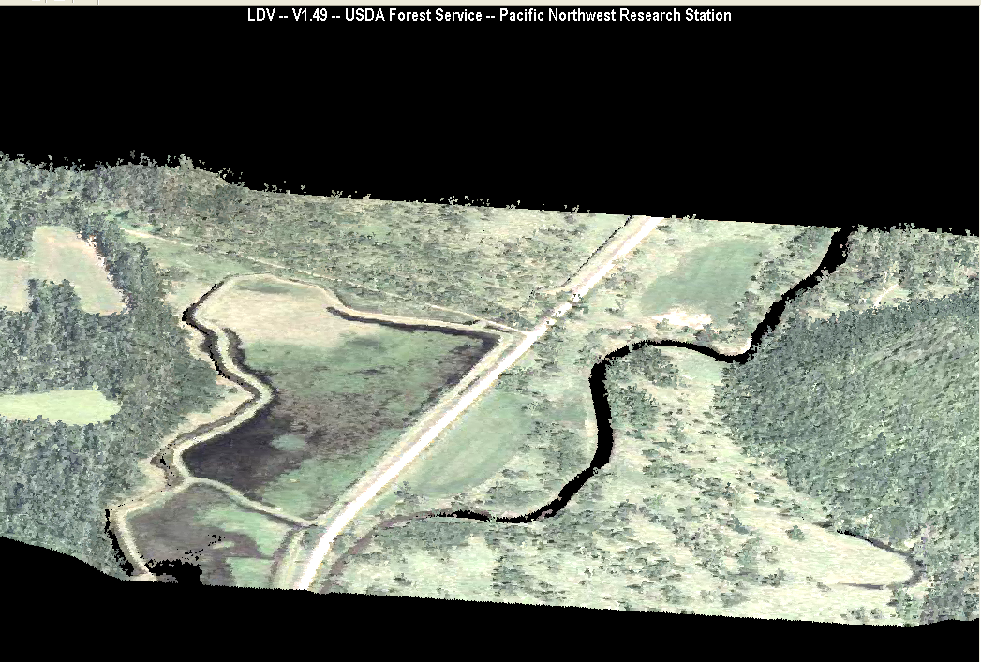
Fusion for Visualization
Notes:
Fusion can be a good tool for visualization. Here is the 2010 NAIP flight used to color the point cloud. It is not a solid surface but each point in the LiDAR cloud colored by the photo at that point and elevation. Trees actually stand out as individual trees in the photo.

Slide 35
Outcomes
Comparison at each x-section of the elevation for each time epoch in the study.
Calculation of volumetric differences between epochs for each x-section
Create a surface of the valley floor for each epoch and compare the differences between them

Slide 36
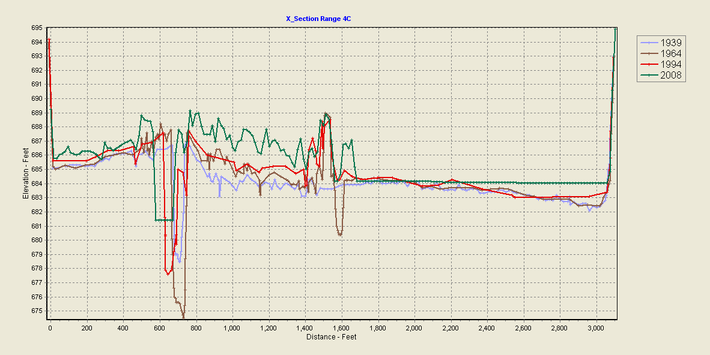
Comparison of data at X-section 4C

Slide 37
Alternative method w/o LiDAR
Manual method employed in the past
Better accuracy
Expensive
3 people – 6 months
Time consuming

Slide 38
Concerns
Workload and weather restricting the completion of locating and registration of endpoints
Lack of vertical control points in WW valley
GPS VRS reception limited in upper reaches
Difficult getting QA ground shots along x-sections
Retirement of only remaining 1992 survey party member looming

Slide 39
Similar Projects
Platte River Riparian Corridor
USGS
USDI USWS
John Day River Oregon
USFS
Analysis of LiDAR Data for Fluvial Geomorphic Change Detection
Vincent J. Gardina
Notes:
There are studies of multiple LiDAR surveys of a river basin to detect change and characterize the river valley. But I have not found a study that attempted to use historical survey data and LiDAR. Will it return the same results or is it really mixing apples and oranges?

Slide 40
Project TimeLine
Transpose historical data – April 2011
Complete manual re-classification of LiDAR data May 2011
Complete acquisition of survey data – May 2011
Complete project June 2011
Present to the ISPRS Workshop on Laser Scanning 2011 August 2011 Calgary, Alberta, Canada
Notes:
If we don’t get the acquisition of Survey data by may it’s not going to be done. The vegetation will close over and finding the monuments is going to be signficantly harder. No time at work. Retirement of memeber

Slide 41
Questions????????
Lower Whitewater Valley. Photo courtesy of Whitewater River Project

