Slide 1
Modeling Sanitary Sewer Overflows
Binary Logistic Regression Analysis of the Beaver Ruin Sewer Basin
Eric Swett
Penn State MGIS Program
Advisor: Fritz Kessler
Geog 596B, Fall 2020
Notes:
Good afternoon to east coasters and good morning to west coasters
Introduce yourself!
Thank Fritz

Slide 2
Overview
Introduction
Background
Purpose
Previous Research
Methodology
Results
Next Steps

Slide 3
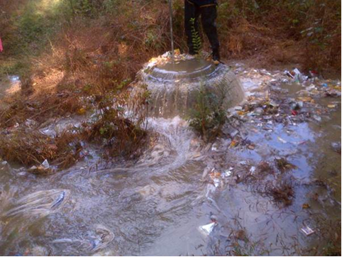
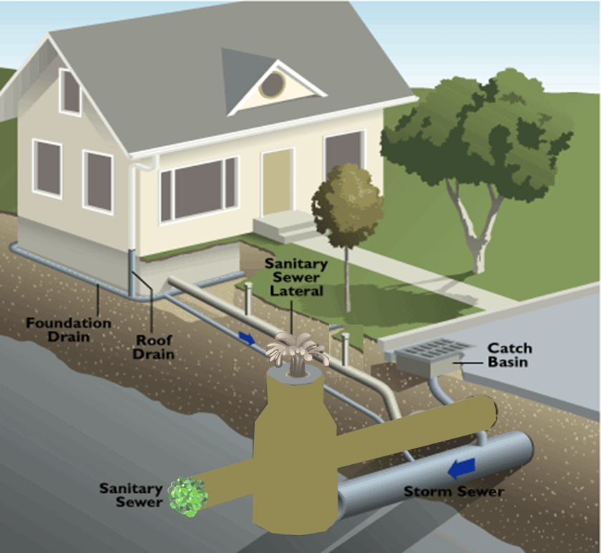
Introduction
What is a Sanitary Sewer Overflow (SSO)?
Notes:
American Water Works Association defines a SSO- As a discharge from a sewer through a manhole, cleanout, pumping facility, customer floor drain, or the drain in a fixture, if that discharge is related to limitations or problems with collection or treatment system components under control of the utility.
ADD Photo fro SSO

Slide 4
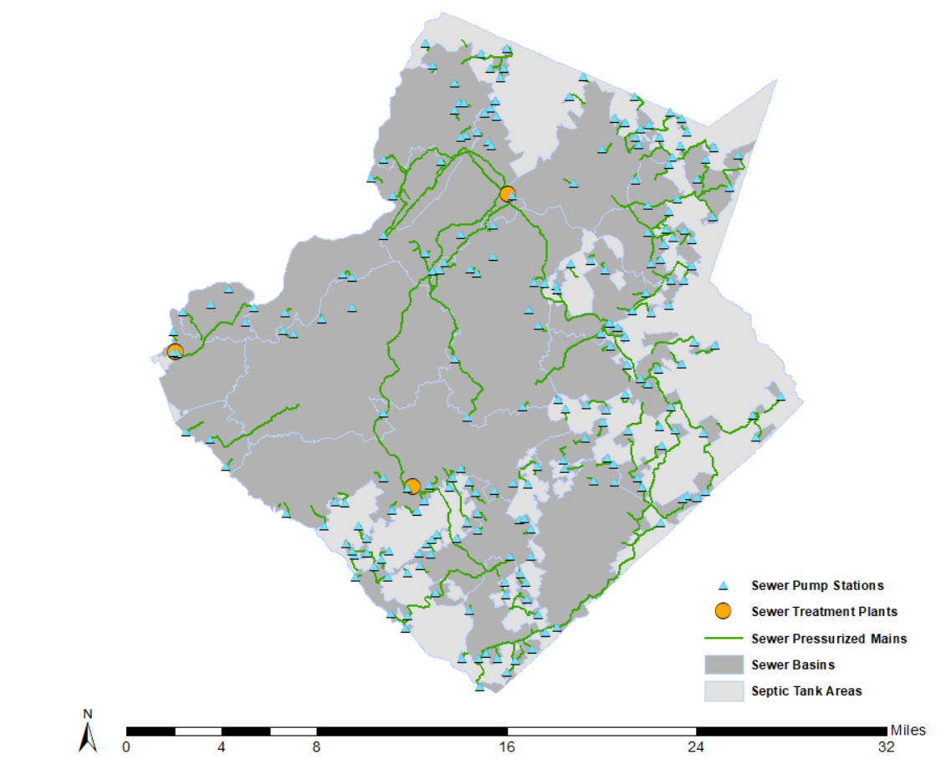
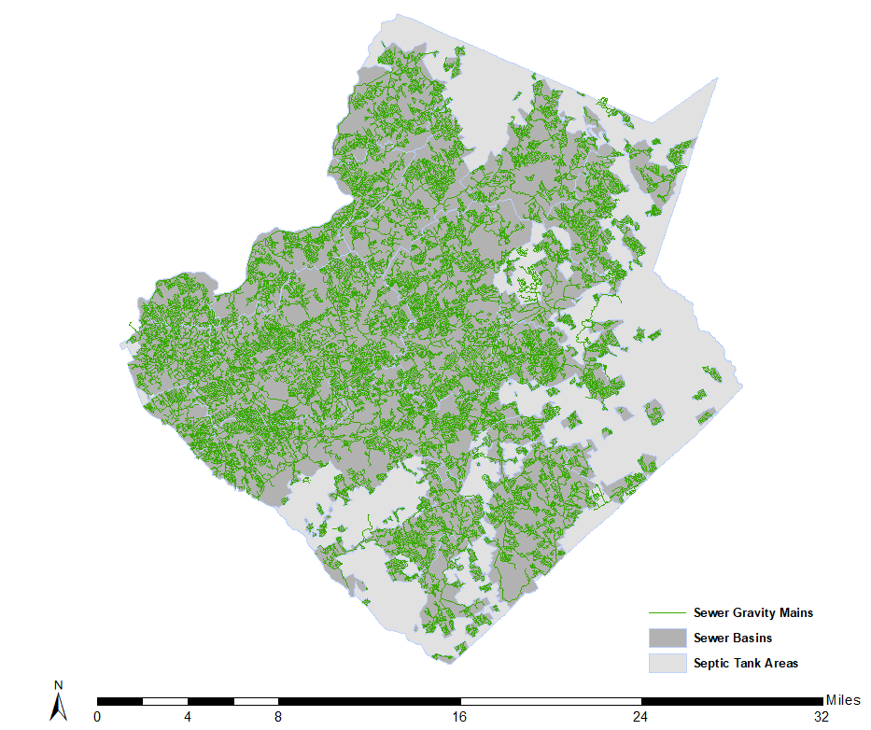
Introduction
437 square miles
2nd most populous county
936,250 residents
178,505 sewer accounts
3,140 miles of sewer pipe
82,913 structures
219 Pump Stations
3 Water Reclamation facilities
58 million gallons of wastewater treaded per day

Slide 5
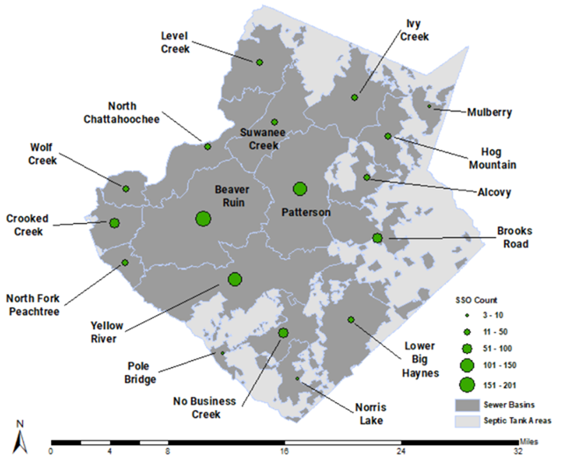
Project Background
Which basins…
are most likely to experience an overflow?
should be the focus for maintenance?
Currently, proactive maintenance is targeted based on pipe material
Notes:
The sewer system is divided into 18 large sewer basins. The map shows that SSO events are not evenly distributed around the county, with some basins having as few as 3 and others having as many has 201, so…

Slide 6
Purpose
Data exploration exercise to determine the relationship between the occurrence of SSO and a number of independent factors
Single out which independent factors contribute the most to SSO
Map location of factors and focus maintenance in these areas
Notes:
Add a slide showing two different extents of Beaver Ruin

Slide 7
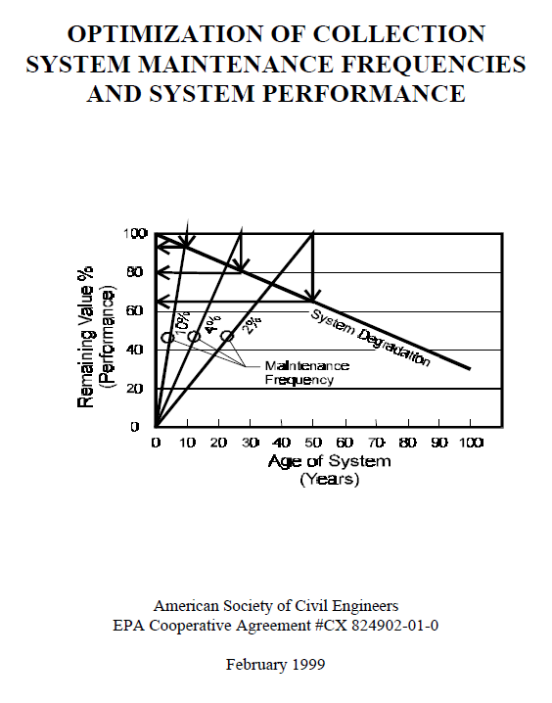
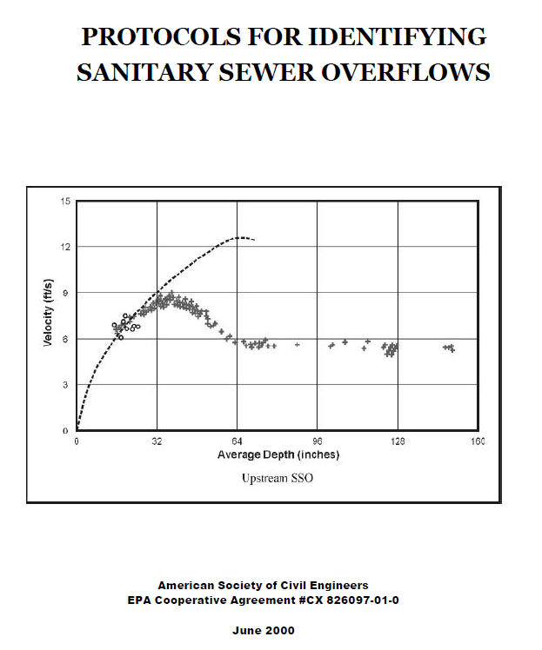
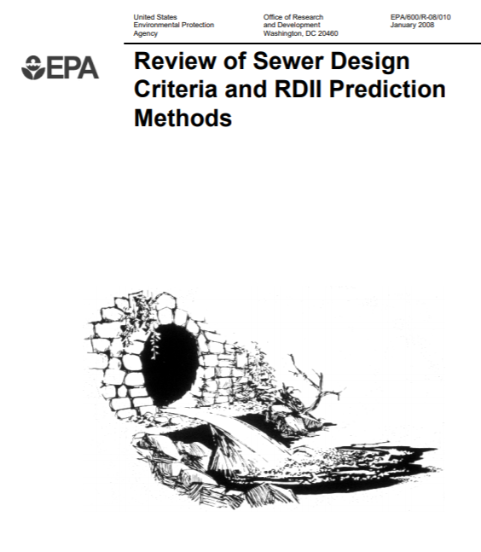
Previous Research
Notes:
Previous publications from EPA on maintenance and design critreria.

Slide 8
Previous Research
Notes:
Regression analysis studies the relationship between a dependent variable, in this case, sewer overflows, and a set of independent variables.
Previous Linear Regression analysis have been done which look at variables that are continuous; however sewer overflows are not continuous throughout the piped sewer system, so I chose binary logistic regression that predicts the outcome of a SSO from occurring.

Slide 9
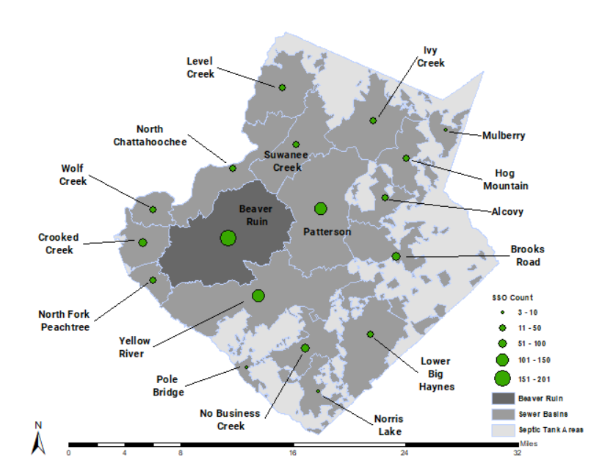
Methodology
Select Study Area
Identify Variables
Classify Sewer Pipe Network
Format Data
Run Binary Logistic
Regression Analysis

Slide 10
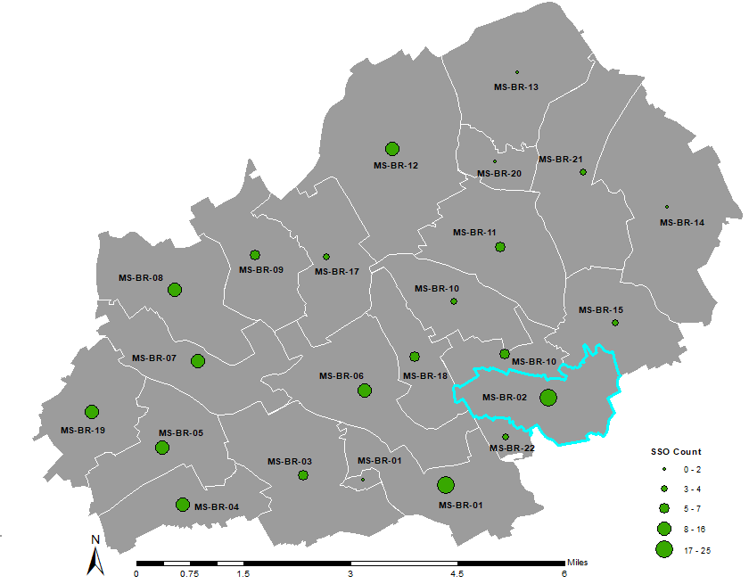
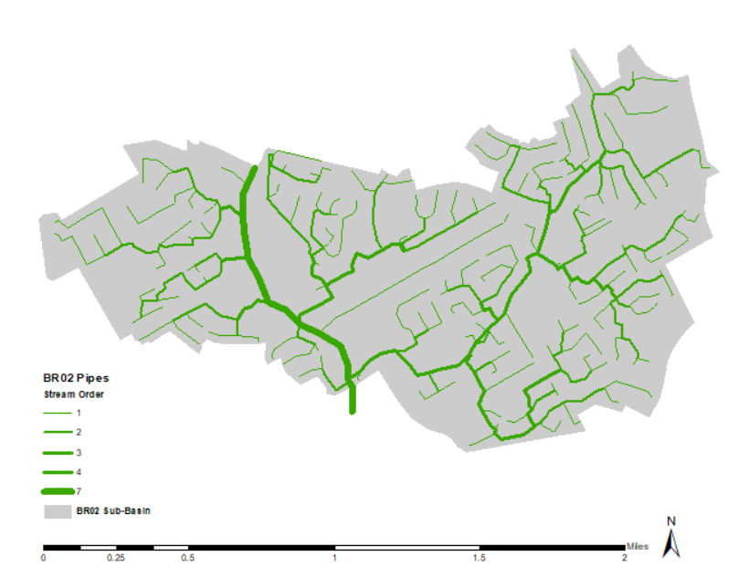
Methodology
Dependent Variable
SSO event
Independent Variables
Nominal Variables
Pipe Material
Stream Order
Scale Variables
Age
Slope
Average Flow
Maximum Flow
Run a Series of Regression
Analyses
Notes:
Briefly mention the Strahler Stream Order Classification. It was a manual process.
The pipe size doesn’t necessarily increase in diameter with the increase in stream order.
For instance, there are plenty of 3rd order pipe segments that are 8 inch.
Pipe diameter did not vary much at all in the dataset, with almost all SSO occurring on 8 inch sewer lines so it was not included as a variable.

Slide 11
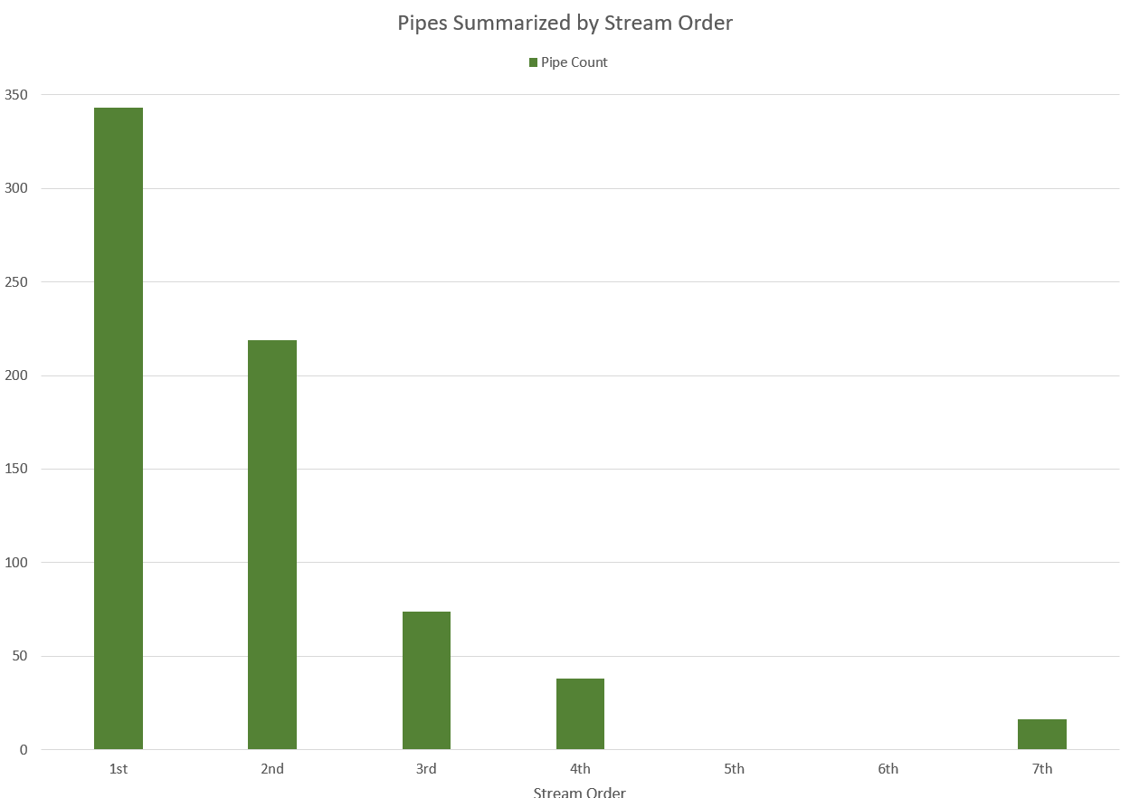
1st Logistic Regression Analysis
Chose BR-02 Basin
20 unique pipes
Unbalanced Dataset:
Control group =50+8m
m=number of variables
Enter Method
Includes all variables in one model
Notes:
Total of 98 control pipes

Slide 12
2nd Logistic Regression Analysis
Chose BR-02 Basin
20 unique pipes
Balanced Dataset:
Control group = 20
Enter Method
Includes all variables in one model
Notes:
Add Stream Order bar chart for BR-02, show count by Stream order

Slide 13
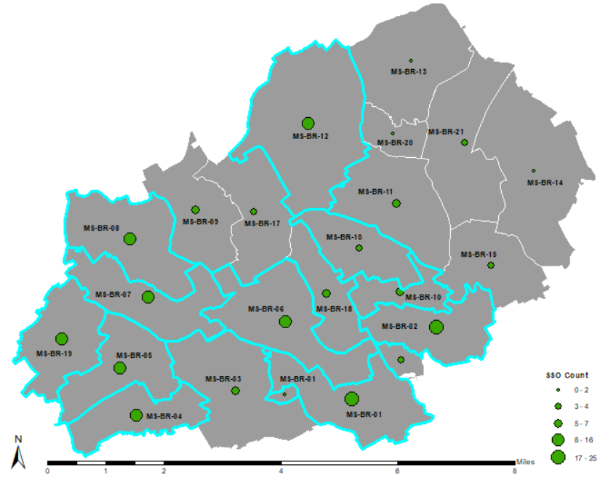
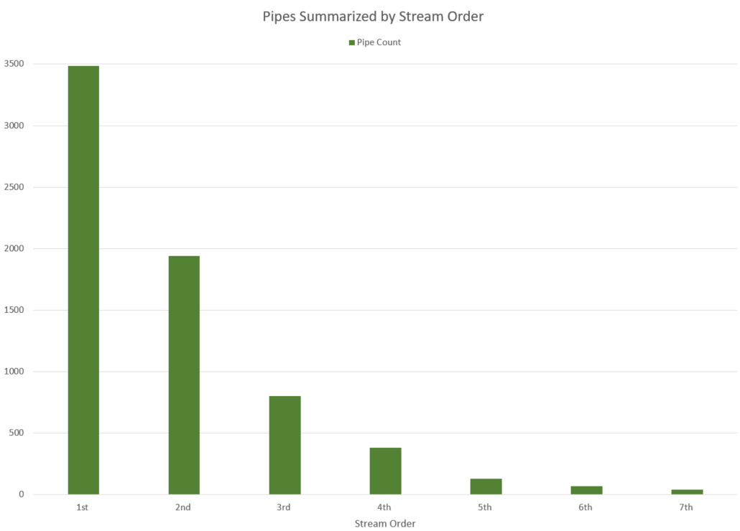
3rd Logistic Regression Analysis
Chose Top 10 Basins
123 unique pipes
Balanced Dataset:
Control group =123
Enter Method
Includes all variables in one model
Notes:
Add Stream Order bar chart for BR-02, show count by Stream order

Slide 14
4th Logistic Regression Analysis
Chose Top 10 Basins
123 unique pipes
Balanced Dataset:
Control group =123
Forward Likelihood Ratio Method
Adds and removes variables based on significance
Notes:
Forward Selection Method: Stepwise method which adds or removes independent variables into the regression equation based on it’s statistical significance to minimize the -2 log likelihood value.

Slide 15
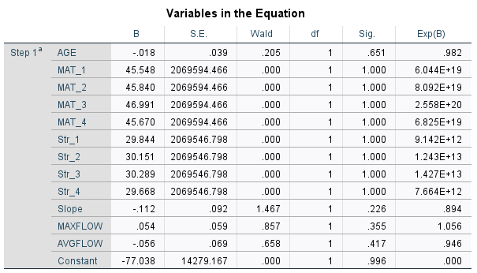
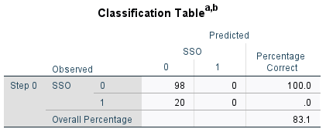
Results Analysis 1: BR02-Unbalanced
Notes:
Hosmer and Lemeshow Test shows the statistical significance of the model, which in this case proved to be statistically significant at the .1 level with a value of .033.
The Classification table shows the results of the model in how it predicts the occurrence of an overflow, shown as the number 1 or not shown as the number 0. The rows on the left show the values in the data that was analyzed. The unbalanced data set had more pipes without an overflow than pipes with an overflow.
The model did a great job at predicting 0’s or pipes not experiencing an overflow, being correct 100% of the time but the model did not predict any overflows.
The variables table shows the statistical significance of each variable in the model. The pipe material data and the stream ordering data are categorical so I had to create dummy variables for the regression analysis to use the information. None of the variables were statistically significant.

Slide 16
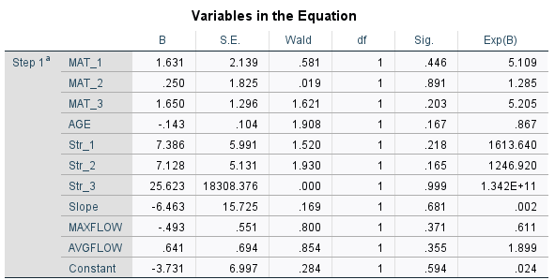
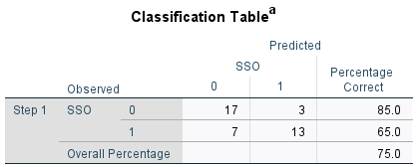
Results Analysis 2: BR02- Balanced
Notes:
Hosmer and Lemeshow Test shows the model is not statistically significant with a value of .543
The balanced data set had an even number of pipes with and without an overflow.
The overall model accuracy was worse at 75% but the model did a better job predicting pipes that would experience an overflow, with an accuracy of 65%.
Again, None of the variables were statistically significant.

Slide 17
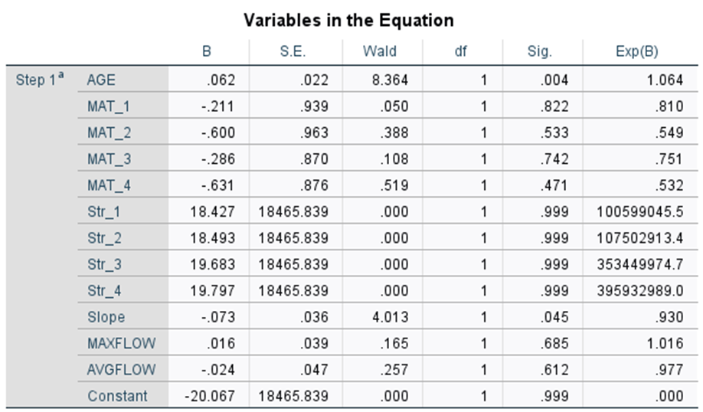
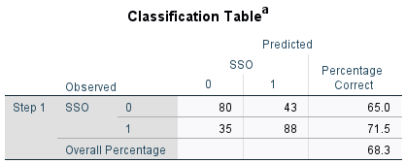
Results Analysis 3: Top 10 Balanced
Notes:
Hosmer and Lemeshow Test shows the model is not statistically significant with a value of .796
The balanced data set had an even number of pipes with and without an overflow.
The overall model accuracy was worse at 68.3% but the model did a better job predicting pipes that would experience an overflow, with an accuracy of 71.5%.
The only variable that showed any statistical significance was age.

Slide 18
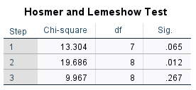
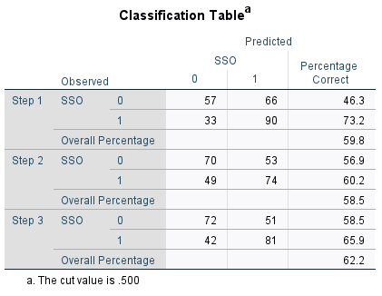
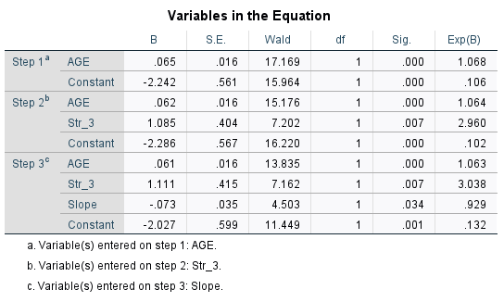
Results Analysis 4: Top 10 Balanced
Notes:
Forward Selection Method: Stepwise method which adds or removes independent variables into the regression equation based on it’s statistical significance to minimize the -2 log likelihood value.
This analysis created 3 different models. The third model was statistically insignificant and therefore the model stopped.
Hosmer and Lemeshow Test shows the significance of each model.
Models 1 was statistically significant less than .1
Model 2 was statistically significant less than .05.
Model 3 was not statistically significant
Discuss model accuracies
Variables in the equation are shown for each model, model one only uses the age variable, model two uses age and 3rd order stream segments, and the third model uses age, 3rd order streams and the slope of the pipe. Each was determined to be significant and therefore used in the equation.

Slide 19
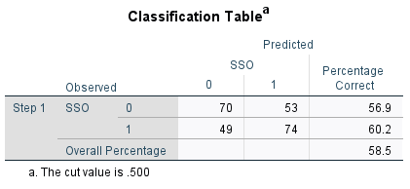
Validate Analysis 4
Notes:
Comparing the Forward Likelihood ratio method to the Enter method.
The enter method is a good way to evaluate and test the significance of all the independent variables.
The forward likelihood ratio method brings independent variables into the equation based on minimizing the -2 log likelihood value.

Slide 20
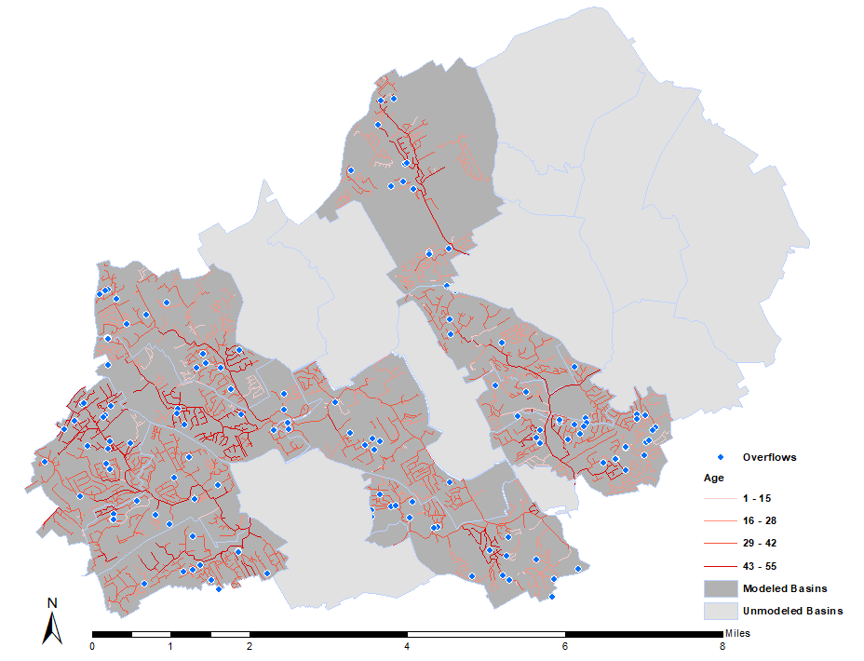
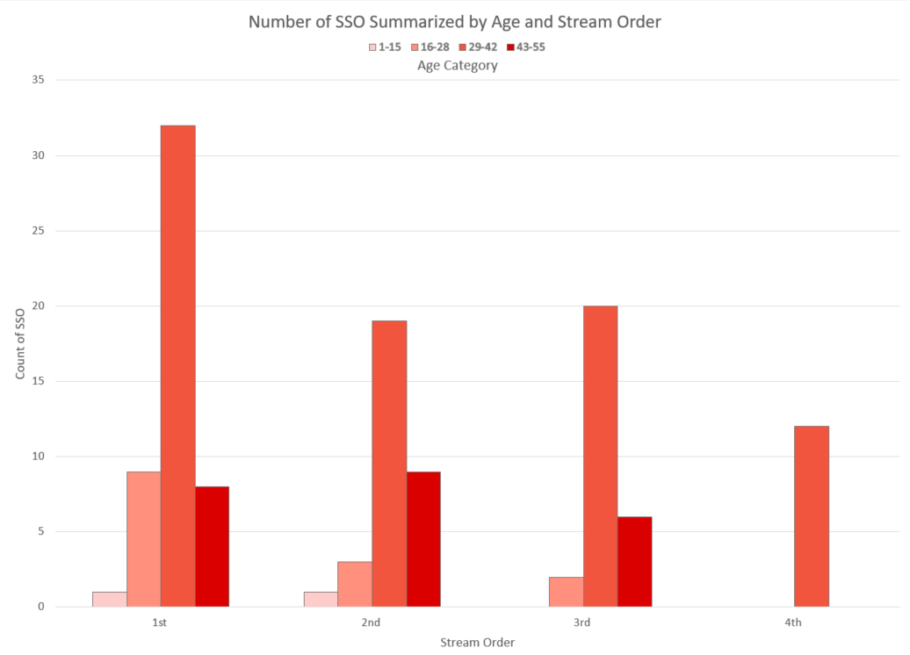
Compare SSO to Analysis 4
Notes:
Have a table to show per stream order per age class Stream order in columns

Slide 21
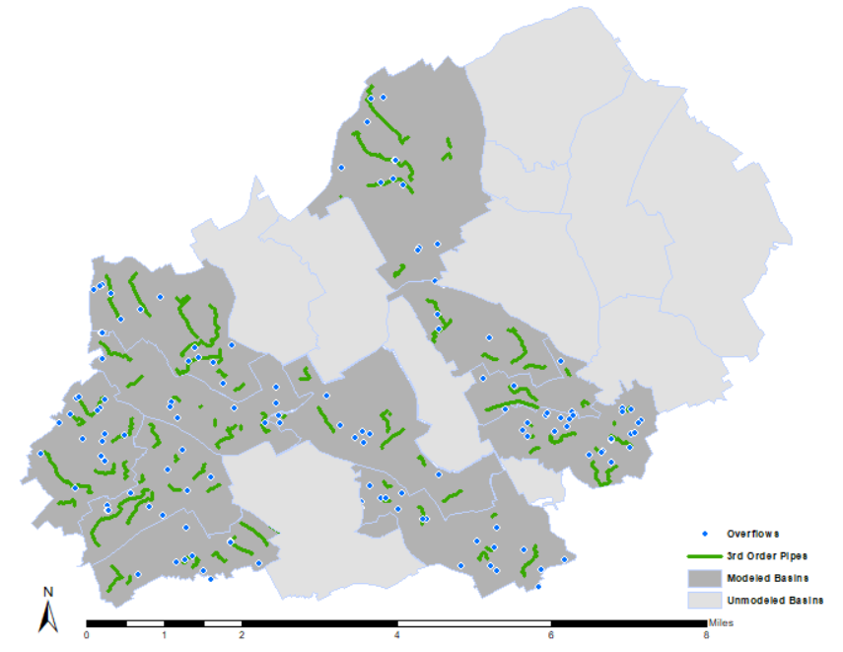
Compare SSO to Analysis 4
Notes:
Have a table to show per stream order per age class Stream order in columns

Slide 22
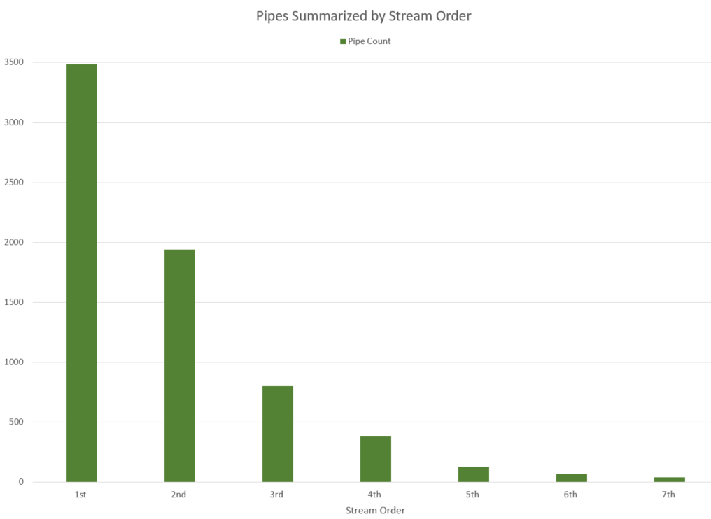
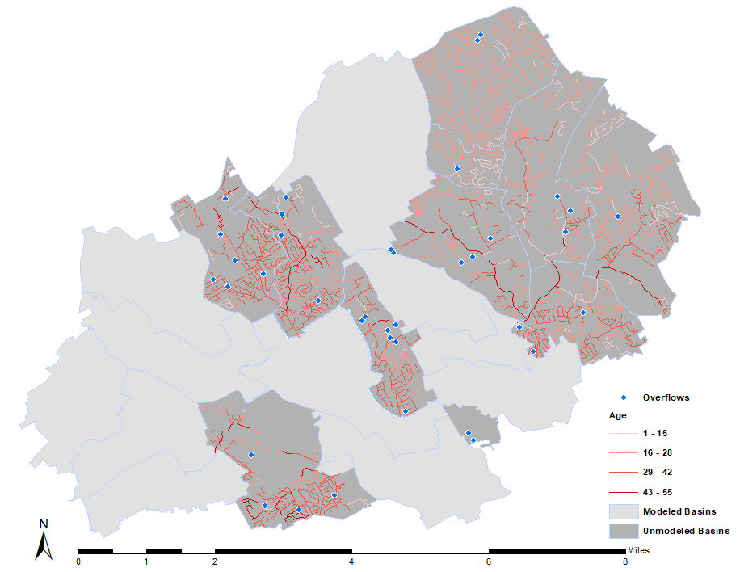
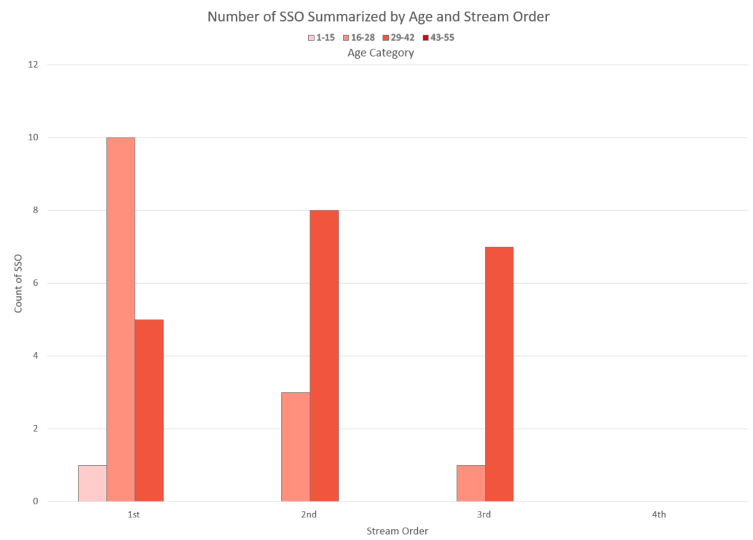
Compare SSO to Analysis 4
Notes:
Have a table to show per stream order per age class Stream order in columns

Slide 23
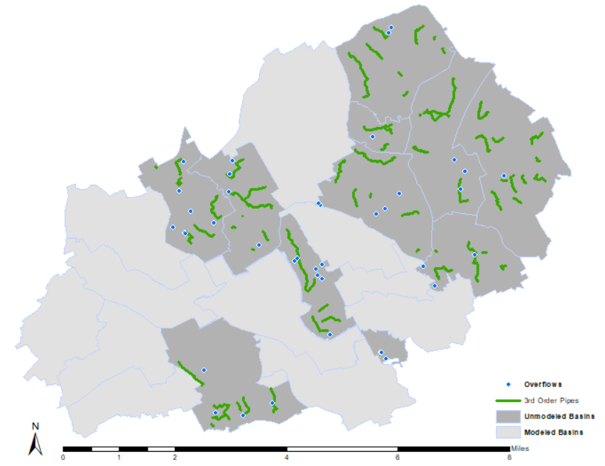
Compare SSO to Analysis 4
Notes:
Have a table to show per stream order per age class Stream order in columns

Slide 24
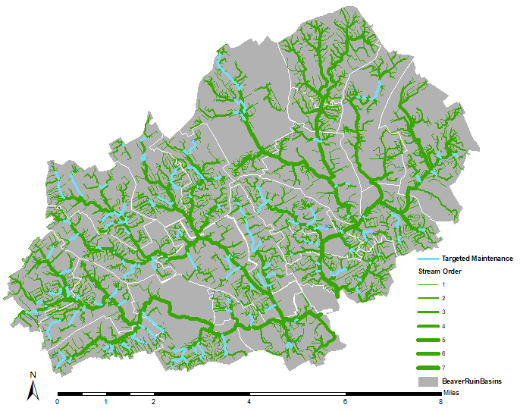
Next Steps
Target Maintenance
3rd Order Pipes
Age >=29
Evaluate Effectiveness
Results may take years
Select Additional Basin
Run analysis- Forward Likelihood Ratio
Target pipes for maintenance

Slide 25
Thank You!
Fritz Kessler
Beth King
Gwinnett County
My Family

Slide 26
Questions?

Slide 27
Questions?

Slide 28
References
Barden, H., Burgess, E., Cheng, F., Fallara, T., Kelly, H. Zhang, L. (2011). "Regression Analysis of the Variation in Rainfall Derived Inflow and Infiltration." Journal of Water Management Modeling, January, 223-236.
Black & Veatch. (1999). Optimization of Collection System Maintenance Frequencies and System Performance, ASCE, EPA Cooperative Agreement #CX 824902-01-0.
Black & Veatch. (200). Protocols for Identifying Sanitary Sewer Overflows (SSOs), ASCE, EPA Cooperative Agreement #CX 826097-01-0.
Gedam, A., Mangulkar, S. and Gandhi, B. (2016) Prediction of Sewer Pipe Main Condition Using the Linear Regression Approach. Journal of Geoscience and Environment Protection, 4, 100-105. http://dx.doi.org/10.4236/gep.2016.45010
Lai, F.-h. (2008). Review of Sewer Design Criteria and RDII Prediction Methods, Report No. EPA/600/R-08/010, EPA Washington, D.C.
U.S. Environmental Protection Agency (USEPA). (2005). Guide For Evaluating Capacity, Management, Operation, and Maintenance (CMOM) Programs at Sanitary Sewer Collection Systems, Report No. EPA 305-B-05-002, EPA Washington, D.C.

