Slide 1
Understanding Water Quality in City Water Systems Using ArcGIS
Jennifer Switzer
Penn State MGIS Program
Notes:
Hi, my name is Jennifer Switzer and this project signifies my capstone project for the MGIS program with Penn State. I am a GIS Analyst with a small municipality in Nevada and my project looks at using the tools in Esri’s ArcGIS environment to understand and model the factors within a city’s water distribution system that contribute to water quality issues.

Slide 2
Background
Chlorine (Cl₂) most common drinking water disinfectant
Residual Cl₂
travels through the distribution system
measures water’s potability
minimum levels (>.5 mg/L) necessary to maintain water quality
Water samples tested throughout the city
Notes:
Chlorine is the most commonly used drinking water disinfectant primarily because it is inexpensive and very effective. It is added to water at a treatment plant where is reacts with organic and inorganic materials.
The chlorine that remains after the initial reactions is called free or residual chlorine. It travels through the distribution system where it continues to disinfect the water. It gets used up through interactions with microbes and pipe material which reduces the Cl₂ levels as it reaches the end of the distribution line. The most common indicator of water quality is the measure of residual chlorine at endpoints in the water system.
Minimum levels need to be maintained to ensure sufficient disinfection takes place. The Environmental Protection Agency requires a "detectable" level of residual chlorine – (CDC suggests 0.2 mg/L, however several other sources state 0.5 mg/L should be the minimum.)
Water samples are regularly taken and tested throughout the city to determine the level of residual Cl₂.

Slide 3
Distribution Systems
Notes:
The image on the left depicts a general water distribution system
The water treatment plant takes in water from a water supply, such as a lake or groundwater, then treats the water before it is delivered to the city’s water network
The pump station pumps the water from the treatment plant to city reservoirs, from which the water enters the water network and is distributed to customers.
The map on the right of the slide gives an overview of the system that will be used in this analysis, with a focus on the main water lines that feed the testing sites.
Water from the nearby lake is filtered at the treatment plant and disinfected with chlorine.
The treated water is then pumped uphill through a series of pump stations to three city reservoirs. Since two of these reservoirs serve the same areas, I counted them as one for this analysis.
A local water authority regularly collects water samples at 12 sites across the city 1-2 times per month or every other month, depending on the site, and then tests the chlorine levels.
Since I could not acquire accurate Cl₂ readings at the reservoirs, I used the last pump station’s values to calculate Cl₂ loss to the test sites

Slide 4
Background (cont)
Water age - water’s travel time from treatment plant to customer
Cl₂ decays as water age increases
Affected by turnover & distance
Water modeling
Water quality typically modeled using hydraulic modeling
State-of-the-art modeling software is expensive and time-consuming to use
Most municipalities invest in GIS, but have limited resources to create models
Notes:
Water age refers to the travel time of water after leaving the treatment plant and before entering the customers' plumbing system.
Chlorine can decay as water age increases, leaving low residual chlorine levels at distant parts of a distribution line.
Many variables contribute to water age, including distance from source and water turnover (difference between system capacity and water used by customers).
Water quality is typically modeled using hydraulic modeling software. It is expensive and time-consuming to establish a model because consultants are typically hired to collect data and build the model. Or you have the expense of purchasing the software and training staff. Free software called EPANet is available, but it is not consistently supported and you would have to recreate your water network in the program.
GIS has become integral in managing and analyzing utility infrastructure, and a municipality should be able to fully utilize their current investment in ArcGIS software to understand their infrastructure and its effects on water quality.

Slide 5
Objective
Determine if this study could be used as a low cost alternative to using additional modeling software to analyze and model factors that affect residual chlorine levels.

Slide 6
Methods
Base Calculations
average monthly & seasonal residual chlorine levels
pipe length to each site
% chlorine loss
chlorine loss per foot
quantity of pipe material to each site
quantity of small, med, & large pipe diameters to each site
Water turnover and use comparisons
Graphical trend analysis
Statistical Modeling
Regression – OLS and GWR
Path distance analysis
Interpolation

Slide 7
Workflow
Notes:
The blue-shaded chain of boxes outlines the sequence of the analyzing the effects of distance analysis, which lead to the darker blue boxes for statistical modeling.
The chain of light and dark purple boxes outline the process for path distance analysis and interpolation.
Pipe material analysis in green
Diameter analysis in red
Water usage in orange

Slide 8
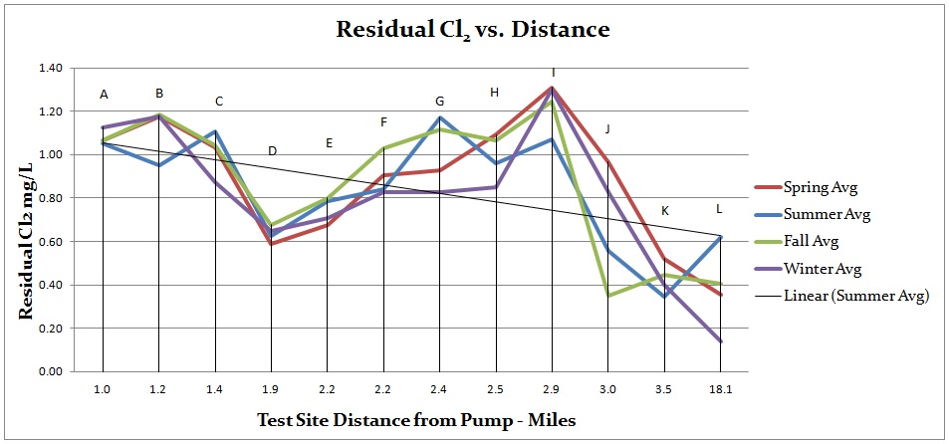
Seasonal Residual Cl₂
Base calculations:
Average monthly Cl₂ levels at each site across all years
Seasonal averages (spring, summer, fall, winter)
Notes:
I calculated the seasonal Cl₂ averages for spring, summer, fall and winter between 2012 and 2015 at each testing location (spring = March/April/May, summer = June/July/August, and fall = September/October/November, winter = December/January/February)
Comparing seasonal averages between sites is intended to normalize the data for more standard comparisons between sites and to see if there are significant changes due to temperature.
This graph plots the seasonal average chlorine values at each testing site against the water’s travel distance, from shortest to farthest distance from the pump
Chlorine levels follow relatively similar trends during each season for all test sites.

Slide 9
Distance
Residual Cl₂ decreases as distance increases
Longer time to react with organisms and pipe material
Notes:
One of the main factors contributing to water age is the distance the water must travel through the network
Increased distance means a longer time to react with organisms and pipe material, which promote Cl₂ decay
This graph shows the average residual chlorine levels for each testing site, ordered from closest to pump station to the farthest.
With the exceptions of sites D and I, the overall trend supports the theory that the further water must travel, the more chlorine decays.

Slide 10
Cl₂ Decay Comparisons
I
Cl₂ loss = ((pump Cl₂ - site Cl₂)/pump Cl₂)
Inconsistencies between sites within similar distances to pump station.
Sites I and J have a water travel distance difference of .1 miles from the pump, but site I has 11% chlorine loss while site J has 51% loss
Site L is 14.6 more miles from the pump than K, however there is only a 3% difference in residual chlorine loss between the sites
Site D has significantly more chlorine loss (54%) than comparable sites like A, B, and C (19% -27% loss)
D
A
B
C
J
K
L
Notes:
I have calculated the percent of chlorine loss from the pump station to the test sites.
This map displays the spatial layout of testing sites and the corresponding percent of chlorine that is lost between the pump station and test locations.
Sites I and J only have a distance difference of .1 miles, but site I only experiences 11% chlorine loss while site J has 51% loss
Water has 14.6 more miles to travel to reach site L than K, however there is only a 3% difference in residual chlorine loss between L and K
The inconsistencies hint that factors besides just distance are affecting the Cl₂ results, such as the material of the pipe and water usage…

Slide 11
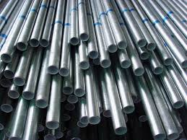
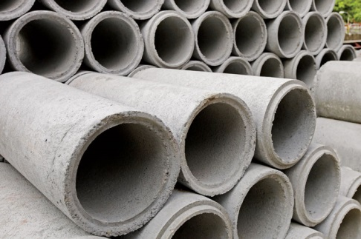
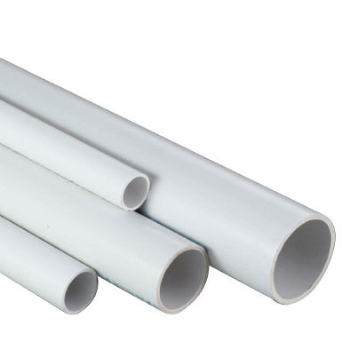
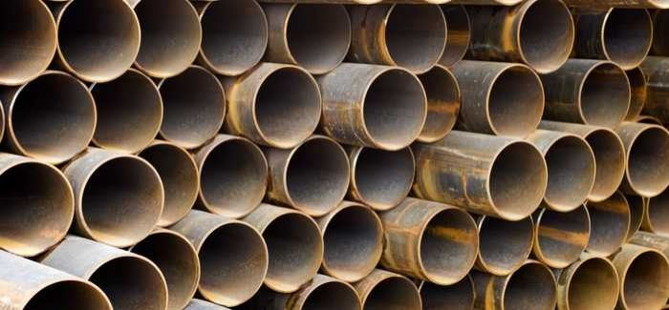
Pipe Material Analysis
Materials have different chemical reactions with Cl₂
Reactive hierarchy
Iron > Steel > Cement > Plastic
% material = (Total ft of material/Total ft of pipeline)*100
Notes:
Pipe material affects water quality because materials react differently with disinfectants, which impacts corrosion and the amount of biofilm growth on pipe walls.
These differences create a hierarchy of reactivity - Metals are classified as reactive and have the most potential for bacterial re-growth and pipe corrosion, whereas plastic and cement-based pipes are considered unreactive material
I determined the percentage of pipe material contained in the line for each test site and compared these statistics between sites with similar distances from the pump station.
Most of the pipes in my analysis were asbestos cement, with polyvinyl pipes in the newer areas of town or where old pipes have been replaced. For sites with more varied material, the PVC pipes were found associated with higher Cl₂ values.

Slide 12
Diameter Analysis
Calculate pipe lengths for each diameter category
% Diameter = Pipe length per diameter/Total pipe length to each test site
Results
No clear trend between diameter size and Cl₂ residuals
Notes:
Pipe diameter has been suggested as a contributing factor to water quality in which smaller diameter pipes would have more effect on Cl₂ decay than larger pipes because there would be more interaction with the pipe material.
Through calculations and graphical analysis, I could not determine a clear trend in Cl₂ values per diameter size.

Slide 13
Water Usage Analysis
Low water turnover lengthens water residence in the system
Turnover affected by network design, water demand & dead ends
Calculate water volume in pipe network
Volume = .785 * d² *l = ft³
where d = pipe diameter, l = length of pipe feature
Calculate water turnover
% Network Turnover = (RW/PV) * 100
where RW = Avg monthly amount of water pumped into reservoir,
PV = Total volume in pipes per reservoir
Notes:
Low water turnover lengthens the time water remains in the distribution network which means more time for Cl₂ to be used up during disinfection.
Affects on water turnover:
- Many water systems are designed to not only meet current drinking water demands, but maintain pressures and quantities for firefighting and future needs.
Changes in water demand due to things like water conservation practices or relocation of a major water user can also greatly affect water turnover rates because water is cycled through the system at a slower rate.
- Dead ends limit the amount of water cycled through that section of water pipe
I calculated the volume contained in the pipe network for each reservoir and then determined the turnover in the system by taking the amount of water pumped into the reservoir to replenish the supply and dividing by the total volume of water in the system.

Slide 14
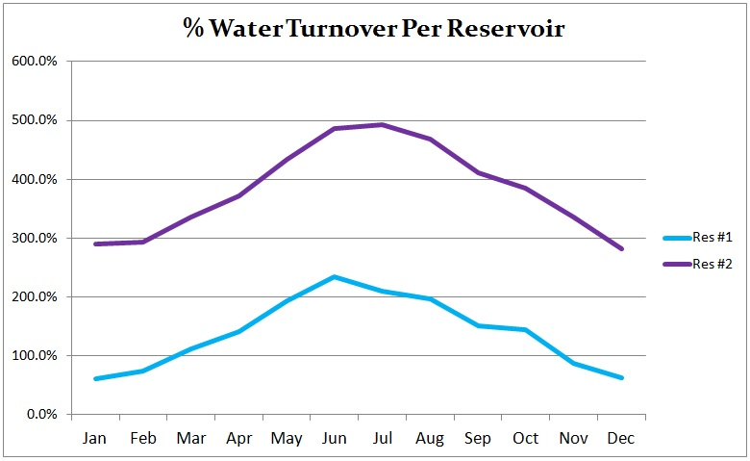
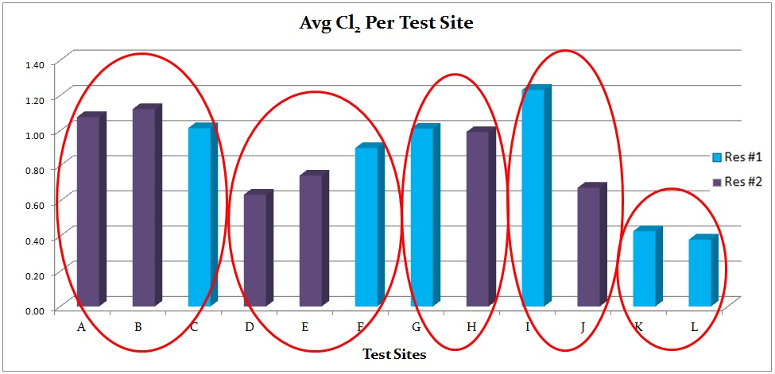
Water Turnover Analysis - Reservoirs
Reservoir #1 had lowest turnover rate, assuming lower residual Cl₂ values
However, Reservoir #1 had higher residual Cl₂ on site by site comparison (compared sites circled in red).
Notes:
The water in Reservoir #1’s pipe network was turned over less frequently than Reservoir #2. Based on research, I would expect it to have lower Cl₂ concentrations. However, on a site by site comparison between sites of similar distance from pump station, Reservoir #1 had higher residual Cl_{2.}
When looking at the Cl₂ values averaged for each reservoir, Reservoir #1 did have lower values. But this is probably due to the fact that Reservoir #1 has the most distant sites and lowest residuals.

Slide 15
Water Usage Analysis – Test Sites
Metered water usage compared between sites of similar distance from source
Avg Cl₂ is higher or difference in values was minimized with sites with higher water usage
Notes:
I compared the metered water usage of each test site and compared the Cl₂ between sites with similar distance from the pump station.
Overall, the test sites with more water usage had higher residual chlorine values or the difference in chlorine was minimized with sites that had higher usage.
For example, we can see between sites D, E, & F that F has the greatest distance and highest water usage and the highest Cl₂ values.
Sites K and L (in orange) have a 14.6 miles difference in distance but their Cl₂ values are fairly similar. Site L has significantly more water usage than site K, indicating that increased water usage at site L is helping the Cl₂ values be higher.
I did similar comparisons with other sites.

Slide 16
Ordinary Least Squares Regression
Prepare line work
Editing Tools → Generalize (4 ft tolerance)
Editing Tools → Densify (100 max distance)
Data Management → Features → Split Line at Vertices
Dependent Variable = Cl₂ loss per foot
Explanatory variables =
Pipe material
PVC = 1
Cement = 2
Steel = 3
Iron = 4
Source (reservoir)
Reservoir #1 = 6
Reservoir #2 = 5
Diameter
Length
Notes:
OLS is commonly the first step in spatial regression analysis - a single regression equation is created to model a process across the entire study region to predict Cl₂
To perform OLS, I first needed to prepare the line work:
- First I removed extra vertices using the “Generalize” tool under the Editing toolbox.
- Then I added vertices every 100 ft using the Densify tool
- Finally, I split the lines into more even segments using the “Split Line at Vertices” tool under the Data Management → Features toolbox.
The explanatory variables must be in numerical form, so I used the relationships observed in the graphical analysis to assign low integers to less effective factors and higher values to more effective factors.

Slide 17
OLS Regression Results
Significant model w/ good model performance (Adj R² = .73, AICc = -19148.8)
Residuals spatially autocorrelated – explainable with linear features
Overall relationships:
Material (+) : the more reactive the pipe material, the more Cl₂ is lost
Length (mostly +) : as length increases, more Cl₂ is lost
Source (-) : the reservoir with greater turnover had more Cl₂ loss
Diameter (not very significant, but mainly positive) : as diameter increases, the amount of Cl₂ loss increases
Notes:
Significant model
Good model performance:
- Akaike’s Information Criterion (AICc) is a widely used mathematical statistic to measure model performance and the lower the value, the better. My model had good model performance (AICc = - 19148.8)
- Adjusted R² = .73 → 73% - indicates that the model (explanatory variables) explains 73% of the variation in the dependent variable; the higher the value the better
Residuals displayed positive spatial autocorrelation meaning the model is biased. But this is hard to avoid with linear features where pipes of the same length and material are going to be near each other.
Material – matched research and analysis
Length – matched research and analysis
Source (turnover) – matched graphical analysis
Diameter – matched graphical analysis but not literary research

Slide 18
Geographically Weighted Regression
Convert line features to points
Spatial Statistics → Modeling Spatial Relationships → GWR
Dependent variable = Cl₂ loss per foot
Explanatory variables = Diameter & material
Kernel = Fixed
Bandwidth = AICc
Notes:
GWR - creates a local regression equation for each feature in the dataset, which provides statistics on the relationships between variables
GWR doesn’t work with line features, therefore I used the “Feature to Point” tool in the Data Management → Features toolbox to convert the pipelines to points.
Results:
Good model fit,
low residual squares (.003178) – the smaller the number, the closer the fit of the GWR to the observed data
AICc = -18350.87 - measures model performance; lower values have better fit to observed data
R² = 58% - measures goodness of fit; ranges 0-1.0; higher values are better

Slide 19
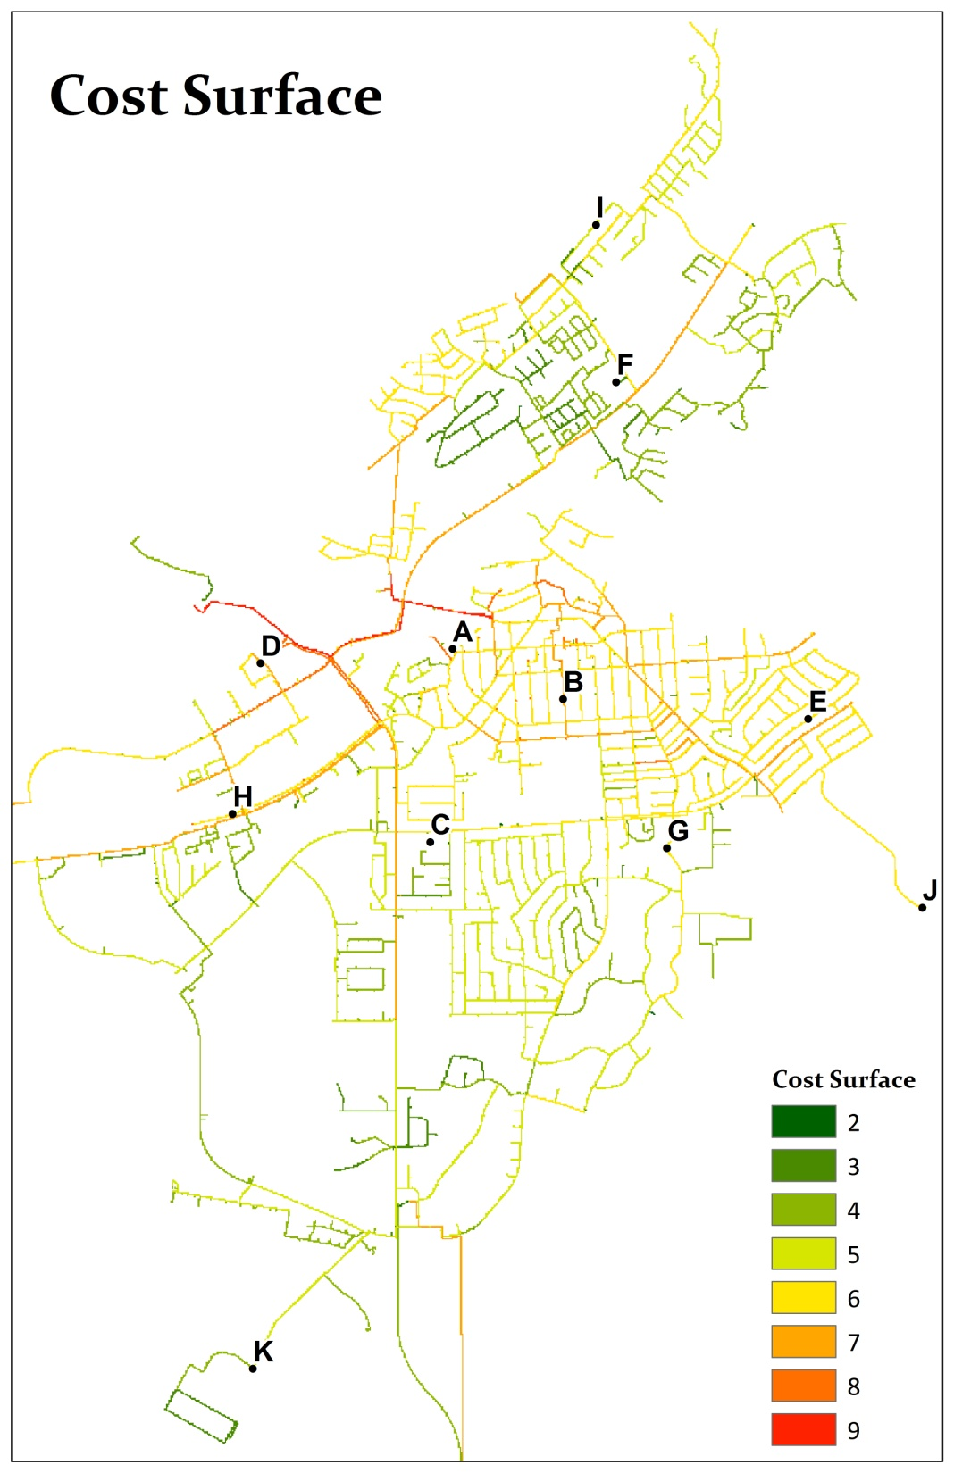
Path Distance
Analysis
Create weighted rasters for material, source, and diameter based on OLS results
Null attributes need a value for path distance
Reclassify rasters to common scale
Create cost surface (add weighted rasters with Raster Calculator)
Notes:
Path distance analysis determines the "cost" of travel from a source to each cell on a raster by considering a cost surface (weighted cell values for certain factors) and the surface distance (elevation layer)
I applied the path distance analysis to the entire water network.
Using the relationship results from the regression and graphical trend analysis, I assigned weights to the water system attributes and created weighted raster layers (cell size = 20) where attributes with greater influence received a higher weight, and less influence were given a lower weight.
For features that had Null values in the attribute field, I entered zero because you need to have a value here otherwise the feature will be excluded in the path distance analysis, but I didn’t want to give it too much weight and skew the results.
I reclassified the diameter layer to be on a more consistent scale with the other factors.
I then used the Raster Calculator tool to add the weighted rasters to create an overall cost surface layer

Slide 20
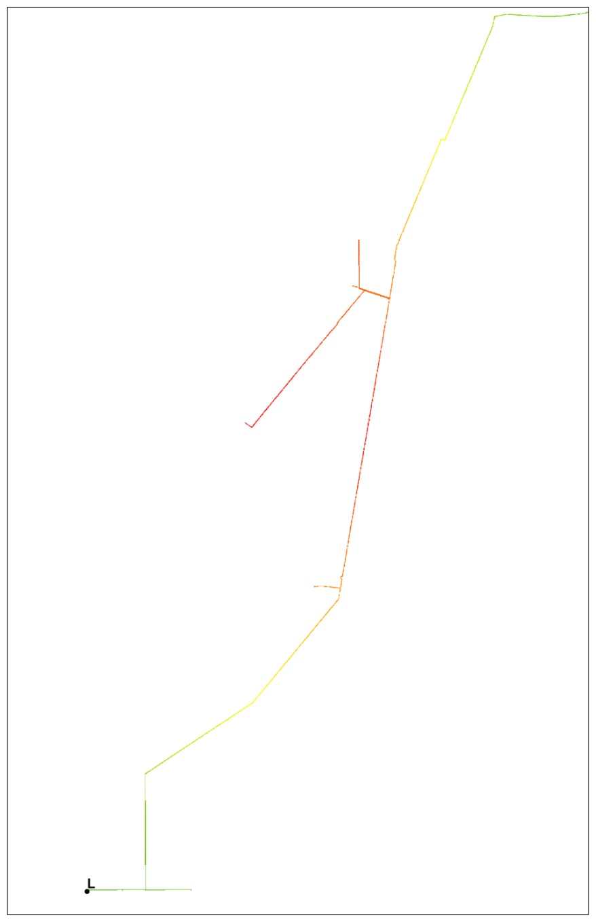
Path Distance Results
Notes:
Here are the results of the path distance analysis where we can see that the outer parts of the system have a higher cost than the more centralized locations.
It is interesting to see the red area on the line headed to site L. This might be an area to test to ensure sufficient Cl₂ values are present.

Slide 21
Interpolation –
Kriging
Spatial Analyst Tools → Interpolation → Kriging
Input features = Test sites
Z value field = Cl₂ loss per ft
Kriging method = ordinary
Semivariagram model = exponential
Variable radius, 12 points
Performed interpolation on each season’s Cl₂, then combined surfaces using Cell Statistics tool
Notes:
I used interpolation to visualize the overall dispersion of Cl₂ throughout the city
I used ordinary kriging with an exponential semivariagram (autocorrelation decreases exponentially with distance) and variable radius. The Cl₂ averages for each season were interpolated and then combined using the cell statistics tool to find the mean values.

Slide 22
Conclusions
Distance & turnover most significant factors
Graphical analysis helps support or question the statistical analysis
Analysis changes:
GWR not necessary
More frequent Cl₂ test results to establish averages
Greatest challenge – data availability
Use analysis to determine “normal” system behavior & track changes
Operators and managers can visually interpret Cl₂ results and system behavior to focus maintenance operations
Notes:
Recall that our objective was to determine if this approach could be used as a low cost alternative to model water quality factors without employing complex modeling software. Given that, I have found that…
The most significant factors in water quality seem to be distance and water turnover. Diameter and material may have some effect, but do not cause significant Cl₂ degradation
Using graphs helps to support or raise questions to the results of statistical analysis and are an important part to determine of your model is reflecting your distribution system.
Some changes I would make to the analysis methods:
I found that GWR was not significant in this analysis and could be easily left out.
Since water tests are performed 1-2 times per month or every other month, I think it would have been better to obtain more frequent tests to ensure more accurate averages.
The greatest challenge to this or any analysis is the availability of data and making sure it is input into the GIS database. I was able to gather data about the system using engineering drawings, water usage from the utility department, and Cl₂ values from the treatment plant and the testing organization. This is information that municipalities should have access to and it would have to be gathered by the consultant anyway if they were to build the model.
The analysis is best performed using data over several years to establish a “normal” trend. As new Cl₂ test are done, cities can determine if the values are within predictable ranges. If values are way off, you can mostly focus on water usage changes since distance wouldn’t have changed or a possible hidden pipe break or leak that could be allowing contaminants into the system which would overwhelm the Cl₂
Overall, I would recommend this analysis to municipalities as a way to analyze their infrastructure as a whole and identify normal trends throughout the town. This analysis helps to raise awareness of the factors within a distribution system that are not apparent by reading tables of Cl₂ test values. It creates a visual interpretation of how the system is behaving and allows the operators to be more proactive by focusing on areas that need the most maintenance attention.

Slide 23
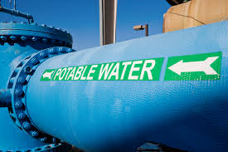
Questions?

