Slide 1
Utility Poles failures in relation to soil and terrain
Analyzing utility pole relationships with soil hydrography and terrain
Advisor: Seth Blumsack
Timothy Tabor GEOG 596A, Summer 2016

Slide 2
Table of Contents
Background
Study Area
Data
Process
Timeline
Sources

Slide 3
Goal
Determine if terrain, slope, and soil hydrography impact pole failure rates

Slide 4
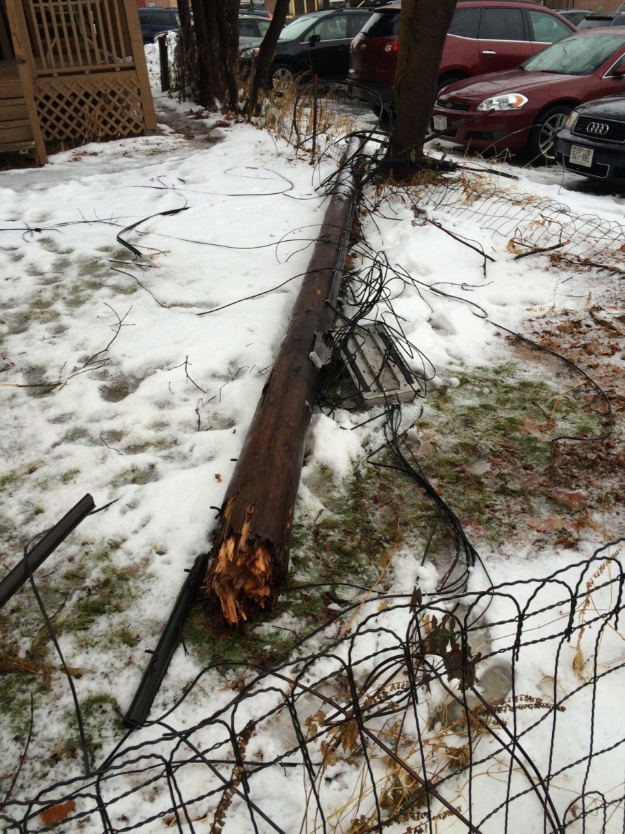
Background
National Electric Safety code requires poles to be replaced if less than 67% of installed strength remaining.
Failed poles can cost companies millions of dollars
Companies must inspect utility poles to determine remaining strength
Minnesota Power owns ~160,000 poles and inspects ~10% of their system every year
Notes:
http://www.coloradoindependent.com/2698/qwest-ordered-to-pay-84-million-to-injured-lineman – Xcel lineman paraplegic due to Qwest failing to inspect utility pole.

Slide 5
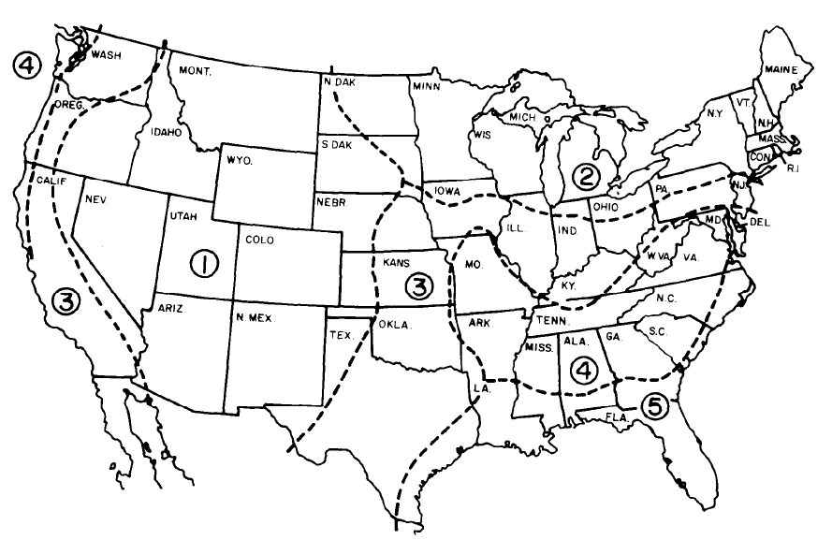
Pole Failure Background
Pole failure usually caused gradually by insects for rot
Moisture increases probabiltiy of decay
Poles are treated to delay decay and repel insects
USDA Rural Utilities Services has 5 zones for decay in the US
Zones are based on summer humidity
Decay severity zones for wood utility poles as defined by the USDA Rural Utilities Service. Decay is least severe in zone 1, most severe in zone 5.
Notes:
http://www.coloradoindependent.com/2698/qwest-ordered-to-pay-84-million-to-injured-lineman – Xcel lineman paraplegic due to Qwest failing to inspect utility pole.

Slide 6
Study Area
Minnesota Power feeds North Central Minnesota, Duluth &35 Corridor, and the Iron Range
Service Territory contains large amount of wetlands
Covers all types of drainage, aspect, and slope
Notes:
MP Service territory with each area highlighted

Slide 7
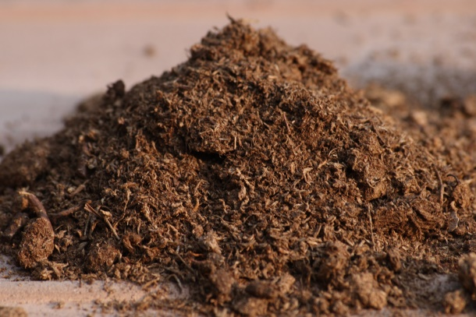
Data Overview
Tools Used
ArcGIS 10.2.2
Soil Data Viewer 6.2
Microsoft Excel 2010
R
Data Sets
Minnesota Power Groundline Inspection Records
Soil Survey Spatial and Tabular Data (SSURGO 2.2)
Digital Surface Model (DSM), Minnesota (2006-2012)
Notes:
STATSGO2 Hydrologic Soil Conditions for State of Minnesota

Slide 8
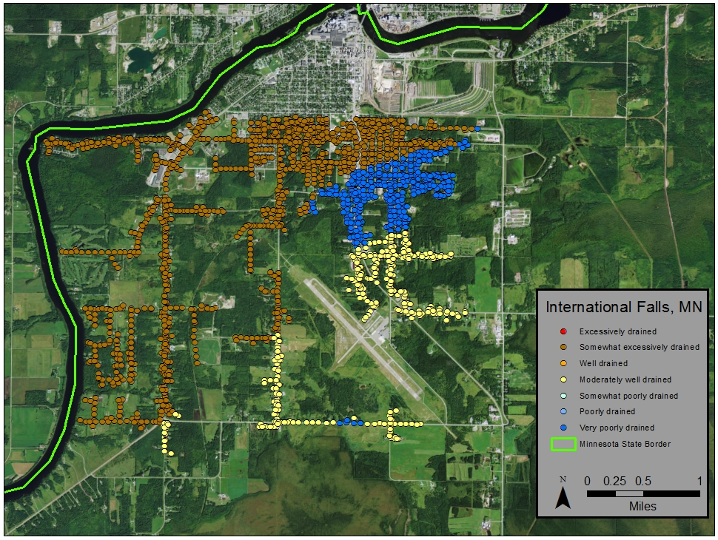
Pole Data
POLEYEAR
0E
0E
1
1075
0E
9
168
67
67
0E
0R
1040
2021
2110
167
1075
`2
1075
82
134E
150E
78
Pole Data required cleanup
Many records missing data or unknown values
Soil data needed Soil Data viewer tool for ArcGIS
Spatial join between poles, drainage, and hydrologic soil type to locate required values in one table
Assumptions
All poles have been treated from the factory to prevent decay
No poles are structurally overloaded
There is no mechanical damage to any pole
Each pole is in its initial install position (no replanted poles)
Notes:
Example of some values in the Pole installed year field
Soil Data viewer window

Slide 9
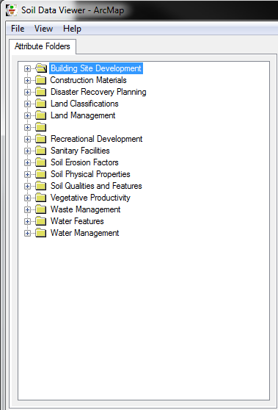
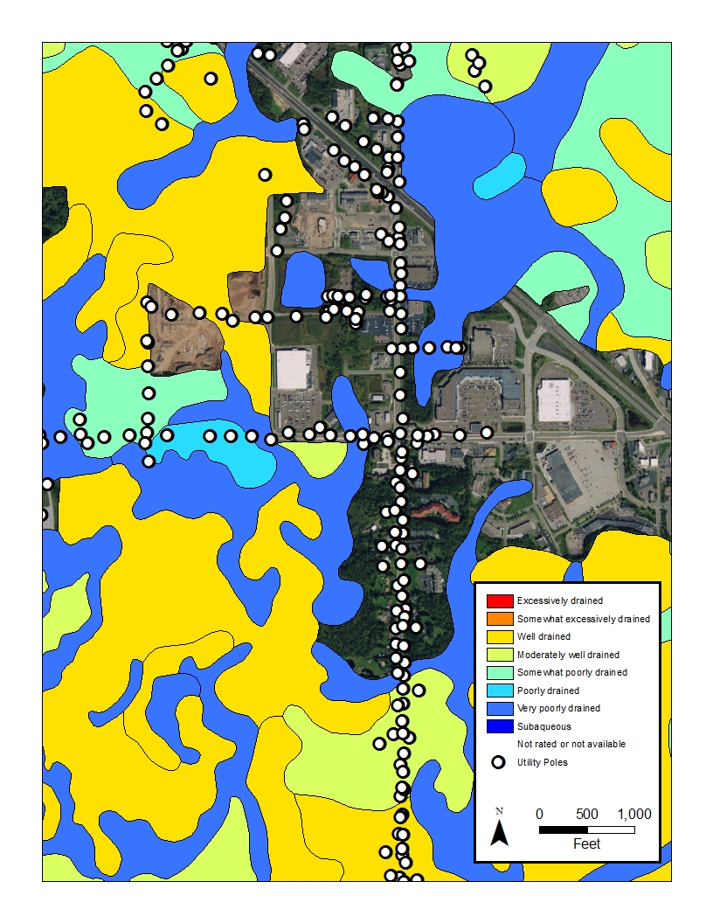
Soil Data
Downloaded from United States Department of Agriculture (USDA) – Natural Resources Conservation Service
Comes as tabular data which must be referenced to an Access template
Use the Soil Data Viewer tool to display in ArcGIS
Notes:
Example of some values in the Pole installed year field
Soil Data viewer window

Slide 10
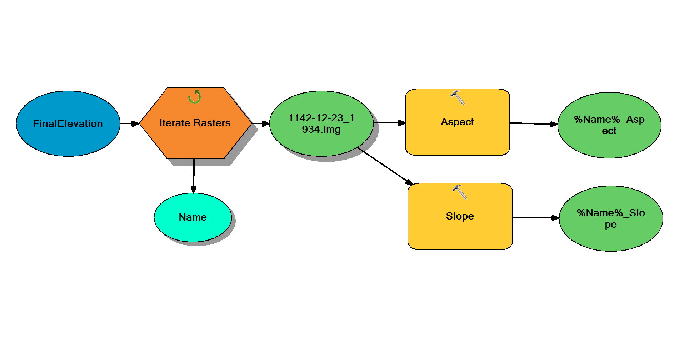
Elevation Data
1m resolution
Generated from raw LIDAR
Collected between 2006 and 2012
Used to for aspect and slope layers
ArcGIS model to generate aspect and slope rasters
Notes:
Example of some values in the Pole installed year field
Soil Data viewer window

Slide 11
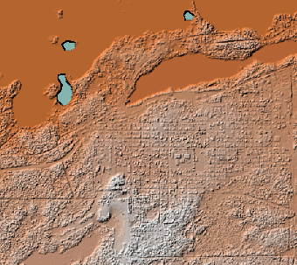
Workflow Overview
Clean up Pole Data
Download Required Data
SURGO
Elevation
Create shapefiles from SURGO Databases
Generate Aspect and Slope from elevation
Join soil, slope, and aspect to pole data
Export to Excel for further cleanup
Conduct regression analysis to determine effect on pole failures using R
Point Data
Soil Data
DSM

Slide 12
Timeline
June-July 2016
Gather Data and produce final table
August-September
Conduct analysis
October
Present at MN GIS/LIS Conference in Duluth, MN
November-December
Finalize paper
December
Turn in final results paper

Slide 13
Sources
Bajestani, Maliheh Aramon, et al. "Maintenance Resource Planning for Utility Poles in a Power Distribution Network".Web.
Gao, Lu. “GIS Application to Investigate Soil Condition Effect on Pavement Performance.” GIS Hydro 2006. University of Texas at Austin. 2006. Web. 27 May. 2016.
Gezer, Engin Derya, Ali Temiz, and Turan Yüksek. "Inspection of Wooden Poles in Electrical Power Distribution Networks in Artvin, Turkey." Advances in Materials Science and Engineering 2015 (2015): 1-11. Web.
Johnson, Alan A., and Randall J. Storey. "Failure Of A Southern Pine Utility Pole. “Technology, Law & Insurance 4.1/2 (1999): Business Source Premier. Web. 30 May 2016.
Li, H., J. Zhang, and G. Bhuyan. "Reliability Assessment of Electrical Overhead Distribution Wood Poles".Web.
Onyewuchi, Urenna P., et al. "A Probabilistic Framework for Prioritizing Wood Pole Inspections Given Pole Geospatial Data." IEEE Transactions on Smart Grid 6.2 (2015): 973-9. Web.
Rahman, A., and G. Chattopadhyay. "Soil Factors Behind In ground Decay of Timber Poles: Testing and Interpretation of Results." IEEE Transactions on Power Delivery 22.3 (2007): 1897-903. Web.
“RUS Bulletin 1730B-121.” Rural Utilities Service. United States Department of Agriculture, 13 Aug. 2013. Web. 28 May 2016.
Ryan, Paraic C., et al. "Reliability Assessment of Power Pole Infrastructure Incorporating Deterioration and Network Maintenance. "Reliability Engineering & System Safety 132 (2014): 261-73. Web.
Shafieezadeh, Abdollah, et al. "Age-Dependent Fragility Models of Utility Wood Poles in Power Distribution Networks Against Extreme Wind Hazards." IEEE Transactions on Power Delivery 29.1 (2014): 131-9. Web.
Yumbe, Y., T. Hasegawa, and N. Furukawa. "Optimization Method for Inspection Scheduling of Power Distribution Facilities." IEEE Transactions on Power Delivery 28.3 (2013): 1558-65. Web.

Slide 14
Thank You
Special Thanks to my advisor: Seth Blumsack.

Slide 15
Questions?
Timothy Tabor
tut150@psu.edu

