Slide 1
Utility Poles failures in relation to soil and terrain
Analyzing utility pole relationships with soil hydrography and terrain
Timothy Tabor
Notes:
Introduction:
Tim Tabor
Started off as high voltage electrician where I learned to install and climb poles
While in the Air Force Reserves I went to University of Minnesota for Geography/GIS
Upon Graduation received a job at Minnesota Power doing line design and modernizing the inspection program from access database to GIS
Started my Masters in GIS in 2014
Currently supervisor at MnDOT for maintaining map of all roads in Minnesota

Slide 2
Table of Contents
Background
Study Area
Data
Process
Initial Statistics
Cox Regression
Results
Conclusion
Sources

Slide 3
Goal
Determine if terrain, slope, and soil hydrography impact pole failure rates using GIS and statistical analysis tools
Notes:
This type of Geospatial analysis has not been conducted on utility poles before so part of the goal is to understand how this analysis could be used to help utilities plan for pole replacement or future line placement. Most relevant study found went into field in Australia to collect soil samples around failed poles. Moisture content shown to influence decay on utility poles. Also identified other soil factors (ph value, salinity, and electrical conductivity). Work flow was adapted from GIS Application to Investigate Soil Condition Effect on Pavement Performance by Lu Gao.

Slide 4
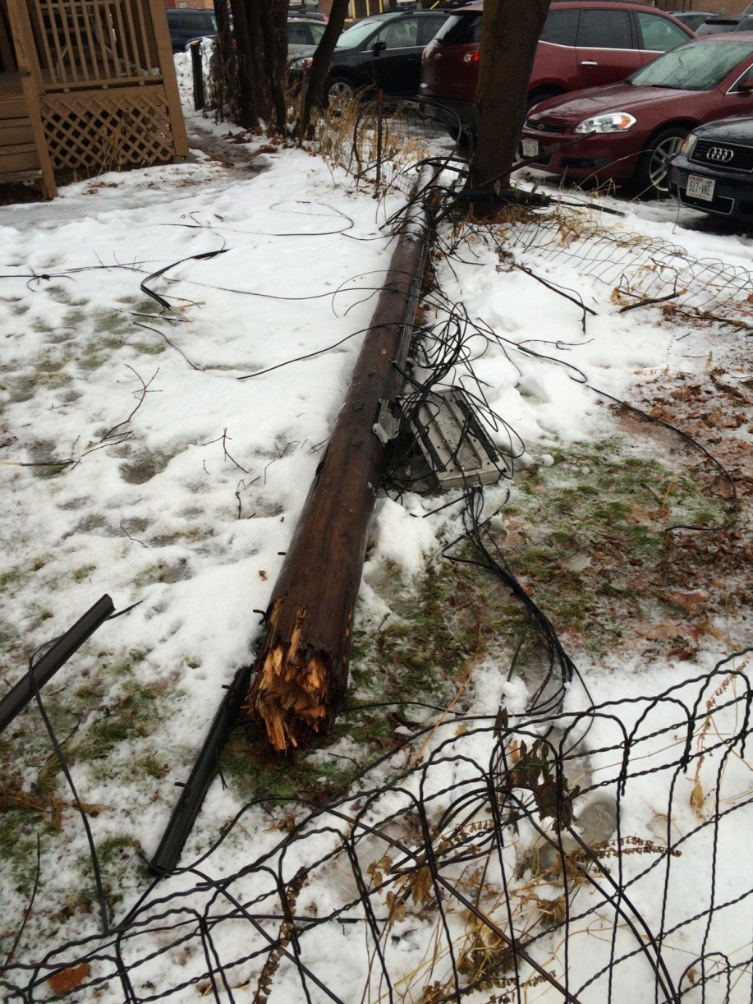
Background
National Electric Safety code requires poles to be replaced if less than 67% of installed strength remaining.
Failed poles can cost companies millions of dollars
Impact SAIDI & SAIFI
Companies must inspect utility poles to determine remaining strength
Minnesota Power owns ~160,000 poles and inspects ~10% of their system every year
Notes:
National Electric Safety Code (NESC) – governs safety requirements for utilities – minimum safety standards
Xcel lineman paraplegic due to Qwest failing to inspect utility pole.
Replace pole 35ft ~$1500, 40ft ~$2000
Annual Measurements
Saidi – System Average Interruption Duration Index – media value 1.5
Saifi – System Average Interruption Frequency Index – 1.1 interruptions/customer
Inspection involves visual inspection for poles <20 years old, 1 drilling for poles 20-30 years old, 3 drillings for poles >30 years old
Drilling is done at groundline, 45 degree angle to try to detect decay at and below groundline

Slide 5
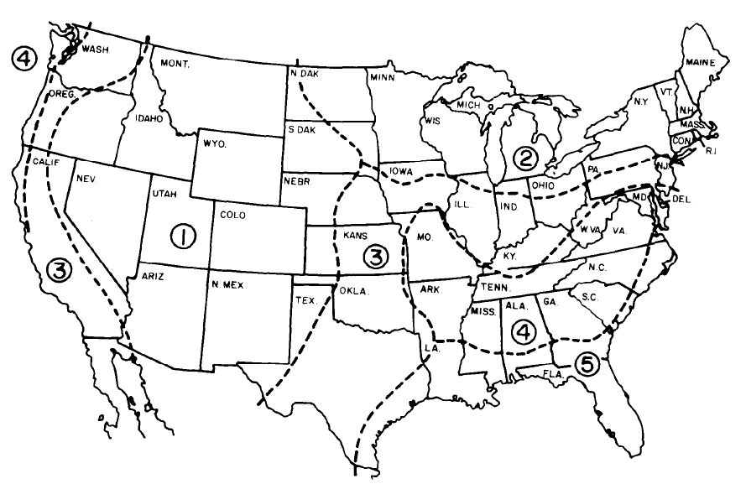
Pole Failure Background
Pole failure usually caused gradually by insects or rot
Moisture increases probability of decay
Poles are treated to delay decay and repel insects
USDA Rural Utilities Services has 5 zones for decay in the US
Zones are based on summer humidity
Decay severity zones for wood utility poles as defined by the USDA Rural Utilities Service. Decay is least severe in zone 1, most severe in zone 5.

Slide 6
Study Area
Minnesota Power feeds North Central Minnesota, Duluth &35 Corridor, and the Iron Range
Service Territory contains large amount of wetlands
Covers all types of drainage, aspect, and slope
Notes:
MP Service territory with each area highlighted

Slide 7
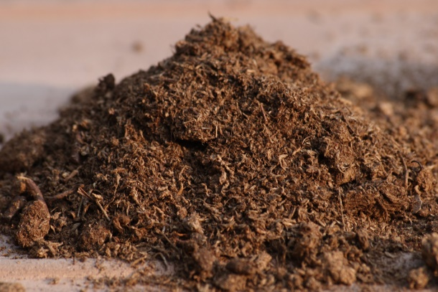
Data Overview
Tools Used
ArcGIS 10.2.2
Soil Data Viewer 6.2
Microsoft Excel 2010
R
Data Sets
Minnesota Power Groundline Inspection Records
Soil Survey Spatial and Tabular Data (SSURGO 2.2)
Digital Surface Model (DSM), Minnesota (2006-2012)
Notes:
STATSGO2 Hydrologic Soil Conditions for State of Minnesota

Slide 8
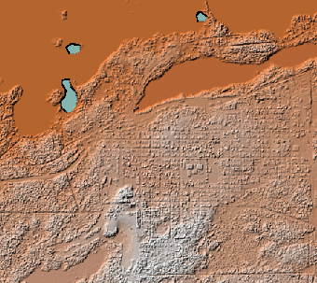
Workflow Overview
Clean up Pole Data
Download Required Data
SURGO
Elevation
Create shapefiles from SURGO Databases
Generate Aspect and Slope from elevation
Join soil, slope, and aspect values to pole data
Export to Excel for further cleanup and initial statistics
Conduct regression analysis to determine effect on pole failures using R
Point Data
Soil Data
DSM

Slide 9
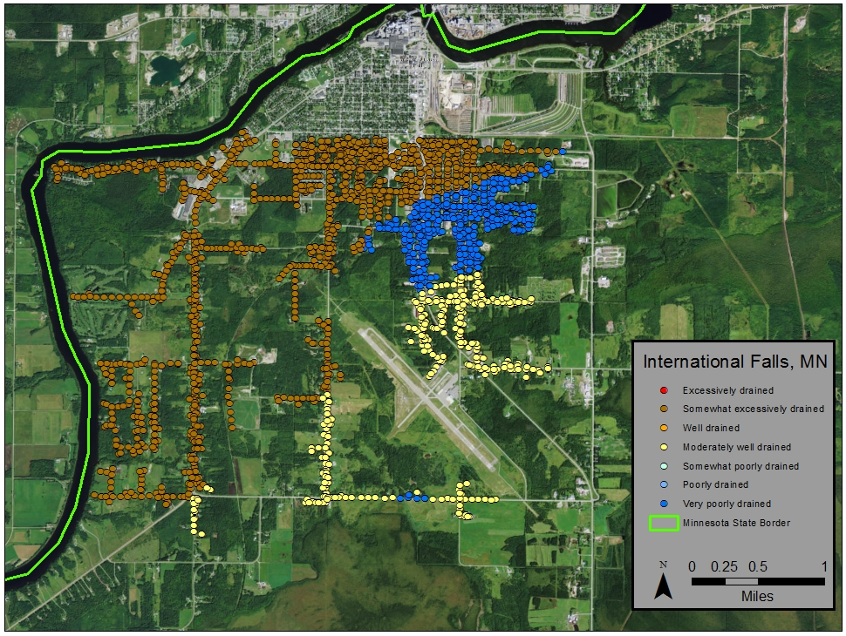
Pole Data
POLEYEAR
0E
0E
1
1075
0E
9
168
67
67
0E
0R
1040
2021
2110
167
1075
`2
1075
82
134E
150E
78
Pole Data required cleanup
Many records missing data or unknown values
Soil data needed Soil Data viewer tool for ArcGIS
Spatial join between poles, drainage, and hydrologic soil type to locate required values in one table
Assumptions
All poles have been treated from the factory to prevent decay
No poles are structurally overloaded
There is no mechanical damage to any pole
Each pole is in its initial install position (no replanted poles)
Notes:
Example of some values in the Pole installed year field
Soil Data viewer window
Data is right censored – not all poles wait until failing an inspections, poles can be replaced for other reasons (increase in clearance requirements, line upgrade)

Slide 10
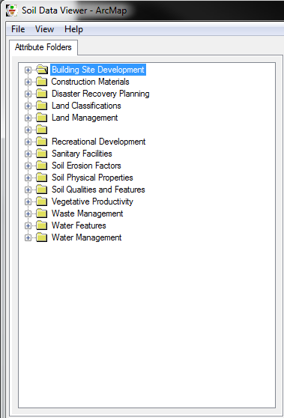
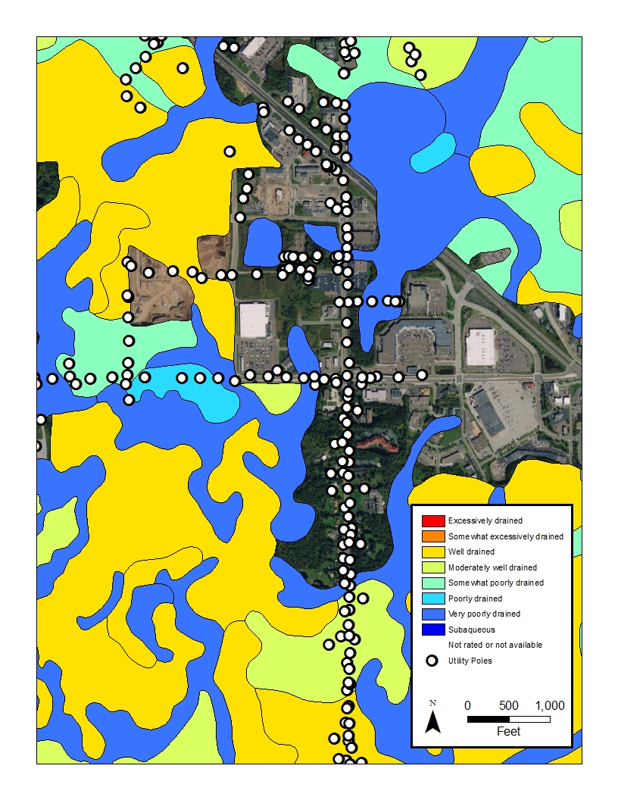
Soil Data
Downloaded SSURGO from United States Department of Agriculture (USDA) – Natural Resources Conservation Service
Comes as tabular data which must be referenced to an Access template
Use the Soil Data Viewer tool to display in ArcGIS
Old project used STATSGO – state level
Notes:
Example of some values in the Pole installed year field
Soil Data viewer window
Add soil attributes to pole points

Slide 11
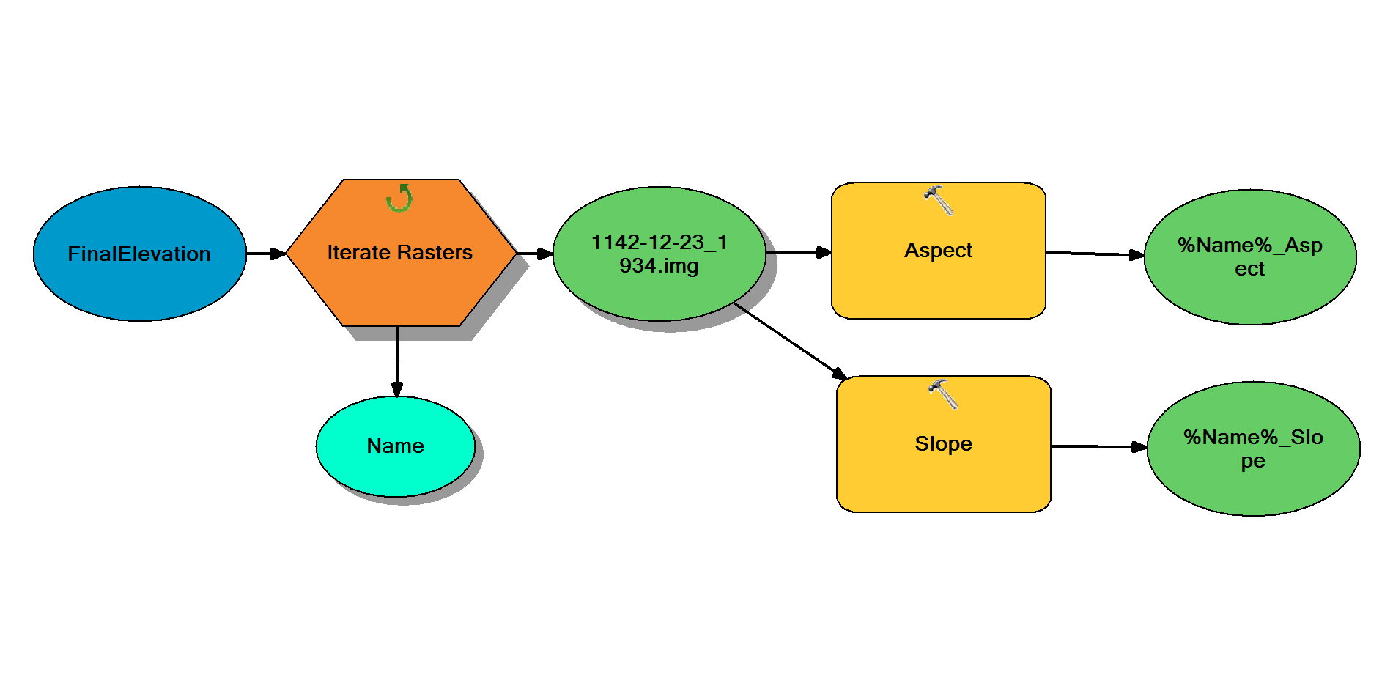
Elevation Data
1m resolution
Generated from raw LIDAR
Collected between 2006 and 2012
Used to for aspect and slope layers
ArcGIS model to generate aspect and slope rasters
Notes:
Model to generate slope rasters and aspect rasters automatically.
Add raster values to pole data

Slide 12
Initial Statistics
Compared to previous study with different soil data
Higher percentage of rejects in poorly drained areas
Notes:
STATSGO – 1:250000 – State, Regional, Multi-state
SSURGO – Ranging from 1:63360 to 1:12000 – Landowners, townships, and counties

Slide 13
Cox Proportional-Hazards Regression
Used to investigate effects of several variables upon time to failure
Gives risk between subjects – not absolute
Assumes effects of predictors are constant over time
Notes:
Can say poles in this type of soil X% more/less likely to fail than pole is other type of soil
Good for this study because terrain/slope/soil type do not change very fast/often

Slide 14
Results
Aspect and slope not significant
Slope related to drainage has limited effect
Most significance is with poorly drained soils
Best model fit from stratification by decade
Notes:
Aspect and slope might be significant in other models but soil type seemed to be overwhelmingly significant.
Stratified by decade – what this means is that each decade have a different baseline hazard function but share hazard ratios – chose decade since it had few values and was not interested in the variable

Slide 15
Results - 2
Proportional Hazard Matrix
Notes:
To be read by column/vertically (i.e. Column 2 is hazard ratio to all other soil type)

Slide 16
Conclusion
More attention should be shown to soil type in line design
Better drained soils should be inspected more often due to increased failure chance
GIS is a feasible tool for this type of analysis
Notes:
To be read by column/vertically (i.e. Column 2 is hazard ratio to all other soil type)

Slide 17
Sources
Bajestani, Maliheh Aramon, et al. "Maintenance Resource Planning for Utility Poles in a Power Distribution Network".Web.
Gao, Lu. “GIS Application to Investigate Soil Condition Effect on Pavement Performance.” GIS Hydro 2006. University of Texas at Austin. 2006. Web. 27 May. 2016.
Gezer, Engin Derya, Ali Temiz, and Turan Yüksek. "Inspection of Wooden Poles in Electrical Power Distribution Networks in Artvin, Turkey." Advances in Materials Science and Engineering 2015 (2015): 1-11. Web.
Johnson, Alan A., and Randall J. Storey. "Failure Of A Southern Pine Utility Pole. “Technology, Law & Insurance 4.1/2 (1999): Business Source Premier. Web. 30 May 2016.
Li, H., J. Zhang, and G. Bhuyan. "Reliability Assessment of Electrical Overhead Distribution Wood Poles".Web.
Onyewuchi, Urenna P., et al. "A Probabilistic Framework for Prioritizing Wood Pole Inspections Given Pole Geospatial Data." IEEE Transactions on Smart Grid 6.2 (2015): 973-9. Web.
Rahman, A., and G. Chattopadhyay. "Soil Factors Behind In ground Decay of Timber Poles: Testing and Interpretation of Results." IEEE Transactions on Power Delivery 22.3 (2007): 1897-903. Web.
“RUS Bulletin 1730B-121.” Rural Utilities Service. United States Department of Agriculture, 13 Aug. 2013. Web. 28 May 2016.
Ryan, Paraic C., et al. "Reliability Assessment of Power Pole Infrastructure Incorporating Deterioration and Network Maintenance. "Reliability Engineering & System Safety 132 (2014): 261-73. Web.
Shafieezadeh, Abdollah, et al. "Age-Dependent Fragility Models of Utility Wood Poles in Power Distribution Networks Against Extreme Wind Hazards." IEEE Transactions on Power Delivery 29.1 (2014): 131-9. Web.
Yumbe, Y., T. Hasegawa, and N. Furukawa. "Optimization Method for Inspection Scheduling of Power Distribution Facilities." IEEE Transactions on Power Delivery 28.3 (2013): 1558-65. Web.

Slide 18
Thank You
Special Thanks to: Seth Blumsack, Minnesota Power, Mehdi Shahriari, Ann Johnston, and Mauricio Fernandes.
Notes:
Seth Blumsask – Advisor
Minnesota Power – provided pole data
Mehdi Shahriari – provided help with raster processing.
Ann Johnston & Mauricio Fernandes – Statistics help at Penn State.

Slide 19
Questions?
Timothy Tabor
tut150@psu.edu

Slide 20
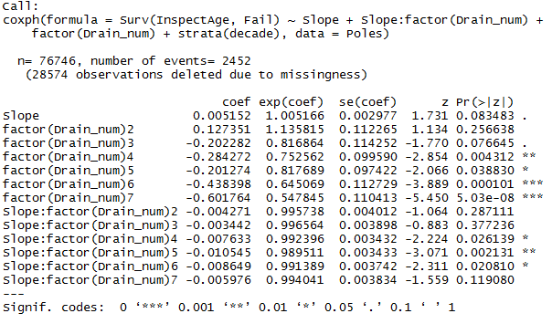
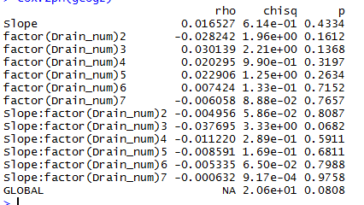
Raw Output
Run in RStudio
Top shows coefficients used to build Hazard Ratio
Bottom shows test for proportional Hazards
Notes:
Top – Lower score to the far right = more significant
Bottom – Low score means it violates proportional hazards

