Slide 1
Finding Balance:
Estimating bikeshare rebalancing events using trip data
Nathan L. Teigland

Slide 2
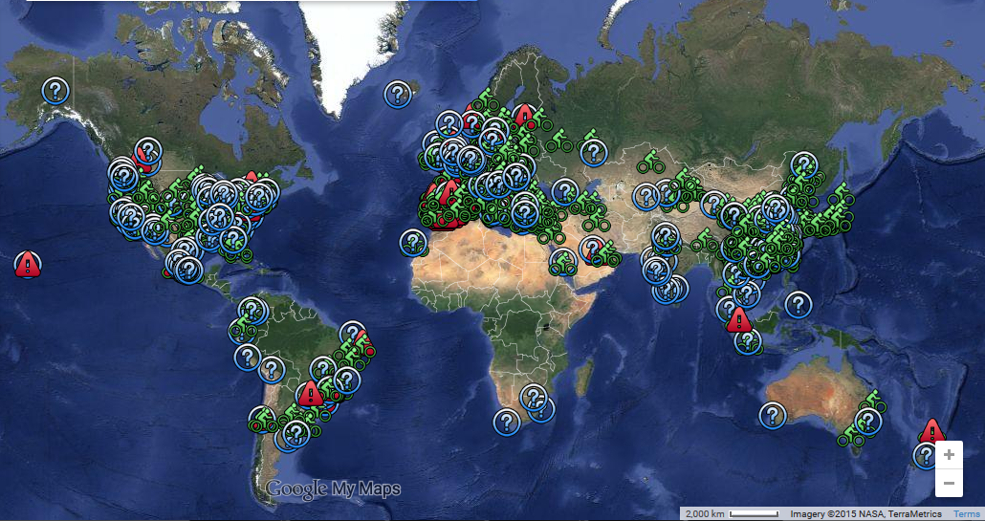
Background
Source: The Bike-sharing World Map, www.bikesharingmap.com. Used for educational purposes.

Slide 3
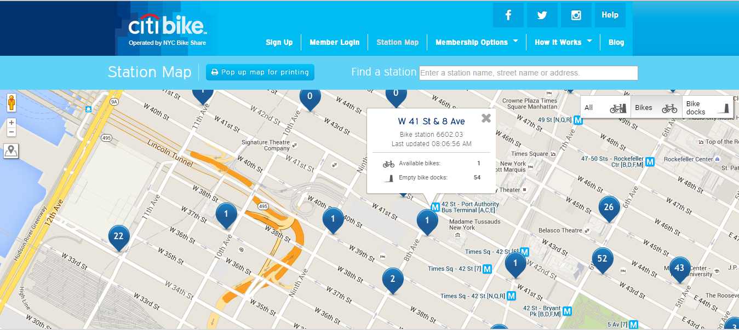
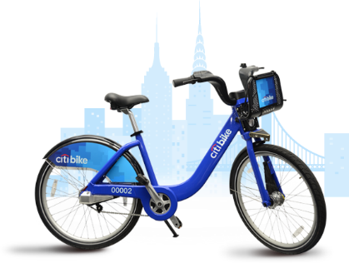
 | Annual | Week | Day
Base Fee | $149 | $25 | $9.95
Free Trip Length | 45 min | 30 min | 30 min
+30 min | $2.50 | $9 | $9
+30 min more | $4 | $9 | $12
+30 min extensions | $4 | $9 | $12
Source: New York Citi Bike (http://www.citibikenyc.com/), used for educational purposes.

Slide 4


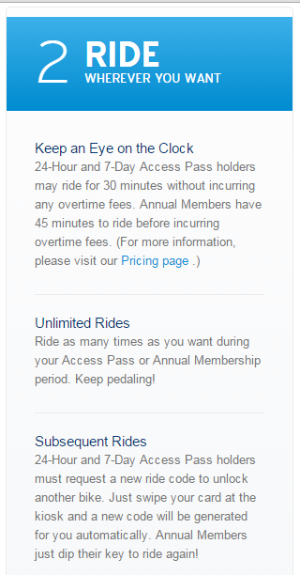
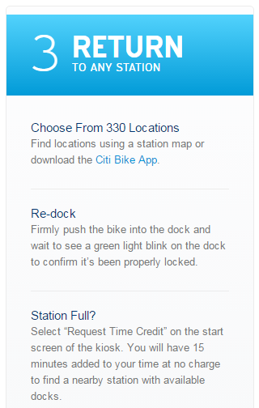
Source: New York Citi Bike (http://www.citibikenyc.com/), used for educational purposes.

Slide 5
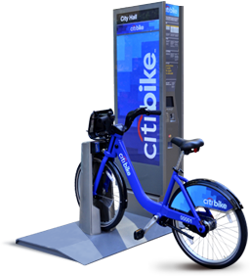
Optimizing Bike Allocation
Complex algorithms
  Optimal available bikes
  Optimal open docks
Problem
  Bikes are not in the right
  place at the right time
Solution
  Rebalancing
Source: New York Citi Bike (http://www.citibikenyc.com/), used for educational purposes.
Sources: New York Citi Bike, Open StreetMap, used for educational purposes. Mapping by the author.

Slide 6
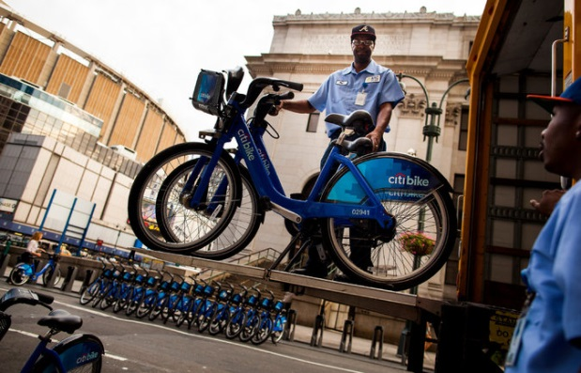
Rebalancing
Manually moving bikes from full stations to empty stations to meet user demand for both bikes and open docks
Box trucks, sprinter vehicles, and bicycle trailers
Crews travel in pairs. Loading a truck can take 45 minutes
Lease three staging areas near stations that empty quickly
Plan to introduce bike trailers
for one bike to haul a few others
during traffic congestion
Source: New York Citi Bike (http://www.citibikenyc.com/), used for educational purposes.

Slide 7
Literature
Improve optimization predictions
  GIS-based predictive demand
Fleet Management / Vehicle Routing Problem
  Enhancements through real-time station data and advanced routing capabilities
  Cluster-based routing vs station-based
Reducing rebalancing demand
  Rebalancing through pricing schemes

Slide 8
Objectives
Develop methodology to standardize and automate estimations of rebalancing trips
Develop analytic framework to support comparative geographic analysis of rebalancing operations
Assess utility of comparative analysis—between systems versus within systems
Explore different comparative measures at the station, route, and system levels
Data source for remainder of presentation: New York Citi Bike, August 2014

Slide 9
Methodologies
Statistical Attributes
  Timeframe of rebalancing operations?
  Ratio of rebalancing trips to rider trips?
  Number of rebalancing routes?
  Volume of rebalancing operations by day/time?
  Station-level inflow/outflow?)
Spatial Attributes
  Average rebalancing distance?
  Number of rebalancing trips by distance?
  Popular routes: rebalancing vs. rider trips?
  Rebalancing station location/density?
Visualization options
  Popular routes?
  Stations (inbound, outbound, net change, time series)?
  Hotspot analysis?
Does comparative analysis of different programs make sense? If so, can we establish a baseline for identifying “healthy” rebalancing characteristics, evaluate effectiveness of rebalancing techniques, or develop new techniques?

Slide 10
Rebalancing Estimation—Flow Data
Bike ID | Start Station | End Station | Start Time | End Time
19117 | 470 | 312 | 8/1/2014 0:00 | 8/1/2014 0:19
20549 | 236 | 432 | 8/1/2014 0:00 | 8/1/2014 0:02
15997 | 224 | 340 | 8/1/2014 0:00 | 8/1/2014 0:09
21437 | 150 | 522 | 8/1/2014 0:00 | 8/1/2014 0:35
16693 | 519 | 477 | 8/1/2014 0:00 | 8/1/2014 0:05
19797 | 477 | 478 | 8/1/2014 0:00 | 8/1/2014 0:05

Slide 11
Reading Between the Lines
Bike ID | Start Station | End Station | Start Time | End Time
19117 | 529 | 498 | 8/1/2014 17:30 | 8/1/2014 17:36
19117 | 498 | 520 | 8/1/2014 18:01 | 8/1/2014 18:09
19117 | 520 | 492 | 8/1/2014 18:09 | 8/1/2014 18:39
19117 | 362 | 478 | 8/1/2014 19:04 | 8/1/2014 19:13
19117 | 462 | 468 | 8/2/2014 13:12 | 8/2/2014 13:37
19117 | 468 | 362 | 8/2/2014 13:42 | 8/2/2014 13:55
19117 | 362 | 450 | 8/2/2014 14:09 | 8/2/2014 14:17

Slide 12
Reading Between the Lines
Deriving rebalancing trips from flow data

Slide 13
Duration / Timeframe - Trips
Chart 1: Timeframe of Rebalancing Trips (blue line) and Total Cumulative Percentage (green bars) of Rebalancing Trips, New York Citi Bike (August 2014)

Slide 14
Duration / Timeframe - Trips
Chart 2: Comparison of Rebalancing Trips (48 hour or shorter timeframe) and Rider trips by Hour of Day and Timeframe, New York Citi Bike (August 2014).

Slide 15
Spatial Comparison - Routes
Rider Routes |  |  |  |  | Rebalancing Routes
Route | Trips | %Total | Rebal Trips |  | Route | Trips | %Total | Rider Trips
2006_2006 | 1954 | 0.20% | 0 |  | 477_465 | 1008 | 0.81% | 21
281_281 | 1029 | 0.11% | 0 |  | 484_318 | 885 | 0.72% | 18
499_499 | 947 | 0.10% | 0
 |  |  |  |  | 510_500 | 705 | 0.57% | 41
387_387 | 535 | 0.06% | 0 |  | 510_469 | 584 | 0.47% | 21
457_457 | 474 | 0.05% | 0 |  | 529_2021 | 566 | 0.46% | 5
281_499 | 470 | 0.05% | 40 |  | 492_267 | 475 | 0.38% | 8
426_426 | 449 | 0.05% | 0 |  | 359_519 | 473 | 0.38% | 19
514_514 | 430 | 0.04% | 0 |  | 493_477 | 465 | 0.38% | 94
514_426 | 381 | 0.04% | 82 |  | 492_362 | 342 | 0.28% | 10
281_2006 | 370 | 0.04% | 48 |  | 359_318 | 292 | 0.24% | 7
Table 6: Top ten rider routes compares with top ten rebalancing routes, New York Citi Bike, August 2014.

Slide 16
Top 10 Rebalancing Routes
Map 1: Top ten rebalancing routes and trip count, New York Citi Bike, August 2014.
Data source: New York Citi Bike (http://www.citibikenyc.com/), used for educational purposes. Basemap source: OpenStreetMap. Mapping by author.

Slide 17
Station 447—Rebalancing
Chart 4: Station 477 rebalancing by direction, New York Citi Bike, August 2014. Data limited to rebalancing trips with timeframe <= 24 hours (n=3922).

Slide 18
A Day in the Life of Station 447
Chart 5: Gains and losses for Station 447 on Wednesday, August 6, 2014.

Slide 19
Station 447 Rebalancing—Spatial Attributes
Chart 6: Inbound and outbound rebalancing trips for station 447 by route length (mi), and total cumulative rebalancing distance (% of rebalancing miles), New York Citi Bike, August 2014.

Slide 20
Stations—Hotspot vs Surface
Start End Net Change
Rider
Rebal
Manhattan
Brooklyn

Slide 21
Going Forward
Next Steps
  Obtain true rebalancing data from bikeshare system(s)
  Develop method to differentiate between rebalancing and maintenance operations
  Develop and finalize datasets for each system
  Compute baseline comparative statistics for each system
Expected Outcomes
  Develop method to reliably estimate rebalancing operations within a public bikeshare system (and differentiate maintenance operations)
  Analytic framework to support comparative geographic analysis of rebalancing operations
  Assess utility of comparative analysis—between systems versus within systems

Slide 22
Timeline
Fall 2015:
  Obtain rebalancing data in order to validate results
  Comparative analysis of rebalancing data between selected bikeshare programs
Spring 2016:
  Prepare abstract for conference submissions
  Finalize paper to submit for publication February
 | Trips | Rebalances | Rate
Boston | 1,579,025 | 183,413 | 12%
Minneapolis | 308,051 | 31,079 | 10%
New York | 10,407,546 | 1,259,469 | 12%
San Francisco | 144,015 | 23,804 | 17%
Washington DC | 2,945,512 | 384,885 | 13%

Slide 23
References
Bikeshare.com, 2012. Bike Share Cities. Retrieved on November 14, 2014 from http://bikeshare.com/map/.
Caggiani, Leonardo & Michele Ottomanelli, 2012. A Modular Soft Computing based Method for Vehicles Repositioning in Bike-sharing Systems, Procedia - Social and Behavioral Sciences, Volume 54, 4 October 2012, Pages 675-684, ISSN 1877-0428, http://dx.doi.org/10.1016/j.sbspro.2012.09.785.
Chemla, Daniel & Frédéric Meunier, Roberto Wolfler Calvo, 2013. Bike sharing systems: Solving the static rebalancing problem, Discrete Optimization, Volume 10, Issue 2, May 2013, Pages 120-146, ISSN 1572-5286, http://dx.doi.org/10.1016/j.disopt.2012.11.005.
Citi Bike, 2014. Expansion! Woo hoo! Retrieved on November 14, 2014 from http://Citi Bikeblog.tumblr.com/post/101182979267/expansion-woo-hoo.
Corcoran, Jonathan and Tiebei Li, 2014. Spatial analytical approaches in public bicycle sharing programs. Journal of Transport Geography, Volume 41, December 2014, Pages 268-271, ISSN 0966-6923, http://dx.doi.org/10.1016/j.jtrangeo.2014.09.005.
Dell'Amico, Mauro, Eleni Hadjicostantinou, Manuel Iori, & Stefano Novellani, 2014. The bike sharing rebalancing problem: Mathematical formulations and benchmark instances, Omega, Volume 45, June 2014, Pages 7-19, ISSN 0305-0483, http://dx.doi.org/10.1016/j.omega.2013.12.001.
DeMaio, P., 2009. Bike-sharing: history, impacts, models of provision, and future. Journal of Public Transportation. 12 (4), 41-56.
DeMaio, P., No Date. The Bike-sharing World Map. Retrieved on November 14, 2014 from https://www.google.com/maps/d/viewer?mid=zGPlSU9zZvZw.kmqv_ul1MfkI and http://www.metrobike.net/the-bike-sharing-world-map/.
Erdoğan, Güneş & Gilbert Laporte, Roberto Wolfler Calvo, 2014. The static bicycle relocation problem with demand intervals, European Journal of Operational Research, Volume 238, Issue 2, 16 October 2014, Pages 451-457, ISSN 0377-2217, http://dx.doi.org/10.1016/j.ejor.2014.04.013.
Flegenheimer, M., 2013. The balancing act that bike-share riders just watch: Metropolitan desk. New York Times.
Forma, Iris A., Tal Raviv, & Michal Tzur, 2015. A 3-step math heuristic for the static repositioning problem in bike-sharing systems, Transportation Research Part B: Methodological, Volume 71, January 2015, Pages 230-247, ISSN 0191-2615, http://dx.doi.org/10.1016/j.trb.2014.10.003.
García-Palomares, J. C., Gutiérrez, J., & Latorre, M., 2012. Optimizing the location of stations in bike-sharing programs: A GIS approach. Applied Geography, 35(1-2), 235-246. doi:10.1016/j.apgeog.2012.07.002
Garcia-Palomares, J.C., Gutierrez, J., & Latorre, M., 2012. Optimizing the location of stations in bike-sharing programs: A GIS approach. Applied Geography 35, 235-246.
Gordon-Koven, L. & Levenson, N., 2014. Citi Bike Takes New York. NYU Robert F. Wagner Graduate School of Public Service: Rudin Center for Transportation Management and Policy.
Haider, Z., 2014. Inventory rebalancing through pricing in public bike sharing systems (Order No. 1566895). Available from ProQuest Dissertations & Theses A&I. (1625768707). Retrieved from http://search.proquest.com/docview/1625768707?accountid=13158
Ho, Sin C. & W.Y. Szeto, 2014. Solving a static repositioning problem in bike-sharing systems using iterated tabu search, Transportation Research Part E: Logistics and Transportation Review, Volume 69, September 2014, Pages 180-198, ISSN 1366-5545, http://dx.doi.org/10.1016/j.tre.2014.05.017.
Kurtzleben, Danielle, 2012. Bike Sharing Systems Aren't Trying to Peddle for Profit. US News & World Report, April 17, 2012. Retrieved from http://www.usnews.com/news/articles/2012/04/17/bike-sharing-systems-arent-trying-to-peddle-for-profit.
Lin, J. H., & Chou, T. C., 2012. A geo-aware and VRP-based public bicycle redistribution system. International Journal of Vehicular Technology, 2012 doi:10.1155/2012/963427
Lin, Jenn-Rong & Ta-Hui Yang, 2011. Strategic design of public bicycle sharing systems with service level constraints, Transportation Research Part E: Logistics and Transportation Review, Volume 47, Issue 2, March 2011, Pages 284-294, ISSN 1366-5545, http://dx.doi.org/10.1016/j.tre.2010.09.004.
Médard de Chardon, Cyrille & Geoffrey Caruso, 2015. Estimating bike-share trips using station level data. Transportation Research Part B: Methodological, Volume 78, August 2015, Pages 260-279, ISSN 0191-2615, http://dx.doi.org/10.1016/j.trb.2015.05.003.
Nair, Rahul & Elise Miller-Hooks, 2011. Fleet Management for Vehicle Sharing Operations. Transportation Science 45(4):524-540. http://dx.doi.org/10.1287/trsc.1100.0347
Nair, Rahul & Elise Miller-Hooks, 2014. Equilibrium network design of shared-vehicle systems, European Journal of Operational Research, Volume 235, Issue 1, 16 May 2014, Pages 47-61, ISSN 0377-2217, http://dx.doi.org/10.1016/j.ejor.2013.09.019.
O’Brien, Oliver , James Cheshire & Michael Batty, 2013. Mining bicycle sharing data for generating insights into sustainable transport systems, Journal of Transport Geography, Volume 34, January 2014, Pages 262-273, ISSN 0966-6923, http://dx.doi.org/10.1016/j.jtrangeo.2013.06.007.
Raviv, Tal & Ofer Kolka, 2013. Optimal inventory management of a bike-sharing station, IIE Transactions, 45:10, 1077-1093, DOI: 10.1080/0740817X.2013.770186
Regue, Robert & Will Recker, 2014. Proactive vehicle routing with inferred demand to solve the bikesharing rebalancing problem, Transportation Research Part E: Logistics and Transportation Review, Volume 72, December 2014, Pages 192-209, ISSN 1366-5545, http://dx.doi.org/10.1016/j.tre.2014.10.005.
Schuijbroek, Jasper, Robert Hampshire & Willem-Jan van Hoeve, 2013. Inventory Rebalancing and Vehicle Routing in Bike Sharing Systems. Carnegie Mellon University, Tepper School of Business, Research Showcase, 2-2013. Accessed at http://repository.cmu.edu/cgi/viewcontent.cgi?article=2490&context=tepper.
Shaheen, S. A., Martin, E. W., Cohen, A. P., & Finson, R. S., 2012. PUBLIC BIKESHARING IN NORTH AMERICA: EARLY OPERATOR AND USER UNDERSTANDING. Mineta Transportation Institute Report CA-MTI-12-1029, June 2012. Retrieved from http://transweb.sjsu.edu/PDFs/research/1029-public-bikesharing-understanding-early-operators-users.pdf
Singla, Adish, Marco Santoni, Gabor Bartok, Pratik Mukerji, Moritz Meenen, and Andreas Krause, 2015. Incentivizing Users for Balancing Bike Sharing Systems, In Proc. Conference on Artificial Intelligence (AAAI), 2015. Retrieved from http://las.ethz.ch/files/singla15incentivizing.pdf.
Vogel, P., Mattfeld, D., 2011. Strategic and operational planning of bike-sharing systems by data mining – a case study. Lect. Notes Comput. Sci. 6971, 127–141.
Vogel, Patrick, Torsten Greiser and Dirk Christian Mattfeld, 2011. Understanding Bike-Sharing Systems using Data Mining: Exploring Activity Patterns, Procedia - Social and Behavioral Sciences, Volume 20, 2011, Pages 514-523, ISSN 1877-0428, http://dx.doi.org/10.1016/j.sbspro.2011.08.058.
Waserhole, Ariel, Vincent Jost, and Nadia Brauner, 2013. Pricing techniques for self regulation in Vehicle Sharing Systems. Electronic Notes in Discrete Mathematics, Volume 41, 5 June 2013, Pages 149-156, ISSN 1571-0653. Retrieved from https://ddv.ull.es/users/inoc2013/public/Proceedings/ENDM-024.pdf.

Slide 24
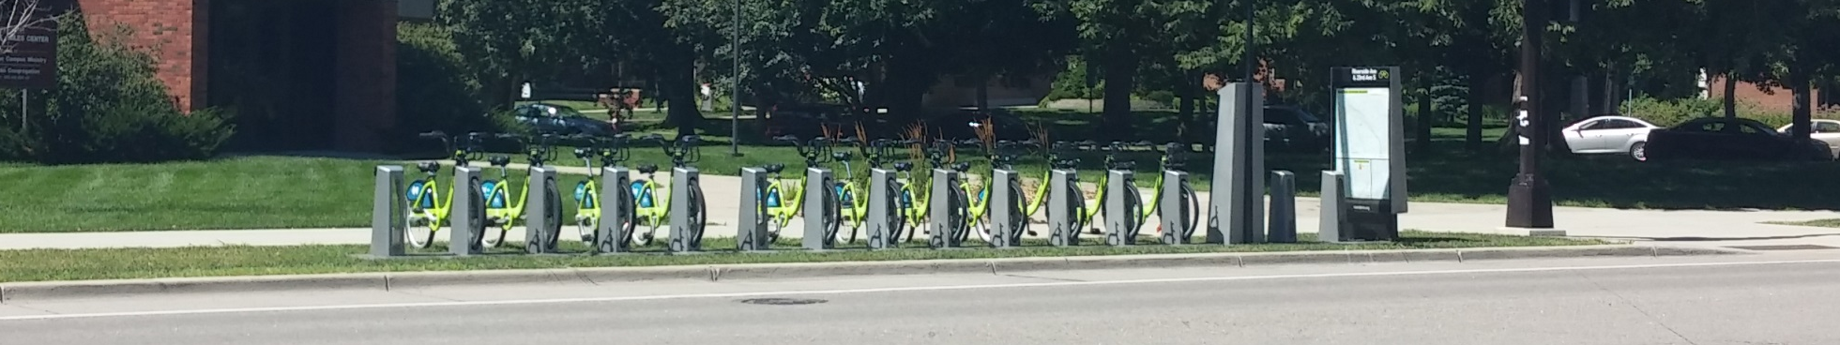

Acknowledgements
Questions
Dr. Justine Blanford, Department of Geography, Pennsylvania State University
GEOG 586 – Geographic Information Analysis
New York Citi Bike
Notes:
Riverside Ave & 23rd Ave S

