Slide 1
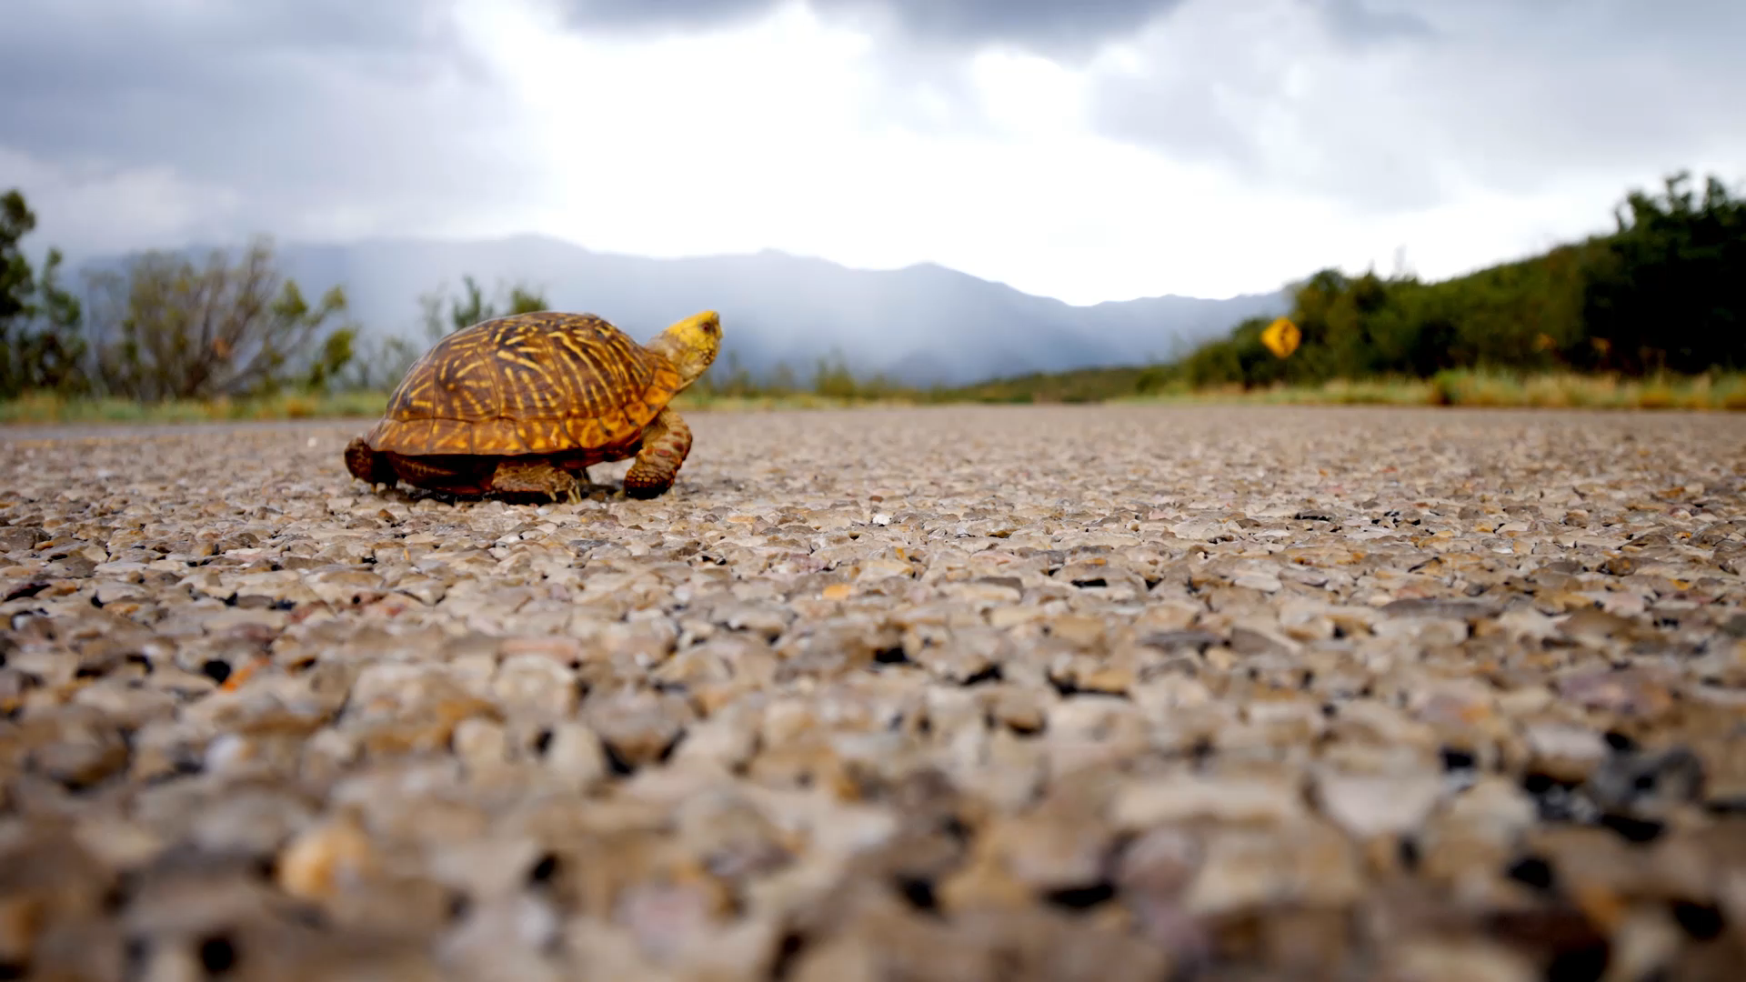
Hibernaculum Site Selection in Eastern Box Turtles
Understanding patterns, preferences and behaviors to enhance conservation efforts

Slide 2
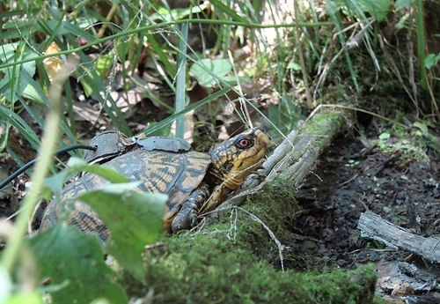
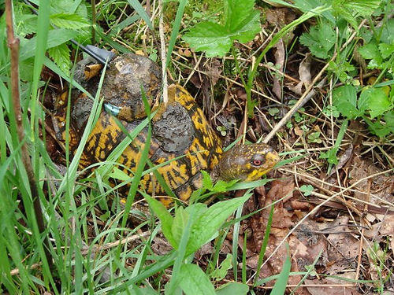
Outline
Background
  Personal
  Project
  Eastern Box Turtles
Objectives
  Data validation and extraction
  Habitat Analysis
  Behavior analysis
Methods
Expected outcomes
Timeline
Notes:
I will cover my personal background, interest in the Eastern Box Turtle Conservation Trust Project and of course Eastern Box Turtles. I will cover areas of interest and previous research on variables from demographic variability to fidelity and homerange preference. Additionally, I will cover some key research limitations with Eastern Box Turtle studies.
There are three main objectives associated with the project and include…
Each method will be briefly covered with expected outcomes and a timeline.

Slide 3
Personal Background
Seasonal Biologist
  Predictive based ecological modeling for wildlife management using GIS
  Wildlife habitat development and environmental surveying
Biologist / GIS Specialist at the Eastern Box Turtle Conservation Trust
  Data collection
  Processing, analysis
  Database management
  Publications and training
GIS Program Manager at USMC Quantico
Notes:
During my undergraduate I worked on projects modeling spatial responses by animals across a landscape. After graduation I began working as a seasonal biologist for several organizations were continued to model ecological relationships.
After I was introduced to EBTCT, I was a participant in field surveys, data collection, and post processing. I helped reset their infrastructure and geospatial workflows from data collection to publication.
I am not longer in that role. Recently I have transitioned to a position as the GIS program manager for MCB Quantico.

Slide 4
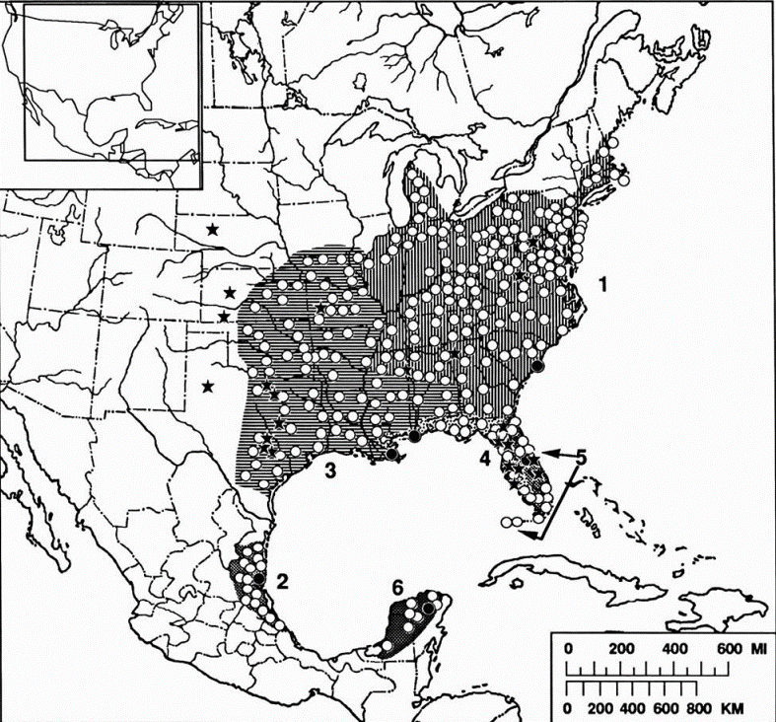
Eastern Box Turtles
Species description
History
Conservation status
Population
Figure 1. Solid circles mark type-localities; hollow circles indicate other selected records. Stars represent selected fossil localities (Ernst & McBreen, 1991)
Notes:
Eastern Box Turtles are common throughout the Eastern from Main to Florida. Box turtles are unique because they can completely retract into there shell. They range in color from bright yellow to orange but can be dull depending on the time of year. They are measured by the length of there shell and adults are 8 inches in length. They are very long lived which is thought to range from…
Populations are..
The population decline is in part due to the pet industry and slow maturation time. Eastern Box Turtles are not federally listed. Most states consider Eastern Box Turtles to be threatened or vulnerable due to the decreasing population levels.

Slide 5
Eastern Box Turtle research
Model Species
Variables
Demographic Variability
Translocation status
Juveniles
Population fragmentation
Disease
Habitat
Homerange
Brumation
Notes:
Eastern Box Turtles have been used as a model species for determining reptile behaviors for over 100 years. This is due to the species size, longevity, geospatial range and low mobility.
Eastern Box turtle research focuses on many variables. Key variables include…
There is a lack of information about Eastern Box Turtles hibernacula selection preferences and behaviors. A research gap has been identified and this project will help fulfill the knowledge gap in the literature.

Slide 6
Research Limitations
Financial
Limited study duration
Observation Frequency
Fragmentation in landscape
Human interaction
Notes:
There are always limitations to research. These become more prevalent with Eastern Box Turtles due to the longevity of the species. Conducting long term studies are expensive. Long term studies are often conducted out of proximity to a native population. Studies are often have a short duration compared to the life span of an individual. Studies have highly variable observation frequencies which means…
The increasing fragmentation level of the landscape can interfere with long term studies occasional changing behaviors due to human interaction. Studies in highly urban environments have had issues with human interactions. It has been documented that turtles last located along corridors disappear and later reappear in nearly the same place years later due to being used as a pet.
This can lead to results showing a snapshot of a turtle's life occasion showing bimodal behaviors missing the flexibility of the species. This often leads to regional disparities in the literature and regional conservation efforts.

Slide 7
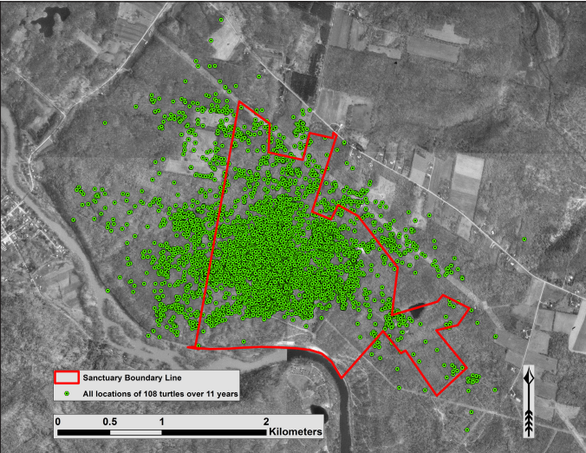
Eastern Box Turtle Conservation Trust (EBTCT)
EBTCT was established to enhance box turtle conservation and native population recruitment to improve declining populations in northwest Pennsylvania.
Notes:
The study has been ongoing for 29 years and includes a history on 148 turtles. The observation frequency averages 11 days for actively tracked turtles. The study site is minimally fragmented with turtles free to cross boundaries but rarely cross roads. Surveys were conducted to locate existing populations but due to previous mining activity Eastern Box Turtles were extirpated from the area. This is a great opportunity because all individuals in the study were known to be translocated.

Slide 8

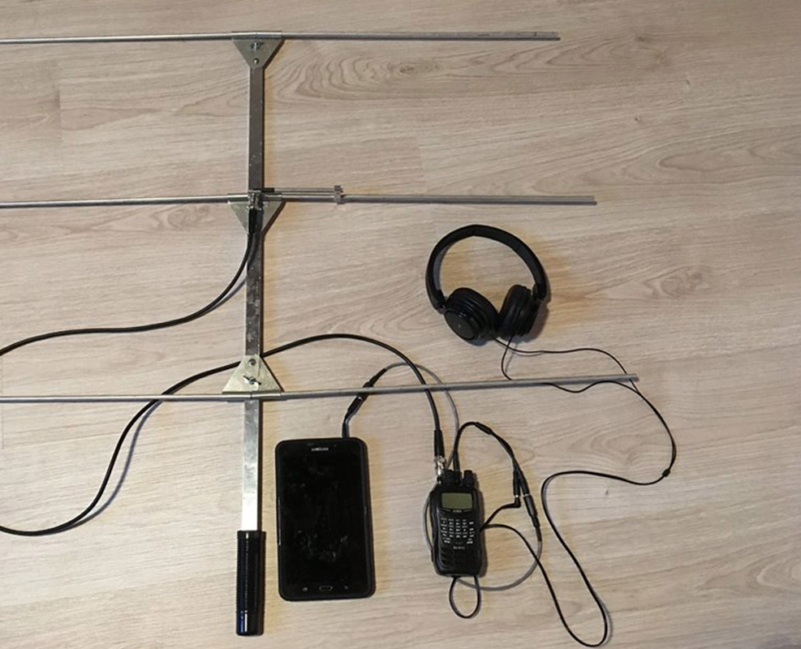
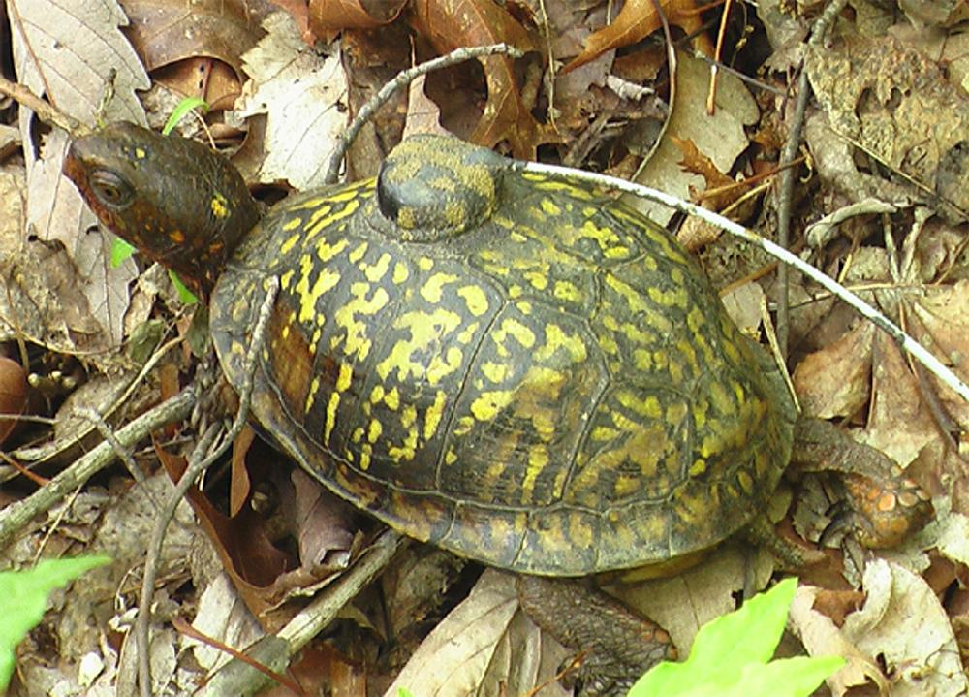
Radio Telemetry
Why is it useful?
  Silent way to track animals
  Transmitters are small
In use for over 60 years
Receiver vs transmitter
VHF signal
Notes:
Why is it useful?
-Understand population dynamics
-Age and growth studies
-Home range
Transmitters are attached to the animal
Receivers are used with an antenna to locate the receivers.
Transmitters in the study last about 3 years before they are replaced. The signal is VHF Very high Frequency and does not affect individuals.

Slide 9
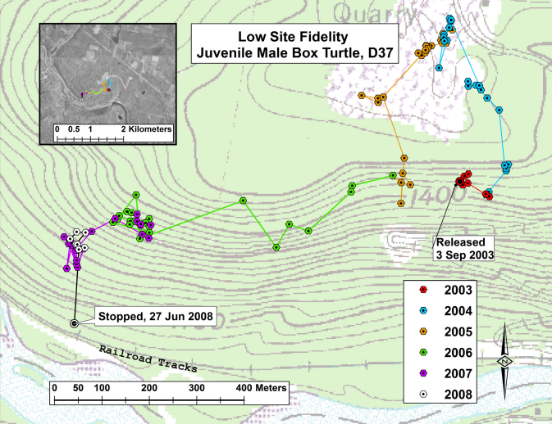
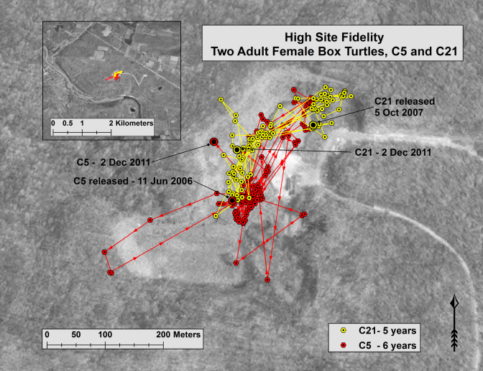
Fidelity
Spatial distributions are described by fidelity
Low Site Fidelity
High Site Fidelity
Notes:
Spatial distributions are described by fidelity. A low site fidelity means they turtle does not stay in a singular location. High site fidelity is described as a the relatively small location that an individual resides in.
The map on the left describes 1 individual with a low site fidelity who over the course of 6 years never stayed at a site year after year.
The map on the right describes two turtles with high site fidelity who chose to occupy a field habitat and not leaving for the duration of the study.

Slide 10
Database
Periods of activity
Fall
Spring
Data collection
  Approximately 8 months
  High observation intervals
Technology
  GPS character spacing
    Encoded name, date and status
    6 characters
Notes:
The active field season is approximately 8 months long and observations range from 3 to 15 days. The average observation internal is 11 days while being tracked with an average observation period of 13 years across 148 turtles. The longest individual recording period currently is 23 years long.
The GPS technology has changes since the project began. At the beginning the editable fields were 6 characters in length. To record all information needed including the name, date, and status the dataset was encoded.

Slide 11
Data
GIS Field
Characters 1 and 2 denote turtle ID
  41 corresponds with turtle C41
Character 3 represents year class
  J corresponds with 2019
Character 4 represents the month
  8,9,0 represent August, September, November respectively
Characters 5 and 6 represent the day
  10 corresponds with the 10th day of the month
Notes:
(Click) This has resulted in just over 38,000 spatial locations being encoded into the database. The decoding key has been described for each of the 6 character in the GIS field.

Slide 12
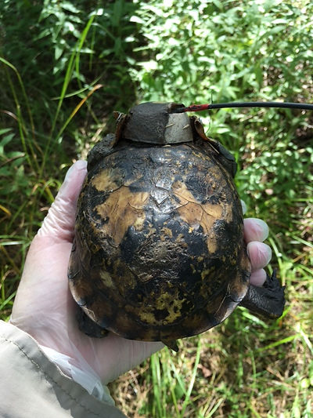
Data Anomalies
  Characteristics of note are recorded by an additional (Duplicate WP) and contain a special identifier
  Hibernacula _ _ _ H _ _
  Infection _ _ _ M _ _
  Death _ _ _ _ D D
  Unlocatable _ _ _ _ _ L
  Relocated _ _ _ _ _ E
  Removed from Study _ _ _ H H I
Notes:
When there was an anomaly or characteristic of note and additionally waypoint was captured. Anomalies could have been any of the notated characteristics…… including……
The turtle ID, year and month were unchanged to fit the WP into the timeline for further analysis. This is a sample of the anomalies that can be extracted from the dataset.

Slide 13
Goals and objectives
  Phase 1: Decode the database for data extraction
  Phase 2: Perform vegetation and habitat analysis of the study site
  Phase 3: Evaluate the behavioral fidelity of eastern box turtle Homerange and Hibernaculum site selection
Notes:
There are three main goals and objectives for this project. The first is to decode the entire database. This involved cleaning any identified errors and identifying all the anomalies present through the database. The second is to perform a vegetation analysis and develop a habitat analysis of the entire study site. The final objective is to evaluate the behavioral fidelity of eastern box turtle Homerange and Hibernaculum site selection. This will establish baseline preferences that can be further insight to the behaviors and preferences of Eastern Box Turtles.

Slide 14
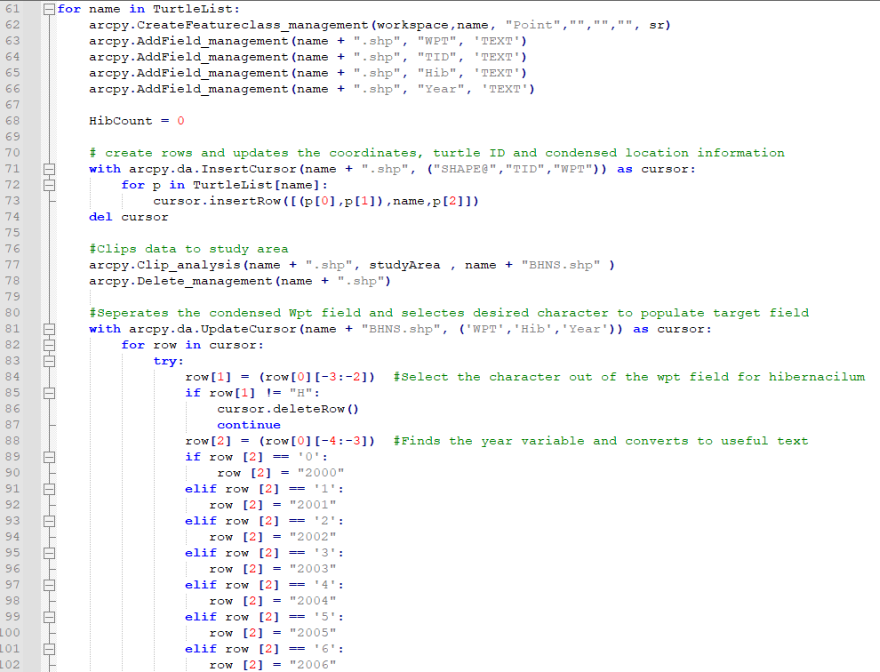
Decoding the Database
GEOG 485: Developed the framework for pre-processing the database
Flags coordinates outside of error margin
Identifies the length of continuous data
Identifies anomalies
Converts anomalies to usable text
Notes:
Phase 1: Decoding the database began in GEOG 485 which developed the framework for pre-processing the database. The tool was written in Python and built as a custom tool in ArcGIS PRO. I was able to identify geospatial errors outside the project bounds, identify individuals with an active study length required. The script identifies and extracts the anomalies that are selected for. The selected values were then converted to text for analysis. I did not change the active database because the study is ongoing and new data can be easily added by obtaining a current database.

Slide 15
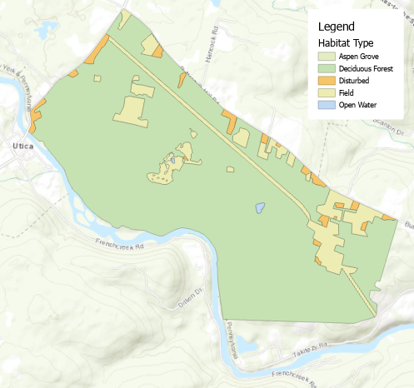
Vegetation Analysis
Cursory habitat delineations are identified
  Edge habitats
Type | Hectares | Percent
Disturbed | 34.65 | 2.40%
Field | 162.15 | 11.5%
Riparian | 2.01 | 0.14%
Deciduous Forest | 1206.98 | 85.70%
Aspen Groves | 1.76 | 0.13%
Total | 1407.55 | 100%
Notes:
Phase 2 Began in 481 using LIDAR to extract habitat types from the landscape. Using LP360 habitat profiles were extracted and quantified. This phase is not completed as microhabitats for Eastern Box Turtles are not identified. A review of the literature on habitat analyses with Easter Box Turtles indicates a need to include low lying vegetation and edge habitats referred to as ecological travel corridors.

Slide 16
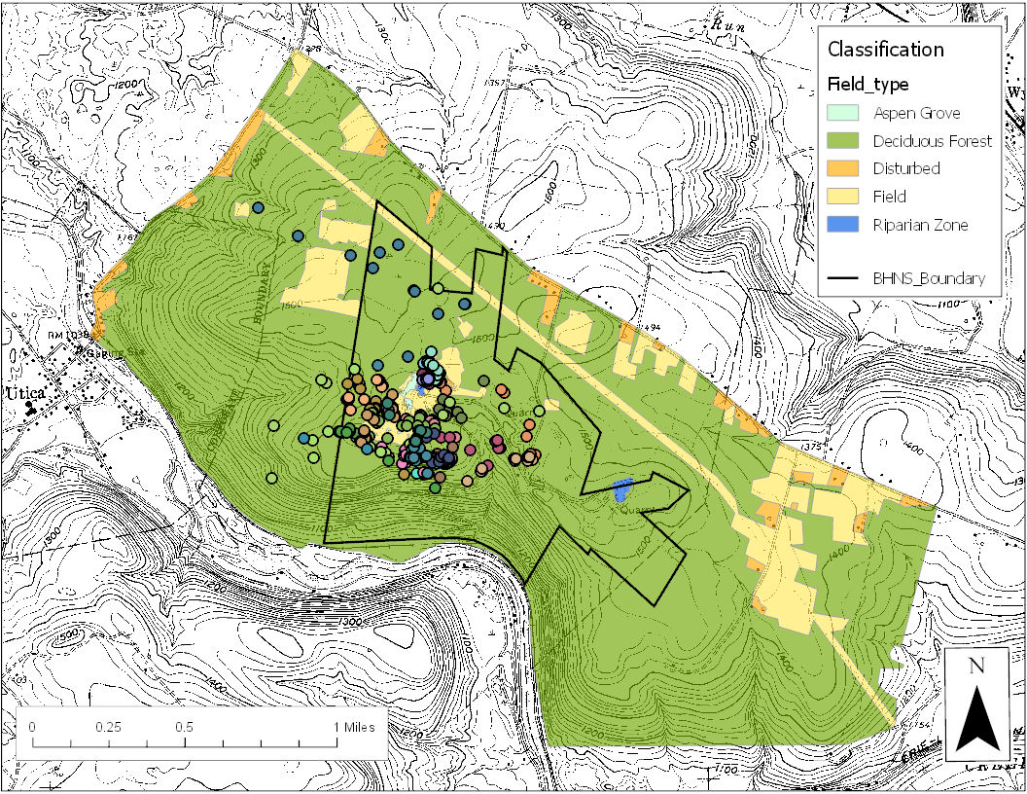
behavioral fidelity
Identify preferences between high and low site fidelity.
Develop homerange extents
Develop hibernacula extents
Compare and report Global Moran’s I auto correlation values to evaluate the overall data relationship.
Hypothesis: If individuals have a high site fidelity, they with a high hibernacula fidelity.
Notes:
Phase 3: Assess the behavioral site preferences of a long-term study with high observation intervals to identify areas of consideration for conservation efforts. This will begin by identifying home range extents using minimum convex polygons for site occurrences and hibernaculum occurrences for each turtle. Once this is complete, We can identify if individuals with a high site fidelity also have a high hibernacula fidelity.

Slide 17
Conservation efforts
What needs to be changed or considered in current conservation programs to better protect the species?
Notes:
Using the data from the long-term high observation interval study we can identify are the current variables enough to conserve the species. This study will highlight the disparity in behaviors and fulfill a gap in the literate regarding hibernacula site selection in Eastern Box Turtles.

Slide 18
Timeline
December 2020 – February 2021
*October 2020 – June 2022
Obtain the Data
Phase 1: Decode the Database
Data Pre-Processing
Phase 2: Vegetation Analysis
Habitat analysis
Phase 3. Integrate Post-Processed Data & Habitat Analyses
Visualize Data & Generate Reports
Develop Fidelity Relationships
Present documented work & Finalize Report
April 2020
April - July 2020
*June – July 2022
*August - September 2022
*November -December 2022
*October 2022
*December 2022

Slide 19
Expected results
  Decode the database for data extraction
    Completed
  Perform vegetation analysis of the study site
    In progress
  Establish baseline hibernaculum site preferences and behaviors for translocated Eastern Box Turtles by evaluating translocated fidelity homerange and hibernaculum site selection.
    I expect that individuals high site fidelity will exhibit hibernaculum site fidelity. Additionally, individuals with low site fidelity will exhibit low hibernaculum site fidelity.

Slide 20
Acknowledgements
The Eastern Box Turtle Conservation Trust for the use of there dataset.
The study thanks the Pennsylvania Fish and Boat Commission, Natural Diversity Section, for the special long-term research permit, issued in 1993, which enables field studies. Federal permits are not applicable. The animals in this paper were free-roaming box turtles and therefore not subjected to captive care hazards.

Slide 21
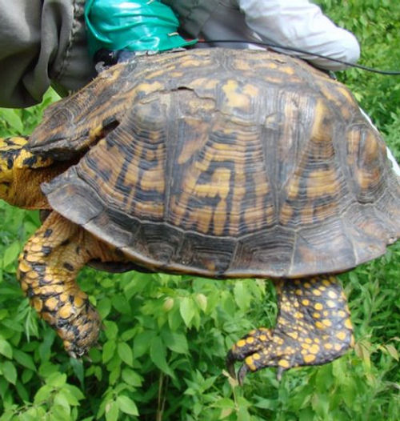
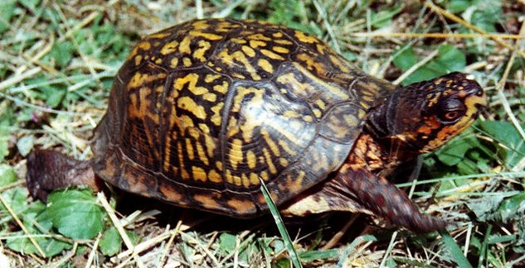
Questions?

