Slide 1
Seeing the Forest and the Trees with LiDAR and Multi-Spectral Imagery:
A GIS Method for Evaluating Effective Shade for Riparian Restoration Projects
LiDAR
Multi-Spectral Imagery
Tree Canopy Extraction
Chad Tinsley
Adviser: Jarlath Oneil-Dunne
October 2014
Penn State MGIS: Capstone 596A
Incoming Solar Radiation

Slide 2
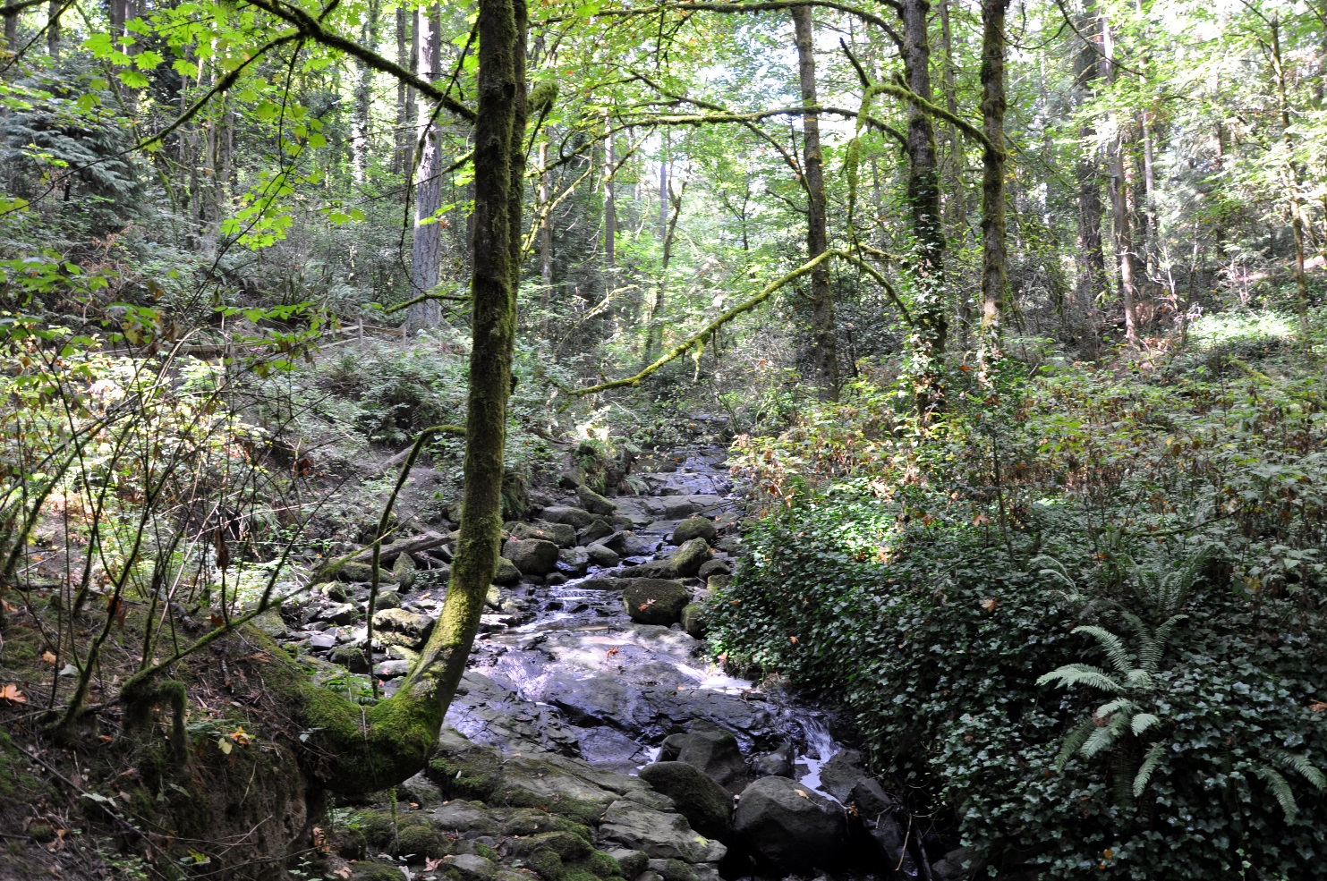
Project Purpose
**Develop an improved methodology to model incoming solar radiation and effective tree canopy shading.
*Implement the method to analyze the effective tree canopy shading within stream corridors from protected trees within the City of Lake Oswego’s Water Quality Resource Areas (WQRAs).
Tryon Creek, Lake Oswego. Photo credit wikipedia.org
Notes:
My purpose for the City is to implement this method specifically to model the effective tree canopy shading within stream corridors from the city’s Water Quality Resource Areas which are protected by the sensitive lands program. We were more interested in shade provided from those areas because the future of shade coming from trees outside of those areas is uncertain and riparian restoration projects are more supported within the protected areas. Most importantly I wanted to develop an improved methodology to model incoming solar radiation and effective tree canopy shading.

Slide 3
Agenda
Water Quality - Total Maximum Daily Load (TMDL)
Current Method
Lake Oswego Case Study
Methodology
LiDAR Processing
Tree Canopy Extraction
Solar Radiation and Shade Modeling
Display Results
Questions

Slide 4
Total Maximum daily Load (TMDL)
With regards to Temperature and shading
TMDL: The calculated pollutant amount that a body of water can receive and still meet water quality standards.
The TMDL Process
Assess the state’s waters
List those that do not
meet standards
Identify sources and reductions
needed (TMDL Study)
Implement restoration activities
(Implementation Plan)
Evaluate water quality
Notes:
Point Sources are pollutant loads discharged directly from pipes, outfalls, or channels from wastewater plants or industrial waste treatment facilities, or even tributary streams. Non-points sources are pollutants that are not released from pipes, but instead come from a variety of activities such as land or water use, improper animal-keeping practices, urban and rural runoff, and forestry practices. Analyzing solar heating from the urban canopy, therefore, is a nonpoint source of pollutants. In fact the greatly elevated temperatures in summer is one of the biggest issues to stream water quality in the Northwest. It causes damage to cold water fish and other native species, lifecycle timing, nutrient cycles, oxygen concentrations, and results in a loss of resistance to invasive species.

Slide 5
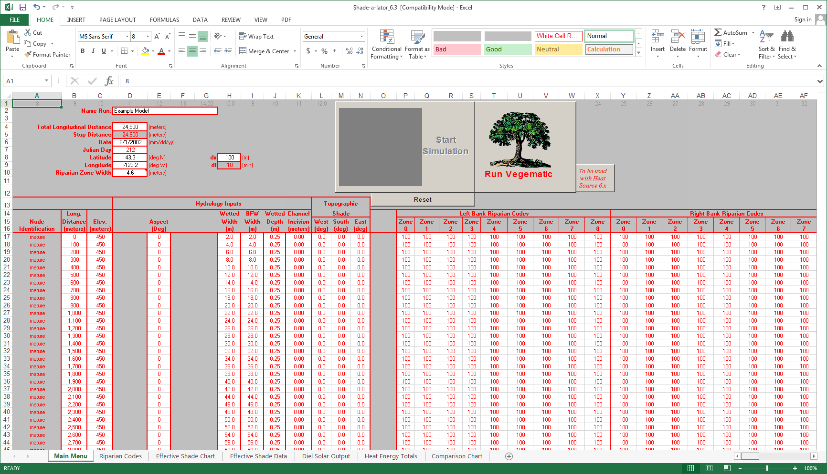
Current methods
Notes:
This spreadsheet is a tool put out by Oregon’s DEQ called Shade-a-lator. It’s used in combination with a heat source tool to input GIS data and eventually output statistics on solar heating for 100 meter segments of stream.

Slide 6
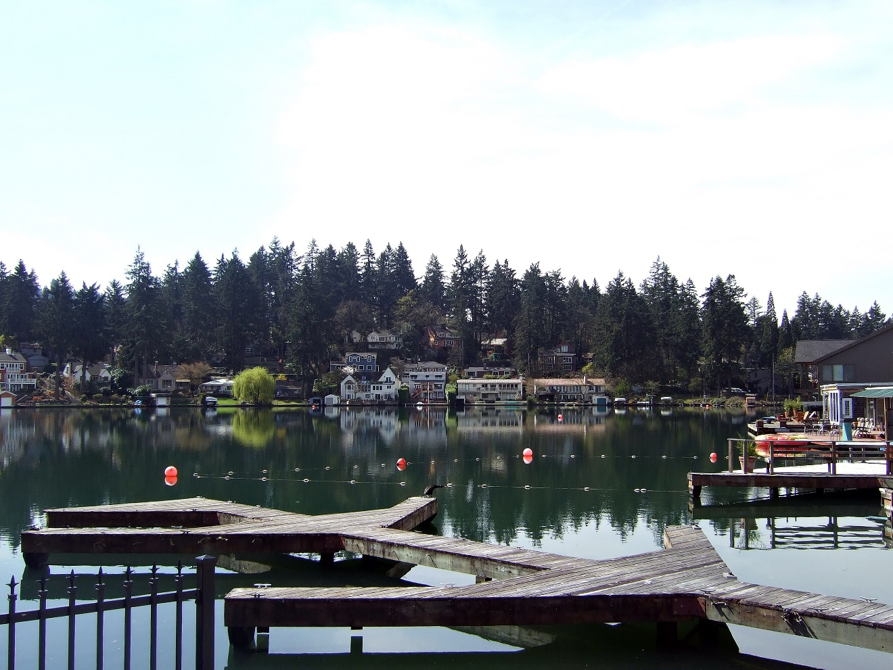
Case Study: City of Lake oswego
Photo Credit: wikipedia.org

Slide 7
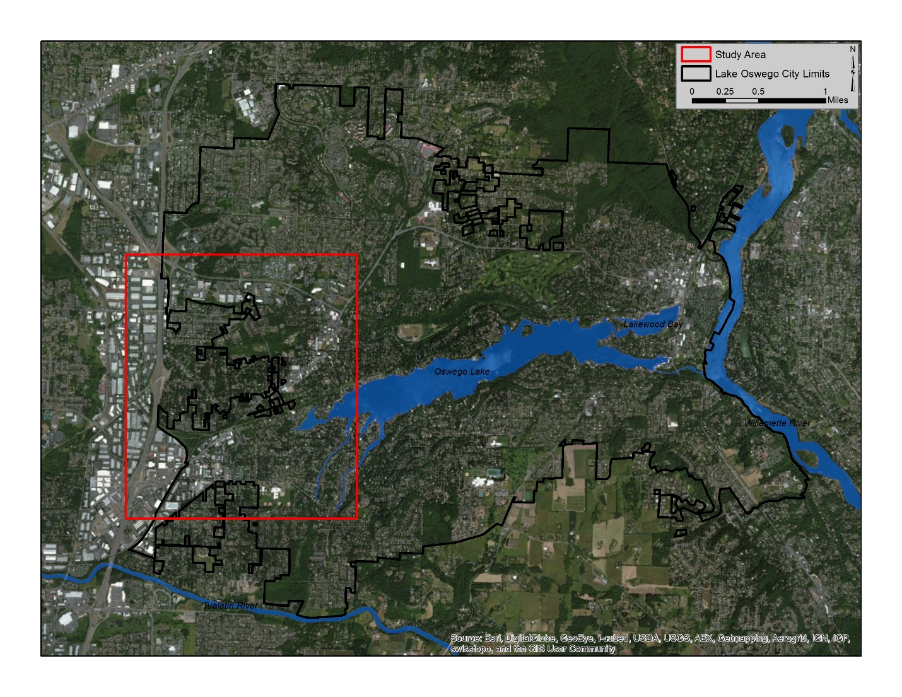
Study area

Slide 8
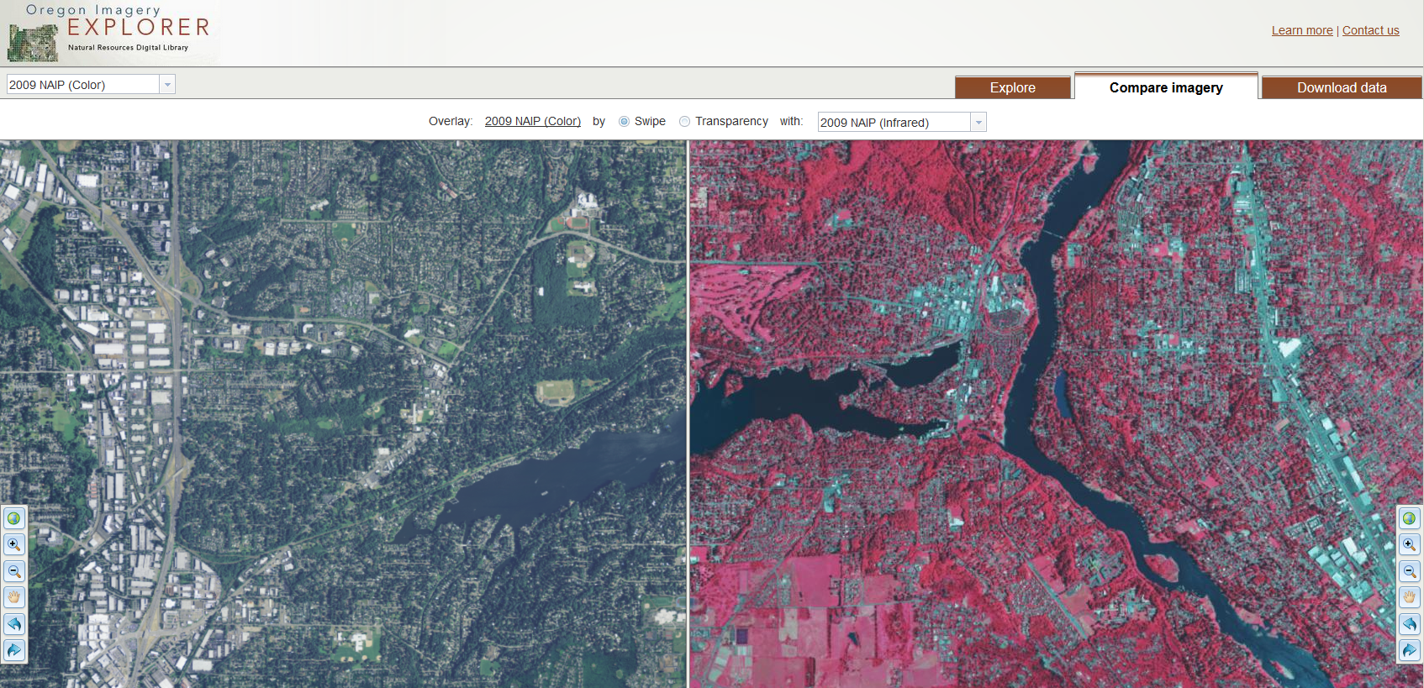
Data
Multi-Spectral Imagery

Slide 9
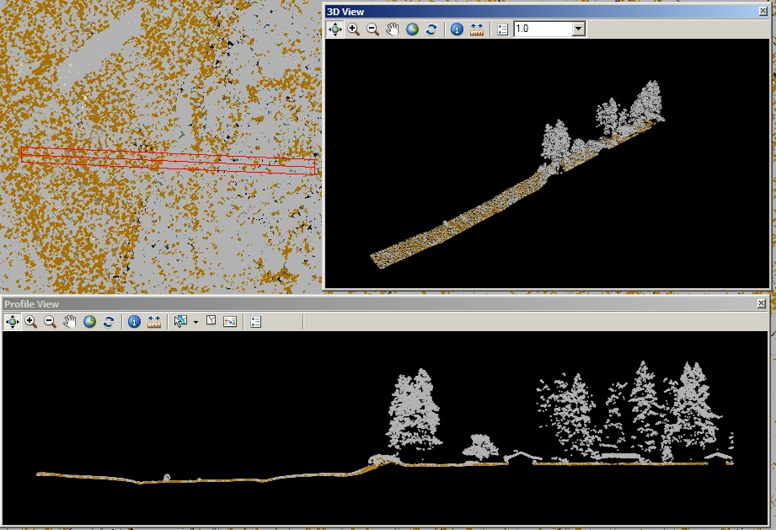
Data
LiDAR (LAS Files)

Slide 10
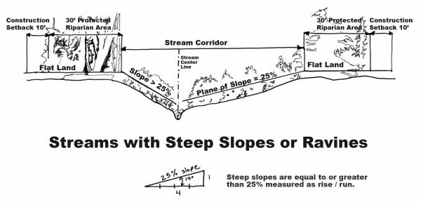
Data
Primary and Secondary Streams, Stream Corridors, Water Quality Resource Areas (WQRAs)
Notes:
The image here shows one circumstance in which stream corridors are delineated based on the slope of the adjacent area.

Slide 11
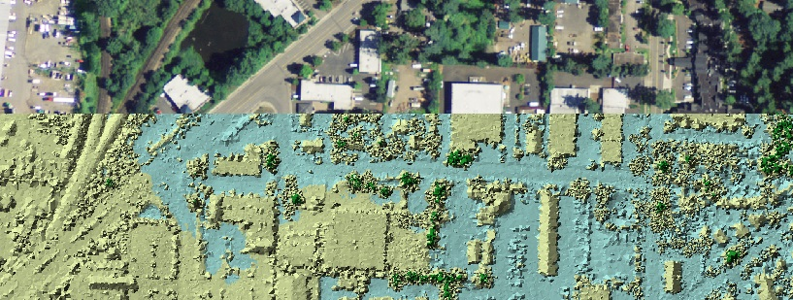
Data Exploration
Notes:
It is important to make sure that the downloaded datasets are all in the correct projection and lining up before the automated feature extraction is performed in eCognition.

Slide 12
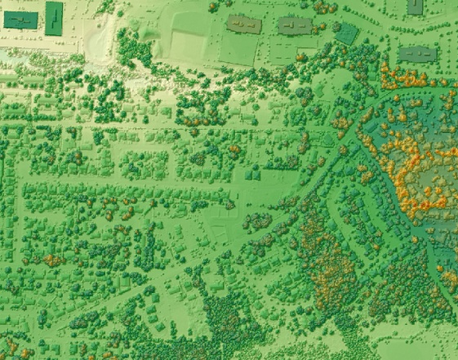
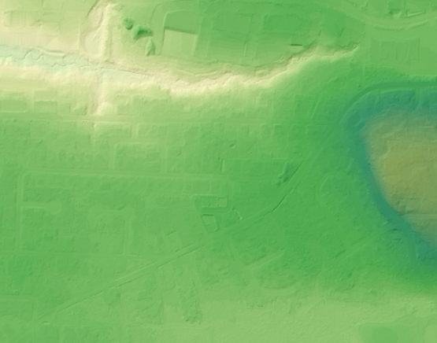
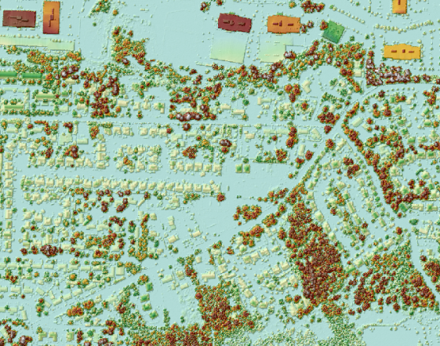
LiDAR Processing
DSM
DEM
nDSM
Notes:
The DSM is derived from the first hit LiDAR points and represents the elevation of the tops of trees, shrubs, and buildings. The DEM is derived from the LiDAR points classified as ground points in the LAS dataset. The nDSM can be calculated by subtracting the DEM from the DSM to get that normalized heights of the trees, shrubs, and buildings.

Slide 13
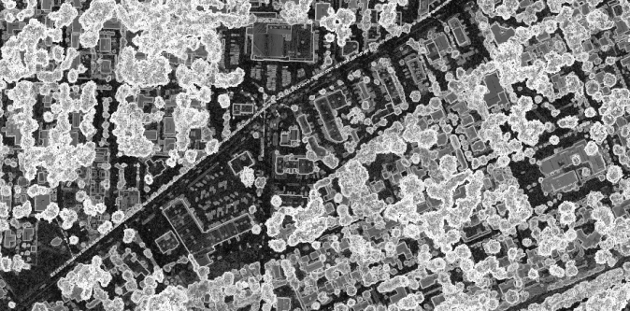
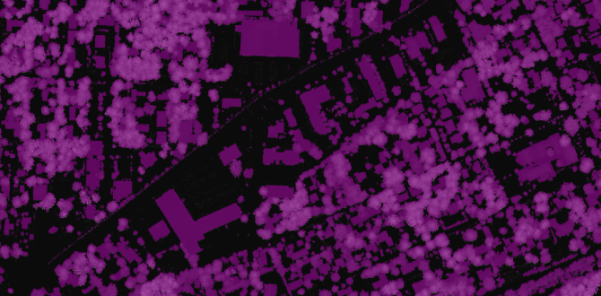
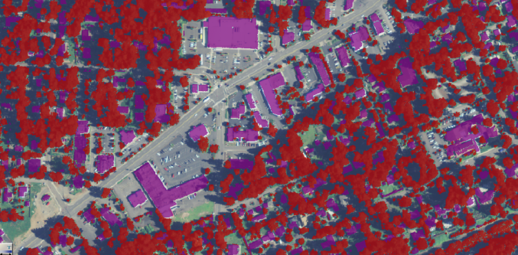
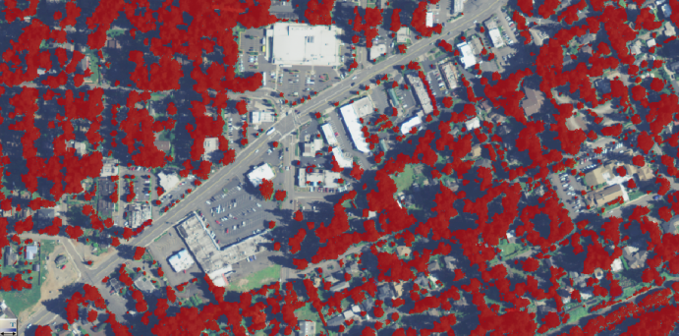
Trimble eCognition
General Workflow
2) Tree Canopy Extraction (Rule Set)
Slope
Segmentation (Tall Objects)
Threshold and Multiresolution
Classify Tree Canopy
Slope and NDVI
Clean Up Classification
Miniscule objects
Merge Tree Canopy
Relative Border
1) Project Layers
Multi-Spectral Imagery
nDSM
Red (Band 1)
Green (Band 2)
Blue (Band 3)
NIR (Band 4)
Notes:
Layers are loaded into a project in eCognition. Then a rule set is created and run to classify objects based on shape, spectral qualities, elevation, patterns, or physical relationships to neighboring objects.

Slide 14
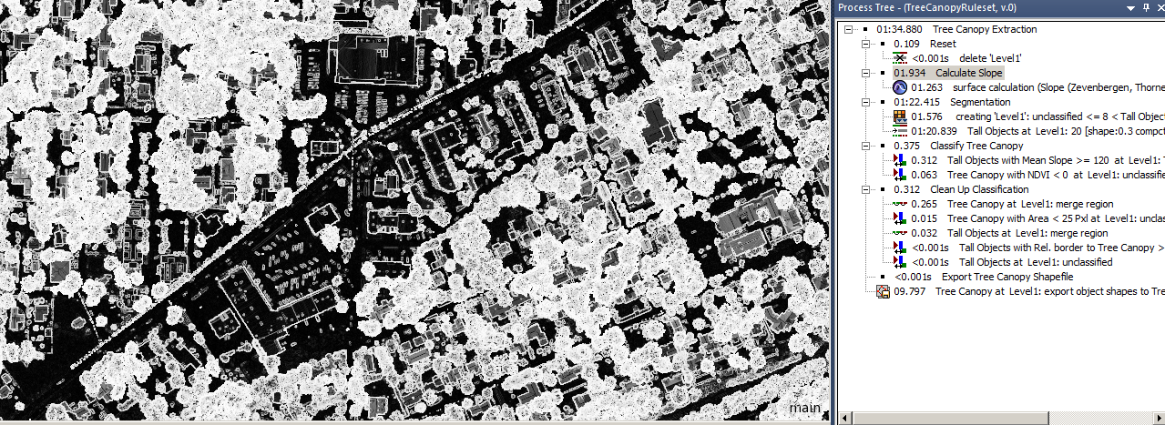
Trimble eCognition Rule Set
Slope
Notes:
First major step of the rule set is to calculate the slope from the nDSM. You can see that trees have a much higher slope than the building roof tops and the bare earth.

Slide 15
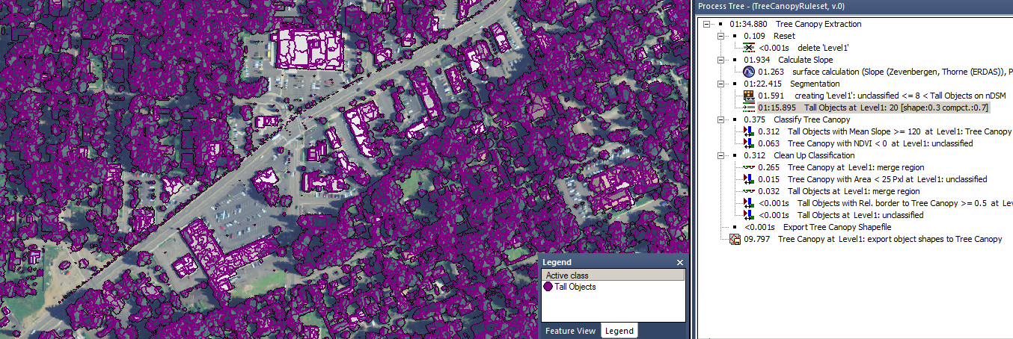
Trimble eCognition Rule Set
Segmentation (Tall Objects)
Threshold and Multiresolution
Notes:
A threshold segmentation works well for creating objects from the nDSM surface that are above 8 feet (the minimum height to be classified as tree canopy). The areas above 8 feet are classified into a “tall objects” class. Next, a multiresolution segmentation will further segment the tall objects that have been isolated based on their spectral and geometric qualities. The influence of individual layers can be weighted using multiresolution segmentation.

Slide 16
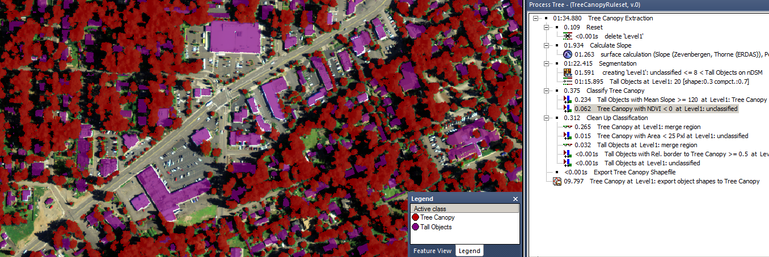
Trimble eCognition Rule Set
Classify Tree Canopy
Slope and NDVI
Notes:
The tree canopy class needs to be derived from the “tall objects” by setting spectral and surface thresholds that differentiate trees from buildings. One important distinguishing characteristic is that trees typically have a higher slope and Normalized Difference Vegetation Index (NDVI) than buildings. NDVI is an indicator of biomass or vegetation vigor (Campbell and Wynne, 2011), and ranges from -1 to 1. Within that range, objects less than 0 are typically objects like buildings, pavement, and water. Objects whose mean NDVI is greater than 0 include vegetated objects like trees, shrubs, crops, and grass

Slide 17
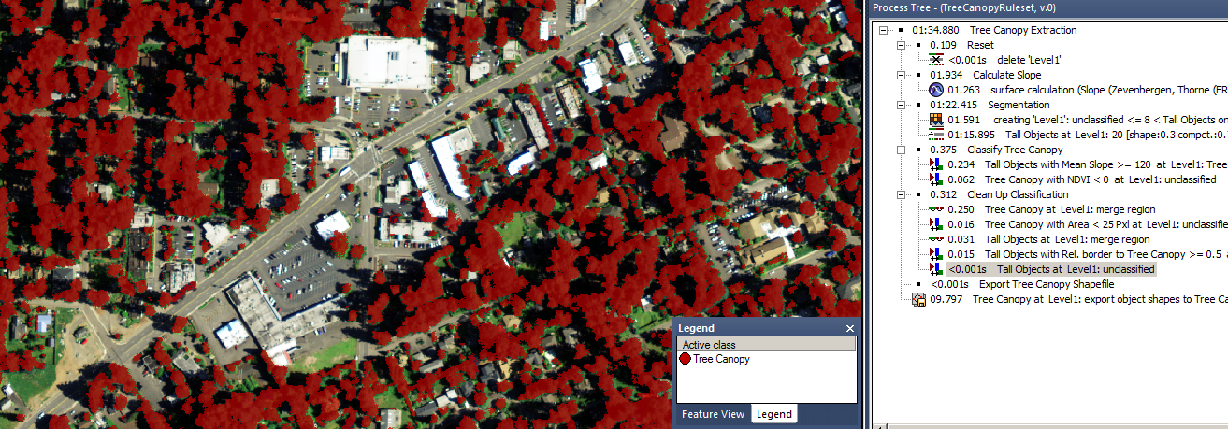
Trimble eCognition Rule Set
Clean Up Classification
Notes:
The objects classified as tree canopy can be merged, and objects smaller than 25 pixels removed to clean up any slivers from signs and wires that should not be classified. I also classified “tall objects” to “tree canopy” if the majority of the border touched a tree canopy object. The final rule in the process tree is to export the objects in the tree canopy class to a vector shapefile.

Slide 18
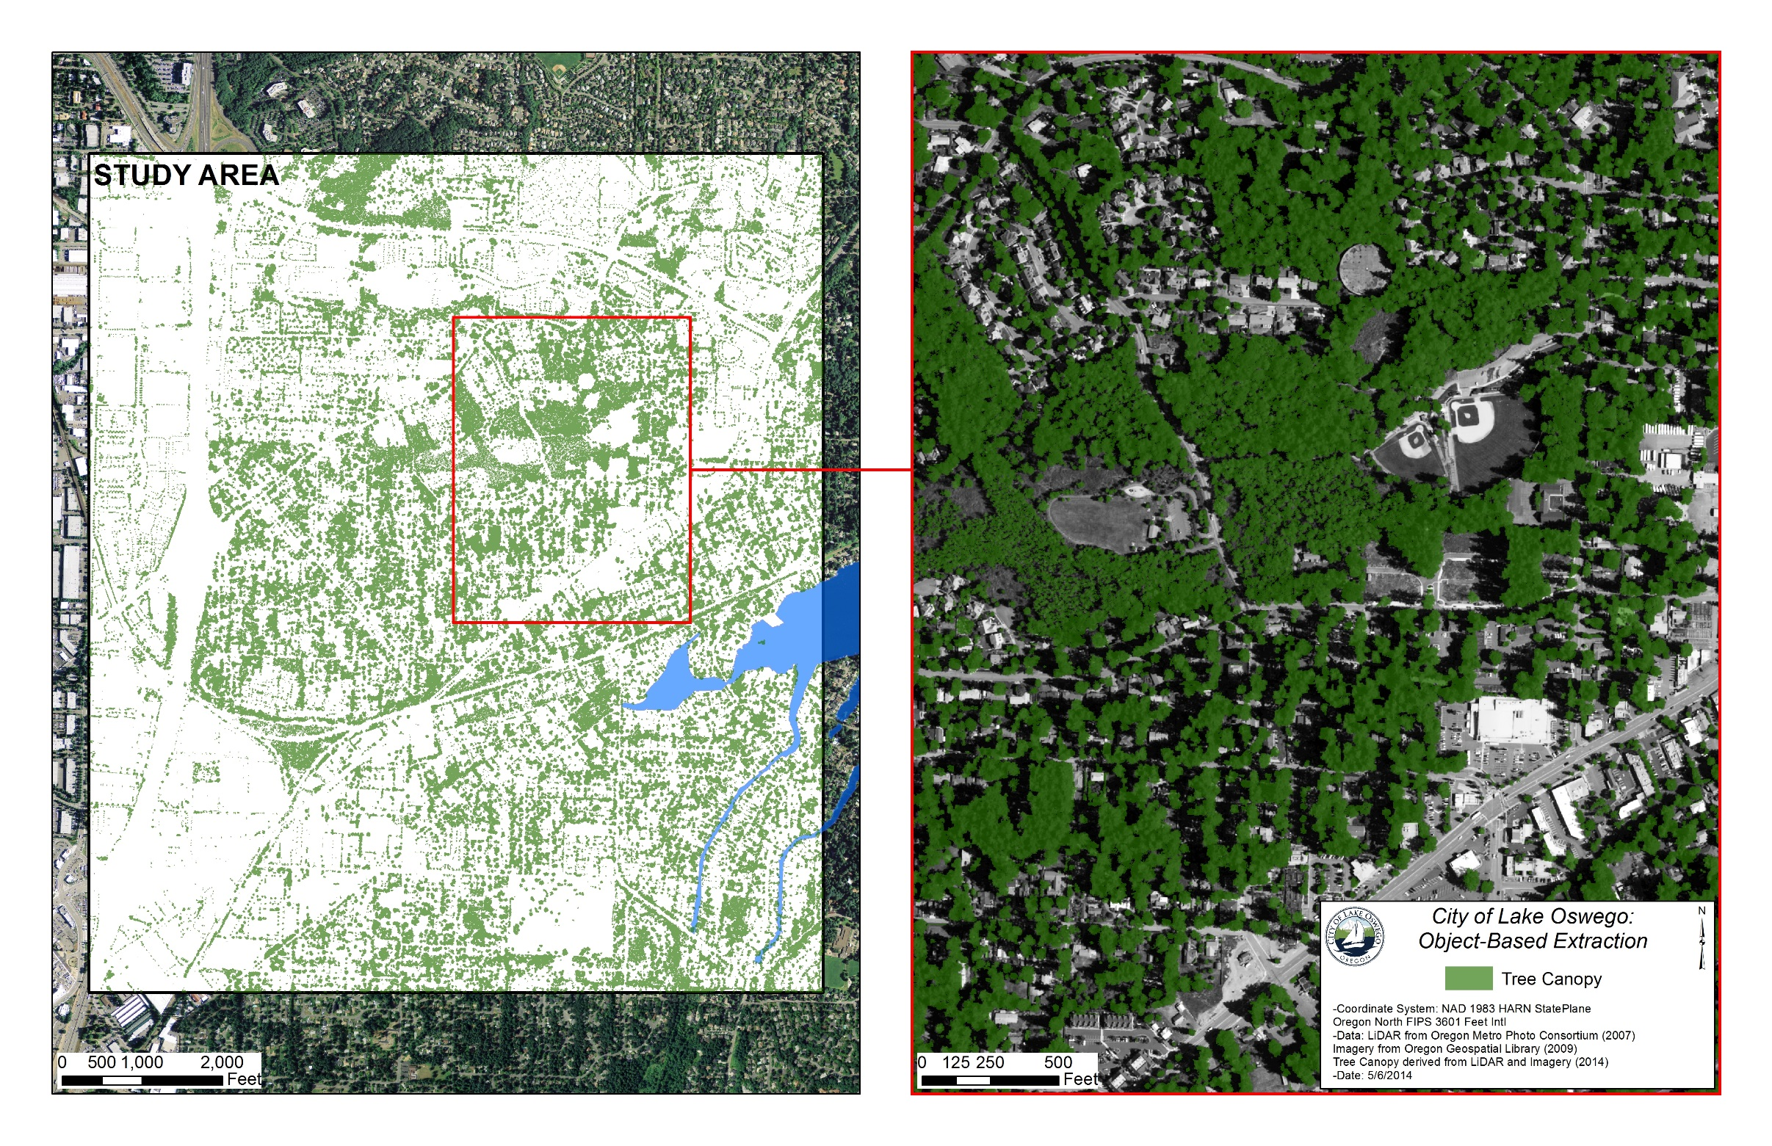
Extracted Tree Canopy
Notes:
The Tree Canopy extracted vector shapefile from the eCognition rule set.

Slide 19
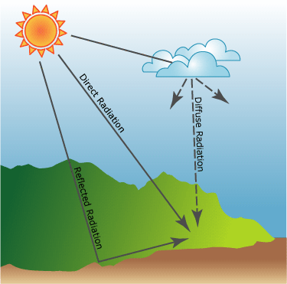
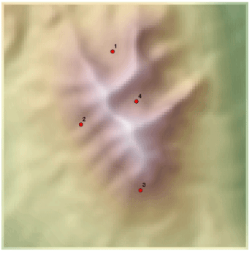
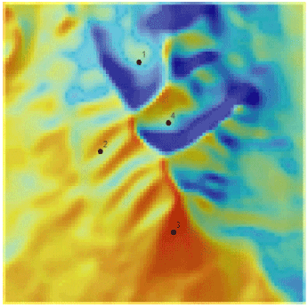
Area Solar Radiation Tool
Derives incoming solar radiation from a raster surface
Notes:
The Area Solar Radiation tool takes into consideration the latitude and allows for inputs to modify diffusion and radiation depending on the study area. The slope of the surface is taken into consideration as well.

Slide 20
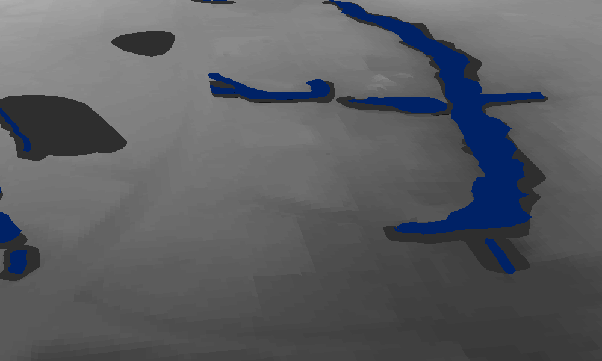
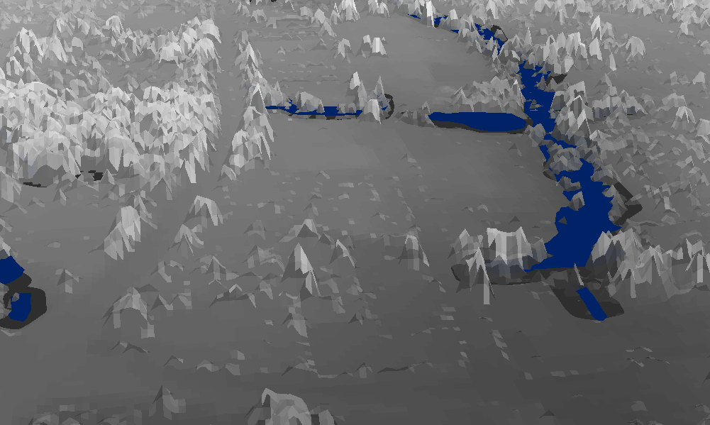
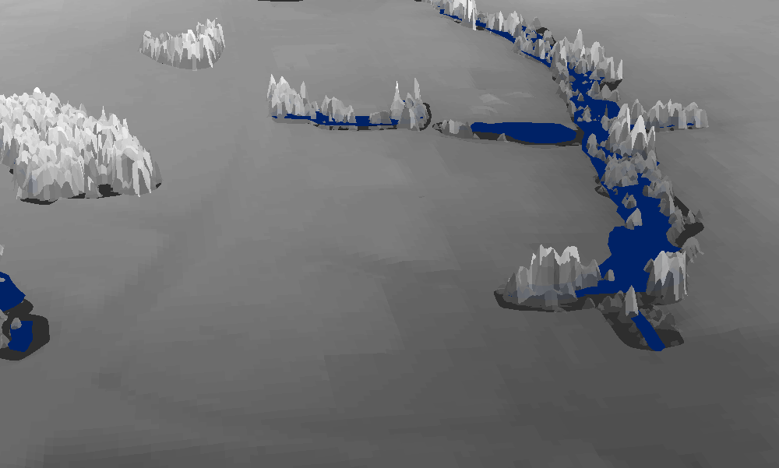
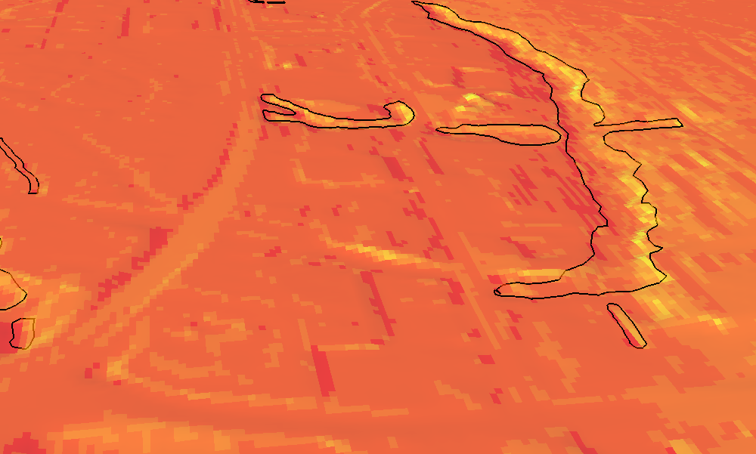
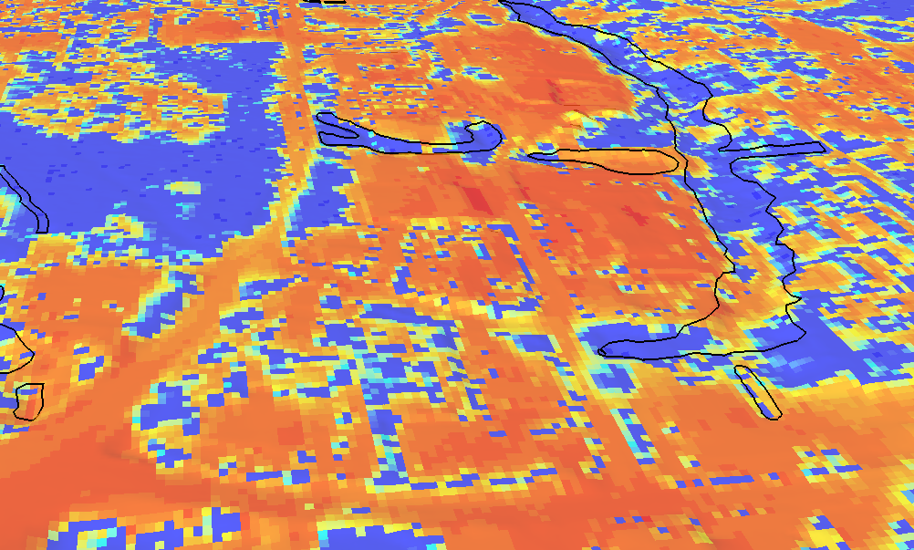
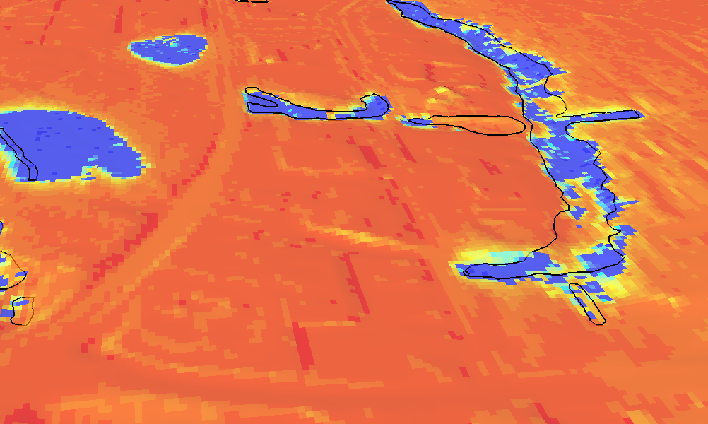
Input Surface Models for Area Solar Radiation Tool
Bare Earth
Tree Canopy
Tree Canopy in WQRA
Notes:
The dark grey areas show the WQRAs on the 3 surface models at the top of the page. The surfaces are created using a combination of the LiDAR derived surfaces and the final tree canopy extraction for the eCognition software.

Slide 21
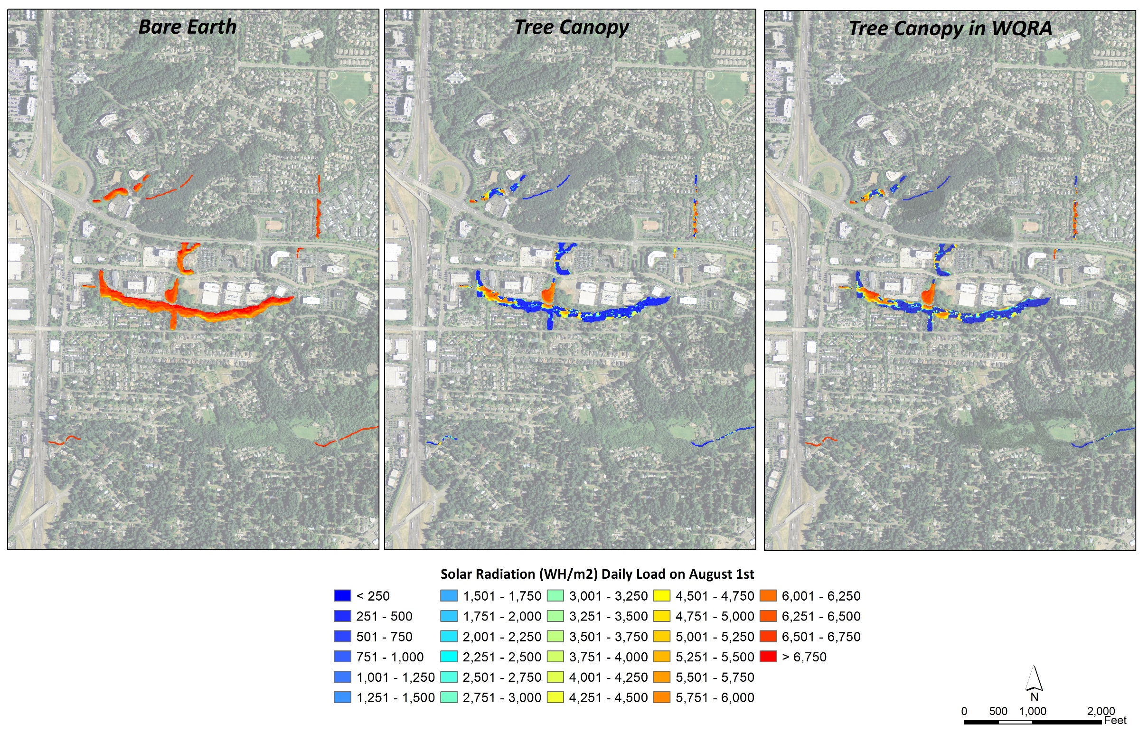
Notes:
Calculated incoming solar radiation is calculated in Watt Hours per square meter for August 1st to model the sunniest day of the year in Oregon. The differences between the 3 graphics show the effect of the tree canopy and the effect of the tree canopy when it is constrained to the protected Water Quality Resource Areas.

Slide 22
Preliminary Results
Notes:
TMDL targets established by the Oregon Department of Environmental Quality. From this sample area based on the analysis, the effective shade from the tree canopy does not meet TMDL goals on stream corridor temperatures.

Slide 23
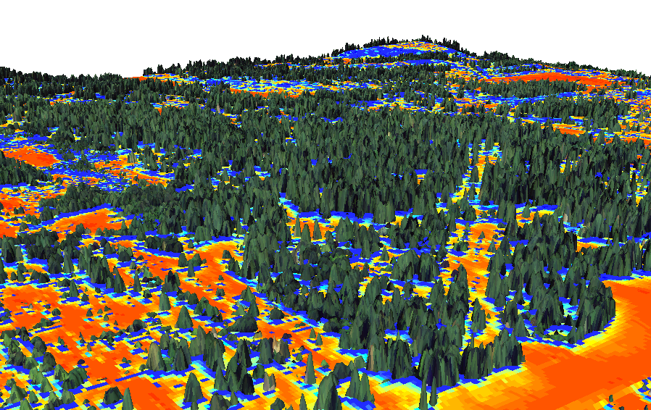
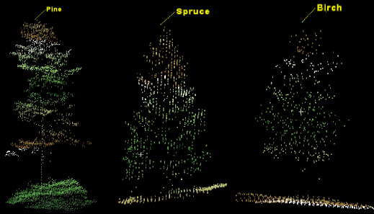
Conclusions
Benefits of Methodology
Future Improvements
Photo credit: KTH Vetenskap Och Konst Royal Institute of Technology
Notes:
Benefits of Methodology
-method has visual outputs that are really key for directing riparian restoration projects
-has very accurate statistical analysis of effective shade
-the method can be used on non linear bodies of water
Improvements in the future
-Improve analysis in the future by accounting for transmissivity of tree canopy based on density and type of tree from LiDAR point cloud and imagery.
-EPA project through 2016 “Fusion of imaging spectroscopy and LiDAR for spatially explicit urban forest inventory” http://cfpub.epa.gov/ncer_abstracts/index.cfm/fuseaction/display.abstractDetail/abstract/10322/report/0.

Slide 24
References
O’Neil-Dunne, J. P. M., S. W. MacFaden, A. R. Royar, and K. C. Pelletier. 2012. An Object-based System for LiDAR Data Fusion and Feature Extraction. Geocarto International 28(3): 1–16.
Campbell, J. B., R. H. Wynne. Introduction to Remote Sensing: Fifth Edition. The Guilford Press. New York. London: 2011.
O’Neil-Dunne, J. P. M., S. MacFaden, A. Royar, M. Reis, R. Dubayah, and A. Swatantran. 2014. An Object-Based Approach to Statewide Land Cover Mapping. In Proceedings of the 2014 ASPRS Annual Conference. Louisville, KY: March 23-28, 2014.
MacFaden, S. W., J. P. M. O’Neil-Dunne, A. R. Royar, J. W. T. Lu, and A. G. Rundle. 2012. High-resolution Tree Canopy Mapping for New York City Using LIDAR and Object-based Image Analysis. Journal of Applied Remote Sensing 6 (1): 063567–1–063567–23.
Shumar, M., and J. Varona. October 2009. The Potential Natural Vegetation (PNV) Temperature Total Maximum Daily Load (TMDL) Procedures Manual. Idaho Department of Environmental Quality.
Fletcher, D. E., S. D. Wilkins, J.V. McArthur, and G. K. Meffe. 2000. Influence of riparian alteration on canopy coverage and macrophyte abundance in Southeastern USA blackwater streams. Ecological Engineering 15: S67-S78.
Nelson, T., R. Macedo, and B. E. Valentine. 2007. A preliminary study of streamside air temperatures within the coast redwood zone 2001 to 2003. USDA Forest Service Gen. Tech. Rep. PSW-GTR-194. pp75- 84
Thompson, Jonathan. 2005. Keeping it cool: unraveling the influences on stream temperature. Science Findings 73, June 2005. USDA Pacific Northwest Research Station. Portland, Oregon.
Total Maxiumum Daily Loads (TMDLs) Program. Oregon Department of Environmental Quality. http://www.deq.state.or.us/wq/tmdls/tmdls.htm
Water: Total Maximum Daily Loads (303d) Glossary. United States Environmental Protection Agency. http://water.epa.gov/lawsregs/lawsguidance/cwa/tmdl/glossary.cfm#p
Tualatin Subbasin TMDL Water Quality Management Plan. August 2012. Oregon Department of Environmental Quality. Chapter 4.

