Slide 1
Creating a Trail Map and Trouble Reporting System Using Open Source Technology Capstone Proposal
David Todd
Advisor: Jan Oliver Wallgrün
GEOG 596A: Individual Studies – Peer Review
Fall 2013
10/25/2013

Slide 2
Overview
Background
Goals and Objectives
Proposal Research
Proposed Methodology
Anticipated Results
Project Timeline
References
Questions

Slide 3
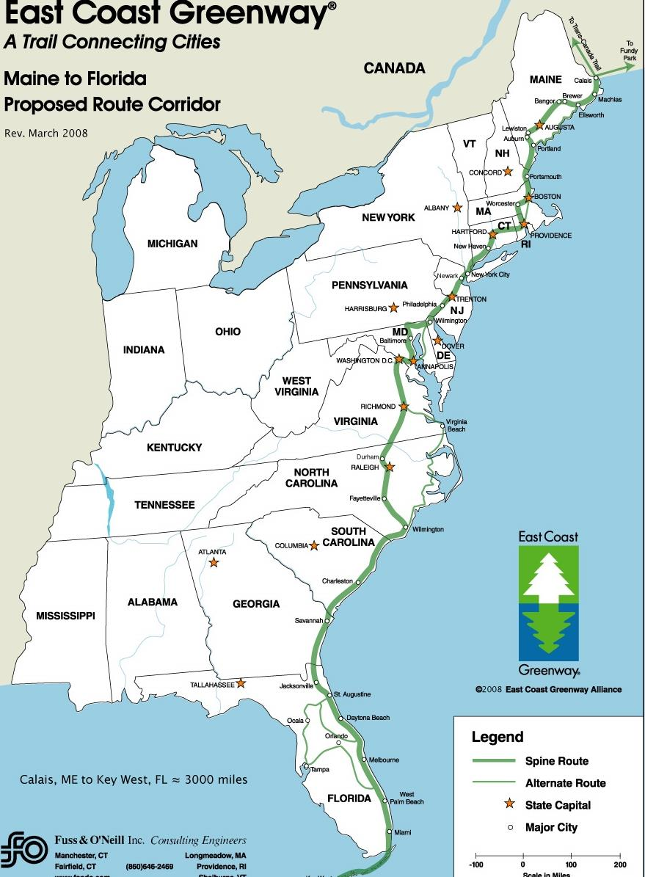
Background
East Coast Greenway (ECG):
~ 3000 miles long
~ 29% trail (834 miles)
Maine to Florida
Managed by ECG Alliance (ECGA)
Notes:
How did I come to this project? As a longtime hiker, biker, and general outdoorsman, I knew I wanted the project to have an outdoor focus. Looking to my local trails for inspiration, I settled on the East Coast Greenway. As an avid trail user of the ECG, it seemed fitting that my project could help alleviate some of the perceived shortfalls of the current ECG mapping system.
So what is the ECG?
It’s an ~3000 mile long trail that spans the entire eastern seaboard, Maine to Florida
Of the 3000 miles, 834 are officially dedicated trail off-road trail
Overall management of the trail is provided by East Coast Greenway Alliance

Slide 4
Background
ECGA:
Non-profit organization
Promotes vision
Provides strategic assistance, guides, signage, maps, cue sheets, and trail promotion
Relies on locals to manage and build trail
Notes:
The East Coast Greenway Alliance is a Non-profit organization.
They promote the vision and provide guides, signage, maps, cue sheets, trail promotion, and strategic assistance
The heart of the Alliance is the local members and groups that volunteer their time and money to build and maintain the trail

Slide 5
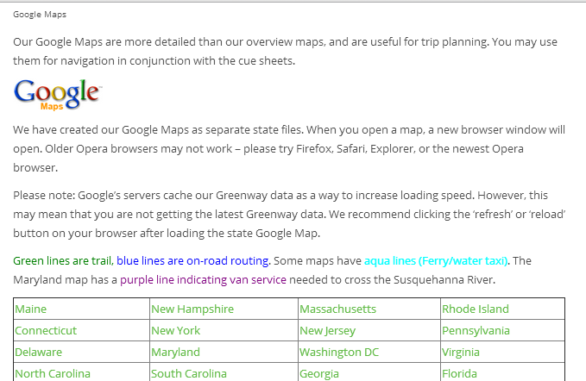
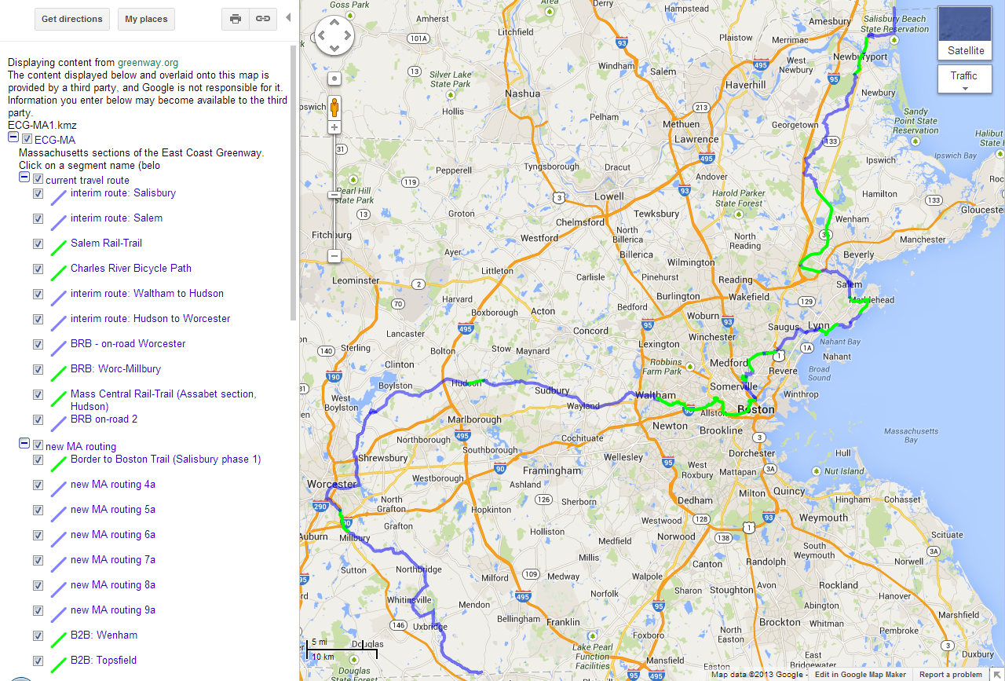
Background
Current System:
Site provides links for each state
Links take user to Google Maps
Trail data in KML format
Google Maps displays KML
Notes:
The current ECG mapping system is quite rudimentary in what it offers users.
Users visit the ECG website and navigate to the Maps page.
The Maps page provides a link to each state.
Each state link opens a new Google Maps page.
Google Maps displays the KML trail data for the state.
With the current setup, there is a lot of site navigation and clicking just to get a simple trail map.

Slide 6
Background
System Pros:
KML includes ALL trails
Google Maps can provide directions to/from places
System Cons:
KML includes ALL trails
No layer toggling
No trail status
No trouble reporting
Notes:
Currently, the ECG mapping system has two things going for it:
Each state KML includes all ECG trails for that state.
Since it’s displayed in Google Maps, all a user has to do is right click a spot on the map to obtain directions to/from
On the downside, the system is missing a lot of functionality. This includes:
Each state KML includes ALL ECG trails for that state, e.g. proposed and closed trails
Trail data is organized by state, so the current system cannot display multiple states of trail data
No filtering or toggling of layers
No trail status
And finally, no mechanism for reporting trail issues

Slide 7
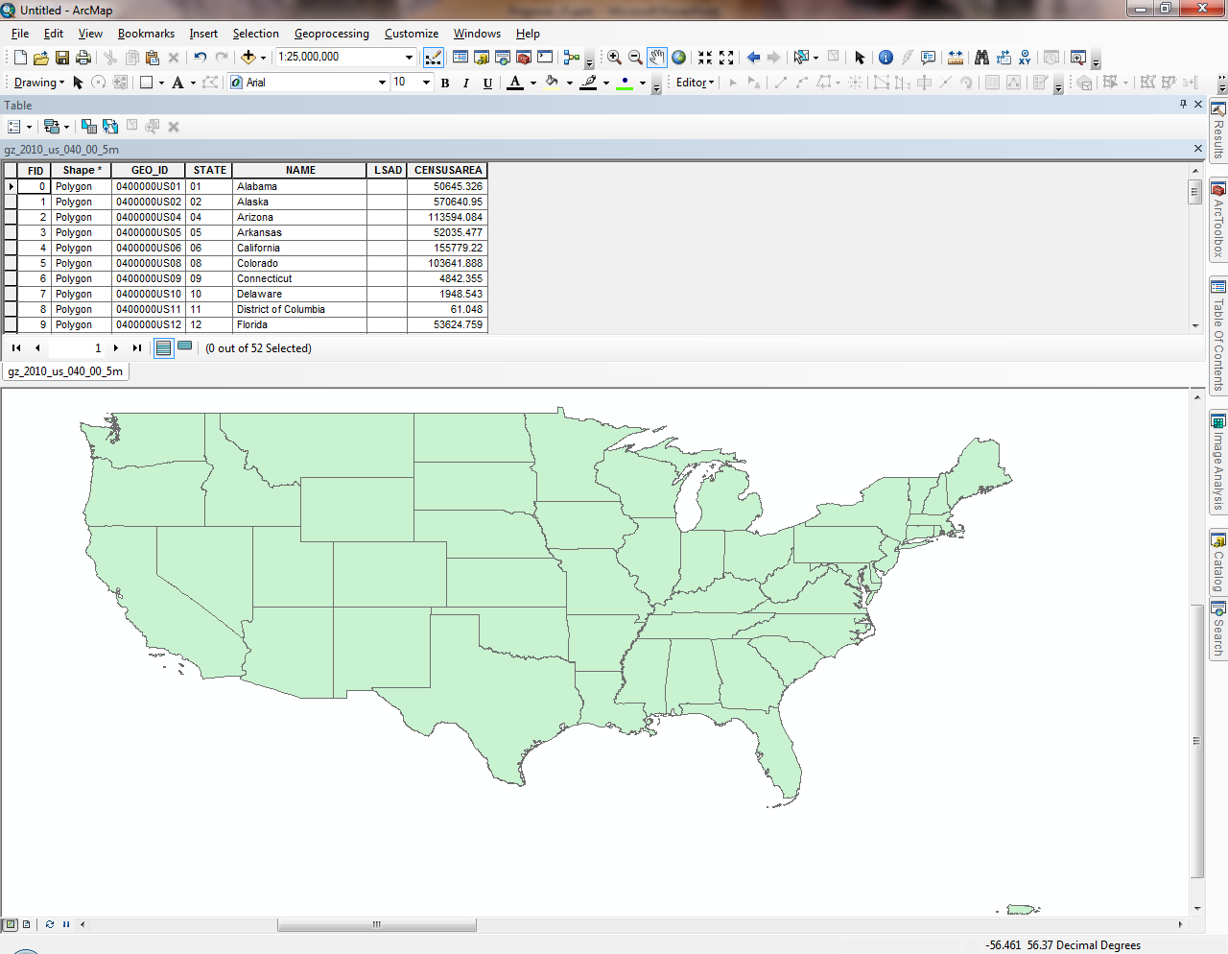
Background
System Users:
Trail Liaisons
Global and regional
Add, delete, update
Trail Users
Visualize
Report
Notes:
Two groups of system users:
Trail Liaisons – administrators both global and regional
Wants ability to insert, delete, merge and update trail data tables, e.g. location, etc., and trail information, e.g. status, contact information, etc.
Trail Users – hikers, bikers, etc.
Wants the ability to visualize trail, see where they located, and report any trail issues, e.g. tree down over trail, hornets nest, etc.

Slide 8
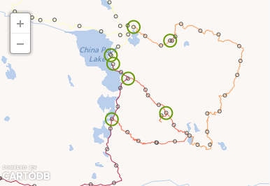
Goals and Objectives
The goal is to provide an integrated open source geospatial publishing and reporting platform that allows volunteer organizations to get up and running quickly.
Notes:
Overall goal of the project is to provide an integrated open source geospatial publishing and reporting platform that allows volunteer organizations to get up and running quickly. Specifically, the project will target the ECG and the ECGA.

Slide 9
Goals and Objectives
Create GIS
Create trouble reporting system
Create simple single install
Notes:
The overall objectives of the project are to:
Create a GIS, which entails -
Building a system on currently available open source software
Converting and ingesting ECG KML files
Making data publically available as web service
And publish web maps of ECG trail system
Create a trail trouble reporting system
Allows users to report the location and description of trouble issues
And finally - Create a simple single install of the whole system
System will be released as an Amazon Machine Image (AMI) or “GIS on a CD” for any organization to reuse

Slide 10
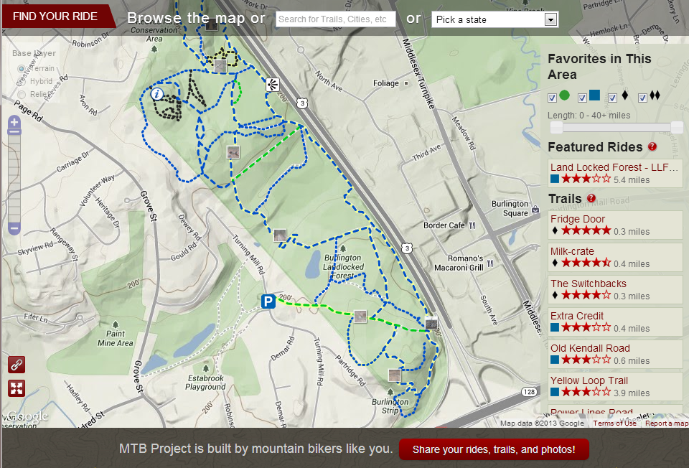
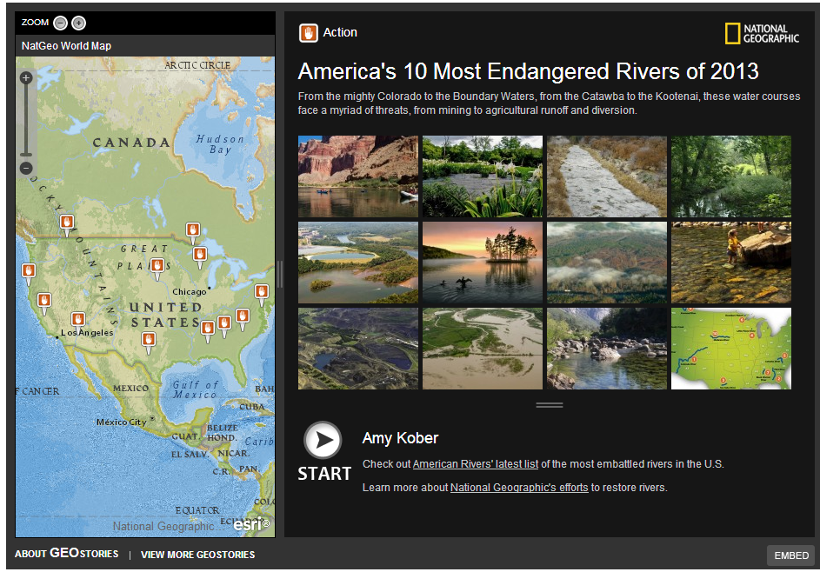
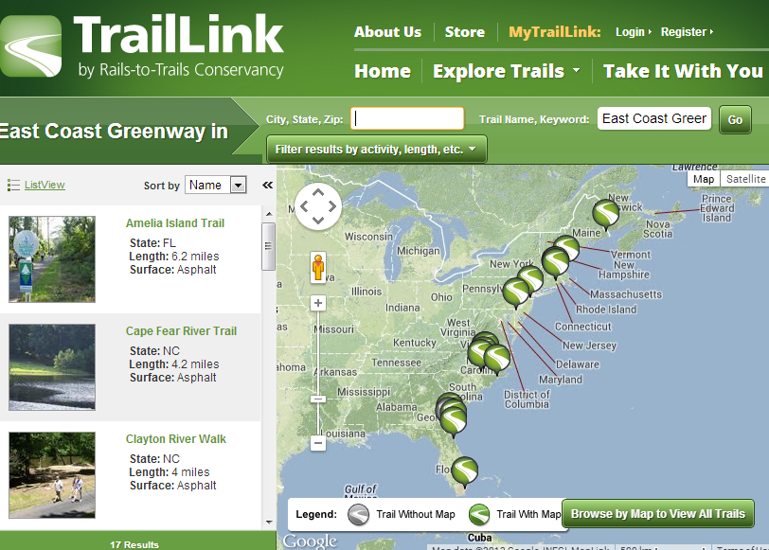
Proposal Research
State of the Art:
Trail Mapping
International Mountain Bike Association (IMBA)
National Geographic
Rails-to-Trails Conservancy
Notes:
Before starting on the project, it is important to know what the current State of the Art is for other trail organizations. How are other organizations doing trail mapping and do they provide trail status or trouble reporting?
Trail Mapping:
IMBA – has a privately developed backend platform that utilizes Google Maps. The trails are a combination of IMBA provided and crowd sourced. Map displays trails, loops, and user generated ratings.
National Geographic – has a customized public website template (provided by ESRI) and uses ESRI’s ArcGIS Online (AGO) as their platform. Users can interact with map by clicking, which pulls up pictures and information, but users cannot update it and all information is static.
Rails-to-Trails Conservancy – has a privately developed backend that utilizes Google Maps. Map doesn’t actually show trails, but displays points that represent trail locations. Sidebar provides picture and trail information.

Slide 11
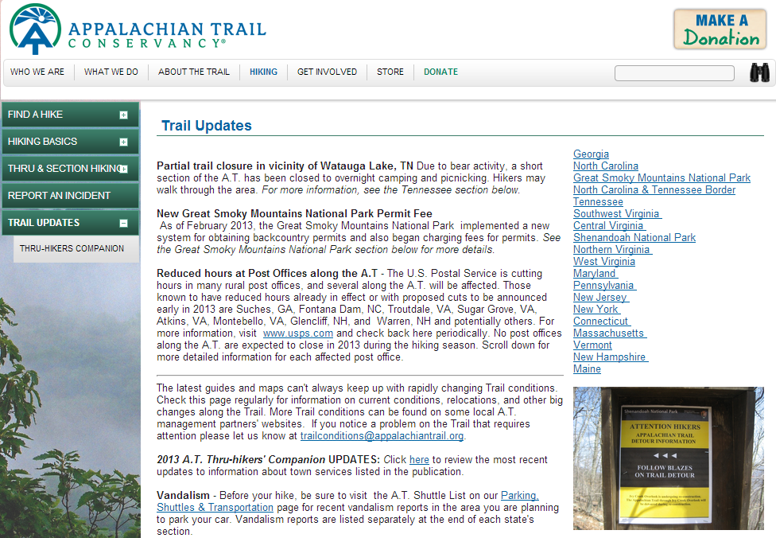
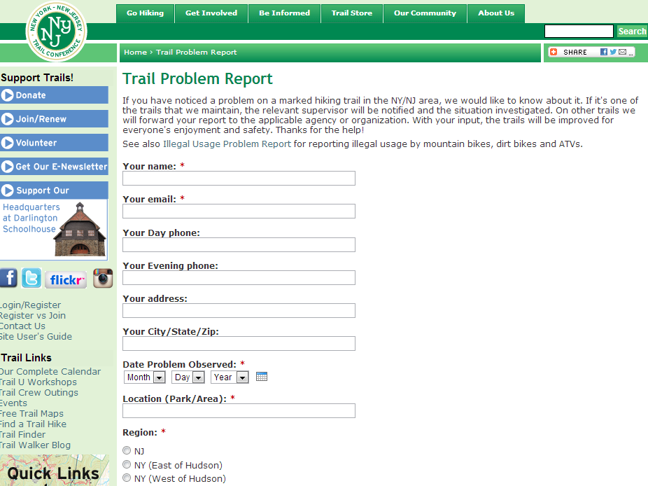
Proposal Research
State of the Art:
Trail Status
Appalachian Trail Conservancy
Trouble Reporting
New York – New Jersey Trail Conference
Fairfax County, Virginia
Seneca Trail
Notes:
State of the Art
Most organizations only provide very rudimentary trail status updates or ability for users to report trouble, if at all:
ATC – Provides trail status and updates in a list format on their site. No map for quick visualization.
NYNJTC – Provides web form for submitting trail issues. No map or list of current issues.
Fairfax County, VA - Provides web form for submitting trail issues. No map or list of current issues.
Seneca Trail – Lists an email or phone number to write/call to report trail issues. No map or list of current issues.

Slide 12
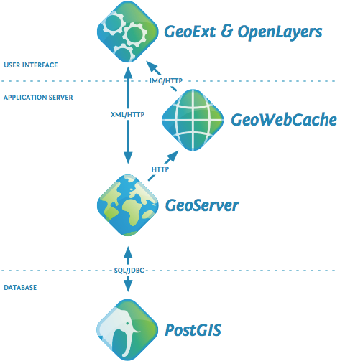
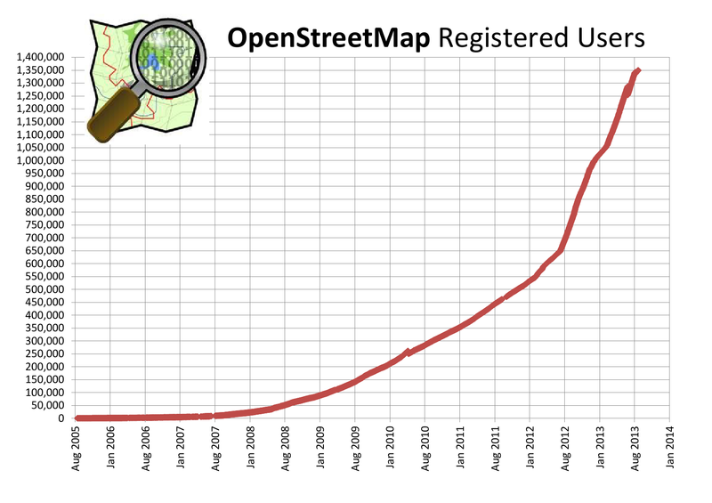
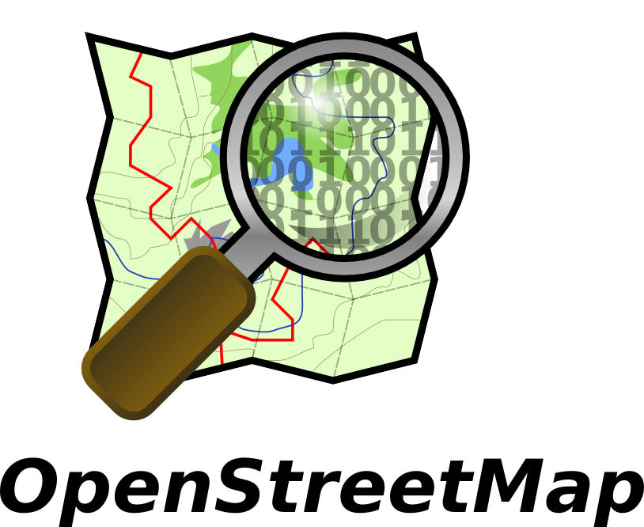
Proposal Research
What is open source and why choose it?
Hardware, Software, FOSS4G
What is volunteered geographic information (VGI)?
How is it used?
Is it trustworthy?
Why is it important?
Notes:
What is open source?
Hardware – open schematics, examples are Arduino, Raspberry Pi
Software – Free as in “Free Speech”, but also free as in “Free Beer”. Users have the freedom to run, copy, distribute, change and improve the software.
FOSS4G – Free Open Source Software for Geospatial. Comes in many different flavors; desktop and server software like GRASS GIS, QGIS, MapServer, or GeoServer; also comes in web and cloud versions like OpenLayers, MapBox/TileMill, CartoDB, MangoMaps
Open source is important because volunteer organizations often have small budgets.
What is VGI?
VGI is geographic data provided voluntarily by individuals and is also known as crowd sourcing or citizen science.
VGI is a special case of the larger Web phenomenon known as user-generated content, e.g. Facebook, Twitter, etc., and provides a participatory approach to GIS.
(How it’s used) The power of VGI has been harnessed by tools like OpenStreetMap, which is using VGI to create an open source basemap of the world.
Another prime example of VGI use is coming from municipalities, which are using VGI to assemble information on their communities, e.g. where are pot holes or graffiti.
(Is it trustworthy?) It depends on how the data is used and what kinds of accuracy are needed. Studies of OpenStreetMap data have shown that the trustworthiness of the data is often directly tied to trustworthiness of the individual behind the data.
Why is VGI important?
Because it allows organizations like the ECGA to get direct timely feedback and trail conditions and status. VGI will be key in making the trouble reporting system useful.

Slide 13
Proposed Methodology
Phase 1:
Data
Obtain, convert, clean
GIS
Open source/cloud based
Templates for map visualization
Notes:
Data:
Data is currently in Keyhole Markup Language (KML) files, which manages the display of 2D and 3D geospatial data.
Data conversion is straightforward. Several converters exist (KML2X, ArcGIS, QGIS).
Data will need to be cleaned and filled out with additional details to make for easier filtering.
GIS:
After researching options, there will initially be no software needed as the decision was made to use CartoDB.
CartoDB is an open source project. It is a cloud based mapping, analysis and visualization engine that lets users build spatial applications for both mobile devices and the web. It provides both data storage and web service publishing. So basically a cloud version of PostGIS.
What CartoDB uniquely offers, is the ability use their cloud based service for a fee or the user can choose to install CartoDB on their own for free.
(Don’t need this part, just for information) CartoDB makes use of many different Open Source projects:
Frontend: Leaflet, Wax, JQuery + plugins, Backbone, Underscore, Google Maps, CodeMirror, Mustache
Backend: Ubuntu, PostgreSQL, PostGIS, Nginx, Node, Varnish, Unicorn, Ruby on rails, Redis, Mapnik, CartoCSS
Other things: Chef, Munin, Nagios, Monit
Amazon Machine Image exists of CartoDB software and dependencies.
Ingesting data is straight forward. Simply drag and drop using a modern web browser.
Configure map visualizations. CartoDB can serve either the map visualization or the data table as GeoJSON.
Create web page templates for presenting both maps and data:
User should be able to turn layers on/off
User should be able to filter layers, e.g. type, status, etc.

Slide 14
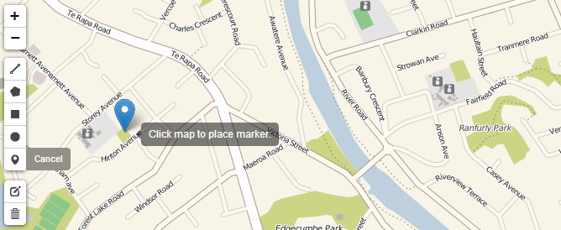
Proposed Methodology
Phase 2:
Testing/peer review (1)
Trail users and trail liaisons
Trouble reporting
Location, location, location!
Build with JavaScript
Testing/peer review (2)
Notes:
Testing/Peer Review (1)
Test primary use cases – trail users and trail liaisons.
Ask trail users to view web maps and provide feedback on what worked and what could be improved. Do the maps make sense cartographically? Ask liaisons to work with the data tables, is it easy and intuitive?
Trouble Reporting
Reporting page should:
Obtain users current location and accuracy error
Allow user to drop and move point on the map
Add location information (lat/lon) to trouble report
Pass all information to private trouble report table on CartoDB
Build with JavaScript, because it can easily be incorporate into the web page templates.
Data can be merged by administrator into a public table that will populate a layer on the web map containing location and description.
Testing/Peer Review (2) – Why so much testing and peer/review – because it will help to catch system and usability issues sooner and testing can be done concurrently with the building.
Ask trail users to view trouble report system and provide feedback on what worked and what could be improved. Is the reporting process intuitive? How simple and intuitive the process is will be a direct link to whether or not the VGI submitted by users can be utilized.
Ask administrators to manage and publish trouble reports. Is the workflow simple and intuitive?

Slide 15
Proposed Methodology
Phase 3:
Single Install
Amazon Machine Image (AMI)
Testing/Peer Review (Final)
End to end testing
Notes:
Single Install
According to my research, a portable GIS would be a nice option, but would require the organization to buy and maintain their own web server, which is a big up front cost and requires a good amount of technical skill. Building an Amazon Machine Image (AMI) on the other hand can be easily deployed and Amazon manages everything on the hardware side.
AMI already exists for CartoDB.
Configure current AMI for trail organizations.
Add web page templates that include the trouble reporting pieces.
Create new AMI and release for free.
Testing/Peer Review (Final)
Ask administrators to install system.
Ask trail users to view web maps and use trouble report system.
Ask administrators to manage system.
Does everything work as expected? Is the workflow smooth and intuitive?

Slide 16
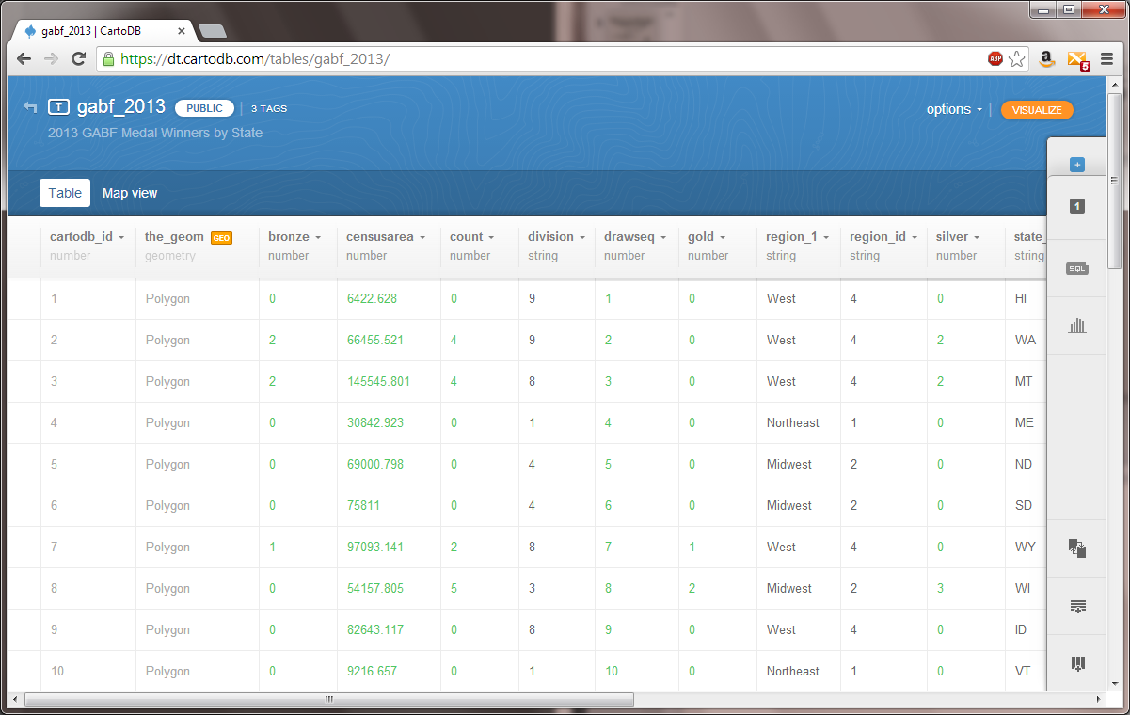
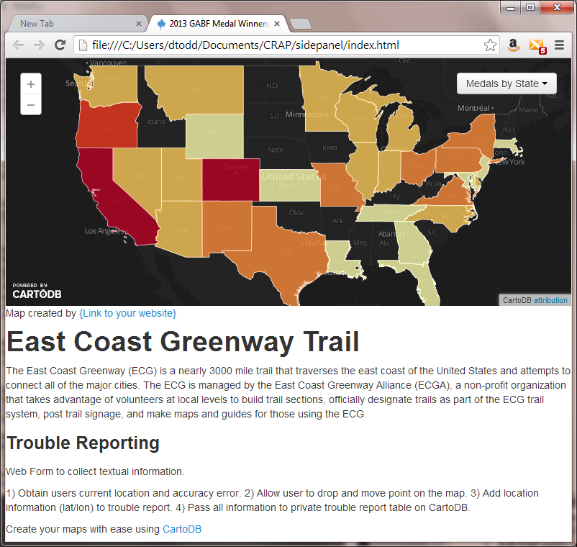
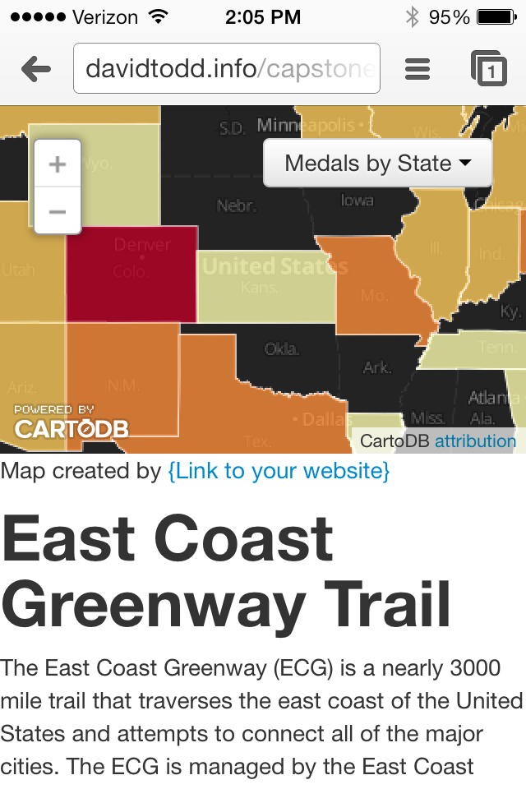
Anticipated Results
Open source GIS that is easy to reproduce
Easy trail administration for trail liaisons
Intuitive web maps for trail users available anywhere, anytime
Ability for trail users to report trail issues

Slide 17
Project Timeline
October & November 2013:
Data/GIS (6 weeks)
November & December 2013:
Testing/Peer Review 1 (1 week)
Trouble Reporting (5 weeks)
January 2014:
Testing/Peer Review 2 (1 week)
January & February 2014:
Single Install (6 weeks)
March 2014:
Final Testing/Peer Review (2 weeks)
February, April or July 2014:
Project presentation (FOSDEM, AAG, or OSCON)
Notes:
Timeline is ok for AAG, but would need to be stepped up to present at FOSSDEM’14. Additionally, if more time was needed, there is OSCON in July.
Free Open Source Developers European Meeting (FOSDEM)
February 1 &2, 2014
Brussels, Belgium
https://fosdem.org/2014/
Association of American Geographers (AAG)
April 8-12, 2014
Tampa, Florida
http://www.aag.org/annualmeeting
Open Source Convention (OSCON)
July 20-24, 2014
Portland, Oregon
http://www.oscon.com/

Slide 18
References
East Coast Greenway. http://www.greenway.org/index.shtml
East Coast Greenway Alliance. http://www.greenway.org/aboutalliance.aspx
OpenGeo. http://opengeo.org/
CartoDB. http://cartodb.com/
MapBox. http://www.mapbox.com/
IMBA. http://www.mtbproject.com/
National Geographic - http://www.geostories.org/
Rails-To-Trails Conservancy - http://www.traillink.com/
OSM In A Box. http://2010.foss4g.org/presentations/3877.pdf
A Process for Assessing Emergent Web Mapping Technologies. http://www.slideshare.net/reroth
Portable GIS. http://www.archaeogeek.com/portable-gis.html
Free Open Source GIS. http://www.academia.edu/460275/Free_Open_Source_GIS
Trust as a Proxy Measure for the Quality of VGI in the Case of OSM. https://speakerdeck.com/crstn/trust-as-a-proxy-measure-for-the-quality-of-vgi-in-the-case-of-osm
Can we Trust Information? - The Case of Volunteered Geographic Information. http://geog.ucsb.edu/~jano/DE2010qp.pdf
Crowdsourcing Geographic. http://books.google.com/books?id=SSbHUpSk2MsC&pg
Mobile App vs. Site. http://www.olson.com/when-to-create-a-mobile-website-vs-a-mobile-app/

Slide 19
Questions?

