Slide 1
Building an Integrated Web Mapping and Incident Reporting Platform for Volunteer Organizations Using Open Source Technology
David Todd
Advisor: Jan Oliver Wallgrün
GEOG 596B: Individual Studies – Capstone Project
Spring 2014
04/11/2014

Slide 2
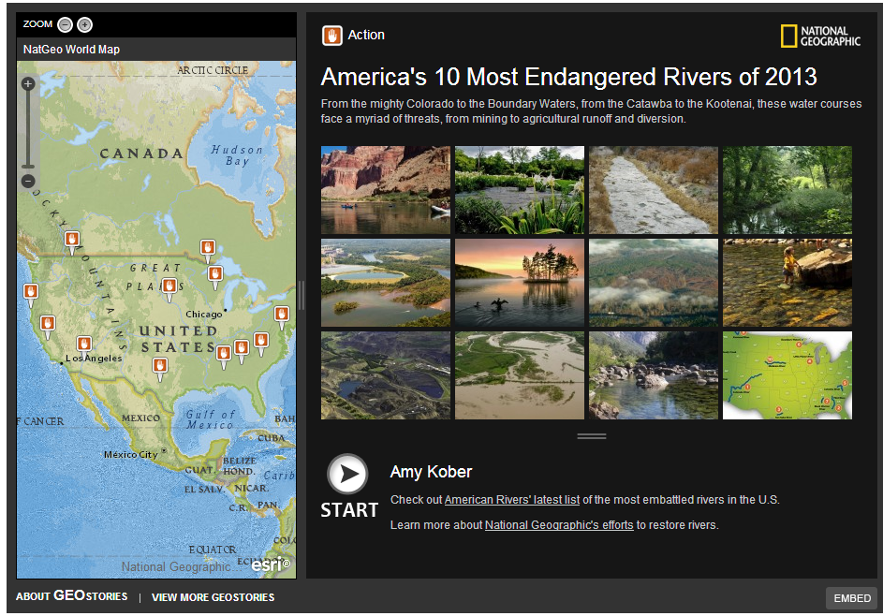
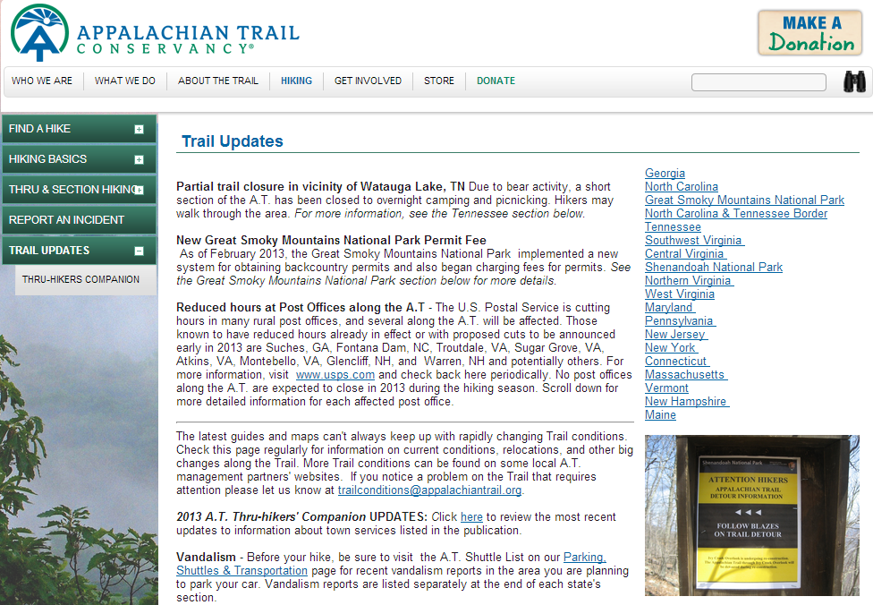
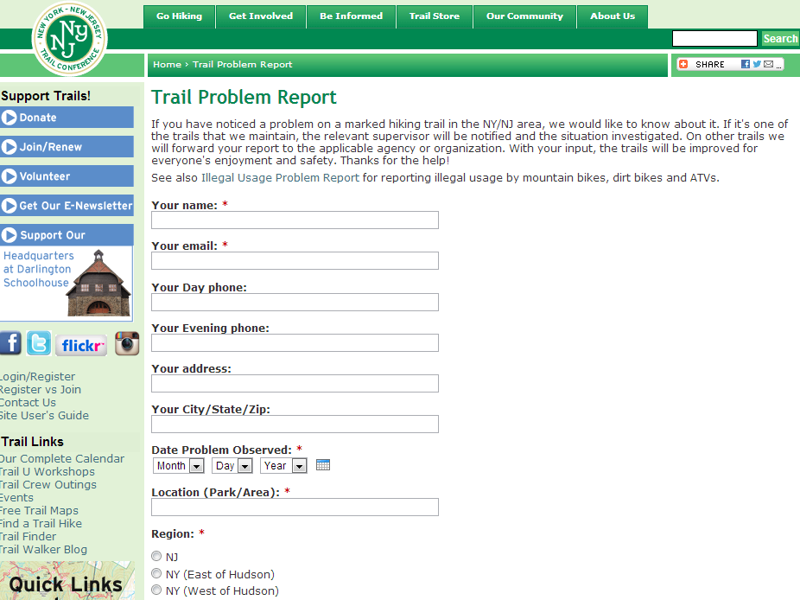
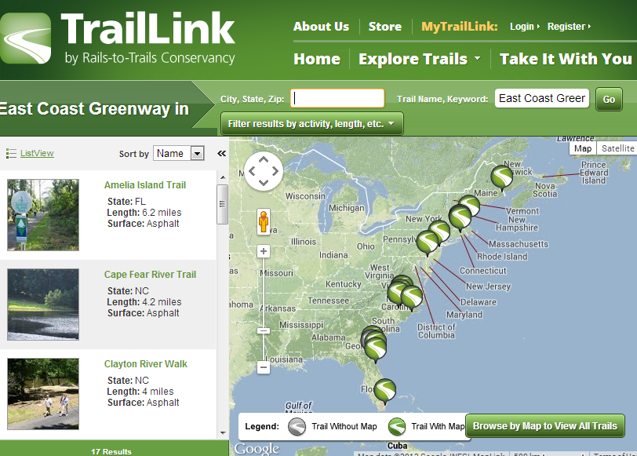
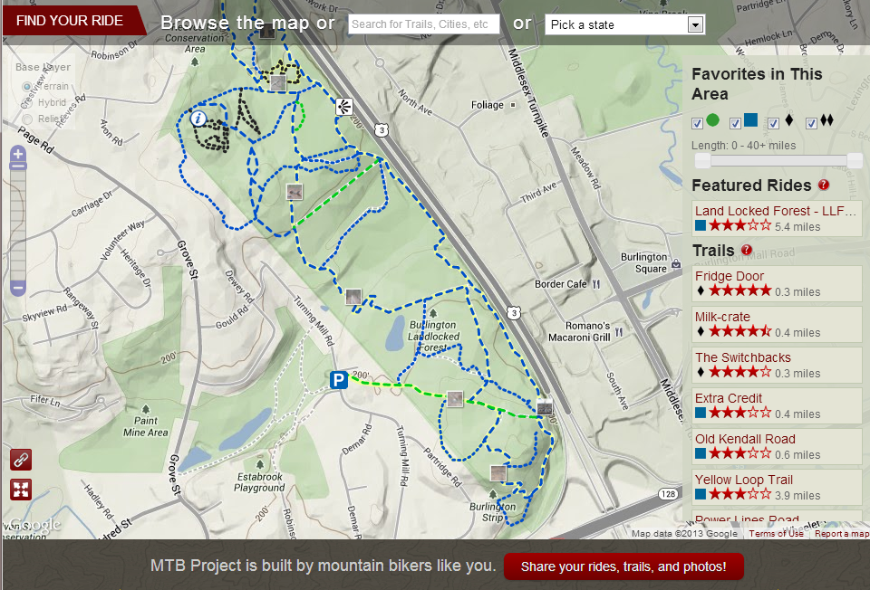
Project Motivation
Notes:
Project Motivation
How did the project come about?
Master GIS student at PSU
Avid outdoor geek, wanted to give something back.
All over trails are being managed by volunteer organizations. Money is often extremely tight, that is if they actually have a budget. They often have a core volunteer base who gives free labor in the form of building and maintaining trails and some even have the technical skills to offer a trail or organization website. Trail data, if it exists, is usually stored in random files and spread across multiple volunteers. Organizations are lucky if they are able to provide updated trail maps, never mind giving timely notes on current trail status. What if there was a better way to focus the volunteers' time on areas that needed the most attention, while also getting the public more involved? With cost being an obvious factor, enter open source, which has the freedom of customizability and often wide community support.
There are a wide range of web mapping applications out there for trail users. These range from simple trail displays to trails with built in loops with user generated ratings and skill or ability levels that one would need to possess. IMBA's MTB Project is one of the better trail mapping sites and really gives users a lot of information in a clean layout. Their trails are a combination of IMBA provided and crowd sourced. Having said that, most organizations only provide very basic options, if at all, for users to report issues on the trail. I was unsuccessful in finding a single trail trouble reporting site that was even paired with a map. The ones that provided a mechanism for reporting trouble issues mostly used simple web forms that ask users to describe what and where the issue is located. The most basic sites simply had an email link for users.
If the user doesn't forget to report the issue, which will happen often, reporting at a later time gives a much greater possibility for incorrect data. Trail users want to help, so why make them jump through unnecessary hoops?

Slide 3
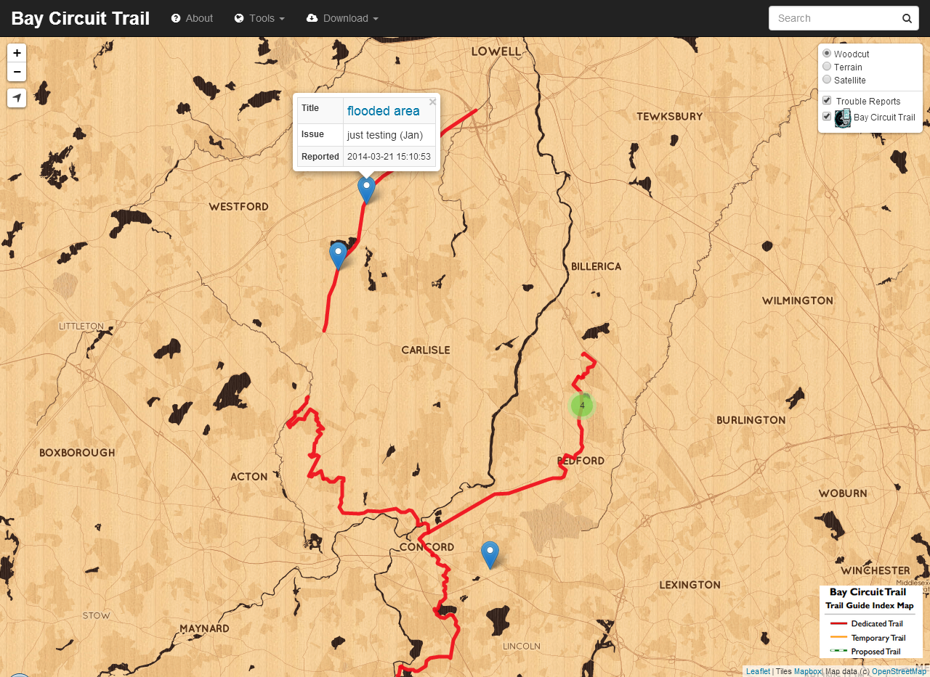
Project Goal
Provide an integrated open source geospatial publishing and reporting platform that allows volunteer organizations to get up and running quickly.
Notes:
Provide an integrated open source geospatial publishing and reporting platform that allows volunteer organizations to get up and running quickly.
Targets two groups of system users:
- Trail Liaisons – administrators both global and regional who want CRUD (create, read, update and delete) abilities
- Trail Users – hikers, bikers, etc. who want the ability to visualize the trail, get their current location, and report any trail issues they come across, e.g. tree down over trail, hornets nest, etc.

Slide 4
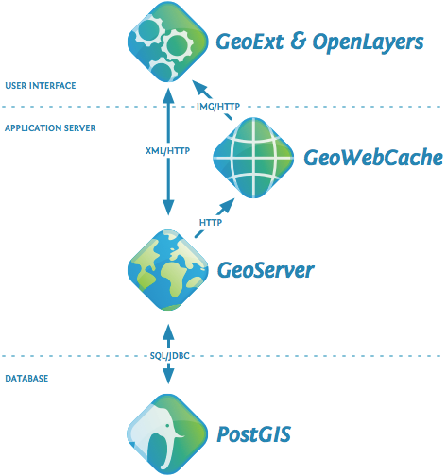
Project Background
Notes:
Project Background
Several iterations - started out very heavy. By heavy, I mean there was a lot of GIS orientated software, which required a lot of installation and the necessary hardware to run it all. This started with an open geo stack - QGIS for the desktop application, PostGIS for the back-end database, and Boundless OpenGeo for the server application. The idea was to take all of this and create a simple single install. But then I took a step back and thought "what if we could remove some of these hardware barriers?“
This led to replacing the PostGIS back-end and OpenGeo server with CartoDB, an open source instantiation of PostGIS in the cloud that provides some really great web mapping features. While this wasn't my final solution, if you want dead simple web mapping with the ability to do advanced SQL queries, definitely check out CartoDB.
Ok, so let's lighten the load even more. QGIS is a great open source alternative to ESRI ArcGIS, but it's GIS...by that I mean you need to be fairly familiar with GIS software to make it useful. I asked my wife to try and use QGIS and she has no real GIS experience. She gave it about 5 minutes before asking if we were done yet. QGIS, gone.
What follows is my final solution and process. It is lightweight and borrows heavily from several open source projects. It requires no additional hardware power than what would normally be available on a shared web hosting account. Also, there is no real installation other than dragging/dropping files.

Slide 5
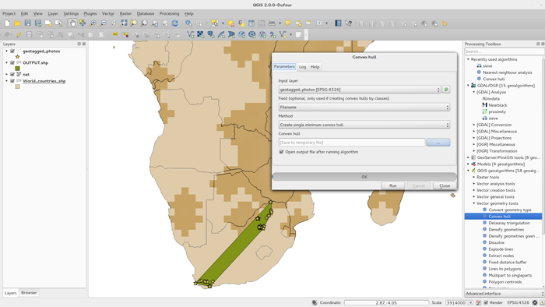
Project Background
Notes:
Project Background
Ok, so let's lighten the load even more. QGIS is a great open source alternative to ESRI ArcGIS, but it's GIS...by that I mean you need to be fairly familiar with GIS software to make it useful. I asked my wife to try and use QGIS and she has no real GIS experience. She gave it about 5 minutes before asking if we were done yet. QGIS, gone.
What follows is my final solution and process. It is lightweight and borrows heavily from several open source projects. It requires no additional hardware power than what would normally be available on a shared web hosting account. Also, there is no real installation other than dragging/dropping files.

Slide 6
Step 1: Data
Obtain – call or email parks/towns to see if trail data has already been collected
Collect – trail data non-existant? Use GPS
Draw – geojson.io to the rescue!
Notes:
Step 1: Data
Obtain, Collect, Or Draw the data!
If trail has not been mapped, use a GPS to map it in GPX format.
You don't know GIS, there is an open source solution for that...
geojson.io (quick, simple, open source website for creating, viewing, and sharing maps) - http://geojson.io

Slide 7
geojson.io
Notes:
geojson.io (quick, simple, open source website for creating, viewing, and sharing maps) - http://geojson.io
drag and drop functionality for easy editing of existing files
easy to drop points or draw lines and polygons to create new data (trails, parking areas, post-ride beer spots, etc.)
possible that somebody has already mapped the trails in OpenStreetMap - http://www.openstreetmap.org/

Slide 8
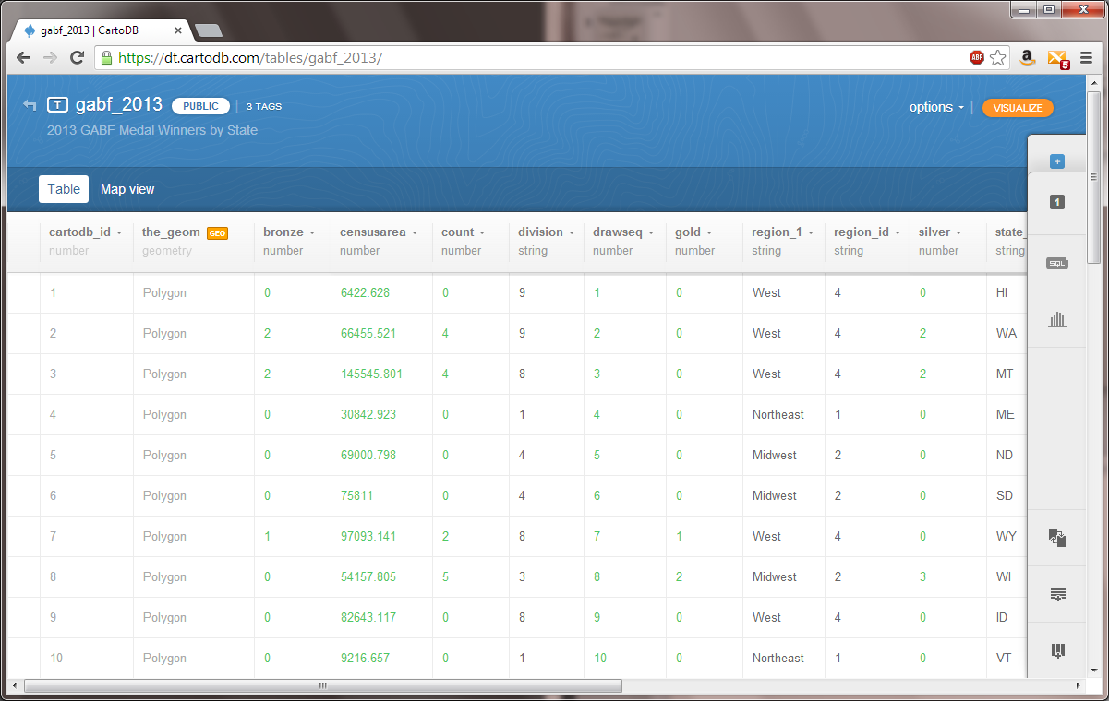
Step 2: Data Management
There are a lot of options…
…but most require hardware
Notes:
For those who can afford some dedicated resources there is the Boundless OpenGeo suite http://boundlessgeo.com/ (actually there are a lot of options for geo-server solutions - http://www.osgeo.org/ ). At the database level there is PostgreSQL/PostGIS - http://postgis.net/ . Software is free, but would still need to pay for hardware/system administrator or pay for dedicated web hosting.
Another option is CartoDB - http://cartodb.com/ - at it’s most basic is a cloud PostGIS installation, but it’s really so much more. Initially, this project focused on using CartoDB for data management. The only downside was the difficulty of maintaining group data as the free plans are tailored to individual users. Check them out - they're awesome.

Slide 9
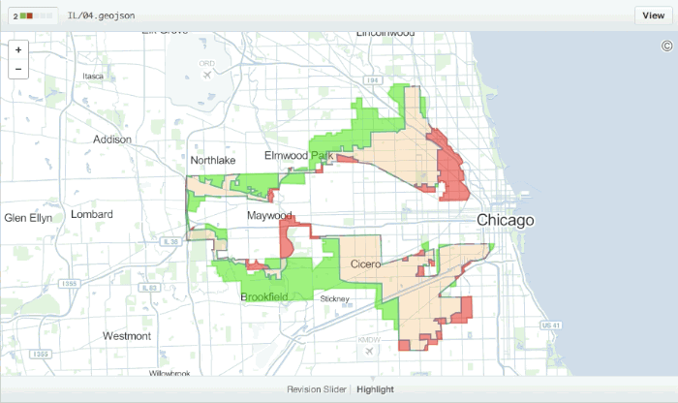
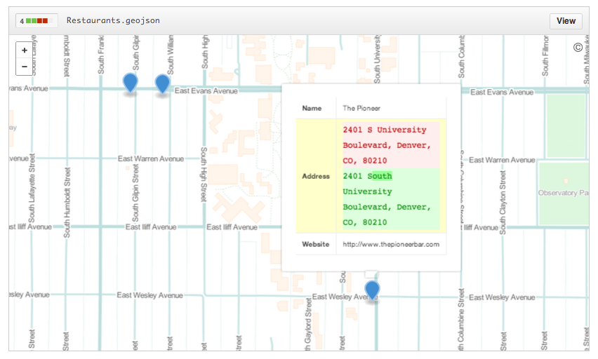
Github
Notes:
Thankfully there is Github - http://github.com - often used to host code for open source projects, Github recently provided the ability to version control spatial data so you can see how your data has changed over time and even rollback if needed. They offer free plans for both individuals and organizations. Github makes it easy for complete strangers to copy your data and make updates, then it's up to you commit those changes. Since Github keeps a history of commits, it's really easy to step back in time to remove an edit.

Slide 10
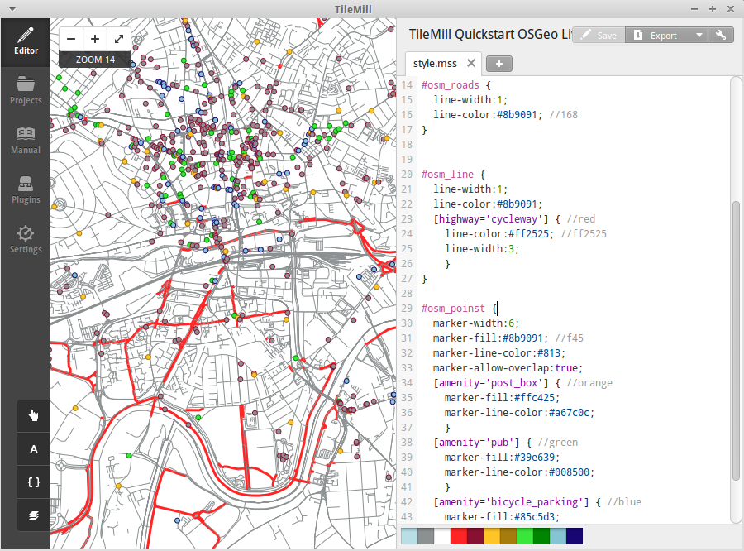
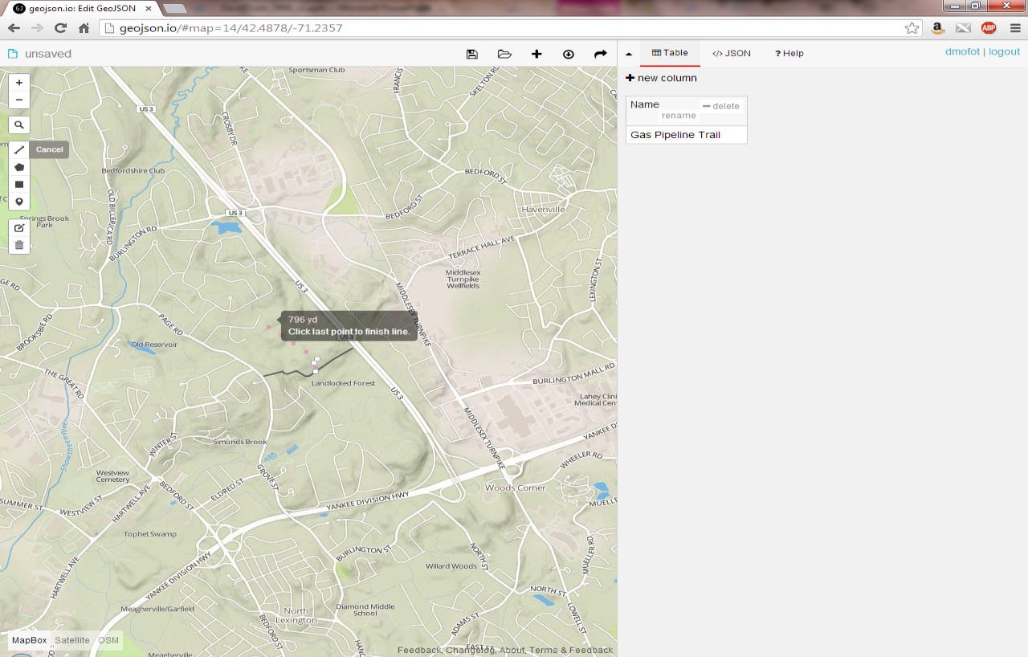
Step 3: Publishing
Notes:
Web Maps:
geojson data format works everywhere…All of the above web mapping libraries take geojson as their preferred format - thankfully geojson.io made it easy for us to create/export our data as geojson...
Leaflet - http://leafletjs.com/ - an open source javascript library for mobile friendly interactive maps. Because it's just a lightweight javascript library, it can easily be hosted on any shared web hosting service. I use Bluehost - http://www.bluehost.com/
Mapbox/TileMill - https://www.mapbox.com/ & https://www.mapbox.com/tilemill/ - makes it easy to create custom maps and is built on Leaflet. This is so you can make pretty maps – those of you using ESRI are now intrigued…
Issue Reporting:
Many database options exist, but SQLite - https://sqlite.org/ - is completely self contained and doesn't require a server or configuration. Because of this, it was chosen to store and push trouble reports.

Slide 11
Step 4: Use it!
Download/fork template from Github
Add/Remove basemaps…or don’t
Add your trail data
Change colors…or don’t
Upload files to your shared web host
Spread the word about your awesome trails!
Notes:
Thankfully there is Github - http://github.com - often used to host code for open source projects, Github recently provided the ability to version control spatial data so you can see how your data has changed over time and even rollback if needed. They offer free plans for both individuals and organizations. Github makes it easy for complete strangers to copy your data and make updates, then it's up to you commit those changes. Since Github keeps a history of commits, it's really easy to step back in time to remove an edit.

Slide 12
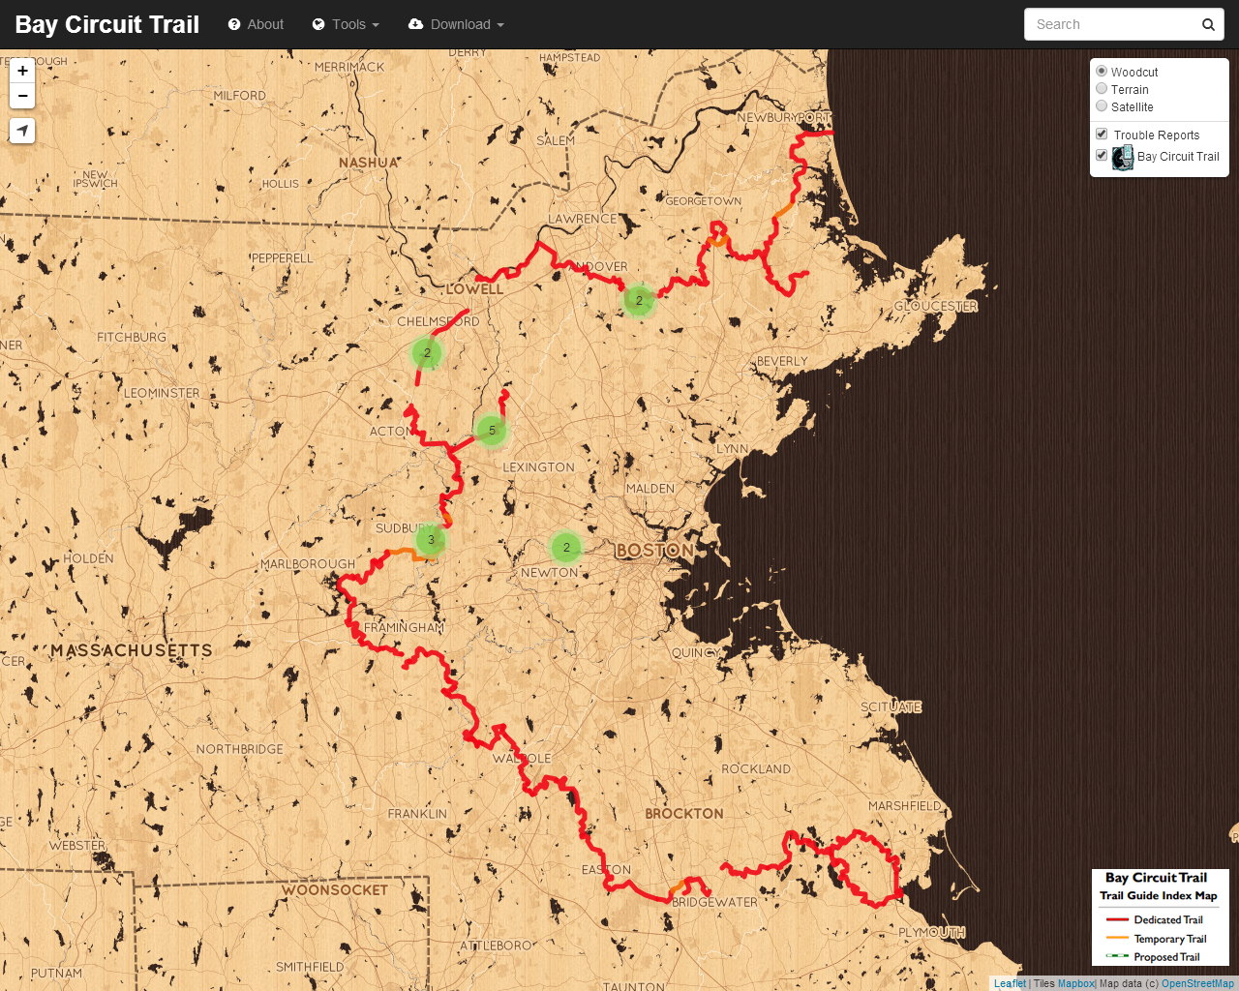
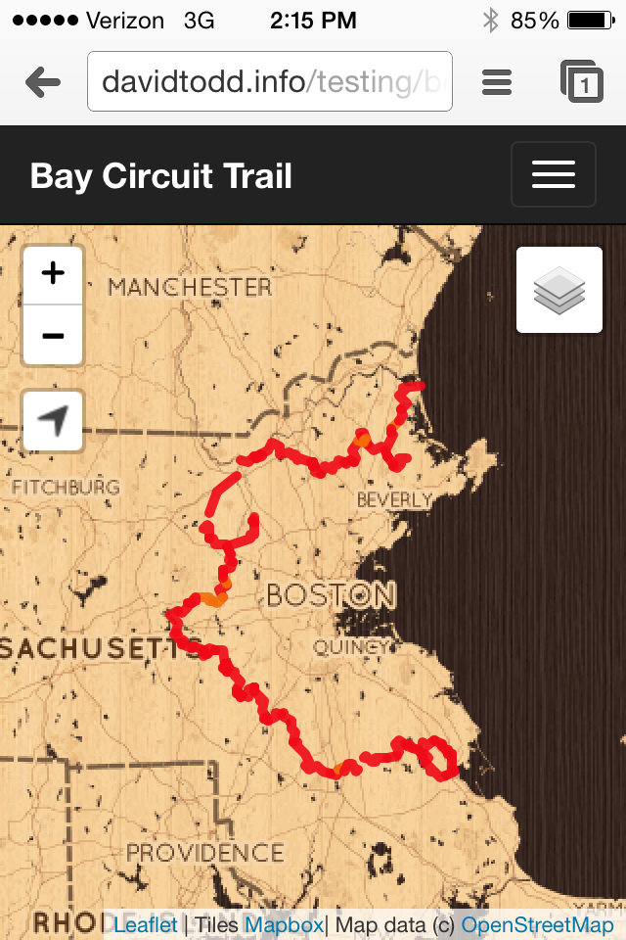
Features
Mobile friendly
Search feature data
Search for places
Zoom to location
Shareable URLs
Add/Remove issues

Slide 13
Lessons Learned
Geo-collaboration is not easy
Use open formats whenever possible
Target your audience
KISS
Notes:
Thankfully there is Github - http://github.com - often used to host code for open source projects, Github recently provided the ability to version control spatial data so you can see how your data has changed over time and even rollback if needed. They offer free plans for both individuals and organizations. Github makes it easy for complete strangers to copy your data and make updates, then it's up to you commit those changes. Since Github keeps a history of commits, it's really easy to step back in time to remove an edit.

Slide 14
Questions?

Slide 15
Check ‘em out!
geojson.io http://geojson.io
Github http://github.com
Leaflet http://leafletjs.com/
MapBox http://www.mapbox.com/
OpenStreetMap http://www.openstreetmap.org/
SQLite https://sqlite.org/
BootLeaf https://github.com/bmcbride/bootleaf
TileMill https://www.mapbox.com/tilemill/
CartoDB http://cartodb.com/
PostgreSQL/PostGIS http://postgis.net/
Boundless http://boundlessgeo.com/
OSGeo http://www.osgeo.org/
QGIS http://qgis.org

