Slide 1
Using Web-Based Tools to Share Symbology:
A Case Study with Mapmakers from the California Department of Water Resources
Capstone Project Proposal by Sarah Troedson
Spring 2011

Slide 2
Introduction
Background
Research Objectives
Methods
Significance and Limitations
Summary

Slide 3
Introduction
Maps are a critical form of communication in Emergency Management
  Analytical tool
  Aid to developing a Common Operational Picture (COP)
Tasks are time sensitive: standards can save lives and property
Standards also make collaboration among agencies more efficient

Slide 4
Introduction
Few existing map symbology standards at the federal level (Homeland Security Working Group, 2005; Dymon 2003)
National Response Framework (2008) does not list flooding as a type of emergency
Existing federal standards inadequate for the California Department of Water Resources (DWR)

Slide 5
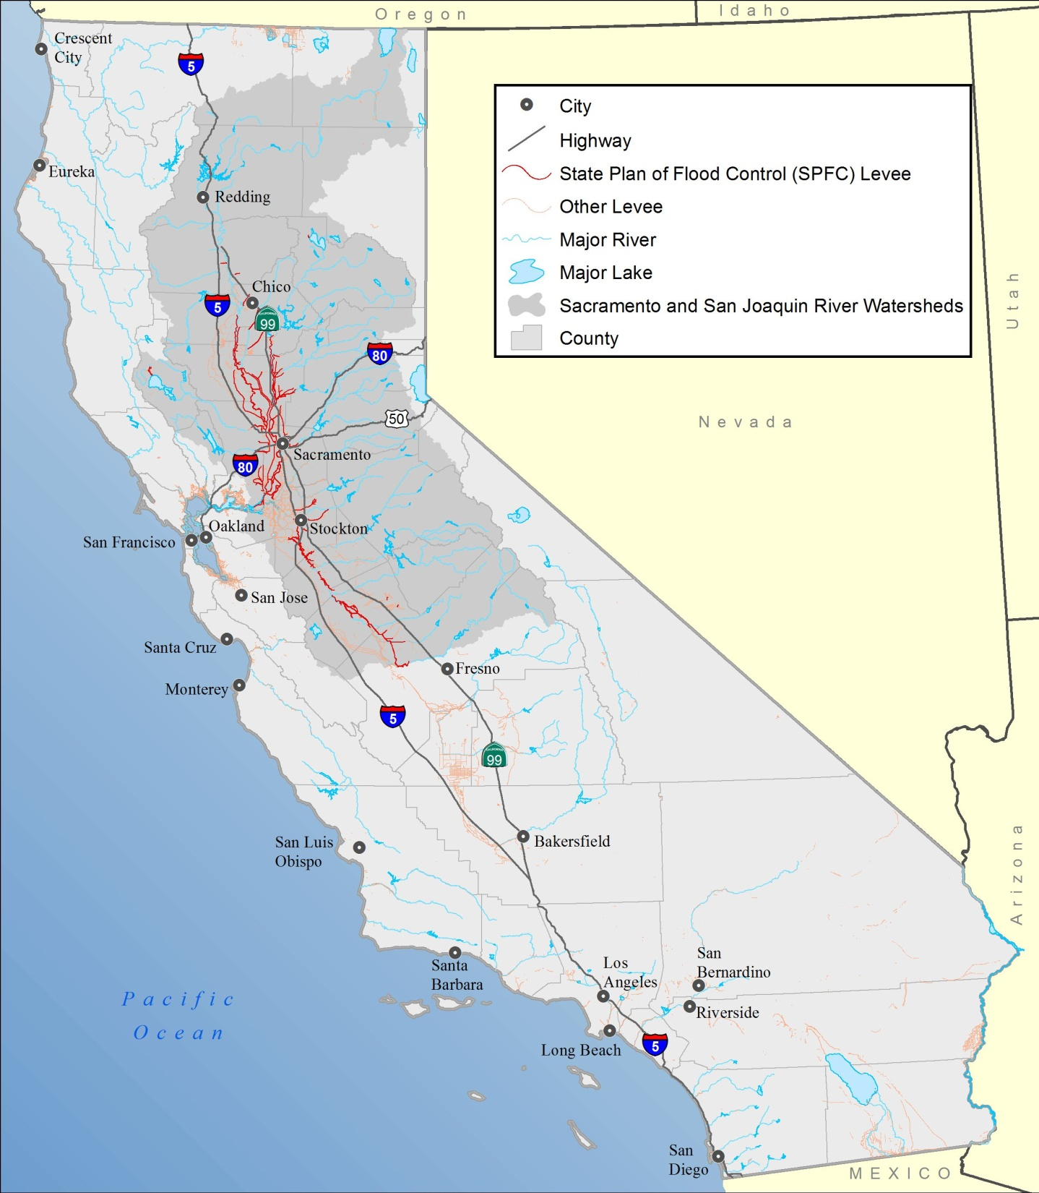
Background
The main locations of flooding in California are:
  Central Valley
  coastal areas
  high desert areas
Notes:
-The flooding in coastal and high desert areas is often along unregulated (no levees) rivers and can occur seasonally
-The Central Valley contains the Sacramento and San Joaquin River systems, which converge in the Delta that flows into San Francisco Bay. The lower reaches of these river systems are heavily channeled by levees.
-Outside of the Los Angeles Basin, most of the population in the state is along branches of the Sacramento and San Joaquin Rivers and around the Delta.
-The levees in the Central Valley were designed for different flows over 100 years ago, and are subjected to erosion from wind, rodent burrows, vegetation/root growth, tidal forces (in the Delta), and are often poorly maintained.

Slide 6
Background
Flooding side effect of another hazard but most often due to weather patterns
Levees old and often poorly maintained
Flooding can be predicted but depends on
  certainty of the weather forecast
  condition of the levees
Notes:
The Sacramento and San Joaquin river systems are fed by rainfall and snowmelt, are extensively channeled by levees, and have dams for water supply and flood control on every major branch.

Slide 7
Background
DWR and the United States Army Corps of Engineers (USACE) share jurisdiction over many of the levees
Many of the levees were built by USACE
Nearly all are maintained by local agencies and special districts, coordinating with DWR
Not all meet FEMA levee certification standards (FEMA 2010, Pineda 2007)
Multi-layer responsibility argues strongly for a single mapping standard
DWR does not yet have any GIS standards
Notes:
- Local agencies and special districts: Levee Maintenance Agencies, Reclamation Districts, Levee Districts
– DWR does not yet have ANY existing standards map symbols, scales, data formats, software, metadata, map formats, etcetera

Slide 8
Background
DWR created a GIS Subcommittee to develop standards
DWR lacks support tools to develop and refine standard symbology
The GeoVISTA center at Penn State is designing two tools that can help
  E-Symbology Portal - a set of web tools designed to help groups collaborate to develop and refine symbol standards
  Symbol Store - a web tool designed to help users search for, retrieve, and share their symbols
The focus of this work is on the Symbol Store
Notes:
E-Symbology Portal is a tool for compiling symbols and uploading them to a web based site that utilizes card-sorting methods to organize the symbols.

Slide 9
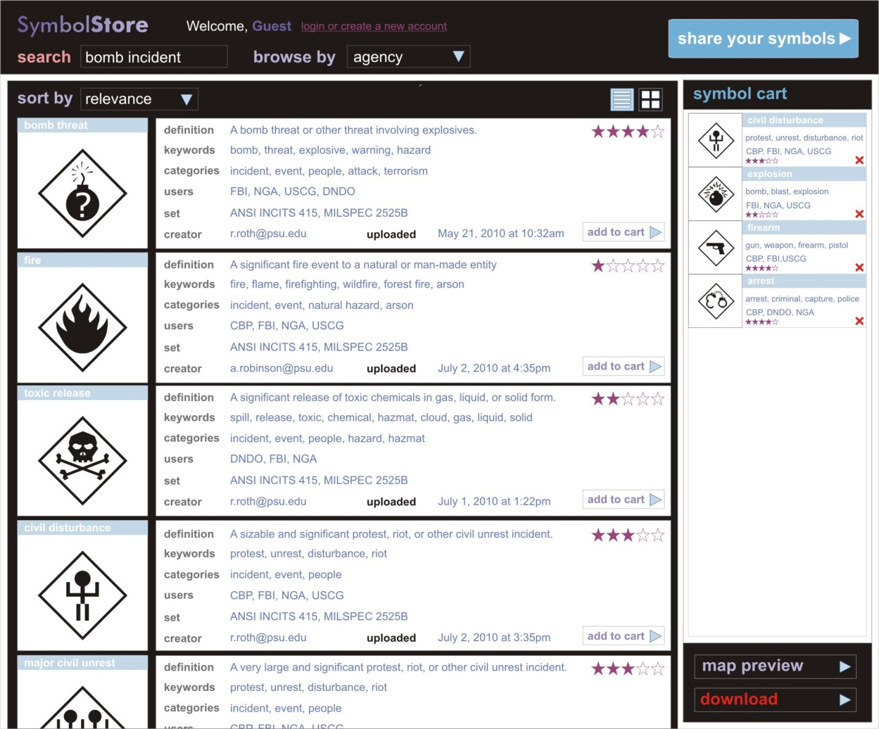
Background
Notes:
Figure 2: Symbol results for a “bomb incident” search query in the Symbol Store prototype.
The Symbol Store is a tool designed to enable symbol interoperability by allowing users to share map symbols, visually browse for them, search for specific types of symbols

Slide 10
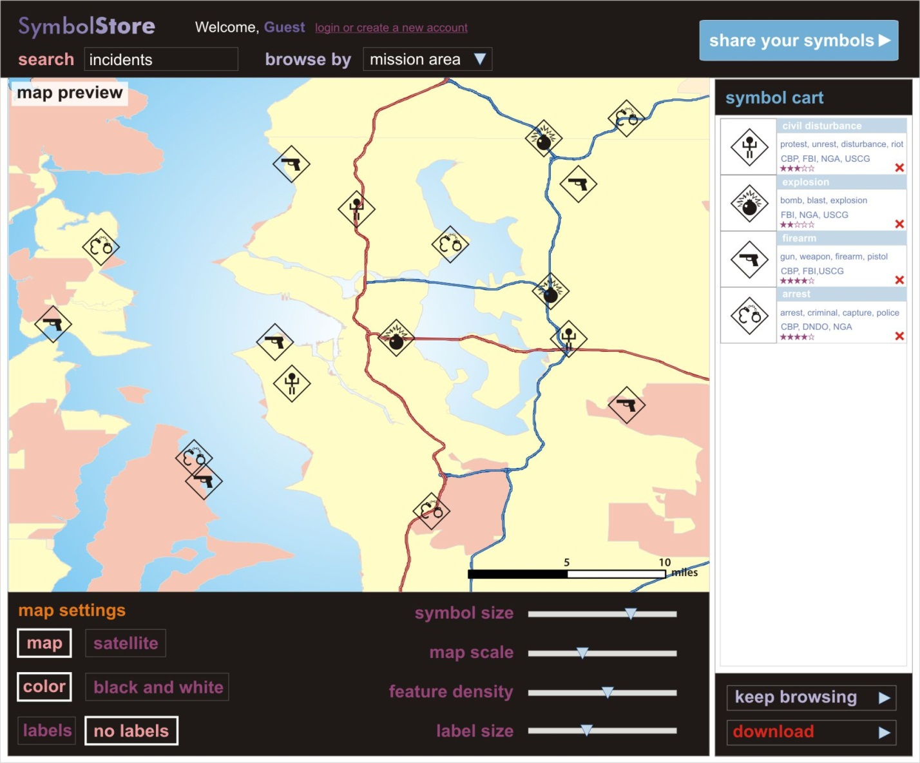
Background
Notes:
Figure 3: Selected “incidents” symbols are kept in the symbol cart and displayed on a sample base map, with options to show satellite imagery, a black and white basemap, etc.
-view samples of how those symbols would appear over realistic base maps, and to download symbols in an ESRI *.style file format.
-The back end of the Symbol Store utilizes ArcObjects to handle the ESRI style files and create the preview images of the styles with a Lucene index handling the text content and .NET web service to support read/write capabilities of both symbols (.style files) and text (Robinson, et al. 2010).

Slide 11
Research Objectives
Evaluate the Symbol Store’s utility as an aid for developing DWR’s GIS Standard Symbology
Assess the utility of the Symbol Store in everyday work flow for all DWR’s GIS staff
Determine effectiveness of the Symbol Store for sharing symbols among different branches of DWR
  Extrapolate potential to use these tools to share symbols among different agencies
Notes:
A subset of DWR’s GIS staff (8-10 study participants) is willing to test the Symbol Store and provide feedback on their experiences. The objectives of this research project are threefold:

Slide 12
Methods
Part 1: Semi-structured interviews
  Work flow
  Plans to develop their GIS Symbology Standards
  Previous attempts to share GIS symbology
Part 2: Building on results from Part 1,
  Create instructions for basic use of the e-Symbology Portal and Symbol Store
  Create sample tasks for the study participants to complete
  Create survey to assess their experience
Notes:
The online survey, like the sample tasks, will be designed to gain specific feedback relating to the three primary research goals of this project.

Slide 13
Methods
Part 3: The study participants work through sample tasks and online survey
Part 4: Compile survey results, discuss with participants
Part 5: Compile all results and provide to developers of e-Symbology Portal and Symbol Store.
Notes:
-Round Table Discussion to gather any additional qualitative feedback or suggestions
-give results to developers for their use in modifying and improving the functionality of the e-Symbology Portal and Symbol Store

Slide 14
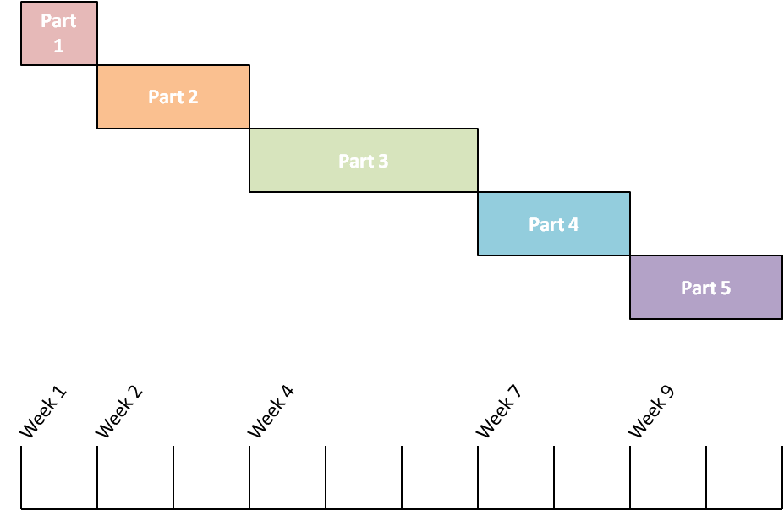
Methods
This is intended to be a formative evaluation (Robinson et al. 2005) of the utility of the Symbol Store.
Notes:
-Total project timeline is expected to be approximately 10 weeks, with some overlap possible among parts.
-Part One will last approximately a week, I may provide additional insight (and reference materials) particularly related to development of the GIS Standard if they don’t have much of a plan already formulated.
-Part Two will last approximately two weeks, with one week spent developing the basic instructions and sample tasks and one week spent in a methodical development of assessment questions for the anonymous survey, both of which will be shaped by the results of the previous step.
-Part 3 is set for three weeks to allow the study participants adequate time to schedule their regular work around their testing and evaluating of the e-Symbology Portal and Symbol Store. I will be present during the testing just in case.
-Part 4 should take approximately two weeks,
-Part 5 will be spent compiling the results of the round table discussion and presenting those to the developers at the GeoVISTA Center and will take approximately two weeks.
-Formative evaluations are intended to be qualitative while summative evaluations are quantitative in nature. Qualitative assessment of the Symbol Store will give a better picture of its overall usability for the objectives of this project

Slide 15
Significance and Limitations
Intended to: Provide valuable insights on
  How symbology standards are disseminated and re-used
  How tools like the Symbol Store can best assist
Intended to: Gather critiques and recommendations for changes to features of the tools
Not intended to: constitute a best practices recommendation
Not intended to: be a complete overview for DWR

Slide 16
Significance and Limitations
Future research possibilities include:
  Additional iterations of evaluation work with DWR testers
  Evaluating the Symbol Store for inter-agency and multi-agency symbol sharing
  Evaluating the tools for developing inter-agency GIS standards
  Adding capacity for line and polygon symbols to the Symbol Store
  Further evaluation once additional functionality is in place

Slide 17
Summary
Based on the need for standard symbology for flooding and flood-related emergencies in California, DWR GIS staff will test the e-Symbology Portal and Symbol Store to assist in developing their GIS standards.
This project will include:
  Creation of testing scenario
  Creation of evaluation survey questions
  Interviews with the participants
  Compilation and presentation of all results

Slide 18
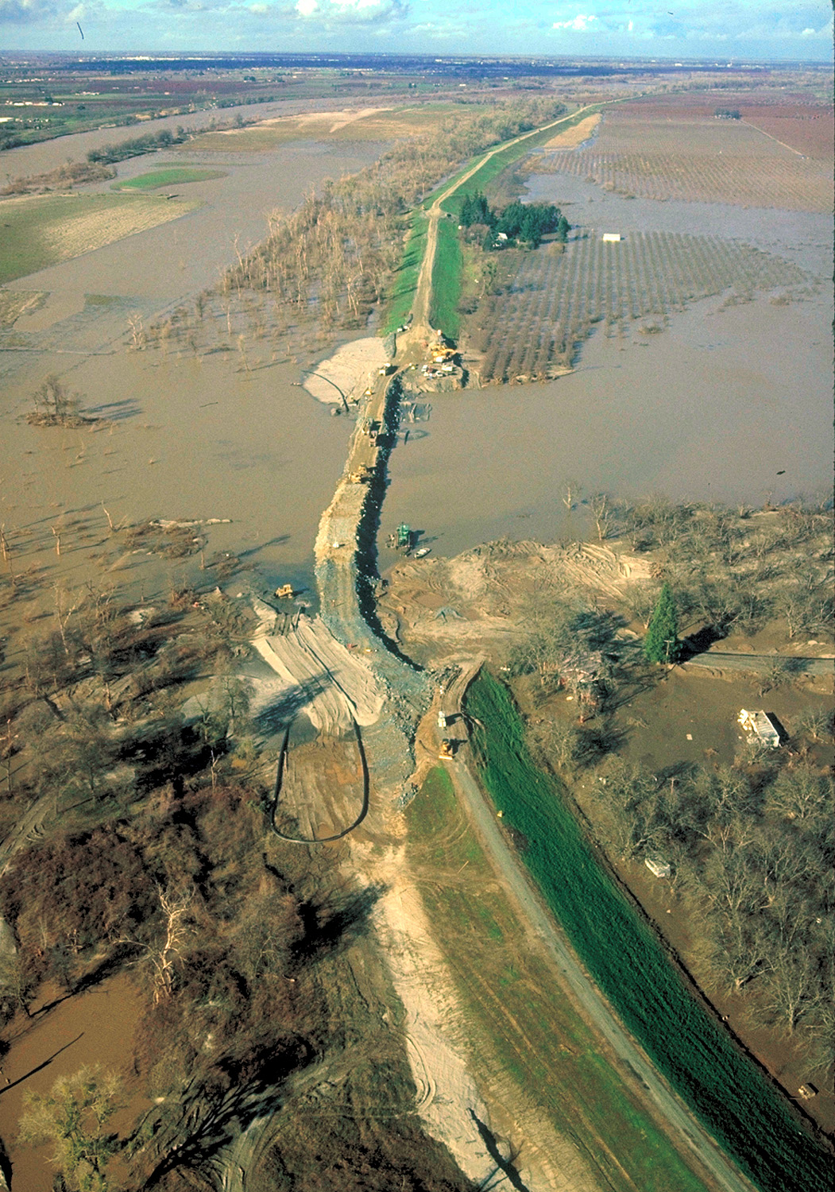
Questions?

Slide 19
References
Boggs, Christina (2011) Personal communication, co-leader GIS Warm Wash Meeting in response to Golden Guardian Exercise, 1 June 2011
Cal-Atlas Geospatial Clearinghouse (2010) http://atlas.ca.gov/download.html various data sets accessed over the last 2-3 years with varying publication dates, often modified in-house by GEI Consultants, Inc. GIS staff.
California Department of Water Resources, California Levee Database (2011) version 2.2, revision 2, January 28, 2011, used with permission, file geodatabase format
California Department of Water Resources (DWR 2011) “Levee Repair – Levee Evaluation Program” http://www.water.ca.gov/levees/evaluation/ accessed June 2011
California Department of Water Resources (DWR 2010) “Levee Repair – History of Levees” http://www.water.ca.gov/levees/history/ accessed November, 2010.
California Department of Water Resources Division of Flood Management (DWR DFM 2011) report on “DWR Golden Guardian FY 2011 Flood Emergency Exercise” draft, prepared by Brian Smith and Nova Clemenza
California Emergency Management Agency (2010) “Standardized Emergency Management System-SEMS” Sacramento, CA, http://www.oes.ca.gov/WebPage/oeswebsite.nsf/Content/7386D576C12F26F488257417006C07A7?OpenDocument accessed June, 2011
California Interagency Watershed Mapping Committee, California Department of Water Resources, Calwater Version 2.2.1 (2004), shapefile format extracted from original interchange file distribution
Cova, T J (1999) “GIS in emergency management” Geographical Information Systems: Principles, Techniques, Applications and Management, P.A. Longley et al Editors, John Wiley & Sons, New York, 845-858
Department of Homeland Security (2008) “National Response Framework” Washington, DC, http://www.fema.gov/pdf/emergency/nrf/nrf-core.pdf accessed June, 2011
Dymon, Ute J. (2003) “An analysis of emergency map symbology” International Journal of Emergency Management, Vol. 1, No. 3, 227-237 Inderscience Enterprises Ltd.
Federal Emergency Management Agency (FEMA 2010) “Levees – Frequently Asked Questions” Washington, DC http://www.fema.gov/plan/prevent/fhm/st_broomelv.shtm accessed June 2011
Homeland Security Working Group (2005) Symbology Reference http://www.fgdc.gov/HSWG/index.html accessed June 2011
Matteoli, Jaime (2011) Personal communication, co-leader GIS Warm Wash Meeting in response to Golden Guardian Exercise, 1 June 2011
Pineda, Ricardo (2007) “Cataloging California’s River Levee System” Stormwater: The Journal for Surface Water Quality Professionals, May issue, http://www.stormh2o.com/may-2007/flood-river-levee.aspx accessed June 2011
Radke, John, et al. (2000) “Application Challenges for Geographic Information Science: Implications for Research, Education, and Policy for Emergency Preparedness and Response”, URISA Journal, Vol. 12, No. 2 Spring
Robinson, Anthony, et. al (2005) “Combining Usability Techniques to Design Geovisualization Tools for Epidemiology” Cartography and Geographic Information Science Vol. 32, no.2, 243-255
Robinson, Anthony, et al. (2010) “A Web Based Symbol Store for Sharing Map Symbology” Proceedings of the NACIS 2010 Annual Meeting
Roth, Robert E., et al. (2011) “Card Sorting for Cartographic Research and Practice” CaGIS

