Slide 1
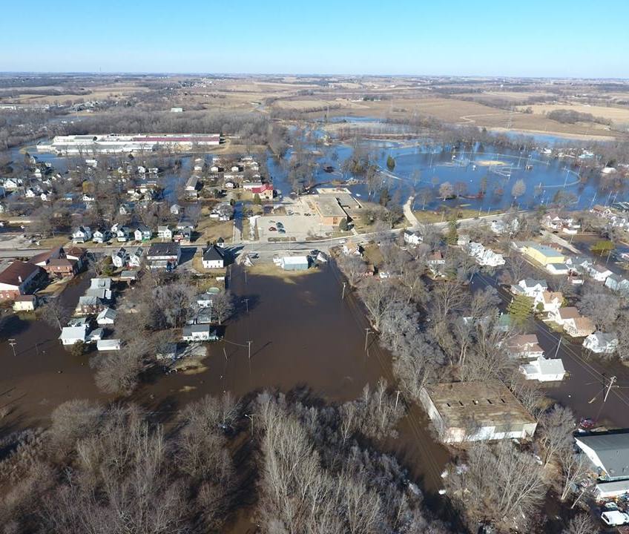
Using Geospatial Intelligence to Determine the Optimal Flood Mitigation Technique for the Pecatonica River
Adam Troxell
Picture courtesy of the Freeport News Network

Slide 2
Outline
Purpose
Background
Previous Research
Goals and Objectives
Methodology
Anticipated Results
Project Timeframe
Possible Presentation Venues
References
Notes:
Here you can see the outline for the presentation today where I will go over the purpose, background, previous research of flood models, goals & objectives, the methodology, anticipated results, the project timeframe, and lastly possible presentation venues.

Slide 3
Purpose
Find
Find the “best” possible flood mitigation technique for the study area
Analyze
Analyze the before and after flood risk of the flood mitigation technique of the study area
Report
Possibly give the policy makers actionable intel to reduce flood damage costs
Notes:
The main purpose of this project is to reduce flood damage costs in the Pecatonica River region.

Slide 4
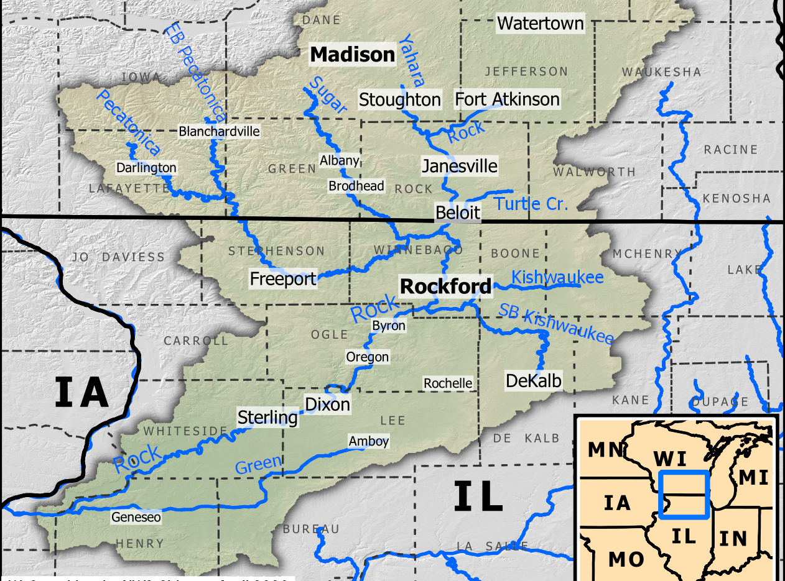
Background
Over 1.2 million acres
Begins in southwestern Iowa County, WI and ends in Rockton, IL where it enters the Rock River
87% of land use is Agriculture (U.S. Dept of Agriculture, 2008)
18 flooding events occurred in the Pecatonica River region from 1950 to present (NWS, 2020)
Picture courtesy of the NWS Chicago WFO (2020)
Notes:
The Pecatonica River encompasses over 1.2 million acres and is a tributary to the Mississippi River. The image to the right shows the Pecatonica river beginning in Blanchardville and near Darlington, WI where it then flows into the Rock River in Rockton IL. According to the US Department of Agriculture, over 87% of the land use in the region is Agriculture and the main metropolitan area is Freeport, IL where the population is less than 30,000.
Now let’s focus on the past flooding events in the region. From 1950 to present, there have been 18 different flooding events according to the National Weather Service. Out of the 18, 4 took place before the year 2000, and from 2017 to present, there have been 7. Also, the city of Freeport alone spent over $1.5 Million in flood cleanup efforts. This amount may not seem like a lot but this region is vastly rural.

Slide 5
Previous Research
ArcGIS Hydrology toolset flood model
Artificial Neural Networks (ANN) flood model
GIS Flood Tool (GFT) model*
Hydrological Engineering Center’s River Analysis System (HEC-RAS) flood model*
LISFLOOD model*
LISFLOOD-FP model*
Shannon’s Entropy Flood Model*
Notes:
The seven flood models listed here are the ones I investigated, and I will go over each one in the next few slides. The ones with the asterisk behind them are flood models that have their own graphical user interface or software to run the models.

Slide 6
ArcGIS Hydrology Toolset Flood Model
Simple raster-based model
Can handle both low-resolution and high-resolution DEMs
Only uses the DEM data to compile the watershed map
Users can do zonal statistics in the watershed output with rainfall raster data to determine where flooding can take place
Notes:
This model is a simple raster-based flood model that can handle low resolution and high-resolution DEMS. The only datasets require to use this flood model is the DEM raster dataset and rainfall amount in a specific period in a raster data format.

Slide 7
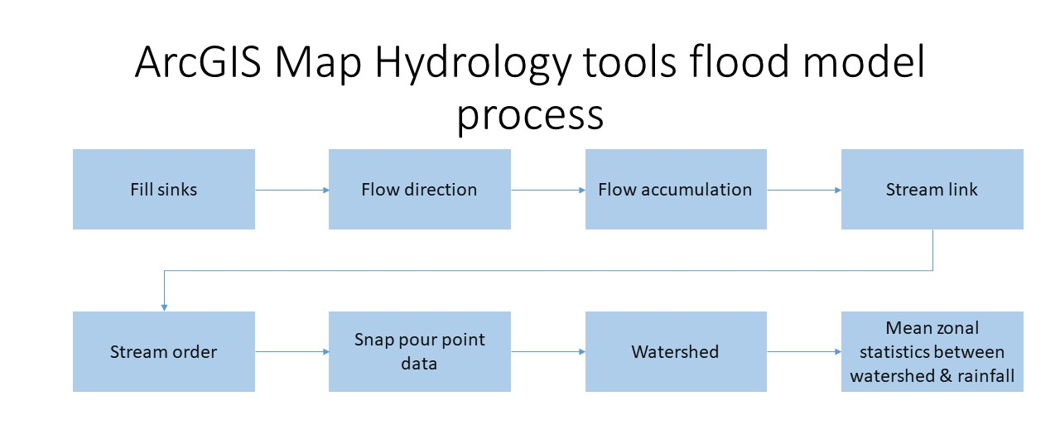
ArcGIS Hydrology Toolset Flood Model Cont.
Notes:
This flowchart shows the processes required to complete this flood model. To minimize error, I will use the Model Builder tool in ArcGIS for this model.

Slide 8
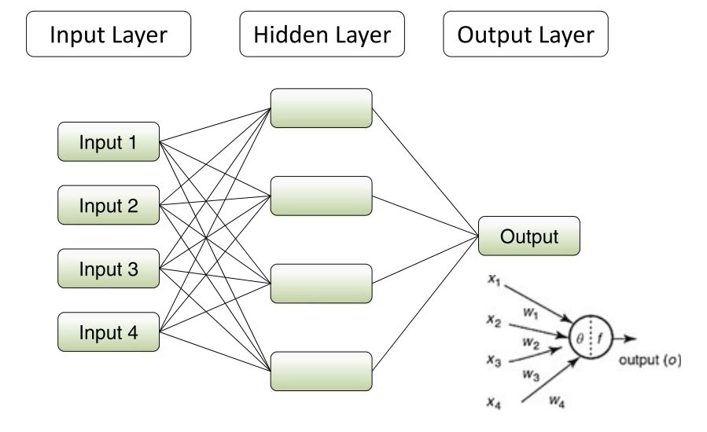
ANN Flood Model
Machine learning/artificial intelligence flood model
DEM, the bedrock, soil types, land use, rainfall, and runoff data of the study area are the input datasets
Consists of three parts: ANN architecture, training, and testing
Notes:
This model employs machine learning and artificial intelligence to run this model and is consisted of three parts which are the architecture, training, and testing. The diagram on the right illustrates how this model uses the input datasets to get the output layer. The input datasets required are the DEM, bedrock, soil types, land use, rainfall, and rainfall-runoff discharge.

Slide 9
GFT Model
Developed by the U.S. Geological Survey
Toolset developed to work as a graphic user interface (GUI) for ArcGIS
Designed to work with low and high resolution DEMs
Notes:
This model was developed by the US Geological Survey to be widely available around the world as an easy-to-use flood model. This tool uses a graphical user interface in ArcGIS to compile the DEM and rainfall data into a flood map.

Slide 10
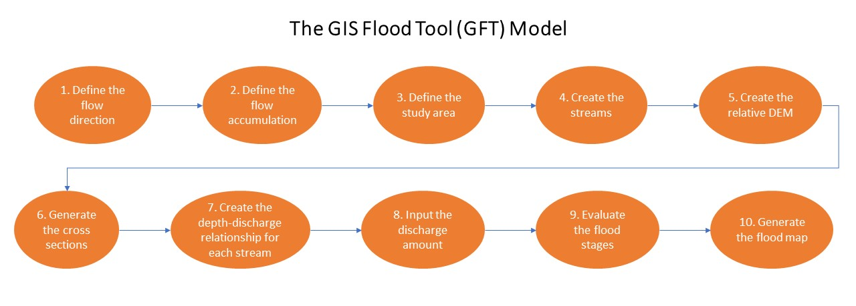
GFT Model Cont.
Notes:
This chart shows the processes for this model. The key thing to take away is that it is similar to the ArcGIS Hydrology toolset model discussed earlier.

Slide 11
HEC-RAS Flood Model
Used by FEMA for generating its Digital Flood Insurance Rate Maps
Regarded as the standard for flood models
Used to determine where to install flood mitigation measures
Notes:
This model is regarded as the standard for flood models and it is used by FEMA to generate its Digital Flood Insurance Rates Maps. Another application of this model is to help determine where to install flood mitigation measures in a study area.

Slide 12
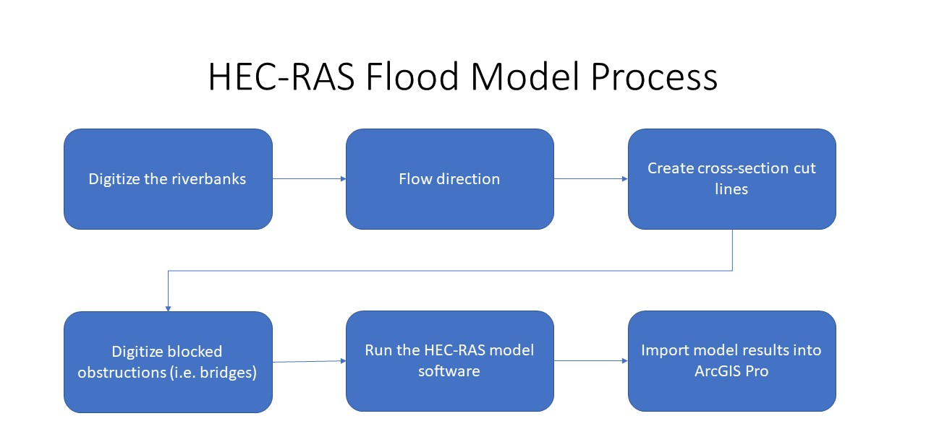
HEC-RAS Flood Model Cont.
Notes:
AS you can see by this flowchart, the process is similar to both the ArcGIS hydrology toolset and the GIS Flood Tool except that for this model, the user creates cross-sectional lines so the software calculates the flood threat in each section rather than the whole region at once.

Slide 13
LISFLOOD Model
Incorporates meteorological, land cover, DEM, and geological data to run the model
Requires vast amount of datasets
Not designed to handle LIDAR DEM
Notes:
The LISFLOOD model requires a vast amount of input datasets including meteorological, geological, and geographical datasets to run this model. Its heavy usage of meteorological data doesn’t make this model usable where that data is scarce like in rural areas and the software for this model does not support high-resolution DEMs like LIDAR which is becoming more relatively available. The next two slides show all the required parameters for this model. The parameters are broken into five sections that are circled.

Slide 14
LISFLOOD Model Cont.
Notes:
Here you can see the snow and frost related parameters and the soil-related parameters.

Slide 15
LISFLOOD Model Cont.
Notes:
And on this slide, you can see the Land Cover related parameters, the Groundwater related Parameters, and the Channel parameters.

Slide 16
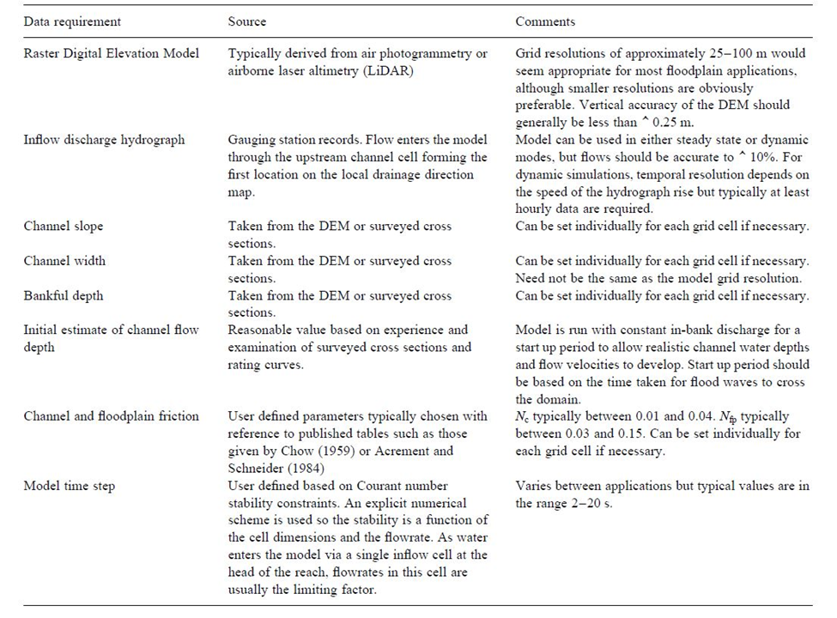
LISFLOOD-FP Model
Based on the earlier version of the LISFLOOD model
Designed to handle LIDAR DEMS
Simple raster-based flood model
Notes:
The LISFLOOD-FP is a later version of the previously mention LISFLOOD model where this version is simplified and can handle the high-resolution LIDAR DEMs. The table on the right shows the parameters for this model and the underlined ones are derived from the DEM and the two requirements underneath them are user inputs

Slide 17
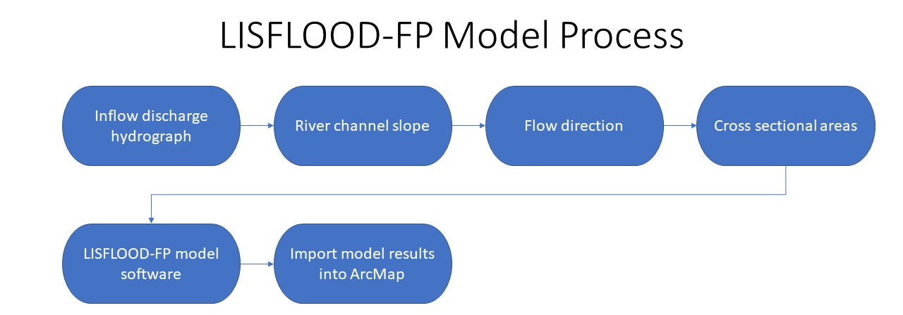
LISFLOOD-FP Model Cont.
Notes:
The process steps for the LISFLOOD-FP model are almost identical to the HEC-RAS model with the key difference being this model does not digitize river blockage.

Slide 18
Shannon’s Entropy Flood Model
Uses land use, soil type, drainage density, topographic wetness index (TWI), altitude, slope aspect, slope angle, lithology (characteristics of the rock), plan curvature (curvature of the Earth), and distance from the river data
Uses weighted values to determine the importance of each dataset
Notes:
The Shannon’s Entropy Flood Model is different from the other models examined. The main reason for that is just as the name suggests, it uses Entropy calculated weights for each dataset to determine the importance of that dataset as well as to calculate the final flood susceptibility map.

Slide 19
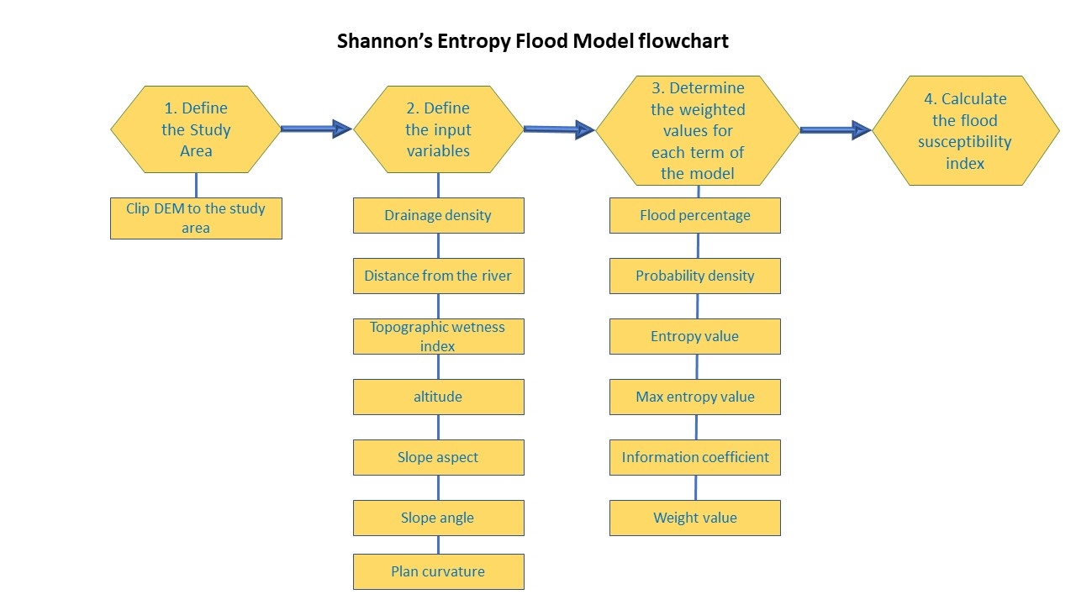
Shannon’s Entropy Flood Model Cont.
Notes:
This chart illustrates the steps, variables, and calculations that will be required to complete this model.

Slide 20
Goals and Objectives
Primary goal is to reduce the flood risk along the Pecatonica River
Objectives
Compare the different flood models outputs and determine the “best” one
Complete the ACH Matrix for the “best” possible mitigation technique
Simulate the mitigation technique in the study area using the “best” flood model
Notes:
The primary goal of this project is to reduce the flood risk along the Pecatonica River. To do that I will compare the different flood model outputs to determine the best one, complete the Analysis of Competing Hypotheses Matrix to determine the best possible mitigation technique, and then simulate that mitigation technique in the study area to illustrate how well that technique performs. To determine the best flood model, I will use an Accuracy Assessment with a well-documented flooding event with National Agricultural Imagery Program imagery and the model with the best user and producer accuracy will be classified as the best model for this study.

Slide 21
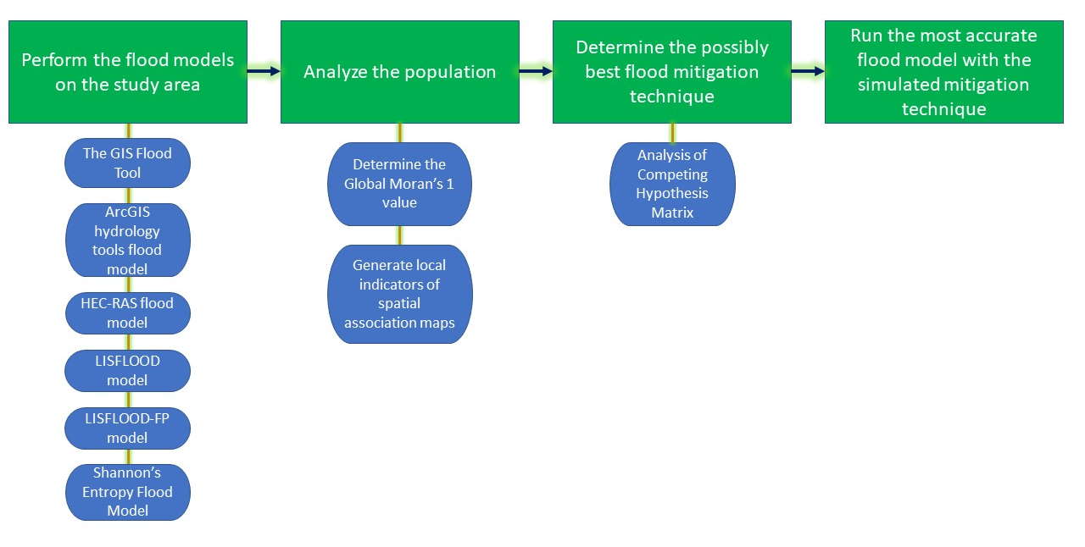
Methodology
Notes:
The chart shown here is how I will complete this project. As this chart shows, the flood models will be the most labor-intensive portion of this project depending on data and software availability. The analysis of the population section is mainly to determine what population is at the highest risk for flooding and determine if there is any autocorrelation within the area.

Slide 22
Anticipated Results
All models output will be similar except for the Shannon’s Entropy flood model
For the ACH Matrix, I do not want to speculate so that my analysis will not be skewed
The mitigation technique will reduce the flood risk with the possibility to increase the flood possibility downstream
Notes:
I anticipate all the flood models will show similar results since they are all similar except for the Shannon’s Entropy Flood Model. Then, for the best mitigation technique, I don’t want to speculate on it so my analysis will not be skewed. Lastly, for the simulating of the mitigation technique, I think it will reduce the flood risk in the study area but it could increase the flood risk possibly downstream or somewhere else unforeseen.

Slide 23
Project Timeframe
Dec 2020 & Jan 21
Download data and software and Pre-process data and begin creating the layers needed
Feb 21
Generate the flood models
March 21
Complete the ACH Matrix
April 21
Simulate the mitigation technique with the flood model
May & June 21
Finalize the data
July 21
Present capstone project
Aug 21
Graduate
Notes:
Here you can see my anticipated timeframe for this project where I will finalize the project in May or June before presenting this project sometime in the Summer of 2021.

Slide 24
Possible Presentation Venues
ESRI User Conference
Illinois GIS Association Regional Meeting
The 2021 American Water Resources Association Summer Conference: Connecting Land & Water for Healthy Communities
Notes:
After consulting with my advisor on possible presentation venues, the three venues listed here are the likely venues where I will present my findings depending on when they are being held.

Slide 25
References
Abdulrazzaq, Z., Aziz, N., & Mohammed, A. (2018). Flood modeling using satellite-based precipitation estimates and digital elevation model in eastern Iraq. International Journal of Advanced Geosciences, 6(1), 72. https://doi.org/10.14419/ijag.v6i1.8946
Alaghmand, S., Bin Abdullah, R., Abustan, I., & Eslamian, S. (2012). Comparison between capabilities of HEC-RAS and MIKE11 hydraulic models in river flood risk modeling (a case study of Sungai Kayu Ara River basin, Malaysia). International Journal of Hydrology Science and Technology, 2(3), 270–291. https://doi.org/10.1504/IJHST.2012.049187
Bates, P. D., & De Roo, A. P. J. (2000). A simple raster-based model for flood inundation simulation. Journal of Hydrology, 236(1–2), 54–77. https://doi.org/10.1016/S0022-1694(00)00278-X
Baumann, J. (2016). A GIS-Based Flood Forecasting System. GeoInformatics, March, 16–17.
Birkland, T. A., Burby, R. J., Conrad, D., Cortner, H., & Michener, W. K. (2003). River ecology and flood hazard mitigation. Natural Hazards Review, 4(1), 46–54. https://doi.org/10.1061/(ASCE)1527-6988(2003)4:1(46)
Bubeck, P., Botzen, W. J. W., & Aerts, J. C. J. H. (2012). A Review of Risk Perceptions and Other Factors that Influence Flood Mitigation Behavior. Risk Analysis, 32(9), 1481–1495. https://doi.org/10.1111/j.1539-6924.2011.01783.x
Castellarin, A., Domeneghetti, A., & Brath, A. (2011). Identifying robust large-scale flood risk mitigation strategies: A quasi-2D hydraulic model as a tool for the Po river. Physics and Chemistry of the Earth, 36(7–8), 299–308. https://doi.org/10.1016/j.pce.2011.02.008
Chase, B. (2019). Neighborhoods Face Extinction As Floods Increase. Better Government Association. https://www.bettergov.org/news/neighborhoods-face-extinction-as-floods-increase/
Cheng, C., Yang, Y. C. E., Ryan, R., Yu, Q., & Brabec, E. (2017). Assessing climate change-induced flooding mitigation for adaptation in Boston’s Charles River watershed, USA. Landscape and Urban Planning, 167(October 2016), 25–36. https://doi.org/10.1016/j.landurbplan.2017.05.019
County, A. V. B., Buren, V., County, V. B., County, V. B., & County, V. B. (2010). 6.1 mitigation measures.
Dang, A. T. N., & Kumar, L. (2017). Application of remote sensing and GIS-based hydrological modeling for flood risk analysis: a case study of District 8, Ho Chi Minh City, Vietnam. Geomatics, Natural Hazards and Risk, 8(2), 1792–1811. https://doi.org/10.1080/19475705.2017.1388853
Notes:
This slide and the next two slides are all the references that I have so far for this project that you can review.

Slide 26
References cont.
Haer, T., Botzen, W. J. W., de Moel, H., & Aerts, J. C. J. H. (2017). Integrating Household Risk Mitigation Behavior in Flood Risk Analysis: An Agent-Based Model Approach. Risk Analysis, 37(10), 1977–1992. https://doi.org/10.1111/risa.12740
Haghizadeh, A., Siahkamari, S., Haghiabi, A. H., & Rahmati, O. (2017). Forecasting flood-prone areas using Shannon’s entropy model. Journal of Earth System Science, 126(3). https://doi.org/10.1007/s12040-017-0819-x
Khattak, M. S., Anwar, F., Saeed, T. U., Sharif, M., Sheraz, K., & Ahmed, A. (2016). Floodplain Mapping Using HEC-RAS and ArcGIS: A Case Study of Kabul River. Arabian Journal for Science and Engineering, 41(4), 1375–1390. https://doi.org/10.1007/s13369-015-1915-3
Kia, M. B., Pirasteh, S., Pradhan, B., Mahmud, A. R., Sulaiman, W. N. A., & Moradi, A. (2012). An artificial neural network model for flood simulation using GIS: Johor River Basin, Malaysia. Environmental Earth Sciences, 67(1), 251–264. https://doi.org/10.1007/s12665-011-1504-z
Koks, E. E., Jongman, B., Husby, T. G., & Botzen, W. J. W. (2015). Combining hazard, exposure and social vulnerability to provide lessons for flood risk management. Environmental Science and Policy, 47(November), 42–52. https://doi.org/10.1016/j.envsci.2014.10.013
Leon, A. S., Kanashiro, E. A., Gichamo, T. Z., Valverde, R., & Gifford-Miears, C. (2012). Towards the intelligent control of river flooding. World Environmental and Water Resources Congress 2012: Crossing Boundaries, Proceedings of the 2012 Congress, 2009, 1687–1696. https://doi.org/10.1061/9780784412312.167
Lollino, G., Arattano, M., Rinaldi, M., Giustolisi, O., Marechal, J. C., & Grant, G. E. (2015). Engineering geology for society and territory – volume 3: River basins, reservoir sedimentation and water resources. Engineering Geology for Society and Territory - Volume 3: River Basins, Reservoir Sedimentation and Water Resources, 3, 1–657. https://doi.org/10.1007/978-3-319-09054-2
Masood, M., & Takeuchi, K. (2012). Assessment of flood hazard, vulnerability and risk of mid-eastern Dhaka using DEM and 1D hydrodynamic model. Natural Hazards, 61(2), 757–770. https://doi.org/10.1007/s11069-011-0060-x
Merwade, V. (2012). Tutorial on using HEC-GeoRAS with ArcGIS 10 and HEC- RAS Modeling. School of Civil Engineering, Purdue University, 1–34. http://web.ics.purdue.edu/~vmerwade/education/georastutorial.pdf
Modeling, R. B., Mitigation, F., & Report, F. (1999). River Basin Modelling, Management and Flood Mitigation Final Report. In Group (Issue March).

Slide 27
References cont.
Munoz, A. S. E., Giosan, L., Therrell, M. D., Remo, J. W. F., Sullivan, R. M., Wiman, C., Donnell, M. O., & Donnelly, J. P. (n.d.). Climatic control of Mississippi River flood hazard amplified by river engineering.
National Weather Service (2020). Weather Related Fatality and Injury Statistics. https://www.weather.gov/hazstat/
Overton, I. C. (2005). Modeling floodplain inundation on a regulated river: Integrating GIS, remote sensing and hydrological models. River Research and Applications, 21(9), 991–1001. https://doi.org/10.1002/rra.867
Pinho, J., Ferreira, R., Vieira, L., & Schwanenberg, D. (2015). Comparison Between Two Hydrodynamic Models for Flooding Simulations at River Lima Basin. Water Resources Management, 29(2), 431–444. https://doi.org/10.1007/s11269-014-0878-6
Plate, E. J. (2002). Flood risk and flood management. Journal of Hydrology, 267(1–2), 2–11. https://doi.org/10.1016/S0022-1694(02)00135-X
Turner, A. B., Colby, J. D., Csontos, R. M., & Batten, M. (2013). Flood modeling using a synthesis of multi-platform LiDAR data. Water (Switzerland), 5(4), 1533–1560. https://doi.org/10.3390/w5041533
van der Knijff, J. M., Younis, J., & de Roo, A. P. J. (2010). LISFLOOD: A GIS-based distributed model for river basin scale water balance and flood simulation. International Journal of Geographical Information Science, 24(2), 189–212. https://doi.org/10.1080/13658810802549154
Verdin, J., Verdin, K., Mathis, M., Magadzire, T., Kabuchanga, E., Woodbury, M., & Gadain, H. (2016). A Software Tool for Rapid Flood Inundation Mapping.
Vis, M., Klijn, F., Bruijn, K. M. D., & Buuren, M. Van. (2003). Resilience strategies for flood risk management in the Netherlands. International Journal of River Basin Management, 1(1), 33–40. https://doi.org/10.1080/15715124.2003.9635190
U.S. Department of Agriculture, N. R. C. S. (2008). Wisconsin Illinois Rapid Watershed Assessment Pecatonica River Watershed Rapid watershed assessments provide initial estimates of where conservation investments would best address the concerns of landowners, conservation districts, and other local leaders (Vol. 2600, Issue June).

Slide 28

Questions?
GEOINT IS THE WAY

