Slide 1
Design and Implementation of a Geodatabase for New York Canal Inspection Data
Capstone Project Proposal
Ruth Ann Trudell
Spring 2009

Slide 2
Credits
Patrick Kennelly, Associate Professor, Penn State University
Jamie DeLuca, GIS Specialist, NY State Canal Corporation
DOT staff for support and insights

Slide 3
Discussion Outline
Geographic context and brief history of NY State Canals
Current canal management
Embankment inventory methods/need for modernization
Status of existing inventory data
Time line for data model development

Slide 4
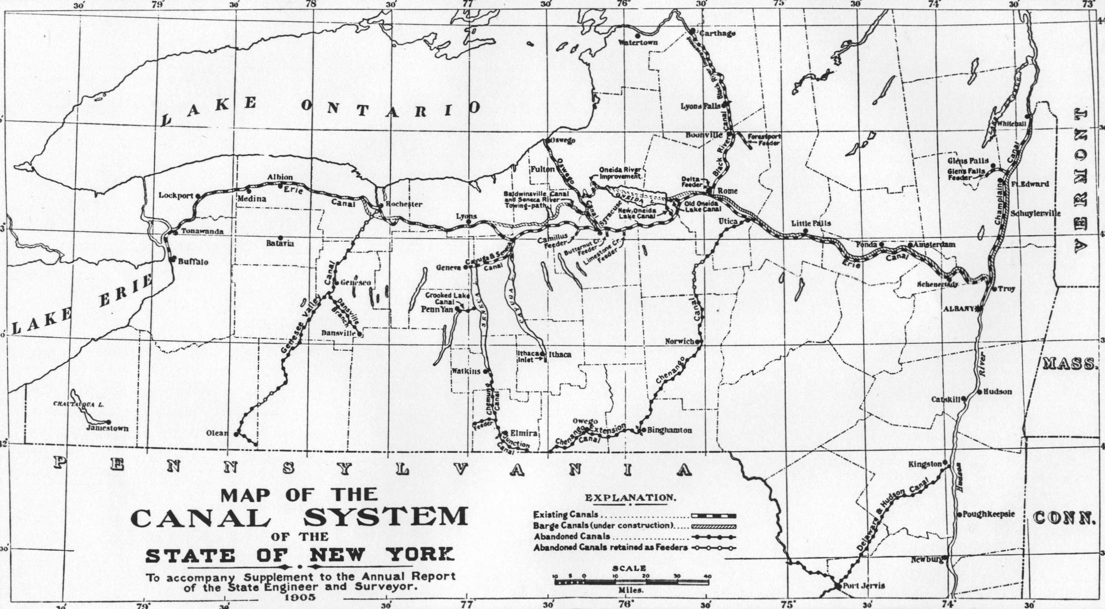
Geography and History of NY State Canal System
Notes:
Map of Canal System dated 1905

Slide 5
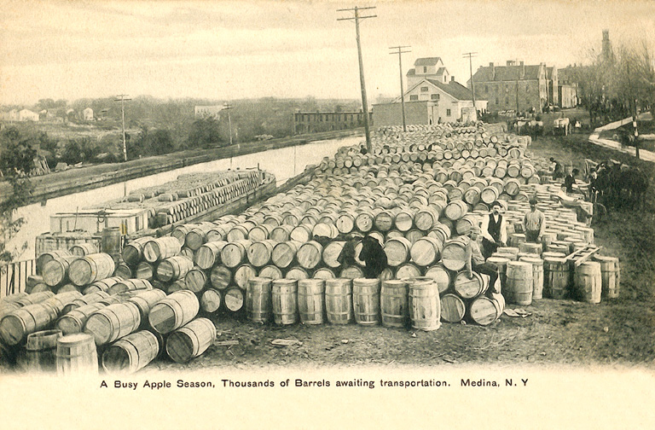
Travel Way for Commerce
Notes:
Pic of apples to be loaded on barges headed to NYC
Canals connected wester and central NY to NY City Also connected Great Lakes territories to the Atlantic Ocean.
Opened the west for settlement early in the history of the country.

Slide 6
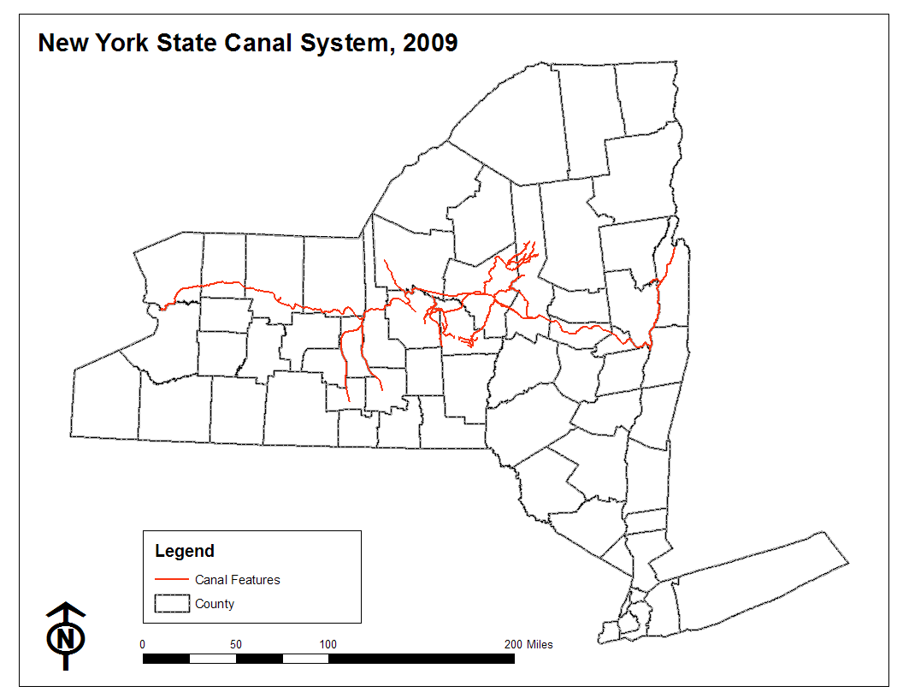
Current Canal System

Slide 7
Canal Management
Operated and maintained by the Canal Corporation, New York State Thruway Authority
Inventory performed by NYS DOT through MOU
Canals managed primarily for recreational boating and historic characteristics

Slide 8
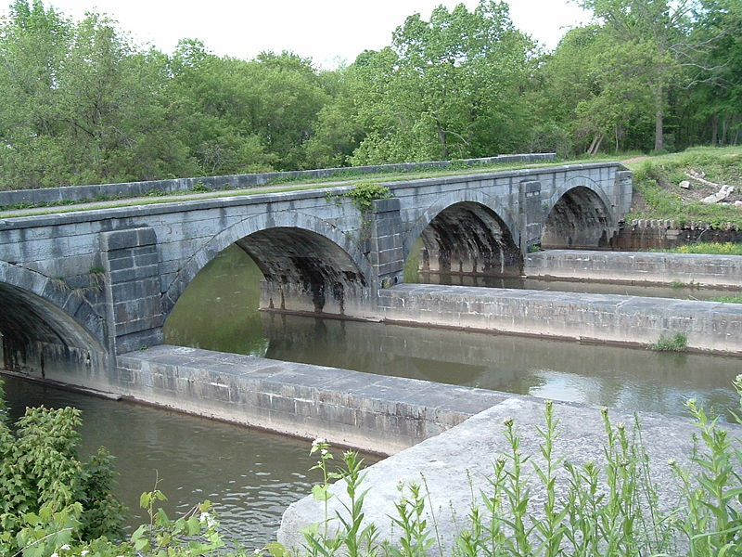
Historic Values
Notes:
Here you are looking at an aquaduct used to carry the canal over a river. The river still exists as does the towpath... the piers in the center were designed to hold a wooden structure used to carry canal water. The canal were originally on average 4' deep.

Slide 9
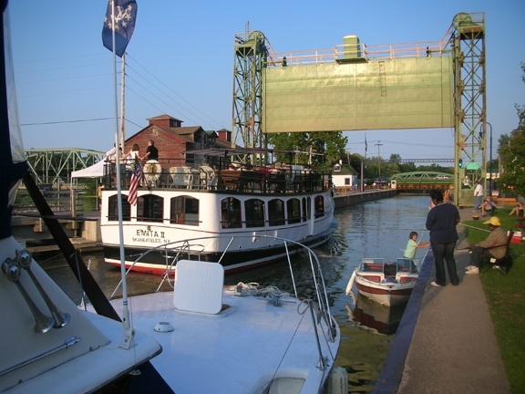
Recreational Boating

Slide 10

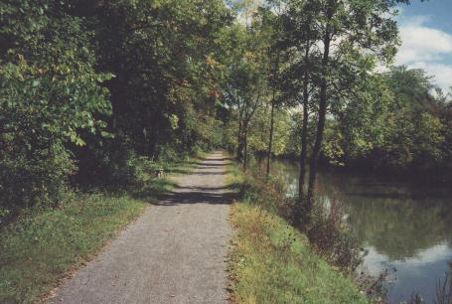
Bicycling

Slide 11
Canal Construction
Parts of canal are embedded in the landscape; parts raised above.
Portions are raised above the surrounding landscape with the use of levees or embankments. (124 of 575 total miles)
Notes:
Critical understanding the need for inspections of specific segments of the canal is an understanding of its design.
To maintain no flow, therefore VERY low gradient
In order to accomplish, portions of the canal had to be constructed above natural grade.
Leads to the construction of embankments sometimes up to 40 feet above natural landscape

Slide 12
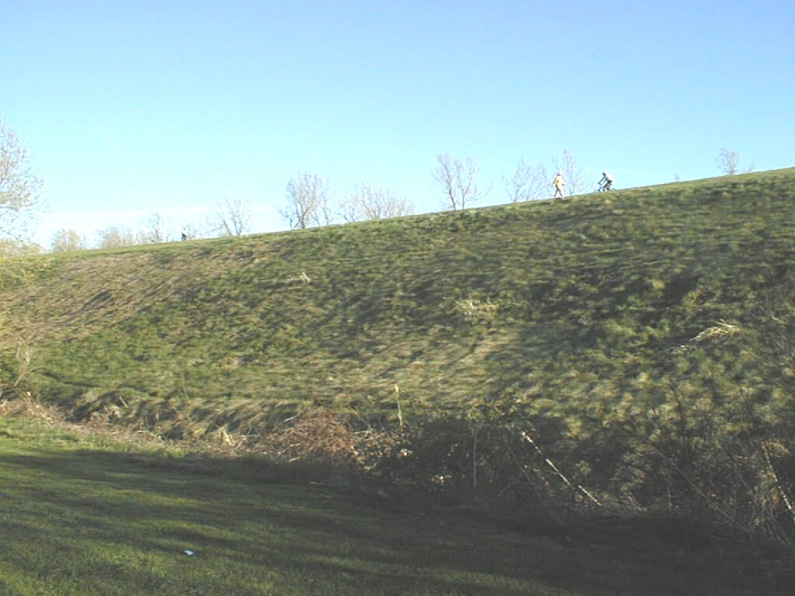
Typical High Embankment

Slide 13
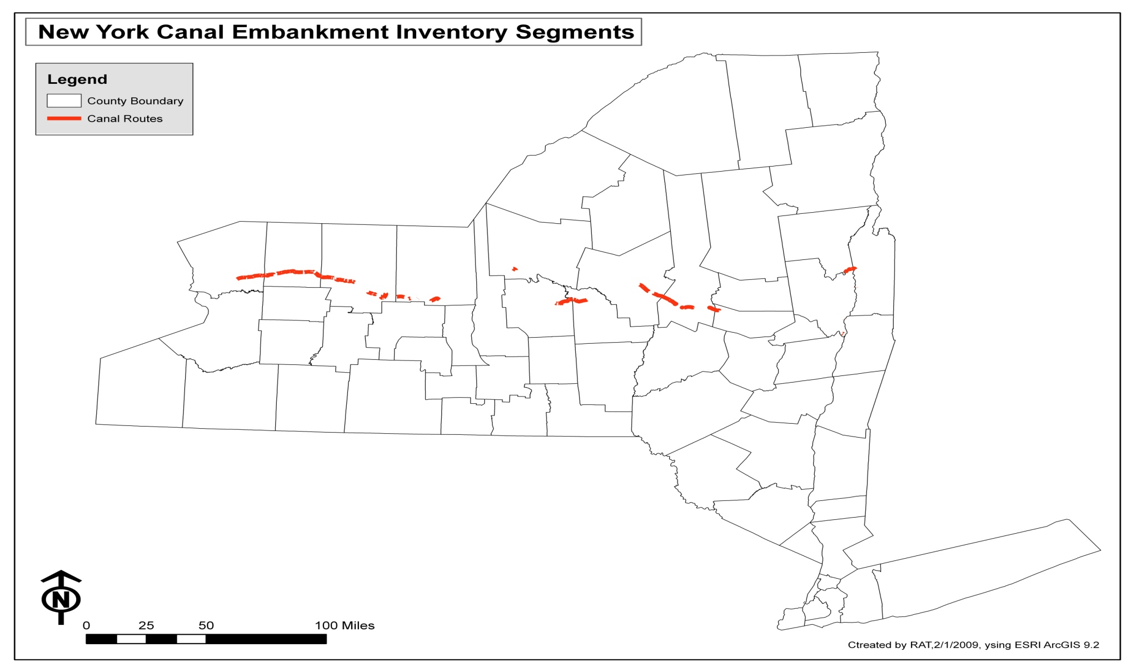
Embankment Segments

Slide 14
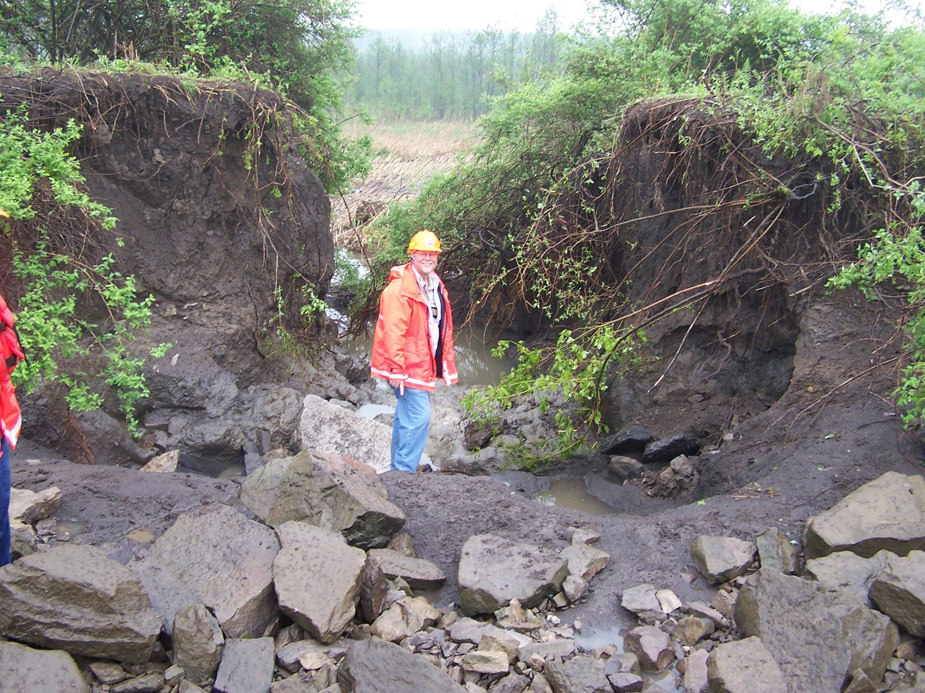
Embankment Failure

Slide 15
Current Inventory Methods
  Inventory segments delineated on paper map
  Embankment conditions documented in field
  Pictures taken at points of interest
  Length of segments by county and rating summarized
  Report written

Slide 16
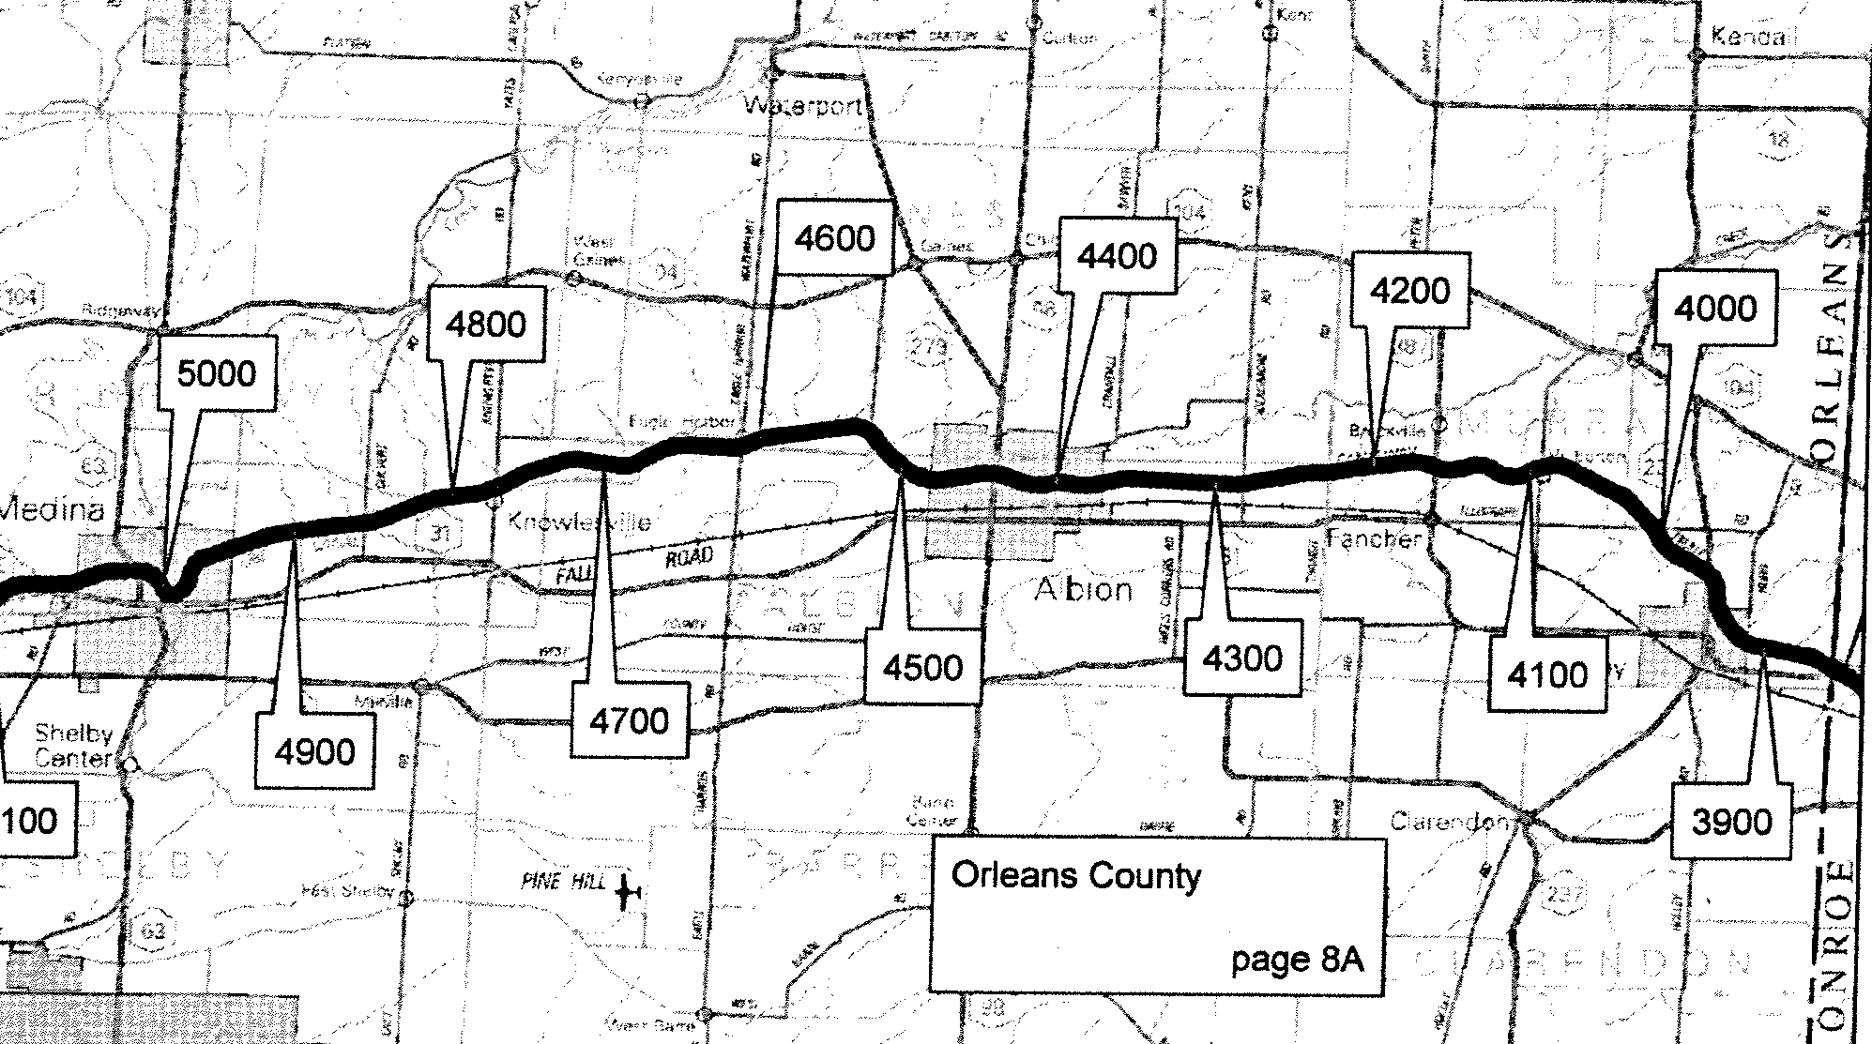
Inventory map

Slide 17
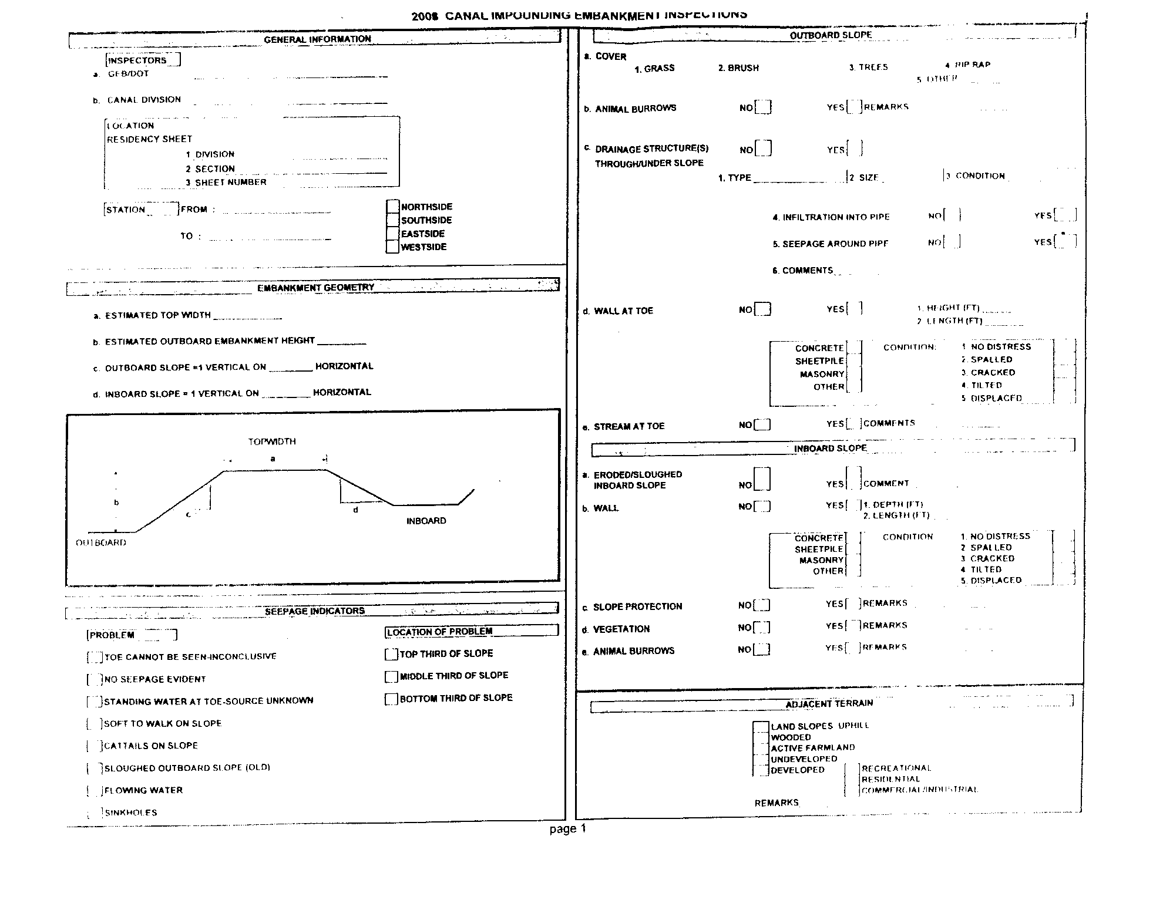
Notes:
Example of Inventory Form

Slide 18
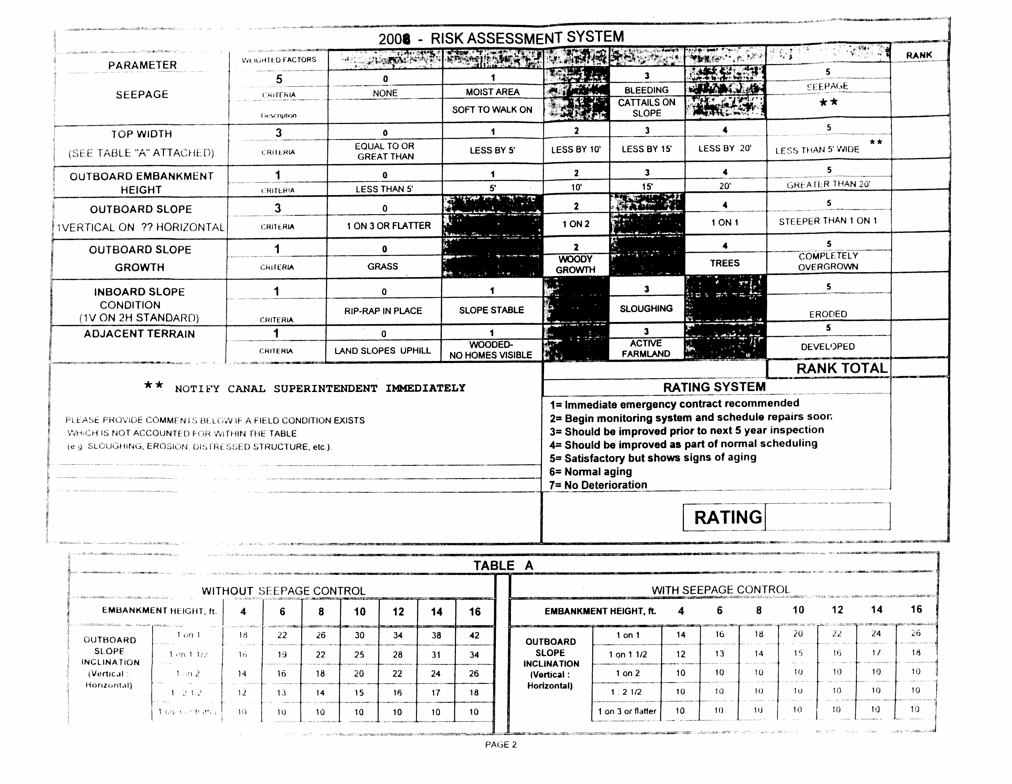
Notes:
Back side with Risk assessment calculations

Slide 19
Current State of Data
Paper maps, inventory forms and copies of Final Report stored in paper format at DOT office in Albany
Pictures stored on servers at CC and DOT
Variety of spatial data maintained at Canal Corporation and DOT
  DOT
    Inventory segments as line features
  Canal Corporation
    Canal, feeders and specific streams center line as routed line features
    Inventory segments from DOT
    Canal stationing as stand alone points

Slide 20
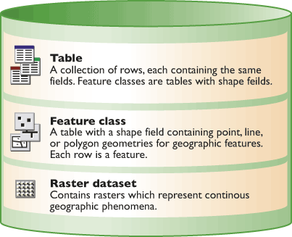
Solution? Geodatabase!

Slide 21
Project Timeline
Meeting with Canal Corps occurred February, 2009
Database design completed by July 2009
Full data migration and deployment September 2009
Present results at NY State GIS Users Conference in Lake Placid October 2009.

Slide 22
February Meeting
Validate data input and output needs (business functions)
Discuss database design issues
Spatial representations- cartographic vs. referencing
Appropriate route
Aggregation/disaggregation of data
Image format
Identify scope of project
Design geodatabase
Migrate 2008/09 data
Notes:
Meeting s will be key to ensuring that database includes all elemants necessary for data storage and reporting.
Foresee two meetings, an initial one to discuss elements in this slide; meeting after database is designed and partially populated.

Slide 23
Business Functions
Use Case Scenario

Slide 24
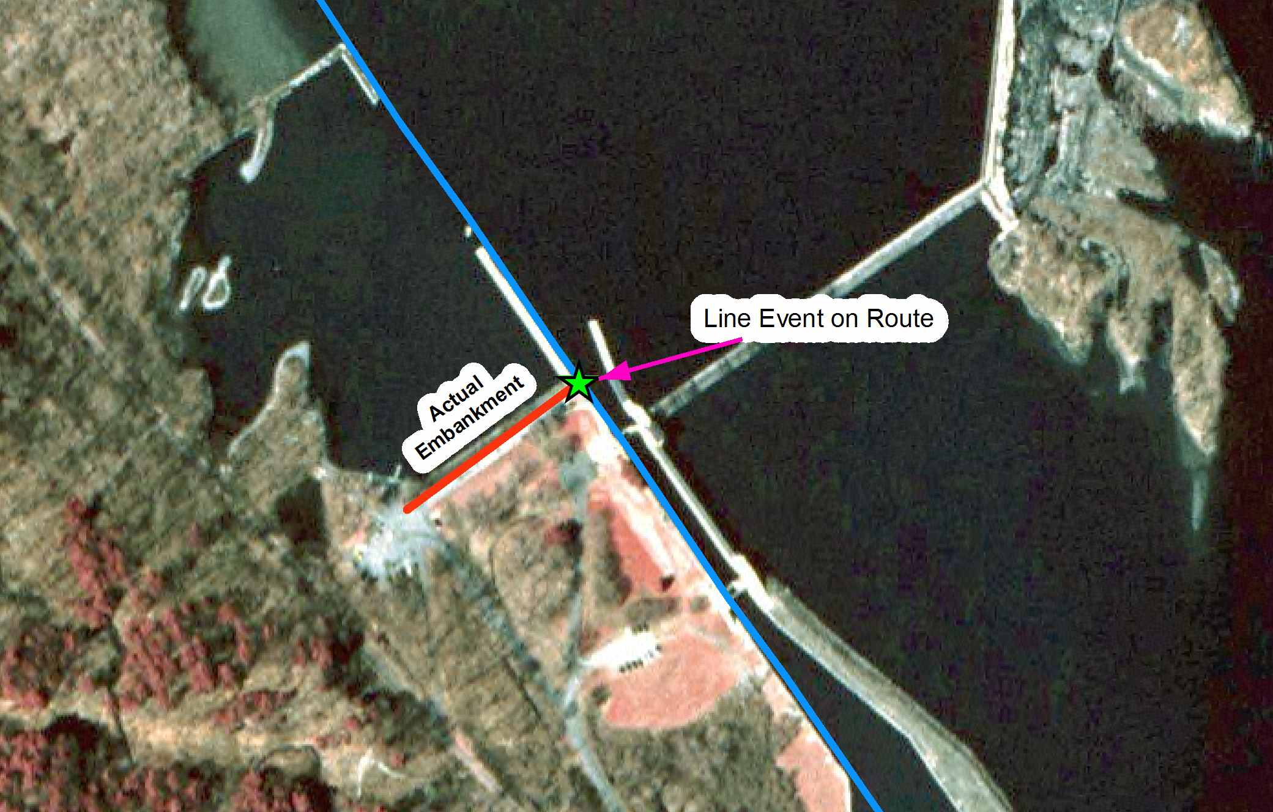
Cartography vs Linear Referencing

Slide 25
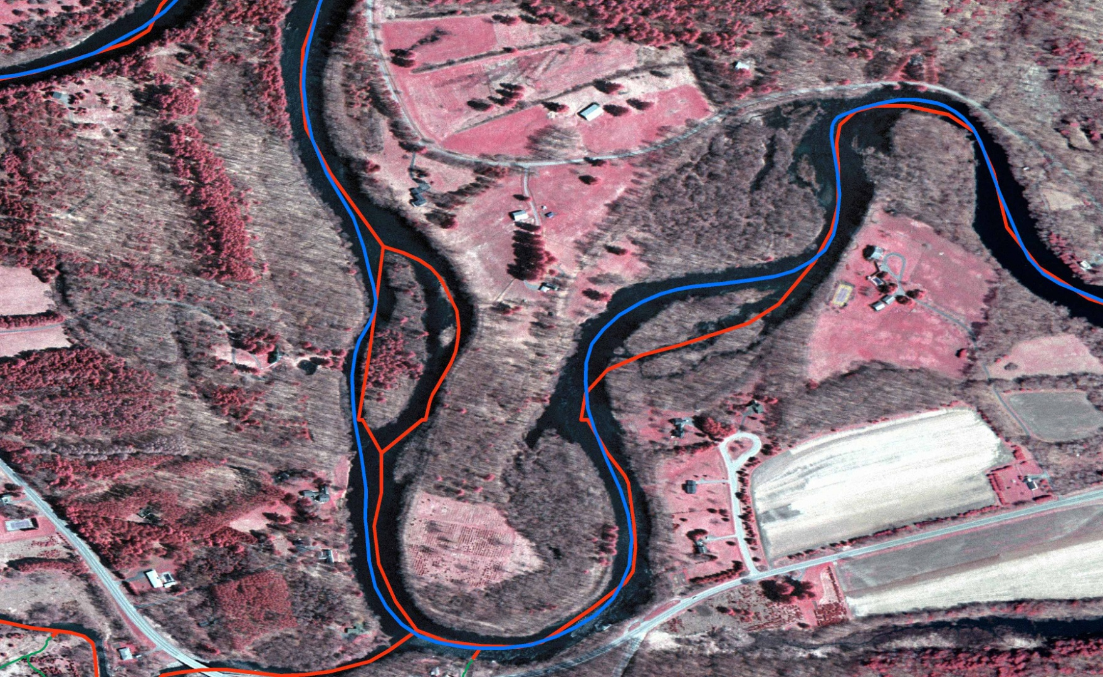
Cartographic Representation
Canal Prism vs NHD

Slide 26
Linear Route Considerations
Canal Corporation lines calibrated to stationing in feet.
  Meets current inventory reporting standard
Canals Corporation routed lines (measure in meters)
  Expands use of existing Canal Corp routes
  Requires Canal Corps to standardize measures
National Hydrography Dataset - National Standard (measure in meters)
  Enhances future hydraulic modeling capabilities
  Allows spatial analysis of features affecting canals but that on unrouted tributaries

Slide 27
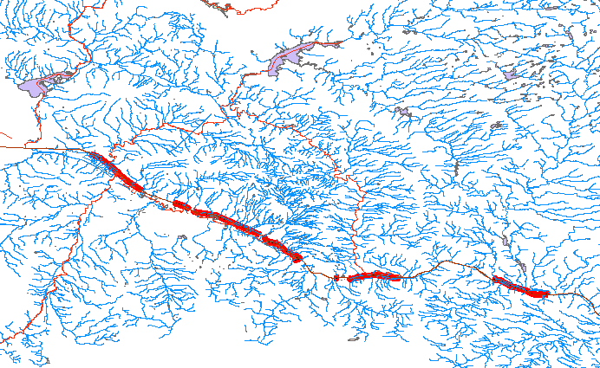
Hydraulic Modeling

Slide 28
Project Scope
Implement Personal Geodatabase Structure
  Uses Microsoft Access
  Supports feature, attribute and relationship classes
  Supports topology
  Supports annotation
Ensure compatibility with existing CC database
Use three reference routes
Hyperlink pictures and scanned inspection forms to database table
Create data tables/relationships for raw inventory values; input raw data from 2008/09

Slide 29
Where to Now?
Design geodatabase using Visio and ArcGIS Diagrammer
Assemble and normalize existing data
Create new and copy existing reference routes
Load data tables, spatial features, and images
Create relationship classes
Create and validate topology
Create FGDC compliant metadata
Test /deliver model

Slide 30
Research
de Jonge, Erik. 2001. Application of the ArcHydro Data Model to the Netherlands. Found at http://www.crwr.utexas.edu/gis/gishydro01/data/holland/netherlands.htm
ESRI, 2004. Building a Geodatabase. Redlands, CA.: ESRI Press.
ESRI, 2007. “Geodatabase Design Steps”. Redlands, CA.: Located on the Web at http://webhelp.esri.com/arcgisdesktop/9.2/index.cfm?TopicName=Geodatabase_design_steps
Penn State Geog 583- Geospatial System Analysis and Design
Penn State Geog 584- Project Management
Penn State Geog 484- GIS Database Development
Tomlinson, Roger. 2003. Thinking About GIS. Redlands, CA.: ESRI Press.

Slide 31
Questions?

