Slide 1
Searching for Refugees
Correlating Online Search Results with Factors Influencing Public Support for Refugees
By Tim Ultee

Slide 2
Overview
Introduction
The refugee crisis
Project Origin
Research
Existing Research
My Project’s Contribution
Project Goals
Methodology
Expected Results
Timeline
Questions & Feedback

Slide 3
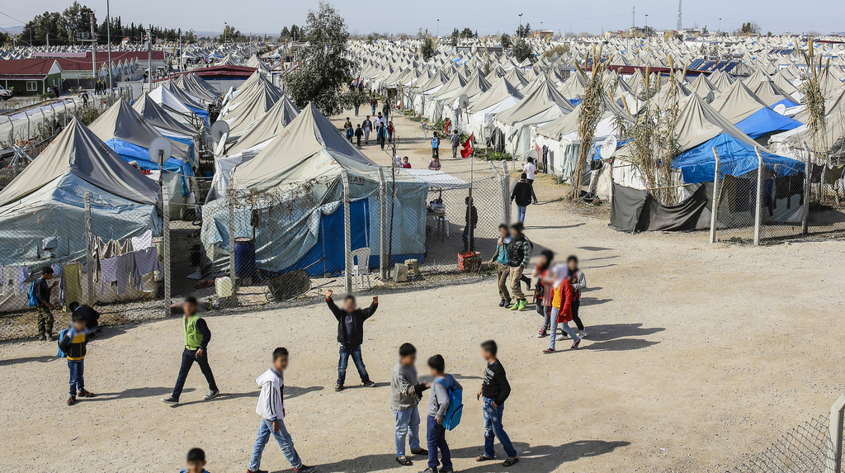
The Global Refugee Crisis
Over the last 4 years the world has experienced an unprecedented increase in the number of refugees and displaced people, the likes of which haven’t been seen since the Second World War.
-Rescue, 2017

Slide 4
Refugee Crisis At a Glance (UNHCR, 2018)

Slide 5
“The biggest obstacle we face in the refugee crisis is not the scale of the problem but the sapping, nagging fear that we can’t make a dent.”
David Miliband, President of the International Rescue Committee (IRC).
Like many of today’s greatest challenges, I believe the refugee crisis is much more a political than a technical problem. That is to say, it is the lack of political will rather than scarce resources that is preventing us from caring for the world’s refugees.

Slide 6
Project Origin Story
Study the factors potentially affecting public support for pro-refugee policies.
Understanding the factors affecting people’s drive to help refugees could be vital to NGOs, governments, and individuals hoping to increase public support for pro-refugee policies.
Plan is to analyze the geographic variation in the support for refugees against other datasets to search for correlations that may turn out to be causal.

Slide 7
Research
Effects of Refugees
Correlations with Opinions
Attitudes toward Asylum Seekers in Small Local Communities
Zorlu, A.
Polling the effects of asylum centers in Dutch communities.
Contact Reduces Immigration-Related Fears for Leftist but Not for Rightist Voters
Homola, J. & Tavits, M.
Study of Contact Theory & Motivated Reasoning on public opinion of refugees adjusted for political affiliations.
Explaining opposition to refugee resettlement: The role of NIMBYism and perceived threats
Ferwerda, J., Flynn, D J. & Horiuchi, Y.
Survey studying the effect of settlement location on public opinions towards refugees.
The Global Refugee Crisis: Empirical Evidence and Policy Implications for Improving Public Attitudes and Facilitating Refugee Resettlement
Esses, V., Hamilton, L. & Gaucher, D.
Analysis of correlations with anti-refugee sentiments.

Slide 8
What does my project bring to the table?
Focus on the positive and action-oriented
Most research focuses on general public opinion, with a stronger emphasis on negative sentiments.
Focusing on pro-refugee searches looks at the issue from a positive angle.
Potentially measures willingness to actively support refugees.
Online Search as an Indicator
The field is dominated by research using traditional opinion polling.
Online searches provide a window into the private motivations and opinions of the public.
Measures people’s private desire to help more than their potentially ego-driven desire to look like they’re helping (i.e. social media).

Slide 9
Project Goals
To assess whether there is any correlation between the location of resettled refugees and the desire to help refugees as manifested through Google searches.
To search for correlation between Google searches supporting refugees and other geographic datasets
household income, party affiliation, demographics, crime, etc.

Slide 10
Methodology
Getting from here to there

Slide 11
Google Trends API
Since gaining access to the API, the first task will be learning to use the system (python based).
Planned search terms (text inclusive)
“Help refugee”
“Donate refugee”
“International Rescue Committee”/”IRC”
“United Nations High Commissioner for Refugees”/”UNHCR”
Geographies are limited to states, “metro areas”, or cities

Slide 12
Refugee Resettlement Data
Office of Refugee Resettlement
State Department
The refugee resettlement analysis will have to be limited to the state level due to the lack of more precise data.

Slide 13
Comparative Datasets
American Fact Finder – US Census Bureau. American Community Survey datasets are available at the county level.
Household Income
Ethnicity
Age
Education
Bureau of Justice Statistics
Crime victimization
Google Trends API
Searches related to “Stop Refugees”
Still searching for reliable political affiliation/leaning dataset.
If none is available, can revert to congressional representation.

Slide 14
Geographic Analysis
Work will be done using ArcGIS Pro
Normalizing datasets
State-level refugee resettlement and search datasets
Demographic & political datasets will need to be resampled to match Google Trends API metro-areas.
Analyze for correlations
Plan to use Spatial Statistics regression tools.
Also plan to check if there is any spatial correlation between variables.
May also use R if Pro isn’t sufficient.

Slide 15
Expected Results
Little to no correlation between refugee resettlement populations and the prevalence of pro-refugee search results.
I expect that the number of resettled refugees will be too few relative to the total population of study areas to have a significant impact on public opinions.
Datasets expected to show correlation with search results:
Political party affiliation/identification – Positive for left-leaning areas
Ethnic Diversity – Positive (though negative counterweight is possible among Whites)
Education – Positive
Age
Unknown datasets
Household income
“Stop refugees” searches

Slide 16
Remaining Question
Time Lapse
What is the value of a snapshot comparison versus analyzing the change over time between variables?

Slide 17
Timeline
December 2018
Incorporate presentation feedback into workplan.
January – February 2019
Download Google Trends API datasets
Finish collecting and cleaning comparative datasets for analysis.
March – April 2019
Regression analysis of datasets to determine spatial correlation.
May - June 2019
Develop Presentation and report.
July 2019
Present at the Esri User Conference in San Diego, CA.

Slide 18
Questions & Feedback

