Slide 1


Redistricting Models in Wisconsin
Tony J. Van Der Wielen
Penn State - Master of GIS Student
tjv118@psu.edu
Advisor: Dr. Stephan Mathews
Notes:
I choose this topic because this is a question I get all the time, from friends, relatives, co-workers and customers. It is important for me to understand what our state and other states are doing in regards to redistricting.

Slide 2
Project Background
Legislative redistricting is the most political process that happens in the State of Wisconsin (and for that matter, the nation)
Districts that were drawn 10 years prior to the most current census may not represent an equal number of constituents and are required to be redrawn due to shifts in population.
The responsibility of redistricting in Wisconsin is given to the currently elected legislators
This process has resulted in judicial intervention in 5 of the last 6 decades.
Notes:
Why is this political? This is how people are elected in our representative government.
Court drew the plan in 1981 was renumbered and passed in 1983 , 72, passed plan.

Slide 3
Project Goals and Objectives
Provide a non-partisan analysis of the current redistricting process in the state of Wisconsin.
Look at other state’s processes for Legislative redistricting, in particular ones that use a non-partisan model such as Iowa and California.
Identify a model that may work for Wisconsin, and provide an outline on how this new model may be implemented.
Look at the cartographic and principle measures of redistricting and explain how these measures may be impacted by the different redistricting models.

Slide 4
Research and Analysis
In order to see how a new model of redistricting would be implemented, I will need to fully understand how the current process works in Wisconsin.
  Examine current law
  Look at any proposed legislation
  Explore all related redistricting processes
  Identify any existing research
I will need to identify states that use a non-partisan form of redistricting and focus on a state that uses a model that could be implemented in Wisconsin.
  Examine current law
  Look at how this model could be implemented

Slide 5
Final Product
An overview of the current process of Legislative redistricting in Wisconsin
Identify one state’s non-partisan redistricting process and explain how it could be implemented
Explore how the principal and cartographic measures of redistricting may be impacted by implementing a new model of redistricting
Answer the following questions with my final thoughts
  Could this model save time?
  Could it save money?

Slide 6
Current Wisconsin Model
Wisconsin traditionally goes through a series of steps before the actual redrawing of maps begin.
Redistricting Data Program
  U.S. Census Based Program
Local Redistricting
  Performed by all 72 Wisconsin Counties
Legislative and Congressional Redistricting
  Typically performed after the local redistricting process has finished***
Notes:
Process of local redistricting is not unique but using the result as a base for legislative redistricting is…Locals know there local geography and where splits in there communities should occur.

Slide 7
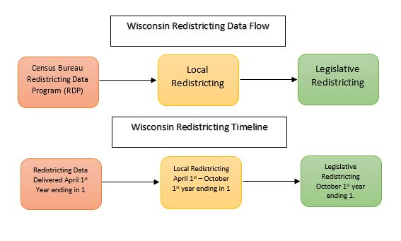
Redistricting Data Flow Diagram

Slide 8


Redistricting Data Program (RDP)
U.S. Census Bureau program consists of five phases
Phase 1 - State Legislative District Project
Phase 2 - Voting District/Block Boundary Suggestion Project
Phase 3 - Delivery of the P.L. 94-171 Redistricting Data Files and Geographic Products
Phase 4 - Collection of Post-Census Redistricting Plans
Phase 5 - Evaluation of the Census Redistricting Data Program
Notes:
Wisconsin’s Constitution requires that Census Data from this program is used for legislative and local redistricting in Wisconsin.
Phase 1 is a chance for states to insert there current legislative districts into the Census Bureau’s Geographic database TIGER. These districts will be enumerated in the next census. This is important, when these districts are enumerated with new census data you can see the population shifts and determine if the districts need to be withdrawn.
Phase 2 is a chance for a state to make changes to small units of geography that will be enumerated. Census Blocks and Ward (precinct) geography.
Phase 3 Data delivery. This is the delivery of small unit geographic data and population totals to the states for redistricting.
Phase 4 Collection of new redistricting plans to be inserted into the TIGER database.
Phase 5 Evaluation of the program. Voting districts were added because of the feedback from the states during the evaluation phase of Census 2000.

Slide 9
Local Redistricting
  The local redistricting process in Wisconsin starts after the 3rd phase of the RDP. This is a 180 day statutorily mandated process
  First 60 days – Counties use these first 60 days to draw a tentative county supervisory district plan
  Second 60 Days – After the tentative supervisory plan has been created, municipalities must then create municipal wards based on the tentative supervisory plan
  Final 60 Days – During this period the county must finalize and adopt a supervisory plan, while municipalities that are required to do so, must create aldermanic districts
Notes:
County Supervisory Districts are drawn to elect members of a county board.
Wards are drawn to fit within supervisory districts.
Final 60 days counties and mcd fight it out to finalize ward and supervisory plans.

Slide 10
Legislative Redistricting
Once census data has been delivered to the state, and the process of local redistricting has finished, the process of legislative redistricting, traditionally, may begin.
The municipal ward data that is created in local redistricting is reported to the Wisconsin Legislature and is typically used as the base layer for legislative redistricting.
  Why has there been a call for a new model to be implemented?
  Current model is seen as divisive
  Costly (primarily due to litigation)
  Has resulted in judicial intervention for the last 5 out of 6 decades
    Plan was brought to court after the plan was passed in 2011
Notes:
Sometimes members of communities of interest don’t agree on how districts should be drawn and lawsuits may arise…more on this soon.

Slide 11
Measures of Redistricting
Geographic Measures
  Equal Population – Deviation from ideal district population
    Total state population/99 assembly districts = Ideal district population
  Compactness and Complexity
  Contiguity
These are metrics that can be easily detected using GIS.
Other Measures
  Protection of Minority Rights
  Community of Interest
These are more difficult for GIS to detect as they are more subjective.
Notes:
Objective and Subjective measures
Equal population is the fundamental principle of redistricting.
Courts interpret the Federal Voting Rights Act in regards to protection of minority rights
Communities of interest may not agree on what is best from them when redistricting

Slide 12
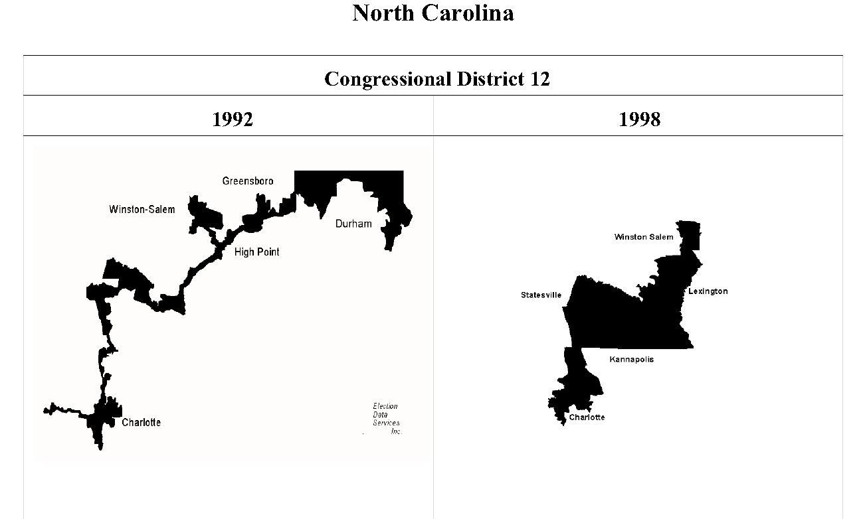
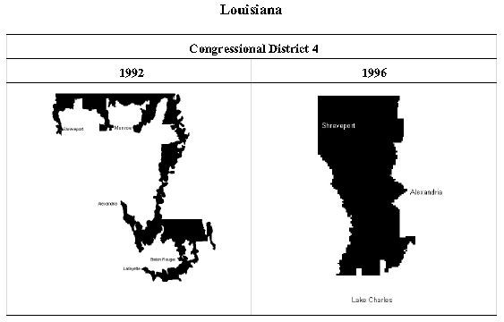
Compactness and Complexity
Notes:
North Carolina – The 1992 district is not compact – compactness is a measure of the area of a district compared to the area of a comparable circle (generally).
Louisiana – 1992 district is very complex – complexity is a measure of the perimeter of a district compared to its area.
Rivers or water can affect these calculations.
Famous districts trying to capture black population.

Slide 13
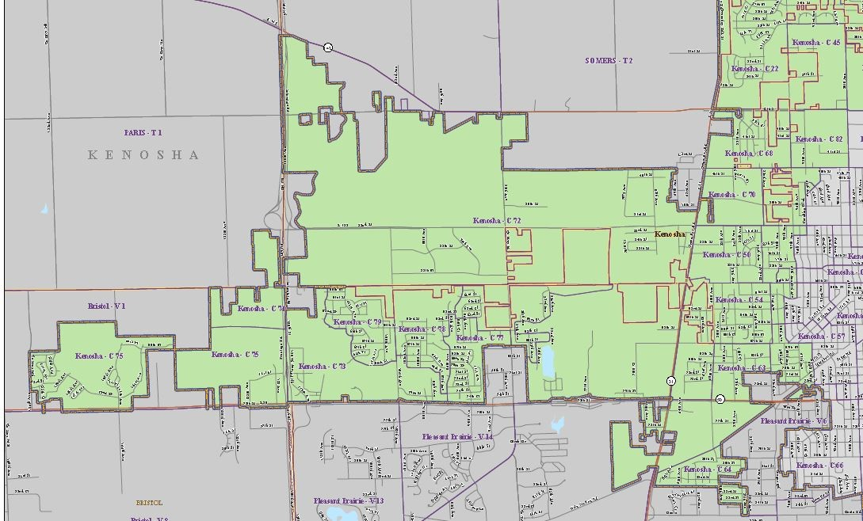
Contiguity and community of interest
Notes:
Contiguous districts – all parts of the district must be touching and not by a single point.
Community of Interest – Black population in Wisconsin is only concentrated in the City of Milwaukee. This is considered a community of interest.

Slide 14
Commission Based Model
“Twenty-one states have a redistricting commission that draws up the plan, advises the legislature on drawing up the plan or acts as a backup if the legislature fails to draw up the plan for legislative districts” (NCSL - Redistricting, 2013)
The Iowa model seems to be the commission model that has sparked the most interest in Wisconsin, for this reason I will concentrate my research on this model, and how it could be implemented in Wisconsin
Assembly Bill 185 was attempted to be brought out of committee and voted on in our current session

Slide 15
Iowa Redistricting Model
Based on state statute and not a constitutional amendment
Redistricting plans are drawn by a non-partisan bureau of the legislature
  Legislative Services Bureau (LSB)
  3 chances before the matter goes to the Iowa Supreme Court
5 member redistricting commission based
  4 legislators (appointed by legislative leadership)
  Final member is non-partisan (non-legislative employee); elected by the committee with at least 3 votes
  Commission serves in an advisory role to the LSB
    Answer any questions that arise regarding the drawing of the maps
    Holds public hearing on plans
    Provides feedback to LSB on submitted plans from the public and legislative bodies
Notes:
A constitutional amendment in Wisconsin requires passage in two consecutive sessions of the legislature and passage of a referendum by the citizens – very difficult to pass and very difficult to change.
Could be changed or set aside by a legislative majority.

Slide 16
Iowa Redistricting Model
Principle and Cartographic Measure Requirements
Equal Population
  Mean deviation of House plans +/-1%
  Mean deviation of Senate plans +/- 5%
Compactness
  Proposed districts should be square, rectangular or hexagonal (match political boundaries)
Other Considerations
Should not be drawn to
  Favor an incumbent
  Political Party
  Or any other person or group
Data not to be used
  Previous election data
  Incumbent Addresses
Community of Interest concerns should NOT be used to draw a district
Notes:
Community of Interest – This would be hard in Wisconsin with the concentrations of Black and Hispanic population in the City of Milwaukee – How would this affect the federal voting rights act?

Slide 17
Committee Based Model for Wisconsin
In order to implement the Iowa model of redistricting in Wisconsin, some changes would need to be made to fit with Wisconsin’s statutes relating to local redistricting, data collection and data dissemination
Assembly Bill 185
  Language is very similar to the Iowa statutes
  Not a constitutional Amendment
  Takes into account:
    Our nested district scheme (3 Assembly districts = 1 Senate district)
    Ward based redistricting
  Does not take into account:
    Improvements to US Census data throughout the decade
    Local redistricting timelines

Slide 18
Redistricting Measures Comparison (Observations)
Deviation from Ideal Population
  Would probably be higher with the committee based model
  Would be drawn on wards not blocks (like Act 43)
Compactness
  Committee model would probably be more compact than current model
    Drawing based only on population and community of interest
Competiveness
  May not be more competitive
    Communities with similar voting patterns may be kept together
    Current model may stretch districts to “mix” voters
Notes:
These are my observations based on 15 years of redistricting experience.
Deviation – AB 185 Iowa based model would be drawn on wards, this is a larger geography with higher population totals. Act 43 was drawn on blocks smaller geography with lower population totals, this made it easier to get closer to the ideal population of a district.
Compactness – Iowa model would be more compact because political geography would be more likely to be grouped together, population would drive the creation of the plan and not election data or incumbents.
Competiveness – Iowa model may not be more competitive due autocorrelation (in regards to voting patterns) political geography that is grouped together may tend to vote alike.

Slide 19
Final Thoughts
A non-partisan committee based redistricting model like Iowa could be adopted with some changes to our current statutes
  This would not need to be a constitutional amendment
  Could be changed or set aside by a legislative majority.
Local redistricting needs to be accounted for in any legislation
Only a test would tell if principle and cartographic measures of redistricting would change
It is not conclusive to me that a new non-partisan model of redistricting in Wisconsin would result in better measures of deviation from idea district population or competitiveness.
  And unless the statutes were further altered, time and money associated with redistricting in Wisconsin would likely not be greatly affected
Notes:
In my current position a test is not possible.
Time would not be greatly affected due to the local redistricting process.
Money may not be greatly affected because when a plan is passed like Act 43 in 2011, a community of interest may bring the matter to court.

Slide 20
Redistricting Models in Wisconsin
Tony J. Van Der Wielen
Penn State - Master of GIS Student
tjv118@psu.edu
Advisor: Dr. Stephan Mathews
WLIA Annual Conference – February 12-14th 2014
Notes:
I choose this topic because this is a question I get all the time, from friends, relatives, co-workers and customers. It is important for me to understand what our state and other states are doing in regards to redistricting.
I will be presenting this topic at the Wisconsin Land Information Associations Annual meeting in February of 2014.

